Slide 1
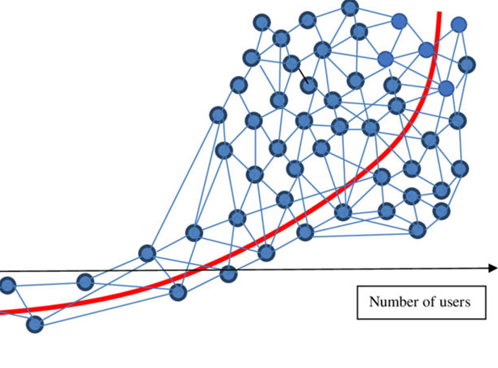
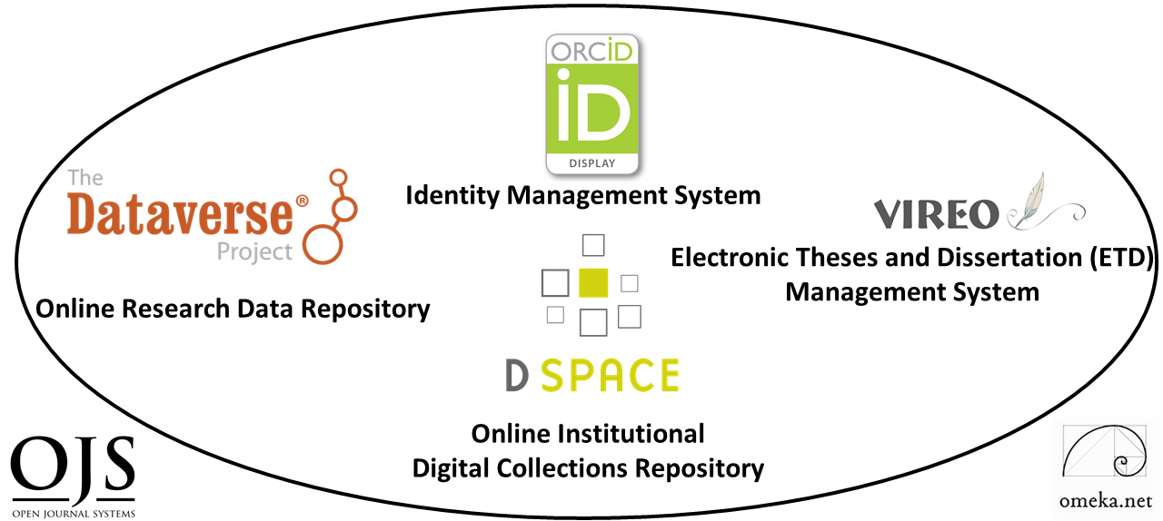
New Opportunities for Libraries
Open Source & Open Access Software and Digital Scholarly Ecosystems
Open Access to Knowledge and Libraries
Achievements and Trends
Eurasian Academic Libraries Conference
October 22nd, 2022, Kazakhstan
Ray Uzwyshyn, Ph.D. MBA MLIS
Director, Collections and Digital Services
Texas State University Libraries

Slide 2

What is a Digital Scholarly Research Ecosystem?
Network of Several Open Source Software Components to Enable Faculty and Student Research
and Raise Research Profiles, Retrieval and Accessibility

Slide 3
What are the General Common Characteristics for a Data Repository and Digital Scholarship Ecosystem?
Customizable Components
Active Developer Communities
Open Source Software

Slide 4

A Digital Scholarship Research Ecosystem
Consists of Six Open Source Components
TWO PRIMARY COMPONENTS
DIGITAL COLLECTIONS REPOSITORY
FOUR TERTIARY COMPONENTS
(Communication)
Electronic Thesis and Dissertation Management System (VIREO)
User Interface/Content Management Software (OMEKA)
Identity Management System (ORCID)
Open Academic Journal Software (OJS3
RESEARCH DATA REPOSITORY
(Content)
Digital & Web Services : University Libraries : Texas State University (txstate.edu)

Slide 5
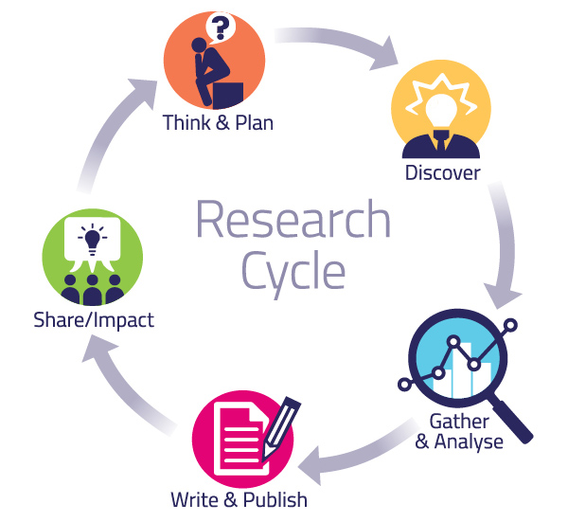
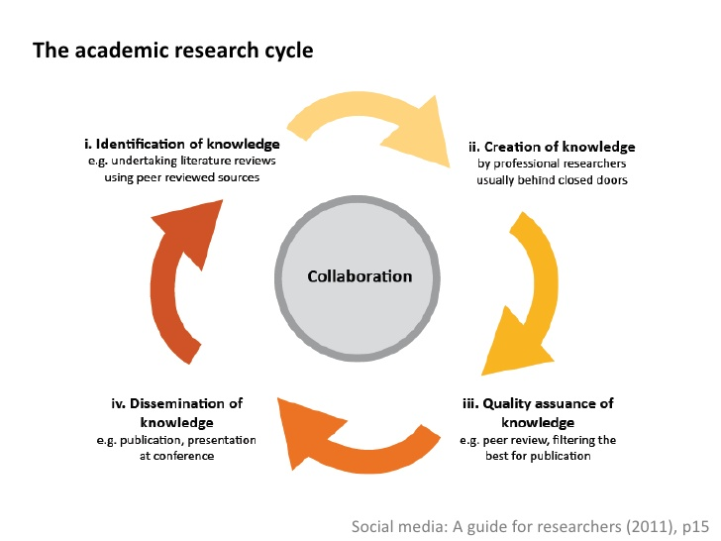
Together These Components Enable
Various Parts of the Academic Research Cycle
Pragmatic
System Levels
Abstract Levels
Collocating Open Source Digital Components in a Networked Research Ecosystem Enables Connections and Larger Network Effects

Slide 6
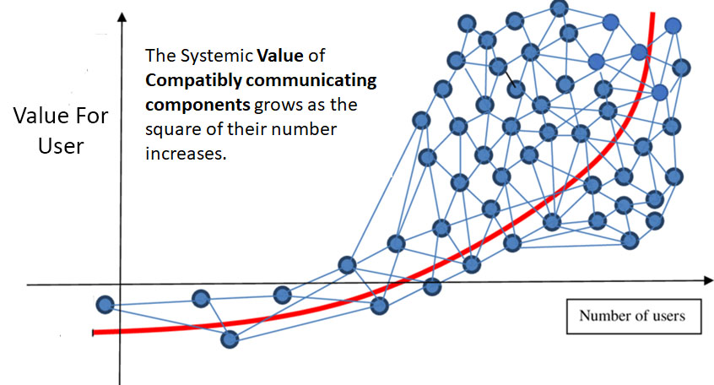
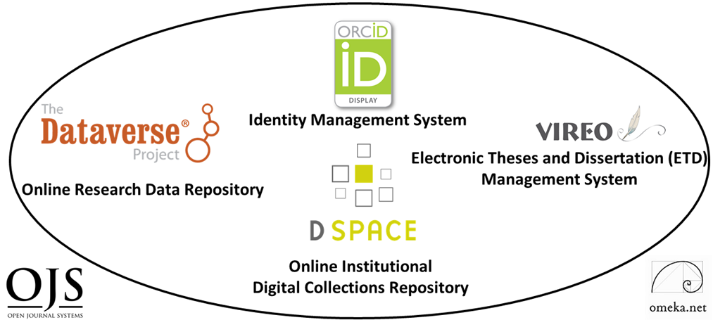
Network Effects: Metcalfe’s Law
Early Telecommunications Law for Ethernet (1993)
Component Networks may be Internal and/or External

Slide 7
Network Effects of Digital Ecosystems Allow Opportunities among Research Institutions
Research
Institution A
Research
Institution B
Research
Institution C

Slide 8


Texas State University
Libraries
Digital Scholarly Research Ecosystem
Primary Components
(Deep Dive)

Slide 9
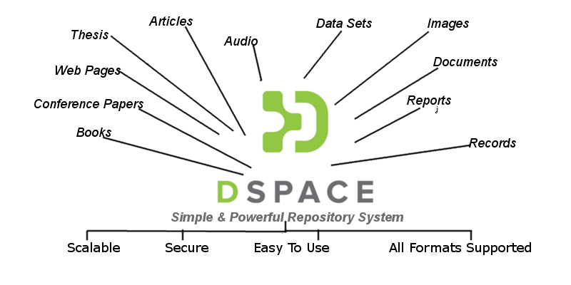
Institutional Digital Collections Repository (Dspace)
Organizes, centralizes and makes accessible
research and knowledge generated by the institution’s research community (Faculty, Graduate Students and Researchers):
Pre-prints
Faculty Publications
White Papers
Conference Presentations
Graduate Student Theses
and Dissertations

Slide 10
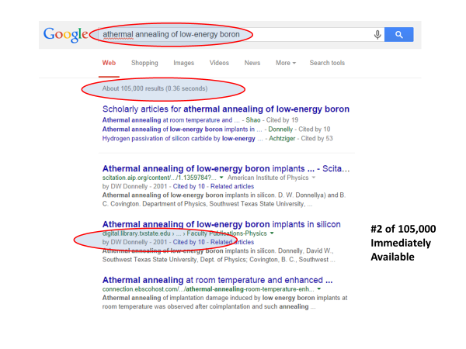
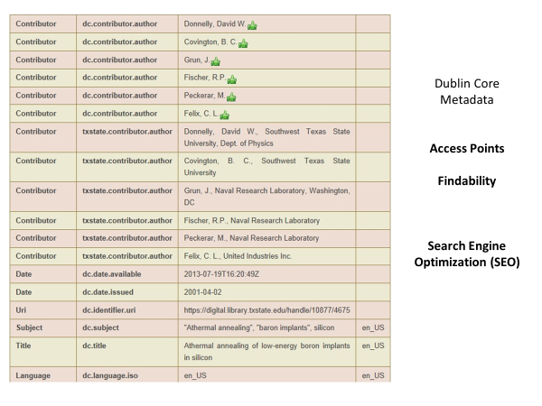


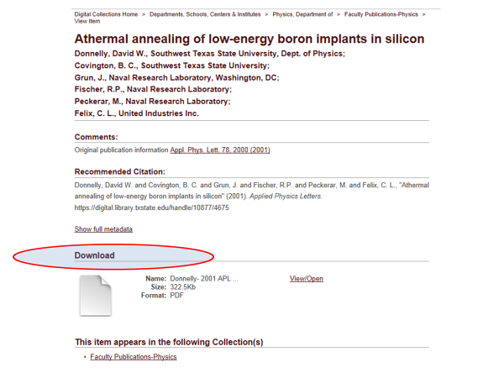
Important Use Case Value
Application of Structured Metadata Schema for Search Engine Optimization

Slide 12
Application of Structured Metadata Schema for Search Engine Optimization
Opens Accessibility and Multiple Points of Access

Slide 13
Percent Increase in Article Citations by Discipline with Open Access Online Availability
(Immediately Available Through Google)
Range = 36%-250%
(Data: Stevan Harnad and Heather Joseph, 2014)

Slide 14
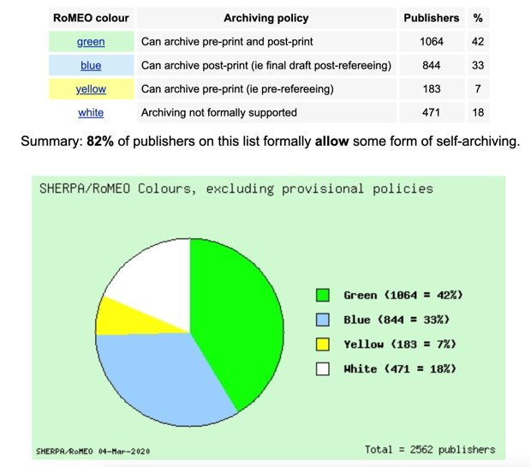
A Vast Majority of Publishers Allow Digital Archiving
in some form. (82% from 2562 publishers)
March 2020 Sherpa/Romeo Copyright Polices & Self Archiving
Source: www.sherpa.ac.uk/romeo/statistics.php?la=en&fIDnum=|&mode=simple
Clicto adtext

Slide 15
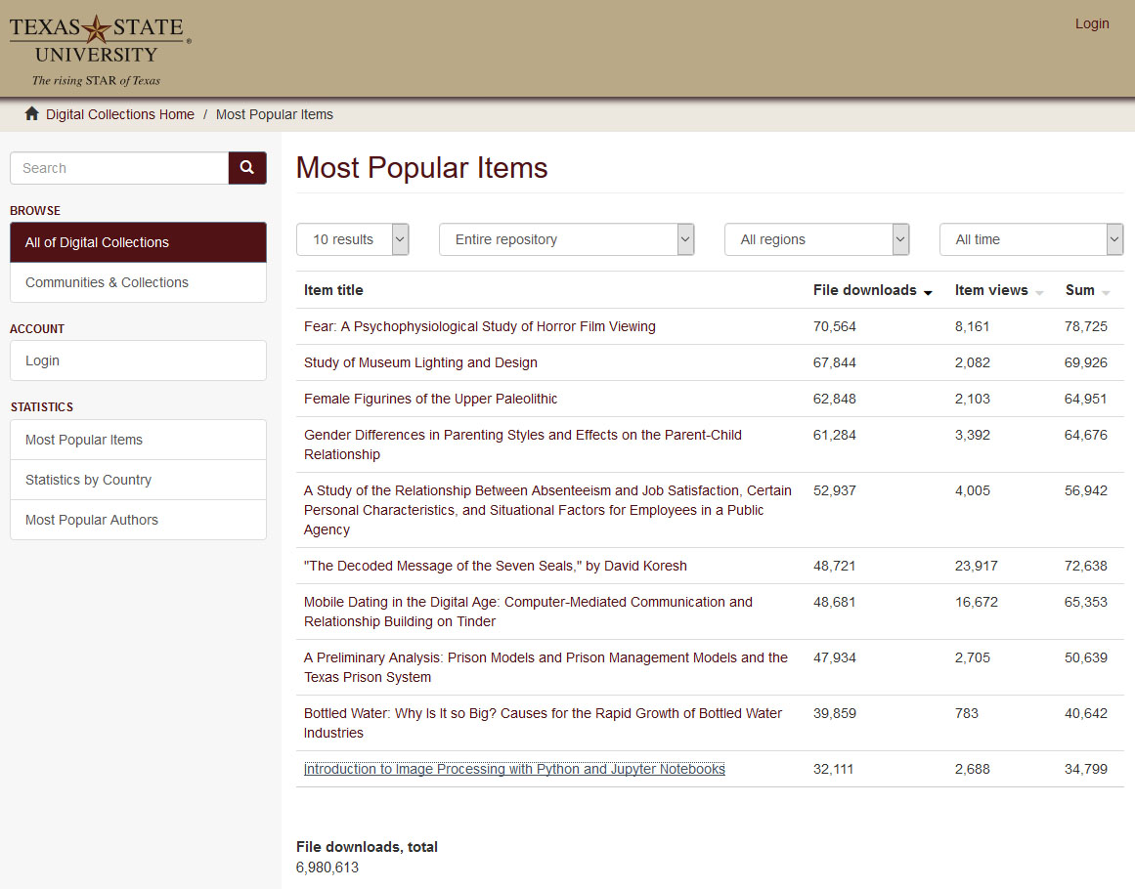
Digital Collection Repositories Give Insight and another window/Altmetrics Faculty/Student Research (Statistics)

Slide 16
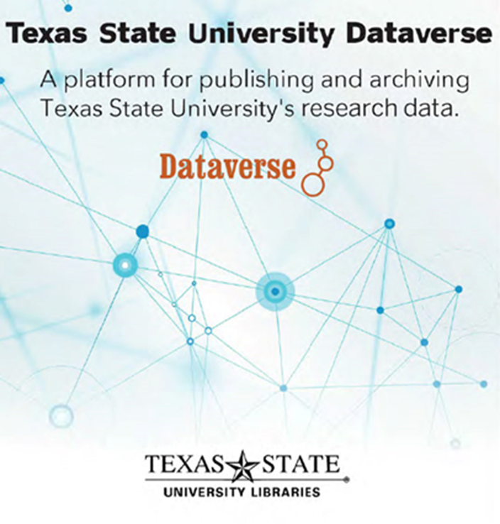
Research Data Repository

Slide 17
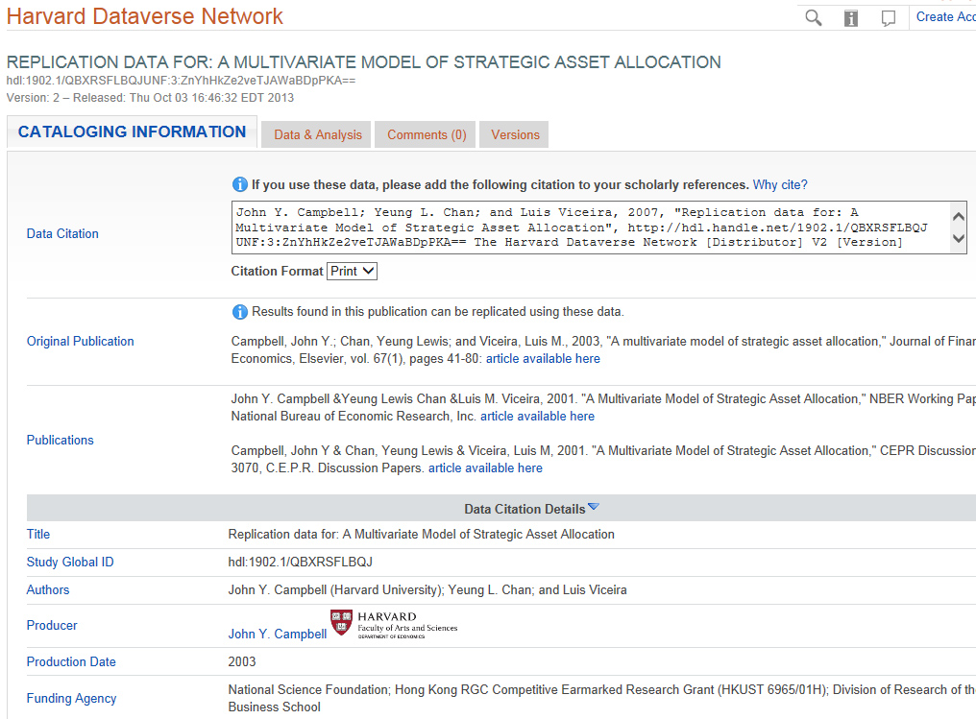
Data Citation and Metadata

Slide 18
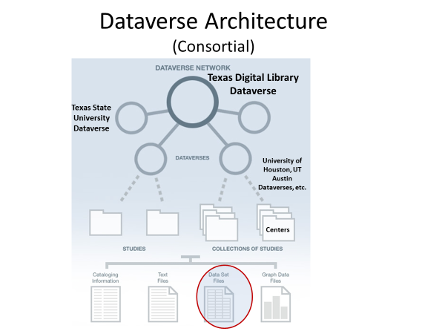
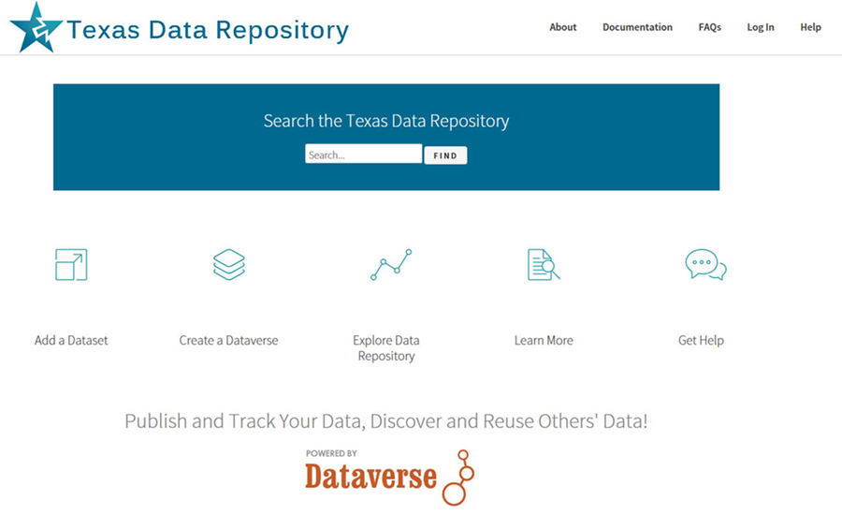
The Dataverse can be configured as a single Instance or as a Consortial Model
(Texas Aggregates
22 Individual Instances, through the Texas
Digital Library)

Slide 19
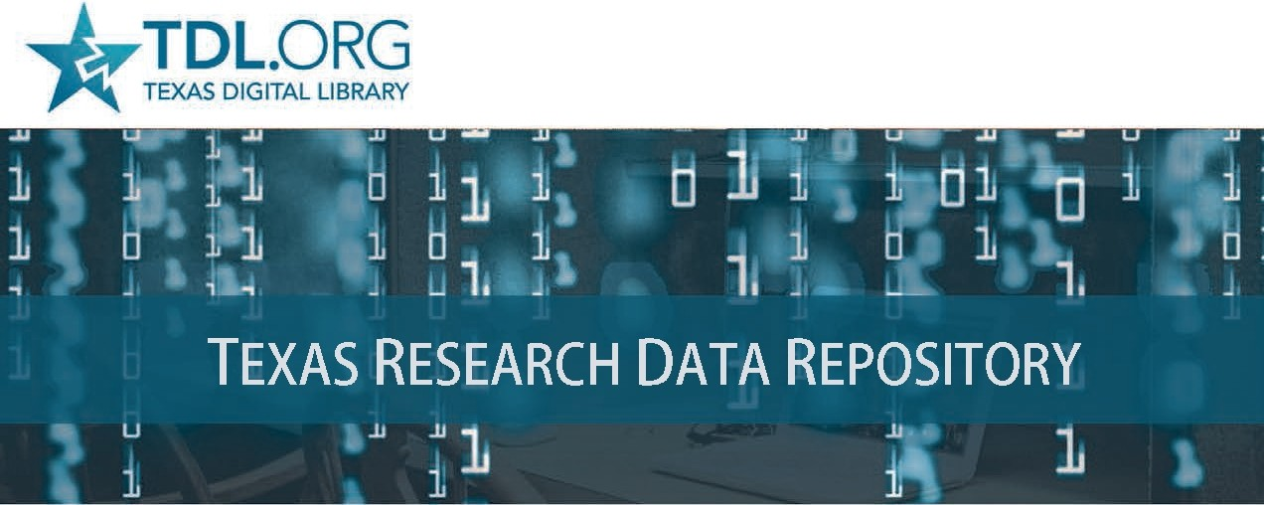

Slide 20
Digital Scholarly
Research Ecosystem
Secondary Communication
Components
(Dependent on and work in
Concert with Primary Digital
Content Repositories for both Content and Data)

Slide 21

Vireo
Electronic Thesis and Dissertation Management System
Addresses Intermediary steps in the ETD Process
Bridges Student Thesis/Dissertation Submission with Graduate School Review, Online Publication and ETD Preservation
Connects with Both the Collections Repository And Data Repository so students can publish and link their theses, dissertations and data

Slide 22
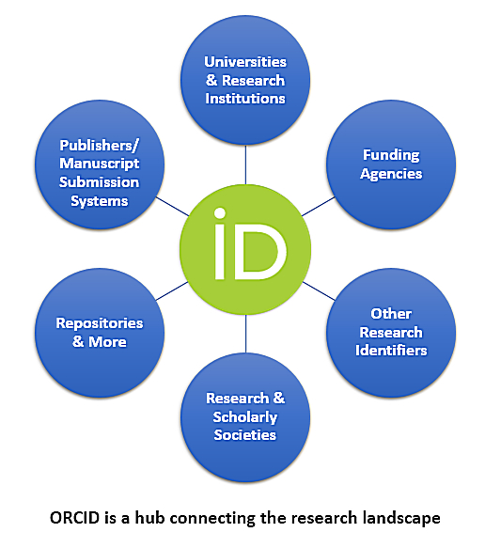

Researcher Identity Management System
Gives Researchers Unique Number (ORCID ID) Connecting and Disambiguate Scholars names
Maria Hernandez, Biochemist
Maria Hernandez, M.D. or Astrophysicist
Allows publications from a researcher to be found, linked and aggregated across multiple information Systems. Essentially, papers in the collections repository and datasets in data repository can be associated with ORCID ID’s for aggregation of research profiles.
Orcid can act as a Network Hub aggregating from several sources and connecting to other internal and external networks

Slide 23


Omeka and OJS
Open Source User Interface Software
Allows an elegant portal/gateway entrance for large research
projects, digital collections and data repositories - linking research texts, images, media and research datasets and acting as a middleware front end to connect components and component networks.
Open Access Academic Journal Software for refereed journal workflow, online publishing. Allows connections to Dataverse/Dspace to background research and datasets etc.

Slide 24
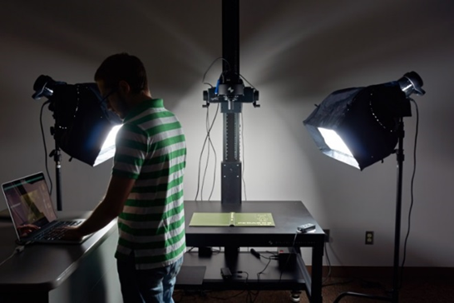


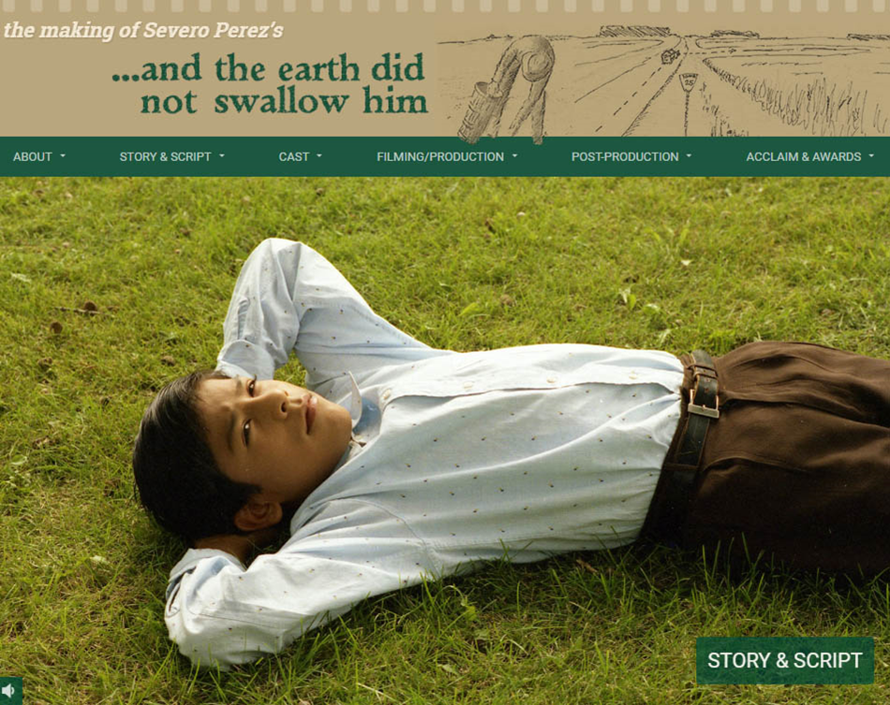
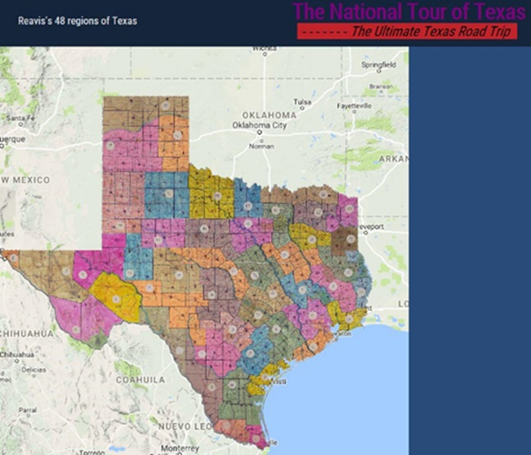
The Digitization Lab Expands Possibilities for Faculty and Graduate Student Research Projects
Digitization possibilities on research levels range from OCR to and textual digitization digitization to images, 3D objects, audiovisual and visualization possibilities (IIIF etc)
(i.e. Digitization Lab’s IIIF Framework can create internal or globally distributed Image Libraries.

Slide 25
Combining These Research Ecosystem Components
Opens Amazing Possibilities For Digital Scholarship & Research Collaboration Opportunities
Cognitive Cartography/Multimedia Archives
(Video, Text, GIS, Images, Field Notes)
Dick Reavis: National Tour of Texas
Multimedia, Digital Archives/Retrospective ETD Projects
(Digital video, online exhibit images, text, digital archives)
Severo Perez: And the Earth Did not Swallow Them
Online Exhibits/Digital Archives/ Online Academic Journals
(images and text, Omeka front end/Database back end, IIIF)
Cabeza de Vaca La Relacion Digitization
Santiago Tafolla: Mexican Amer. Confederate Soldier
Interactive Image Archives/Data & Research Projects
(Image libraries, Interactive Commenting/Metadata)
Texas State Flickr Commons
Digital Libraries Archiving & Documentation Projects
(Text, Metadata, OCR, Search, Zoom ability, Page Turning)
Pedagogs University Yearbooks
Faculty Digitization Proposals/Partnerships
Complexity
Projects,Prototypes Grant Partnerships

Slide 26
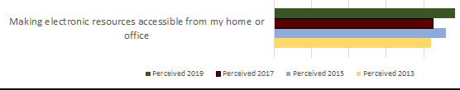
Assessment and Results
Quantitative and Qualitative Measures
Annual Usage Growth
(Downloads, Number of Items, ORCID ID’s
and Hosted Journals)
LibQual Biannual Survey 2013-2019, Faculty and Student System Perceptions, Comments
Ecosystem Implemented in Stages, 2014-2019
System | 2014 | 2015 | 2016 | 2017 | 2018 | 2019
Downloads
DSpace | 326,762 | 318,742 | 385,163 | 341,224 | 972,359 | 1,010,349
ETDs | 136,985 | 158,240 | 200,373 | 328,420 | 470,437 | 505,658
Dataverse | n/a | n/a | n/a | 455 | 3,451 | 2,043
Number of Items
DSpace | 1,340 | 1,437 | 1,546 | 1,660 | 2,135 | 2,720
ETDs | 967 | 1,174 | 1,326 | 1,581 | 1,789 | 2,218
Dataverse | n/a | n/a | n/a | 28 | 33 | 53
ORCID IDs
ORCID | 101 | 190 | 316 | 438 | 545 | 669
Hosted Journals
OJS | 1 | 1 | 2 | 2 | 3 | 4

Slide 27


Timelines and Implementation Paths
Many Roads To Rome (1-5 Year Paths)
Year 1
Digital Collection Repository and Digitization Lab
Year 2
User Interface Software (OMEKA), Identity Management System, ORCID
Year 3
Data Repository
Year 4
ETD Middleware (VIREO) and OJS Software
Year 5
Complex Digitization Projects, IIIF Server, Faculty Grant Projects etc.

Slide 28

Human Resources
System Administrator/Programmer
server infrastructure set-up/maintenance/basic customization
Digital Collections Librarian: Administration, Marketing, User Support, Collections and Data Repository, OJS/ORCID
Metadata Librarian: Dublin Core, Specialized Schema
Web Developer/Programmer: OMEKA, System Integration
Project Manager/Department Head (PMP Certification)
Digitization Specialist
GIS Specialist/Data Visualization Specialist
AI Specialist/Post-Doc/CLIR Fellow

Slide 29
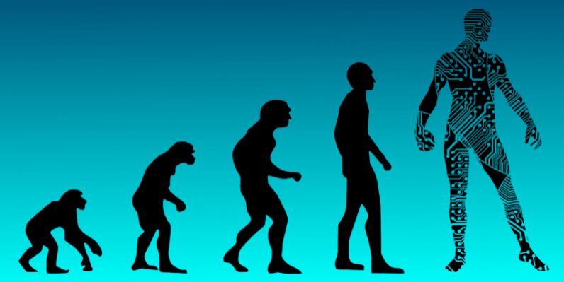
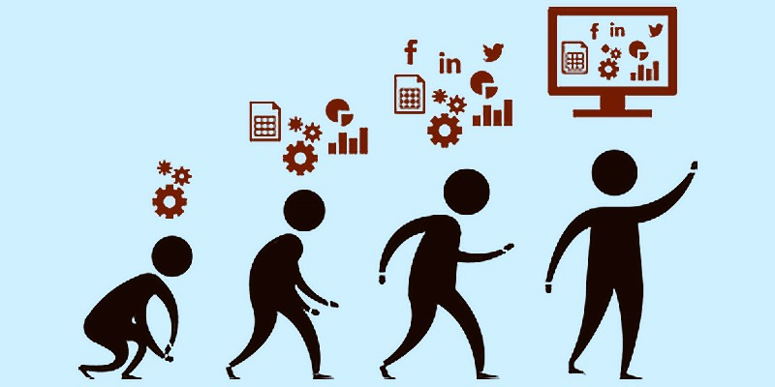
Summary Reflections
Placing Digital Scholarship Components within an Ecosystem Paradigm Enables:
New Possibilities For Researchers within the academic research cycle
Better Guidelines and Roadmaps for Developing Digital Scholarly Research
Evolutionary Possibilities for Digital Library Research System Development

Slide 30



Future
Pathways
Networked Global Scholarly Research Environment

Slide 31

Questions, Comments
Ray Uzwyshyn, Ph.D. MBA MLIS
Director, Collections and Digital Services
Texas State University Libraries
ruzwyshyn@txstate.edu, 512-245-5687
http://rayuzwyshyn.net

Slide 32
Further References
Uzwyshyn, R. 2020 Developing an Open Source Digital Scholarship Ecosystem (Preprint). ICEIT2020. Oxford, UK. https://www.researchgate.net/publication/336923249_Developing_an_Open_Source_Digital_Scholarship_Ecosystem
Texas State University Libraries Website. https://www.library.txstate.edu/
Texas State Digital Collections Repository https://digital.library.txstate.edu/
Texas State Data Research Repository https://dataverse.tdl.org/dataverse/txstate
Texas State Online Research Identity Management System:
https://guides.library.txstate.edu/researcherprofile/orcidTexas State Electronic Thesis and Dissertation Management (VIREO): https://www.tdl.org/etds/
Texas State Digital & Web Services:
https://www.library.txstate.edu/services/faculty-staff/digital-web-services.html

Slide 34

Can we Enable Scholarly Research Network Ecosystem Possibilities on Global Levels?
Is it Desirable or Time to Begin Thinking About Empowering a Global Research University Community ?

Slide 35


Research Universities and Digital Research Ecosystems
~266-300 Research Institutions US & Canada
Carnegie R1 & R2, Very High or High Research Activity
~1000-1250 Research Universities Worldwide
QS Rankings and Times Higher Education Supplement. (40% Europe, 26.5% Asia Pacific, US/Canada 18%, Latin America 9% and Middle East/Africa.
Enable Top 2-3% Research Institutions Globally, 1000 Institutions beyond the US and Canada.
(This represents the other 90% of Research Libraries Globally)

Slide 36





One Server Per Research Institution
2020-2025
Empower 1000 Research University Institutions/Research Libraries Globally
Gift each Research University One Configured Server Ecosystem with 6 Open Source Scholarly Research Software Components,
< $1000.00 US/Server or set up Fractional Server Space with Mirror Sites Globally (SAAS)
Set Up brief weeklong training over five continents
Connect Networks
Measure the Effects

Slide 37
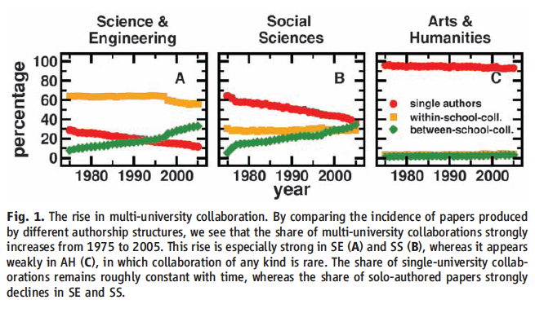
Collaboration Across Institutions
Continues to
Increase
Jones et al. (2008). Science 322: 1259-1262.
Notes:
The model assumes that each lead author forms a core team through a Poisson process.
Extended teams arise from core teams by adding new members in proportion to the productivity of the team.
This process of cumulative advantage leads to the appearance of the power-law component of large teams at later times.

Slide 38


Brainstorming Models
One Laptop Per Child
Dreamed up mid-late 90’s, Launched 2005
Nicholas Negroponte, MIT Media Lab Founding Director
Noble Initiative/Grand Ambitions
Vision: Give each child in world access to a laptop with open source software for less than 100.00 $US/laptop
Gage Effects For Education Globally
Can We do the same thing for academic research globally?

Slide 39
Larger Digital Scholarly Research Projects
Can Act as Qualitative/Quantitative Benchmarks
Cognitive Cartography/Multimedia Archives
(Video, Text, GIS, Images, Field Notes)
Dick Reavis: National Tour of Texas
Multimedia, Digital Archives/Retrospective ETD Projects
(Digital video, online exhibit images, text, digital archives)
Severo Perez: And the Earth Did not Swallow Them
Online Exhibits/Digital Archives/ Online Academic Journals
(images and text, Omeka front end/Database back end, IIIF)
Cabeza de Vaca La Relacion Digitization
Santiago Tafolla: Mexican Amer. Confederate Soldier
Interactive Image Archives/Data & Research Projects
(Image libraries, Interactive Commenting/Metadata)
Texas State Flickr Commons
Digital Libraries Archiving & Documentation Projects
(Text, Metadata, OCR, Search, Zoom ability, Page Turning)
Pedagogs University Yearbooks
Faculty Digitization Proposals/Partnerships
Complexity
1) Project Completion
(Milestones)
2) Usage Statistics
Projects,Prototypes Grant Partnerships

Slide 40
Research Universities and Digital Research Ecosystems
~266-300 Research Institutions US & Canada,
Carnegie R1 & R2, Very High or High Research Activity, 124 ARL Libraries
~1000-1250 Research Universities Worldwide
QS Rankings and Times Higher Education Supplement. (40% Europe, 26.5% Asia Pacific, US/Canada 18%, Latin America 9% and Middle East/Africa.
26,000-40,000 Universities Globally. Research Universities 2.7% - 4.2% of all universities worldwide. Highest by Country: US 156, UK 76, Germany 45, Japan 44.
Other Top 2-3% Research Institution Academic Libraries Globally, 1000 Institutions beyond the US and Canada. This represents the other 90% of Research Libraries Globally

Slide 41
Research Universities and Digital Research Ecosystems
124 ARL Research Libraries (US and Canada)
131 US Research Universities (Carnegie R1, Very High Research Activity)
135 Doctoral Universities (Carnegie R2, High Research Activity, US), ~266-300 Research Institutions US & Canada
1011 Research Universities Worldwide (40% Europe, 26.5% Asia Pacific, US/Canada 18%, Latin America 9% and Middle East/Africa.
QS Rankings
1250 Research Universities Worldwide, Times Higher Education Supplement (2.7% - 4.2% of all universities worldwide)
By Country: US 156, UK 76, Germany 45, Japan 44
Global Estimates of General University #’s 26,000-40,000
Empower Other Top 2-3% Research Institution Libraries Globally,
1000 Institutions, the other 90% of Research Libraries Globally

Slide 42



Combining Components
System Synergies
Digital Scholarly Research Ecosystem

Slide 43
Network Effects
Both In and Between Individual Components and In and Among Component Networks
ORCID Aggregates from Several Sources and Networks and Connects to Other Networks, Internal and External
OMEKA can act as a middleware front end connecting several components and component networks internally.
3) Digitization Lab’s IIIF Framework can create internal or globally distributed Image Libraries.
4) Dataverse can be configured as a single Instance or as a Consortial Model (Texas 22 Individual Instances, TDL)

Slide 44

Ecosystem as System
Enables Core Research
Articles, Theses, Dissertations in the collections repository can be associated with datasets in the data repository for reference, verification or reproducibility.
Journal article citation lists can be associated with articles and datasets in the Collections and Data Repositories
Further Desired Connections can also guide developmental paths for both component software and the ecosystem

Slide 45
Assessment and Results
Quantitative and Qualitative Measures
Annual Usage Growth
(Downloads, Number of Items, ORCID ID’s
and Hosted Journals)
LibQual Biannual Survey 2013-2019, Faculty and Student System Perceptions, Comments
System | 2015 |  | 2016 | 2017 | 2018 | 2019
Downloads
DSpace | 318,742 | 318,742 | 385,163 | 341,224 | 972,359 | 1,010,349
ETDs | 158,240 | 158,240 | 200,373 | 328,420 | 470,437 | 505,658
Dataverse | n/a | n/a | n/a | 455 | 3,451 | 2,043
Items
DSpace | 1,437 | 1,437 | 1,546 | 1,660 | 2,135 | 2,720
ETDs | 1,174 | 1,174 | 1,326 | 1,581 | 1,789 | 2,218
Dataverse | n/a | n/a | n/a | 28 | 33 | 53
ORCID IDs
ORCID | 190 | 190 | 316 | 438 | 545 | 669
Hosted Journals
OJS | 1 | 1 | 2 | 2 | 3 | 4
Ecosystem Implemented in Stages, 2014-2019

