Slide 1


NAZARBAYEV UNIVERSITY
Efficient Multi-Robot SLAM in a Labyrinth Environment
Final Presentation
Abdirakhman Onabek
Ramazan Andarbayev
Bayurzhan Askarov
Supervisor: Prof. Zhanat Kappassov
ROBT Capstone II
Page 1 of 40

Slide 2
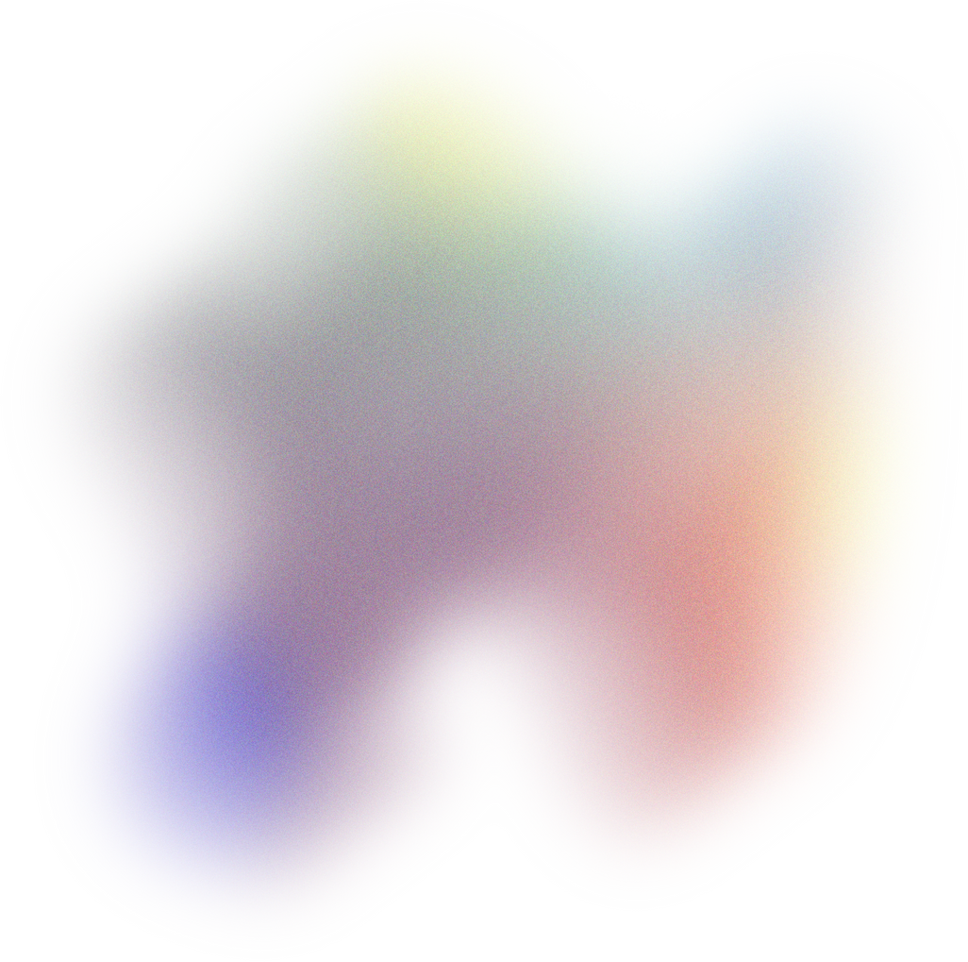
Overview
  Introduction
  Execution
  Statement of the Problem
  Conclusion
  Review of Related Literature
  Limitations and Future Work
  Framework
  References
  Hypothesis
  Q&A
  Methodology
Page 2 of 40

Slide 3

Statement of the Problem
Objectives
  Global matching
  Local Matching
  Pose graph optimisation
Whether multiple robots can map a complex environment fast and efficiently, while overcoming the issues of data consistency, map merging, and communication overhead.
Page 3 of 40

Slide 4
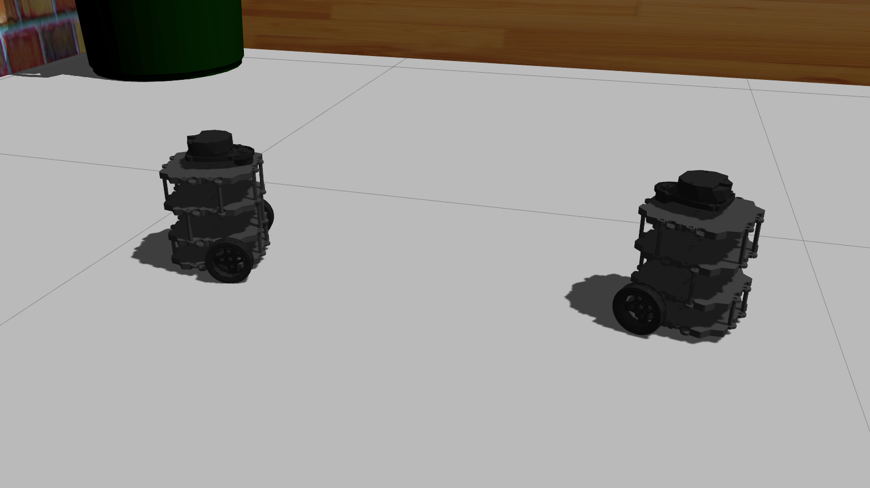
Review of Related Literature
RTAB-Map Framework
  Optimized for environments with large datasets through selective memory management, with sensor choice impacting performance.
C-SLAM (Collaborative SLAM)
TSLAM (Team SLAM Framework)
  Focuses on pose graph sparsification and loop closure detection with distributed methods, using the Distributed Gauss-Seidel (DGS) for map optimization, reducing reliance on centralized communication.
  Centralized system where robots perform local SLAM independently and send data to a central workstation for global optimization.
Page 4 of 40

Slide 5



Hypothesis
Can it be more efficient?
Should it be collaborative?
Can it be faster?
Multiple Turtlebots are better than one in terms of mapping of complex environments
Page 5 of 40

Slide 6

Methodology
Setup | 2 Turtlebots, LIDAR, labyrinth, decentralized communication
Metrics | Mapping time, Accuracy, Map completeness
Procedure 1 | Single-Robot SLAM
Procedure 2 | Independent SLAM of 2 and more robots
Procedure 3 | Pose Graph Optimization
Procedure 4 | Real-life testing and metrics evaluation
Page 6 of 40

Slide 7
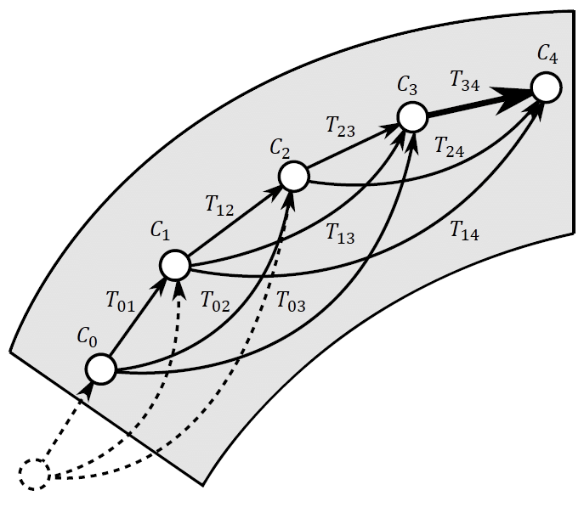
Pose graph
Represents the movement and observations of a robot as it explores an environment
Nodes (robot poses)
Edges (node transforms)
Page 7 of 40

Slide 8
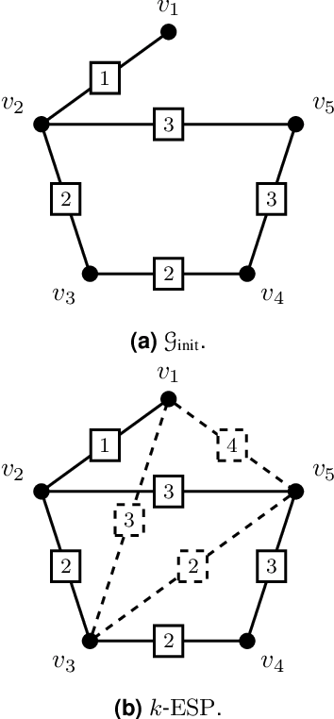
Intra-robot Loop Closure
A robot creates a certain pose graph, and then revisits a noticeable feature. This will create new edges between existing nodes
Loop closure is a 3D point cloud of a noticeable feature that increased graph connectivity
Page 8 of 40

Slide 9
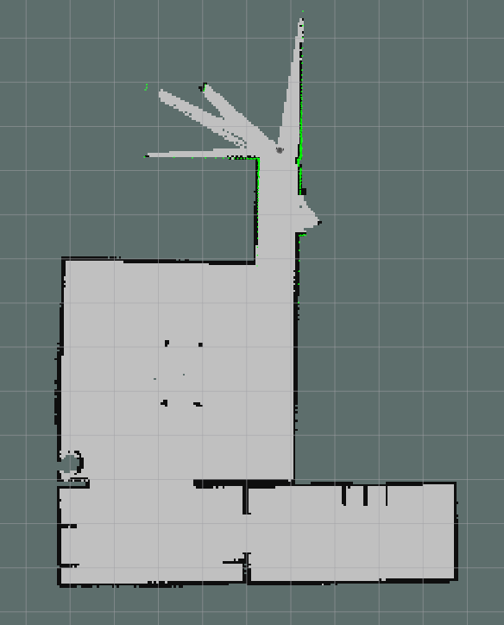
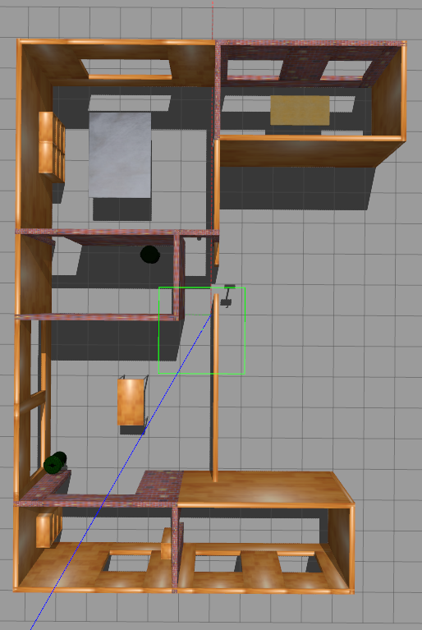
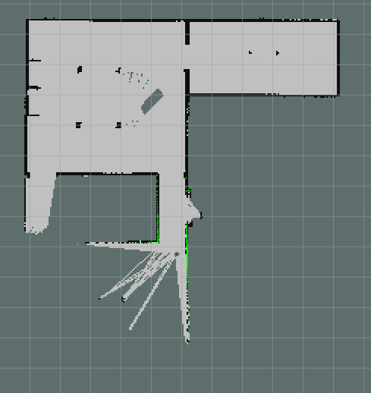
Turtlebot #1
local map
Turtlebot #2
local map
Gazebo map
Page 9 of 40

Slide 10
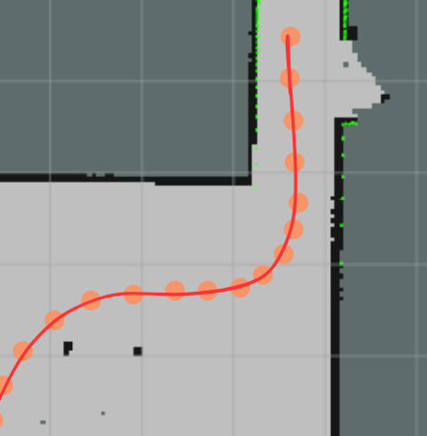
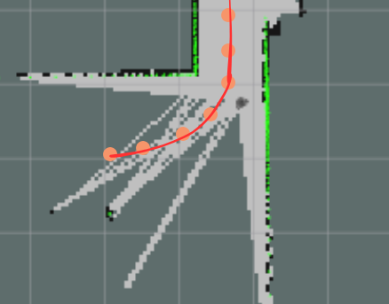
Inter-robot Loop Closure
Page 10 of 40

Slide 11
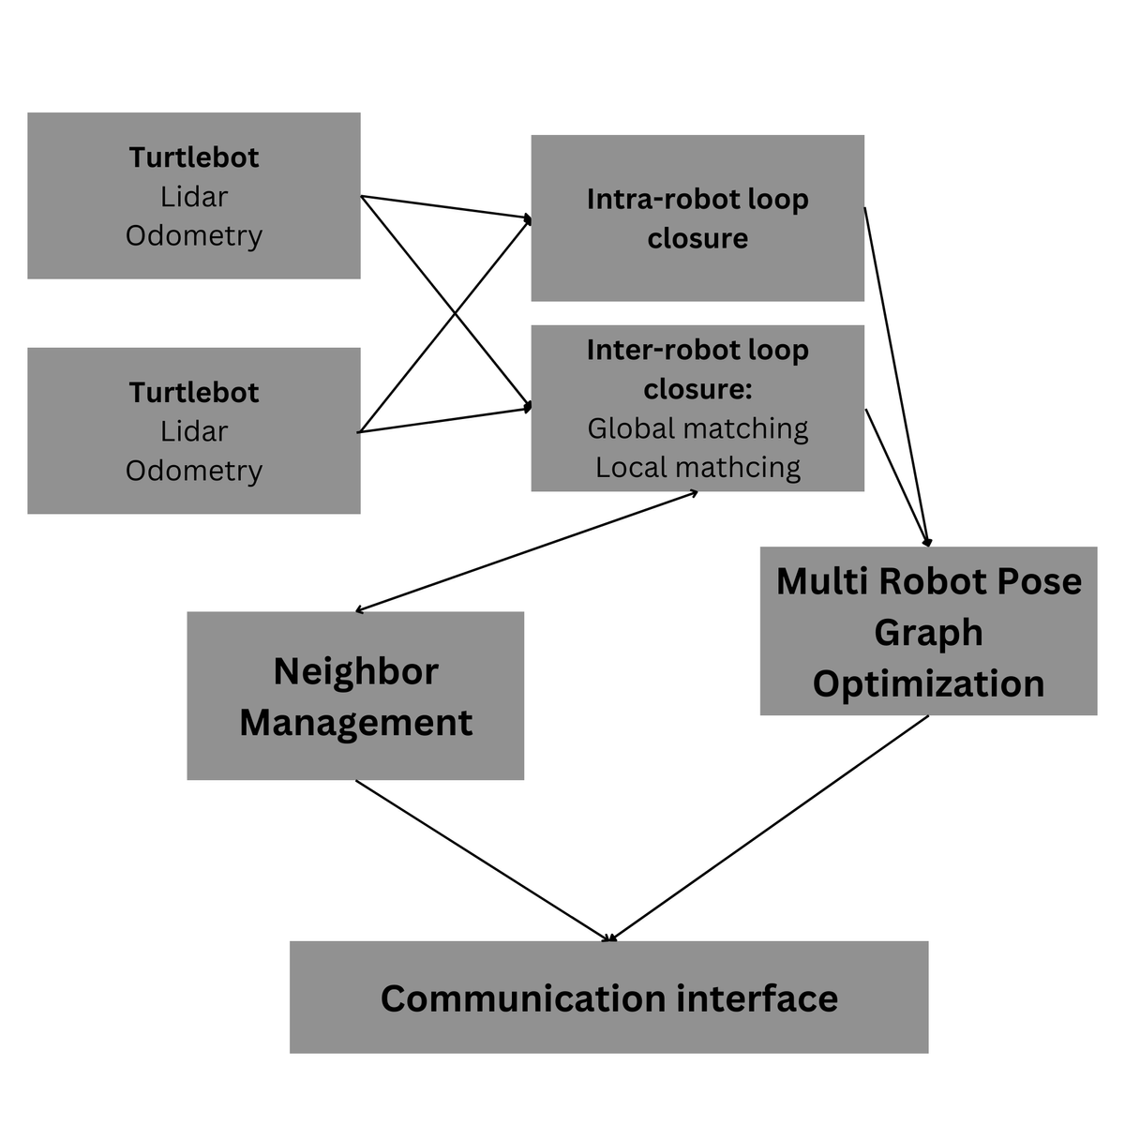
Framework
  Centralized collaborative SLAM framework
  Coupling of LIDAR and odometry through gmapping and then C-Slam
Page 11 of 40

Slide 12
SIngle-robot slam and navigation
Page 12 of 40

Slide 13
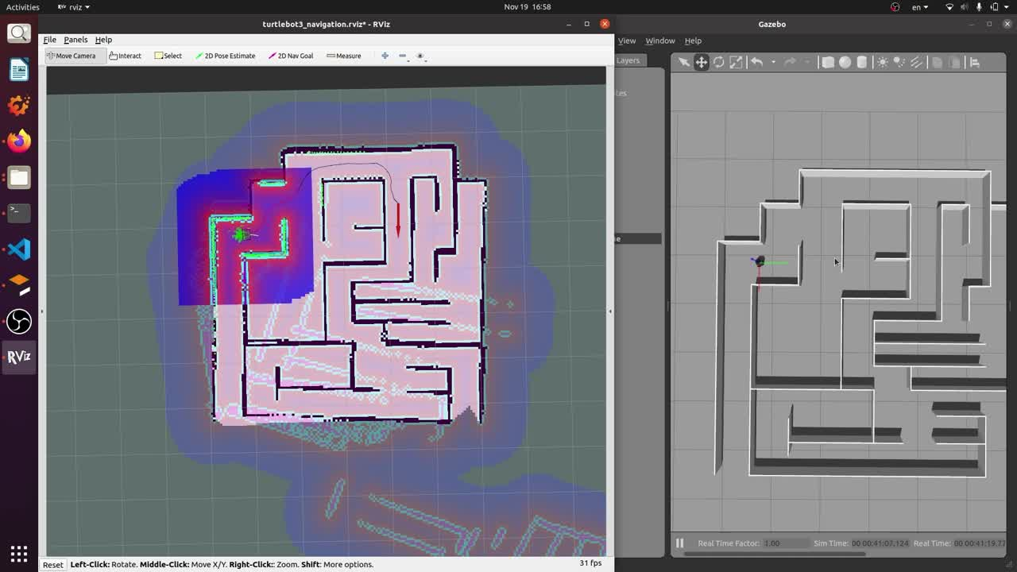
Page 13 of 40

Slide 14
Two robot slam and map merging
Page 14 of 40

Slide 15
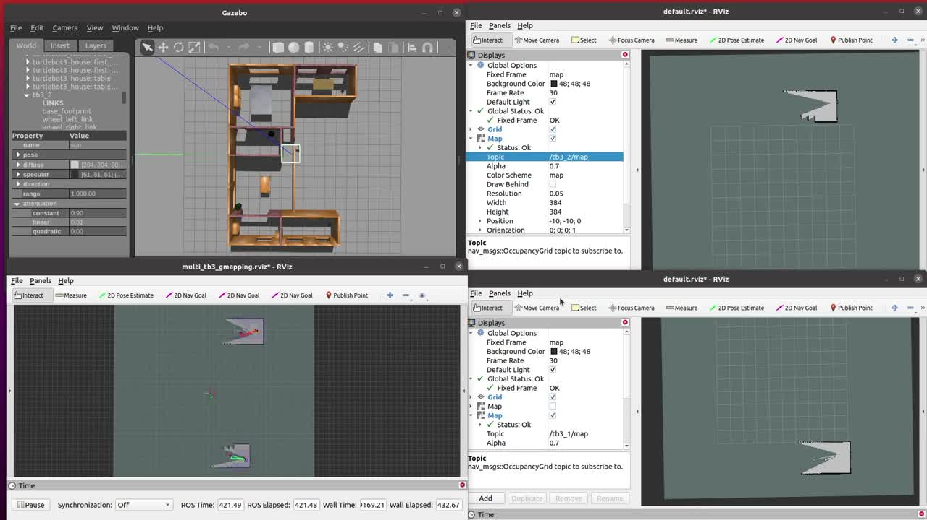
Page 15 of 40

Slide 16
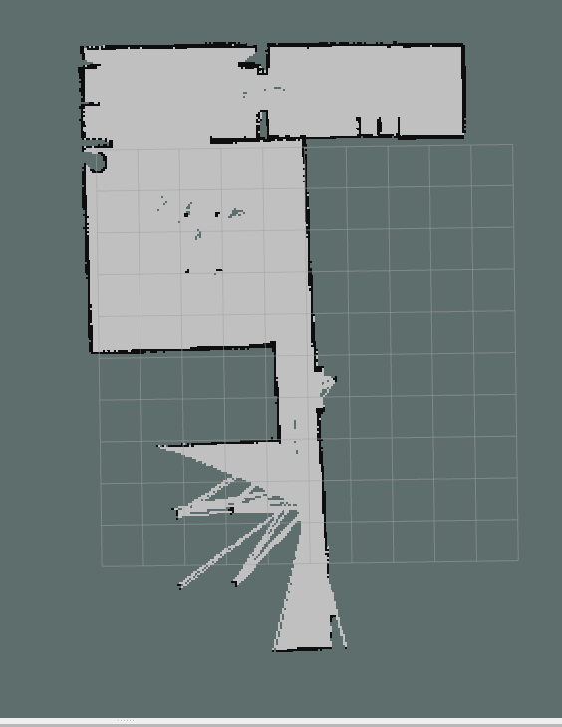
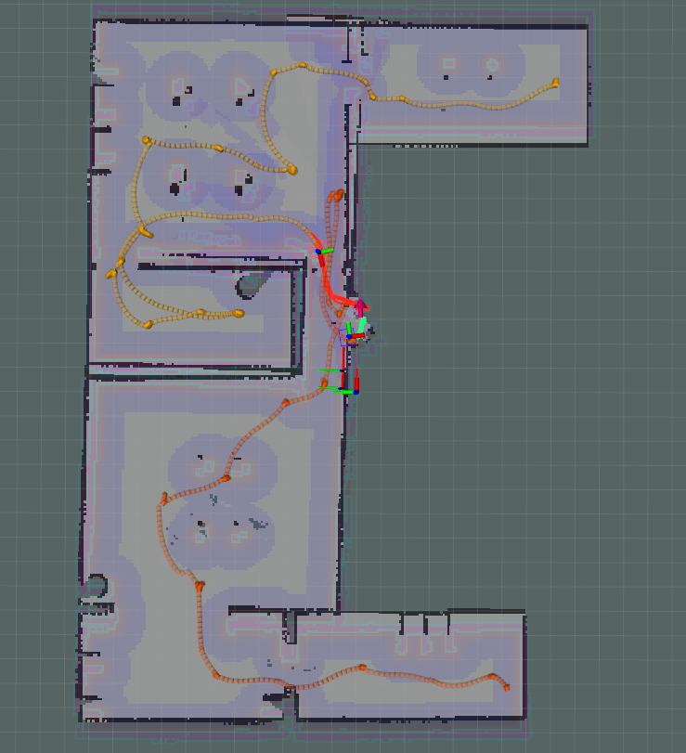
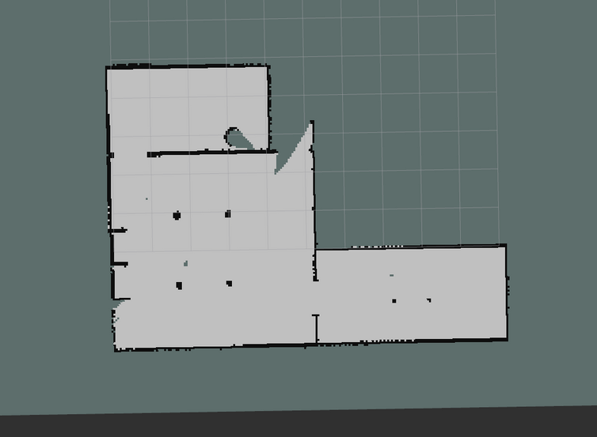
Page 16 of 40

Slide 17
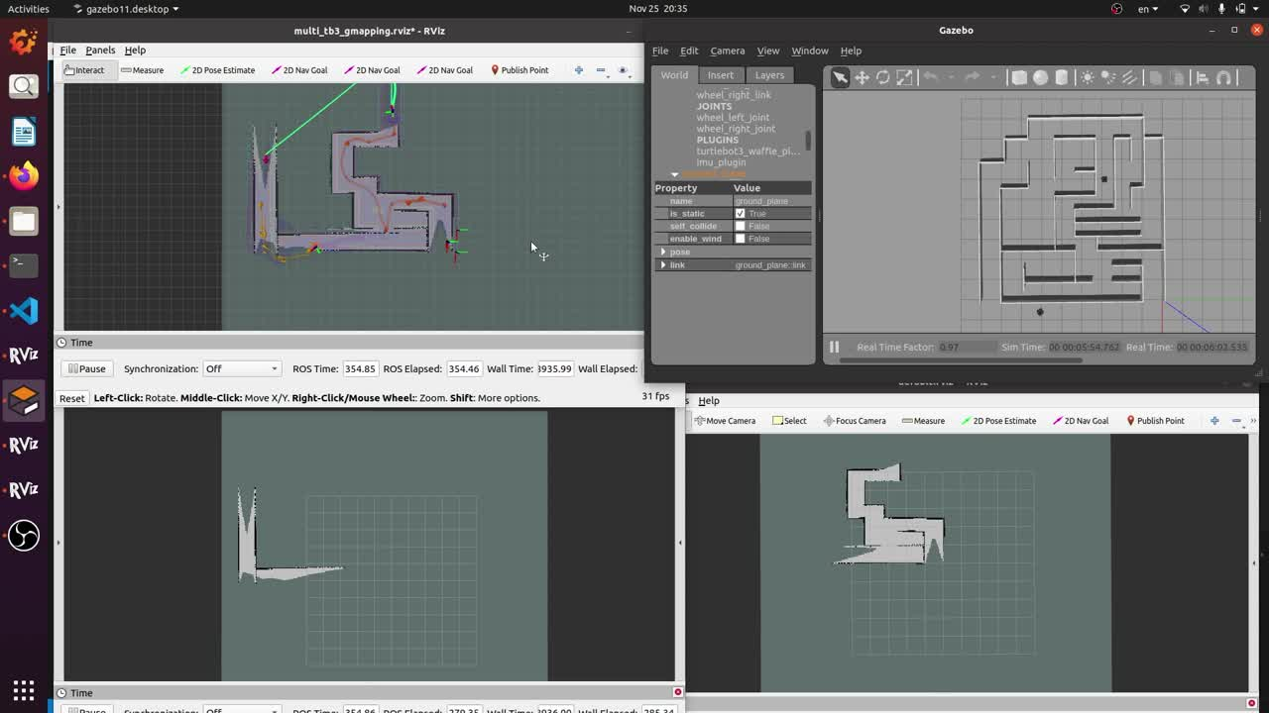
Page 17 of 40

Slide 18
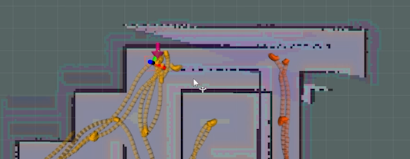
Page 18 of 40

Slide 19
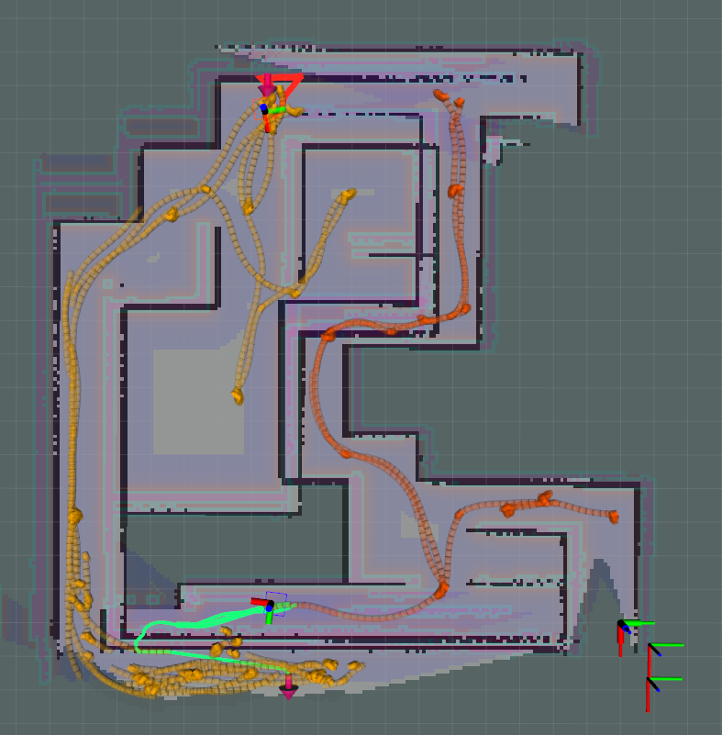
Page 19 of 40

Slide 20
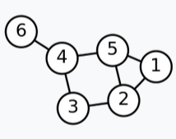
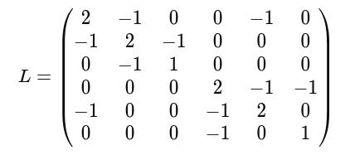
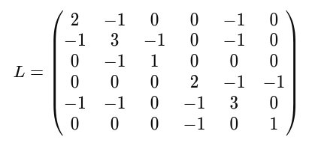
Graph Sparsification
Λ2​ = 0.27
Λ2​ = 0.41
Page 20 of 40

Slide 21
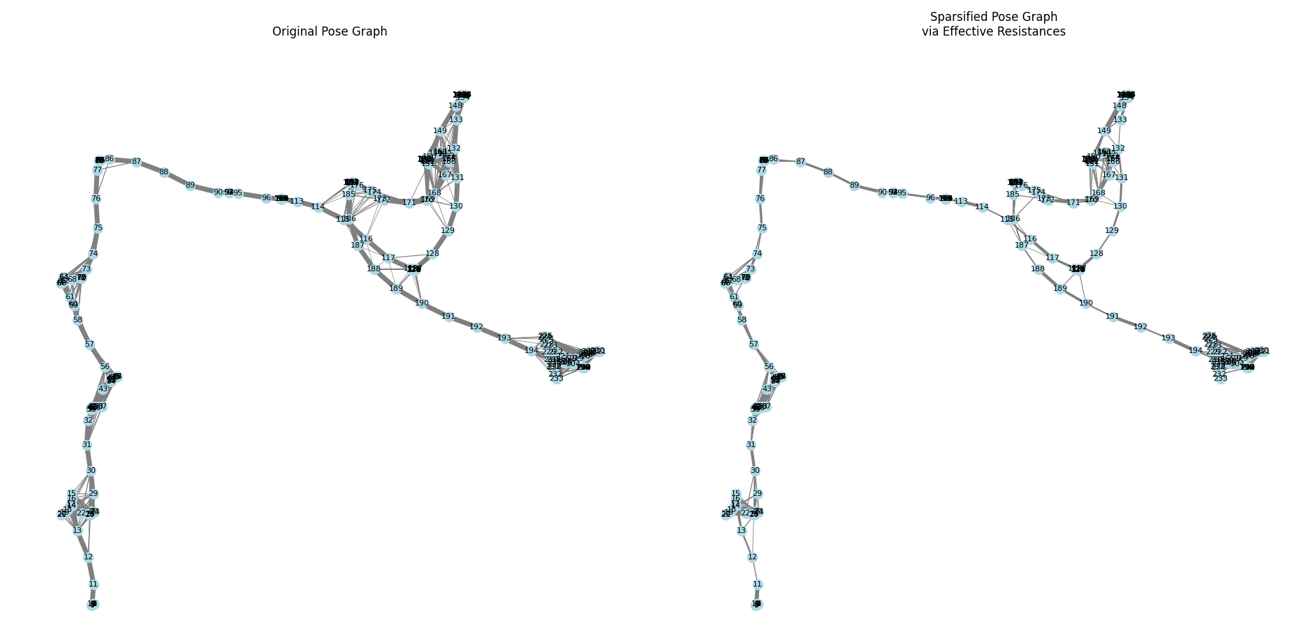
Graph Sparsification for Turtlebot 1
Page 21 of 40

Slide 22
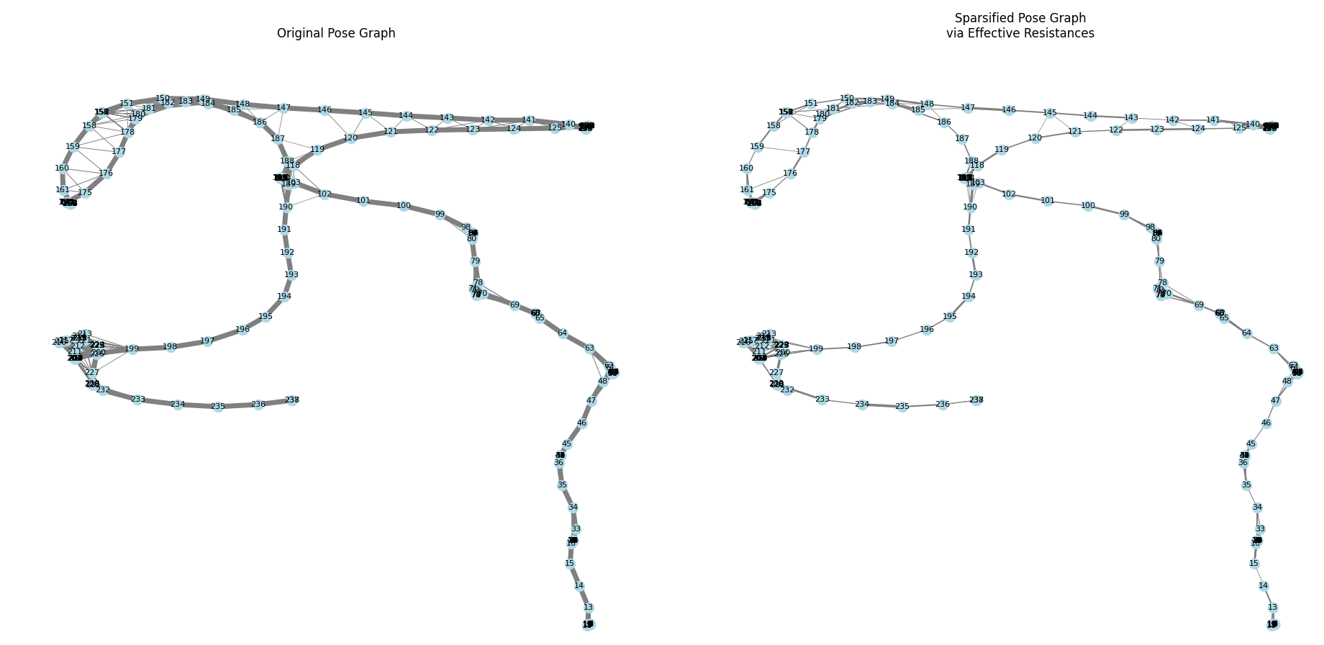
Graph Sparsification for Turtlebot 2
Page 22 of 40

Slide 23
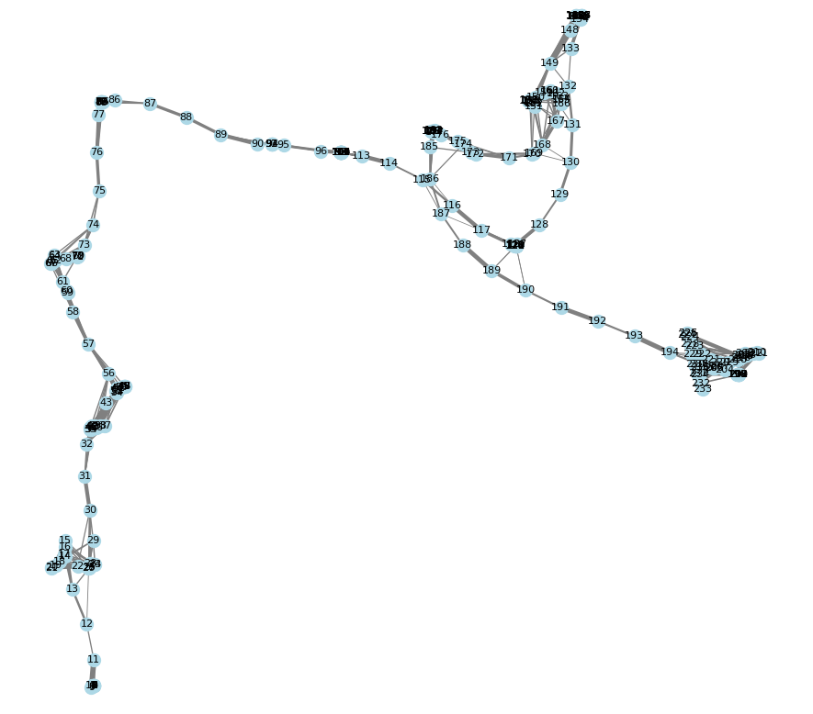
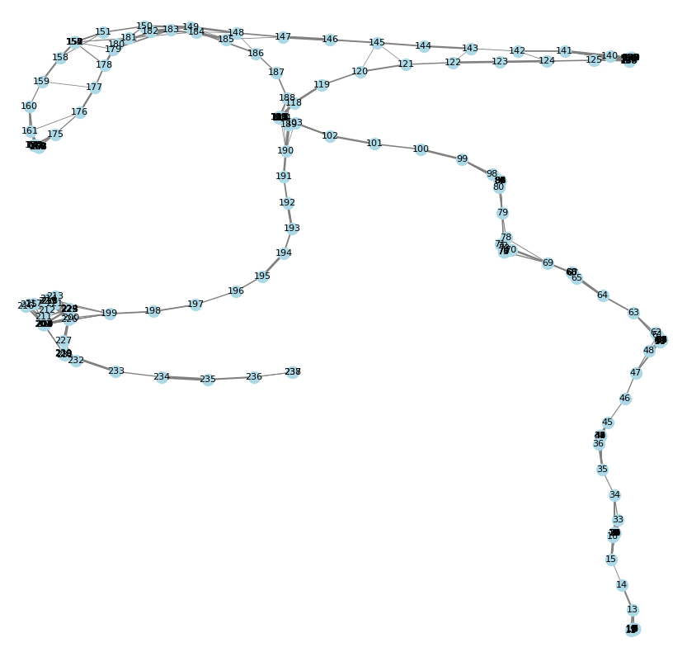
Page 23 of 40

Slide 24
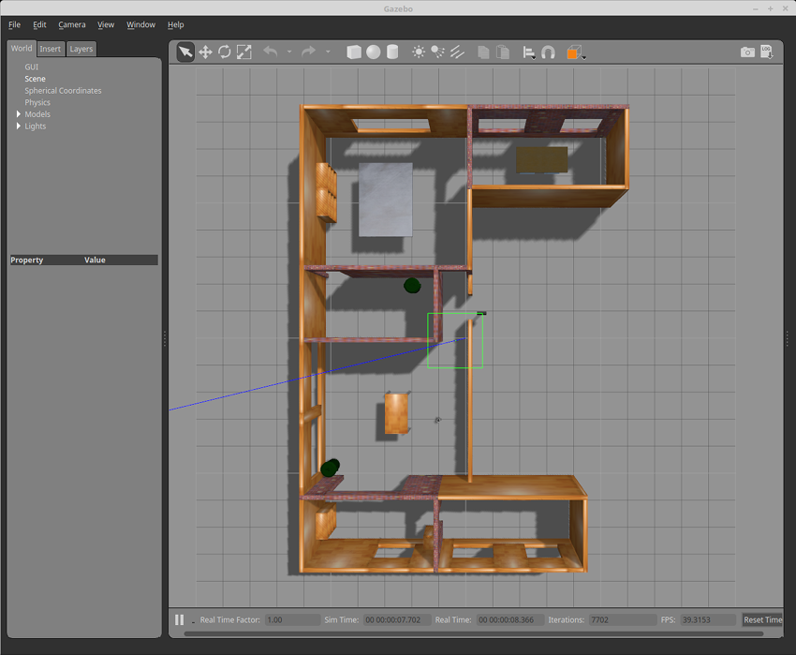
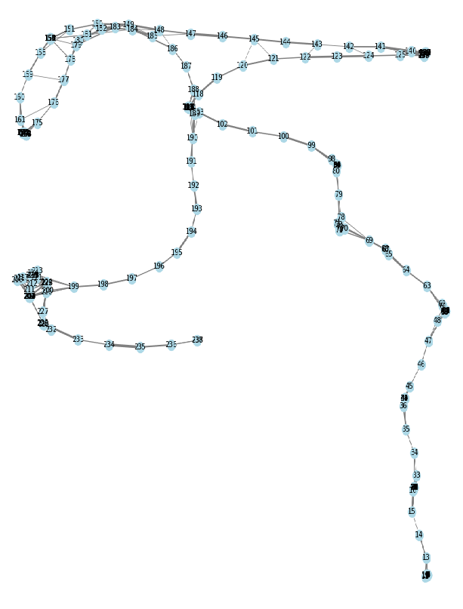
Page 24 of 40

Slide 25
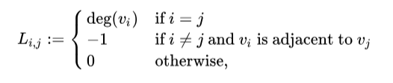
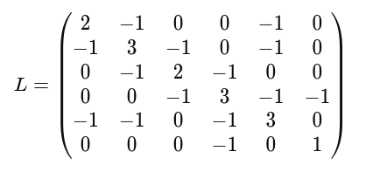
Laplacian Matrix
Λ2​ = 0.72
Page 25 of 40

Slide 26
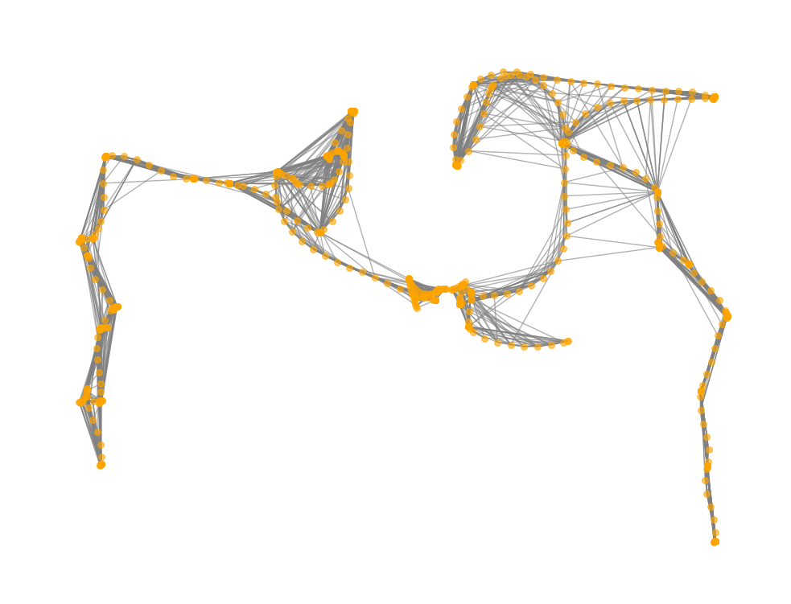
Algebraic connectivity maximization
Page 26 of 40

Slide 27
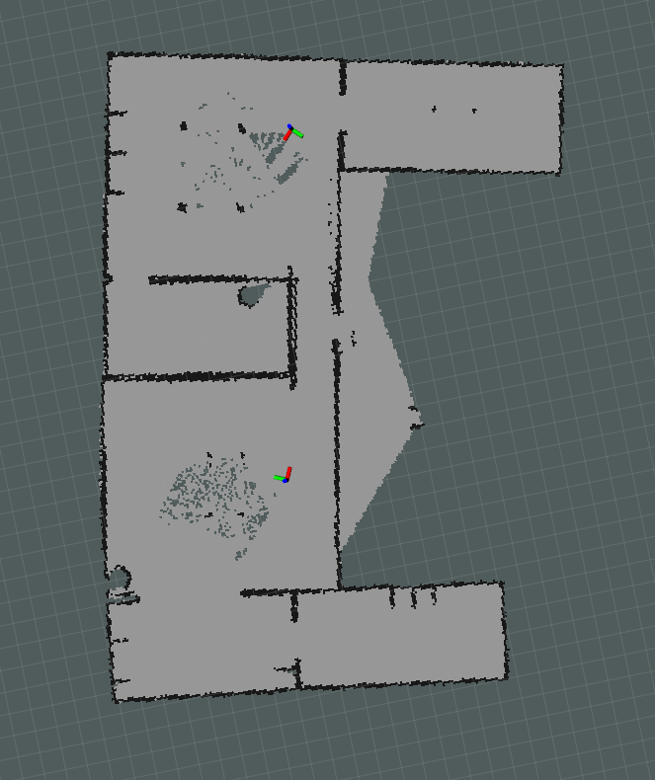
Page 27 of 40

Slide 28
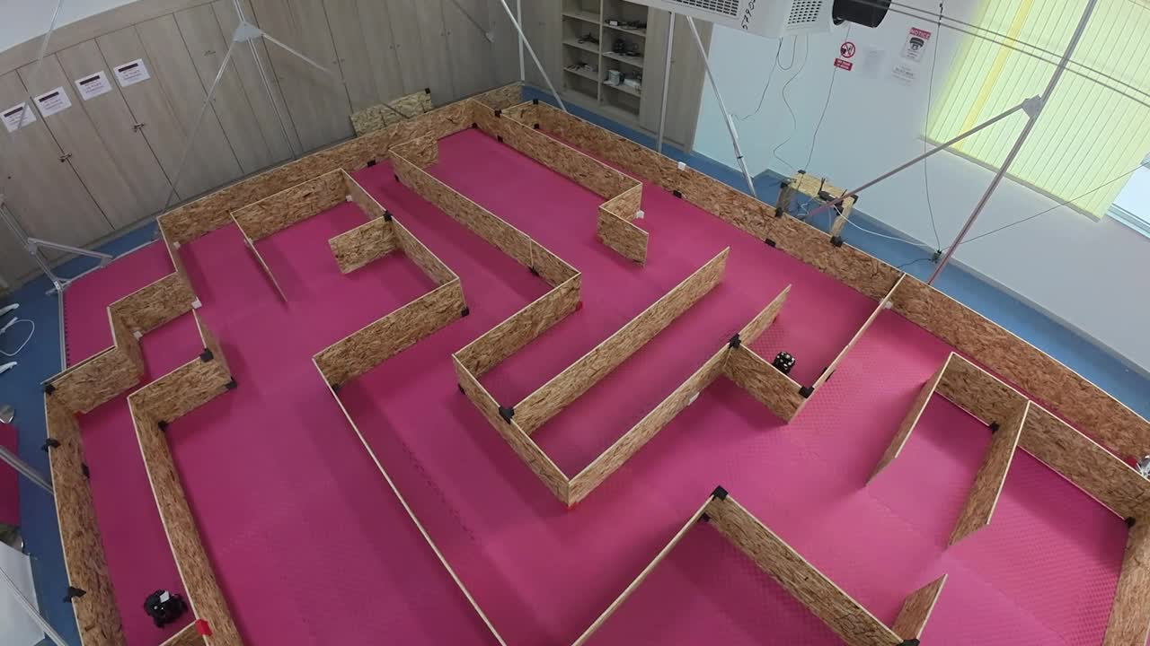
Page 28 of 40

Slide 29


Page 29 of 40

Slide 30
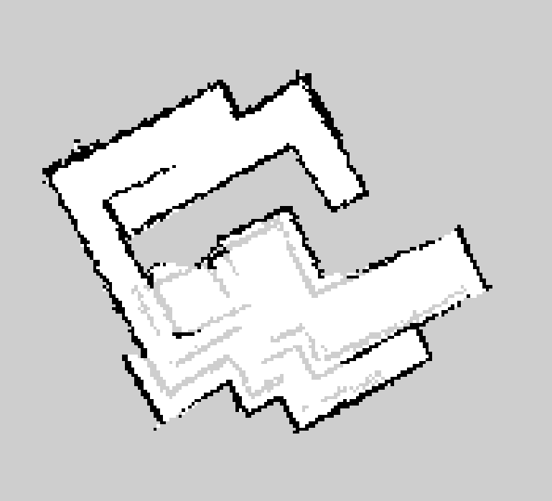
Bayesian fusion
Page 30 of 40

Slide 31
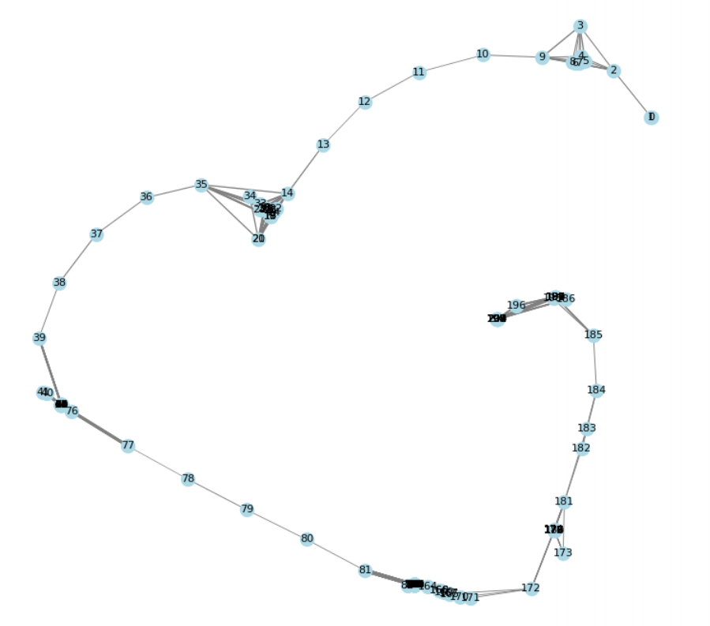
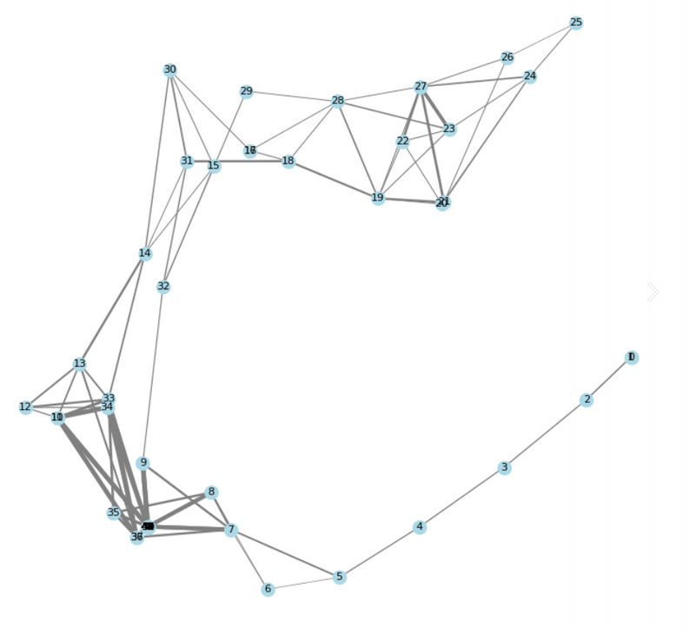
Inter-robot loop closure candidates
Page 31 of 40

Slide 32
The result that we want to get
Page 32 of 40

Slide 33
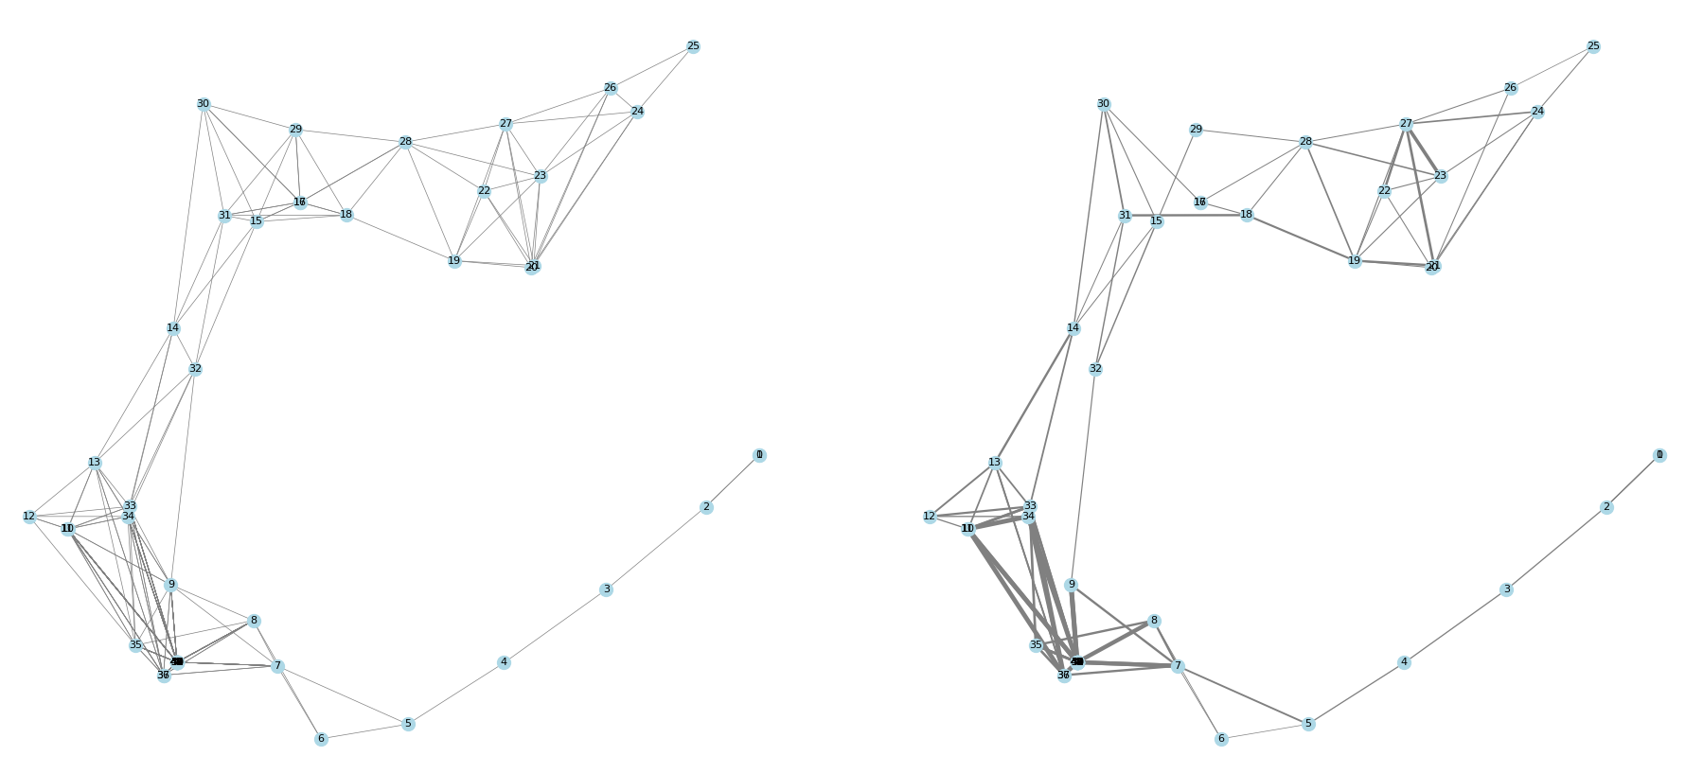
Pose graph #1 sparsified
Page 33 of 40

Slide 34
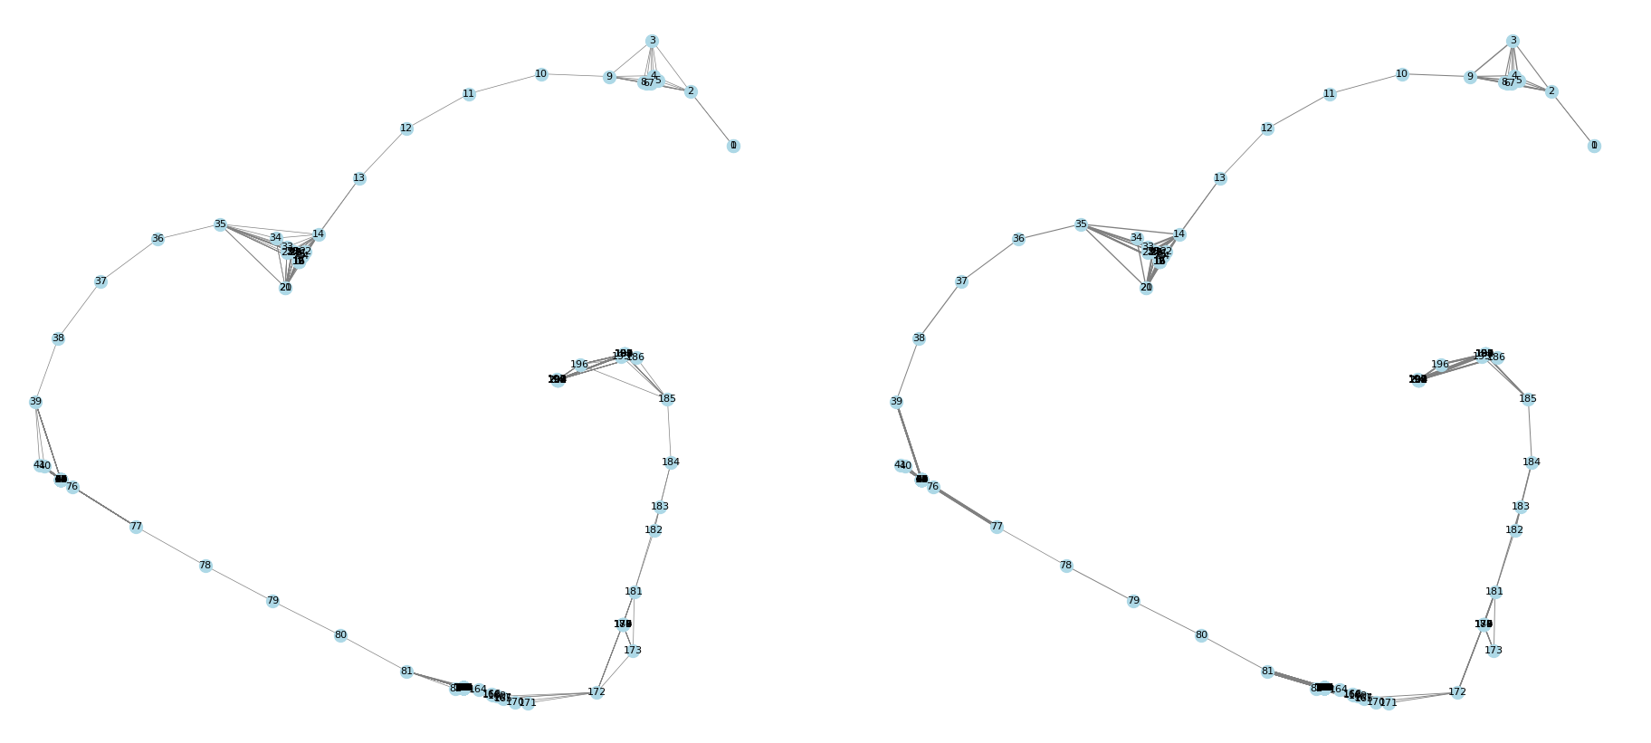
Pose graph #2 sparsified
Page 34 of 40

Slide 35
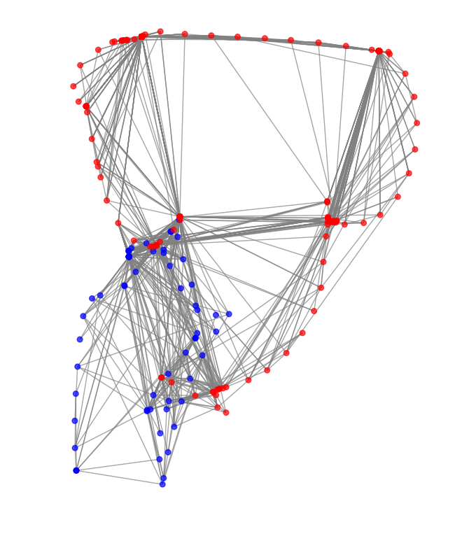
Algebraic connectivity maximization
Page 35 of 40

Slide 36
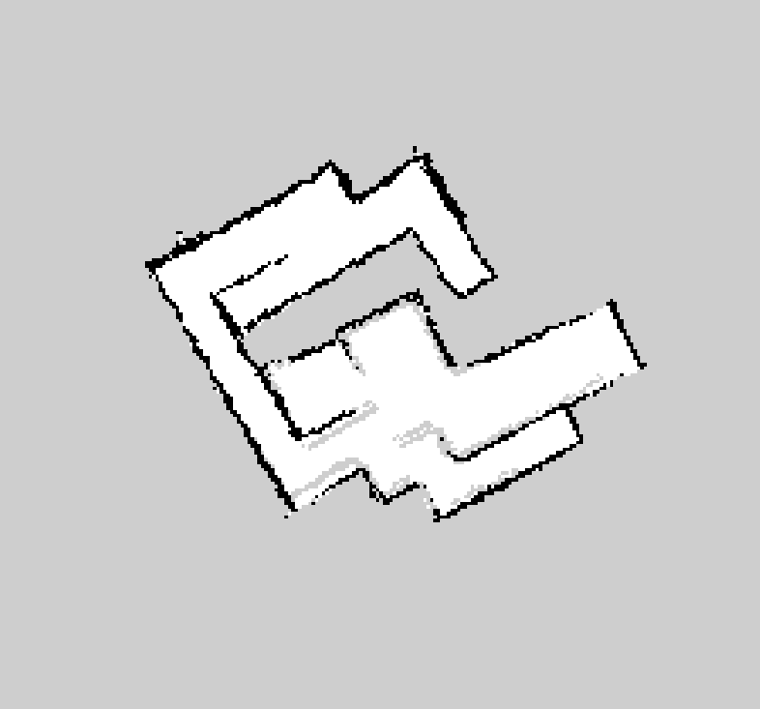
Page 36 of 40

Slide 37
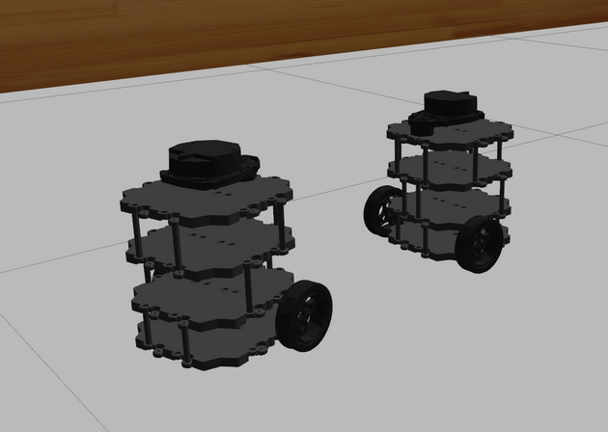
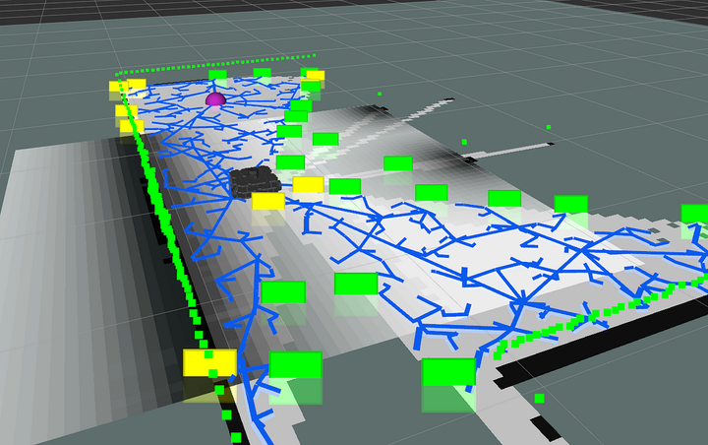
Conclusion
Implementation results
Optimized SLAM method
Map acquiring
We got the map of labyrinth
Simulation and real experiments show positive results
SLAM works too
Page 37 of 40

Slide 38

/Onboard computing
Limitations and Future Work
  TurtleBots typically have limited computational power compared to high-performance simulation environments.
/Variability
  Differences in lighting, texture, and obstacles can make mapping less predictable than in controlled simulations
/Hardware Constraints
  Real-world sensors (e.g., LIDAR, cameras) may have noise, reduced resolution, or inaccuracies due to environmental factors
/Map merging
  Map merging in real experiments is not done online
Page 38 of 40

Slide 39

References
  S. Saeedi, M. Trentini, M. Seto, and H. Li, “Multiple-robot simultaneous localization and mapping: A review,” Journal of Field Robotics, vol. 33, no. 1, pp. 3–46, 2016.
  P.-Y. Lajoie and G. Beltrame, “Swarm-slam: Sparse decentralized collaborative simultaneous localization and mapping framework for multi-robot systems,” IEEE Robotics and Automation Letters, vol. 9, p. 475–482, 2024.
  I. Deutsch, M. Liu, and R. Siegwart, “A framework for multi-robot pose graph slam,” in 2016 IEEE International Conference on Real-time Computing and Robotics (RCAR), pp. 567–572, 2016.
  J. Zhao, S. Liu, and J. Li, “Research and implementation of autonomous navigation for mobile robots based on slam algorithm under ros,” Sensors, vol. 22, no. 11, 2022
  M. Kegeleirs, G. Grisetti, and M. Birattari, “Swarm slam: Challenges and perspectives,” Frontiers in Robotics and AI, vol. 8, 2021.
  M. Labb´e and F. Michaud, “Rtab-map as an open-source lidar and visual simultaneous localization and mapping library for large-scale and long-term online operation,” Journal of Field Robotics, vol. 36, no. 2, pp. 416–446, 2019.
Page 39 of 40

Slide 40
Q&A
Thank you for listening!
Page 40 of 40

