Slide 1


Ontologies and Linked Data
(Introductory Lecture)
Piotr Lapo,
General Library Expert
Nazarbayev University Library
E-mail: piotr.lapo@nu.edu.kz

Slide 2
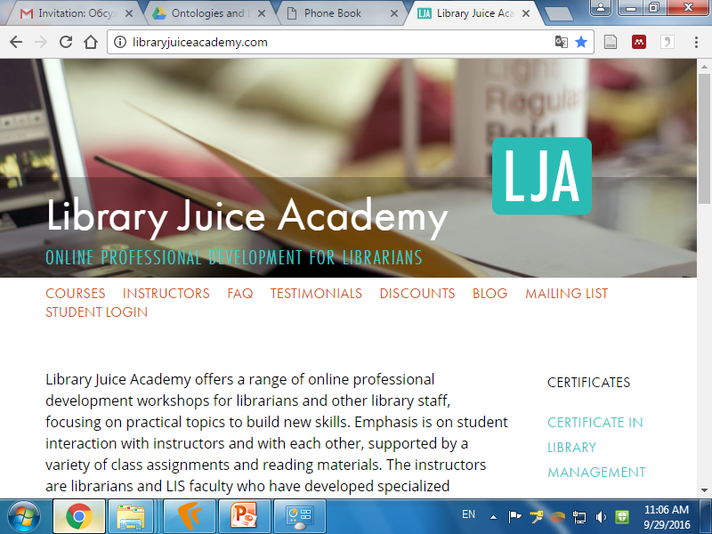

Slide 3
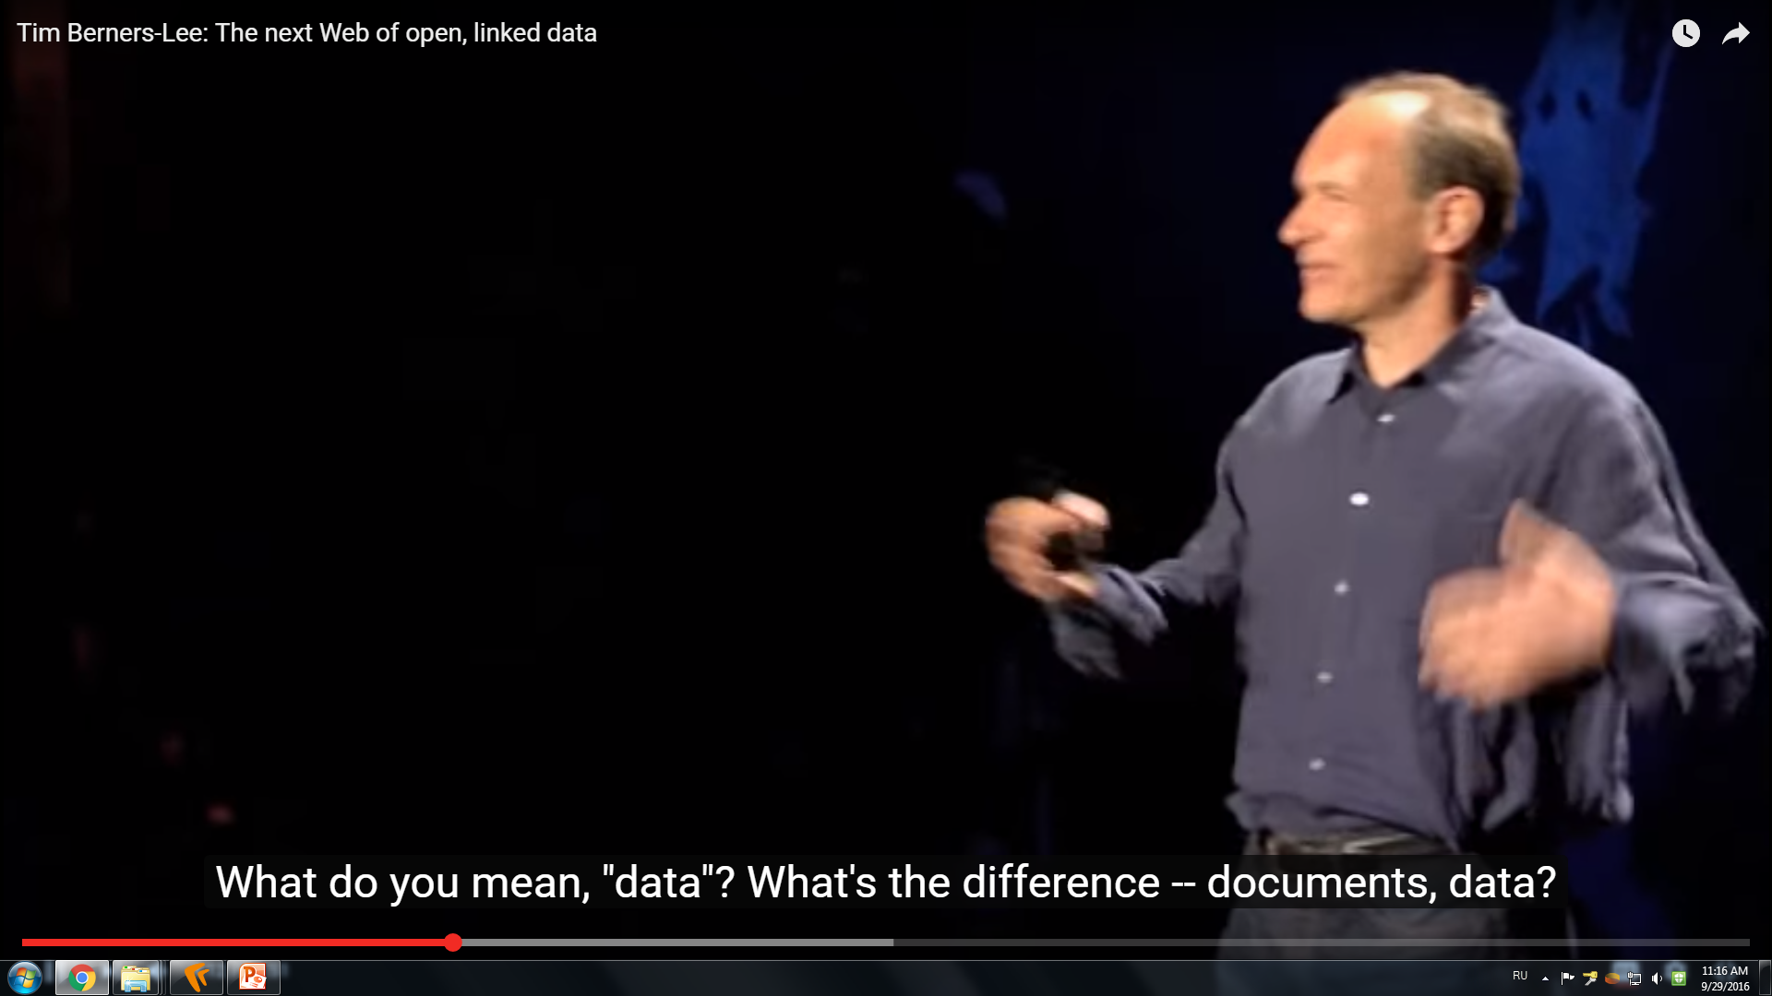
Notes:
Tim Berners-Lee: The next Web of open, linked data
https://www.youtube.com/watch?v=OM6XIICm_qo

Slide 4
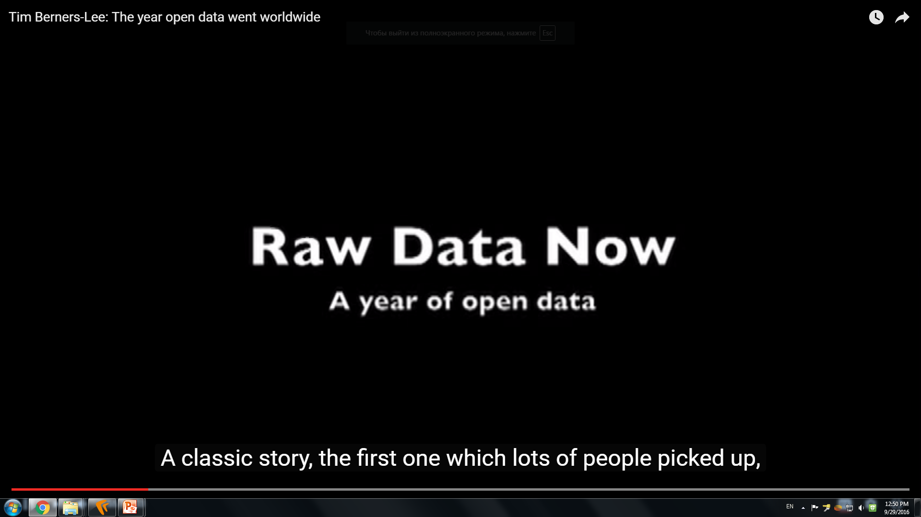
Notes:
Tim Berners-Lee: The year open data went worldwide
https://www.youtube.com/watch?v=3YcZ3Zqk0a8
Uploaded on Mar 8, 2010
http://www.ted.com At TED2009, Tim Berners-Lee called for "raw data now" -- for governments, scientists and institutions to make their data openly available on the web. At TED University in 2010, he shows a few of the interesting results when the data gets linked up.
TEDTalks is a daily video podcast of the best talks and performances from the TED Conference, where the world's leading thinkers and doers give the talk of their lives in 18 minutes. Featured speakers have included Al Gore on climate change, Philippe Starck on design, Jill Bolte Taylor on observing her own stroke, Nicholas Negroponte on One Laptop per Child, Jane Goodall on chimpanzees, Bill Gates on malaria and mosquitoes, Pattie Maes on the "Sixth Sense" wearable tech, and "Lost" producer JJ Abrams on the allure of mystery. TED stands for Technology, Entertainment, Design, and TEDTalks cover these topics as well as science, business, development and the arts. Closed captions and translated subtitles in a variety of languages are now available on TED.com, at http://www.ted.com/translate. Watch a highlight reel of the Top 10 TEDTalks at http://www.ted.com/index.php/talks/top10

Slide 5
What is Web?
The Web (World Wide Web) consists of information organized into Web pages containing text and graphic images.
It contains hypertext links, or highlighted keywords and images that lead to related information.
A collection of linked Web pages that has a common theme or focus is called a Web site.
The main page that all of the pages on a particular Web site are organized around and link back to is called the site’s home page.

Slide 6
How to access the Web?
Your computer must have a connection to a local area network (LAN)
The local computer area must support the TCP/IP protocol stack (Internet connection) including HTTP (HyperText Transfer Protocol)
The local computer area network must be connected to a server of an Internet Service Provider (ISP) (wide area network (WAN))
You need special software called a browser and installed on your computer to access the Web.

Slide 7
Client/Server Structure of the Web
Web is a collection of files that reside on computers, called Web servers, that are located all over the world and are connected to each other through the Internet.
When you use your Internet connection to become part of the Web, your computer becomes a Web client in a worldwide client/server network.
A Web browser is the software that you run on your computer to make it work as a web client.

Slide 8
Client/Server Structure of the Web
Client: web browsers, used to surf the Web
Server systems: used to supply information to these browsers
Computer networks: used to support the browser-server communication
Request “document A”
document A
Client
Server

Slide 9
Web Servers
Main functionalities:
  Server waits for connect requests
  When a connection request is received, the server creates a new process to handle this connection
  The new process establishes the TCP connection and waits for HTTP requests
  The new process invokes software that maps the requested URL to a resource (document or program) on the server
  If the resource is a file, creates an HTTP response that contains the file in the body of the response message
  If the resource is a program, runs the program, and returns the output

Slide 10
Addresses on the Web: IP Addressing
Each computer on the internet does have a unique identification number, called an IP (Internet Protocol) address.
The IP addressing system currently in use on the Internet uses a four-part number.
Each part of the address is a number ranging from 0 to 255, and each part is separated from the previous part by period,
For example, 112.45.231.12

Slide 11
Domain Name Addressing
Most web browsers do not use the IP address to locate Web sites and individual pages.
They use domain name addressing.
A domain name is a unique name associated with a specific IP address by a program that runs on an Internet host computer.
This program, which coordinates the IP addresses and domain names for all computers attached to it, is called DNS (Domain Name System) software.
The host computer that runs this software is called a domain name server.

Slide 12
Domain Name Addressing
Domain names can include any number of parts separated by periods, however most domain names currently in use have only three or four parts.
Domain names follow hierarchical model that you can follow from top to bottom if you read the name from the right to the left.
For example, the domain name nu.edu.kz is the computer connected to the Internet at the Nazarbayev University (nu), which is an educational institution (edu) and located in Kazakhstan (kz).
No other computer on the Internet has the same domain name.

Slide 13
Uniform Resource Locators (URL)
The IP address and the domain name each identify a particular computer on the Internet.
However, they do not indicate where a Web page’s HTML document resides on that computer.
To identify a Web pages exact location, Web browsers rely on Uniform Resource Locator (URL).
URL is a four-part addressing scheme that tells the Web browser:
What transfer protocol to use for transporting the file
The domain name of the computer on which the file resides
The pathname of the folder or directory on the computer on which the file resides
The name of the file
http://www.nu.edu.kz/portal/faces/main/default.htm(?)

Slide 14
Structure of a Uniform Resource Locators
pathname
protocol
http://www.chicagosymphony.org/civicconcerts/index.htm
Domain name
filename
http => Hypertext Transfer Protocol
Uniform Resource Identifier (URI) =>
www.chicagosymphony.org/civicconcerts/index.htm

Slide 15
Uniform Resource Identifier
In information technology, a Uniform Resource Identifier (URI) is
a string of characters used to identify a resource.
Such identification enables interaction with representations of the
resource over a network, typically the World Wide Web,
using specific protocols.
Schemes specifying a concrete syntax and associated protocols define
each URI.
The most common form of URI is the Uniform Resource Locator (URL),
frequently referred to informally as a web address.
More rarely seen in usage is the Uniform Resource Name (URN),
which was designed to complement URLs by providing a mechanism
for the identification of resources in particular namespaces.
Notes:
From Wikipedia

Slide 16
Uniform Resource Name (URN)
A URN is a URI that identifies a resource by name in a particular
namespace.
A URN may be used to talk about a resource without implying its
location or how to access it.
For example, in the International Standard Book Number (ISBN) system (namespace), ISBN 0-486-27557-4 identifies a specific edition of Shakespeare's play Romeo and Juliet. The URN for that edition would be
urn:isbn:0-486-27557-4.
To gain access to the book, its location is needed, for which a URL
would have to be specified.
Notes:
From Wikipedia

Slide 17
Namespace
In computing, a namespace is a set of symbols that are used to organize objects of various kinds, so that these objects may be referred to by name.
Prominent examples include:
file systems are namespaces that assign names to files;
computer networks and distributed systems assign names to resources, such as computers, printers, websites, (remote) files, etc.
Namespaces are commonly structured as hierarchies to allow reuse of names in different contexts. As an analogy, consider a system of naming of people where each person has a proper name, as well as a family name shared with their relatives. If, in each family, the names of family members are unique, then each person can be uniquely identified by the combination of first name and family name; there is only one Jane Doe, though there may be many Janes. Within the namespace of the Doe family, just "Jane" suffices to unambiguously designate this person, while within the "global" namespace of all people, the full name must be used.
In a similar way, hierarchical file systems organize files in directories. Each directory is a separate namespace, so that the directories "letters" and "invoices" may both contain a file "to_jane".

Slide 18
Hypertext Transfer Protocol (HTTP)
Hypertext: a format of information which allows one to move from one part of a document to another or from one document to another through hyperlinks
Uniform Resource Locator (URL): unique identifiers used to locate a particular resource on the network
Markup language: defines the structure and content of hypertext documents

Slide 19
Hypertext Markup Language (HTML)
Example HTML code:
      <HTML>
      <head>
      <title>Hello World</title>
      </head>
      <body bgcolor = “#000000”>
      <font color = “#ffffff”>
      <H1>Hello World</H1>
      </font>
      </body>
      </HTML>

Slide 20
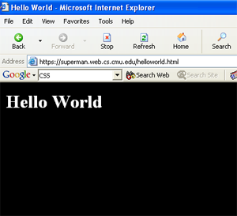
Hypertext Markup Language (HTML)
The visualization of the HTML code example on a computer screen

Slide 21
The HTML Anchor Tag
The <a> tag creates hyperlinks
A container tag that encompasses the text or image (or both) to be used as a link
The syntax for using the anchor tag to create a link is as follows:
<a href="URL"> linked text or image (or both) </a>

Slide 22
Semantic Web
A Human vs a Computer
A human understands that this is my institution’s home page
He/she knows what it means (realizes that it is a research institute in Amsterdam)
On a Web of Data, something is missing; machines can’t make sense of the link alone
New lesson learned:
  extra information (“label”) must be added to a link: “this links to my institution, which is a research institute”
  this information should be machine readable
  this is a characterization (or “classification”) of both the link and its target
  in some cases, the classification should allow for some limited “reasoning”
What we need for a Web of Data:
  use URI-s to publish data, not only full documents
  allow the data to link to other data
  characterize/classify the data and the links (the “terms”) to convey some extra meaning
  and use standards for all these

Slide 23
Semantic Web
Namespaces are based on the domain name system of the Internet. Your namespace is an identity space on the Internet that you control.
For example: Library of Congress owns the namespace "loc.gov"; OCLC has "oclc.org"; the University of Michigan has "umich.edu." When Library of Congress creates an identifier for the subject heading "Guide dogs" it creates an identifier in its namespace: http://id.loc.gov/authorities/subjects/sh85057714. This guarantees that the identifier will be unique on the web since no one else can use "loc.gov".

Slide 24
Semantic Web
Tim Berners-Lee developed a simple strategy with four rules that use Web Technologies to integrate linked open data into the web:
1. Use URIs as names for things
2. Use HTTP URIs so that people can look up those names.
3. When someone looks up a URI, provide useful information, using accepted standards (RDF, SPARQL)
4. Include links to other URIs so that they can discover more things.

Slide 25
Thank you for your attention!

