Slide 1
The 1st Annual Gender Forum at Nazarbayev University
“Challenges and Changes in Gender in Central Asia:
Bridging Researchers, Policy Makers, and Practitioners”
TRANSFORMATION OF GENDER RELATIONS AND THE FAMILY
IN MODERN KYRGYZSTAN
Ibraeva Gulnara, PIL Research Company, Kyrgyzstan
Nazarbaev University, 14 June 2019
Notes:
Sara Amsler many years ago: I would like to develop sociology of hope and trust, sociology of happiness. I would love to deliver the speech about wonderful gender advancement in my country, but unfortunately the reality doesn’t allow it to me. That is why my speech is about current challenges and risks. But I am far away from pessimism. I guess that current challenges and risks can bring progressive development.

Slide 2
Outline
Does CA region have common trends and tendencies in changes of gender relations and family?
The dynamics within the role of state and other actors who constitute the construction of gender.
Gender relations and family in the migration context
Gender relations and family in the context of growth of religion
Closing remarks – and so what for teaching\education?

Slide 3
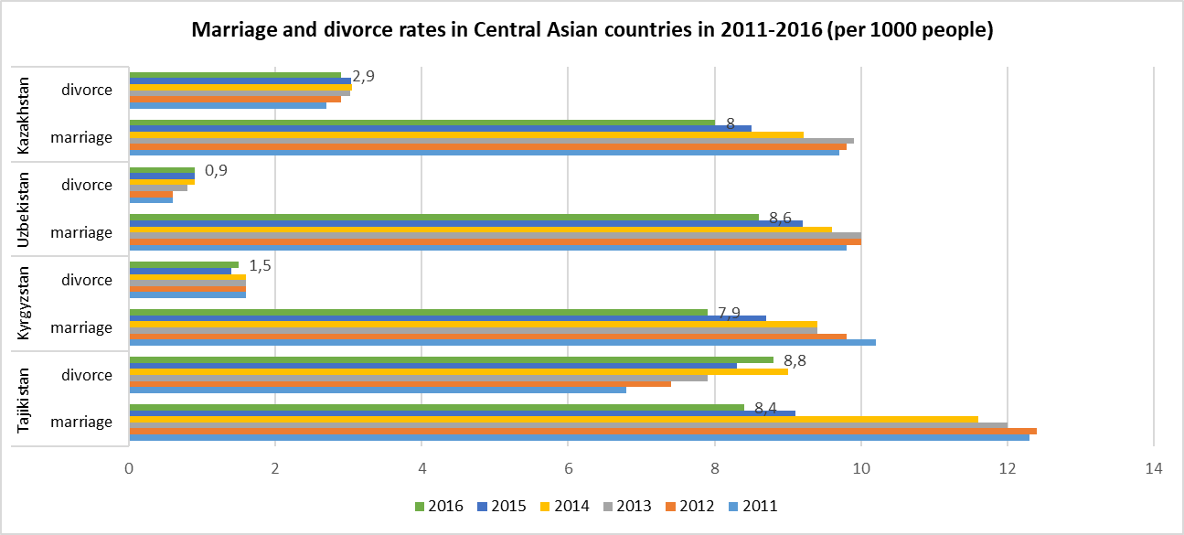
Uneven development intensifies uncertainties
There aren't anymore common regional CA trends and tendencies in transformation of gender relations and family as social institute.
Notes:
Just look at the statistics of marriages and divorces and it will be clear - different things happen in each country

Slide 4
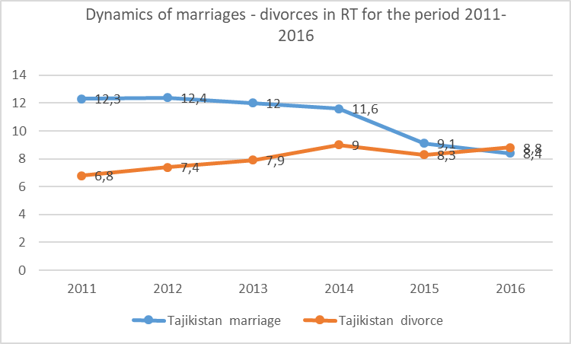
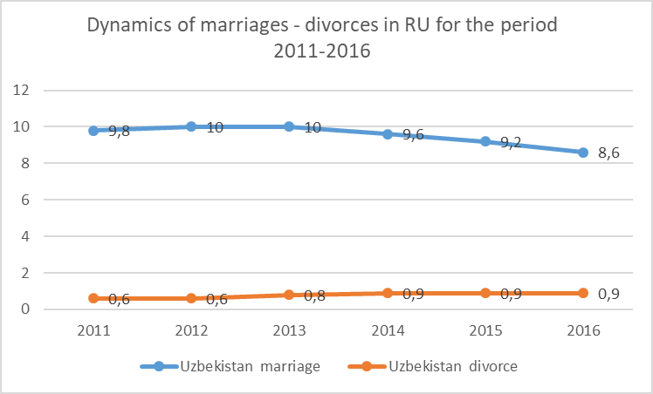
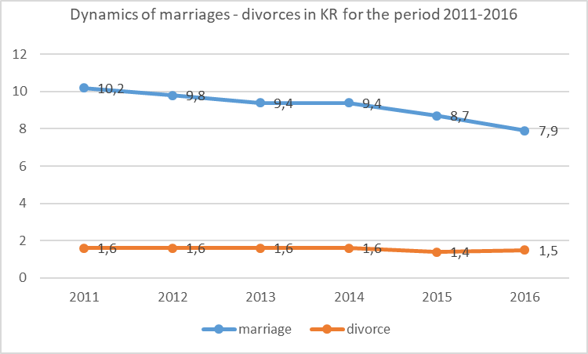
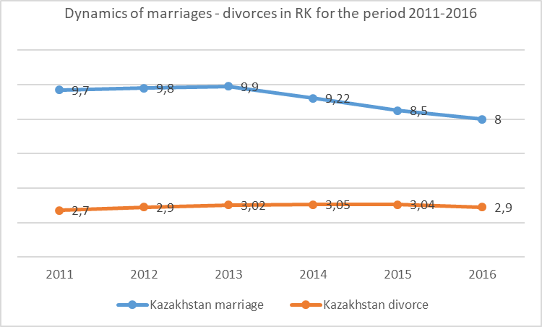
Notes:
Different tempo, ratio … which means the transformation is happening in different contexts.

Slide 5
The difference in trends is associated with the following factors:
• The Soviet period with state’s monopoly on the construction of gender was replaced in CA countries by variations of regimes (different attitudes toward the soviet gender legacy). I.e, in the KR, the state quickly lost its constituent role in post-Soviet transformations, while in other countries state still harshly produces gender norms.
• The post-Soviet public discourse is influenced by various forces: the development of capitalism and market pressure, the growth of culture of consumption, the rise of religiosity and nationalist ideologies, migration.
There are new actors producing gender and new gender roles in everyday life.

Slide 6
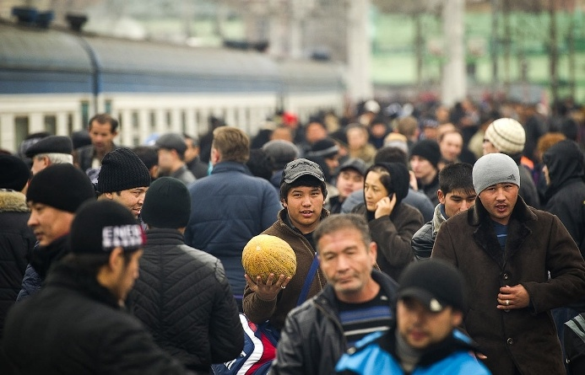
Impact of mass migration on gender relations and family
Predominantly immobile population are leading modern nomadic lifestyle. There are three forms of split households, differentiated by whether the migrant's spouse and children are left behind or have joined the migrant: sole migration, couple migration, and family migration.
The most popular motivation to become labor migration is the need \ dream to build the family house.
]
Notes:
The image of CA labor migration to Russia is always gendered.

Slide 7
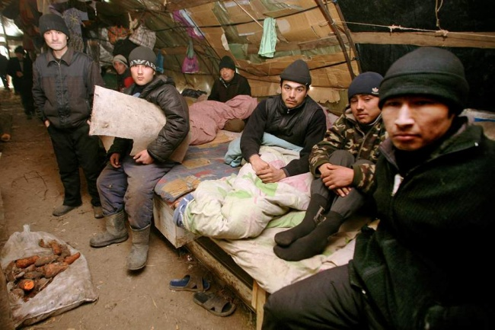
House as a Memorial to the family
Changes of meaning of home (house): in migration the leaving space is related to work place, plays the secondary role, is changeable if needed for better work condition.
House at home (in homeland) is more the place of dream, but not real life.
While making money in migration majority of migrants spend money in house building in place of birth.
But the return is problematic (children, social exclusion, challenges of reintegration) and built houses are waiting in vain the return of owners.
Notes:
There is the case of migrants from KR who begin to build the Kyrgyz village in Tula oblast Russia. But they never succeed: already build houses were considered post factum illegal and the land sale deal invalidated.

Slide 8
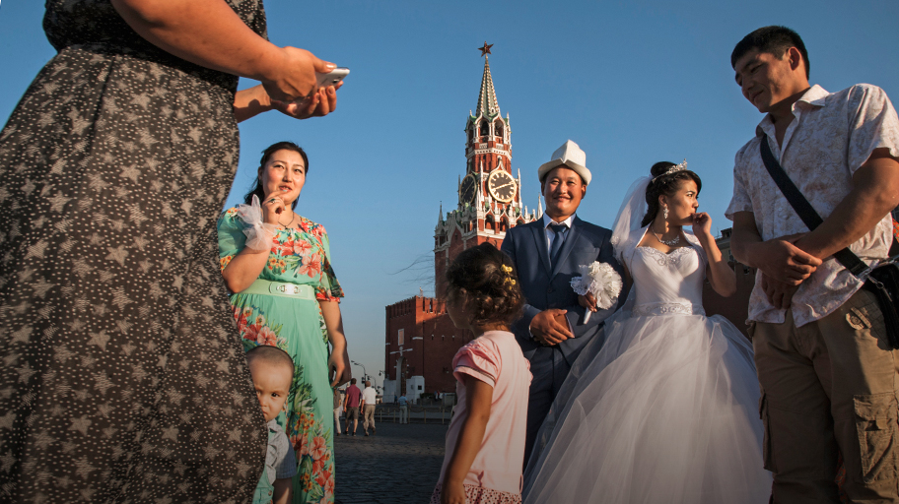
Sexuality in migration: from postponed to perverse
Physical space for labor migrant’s life lost its key feature: intimacy and privacy.
Even in case of couple migration – they often don’t share the leaving space, are on the distance. Their relations, incl. sexual, are rare and publicly observed.
Not only changing the private-public in family relations, but also expanding the horizons and spaces of choice of sexual and marital partners.
The diversification of marriage types and the “alternatives of freedom”
Notes:
the private life of the spouses becomes impossible, since housing no longer gives privacy, it becomes a public place.

Slide 9
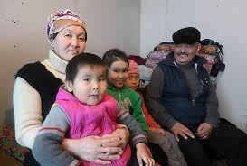
Decline of intimacy in family relations
The claims of parents of migrants: they become egoist, don’t care about the family
Abandoned children and rise of violence against migrants’ children who left behind
The trouble of generation of grand parents: new, intensive reproductive cycle
Commercialization of relations within the family
Instrumentalization of children and the duty of donation

Slide 10
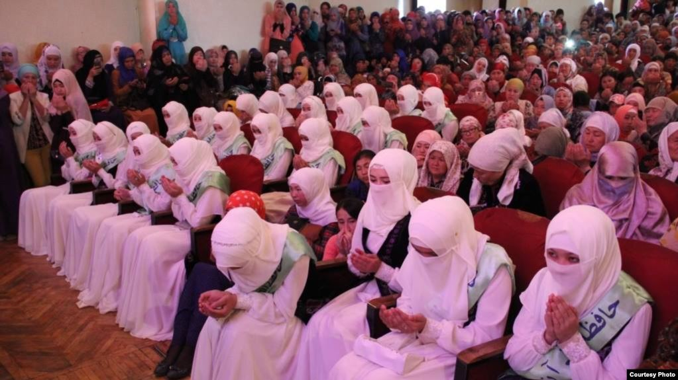
Gender relations and family in the context of ‘religiosity’ on the rise
Revision of gender roles and relationships: husband is a Lord and wife subordinates. Decline of the power of mother-in-law.
Socialization of children in a religious context - new languages and new language practices (case of a 6 years old girl during the field observation in the family)
Formation of new ethics and the way to think: the lack of a language for communication? (case of young women in a workshop)
Notes:
New cases of domestic violence: forced religiozation (involvement into masturat davat)
The story of a six years old girl, from a village in the south of the country. I lived in her family for three weeks and conducted the participant observation. One day, when I managed to establish trust, I talked to the youngest girl from the family and she asked me what I was dreaming about. After I answered, I in turn asked about her dreams. And the girl very sincerely replied that she wants to die as quickly as possible and get into the real world, not false. And she is afraid that if she lives here longer, she will become sinful and will not be able to go to heaven. I was struck by this sincere story, a dream that was not connected with life, but the afterlife. what I learned: the huge masses of the population who joined the Islamic community fervently believe, even if this belief looks irrational to outside observers.
The story of a woman (К.), who is the winner of the Qur'an readers competition in 2018. She participated in one of my seminar on the organizational development of a women's religious NGO. In order to introduce to the group strategic planning and analysis, I began the workshop with a reflexive exercise. I asked each participant to write on separate sheets about what pleased them in her personal life last year, what they might consider their success and what sadden them, what they view as unfulfilled plans. All women in the group began to work, while one sat without understanding what to write. I started talk to her. In the dialogue I have got answers which struck me again. she said: I haven’t been dreaming about anything for a long time, I trust in God. What he deems necessary for me, I will experience in life. What is the use of worrying in vain? It is better to be more persistent in praying and asking for the benefit of the whole of our society. And God himself knows what a blessing it is.
Faced with such ethics and way of thinking, I was irritated - from my point of view, people who don’t want anything just may not exist. But I understand that if I do not understand something, this does not mean that this does not exist.

Slide 11
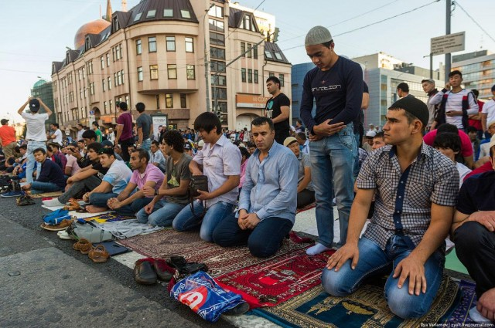
Rise of religiosity: between fear and hope
The risks of having an Islamic identity – myths of violent extremism in Islam
The promise to strengthen the marginalized masculinity
Mobility and rise of religiosity
Notes:
The ambition of Kyrgyz tabligi jamaat to become first in the world in out country davats, they reported we are already third in the world. They don’t carry KR is the among 4 countries across the globe where the Tabligi are legal. But the opportunity to travel outside of country and not only for the labor migration is new and the impact is not even measured.
The triangle of power of the Soviet period - the state - a woman and children. Now = the imam is a husband and a woman with children ...

Slide 12
Closing remarks
Feminist professor Bell Hooks in her book “Teaching to transgress” proposes number of solutions to the problem of education as she sees it, illuminating the ways that education maintains power structures and talking about ways to subvert those structures for both teachers and students.
Some of these methods include encouraging students to think about not understanding another person’s experience or point of view as a place of learning, rather than assuming the differences are insurmountable.
Prof. Hooks also talks about teaching students that conflict is a necessary and unavoidable part of both education and life, and teaching students to think of conflict as a space for change and growth, rather than anger, violence, and fear.
Question to the audience:
Could you see any positive point of view on the transformation of gender relations and family in KR?
Could we develop the sociology of hope and happiness from here?

Slide 13
Thank you!
Any questions?
Comments?

