Slide 1
“Paradigm-Independent Classification on
Multidimensional Neuroimaging Dataset Using
Convolutional Neural Networks”
Kanat Alimanov
Supervisor:
Min-Ho Lee,
Assistant Professor
Co-Supervisor:
Kok-Seng Wong,
Associate Professor

Slide 2
Outline
Brain-Computer Interfaces
BCI Paradigm combination techniques
Data processing
Classification
Discussion

Slide 3
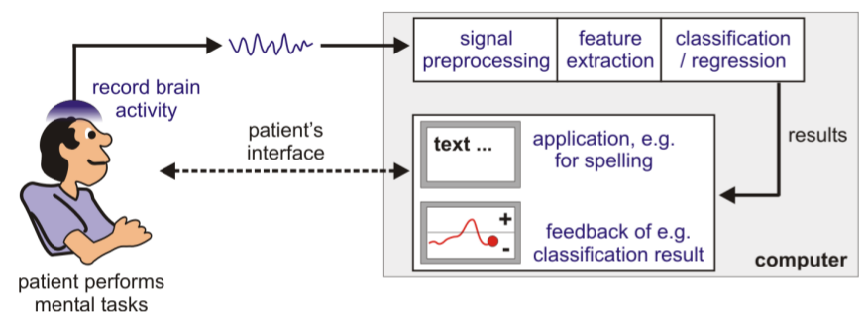
What are Brain-Computer Interfaces
Brain-Computer Interfaces(BCIs) allow subjects to interact with digital devices by reading the EEG-signal of the brain activity and interpreting it as one of the pre-defined set of commands.
Source: https://www.bsdlab.uni-freiburg.de/about-bci-and-brain-state-decoding

Slide 4
BCI Paradigms
Paradigm

Slide 5
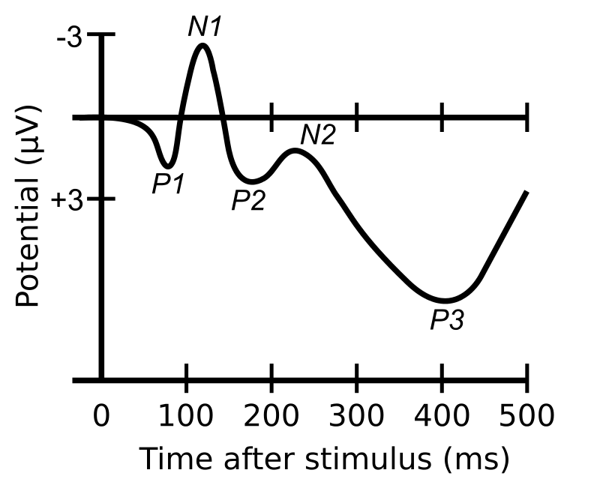
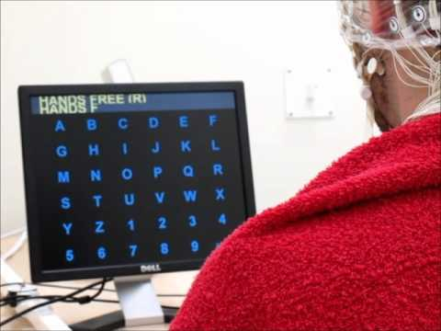
Event-Related Potentials
ERP components: P1, P2, P3, N1, N2, …
  Are observed after an event
  Primarily evoked in the central and visual cortexes
Oddball paradigm
  Frequent non-targets, occasional targets
Example: P300 Speller
Source: https://commons.wikimedia.org/wiki/File:ComponentsofERP.svg,
https://www.youtube.com/watch?v=wKDimrzvwYA

Slide 6
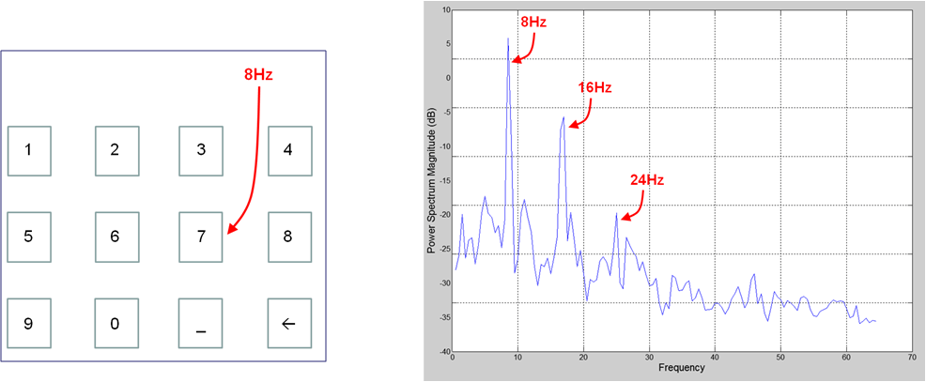
Steady-State Visually Evoked Potentials
Stimuli blink at 7-30 Hz
Subject gazes on a stimuli, the corresponding frequency and its harmonics can be observed in the visual cortex.
Source: https://www.intechopen.com/books/advances-in-robot-navigation/brain-actuated-control-of-robot-navigation

Slide 7
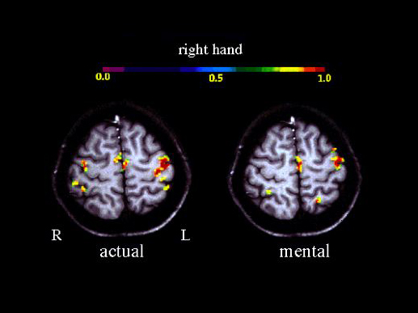
Motor Imagery
Subjects imagine movement of an appendage
Event-Related Desynchronization occur in user-specific frequency bands in the motor cortex
Source: https://commons.wikimedia.org/wiki/File:MI_fMRI.jpg

Slide 8
Unimodal BCI setbacks
ERP and SSVEP paradigms require constant gaze, induces fatigue and eye strain.
Limited number of classes for MI and SSVEP
High illiteracy rate for MI
Solution: Combine multiple paradigms.

Slide 9
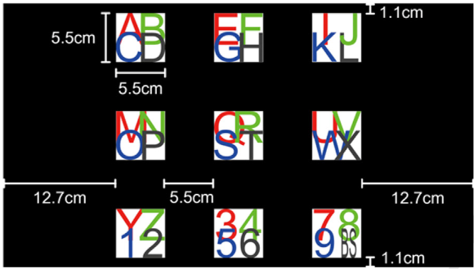
Paradigm Incorporation
Elements of one paradigm are sub-components of the elements of another paradigm.
Used by Chang et al.
  Higher number of classes than regular SSVEP
  Higher ITR than both unimodal ERP and SSVEP spellers (31.8 vs 19.9 and 13 bpm)
Source: Min Hye Chang, Jeong Su Lee, Jeong Heo, and Kwang Suk Park. Eliciting dual-frequency SSVEP using a hybrid SSVEP-p300 BCI. Journal of Neuroscience Methods, 258:104–113, January 2016.

Slide 10
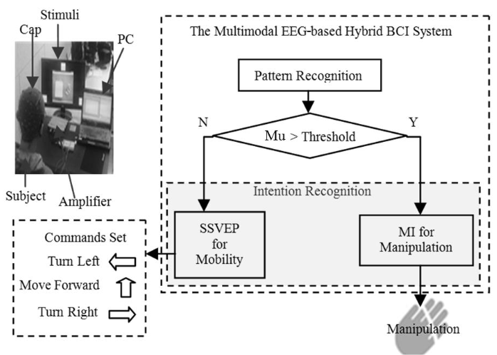
Paradigm Extension
Each participating paradigm increases the amount of classes
Used by Duan et al. to control a robot
  SSVEP left, right, forward.
  MI for a grasping hand
  Paradigms are switched by mu-rhythm gating
Source: Feng Duan, Dongxue Lin, Wenyu Li, and Zhao Zhang. Design of a multimodal EEG-based hybrid BCI system with visual servo module. IEEE Transactions on Autonomous Mental Development, 7(4):332–341, December 2015.

Slide 11
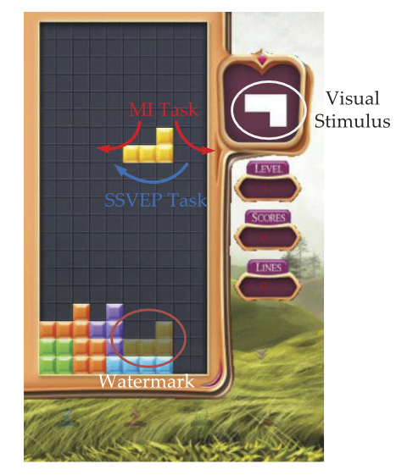
Paradigm Extension
Each participating paradigm increases the amount of classes
Used by Wang et al. to play a game of Tetris
  MI left, right to move pieces
  SSVEP to rotate a piece
  Used priority-based hierarchical fusion for classification
Source: Zhihua Wang, Yang Yu, Ming Xu, Yadong Liu, Erwei Yin, and Zongtan Zhou. Towards a hybrid BCI gaming paradigm based on motor imagery and SSVEP. International Journal of Human–Computer Interaction, 35(3):197–205, March 2018.

Slide 12
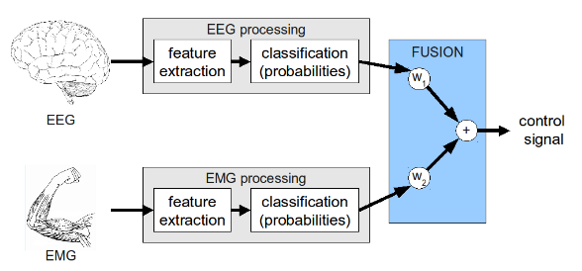
Paradigm Fusion
Additional paradigm reinforces the final classification accuracy
Used by Leeb et al. to classify arm movements
  EMG signals were attenuated and fused with MI to simulate fatigue
  8% Accuracy improvement
  Used Bayesian fusion for classification
Source: R Leeb, H Sagha, R Chavarriaga, and J del R Millan. Multimodal fusion of muscle and brain signals for a hybrid-BCI. In 2010 Annual International Conference of the IEEE Engineering in Medicine and Biology. IEEE, August 2010.

Slide 13
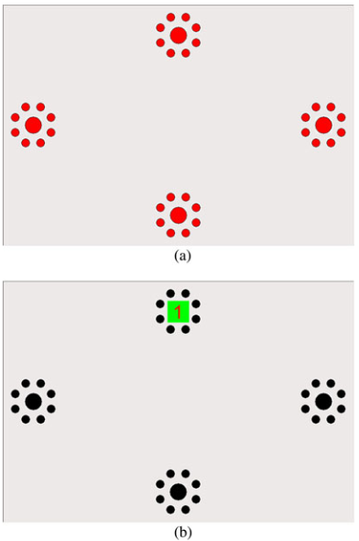
Paradigm Fusion
Additional paradigm reinforces the final classification accuracy
Used by Li et al. to classify arm movements
  ERP is used to improve the SSVEP classification
  Used user-specific threshold for classification
Source: Yuanqing Li, Jiahui Pan, Fei Wang, and Zhuliang Yu. A hybrid BCI system combining p300 and SSVEP and its application to wheelchair control. IEEE Transactions on Biomedical Engineering, 60(11):3156–3166, November 2013.

Slide 14
Paradigm Independent
Each participating paradigm increases the number of classes
Doesn’t require paradigm specific heuristics (µ-gating, priority fusion)
Allows for combining more than two paradigms

Slide 15

Dataset
54 participants
Three paradigms: ERP, MI, SSVEP
  target/non-target
  left/right hand imagery
  5.45, 6.67, 8.57, and 12 Hz SSVEP
At least 200 samples for each paradigm per subject
  200 for MI,SSVEP
  345 for ERP

Slide 16

Data pre-processing
Segmentation 0-4000ms
Down-sampling 100Hz
Baseline correction from -100 to 0 ms
Resulting dimensions: 400x62 per trial
All data went through three paradigm-specific feature generation procedures

Slide 17
ERP-relevant feature generation
ERP is most discriminant in the temporal domain
The signal was bandpass-filtered between 0.1 and 40 Hz
No channel or time-interval selection
The dataset was normalized to zero mean and unit variance.
Result: 400x62 map for each trial

Slide 18
MI-relevant feature generation
MI is most discriminant in the spatial-spectral domain
ERDs occur in user-specific frequency bands
  Construct a filter-bank from the most discriminative frequency bands of the sampled population
Calculate Common Spatial Patterns for each of the bands.

Slide 19
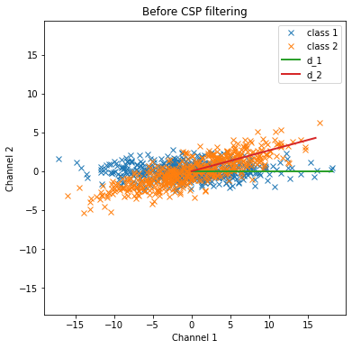
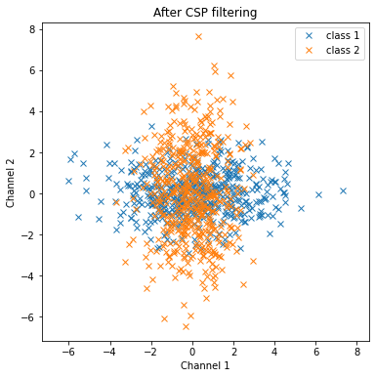
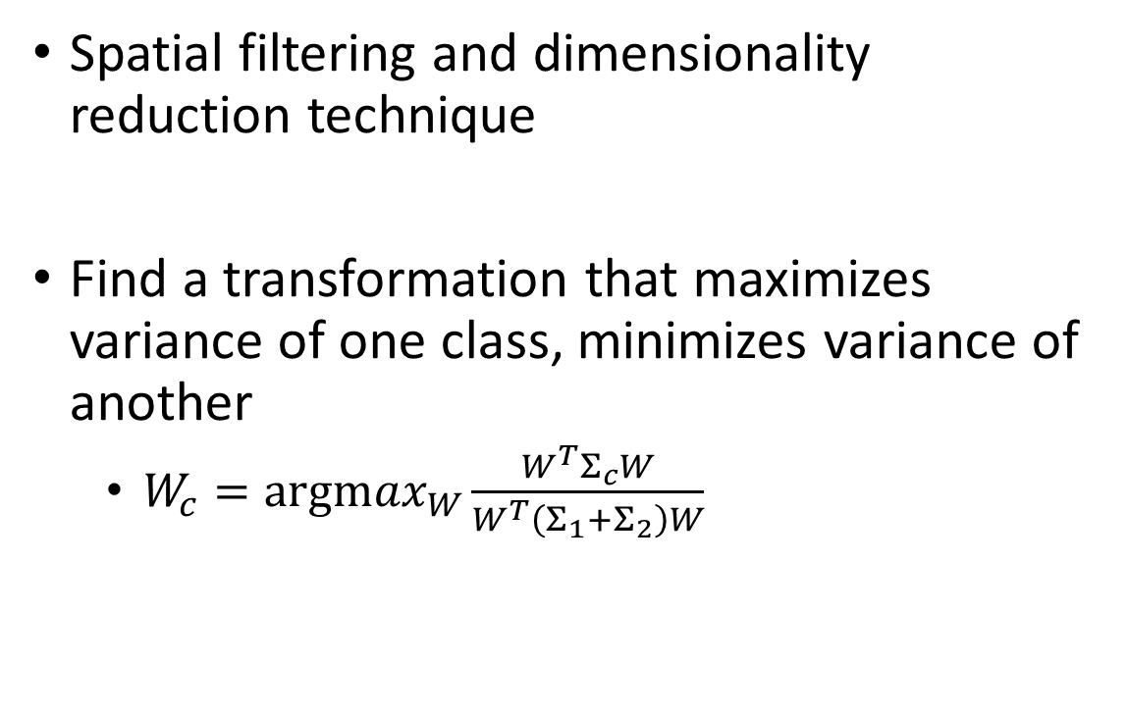
Common Spatial Patterns
Spatial filtering and dimensionality reduction technique
Find a transformation that maximizes variance of one class, minimizes variance of another
  $W_{c}=\underset{W}{argmax}{\frac{W^{T}Σ_{c}W}{W^{T}\left(Σ_{1}+Σ_{2}\right)W}}$
Source: https://en.wikipedia.org/wiki/Common_spatial_pattern

Slide 20
MI-relevant feature generation
MI is most discriminant in the spatial-spectral domain
ERDs occur in user-specific frequency bands
  Construct a filter-bank from the most discriminative frequency bands of the sampled population
Calculate Common Spatial Patterns for each of the bands.
Concatenate the spatially filtered data channel-wise
Normalize to zero mean and unit variance
Result: 400x28 map for each trial

Slide 21
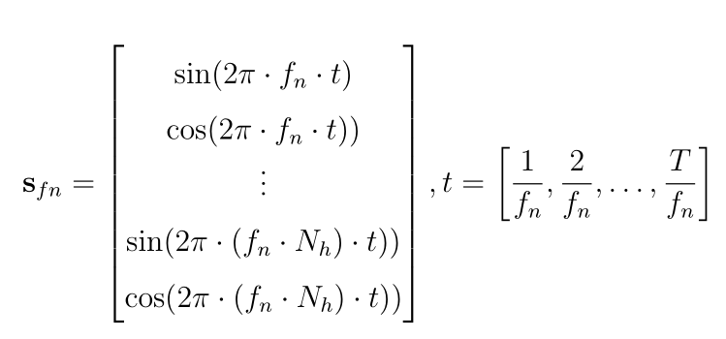
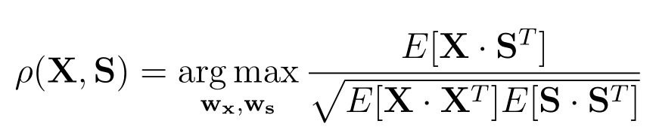
SSVEP-relevant feature generation
SSVEP is most discriminant in the spectral domain
Use canonical correlation analysis (CCA) to maximize the correlation between the input signal and sinusoidal reference signal.

Slide 22
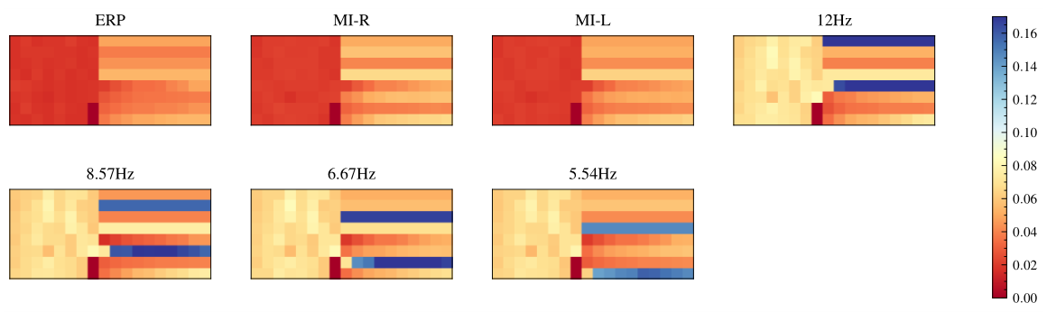
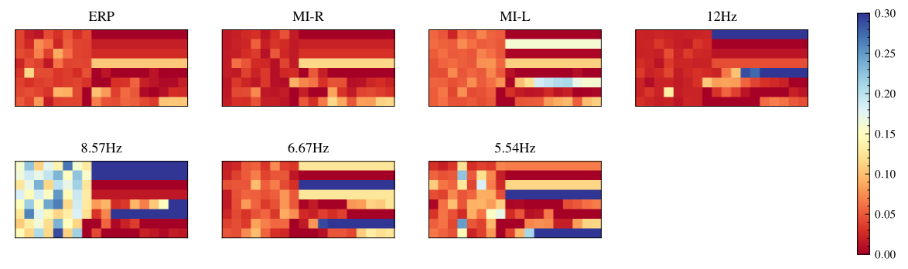
SSVEP-relevant feature generation

Slide 23
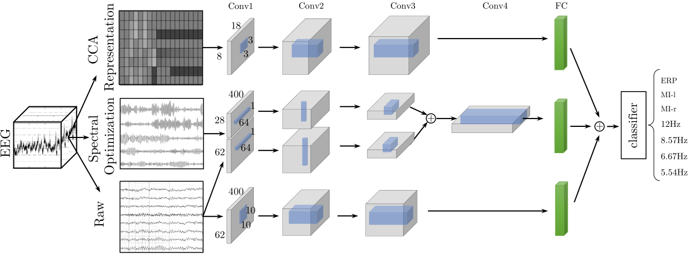
Classification

Slide 24
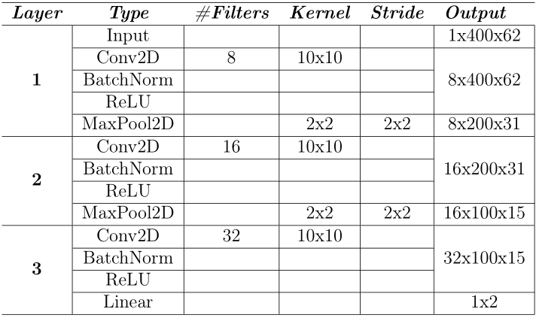
ERP CNN
This CNN model is trained to distinguish between ERP vs non-ERP signals

Slide 25
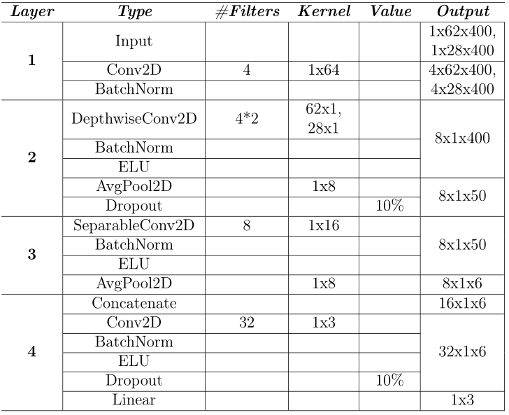
MI CNN
This CNN model is trained to distinguish between MI-left, MI-right and non-MI classes

Slide 26
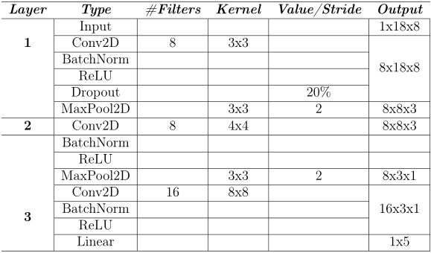
SSVEP CNN
This CNN model is trained to distinguish between non-SSVEP, and 12 Hz, 8.57 Hz, 6.67 Hz, 5.45 Hz

Slide 27
Classification

Slide 28
Meta-classifier
A dataset of feature vectors for every trial is created
  The dataset is used to train a meta-classifier
Meta-classifier was decided based on cross-validation

Slide 29
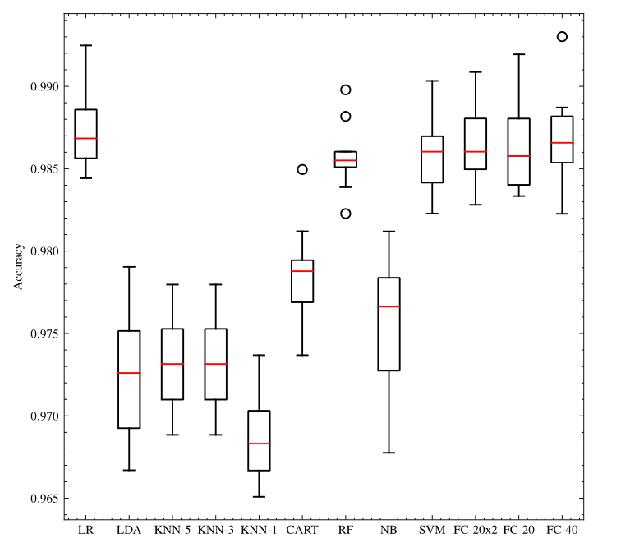
Meta-classifier selection
Several well-known algorithms were tested using 10-fold cross-validation on the constructed “meta-dataset”
Logistic Regression, LDA, KNN, Decision Trees, Random Forests, Naive Bayes, SVM, NN

Slide 30
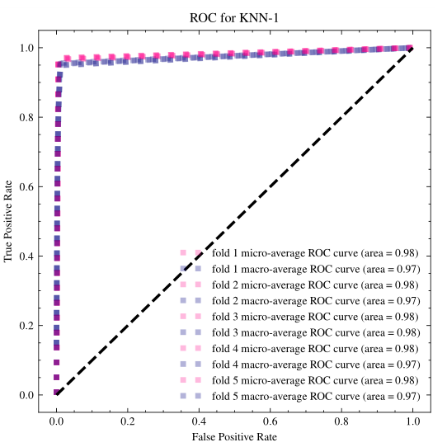
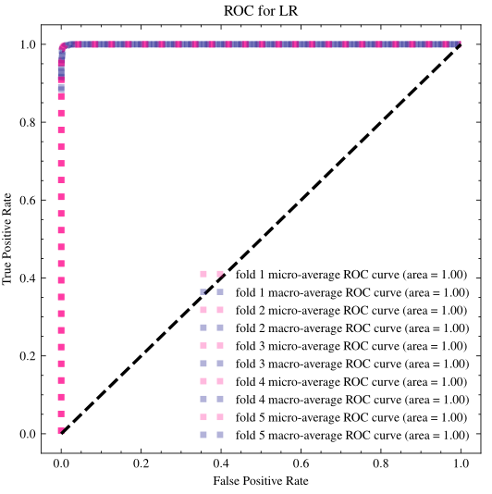

Slide 31
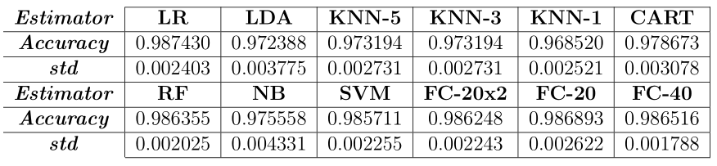
Meta-classifier selection
Logistic Regression was selected as the meta-classifier with 0.987±0.002 average accuracy.

Slide 32
Performance evaluation
Four scenarios were considered.
Subject-dependent scenario
  7-class within-paradigm classification
  3-class between-paradigm classification
Subject-independent scenario
  7-class within-paradigm classification
  3-class between-paradigm classification

Slide 33
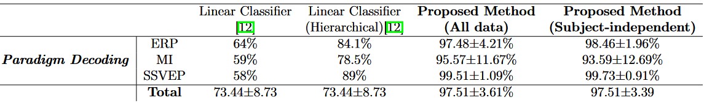
Between-paradigm decoding
97.51% Accuracy in both scenarios.

Slide 34
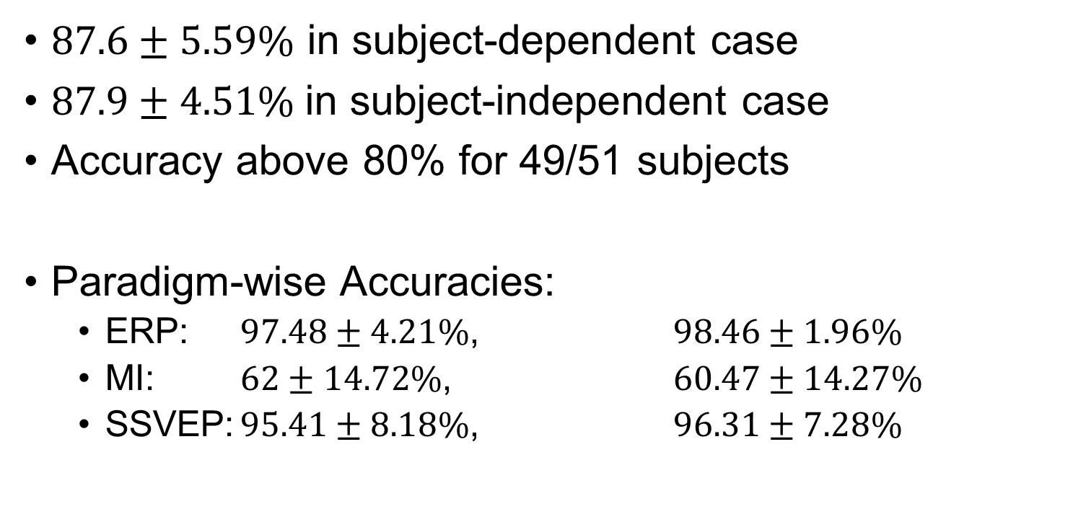
Within-paradigm decoding
$87.6±5.59\%$ in subject-dependent case
$87.9±4.51\%$in subject-independent case
Accuracy above 80% for 49/51 subjects
Paradigm-wise Accuracies:
  ERP: $97.48±4.21\%$, $98.46±1.96\%$
  MI: $62±14.72\%$, $60.47±14.27\%$
  SSVEP: $95.41±8.18\%$, $96.31±7.28\%$

Slide 35
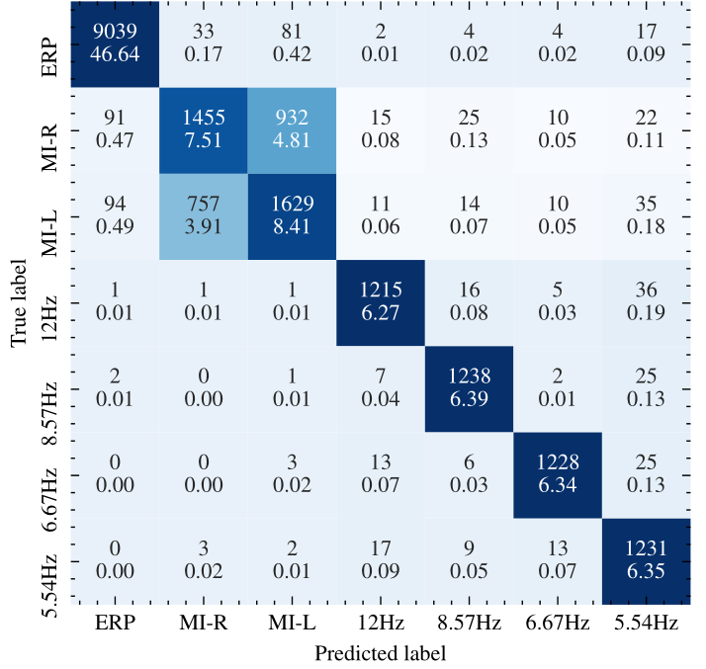
Confusion
8.72% of accuracy is lost within the MI classifier.
A better CNN model for MI classification could improve the results further.

Slide 36
Discussion
The proposed 7-class solution opens the road to designing more complex interfaces.
MI illiteracy could be sidestepped by treating MI as a single paradigm-class.
  50% -> 89% and 90% for subjects 45 and 34
Subject-independent between-paradigm classification showed 97.5% accuracy.

Slide 37
Potential drawbacks
The solution is not tested in the real world.
Paradigms could be misclassified due to more complex interface design.
  Example: aforementioned Tetris game.

Slide 38
Broader Impact
This study proposed a paradigm-independent model construction framework
  It could easily be extended and improved with better models
  And with additional paradigms.
The trained model showed promising accuracy on both between and within-paradigm classification problems.
The paradigm-independent approach has high potential of being a preferred solution for subject-independent BCIs.

Slide 39
Thank you!
Questions?

Slide 40
Outline
Brain-Computer Interfaces
BCI Paradigm combination techniques
Data processing
Classification
Discussion

