Slide 1

NU CORPORATE WEB-PORTAL
Senior Project Presentation
Authors: Assiya Yeraly, Aiganym Shynarbek, Adilzhan Serikzhanov, Alibek Ubaidullayev, Aktan Seraliyev

Slide 2
Outline
Introduction to the problem
Project description
Project approach and execution
Evaluation results
Project demonstration
Conclusion

Slide 3
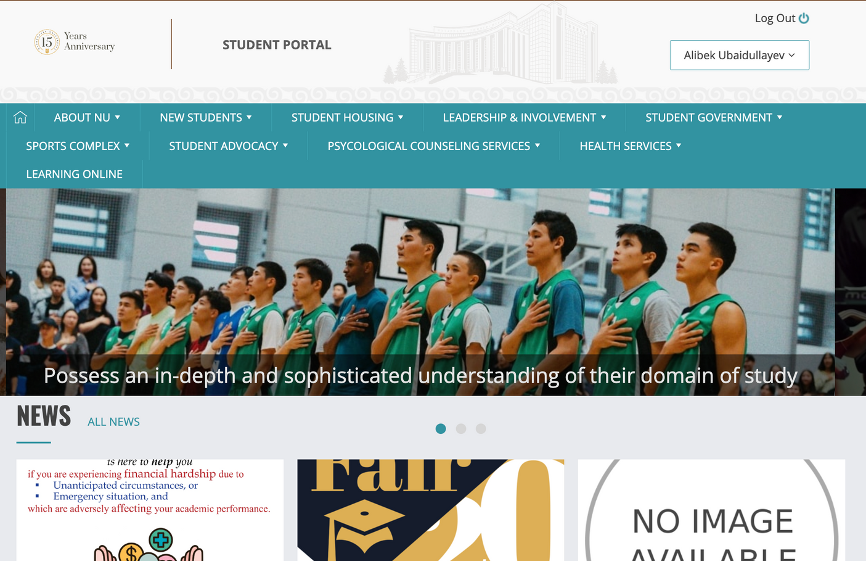
Introduction
my.nu.edu.kz

Slide 4
Problems
  Outdated
  Legacy Code
  Unflexible
TECHICAL DEBT!!!

Slide 5
  dynamic content management
  personalized user profiles
  a calendar for event management
  a dynamic phonebook
  a role-based access system
Project description

Slide 6
Project Execution
Frontend:
Backend:
  RESTful API
  Three Layer Architecture
  Monolith
  PostgresSQL
  Java Spring
  UX/UI design - Figma
  Next.js, a popular React-based framework
  Server-Side Rendering (SSR)

Slide 7
User feedback
Project evaluation
Automation testing
Performance Testing.

Slide 8
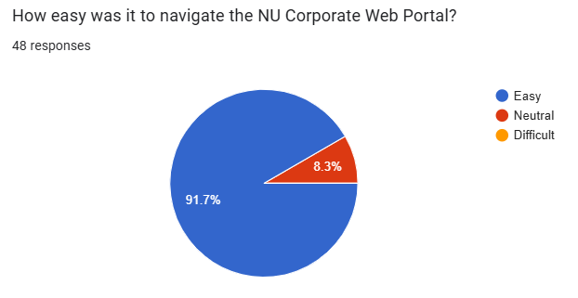
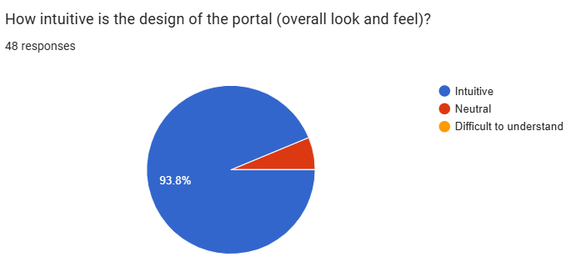
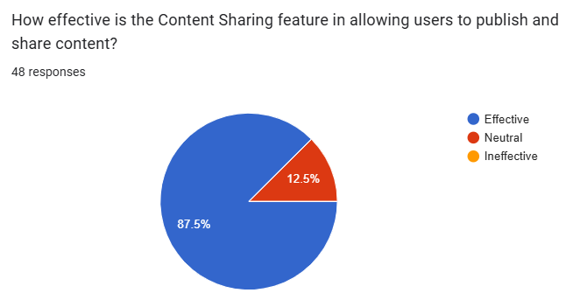
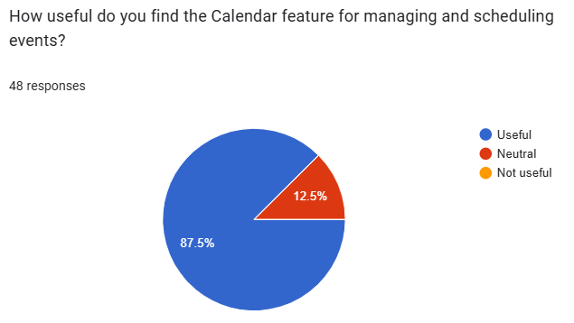
User feedback

Slide 9
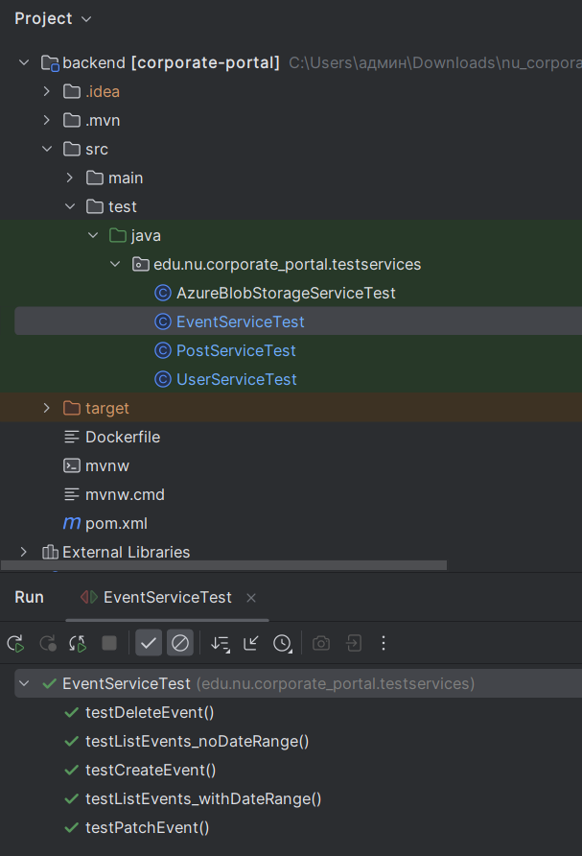
Evaluation results
Unit Testing: JUnit
and Mockito

Slide 10
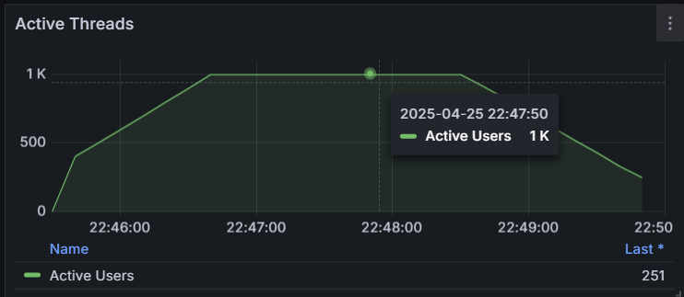
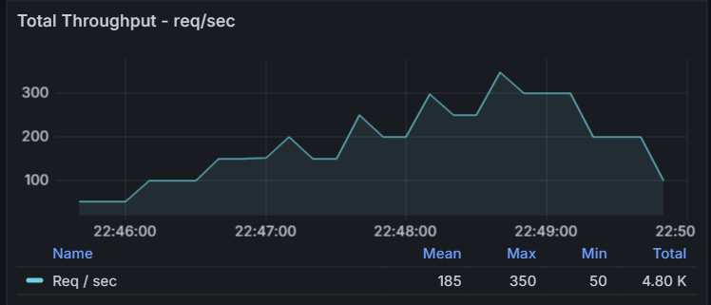
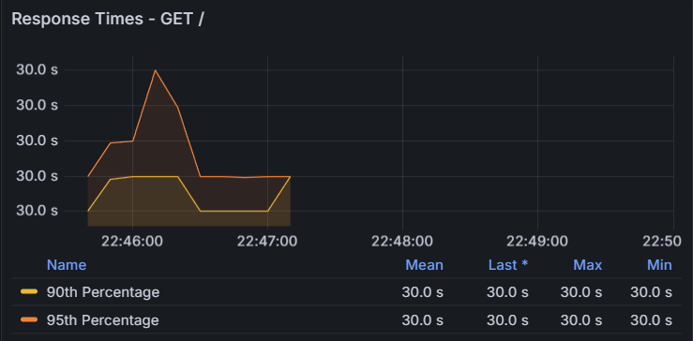
Performance Testing: JMeter

Slide 11
Project Demonstration

Slide 12
Conclusion
  Developed a modern, structured web portal with all core features of my.nu.edu.kz, while integrating additional improvements to the portal.
  Addressed key problems of the previous system, such as poor maintainability and limited scalability.
  Used effective software development tools and methods to overcome technical and organizational challenges.

Slide 13
Future work
  Implementing a mobile version for better accessibility
  Expanding customizability for other educational institutions (easy branding, login, and DB changes)

