Slide 1




Development of Failure Prediction Model for the Oil and Gas Industry
MEM Capstone Project 2023: Presentation of Final Results
Team 5
Altynay Takisheva
Minura Nugumanova
Nursaule Batyrgali
Sayin Kurmankulov
Academic Supervisor
Prof. Essam Shehab
Industrial Supervisors
Gani Kazbek
Shynggys Bimagambetov

Slide 2



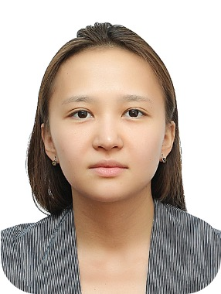
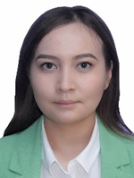
Team members
Altynay Takisheva
Sayin Kurmankulov
Minura Nugumanova
Nursaule Batyrgali
Team Leader
Data Manager
Publication Manager
Research Manager

Slide 3



Agenda
Introduction
Research Background & Motivation
Aim & Objectives
Deliverables
Project Scope
Literature Review
Methodology
Framework Development
Data processing
Model Development
AS-IS and TO-BE
Validation
Conclusions

Slide 4
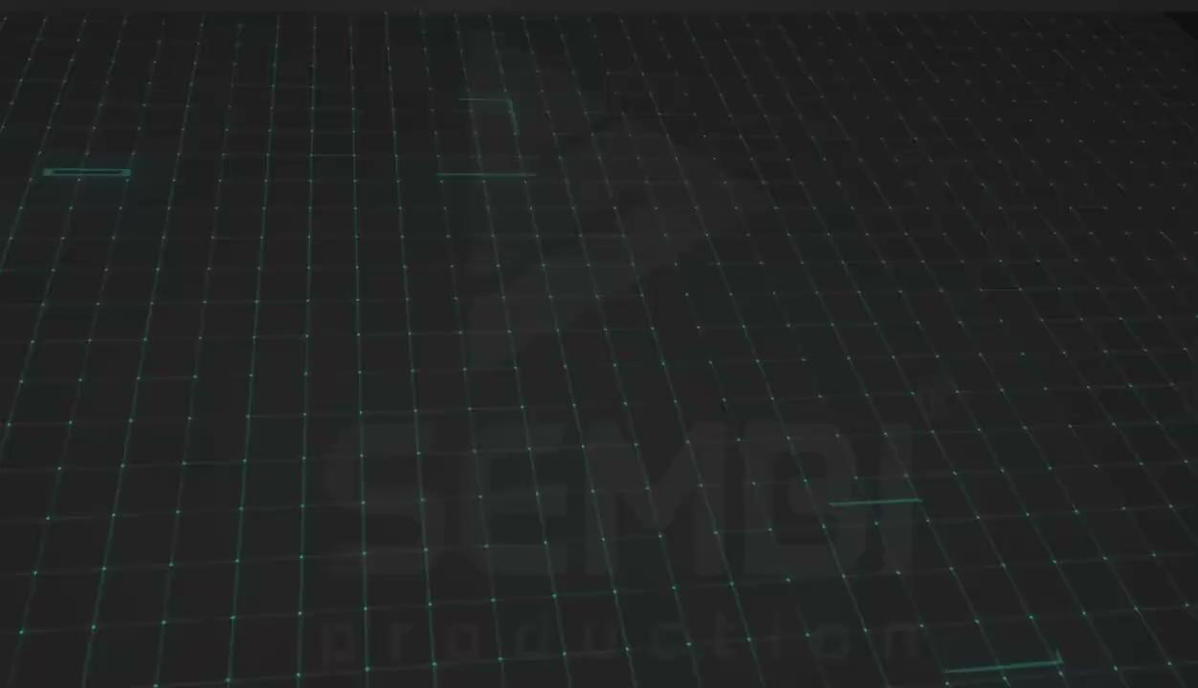
“Smart Oil Field”

Slide 5

Background
Project Motivation
production excellence
improved safety
reduction of costs due to maintenance
Current state of “Smart Oil Field” project
ERP and CRM systems
mounted sensors
control of real-time data
Desired state of “Smart Oil Field” project
prevent the production cycle disruption
utilization of data collected

Slide 6
Background
Reactive
Preventive
Predictive
unplanned downtimes
increased downtime production losses
safety hazards
scientific in origin
original equipment manufacturer (OEM) guidelines
experience and expertise of engineers
monitoring the state of equipment
forecasting
reduces maintenance costs and equipment downtime
sensor network
data storage
Oil and Gas Industry
Digital Transformation
Predictive Maintenance
Failure Prediction Model

Slide 7
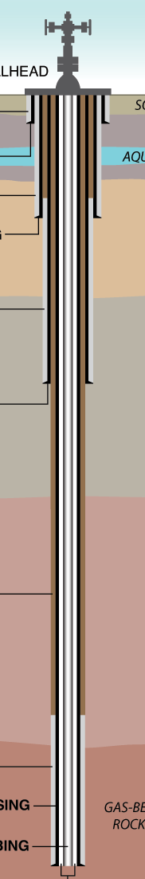
Scope of the Project
Programming
part
Implementation
Oil and gas industry
Vertical wells
(well as a system)
Types of failures and parameters
Data mining and processing techniques
Machine learning models
Validation of the model
Pumps
Algorithms
other
than
wells
Economics
Separate
elements
of the wells
Out of scope
In scope

Slide 8





Aim and Objectives
Develop a framework for the failure prediction for wells
in the oil and gas industry
Identify the critical parameters for wells failure prediction;
Capture the current capabilities and activities of Caspi Neft company (AS-IS analysis);
Develop the prototype of the failure prediction model based on real data from the oilfield and machine learning techniques (ML);
Develop a framework for the implementation of equipment failure prediction in oil and gas companies;
Validate the model and framework through cross-validation and experts’ judgments.

Slide 9
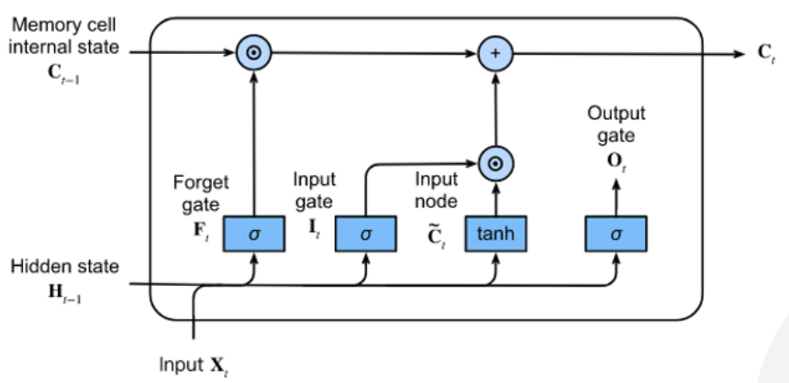
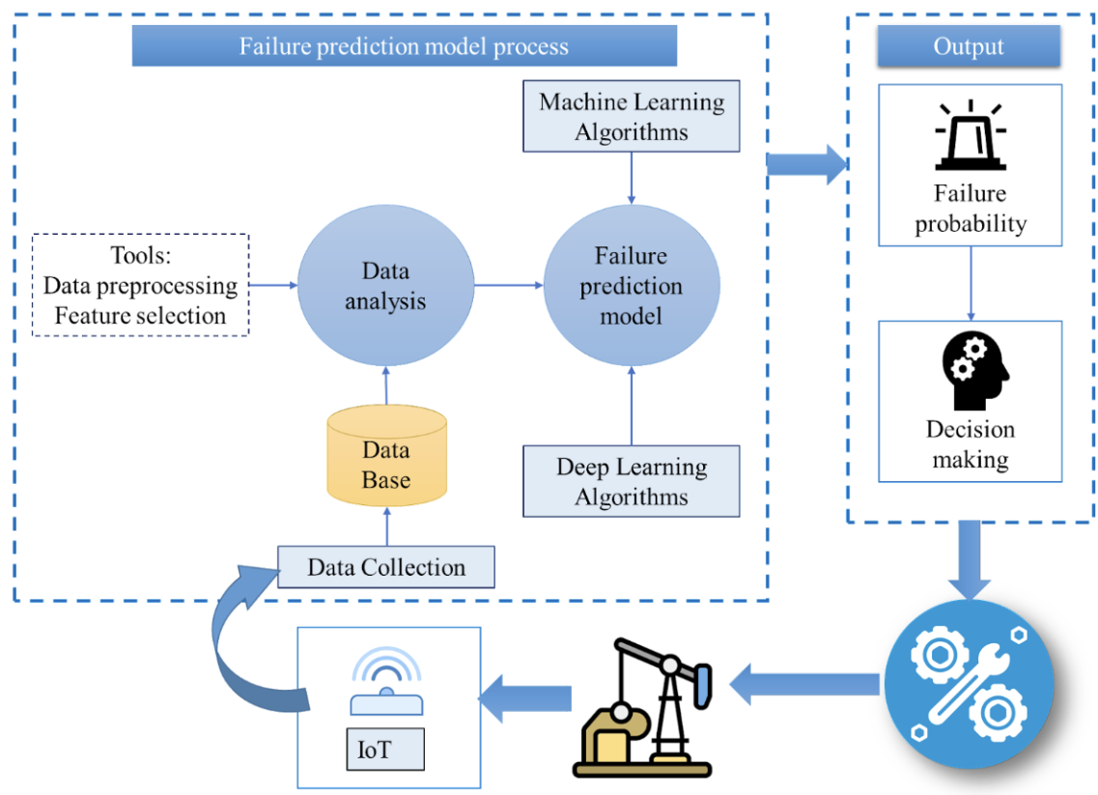
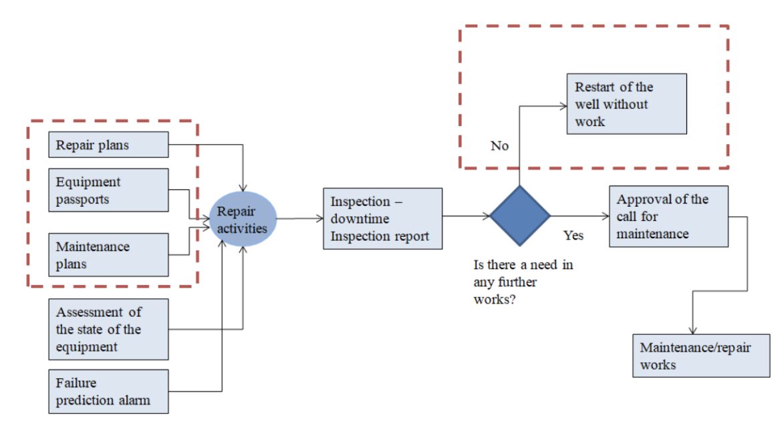
Deliverables
Failure Prediction Model using ML
Framework for implementation of Failure Prediction Model
AS-IS and TO-BE for Caspi Neft

Slide 10
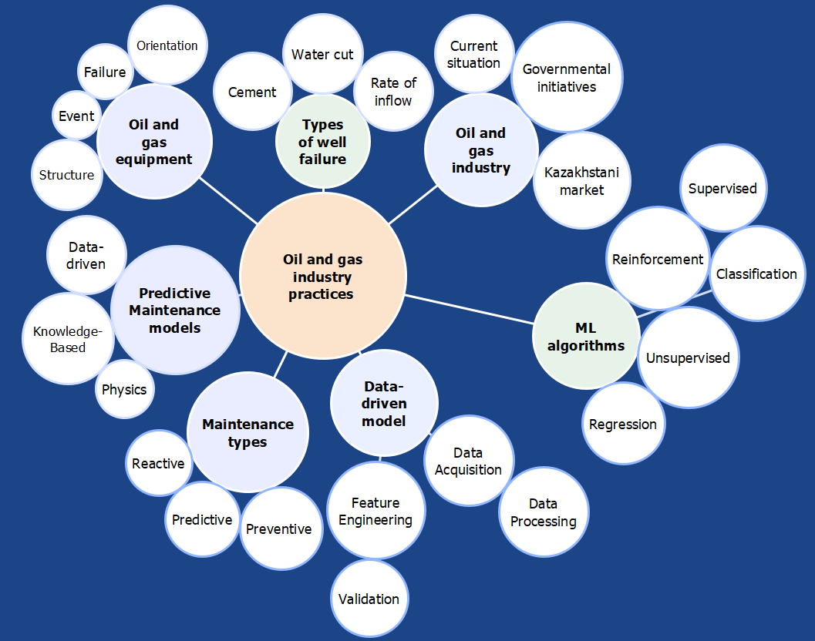
Literature Review Areas

Slide 11

Research Gap Analysis
>
Lack of previous study in Kazakhstan
Failure prediction model for wells
>
Lack of transparency
Companies confidential information
>
Lack of standardized framework
A consistent approach to equipment monitoring, data collection, and analysis
>
Lack of study considering well as a system
Studies on particular parts of well (pumps)

Slide 12
Agenda
Introduction
Methodology
Framework Development
Data processing
Model Development
AS-IS and TO-BE
Validation
Conclusions

Slide 13
Methodology Stages
Initiation
Planning
Execution
Control
Closure
Approval of the company, team, and project
Requirements identification
Identification of the features for the modeling
Assessment of the quality of the data acquired
Deliver the project’s scope
Official project’s kick-off meeting
Refined project’s aim & objectives, scope, schedule, assessment criteria, and validation techniques
Data acquisition
Feedback from industrial and academic supervisors
Final defense & report
Data processing and analysis
High-level requirements and objectives of the project
Model building
Validation of the model
Document lessons learned
Establishment of Client Brief
Control over the work process and deliverables
Comprehensive literature review

Slide 14
Agenda
Introduction
Methodology
Framework Development
Decision-based Framework
Framework for Failure Prediction in the Oil and Gas industry
Data processing
Model Development
AS-IS and TO-BE
Validation
Conclusions

Slide 15
Decision-based Model
Equipment repair is costly and downtimes are frequent?
No
Yes
Reactive maintenance
Proactive maintenance
OEM manual is clear?
No
Yes
Predictive maintenance
Preventive maintenance
Consistent and high quality data?
Having Experts?
Ability to define physical model?
Choose another model
No
Yes
No
Yes
No
Yes
Data-driven model
Knowledge-based model
Physical model

Slide 16






Failure prediction model process
Output
Machine Learning Algorithms
F
Failure prediction model
Failure probability
Data analysis
Tools:
Data preprocessing
Feature selection
F
Data Base
Decision making
SCADA
Deep Learning Algorithms
Data Collection
Framework Development
F
IoT

Slide 17
Agenda
Introduction
Methodology
Framework Development
Data Processing
Most Common Downtimes of Oil Production Wells
Data Сollection and Acquisition
Data Preprocessing
Model Development
AS-IS and TO-BE
Validation
Conclusions

Slide 18
Most common downtimes of oil production wells
High water cut
Pump stuck
Fluid flow rate
Fluid flow rate
Temperature
(submersible electrical motor)
Water production (BSW)
Tumbling head pressure
Casing pressure
wells
Downtime
Pressure (wellhead)
Fluid flow rate
Temperature (wellhead)
Tumbling head pressure
Pressure (bottomhole)
Casing pressure
Wellhead pressure
Common
Rate of inflow

Slide 19

Data collection and acquisition
First dataset from the Oilfield
Second dataset from the Oilfield
negotiations
43 high-yielding production wells
daily record
well parameters with downtime types
inconsistency in value ranges in the production wells dataframe
human errors in the data entry process
66 production oil wells
daily record
consistent dataset
well parameters without downtime types
Pandas, Numpy, Matplotlib, and Seaborn

Slide 20
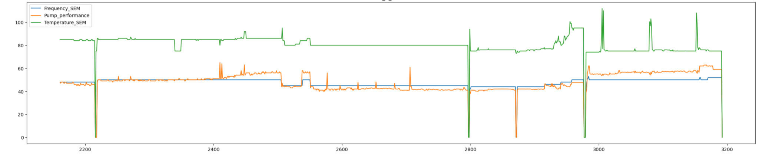
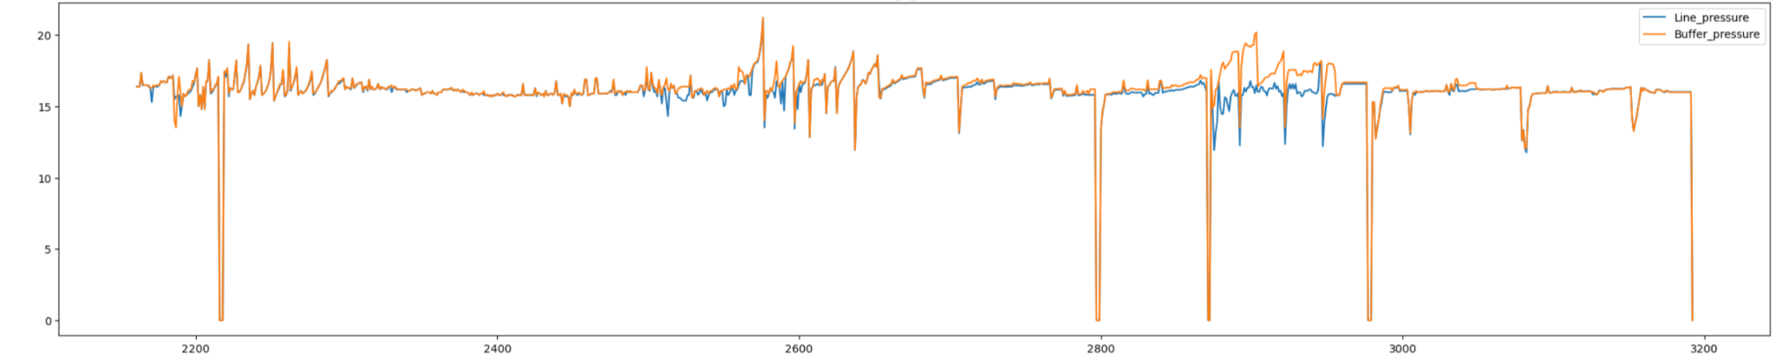
Data preprocessing. Second dataset from the Oilfield
imputing missing values in numeric columns
removing stable parameters
adding new features
parameter influence
Frequency_SEM
Pump_performance
Temperature_SEM
Line_pressure
Buffer pressure

Slide 21
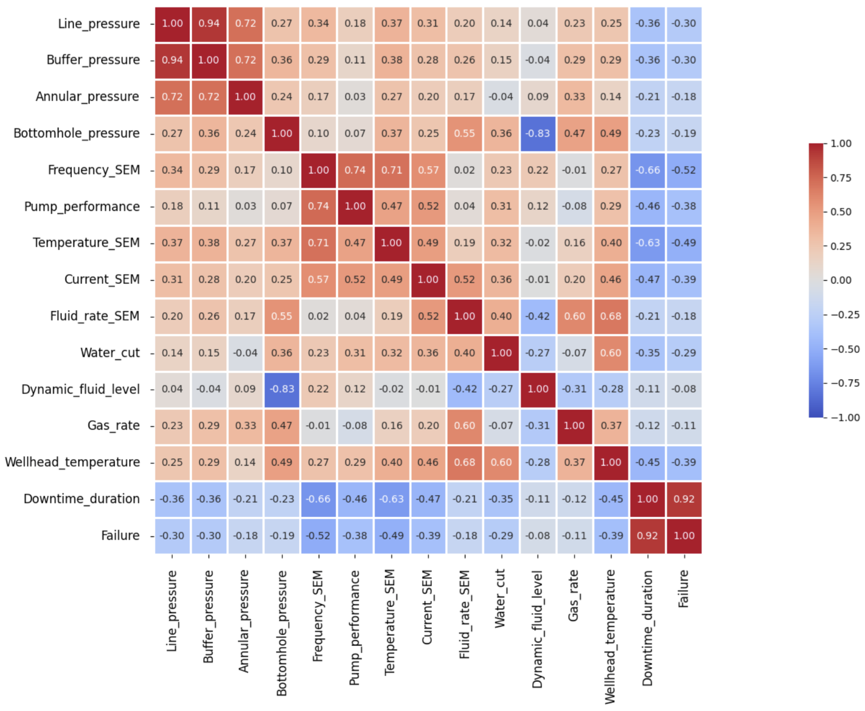
Data preprocessing. Correlation matrix
features are highly correlated
can be redundant and may not add much value to the model
features that are weakly correlated
may not provide sufficient information to the model
Notes:
columns deleting

Slide 22
Agenda
Introduction
Methodology
Framework Development
Data Processing
Model Development
Long-Short Term Memory (LSTM)
Cross-validation
AS-IS and TO-BE
Validation
Conclusions

Slide 23
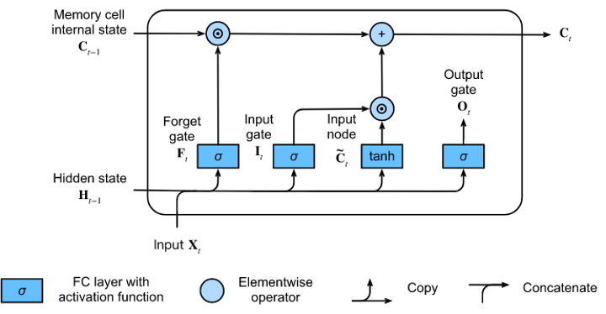
Long-Short Term Memory, what & why?
NN - mimics human brain functions.
RNN - learning long-term dependencies, sequential prediction problems.
LSTM - captures the long-term dependencies of the sequential data and manipulate this data due to its complex architecture.
LSTM decides new data input, deletion, storage and processing.
Ability to model complex patterns.
LSTM | Decision Tree | Random Forest | KNN | SVM
83% | 63% | 67% | 58% | 71%
LSTM showed the best result in preliminary prediction of models comparison.
Potential in predicting various phenomena in the oil and gas industry

Slide 24
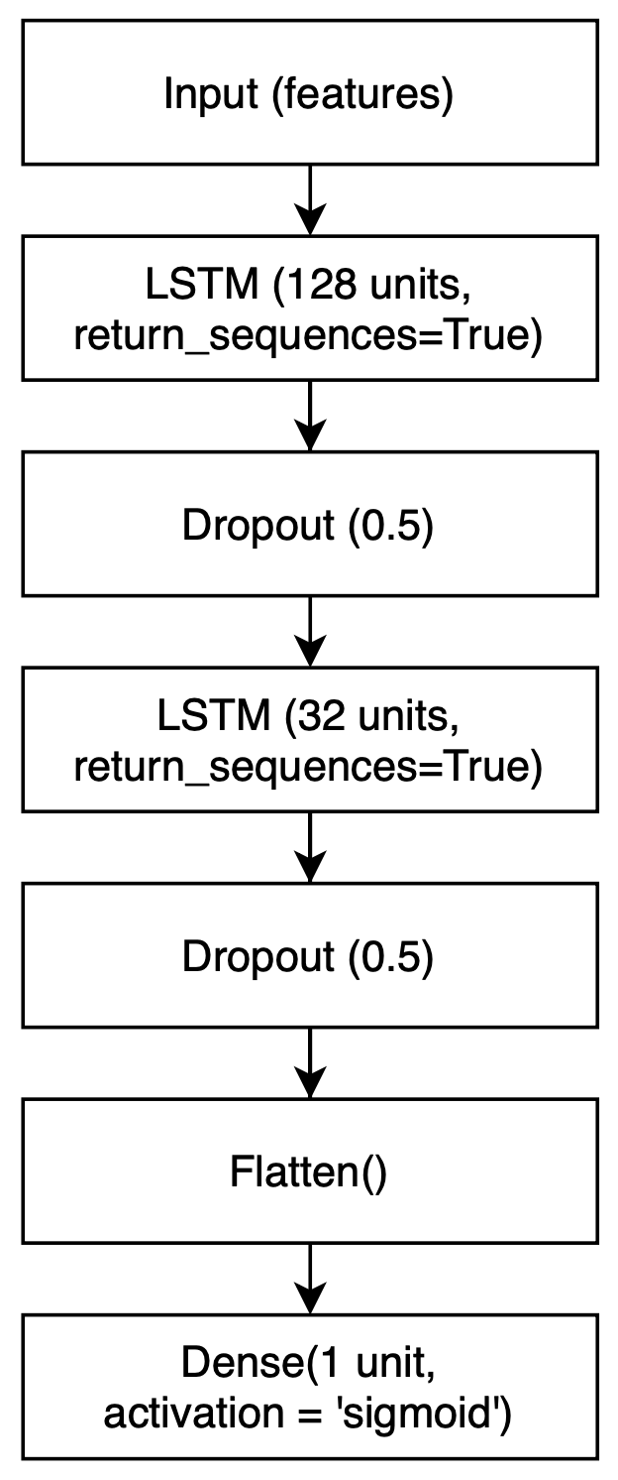
Development of LSTM
Keras library in Python;
Normalization - StandardScaler();
Train_test_split - 80/20%;
2 layers of LSTM;
Dropout & Flatten;
Dense (sigmoid, adam optimizer, binary cross-entropy loss function, and accuracy);
EarlyStopping;
Model fitting (50 epochs, 64 batch size).

Slide 25
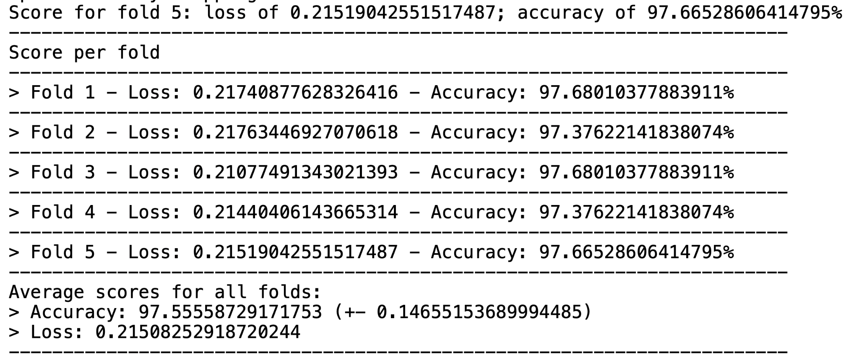
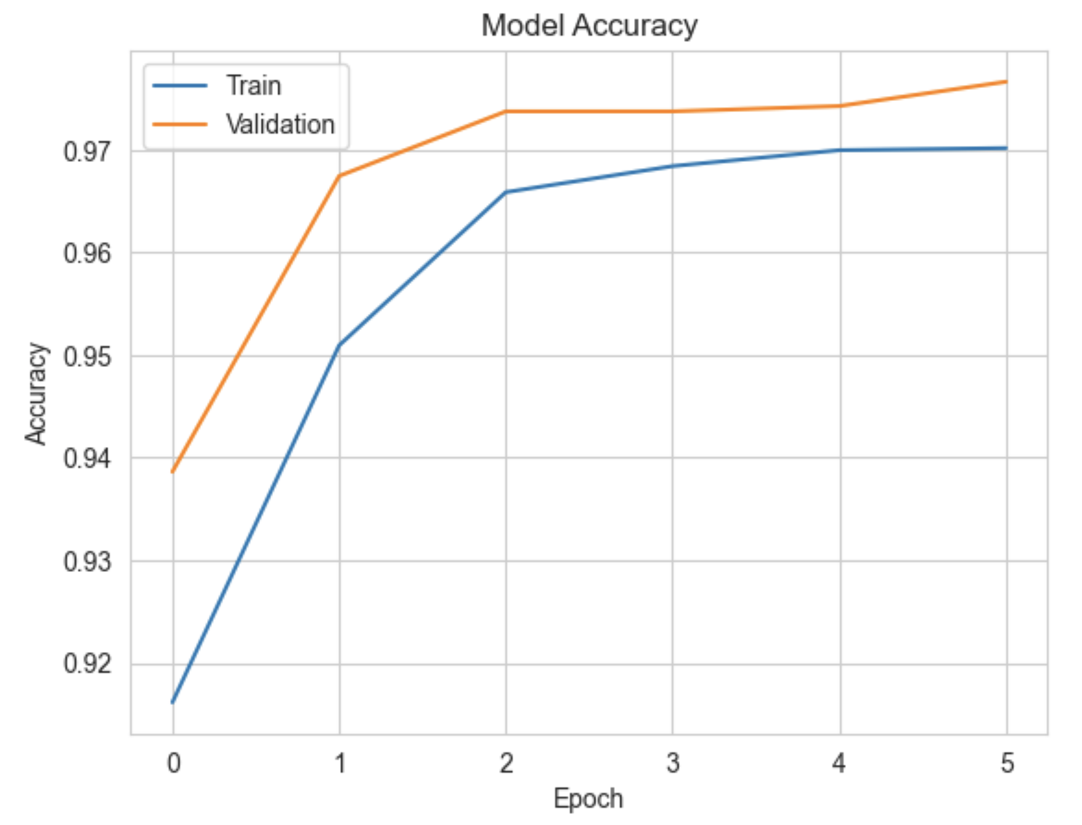
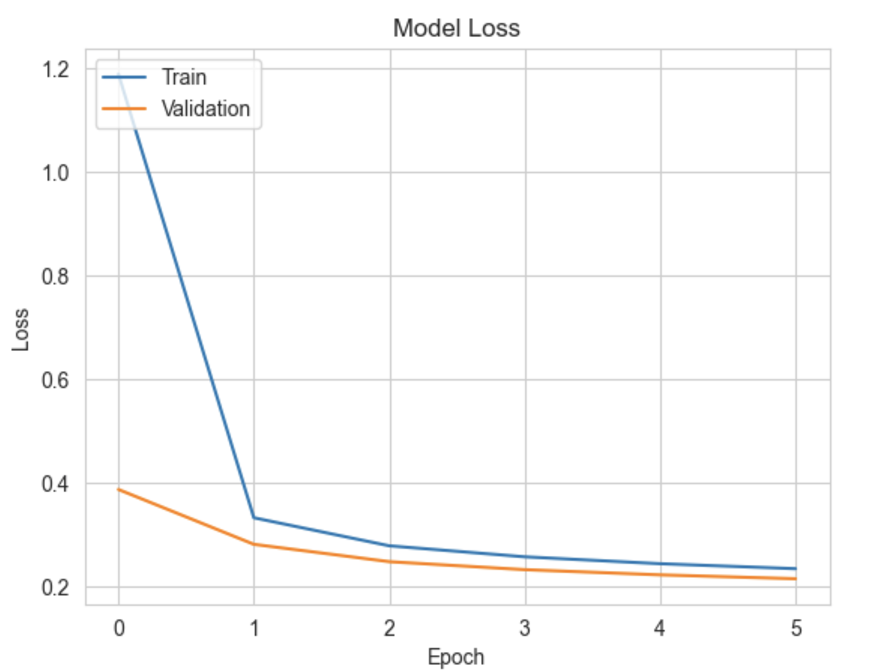
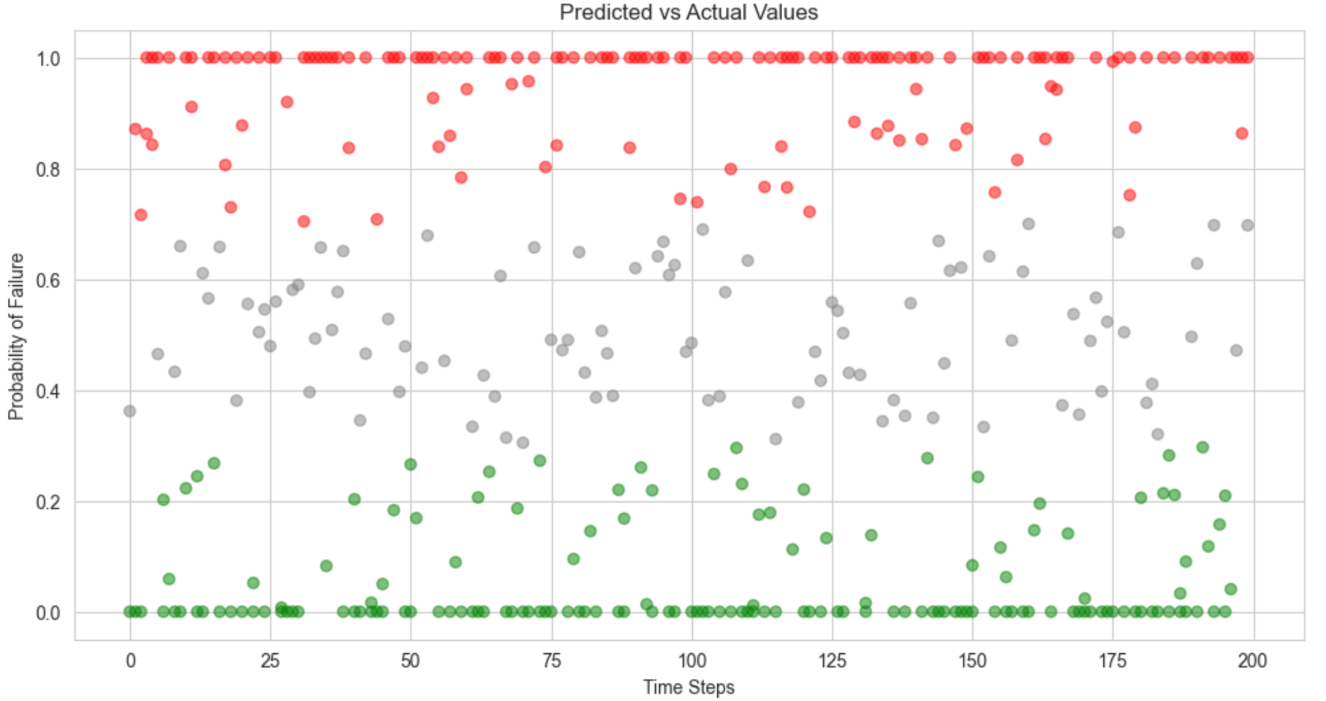
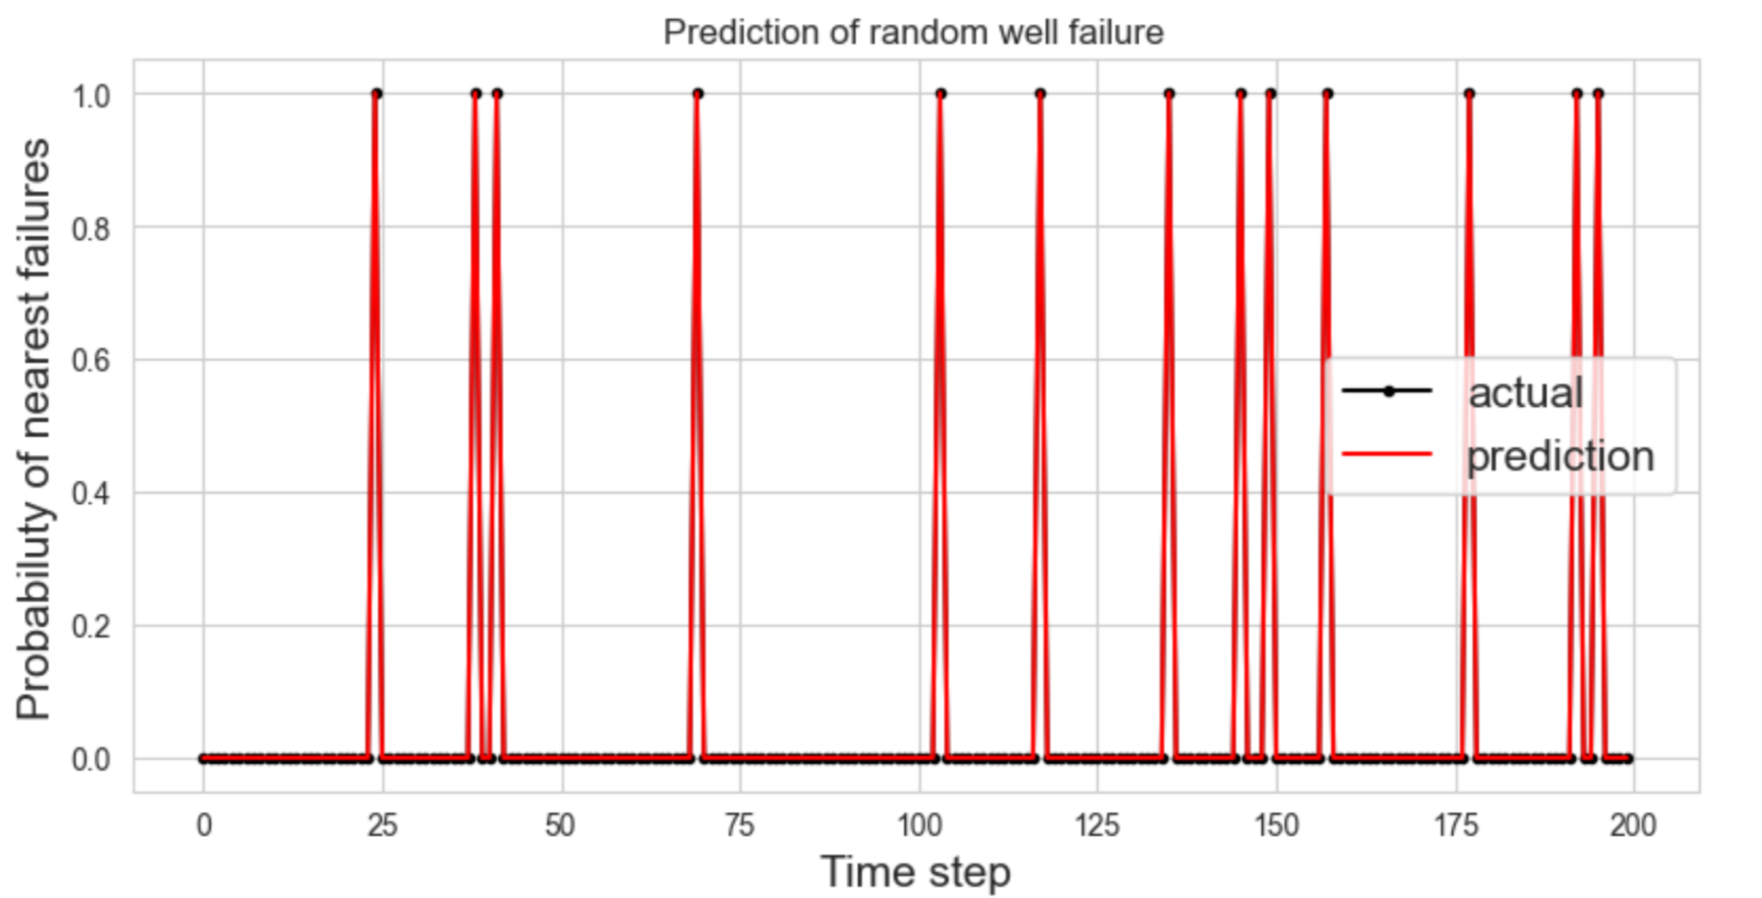
K-Fold cross-validation of LSTM

Slide 26
Agenda
Introduction
Methodology
Framework Development
Data processing
Model Development
AS-IS and TO-BE States
Validation
Conclusions

Slide 27
AS-IS and TO-BE States
Restart of the well without work
Repair plans
No
Equipment passports
Repair activities
Inspection – downtime
Inspection report
Approval of the call for maintenance
Maintenance plans
Yes
Is there a need in any further works?
Assessment of the state of the equipment
Maintenance/repair works
Failure prediction alarm

Slide 28
Agenda
Introduction
Methodology
Framework Development
Data processing
Model Development
AS-IS and TO-BE
Validation
Conclusions

Slide 29


Validation
Qualitative validation over the project lifespan & over results
Academic supervisor | Weekly meetings Assessment of each increment of results
Cross-functional expert | Change in scope Reasonable model results and comprehensive framework
Oil and gas and automation expert | Assessment of data and justifications High accuracy of the model
Industrial supervisors | Data acquisition High accuracy of the model and suitable framework

Slide 30
Agenda
Introduction
Methodology
Framework Development
Data processing
Model Development
AS-IS and TO-BE
Validation
Conclusions

Slide 31



Conclusion
Failure Prediction Model, Framework, AS-IS and TO-BE analysis completed
Development of the Failure Prediction Model for wells, companies should have dynamic data written at the time interval of at least 2-hours.
Companies may use guidance of the Framework developed to decide whether they need predictive maintenance and what steps to follow to develop failure prediction framework

Slide 32

Challenges
Industry specifics
1
Inadequate data collection
2
Quality of data
3
4
Change in scope

Slide 33

Future work
Obtaining type of failures and implementation of classification of failures in the model
Obtaining information on maintenance activities and incorporate them according to the type of failure identified
Implement the model into ERP system of the enterprise or develop a software
Extend the model to systems other than wells

Slide 34

Acknowledgements
Professor Essam Shehab
Panel Committee
Professor Dimitrios Emiris
Gani Kazbek
Shynggys Bimagambetov
Serik Ishangaliyev
Almat Imashev

Slide 35
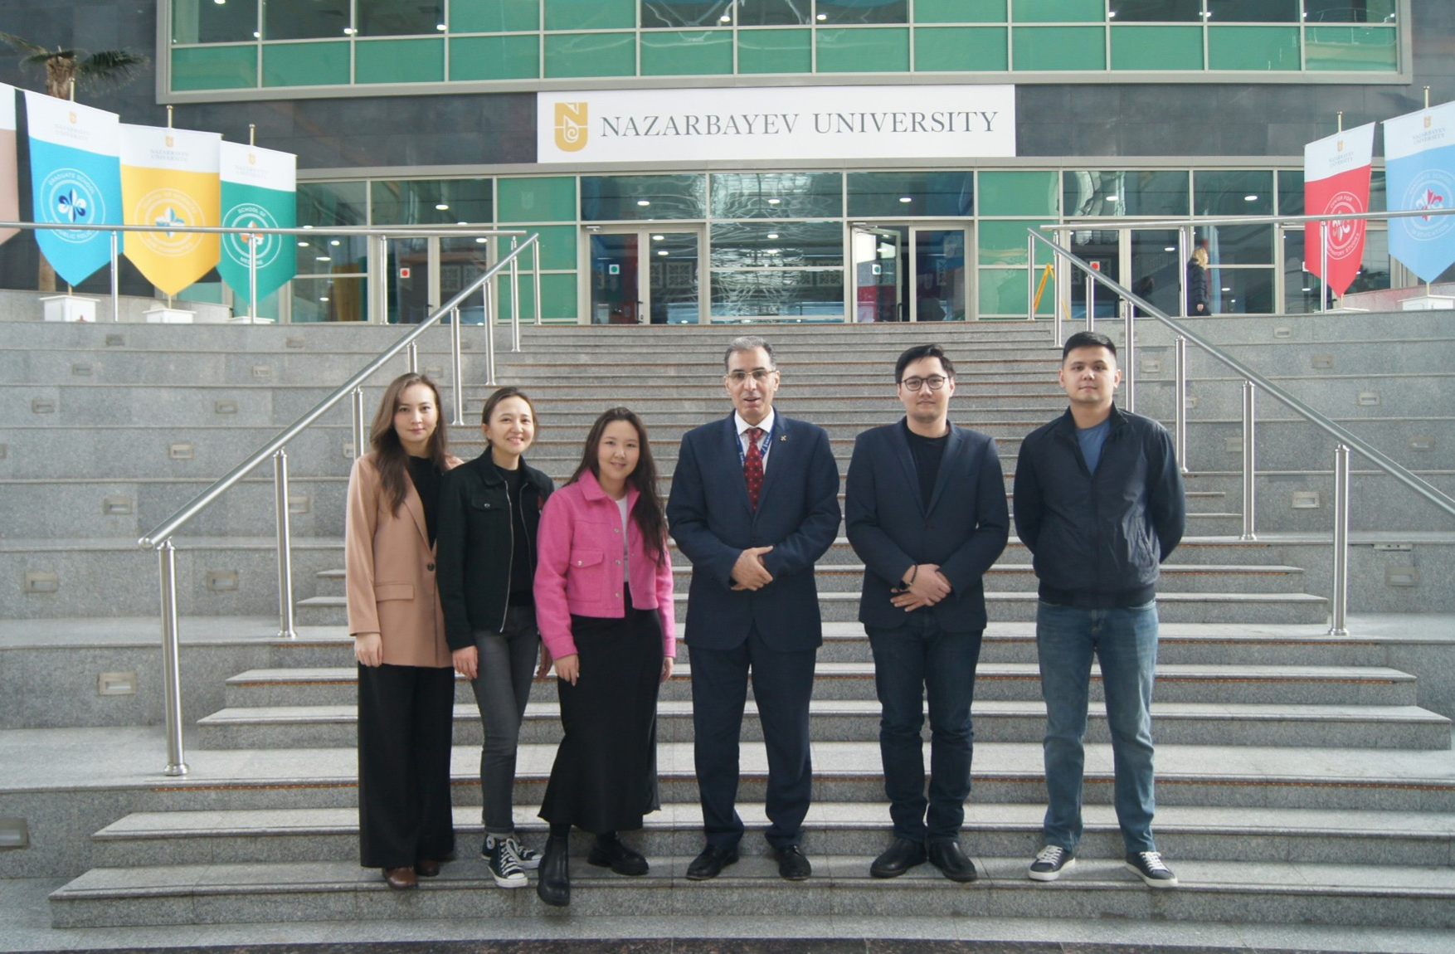
Thank you!

Slide 36

Backup slides

Slide 37
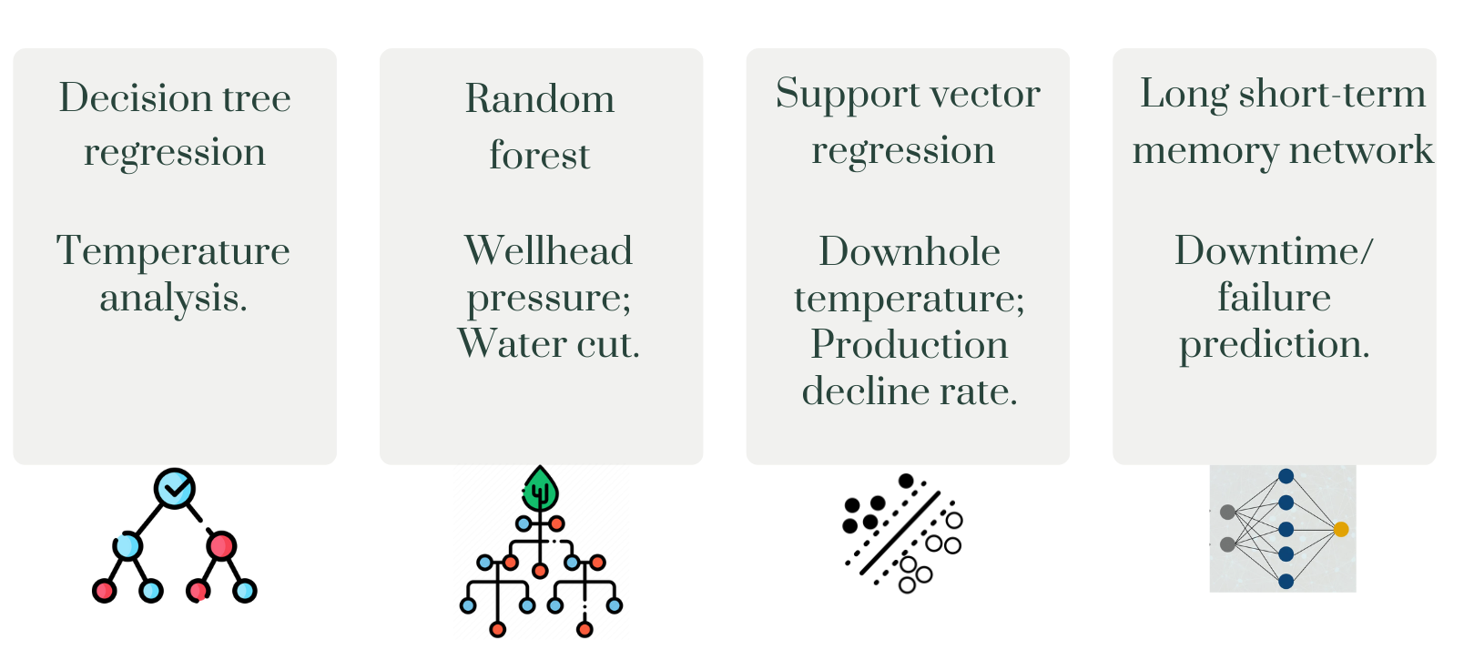
Machine Learning Models
11

Slide 38
Validation
Input data from the company
Benchmarking and Optimum Parameters identification
Qualitative validation over the project lifespan & results
Is data sufficient for particular type of equipment?
No
Oil and gas and automation expert | Assessment of the data
Industrial supervisors | Data acquisition
Yes
Check data quality of data for particular equipment:
Operating conditions
Production rate
Downtime history

Slide 39
Validation
Is quality of data acceptable
Academic supervisor | Weekly meetings, assessment of the results
Cross-functional expert | Reasonable model and comprehensive framework
Oil and gas and automation expert | High accuracy of the model
Industrial supervisors | High accuracy of the model and suitable framework
Yes
Data Preprocessing and Exploratory Data Analysis (EDA)
Develop Fault Prediction Model
Choose applicable ML algorithms
Validate the model
Is accuracy of the model acceptable
No
Yes
Implementation of this model

Slide 40
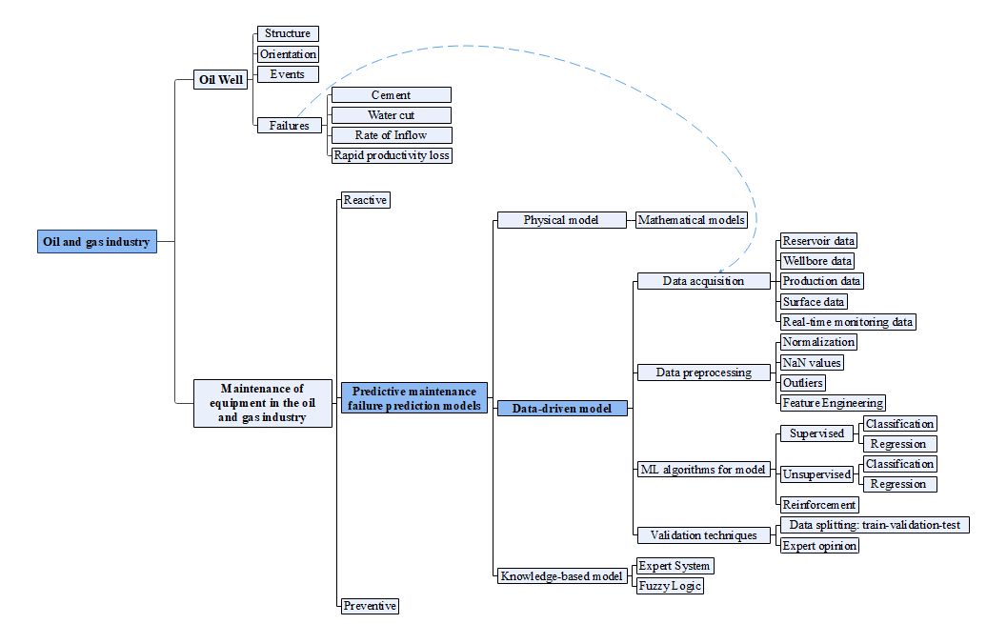
Literature review
11

Slide 41
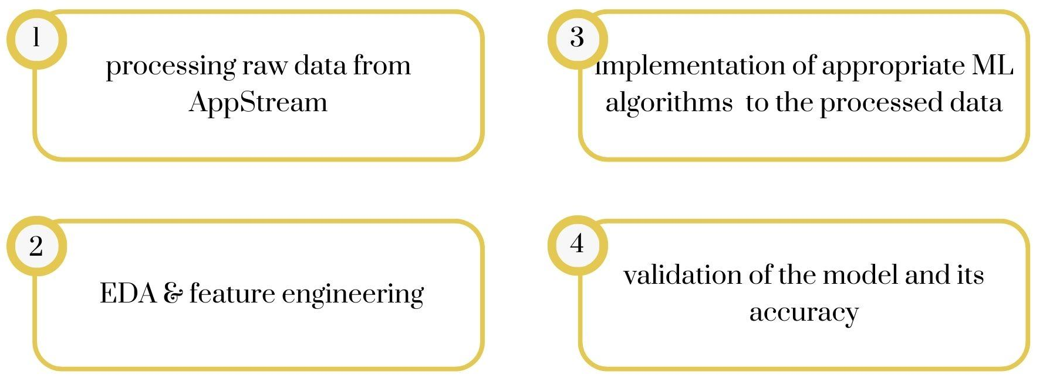
Model Creation Approach
EDA - Exploratory Data Analysis
ML - Machine Learning

Slide 42
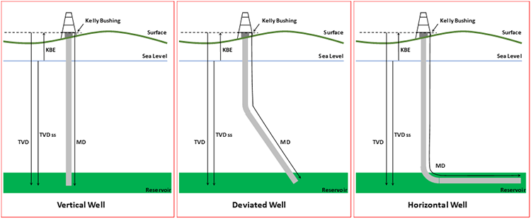

Slide 43
Monitored parameters in the oilfield | Requested parameters
tumbling head pressure casing pressure bottom hole pressure flow line pressure frequency temperature current flow rate of a pump fluid flow rate basic sediments and water (BSW) | well orientation; well age; physical parameters; downtime type; comments to the undesirable well events (downtimes);

Slide 44
Production data
Wellbore data
(casing)
Volume of oil production
Length of the well
Angle from vertical
(for the deviated wells)
Total volume of fluids
(BSW)
Diameter of the well
High watercut
wells
Age of the well
Flow rate
Pressure (bottomhole)
Surface production equipment
Temperature (wellhead)
Pressure (wellhead)
Surface
Real-monitoring

Slide 45




WPO project
Scada system
Avocet
Reports
OilField
Avocet
(mobile application)
 | Real-time mode | Short cycle (weeks) | Average cycle (months) | Long cycle (years)
Actions | monitoring and management of uptime | operational parameters and analysis of deviations from planned production | well development scenarios | stock dynamics. the level of production and watercut
Scenario
Metrics |  |  |  | geological, hydrological and economic model; stock dynamics; integrated modeling based on machine learning
Data | control and measuring devices and automation

Slide 46
Failure Prediction Model
IoT Sensors
SCADA system
Data collection
Data Preprocessing
Feature engineering
Feature selection
Model selection
Machine learning algorithms
Model training
Model evaluation
Deployment

Slide 47
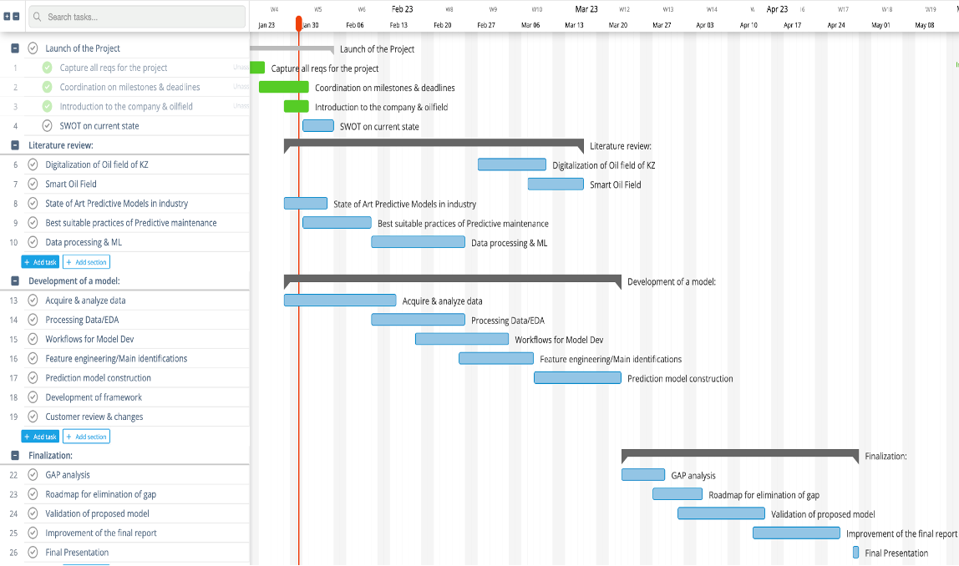
Gantt Chart

