Slide 1
Experimental Design of Novel Geopolymer Mixture for Construction 3D printing
Akerke Baigarina
2nd Year Master in Mechanical and Aerospace Engineering
Supervisor: Assistant Professor Md.Hazrat Ali
Co-Supervisor: Professor Essam Shehab

Slide 2
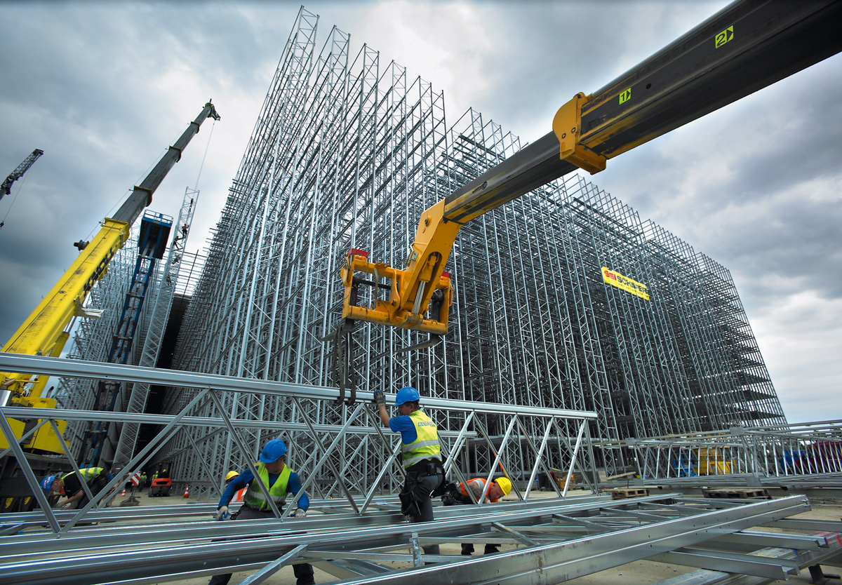
Outline
Introduction
Aim and Objectives
Literature Review
Methodology
Experimental Setup
Results and Discussion
Conclusion and Future Research Direction

Slide 3
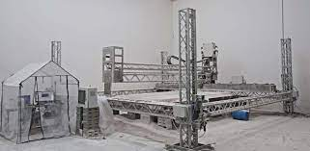

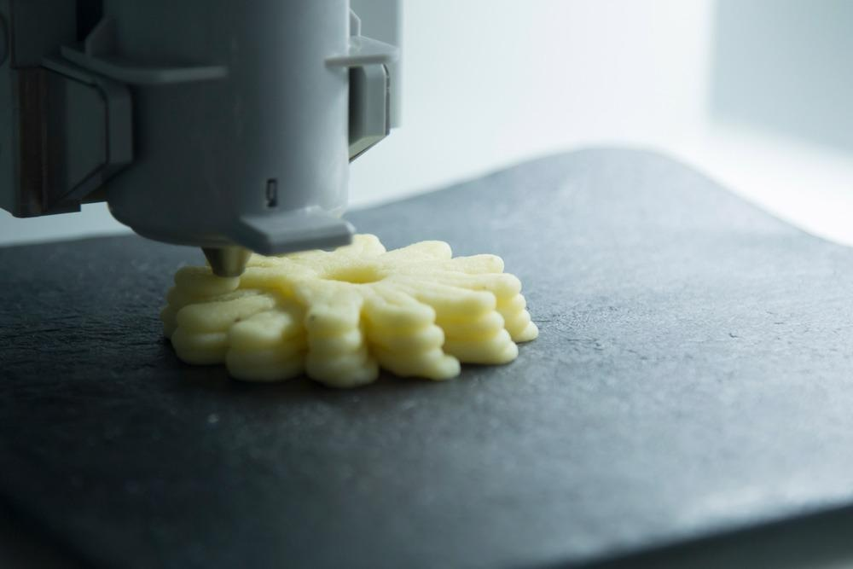
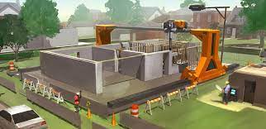

Research Background
Aviation
Construction
1990«
Pegna et al.
2001
Food
Khoshnevis et al.
Biomedicine

Slide 4






Research Background (Cont.)
Kazakhstan committed to reducing greenhouse gas (CO₂) emissions by 15% by 2030. Paris Climate Agreement (Mukhametkaliyev et al. 2022)
Greenhouse gas emmissions
US Portland Cement Association (Craveiroa et al. 2019)

Slide 5
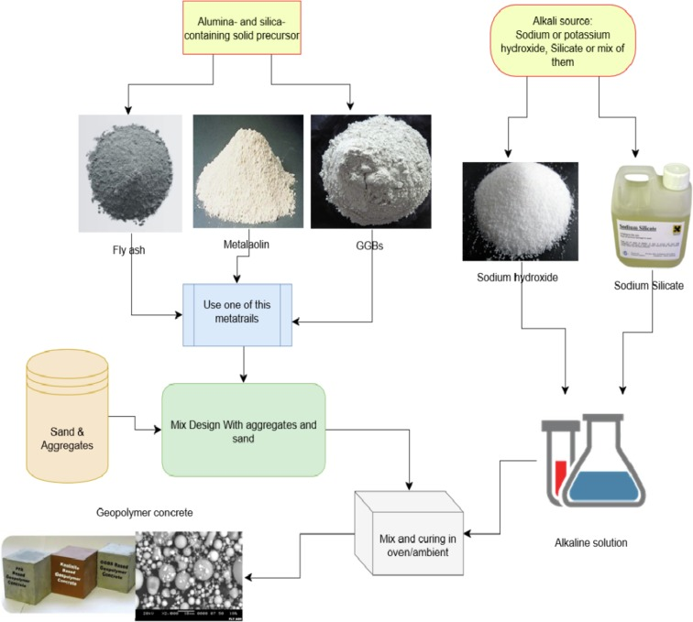
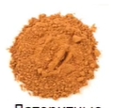

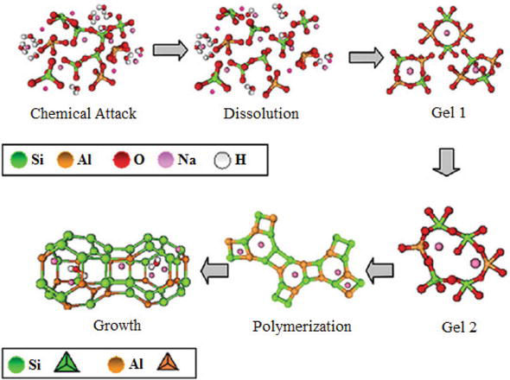



Research Background (Cont.)
Aluminosilicates
Alkaline solution
Fly-ash
Metakaolin
GGBs
Laterite
Sodium hydroxide
Sodium
Silicate
Use one of this material
Cement
Mix design with aggregates and sands
Sand & aggregates

Slide 6
Problem Statement
The current design procedures are not relevant for automated construction
No specific guidelines or standards for a 3D-printed geopolymers
The Microwave Heating system has not been explored for industrial applications

Slide 7
Research Scope
Out of scope
In scope
Examination of other tecniques:
Binder jetting
Powder based 3D printers
Extrusion systems
Mixture of geopolymers
3D printed geopolymers
Experimental validation
Examination of other construction materials:
Powder-based
Cement-based

Slide 8
Aim and Objectives
Aim
Experimental design of novel geopolymer mixture for construction 3D printing
Objectives
Identify the components and parameters of the entire structure necessary for the successful extrusion design
Determine the ideal proportion and mixture of materials for the extrusion process
Investigate the use of microwave heating to speed up the structural development of geopolymer concrete

Slide 9
Literature Review
Literature Review areas
3D printing in the construction industry
Extrusion design
Geopolymers
Existing 3D printers for construction
Machine structure
Investigation of mixture designs
Materials for 3D printing
Microwave heating approach

Slide 10
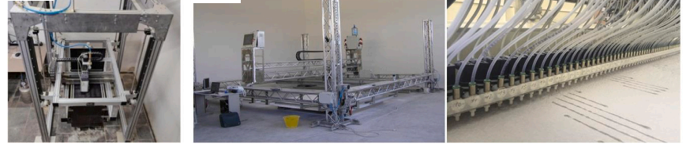
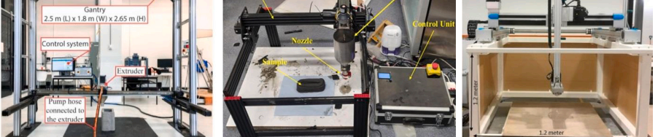
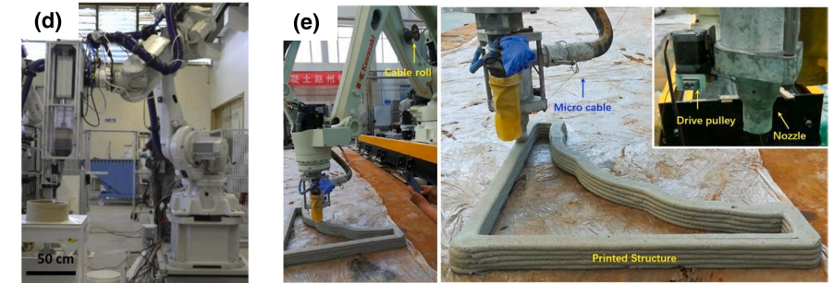
Literature Review (Cont.)
Powder-based 3D printers
Extrusion-based gantry systems
Extrusion-based robotic arm systems
3D printing techniques using geopolymers.

Slide 11
Literature Review (Cont.)
3D Printing process
Digital Modelling
3D Printer:
Gantry
Robotic
Exporting
Printing
Material Delivery System:
Mixer
Pump
Hose Pipe
Slicing
Program Generation
Automated controller:
Printer
Materials delivery system
General process of 3D printing for concrete-like materials (Paul et al. 2018a)

Slide 12
Literature Review (Cont.)
Table 3: Various technologies and components of geopolymers for 3D printing
References | 3D printing machines |  | 3D printable geopolymer components
 | Technique | Parameters of the printer | Aluminosilicate source | Activators | Aggregates
Nematollahi et al. (2015) | Material extrusion | Speed of the printer: 20 mm/s | fly ash+blast-furnace slag +silica fume | Na2SiO3; NaOH | Sands with different grain sizes
Krishnan (2014) | Material extrusion | Diameter of the pipe: 25 mm; Speed of the gantry: 70 mm/s; | fly ash+blast-furnace slag +silica fume | K2SiO3 | Fine river sand
Panda et al. (2017) | Material extrusion | Speed of the printer: 120 mm/s; | fly ash+blast-furnace slag +silica fume | KOH + K2SiO3 | River sand
Musijenko (2021) | Material extrusion | Dimension of the nozzle:25 × 15 mm: | fly ash | NaOH, Na2SiO3 | Silica sand
Hajimohammadi & Deventer (2021) | Material extrusion | Diameter of the nozzle: 15 mm; Speed of the printer: 60 mm/s; | fly ash+blast-furnace slag +silica fume | penta sodium metasilicate | Silica sand
Ziejewska (2022) | Material extrusion | Dimension of the nozzle: 30 × 15 mm: | Fly ash +blast-furnace slag | NaOH + Na2SiO3 | Fine and coarse quartz sand

Slide 13
Literature Review (Cont.)
Deep penetration of the microwave energy
Unique and fine microstructural development
1
2
3
4
5
Rapid heating rates and short processing times
Instantaneous and precise electronic control
Clean heating processes
Microwave heating of geopolymers (Sun et al. 2020)

Slide 14
Research Gap Analysis
Properties of geopolymers
Locally sourced raw materials
Mixture design for novel 3D printed geopolymer
Standards for the production of geopolymers

Slide 15
Methodology
Literature review
Mixture Preparation
Molding and Demolding
Microwave-assisted heating
Experimental validation
Composition of geopolymers
Geopolymerization
G-code of Molds
Microwave heating
Comparison of resulting and heated geopolymers
3D printing
3D printing
Solidification of manually prepared material
Microwave heating
Silicon Molds
Solidification of 3D printed material
Scope
Dissolution
Testing
Enhance buildability
Solidification
Compressive
Extrusion based technique
Gelation
Flexural

Slide 16

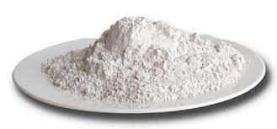
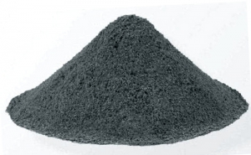
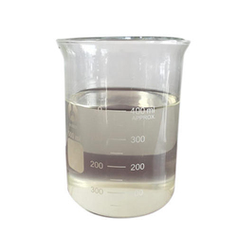
Methodology (Cont.)
List of main materials
 | Material | Minimum | Maximum
 | Fly Ash (FA Ekibastuz) | 60 % | 96,7 %
 | Ground granulated blast-furnace slag (GGBFS) | 1,67 % | 30 %
 | Silica fume (SF) | 1,67 % | 30 %
 | Activator modulus | 0,5 % | 2 %

Slide 17
Methodology: Geopolymer mixture designs
Mixture designs
Materials | Mix proportions (gr)
 | G1 | G2 | G3 | G4
Metakaolin | 64.88 (Austria) | 47.2 (Austria) | 106.49 (Kokshetau) | 102.54 (Kokshetau)
FA class F | - | 184.8 | - | 184.4
Sodium Silicate | 100 | 140 | 100 | 140
GGBS | 20 | 20 | 20 | 20
Sand | 200 | 130 | 200 | 130
Water | 3.8 | 10 | 3.8 | 10

Slide 18
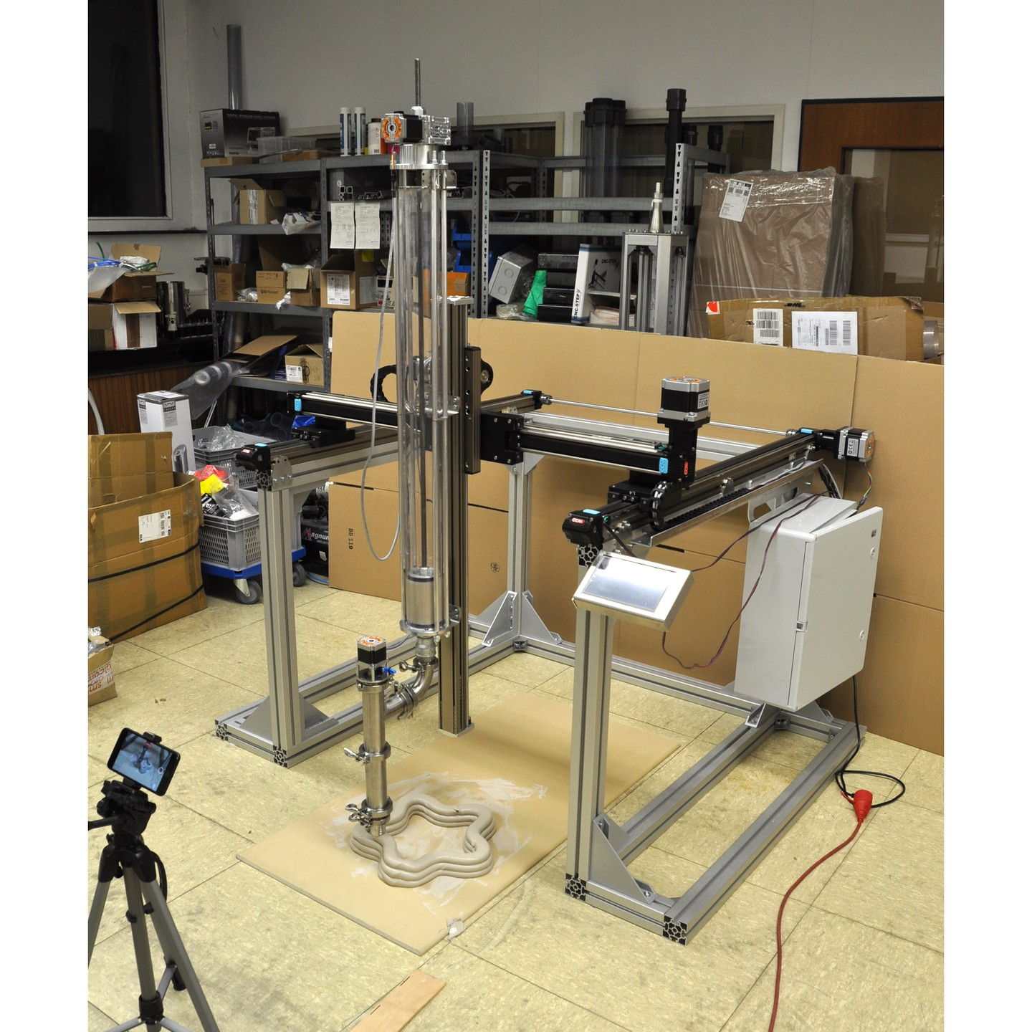
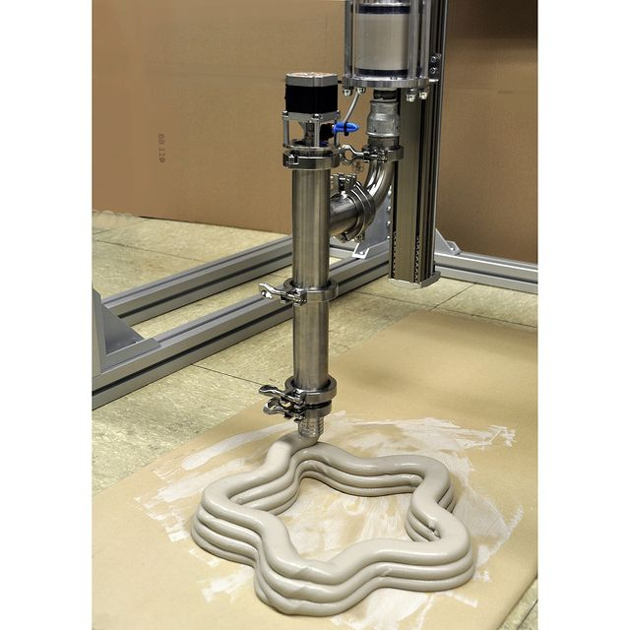
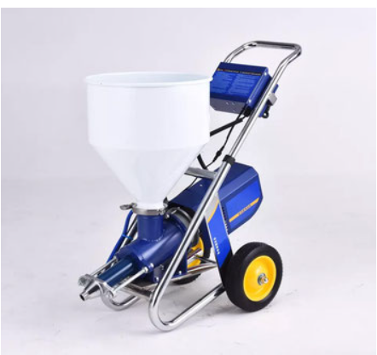
Experimental Apparatus
Custom build volume
100x190x180cm (WxDxH)
Mixing print head
(2 inlets, for mortar and accelerator)
Progressive cavity pumps
27L capacity

Slide 19
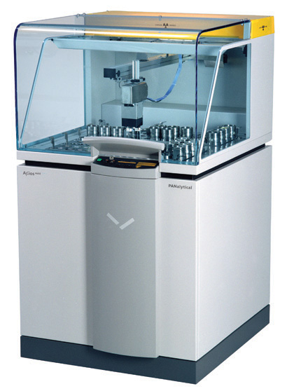
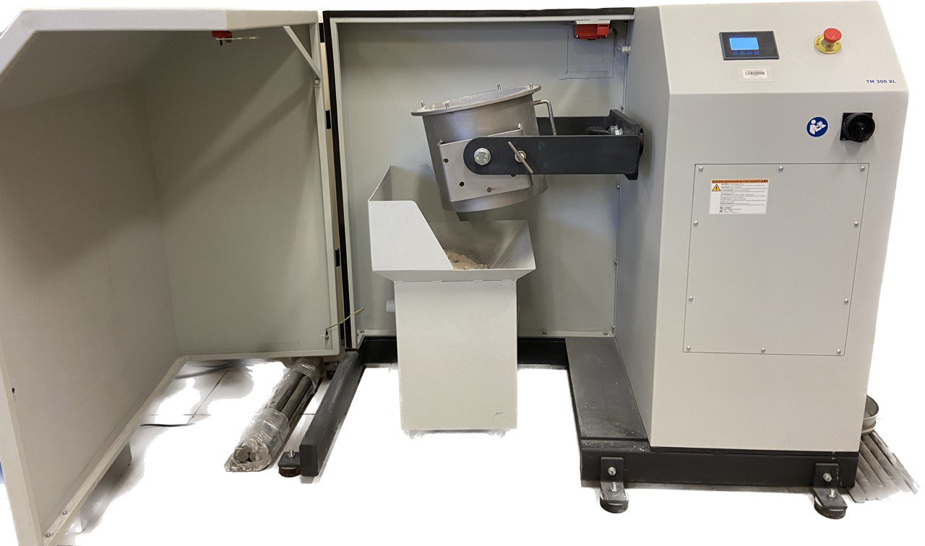
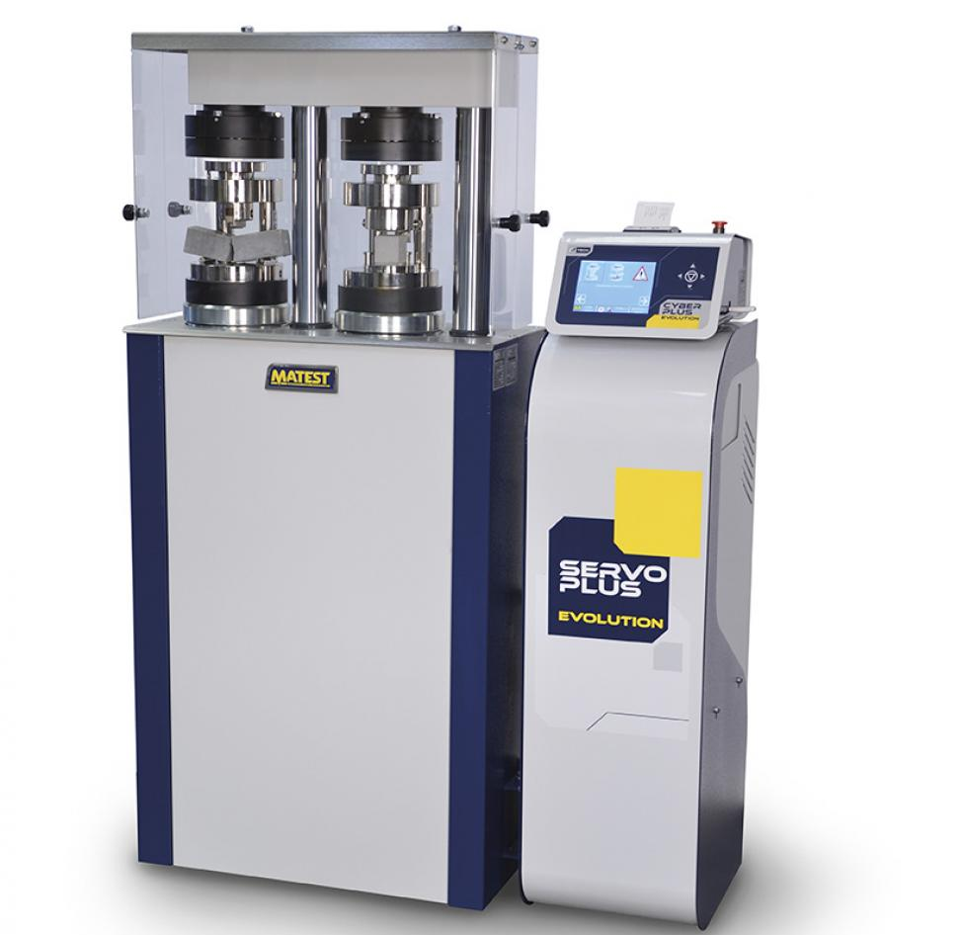
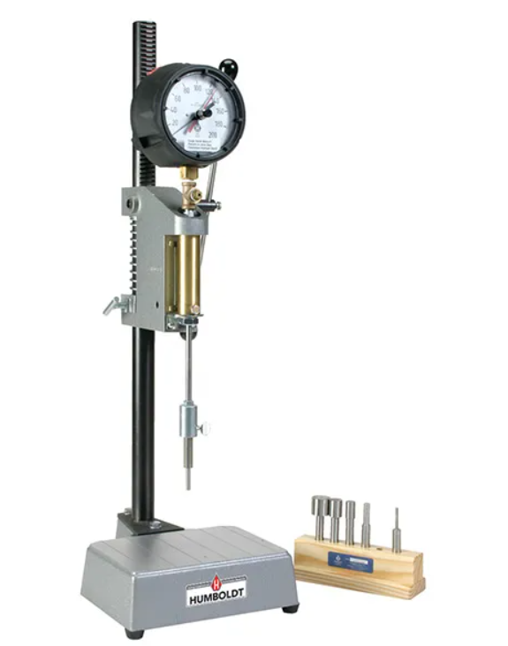
Experimental Apparatus (Cont.)
XRF Axios Pan Analytical
Ball mill
Penetration Resistance Apparatus
Compression and Flexural testing machine

Slide 20
Experimental Setup: XRF analysis

Slide 21
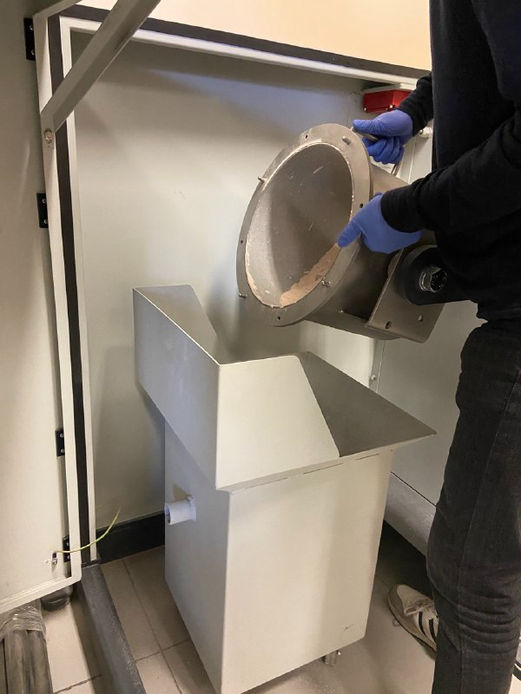
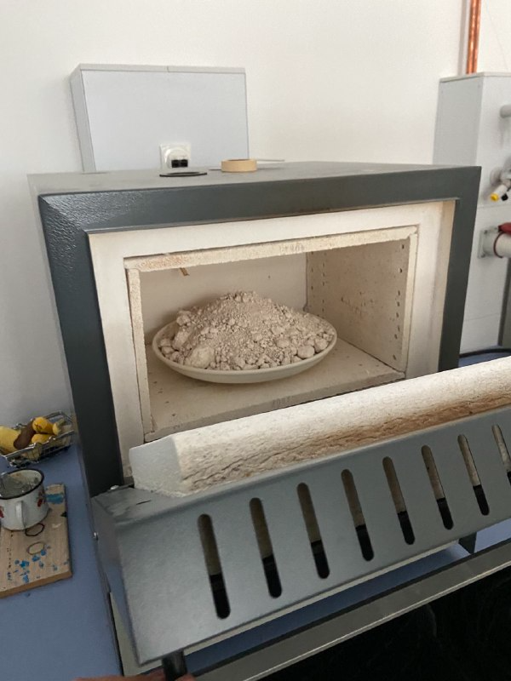
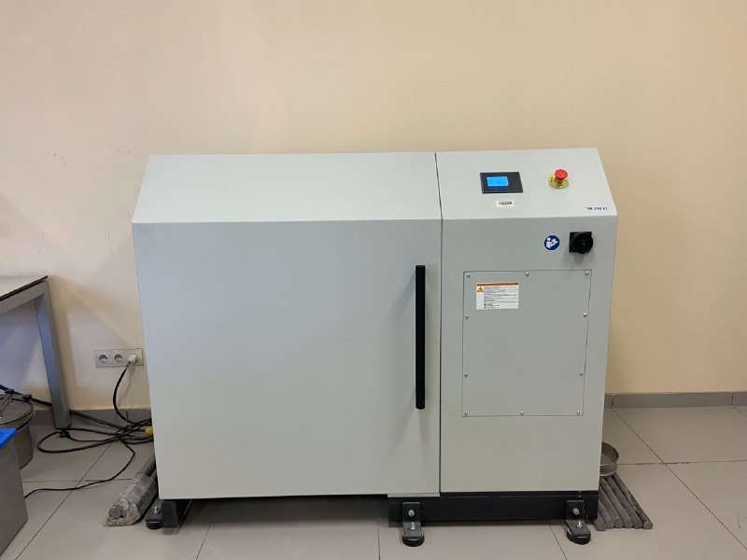
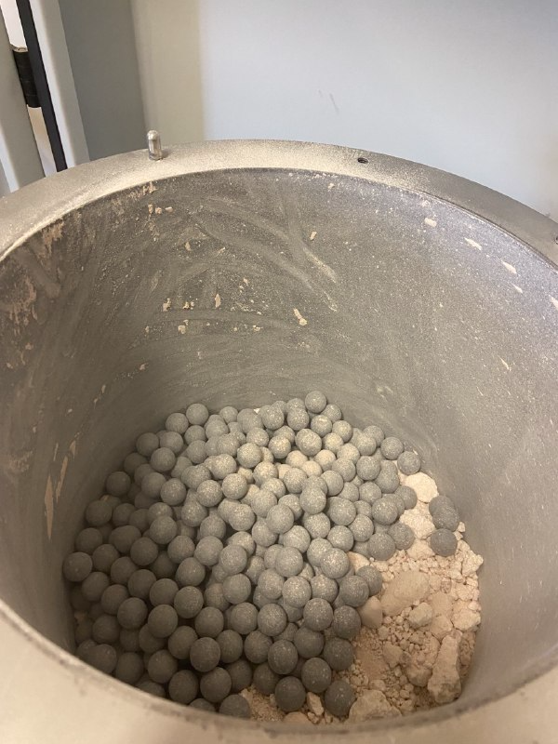
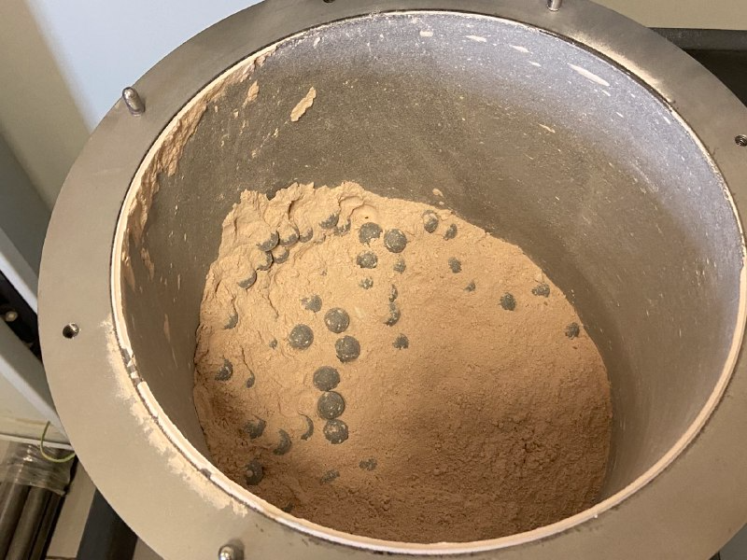
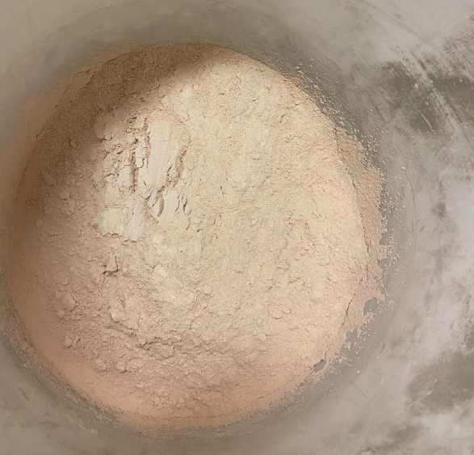
Experimental setup: Metakaolin

Slide 22
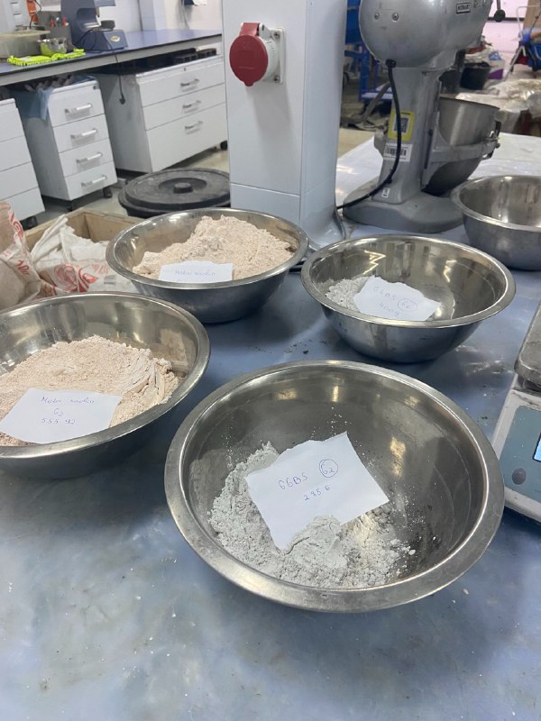
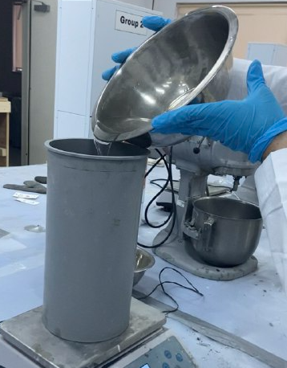
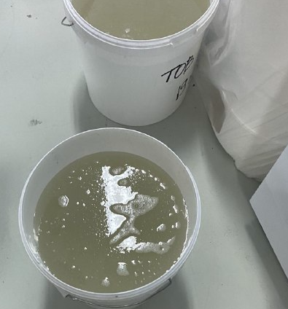
Experimental setup: Geopolymer
Preparation of Sodium Silicate

Slide 23
Experiments: 3D printable geopolymer material
Testing | Preparation | Specimens | Quantity | Measuruments
Compression | 1, 3,7 - day hardened samples | 50x50x50 mm cube | 3 samples for each day | Loaded til fracture
Flexural | 1, 3,7 - day hardened samples | 40x40x160 mm | 3 samples for each day | Loaded til fracture
Setting time | 1,2-hours hardened samples | 70x70x70 mm | 1 sample

Slide 24
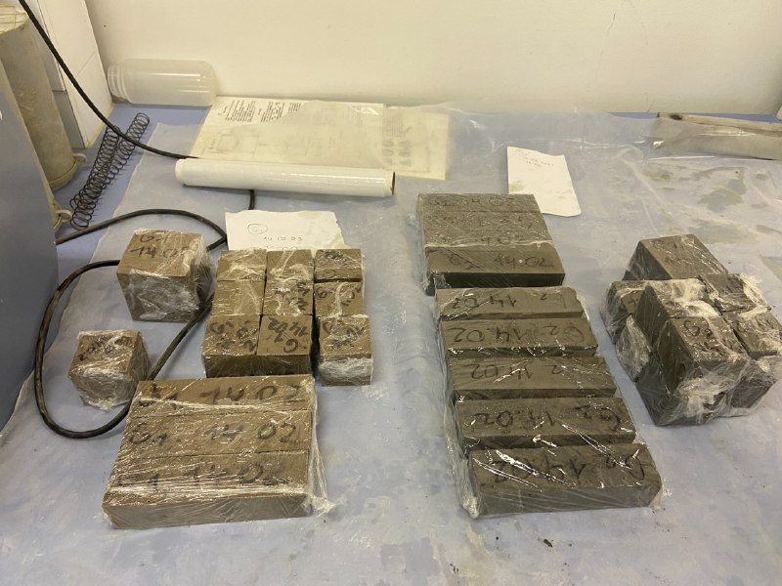
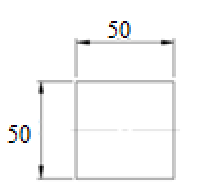
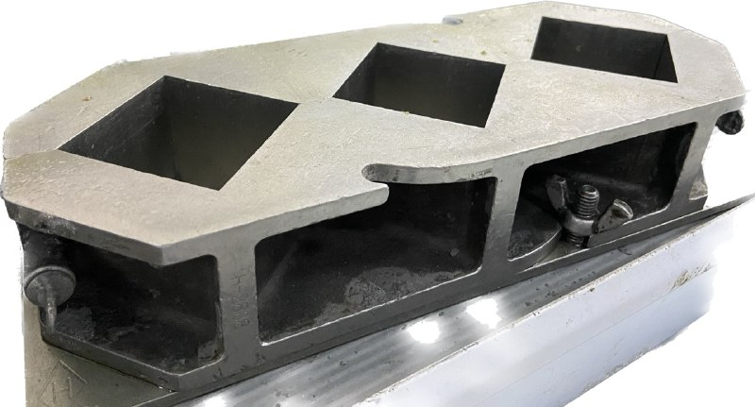
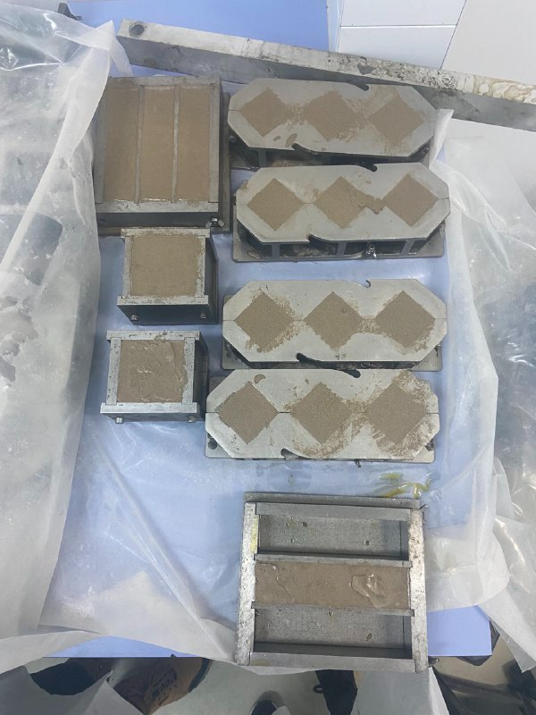
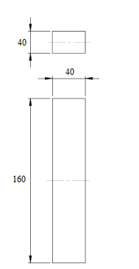
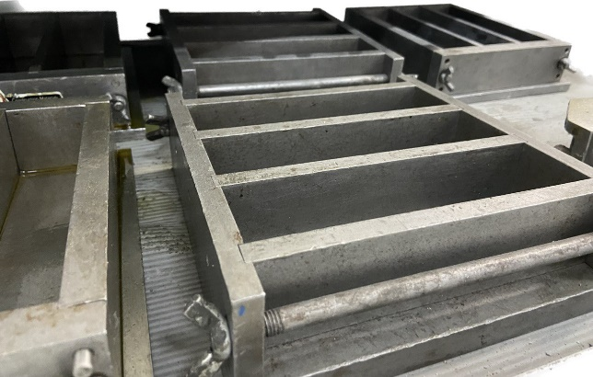
Experimental setup (Cont.)
ASTM 349
ASTM C293

Slide 25
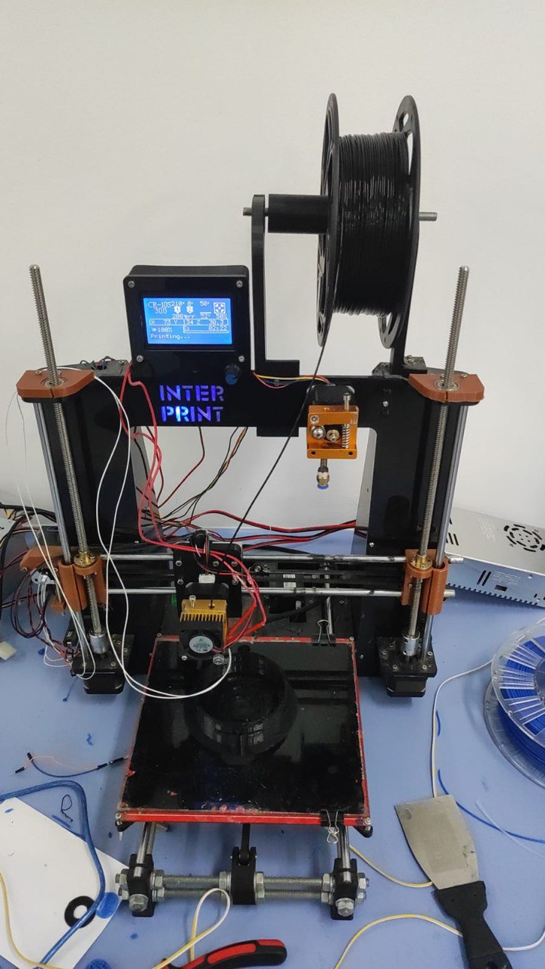
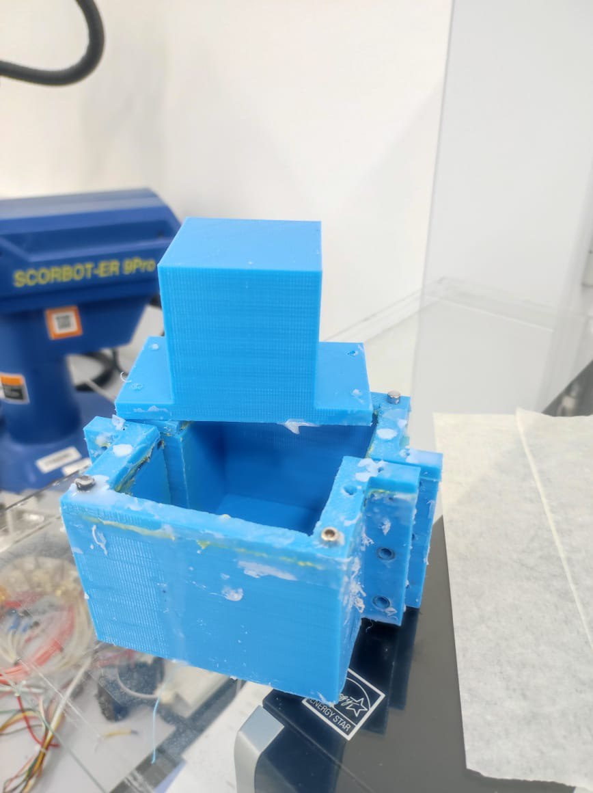
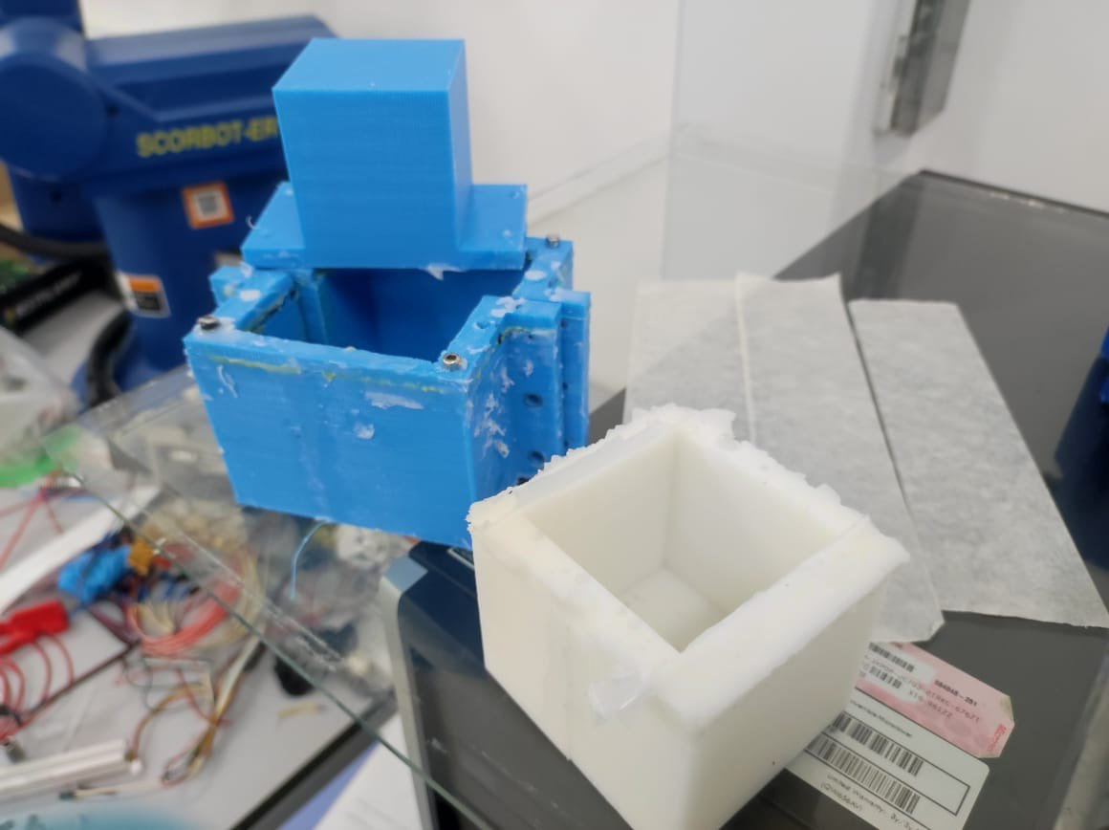
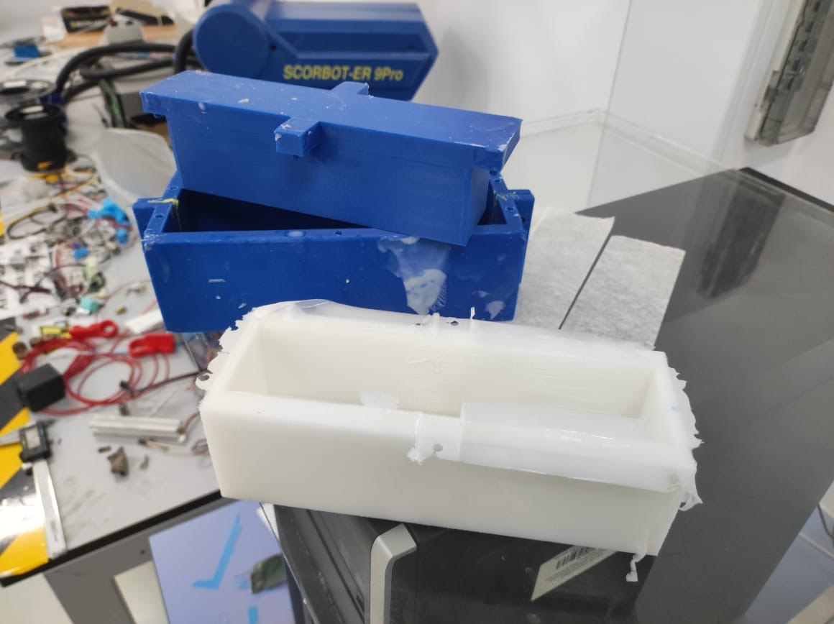
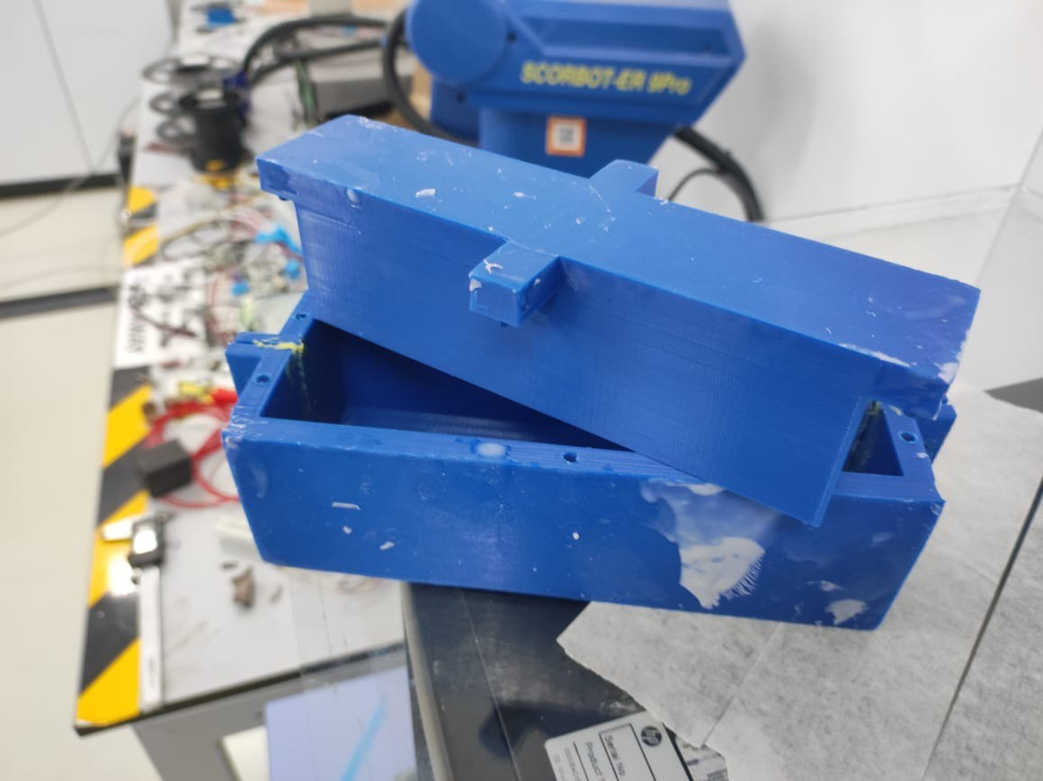
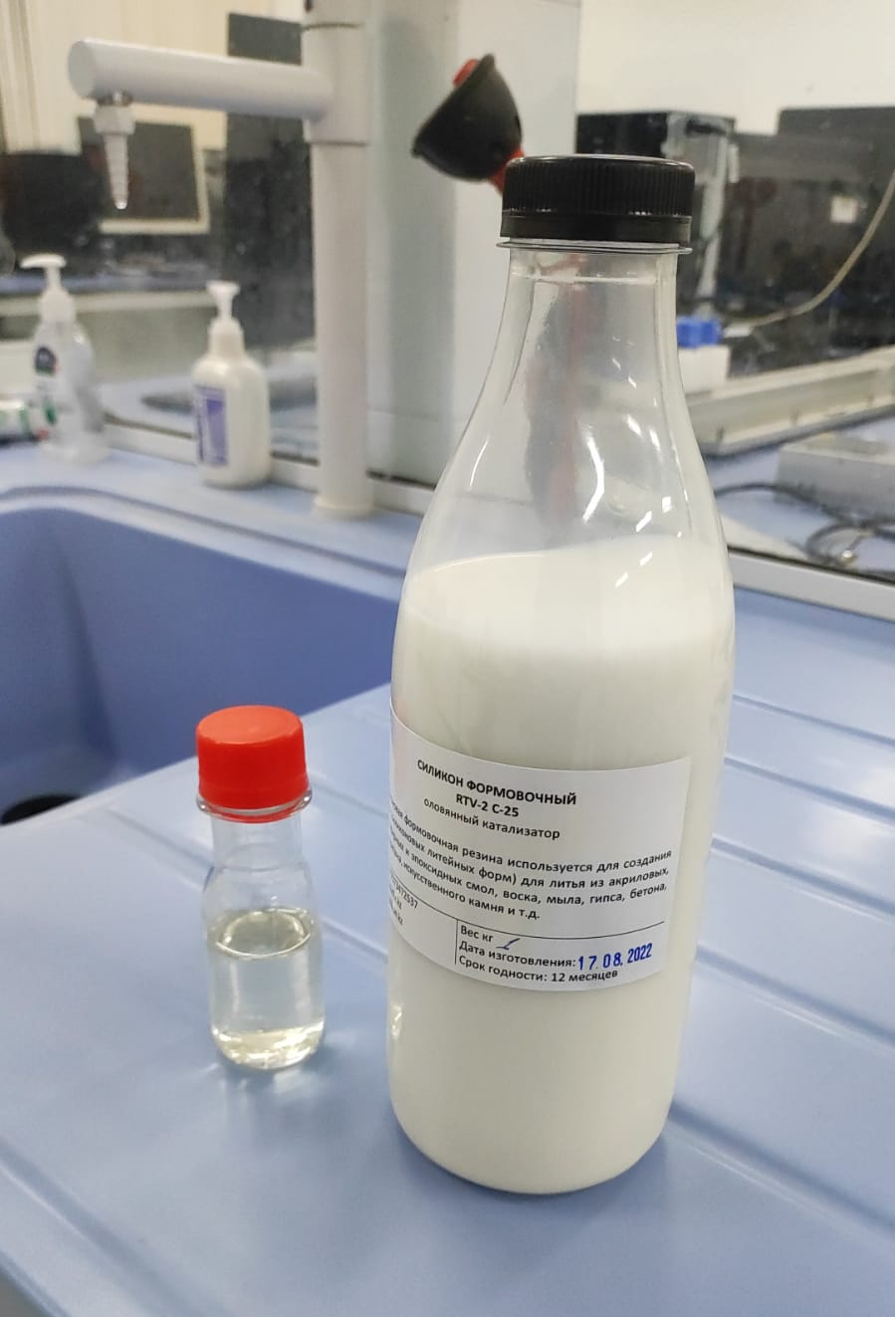
Experimental setup: Microwave Heating

Slide 26
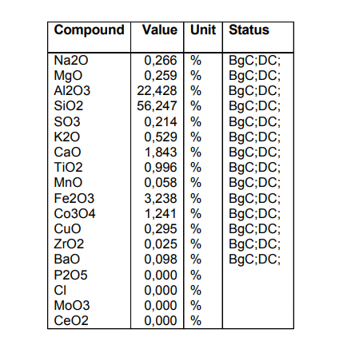
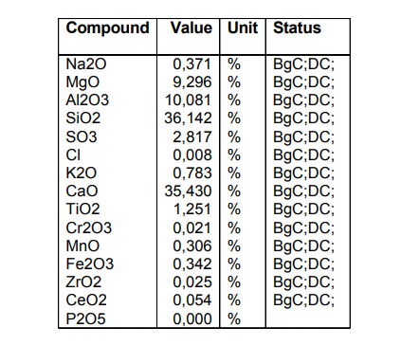
Fly ash GGBFS
Results: XRF analysis

Slide 27
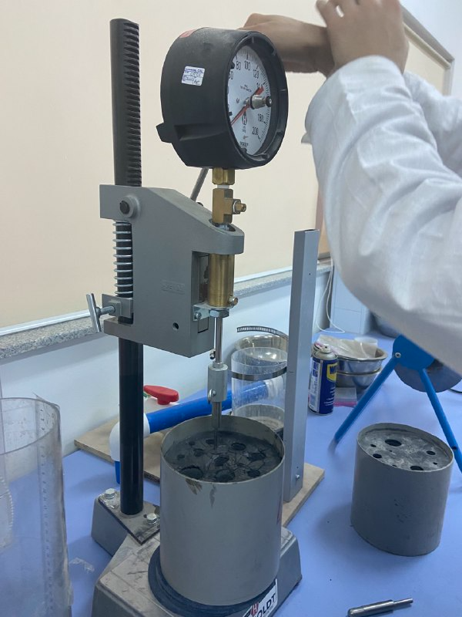
Results: Setting Time
GP1 and GP2
GP3
Initial setting time: 180 min
Final setting time: 420 min
GP4
Initial setting time: 210 min
Final setting time: 450 min
failed (7 hours<…)
ASTM 403

Slide 28
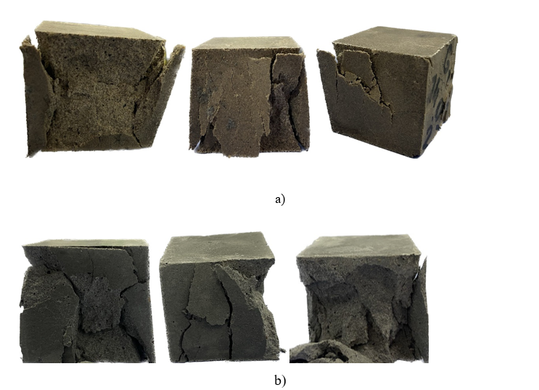
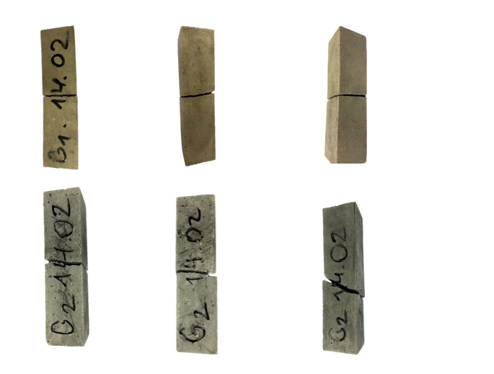
Results: Tested Geopolymer Samples
Some of the samples after compressive and flexural testing: a) GP1, b) GP2

Slide 29
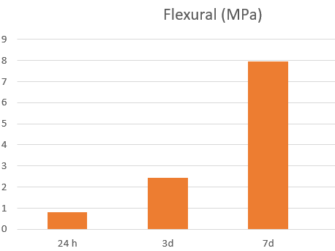
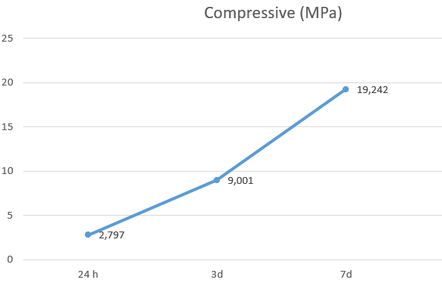
Results: Compressive and Flexural
Age | Compressive (MPa) | Flexural (MPa)
1d | 2,797 | 0,817
3d | 9,001 | 2,435
7d | 19,242 | 7,953
GP1- Metakaolin based (metaver)

Slide 30
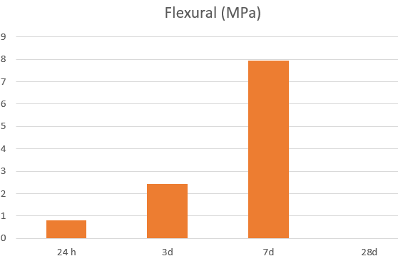
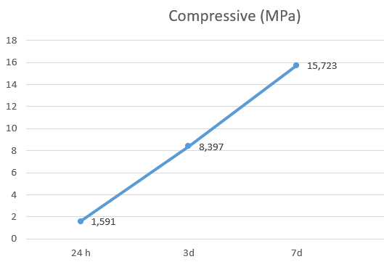
Results: Compressive and Flexural
Age | Compressive (MPa) | Flexural (MPa)
1d | 1,591 | 0,817
3d | 8,397 | 2,435
7d | 15,723 | 7,953
GP2-Fly ash based

Slide 31


Results: Compressive and Flexural
Age | Compressive (MPa) | Flexural (MPa)
1d | 28,749 | 3,67
3d | 47,05 | 8,35
7d | 65,258 | 11,01
GP3-Metakaolin based (Kokshetau)

Slide 32


Results: Compressive and Flexural
Age | Compressive (MPa) | Flexural (MPa)
1d | 6,07 | 1,753
3d | 17,161 | 3,218
7d | 22,63 | 4,78
GP4-Fly ash based (Kokshetau)

Slide 33


Results: Compressive and Flexural
Mix 1 exhibited a low initial compressive strength
Mix 3 exhibited the highest compressive strength

Slide 34

Results: Compressive and Flexural
Mix 1 exhibited a low initial flexural strength
Mix 3 exhibited the highest flexural strength

Slide 35
Results: Microwave Heating
Results of MW heating after 1 day of curing (GP3 & GP4)
GP 4
5.932 MPa
GP3
28,749 MPa
600 W | 10 s | 6.633 MPa
 | 20 s | 5.358 MPa
 | 30 s | 6.014 MPa
700 W | 10 s | 4.668 MPa
 | 20 s | 6.294 MPa
800 W | 10 s | 7.621 MPa
 | 20 s | 5.179 MPa
 | 30 s | 4.884 MPa
800 W | 20 s | 22,632 Mpa
 | 30 s | 9,231 Mpa
 | 40 s | 11,96 Mpa

Slide 36

Results: Printed Sample
Model of the cylinder in Rhino 7.

Slide 37

Results: G-code for 3D printing

Slide 38
Conclusion and Future works
Conclusion:
The proportion and mixture of geopolymer for construction 3D printing was determined
Extended curing times greatly improve the mechanical properties of geopolymer
The use of microwave heating is only applicable for fly ash-based geopolymers
Microwave heating raised the mechanical strength properties by 28 %
Future works:
Investigation of the durability and long-term performance of 3D-printed geopolymer structures
Optimization of the extrusion process parameters
Comparative analysis of geopolymer materials with other construction materials

Slide 39
Contribution to Knowledge
Proposed methodology could be good endeavor toward 3D construction printing among building companies in Kazakhstan.
Economically affordable 3D construction printing system using geopolymer.
Promote the industrialization of microwave-assisted geopolymer production.

Slide 40
Thank you!
Publications:
[1] Baigarina, A., Shehab, E., & Ali, M. H. (2023). Construction 3D printing: a critical review and future research directions. Progress in Additive Manufacturing, 1-29.

Slide 41
References
Jo, J. H., Jo, B. W., Cho, W., & Kim, J. H. (2020). Development of a 3D printer for concrete structures: laboratory testing of cementitious materials. International Journal of Concrete Structures and Materials, 14(1), 1-11.
Gosselin, C., Duballet, R., Roux, P., Gaudillière, N., Dirrenberger, J., & Morel, P. (2016). Large-scale 3D printing of ultra-high performance concrete–a new processing route for architects and builders. Materials & Design, 100, 102-109.
Bos, F., Wolfs, R., Ahmed, Z. & Salet, T. 2016. Additive manufacturing of concrete in construction: potentials and challenges of 3D concrete printing. Virtual and Physical Prototyping, 11: 3. Pp. 209–225
Lao, W., Li, M., Masia, L. & Tan, M. J. 2017. Approaching Rectangular Extrudate in 3D Printing for Building and Construction by Experimental Iteration of Nozzle Design. Solid Freeform Fabrication 2017: Proceedings of the 28th Annual International Solid Freeform Fabrication Symposium – An Additive Manufacturing Conference. Pp. 2612–2623.
Ma, G., Li, Z., Wang, L. and Bai, G. (2019). Micro-cable reinforced geopolymer composite for extrusion-based 3D printing. Materials Letters, 235, pp.144-147.
Muthukrishnan, S., Ramakrishnan, S. and Sanjayan, J. (2022). Set on demand geopolymer using print head mixing for 3D concrete printing. Cement and Concrete Composites, 128, p.104451.
Adams, T., Heuer, C. and Brell-Cokcan, S. (2022). Dynamic 3D print head for spatial strand extrusion of fiber-reinforced concrete: requirements, development and application. Construction Robotics, pp.1-13.
Bos, F., Wolfs, R., Ahmed, Z., & Salet, T. (2016). Additive manufacturing of concrete in construction: potentials and challenges of 3D concrete printing. Virtual and physical prototyping, 11(3), 209-225.
Paul, S. C., Tay, Y. W. D., Panda, B. & Tan, M. J. 2018a. Fresh and hardened properties of 3D printable cementitious materials for building and construction. Archives of Civil and Mechanical Engineering, 18: 1. Pp. 311–319.
Panda, B., Paul, S. C. & Tan, M. J. 2017a. Anisotropic mechanical performance of 3D printed fiber reinforced sustainable construction material. Materials Letters, 209: 2017. Pp. 146–149.

Slide 42
References
Panda, B., Paul, S. C., Mohamed, N. A. N., Tay, Y. W. D. & Tan, M. J. 2018b. Measurement of tensile bond strength of 3D printed geopolymer mortar. Measurement, 113: 2018. Pp. 108–116.
Ma, C-K., Awang, A. Z. & Omar, W. 2018a. Structural and material performance of geopolymer concrete: A review. Construction and Building Materials, 186: 2018. Pp. 90– 102.
Muthukrishnan, S., Ramakrishnan, S., & Sanjayan, J. (2020). Effect of microwave heating on interlayer bonding and buildability of geopolymer 3D concrete printing. Construction and Building Materials, 265, 120786.
Buttress, A., Jones, A., & Kingman, S. (2015). Microwave processing of cement and concrete materials–towards an industrial reality?. Cement and Concrete Research, 68, 112-123.
Makul, N., Rattanadecho, P., & Agrawal, D. K. (2014). Applications of microwave energy in cement and concrete–a review. Renewable and Sustainable Energy Reviews, 37, 715-733.
Sun, Y., Zhang, P., Hu, J., Liu, B., Yang, J., Liang, S., ... & Hou, H. (2021). A review on microwave irradiation to the properties of geopolymers: Mechanisms and challenges. Construction and Building Materials, 294, 123491.
Wei, W., Shao, Z., Qiao, R., Chen, W., Zhou, H., & Yuan, Y. (2021). Recent development of microwave applications for concrete treatment. Construction and Building Materials, 269, 121224.
Ma, G., Li, Z., Wang, L. and Bai, G. (2019). Micro-cable reinforced geopolymer composite for extrusion-based 3D printing. Materials Letters, 235, pp.144-147.
Muthukrishnan, S., Ramakrishnan, S. and Sanjayan, J. (2022). Set on demand geopolymer using print head mixing for 3D concrete printing. Cement and Concrete Composites, 128, p.104451.
Adams, T., Heuer, C. and Brell-Cokcan, S. (2022). Dynamic 3D print head for spatial strand extrusion of fiber-reinforced concrete: requirements, development and application. Construction Robotics, pp.1-13.

