Slide 1
Allocating Collections Budgets in a Changing Environment
Doug Way
Associate University Librarian for Collections and Research Services
University of Wisconsin-Madison

Slide 2
We will discuss three approaches
But first…

Slide 3
Traditional Approach to Collections Allocations
Post-World War II in the West
Funds allocated at a certain level of granularity
  Department, Subject, Language
  Sometimes one fund per area or sometimes broken down by acquisition type or item type
    Firm order versus continuation
    Book versus Journal versus Database

Slide 4
Traditional Approach to Collections Allocations
Logical Approach
  We purchased items one-by-one regardless of item-type
  Professionalization of library selection (from faculty to librarians)
    Increasing budgets
    Spread out load
    Split the work

Slide 5
In the 21st Century…
Model doesn’t necessarily work the same
We acquire different things and things differently
  Bundles of electronic books and journals
    Front and back-lists
  Electronic archival collections
  Databases

Slide 6
In the 21st Century…
Model doesn’t necessarily work the same
Prices are often too high for individual fund lines
Acquisition models often do not make sense for individual fund lines
  Requirements of journal packages
Focus on access over ownership
Changing emphasis of role of librarian
  Focusing less on building collections

Slide 7
Back to the three approaches…

Slide 8
Traditional
Subject, language, department allocations
Incremental budget allocation
  You get what you get based on what you received last year
  Easy
  Politically expedient
  Doesn’t react to changes on campus
  Can be hard to change
    Especially as you need to centralize budgets

Slide 9
Formula Approach
Allocate at the department level
Allocations determined through a weighted formula
  Variables will differ and can often evolve over time
    Faculty
    Students
    Sections/classes
    Average cost of materials

Slide 10
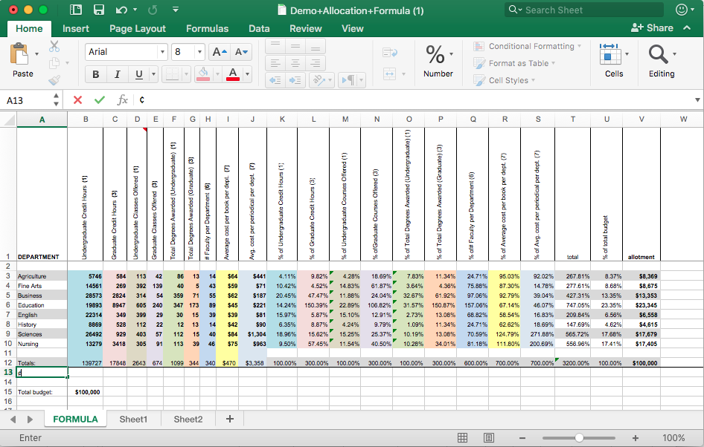
Formula Approach
  www.astate.edu/a/library/charleston
  Template spreadsheet and potential variables:

Slide 11
Formula Approach
Budget changes as campus changes
Less subjective
But not completely objective – requires adjustment to get it right
Formula may not match broader goals
Difficult transition from Traditional to Formula

Slide 12
Centralized Approach
Very few funds and/or selectors
Approach is being adopted more and more, but is still rare
  Some large institutions
  More at smaller institutions
Focus on automating selection and acquisition instead of title by title selection
  Bundled content
  Approval plans
  Demand-driven acquisitions

Slide 13
Centralized Approach
Less of a fixation on arbitrary allocations
Better-aligns with how we acquire things today
Frees librarians to focus on other things
Challenging to track expenditures to show how you support departments or subjects
Selectors may not have adequate subject expertise
Subject specialists will not know the collection as well

Slide 14
At my University
Some background
  Large research university
    40,000 students
    $1.1 Billion in research funding each year
  Established in 1847

Slide 15
At my University
Some background
  Large Library System
    16 libraries in main system
    4 major independent libraries
    $39 Million budget
      $13 Million for Collections
    10 Million volumes

Slide 16
At my University
Some background
  Fund lines organized in three different ways:
    Departments
    language
    geography
  Each area had a single line for all item-types and purchases
  Incremental budget approach
    Had spent three years looking into a formula before I arrived
  Money pushed down to the lowest level possible
    Made sense in the 20th Century
    Lots of challenges today

Slide 17
At my University
What we are doing
  Sticking with incremental budgeting
    Too difficult politically and with funds organized in different ways
  Making funding areas more granular
    Firm order lines
    Continuation lines
    Benefits in tracking spending and in allocations

Slide 18
At my University
What we are doing
  Centralizing budget in certain areas
    Journal packages
    Science disciplines
  Creating capacity for centralized purchases
    Retaining some new allocations for central purchases
    Creating capacity where possible

Slide 19
In Conclusion
There is no perfect system
A hybrid may be the best approach
Let your budget reflect your priorities
Do what is best for the goals you are trying to accomplish
Think long-term

Slide 20
Thank you
Questions?
Doug Way
doug.way@wisc.edu
works.bepress.com/doug_way

