Slide 1
Perfection towards information systems in the field of veterinary medicine of the Republic of Kazakhstan
Amanbayeva Aigerim Akdarbekovna
Master of Management Institute,
Academy of Public Administration
under the President of the Republic of Kazakhstan

Slide 2
Objective:
Identification of problems within information systems used in the field of veterinary medicine with a view to further improvement.
E.g. identification, veterinary and sanitary measures, issuance of veterinary reference, issuance of veterinary certificates

Slide 3




Compared with the experience of other countries

Slide 4
THE SYSTEM
The veterinary system of the Republic of Kazakhstan includes:
The authorized body of The Government of the Republic of Kazakhstan;
2) subdivisions of the state bodies carrying out activities in the field of veterinary medicine;
3) state veterinary organizations established in accordance with network of state veterinary organizations;
4) physical and legal persons carrying out entrepreneurial activity in the field of veterinary medicine

Slide 5

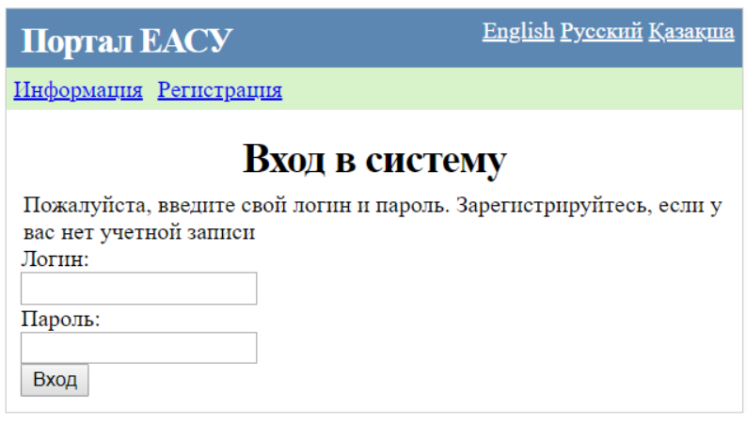
Operating information systems
FARM ANIMAL IDENTIFICATION
iszh.kam.kz
http://portal.minagri.gov.kz/
UNIFIED AUTOMATED CONTROL SYSTEM

Slide 6
FARM ANIMAL IDENTIFICATION
iszh.kam.kz
users: veterinarians

Slide 7
UNIFIED AUTOMATED CONTROL SYSTEM
http://portal.minagri.gov.kz/
filing of applications and processing
issuing permits or denial letters
issuance of veterinary reference
issuance of veterinary certificate
registration of acts of veterinary inspection
users: legal entities and individuals, employees of the Ministry of Agriculture involved in the issuance of veterinary reference responsible for veterinary certificate and related documents

Slide 8
DATA ENTRY IN THE IDENTIFICATION OF FARM ANIMALS
INFORMATION SYSTEM
Veterinarian of the
Veterinary Station of the rural district
Directly with Animals
Conducts veterinary sanitary measures
Fill in Acts and Inventories (handwriting)
Veterinarian of the
Veterinary Station responsible for direct recording
Only Database
Data entry in the Identification of farm animals database

Slide 9
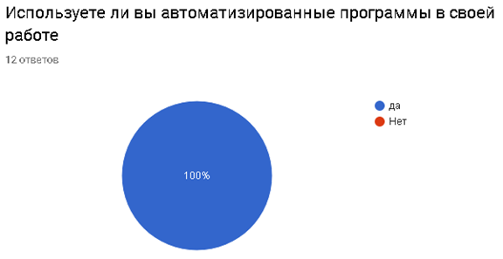
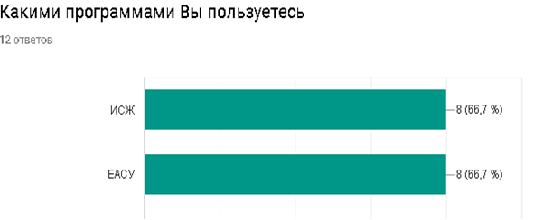
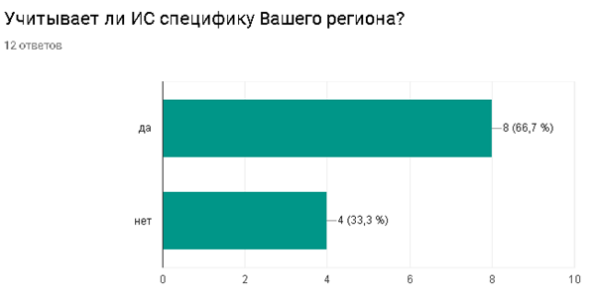
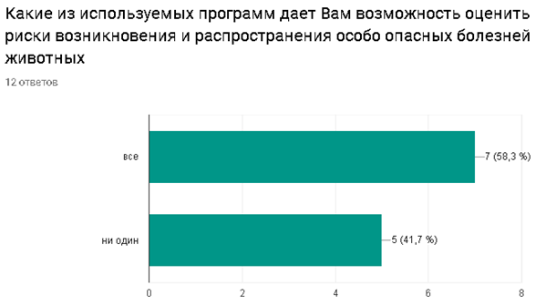
SURVEY

Slide 10
SOME ISSUES IN FARM ANIMAL IDENTIFICATION | WAYS TO SOLVE THEM
Manual data entry for veterinary events | Integration of data through scanners
Not saving data online | Download data offline
Isolation of data by region | Allow access for only viewing data in the information system, for everyone
If you lose your identification number, there is no possibility of assigning a new number. | Assigning a new number with the original data (Animal ID)
When inheriting or transferring an animal as a gift, there is no possibility of changing the owner | Introduce functionality "in inheritance" or "in gift"
Database update after 24 hours | Update data on making changes to the database
At the time of issuing a veterinary certificate, it is necessary to enter the data of the owner, despite a many data already available in the information system | Information Systems Integration of both systems
does not enter data on birds and pets (cat, dog) | The introduction of functionality for the preservation of data on birds and domestic animals
current veterinary system is closed to the public | Open access to all citizens with the assignment of username and password
The inconsistency of the information system to the existing Normative Law Acts (NLA) | Adjust the information system to the applicable regulatory legal acts
Self-study, universal learning | training of veterinarians at the regional level, conducting trainings
Lack of Interest based on Low salary | Salary increase in the implementation of a veterinary assessment system
Centralized Management | Decentralization ( for example, when purchasing veterinary drugs, etc. )

Slide 11
THANK YOU FOR YOUR ATTENTION

