Slide 1

Christos Venetis
Христос Венетис
ICP Германия
SORTING PLANT FOR THE PRODUCTION OF
REFUSE DERIVED FUEL (RDF)

Slide 2
Self introduction
Name: Christos VENETIS
Education: Diploma as Waste Management Engineer at RWTH Aachen University (2007)
Profession: Project Manager in Department -
International Waste Management
Experience: Working in the fields „waste management“ and „energy out of waste“
Address: ICP, Auf der Breit 11
D-76227 Karlsruhe
Germany
e-mail: venetis@icp-ing.de
www: icp-ing.de

Slide 3
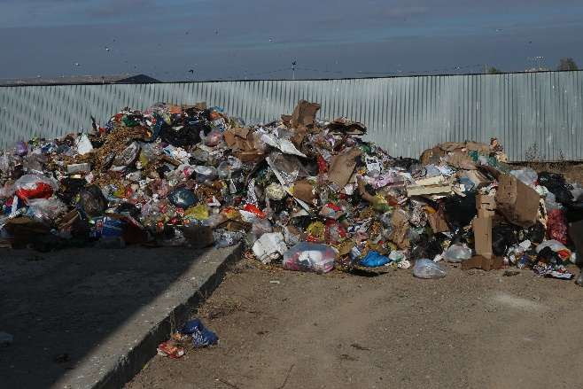
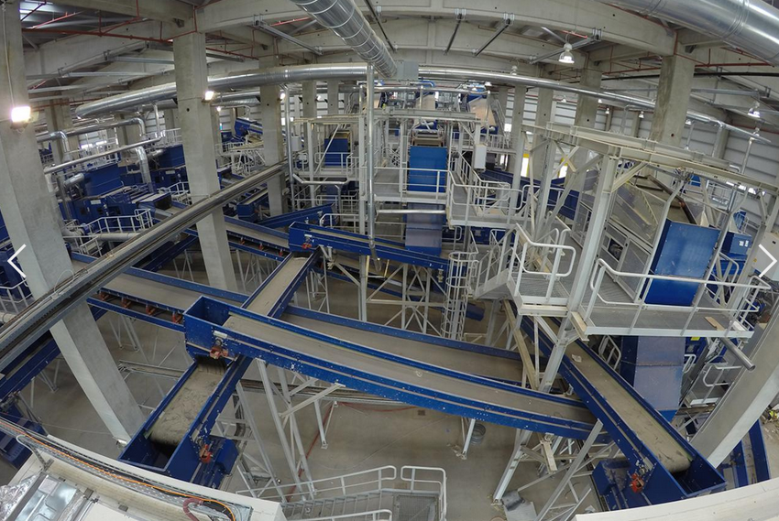
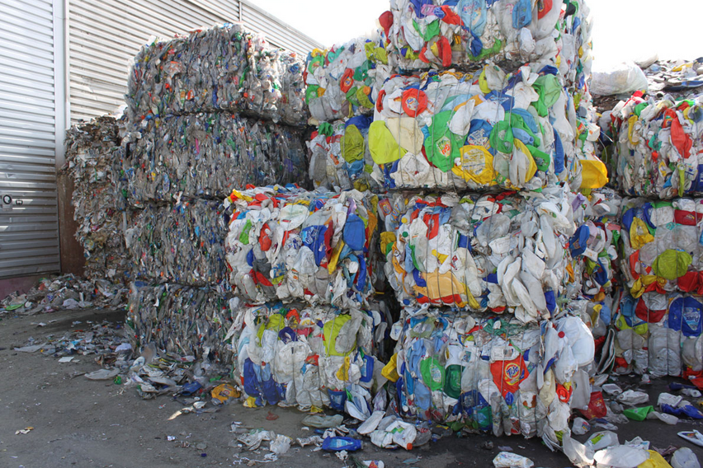
Sorting Plant
Why sorting plant?
Mixed Municipal Solid Waste (MSW) has little value in its crudest form
However individual materials contained in waste do have value
As a result different sorting techniques can be deployed in order to isolate the valuable materials or group of materials

Slide 4
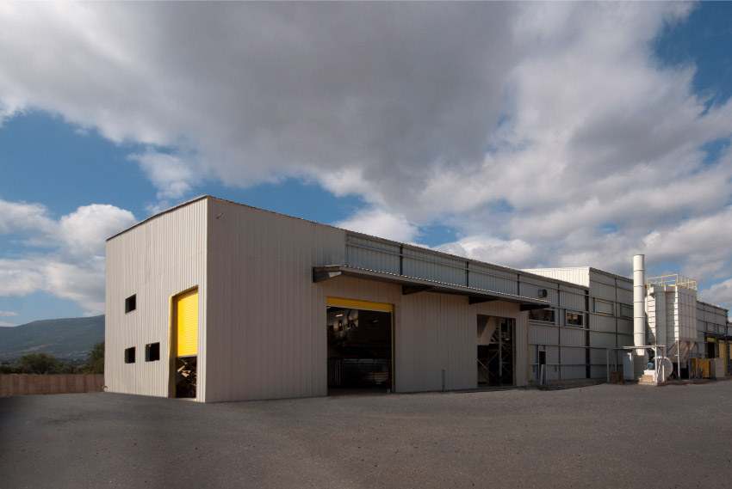
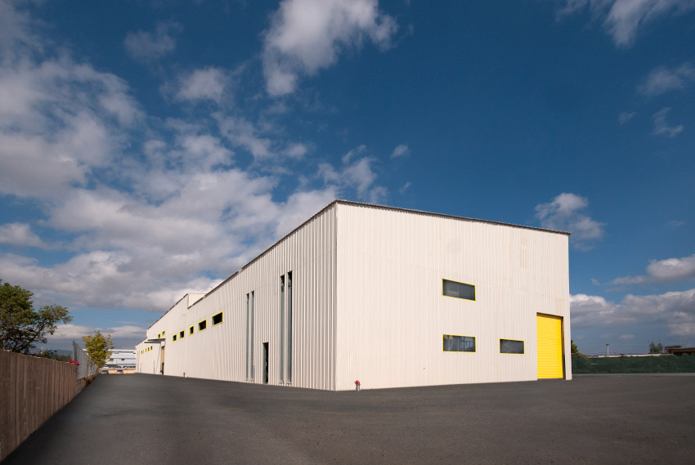
Sorting Plant
www.watt.com.gr

Slide 5
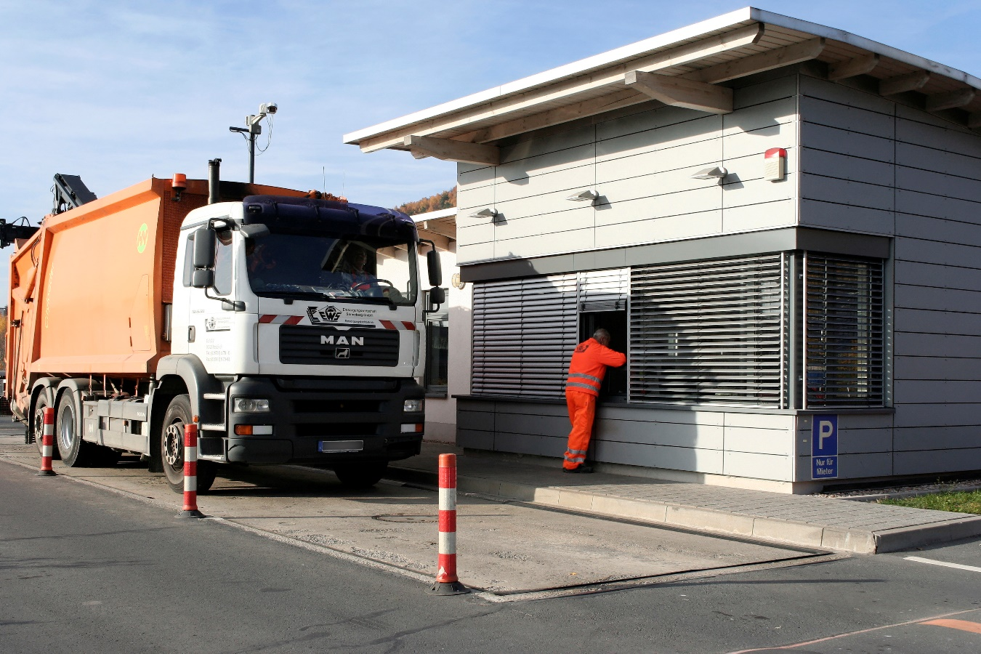
Sorting Plant Sections
Entrance
www.abfallbild.de

Slide 6
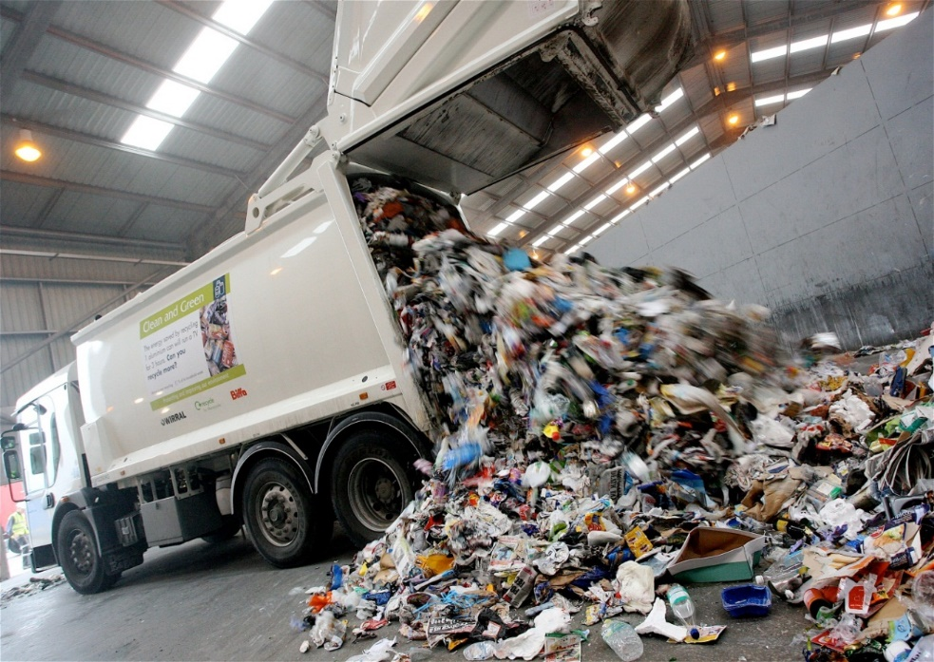
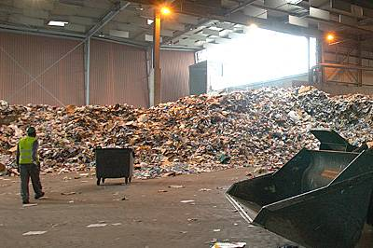
Sorting Plant Sections
Waste Reception (Flat Bunker)
www.wrap.org.uk

Slide 7
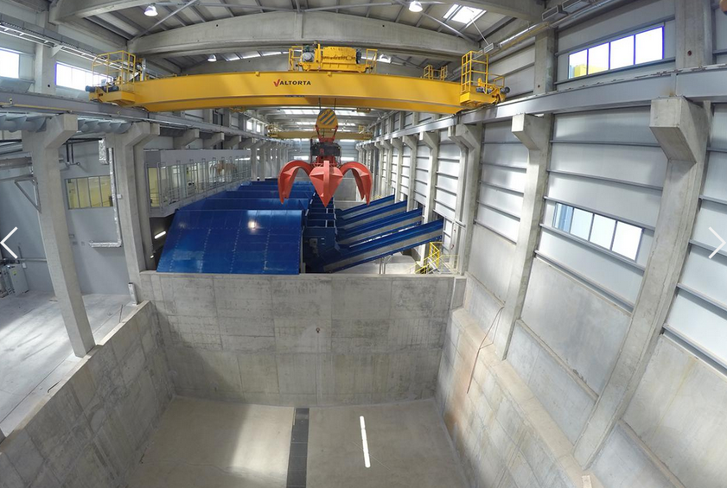
Sorting Plant Sections
Waste Reception (Deep Bunker)
www.helector.gr

Slide 8
Sorting Plant Sections
Sorting line
www.helector.gr

Slide 9
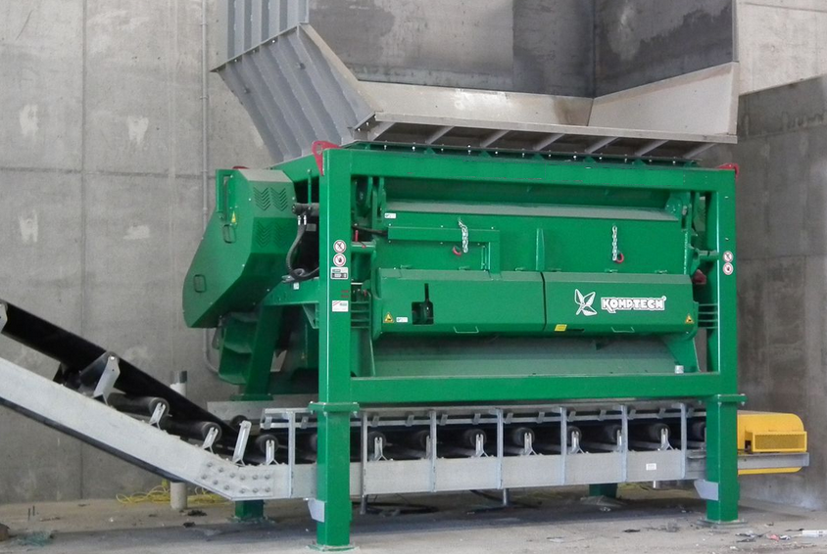
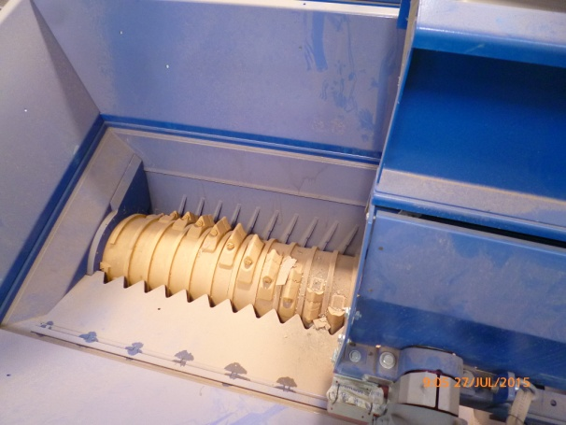
Sorting Techniques
Bag opener
Effect: Gentle shredding used to release the waste content from closed (plastic) bags
Reason: To enable sorting in the subsequent treatment steps
www.komptech.com

Slide 10
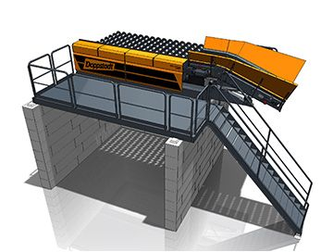
Sorting Techniques
Pre-separation screen (typically at 250-300 mm)
Effect: Separation of oversized materials
Reason: To remove bulky materials not suitable for treatment and to recover larger pieces of recyclable materials that have a selling value
www.albg.eu

Slide 11
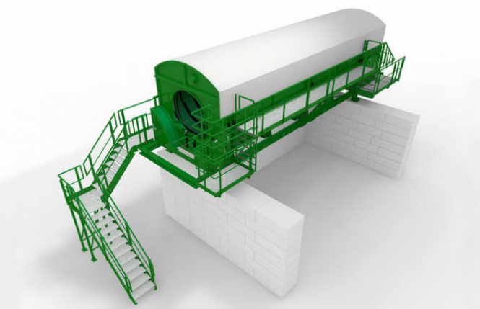
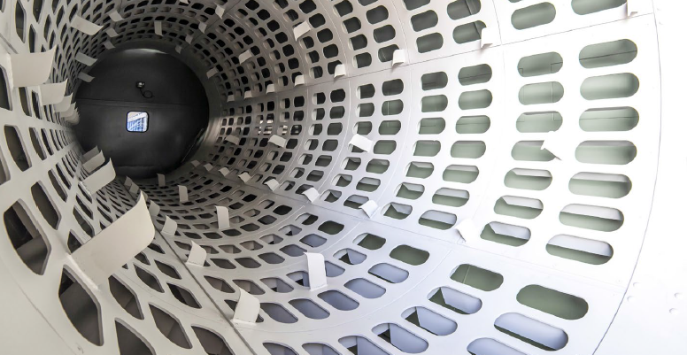
Sorting Techniques
Drum Screen (typically at 80 mm)
Effect: Separation of fine material
Reason: Fine material consists mainly of organics. They are separated in order not to stress the RDF sorting equipment and to be treated eventually with composting or anaerobic digestion
www.biannarecycling.com.com
www.komptech.com

Slide 12
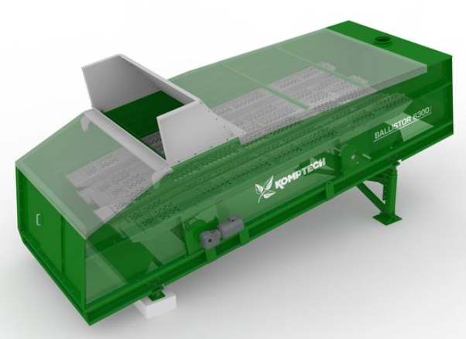
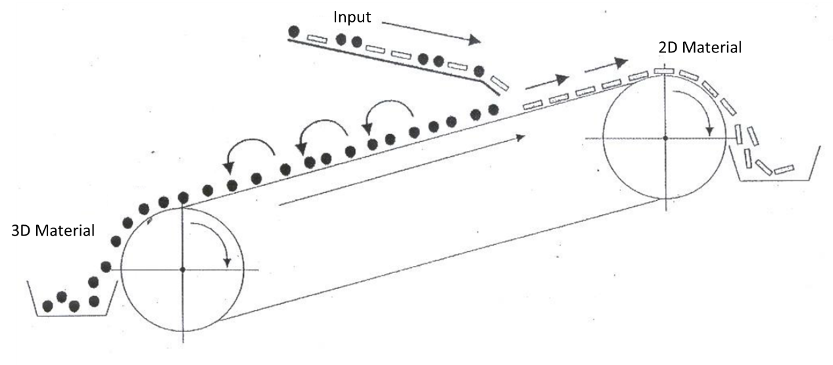
Sorting Techniques
Ballistic separator
Effect: Separates 2D (e.g. paper) and 3D (plastic bottles) material
Reason: 2D fraction consists mainly of high calorific materials. 3D fraction consists mainly of recyclables (e.g. metals).
www.komptech.com
Pretz, IAR, RWTH Aachen

Slide 13
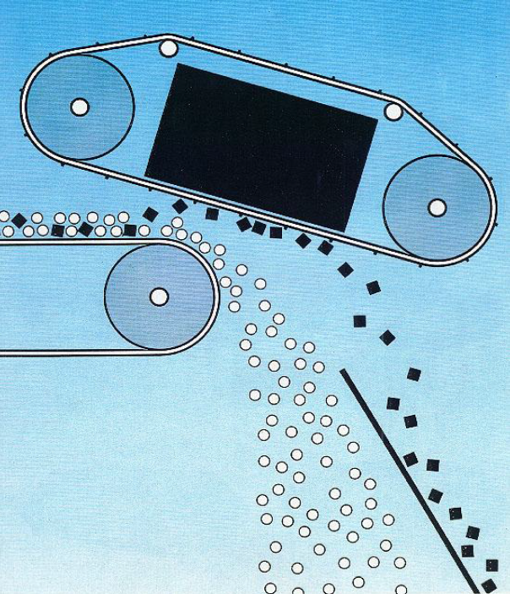
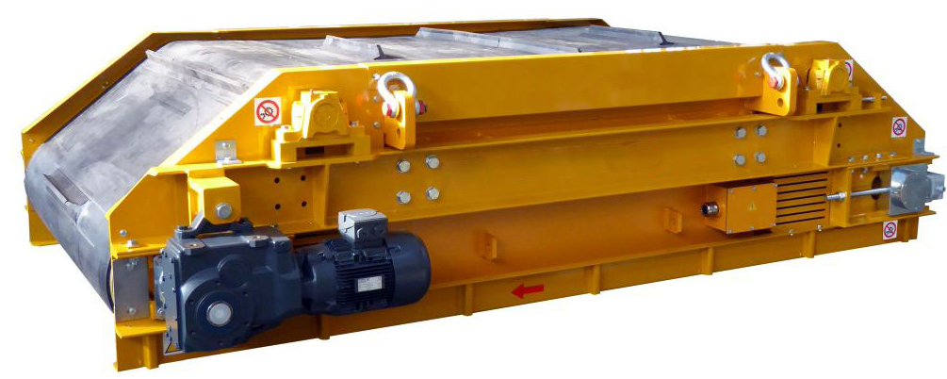
Sorting Techniques
Magnetic separator
Effect: Separates ferrous metals
Reason: Ferrous metals have a good value as recyclable materials
www.pro-tech-con.com
Pretz, IAR, RWTH Aachen

Slide 14
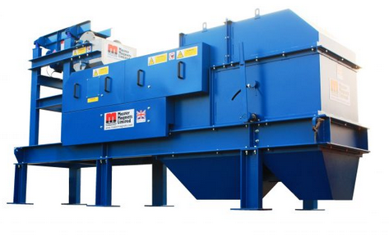
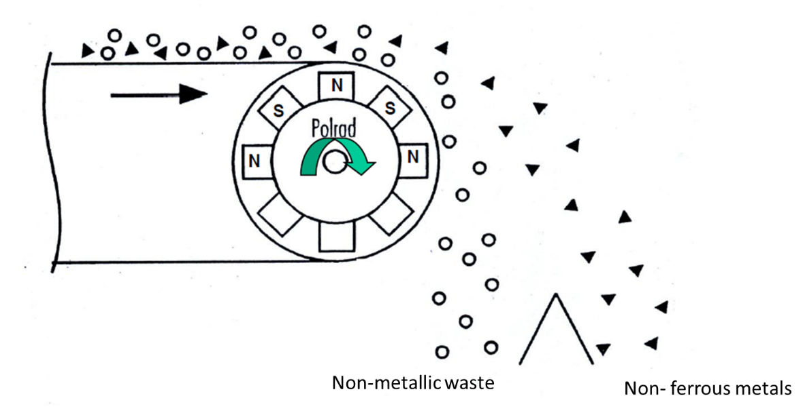
Sorting Techniques
Eddy – Current Separator
Effect: Separates non-ferrous metals
Reason: Non-ferrous metals have a good value as recyclable materials
www.mastermagnets.com
Pretz, IAR, RWTH Aachen

Slide 15
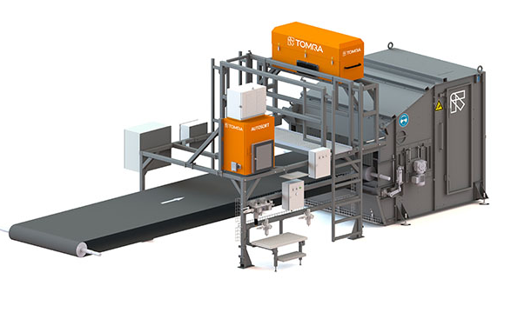
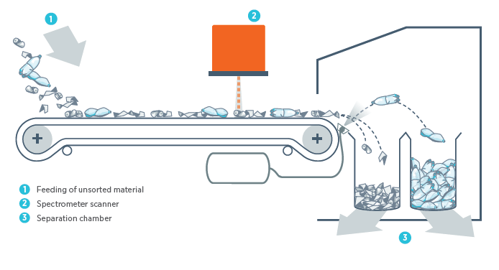
Sorting Techniques
NIR – Optic Separator
Effect: Separates specific materials
Reason: To sort specific types of recyclables (e.g. PET, PE) or to remove materials that reduce the quality of RDF (e.g. PVC)
www.tomra.com

Slide 16
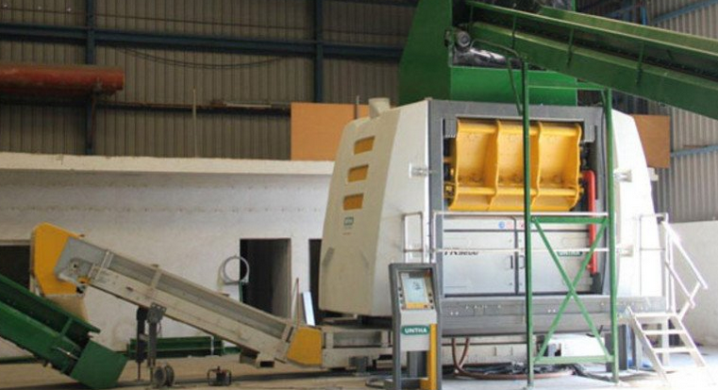
Sorting Techniques
RDF Shredder
Effect: Reduces the size of the calorific fraction destined for RDF
Reason: To meet the size specifications of the end user (e.g. incineration plant)
www.untha.com

Slide 17
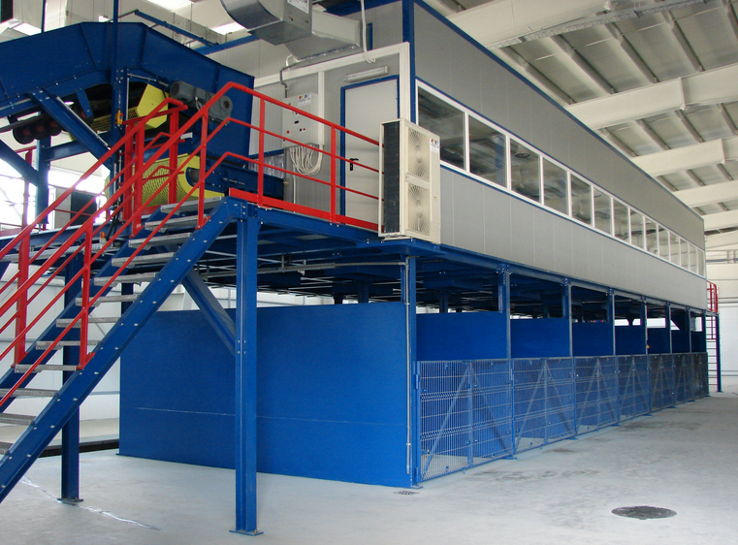
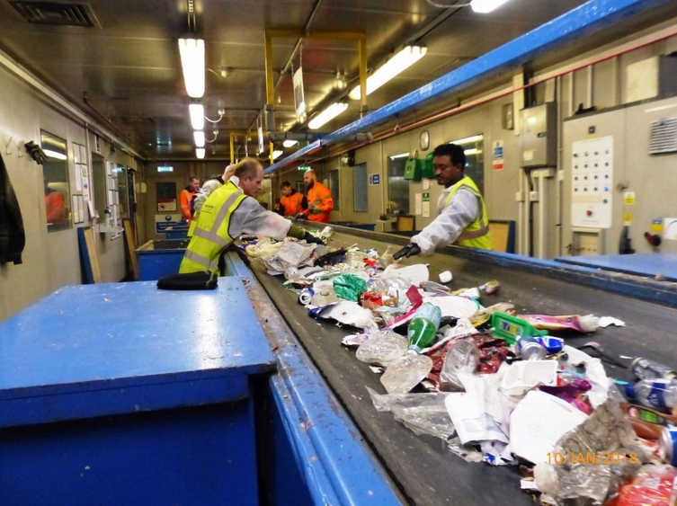
Sorting Techniques
Sorting cabin
Effect: Target materials are removed manually from the waste stream
Reason: To separate recyclables or to remove impurities
www.adarco.ro
www.puttingwastetogooduse.co.uk

Slide 18
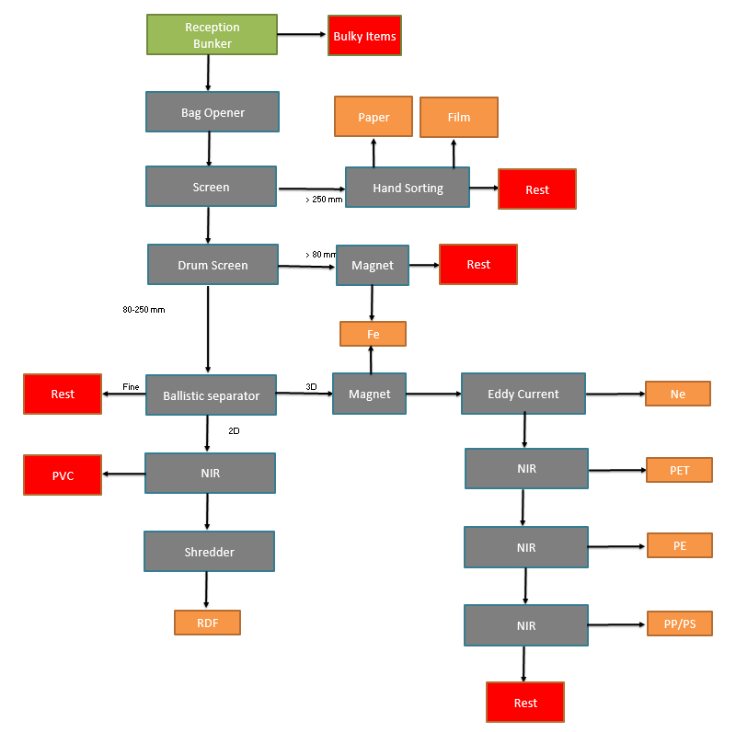
Composting
Anaerobic digestion

Slide 19
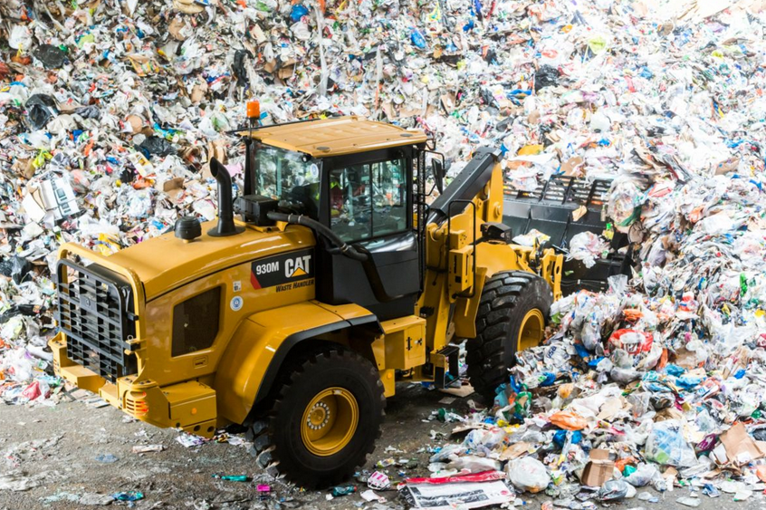
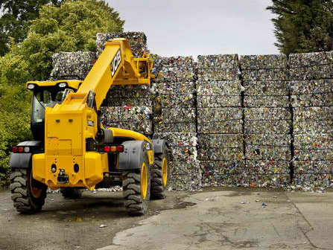
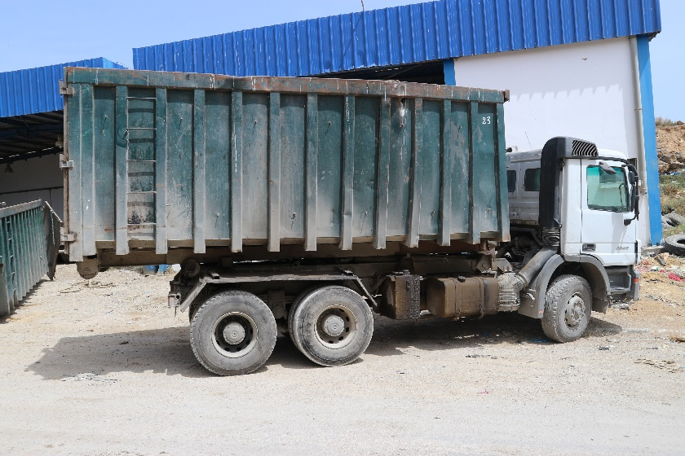
MOBILE EQUIPMENT
Wheel loaders
Telescopic handlers
Trucks

Slide 20
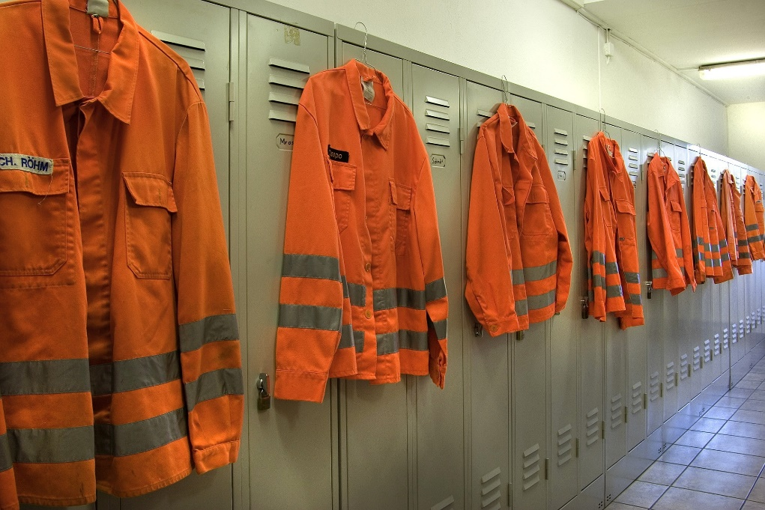
PERSONNEL
Director
Operations foreman
Administrative personnel
Drivers
Mechanic
Electrician
General workers
www.abfallbild.de

Slide 21
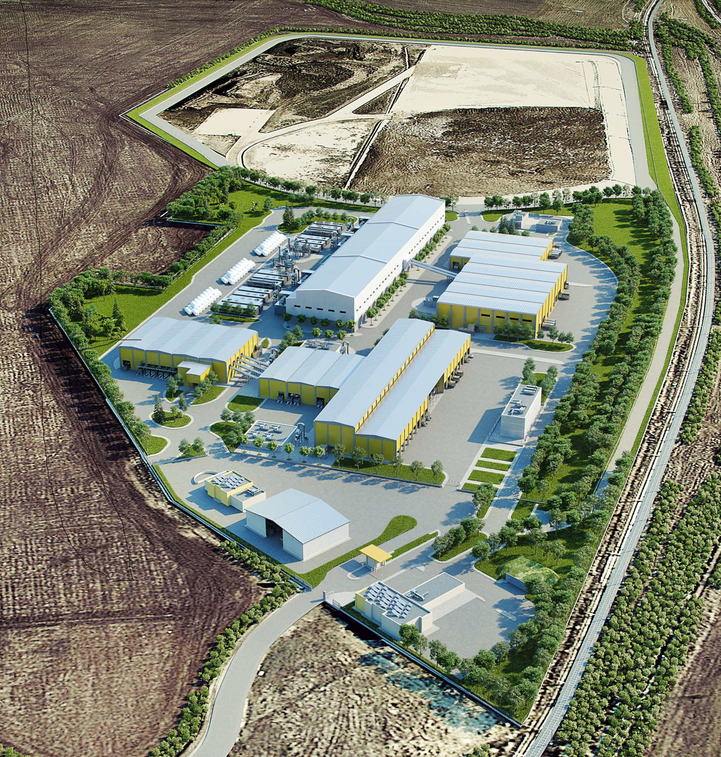
EXAMPLE SORTING PLANT WITH BIOLOGICAL TREATMENT
1. Reception
2. Sorting
3. Biodrying
4. RDF Production

Slide 22
UTILITIES
Electricity supply
Water supply
Security (fence etc)
Fire protection
Paved areas
Buildings
Flood protection
Green areas

Slide 23
Project Stages
Pre-Feasibility Study – Site Selection
Feasibility Study
Permit application (environmental & other)
Financial arrangements
Detailed Design
Tender Documents
Procurement
Site clearance and construction works
Test period

Slide 24
SORTING PLANT IN A WASTE MANAGEMENT SYSTEM
Sorting Plant
Waste Collector
RDF Utilization
Recyclable sales
Landfill

Slide 25
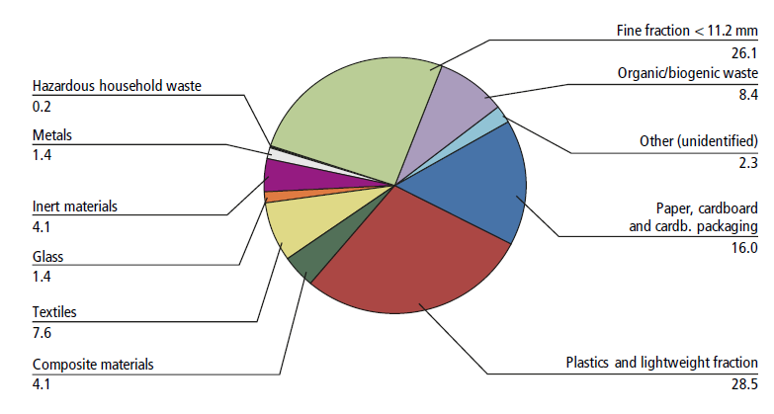
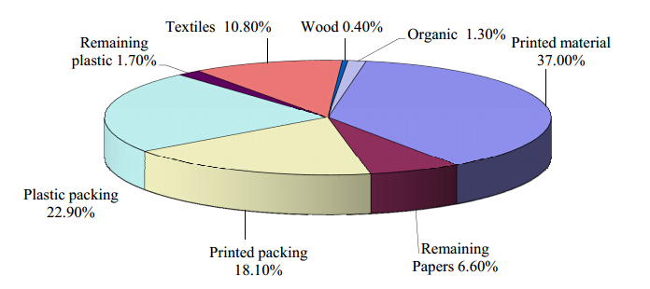
RDF
RDF stands for Refuse Derived Fuel
Sarc, R.; Lorber, K.E.; Pomberger
Athens MBT

Slide 26
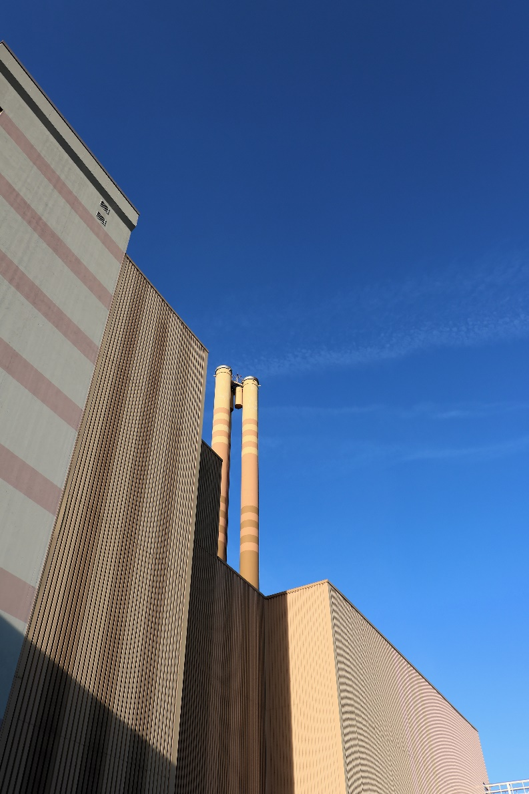
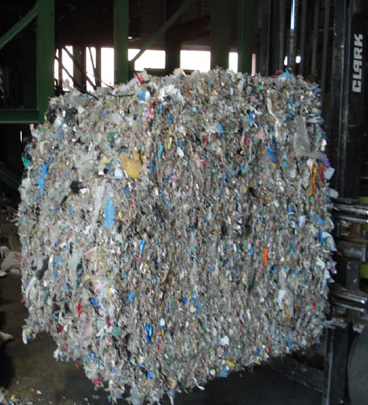
Utilization of RDF
Municipal solid waste incinerators
Cement plants
Co-firing with coal at power stations
Advanced thermal treatment technologies
(pyrolysis/gasification)
Athens MBT
www.abfallbild.de

Slide 27
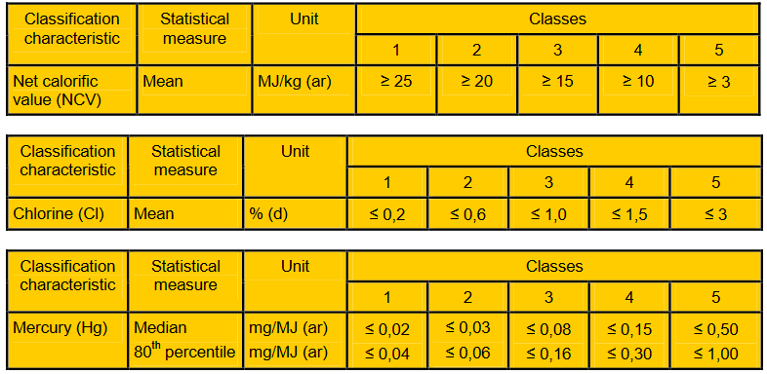
SRF & RDF
SRF is intentionally produced with respect of quality criteria
RDF is a fraction remaining from waste treatment operations
  EN 15359

Slide 28
Why not incinerate mixed waste directly?
Better energy efficiency
RDF is a homogeneous material
Easier to handle & transport
Lower emissions

Slide 29
BENEFITS FROM THE UTILIZATION OF RDF
Substitution of natural resources
Saving of landfill space (at least 15% by weight of incoming MSW turned into RDF)
Greenhouse gas emission saving (350-1000 kg CO₂ eq./ton)

Slide 30
Christos Venetis
venetis@icp-ing.de
www.icp-ing.de
Thank you very much for your attention!

