Slide 1
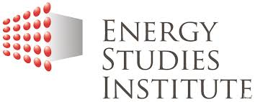

Managing Oil Revenue in the Caspian Region: Azerbaijan and Kazakhstan
Dr. Dina Azhgaliyeva
2018 GSPP CONFERENCE ON CONTEMPORARY ISSUES IN PUBLIC ADMINISTRATION IN POST-SOVIET EURASIA
Astana
5 – 6 OCTOBER 2018

Slide 2

Vision
To be the leading institute for strategic research and a global thought leader in energy policy.
Mission
To conduct research on energy policies and their national, regional and global implications.
To promote discussion and advance collective understanding on issues related to energy policy development.

Slide 3
OUTLINE
Motivation
What is oil revenue fund?
Funds’ objectives?
Literature review: Are oil revenue funds effective?
Theoretical model
Empirical model
  Data
  Model specification
  Results and limitations

Slide 4
The curse of natural resources
“Countries with great natural resource wealth tend nevertheless to grow more slowly than resource-poor countries” (Sachs and Warner, 2001).
Why?
Oil-rich countries suffer from volatile and unpredictable oil revenue movements (Sachs and Warner, 2001).
The quality of institutions and governance matters (Mehlum et al. 2006, Collier 2007).
What can be done in such countries?

Slide 5
Suggested solutions
Keep oil underground (Stiglitz, 2007);
Distribute oil revenue among citizens(Morrison, 2007);
Keep oil revenue out of hands of Government. Place it in a separate fund and having Government commit to use this fund in certain ways (Morrison, 2010).

Slide 6
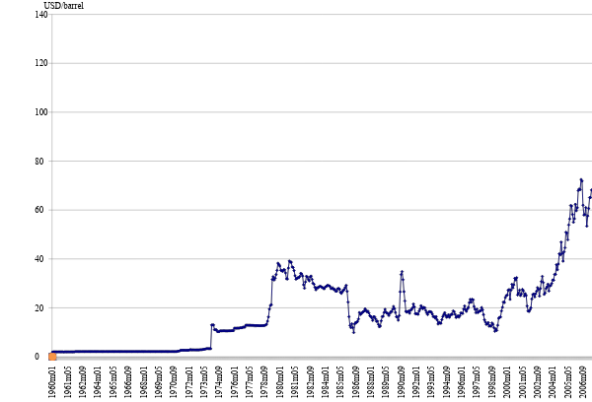
Oil price and establishment of funds
Source of data: 1960-1984 UNCTAD, 1985-May 2010 IMF
Bahrain
Libya
Oman
Qatar
East Timor
Nigeria
Algeria
Kazakhstan
Trinidad
Azerbaijan
Iran
Venezuela
Kuwait
Sausi Arabia
Canada,
UAE,
Alaska
Brunei
Norway
Russia
Oil price

Slide 7
Oil reserves and establishment of funds
Country | Oil reserves, bln barrels | World share | Fund established
Saudi Arabia | 264.6 | 19.85% | 1958
Venezuela | 172.3 | 12.92% | 1998
Iran | 137.6 | 10.32% | 1999
Iraq | 115 | 8.63% | 2003
Kuwait | 101.5 | 7.61% | 1960
UAE | 97.8 | 7.34% | 1976
Russia | 74.2 | 5.57% | 2004
Libya | 44.3 | 3.32% | 2006
Kazakhstan | 39.8 | 2.99% | 2000
Nigeria | 37.2 | 2.79% | 2004
Canada | 33.2 | 2.49% | 1976
USA alaska | 28.4 | 2.13% | 1976
Qatar | 26.8 | 2.01% | 2005
Algeria | 12.2 | 0.92% | 2000
Mexico | 11.7 | 0.88% | 2000
Norway | 7.1 | 0.53% | 1990
Azerbaijan | 7 | 0.53% | 1999
Ecuador | 6.5 | 0.49%
India | 5.8 | 0.44%
Oman | 5.6 | 0.42% | 1980
Egypt | 4.4 | 0.33%
UK | 3.1 | 0.23%
Argentina | 2.5 | 0.19%
Colombia | 1.4 | 0.11%
Trinidad | 0.8 | 0.06% | 2000
Bahrain | 0.1 | 0.01% | 2006
Netherlands | 0.1 | 0.01%

Slide 8
WHAT IS OIL REVENUE FUND?

Slide 9
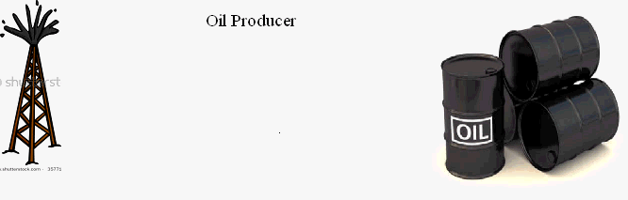
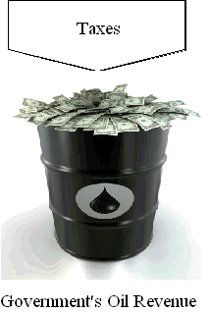
Oil producer
Government
oil revenue

Slide 10
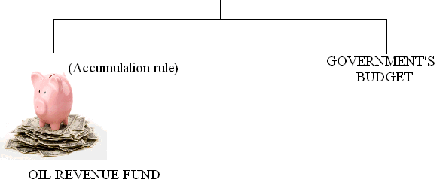

Oil revenue
Oil revenue fund
Government expenditure

Slide 11



Saving fund
Stabilization fund

Slide 12
FUNDS’ OBJECTIVES
Stabilization of exchange rate
Stabilization of government expenditure
Saving for future generations

Slide 13
Objective:
Stabilization of exchange rate
Countries sterilize oil revenue by taking oil revenue during booms away from spending in a domestic country because it will cause real appreciation of domestic currency and save it abroad and then spend it slowly.
Funds can smooth exchange rates by sterilizing foreign currency when invest abroad (cut the link between exchange rates and oil revenues).

Slide 14
ARE OIL REVENUE FUNDS EFFECTIVE?
Authors | Dependent variable | Independent variable | Fund variable | Results
Ilahi and Shabsigh (2007) | REER (volatility) | Oil exports, oil prices | Fund exist | No effect
Hart (2010) | REER | Terms of trade | Fund exist, Fund size | Negative effect
Devis and others (2001) | Government expenditure | Non-renewable resource export earnings per capita | Fund exist | No effect
Crain and Devlin (2003) | Government expenditure (volatility) | Oil exports | Fund exist, Fund size | No effect overall, but effective in some countries
Ossowski and others (2008) | Government expenditure | Balance | Fund exist | No effect

Slide 15
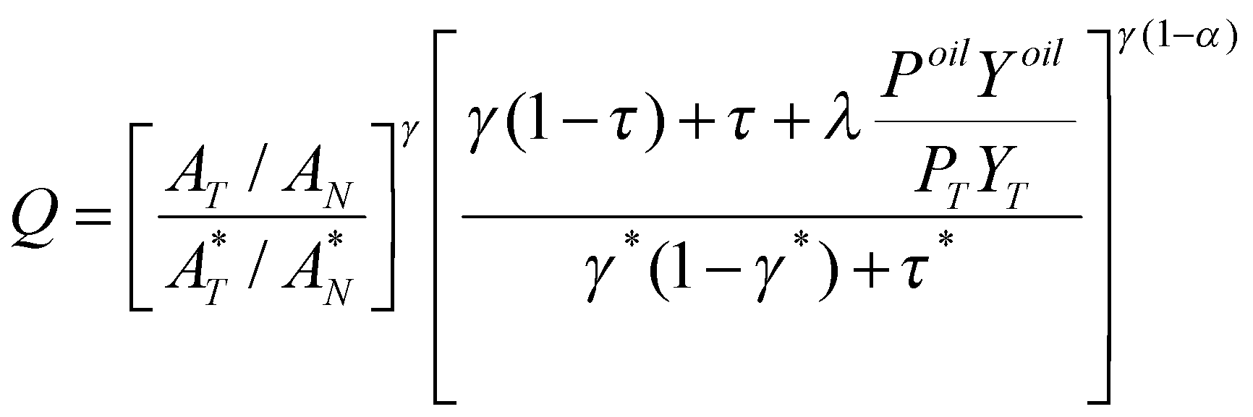
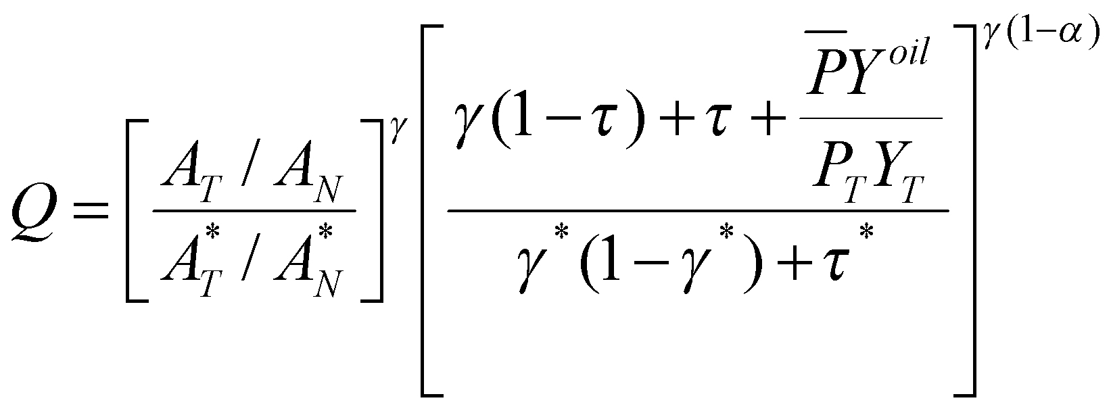
Theoretical model
Effect of oil revenue on exchange rate
Saving fund
Stabilisation fund

Slide 16
Data for Oil Revenue Funds
Country | Data sources
Azerbaijan | State oil fund www.oilfund.az
Kazakhstan | Ministry of finance www.minfin.kz, National bank www.nationalbank.kz
All | Sovereign wealth fund institute www.swfinstitute.org

Slide 17
DATA PROPERTIES
Country | Oil | Log(REER) | Cointegration
Kazakhstan | I(1) | I(1) | CI
Azerbaijan | I(1) | I(0) | CO
I(0) stationary
I(1) nonstationary
CI cointegration
CO no cointegration

Slide 18
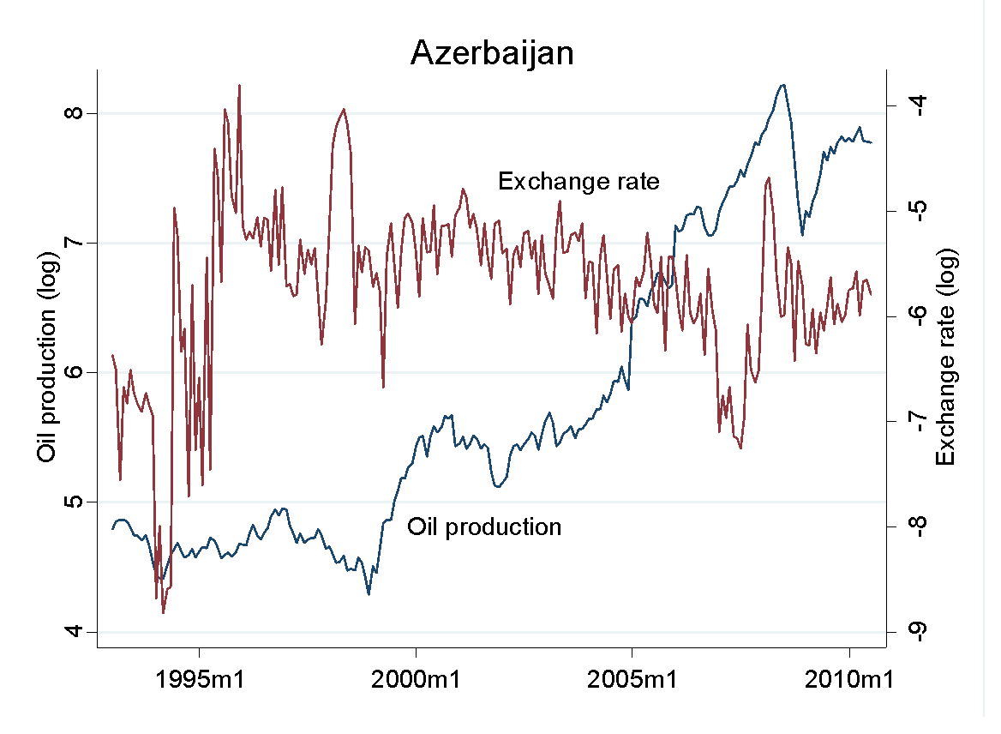

Slide 19
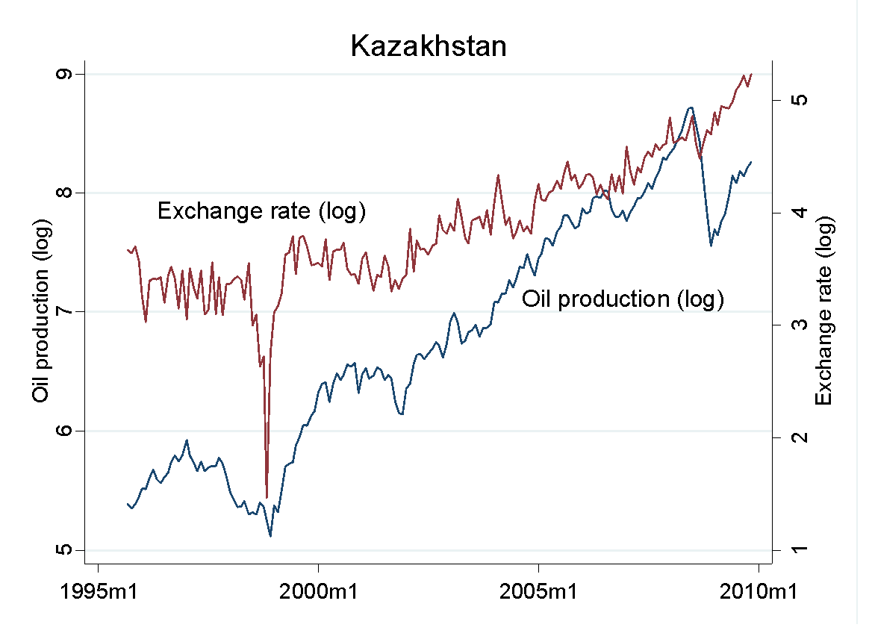

Slide 20
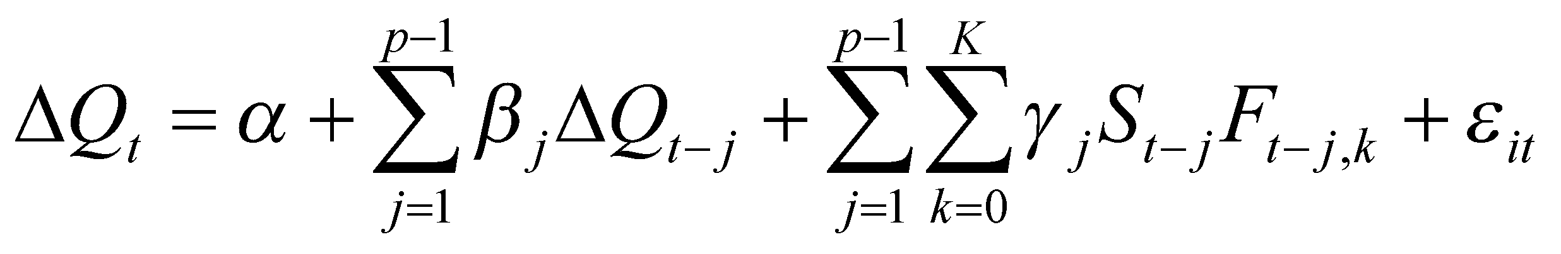
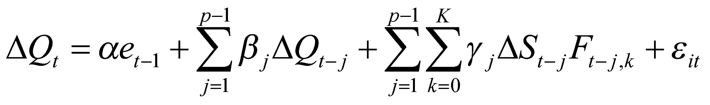
EMPIRICAL MODELS
Only REER is nonstationary (Azerbaijan):
REER and oil are cointegrated ECM (Kazakhstan):
Where Q is a log of real effective exchange rate, S is a ratio of the value of oil produced to total export, F is a dummy variable of the fund existence (fund exists=1) and fund’s rules such as accumulation rules and investment.

Slide 21
Results
REER (log of 1st difference) | Azerbaijan | Kazakhstan
REER (log of 1st difference) | -0.438*** | -0.392***
Oil production | -0.022 | -0.444*
Fund (interaction term) | -0.024 | 0.358*
Error correction term |  | -0.003
Constant | 0.131 | 0.009
Sample size | 149 | 169
R-squared | 0.225 | 0.228
F-statistics | 43** | 48***

Slide 22
Results
Both funds in Azerbaijan and in Kazakhstan were not effective in stabilizing exchange rates.
After the establishment of fund in Kazakhstan exchange rates became even more correlated with oil

Slide 23






THANK YOU
Dr. Dina Azhgaliyeva
esida@nus.edu.sg
+65 65 166 752
esida@nus.edu.sg
https://www.linkedin.com/in/dina-azhgaliyeva-7800b891
http://esi.nus.edu.sg/about-us/our-researchers/dina-azhgaliyeva
Green Finance/Investment
Green FinTech

