Slide 1
Properties of Hybrid Fibers Reinforced Engineered Geopolymer Composite Containing GGBFS and Non-conventional Fly Ash
Presenter: Zhanbolat Artyk
Supervisors: Dichuan Zhang and Chang-Seon Shon

Slide 2
Presentation Outline
Introduction
Literature Review
Experimental Program
Results and Discussion
Conclusions

Slide 3
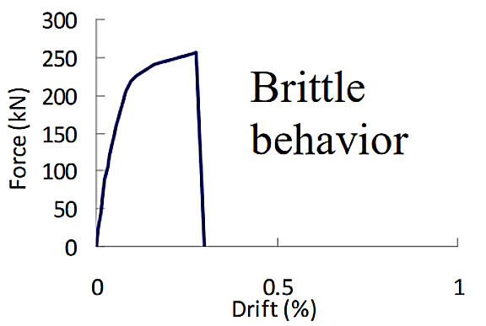
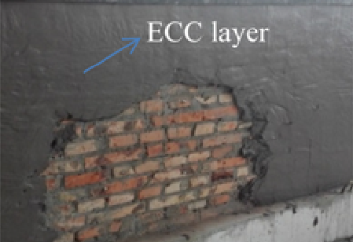
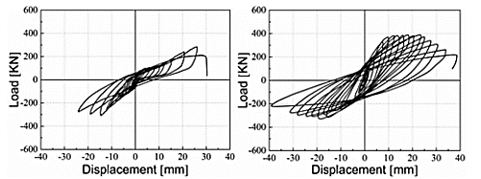
Introduction
Masonry wall behavior
Masonry structures are brittle when subjected to tension.
The likelihood of large earthquakes near the Almaty region is high.
More than 30% of buildings in the Almaty region are unreinforced masonry structures.
Among available methods, engineered cementitious composite (ECC) can improve both strength and ductility of a structure.
ECC is fiber-reinforced composite and exhibits multiple cracking and strain hardening behavior under tension.
The stress of ECC rises or remains constant under tension as strain increases after the first fracture initiation.
Unreinforced Wall
Reinforced with ECC
3

Slide 4
Introduction
ECC has a high dosage of ordinary Portland cement in its composite.
Engineered geopolymer composite (EGC) is seen to be a possible alternative.
Geopolymer, an inorganic polymer made by alkali-activating industrial byproducts such as fly ash and GGBFS, is used as the binder of EGC.
By 2017, Kazakhstan was producing 19 million tons of fly ash annually, while the nation's stockpiles of coal fly ash had grown to 300 million tons.
Local fly ash is categorized as non-conventional fly ash.
Oiled Polyvinyl Alcohol (PVA) fibers are expensive and produced by Kuraray Co., Ltd Japan.
The thermal conductivity of the ECC with a normal weight is significantly higher than that of the ECC with a lightweight fill.

Slide 5
Introduction
Aim
  To develop multifunctional EGC containing non-conventional fly ash and GGBFS reinforced with hybrid Polyvinyl Alcohol (PVA), Polypropylene (PP), and steel fibers.
Objectives
  Investigate the drying shrinkage for the EGC mixed with non-conventional fly ash and GGBFS.
  Investigate the strength and ductility of the EGC mixed with non-conventional fly ash and GGBFS.
  Investigate the thermal conductivity for the EGC mixed with non-conventional fly ash and GGBFS.
  Evaluate the synergistic effect of different fibers on the properties of EGC.
Research hypothesis
  The use of non-conventional fly ash with GGBFS can produce engineered geopolymer composite with required strength and ductility.
  Mixing of different fibers in the EGC can have a synergistic effect for a better performance.
  Using the lightweight aggregate can improve the thermal conductivity performance.

Slide 6
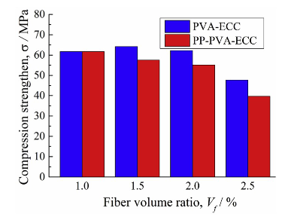
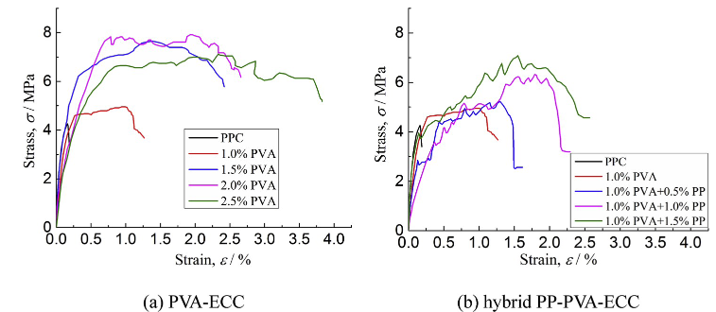
Literature Review
Compressive strength
Engineered cementitious composite: PVA and PP
Lin et al. (2020), studied static and dynamic properties (compression, tensile and impact resistance) of the PP-PVA-ECC and compared with those of PVA-ECC.
The compressive strength decreased as the PP fiber increased.
Increasing PVA fiber content increased both tensile strength and strain.
Replacing PVA fiber with PP fiber decreased both tensile strength and strain.
Tensile properties

Slide 7
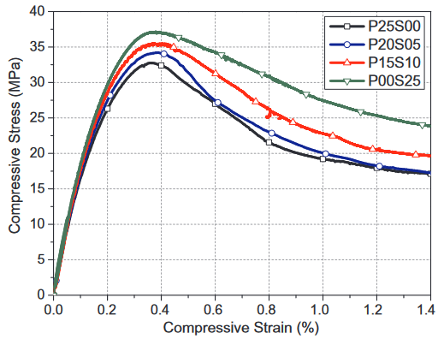
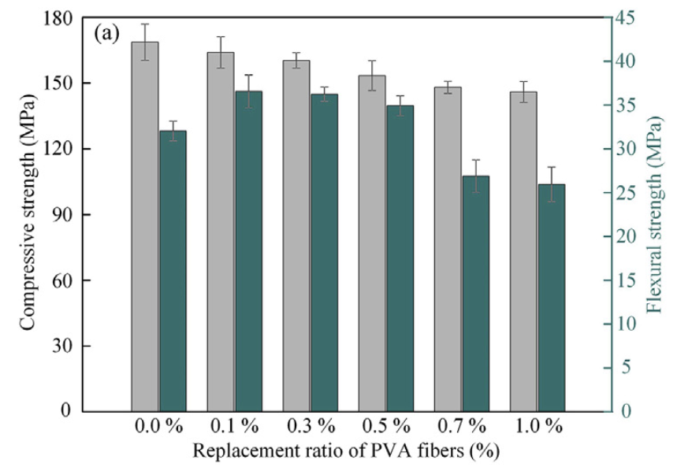
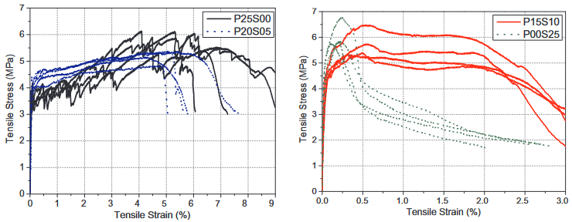
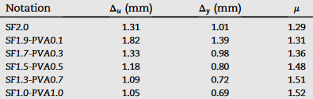
Literature Review
Compressive strength
Engineered cementitious composite: PVA and steel
Yu et al. (2019) comprehensively studied mechanical performance of ECC reinforced with hybrid PVA-steel fibers under compression, tension, static three-point bending and cyclic four-point bending.
Wei et al. (2021) analyzed compressive strength, flexural strength, and ductility of cementitious composite reinforced with hybrid PVA-steel fibers.
Increasing steel fiber dosage in the ECC enhanced the compressive strength.
Increasing steel fiber content decreased tensile strain capacity.
Tensile properties

Slide 8
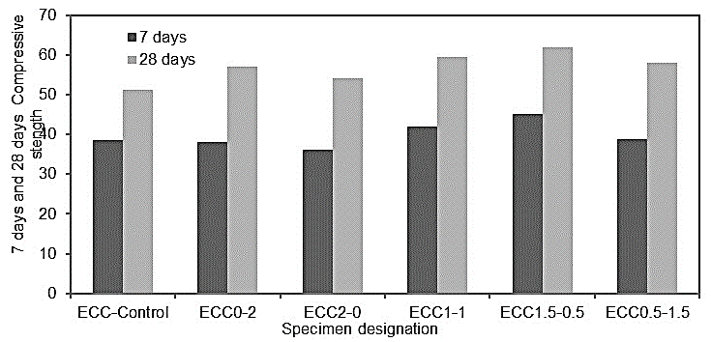
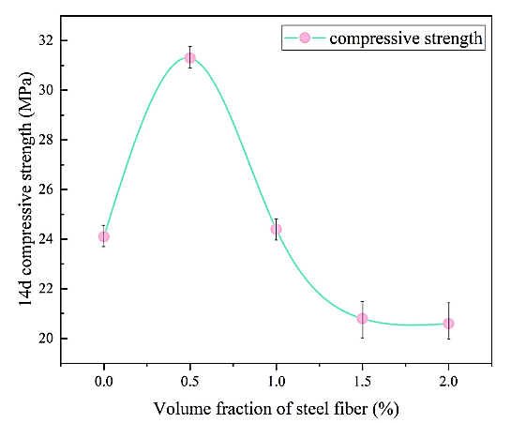
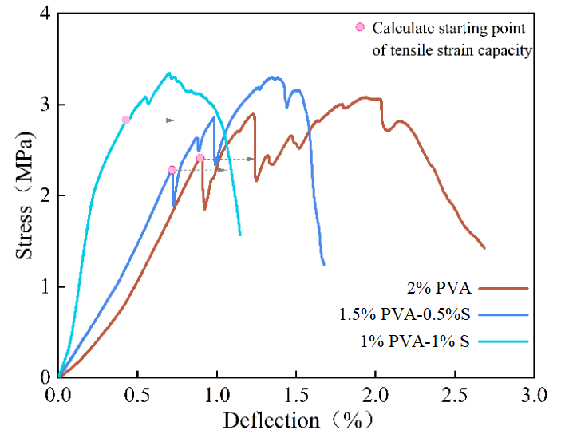
Literature Review
Engineered cementitious composite: PVA and steel
Sridhar and Prasad (2019) studied the behavior of ECC reinforced with hybrid PVA-steel fibers accompanied by compressive, flexural and uniaxial tensile strength.
Li et al. (2022) developed high-ductility cementitious composite reinforced with PVA and steel fiber. The compressive strength, tensile, and bending properties were analyzed.
The composites reinforced with 1.5%PVA-0.5%PP had the maximum compressive strength.
Adding steel fiber decreased tensile strain.
Compressive strength
Tensile properties

Slide 9
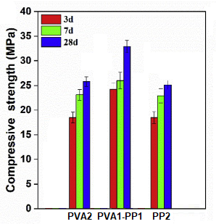
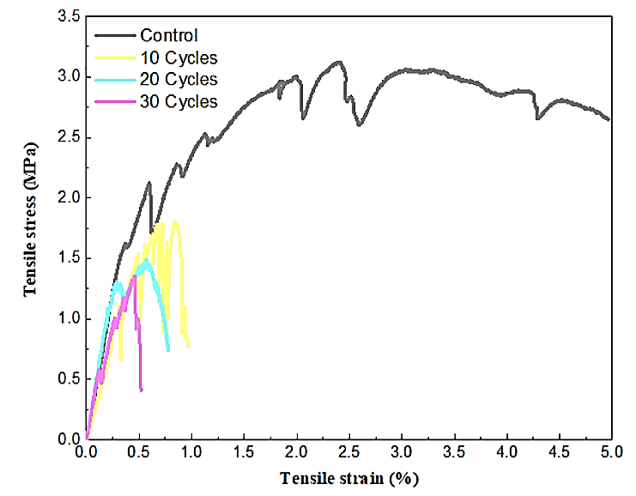
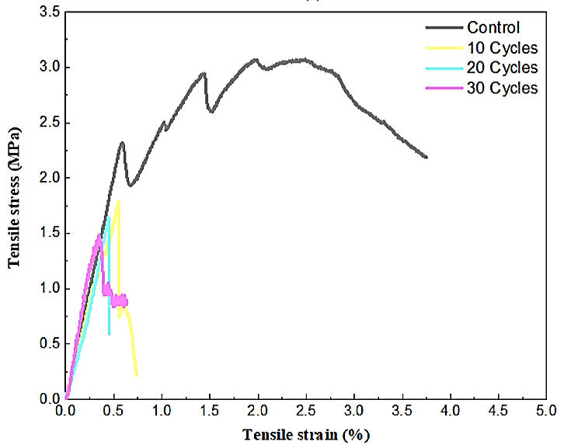
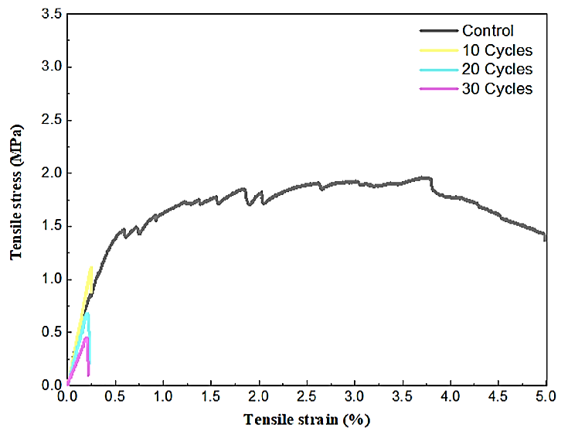
Literature Review
Compressive strength
Engineered geopolymer composite: PVA and PP
Guo et al. (2020) studied the compressive and flexural strength of metakaolin activated EGC containing class F fly ash and GGBFS. As reinforcement unoiled PVA and PP fibers were used.
Humur and Cevik (2022) analyzed the effect of hybrid PVA-PP fibers on compressive, flexural, and tensile properties EGC containing class F fly ash and GGBFS.
The composites reinforced with 1% PVA-1% PP had the maximum compressive strength.
Adding PP fiber decreased the tensile strength; however, increased the tensile strain.
There is no research on EGC containing non-conventional fly ash and reinforced with PVA, PP, and steel fibers.
Tensile properties
2% PVA
1% PVA – 1% PP
2% PP

Slide 10
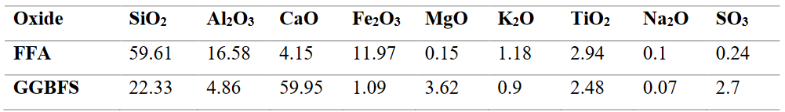
Experimental Program
Material properties: Cementitious materials
Chemical composition of FA and GGBFS.
Fly ash is classified as Class F.
Local fly ash is coarser and does not satisfy the Strength activity index.
GGBFS meets both requirements.

Slide 11
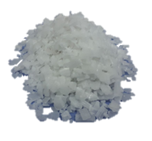
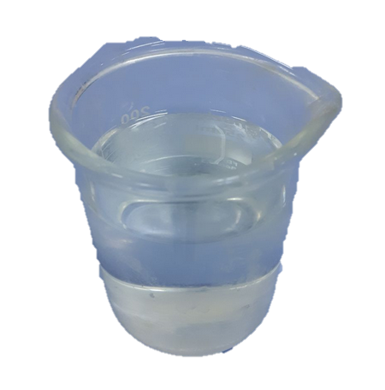
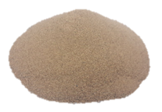
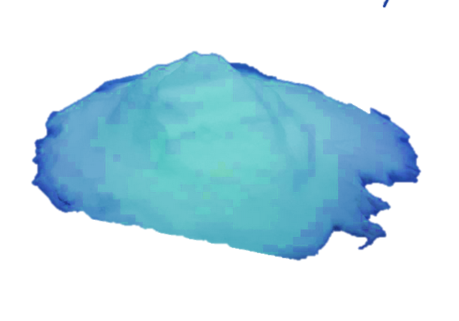
Experimental Program
Material properties: Alkaline Activator Solution
A combination of sodium silicate (Na2SiO3) and sodium hydroxide (NaOH) was used as an alkaline activator solution. The molarity of sodium hydroxide was 12M. The ratio between sodium silicate to sodium hydroxide was 2.5.
Material properties: Aggregate properties
As an aggregate quartz sand from local pit and hollow micro glass bubbles (HMGB) supplied from 3M company were used. The maximum grain size of the sand and HMGB were 0.6mm and 0.06mm, respectively.

Slide 12
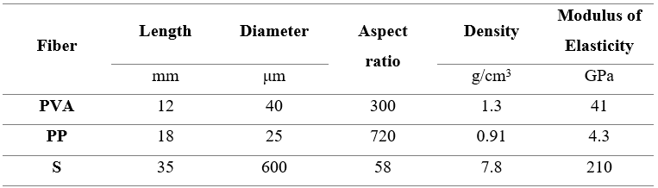
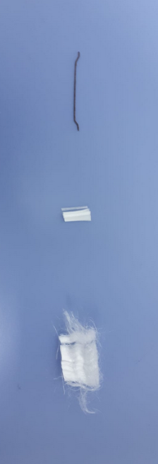
Experimental Program
Material properties: Fiber properties
a)
a)
a)
b)
b)
b)
c)
c)
a)
b)
c)
c)

Slide 13
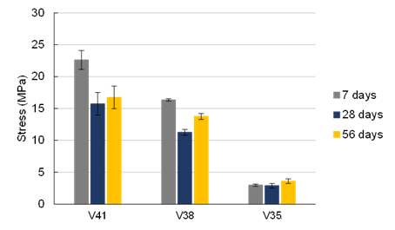
Experimental Program
Mixture proportions of EGC matrix
The matrix proportion was obtained from a previous research. Based on the compressive strength, mixture V41 was selected to develop EGC.
Mix ID | Binder |  | Activator/binder | w/b | Sand/binder | SP/binder
 | FA | GGBFS
Matrix | 0.5 | 0.5 | 0.35 | 0.38 | 0.36 | 0.01

Slide 14
Experimental Program
Mixture proportions of EGC containing normal weight aggregate (Study I)
Mix ID | Binder |  | Activator/binder | w/b | Sand /binder | SP/binder | PVA (vol%) | PP (vol%) | S (vol%)
 | FA | GGBFS
P2PP0S0 | 0.5 | 0.5 | 0.35 | 0.38 | 0.36 | 0.01 | 2 | 0 | 0
P0PP2S0 | 0.5 | 0.5 | 0.35 | 0.38 | 0.36 | 0.01 | 0 | 2 | 0
P0PP0S2 | 0.5 | 0.5 | 0.35 | 0.38 | 0.36 | 0.01 | 0 | 0 | 2
P1.5PP0.5S0 | 0.5 | 0.5 | 0.35 | 0.38 | 0.36 | 0.01 | 1.5 | 0.5 | 0
P1.5PP0S0.5 | 0.5 | 0.5 | 0.35 | 0.38 | 0.36 | 0.01 | 1.5 | 0 | 0.5
P1PP1S0 | 0.5 | 0.5 | 0.35 | 0.38 | 0.36 | 0.01 | 1 | 1 | 0
P1PP0S1 | 0.5 | 0.5 | 0.35 | 0.38 | 0.36 | 0.01 | 1 | 0 | 1
P1PP0.5S0.5 | 0.5 | 0.5 | 0.35 | 0.38 | 0.36 | 0.01 | 1 | 0.5 | 0.5
The mix code P1PP0.5S0.5 means that the mix includes 1% PVA fibers, 0.5% PP fibers, and 0.5% steel fibers.

Slide 15
Experimental Program
Mixture proportions of EGC containing lightweight aggregate (Study II)
Mix ID | Binder |  | Activator /binder | w/b | Sand /binder | HMGB (vol%) | SP/binder | PVA (vol%) | PP (vol%) | S (vol%)
 | FA | GGBFS
P2PP0S0B10 | 0.5 | 0.5 | 0.35 | 0.38 | 0.1 | 10 | 0.01 | 2 | 0 | 0
P1.5PP0.5S0B10 | 0.5 | 0.5 | 0.35 | 0.38 | 0.1 | 10 | 0.01 | 1.5 | 0.5 | 0
P1.5PP0S0.5B10 | 0.5 | 0.5 | 0.35 | 0.38 | 0.1 | 10 | 0.01 | 1.5 | 0 | 0.5
P1PP0.5S0.5B10 | 0.5 | 0.5 | 0.35 | 0.38 | 0.1 | 10 | 0.01 | 1 | 0.5 | 0.5
The mix code P1PP0.5S0.5B10 means that the mix reinforced with 1% PVA fibers, 0.5% PP fibers, and 0.5% steel fibers; and contains 10% HMGB in volume fracture.

Slide 16
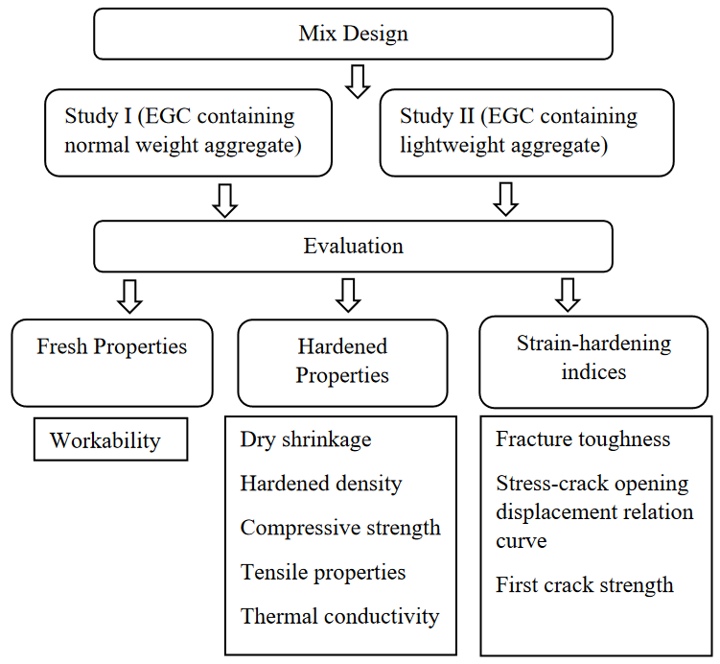
Experimental Program
Study I evaluates the fiber hybridization effect on EGC properties containing normal weight aggregate.
Study II evaluates the HMGB effect on EGC properties.

Slide 17
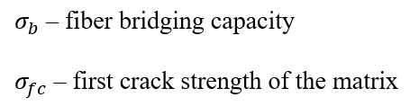


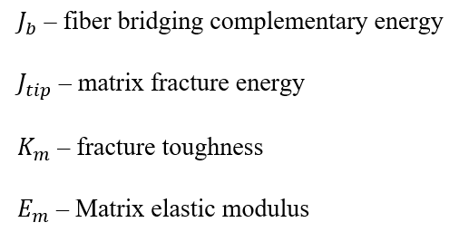


Experimental Program
Strain-hardening behavior
To exhibit strain-hardening behavior, the following criteria should be met.
Strength criterion:
Energy criterion:

Slide 18
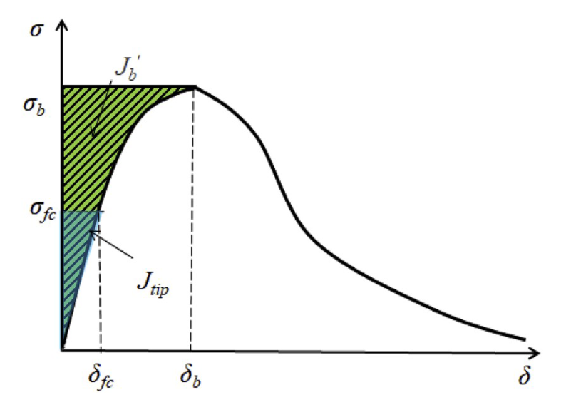
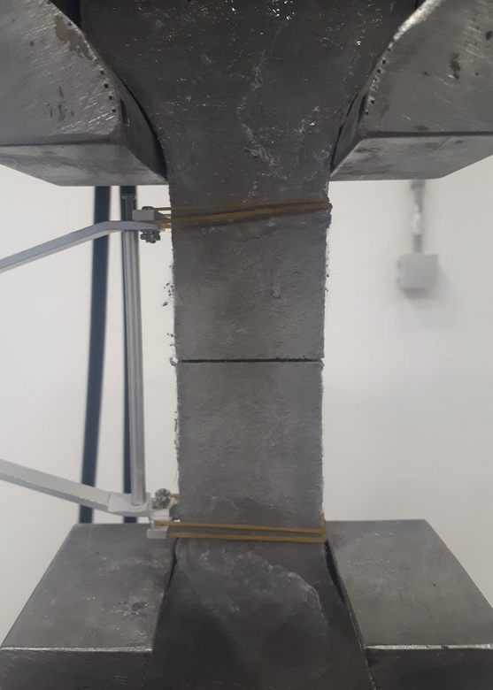
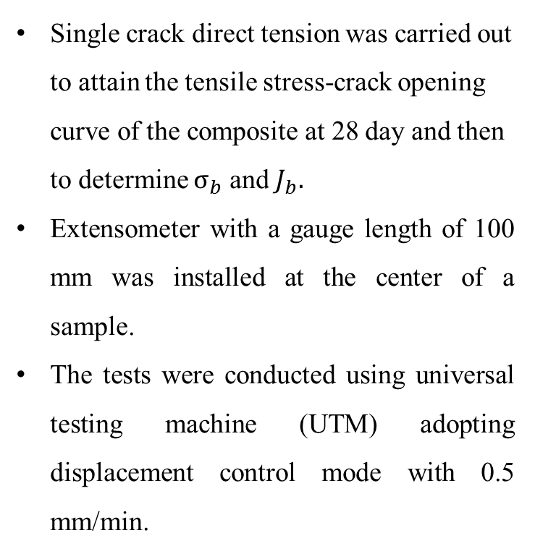
Experimental Program
Strain-hardening indices
Single crack direct tension was carried out to attain the tensile stress-crack opening curve of the composite at 28 day and then to determine $σ_{b}$ and $J_{b}.$
Extensometer with a gauge length of 100 mm was installed at the center of a sample.
The tests were conducted using universal testing machine (UTM) adopting displacement control mode with 0.5 mm/min.
Typical stress-crack opening curve.
P2PP0S0
Single crack tension test.
Obtained stress-crack opening curve.

Slide 19
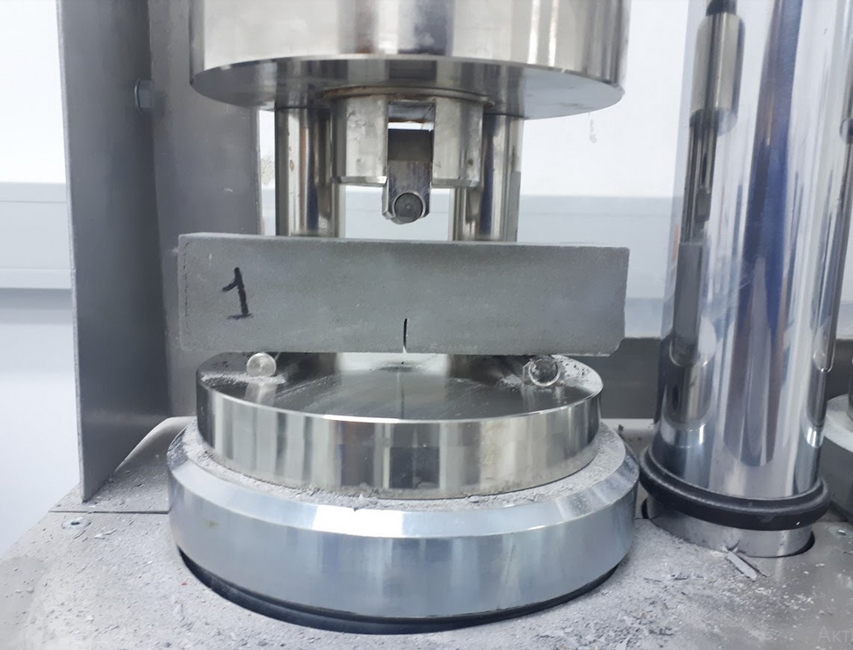
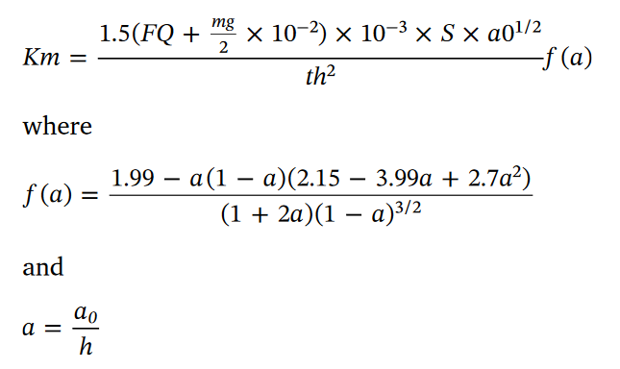
Experimental Program
Strain-hardening indices
To obtain $K_{m}$, three-point bending test was performed on the 40 mm × 40 mm × 160 mm (t x h x S) prismatic specimen with a notch (a0 = 12mm) at 28 day. $K_{m}$ can be calculated using the following equations.
Three-point bending test on a notched beam.

Slide 20
Results and Discussion (Study I)
Flowability
PVA and PP
PVA and Steel
PVA, PP, and Steel
Adding fiber reduced the flow value compared to the matrix.
Replacing 25%, 50%, and 100% PVA fiber with PP increased the flowability by 11%, 17%, and 34%, respectively.
Adding 0.5%, 1.0%, and 2.0% steel fiber increased the EGC workability by 20%, 29%, and 63%, respectively.
Combining all the fibers increased the workability by 24% compared to single PVA fiber reinforcement.

Slide 21
Results and Discussion (Study I)
Dry Density
PVA and PP
PVA and Steel
PVA, PP, and Steel
Lightweight limit = 1850
The density of all mixtures decreased with curing age.
Adding PP fibers did not have significant influence on the dry densities.
The density of EGC increased with the increase of steel fiber dosage.
All the mixtures have density below 1850 kg/m3 satisfying the lightweight concrete requirement.

Slide 22
Results and Discussion (Study I)
Drying shrinkage
The fiber reinforcement decreased drying shrinkage.
Adding PP fibers increased drying shrinkage.
P0PP0S2 had the lowest shrinkage among the composites.
P1PP0.5S0.5 exhibited higher shrinkage strain compared to P2PP0S0 and significantly lower drying shrinkage in comparison with the matrix.
The developed EGC had comparable shrinkage with the normal ECC.

Slide 23
Results and Discussion (Study I)
Compressive strength
PVA and PP
PVA and Steel
PVA, PP, and Steel
Adding fibers reduced 7-day compressive strength compared to the matrix.
The fiber reinforcement enhanced 28-day compressive strength gain.
EGC reinforced with hybrid 1.5% PVA and 0.5% PP had the highest compressive strength.
Adding steel fiber negatively affected both 28- and 56-day strength.
The 7-day strength of P1PP.05S0.5 was equal to of P2PP0S0.
Compared to P2PP0S0, 28- and 56-day compressive strength of P1PP0.5S0.5 were reduced by 20% and 23%, respectively.

Slide 24
Results and Discussion (Study I)
Tensile properties
P2PP0S0
P1.5PP0.5S0
P1PP1S0
P0PP2S0
P1.5PP0S0.5
P1PP0S1
P0PP0S2
P1PP0.5S0.5
The average tensile strains of P2PP0S0 and P1.5PP0.5S0 were 2.3% and 2.0%, respectively.
Replacing PVA fiber with both PP and steel fibers decreased both tensile strength and strain.
Single-PP fiber reinforced EGC was brittle.

Slide 25
Results and Discussion (Study I)
Thermal conductivity
PVA and PP
PVA and Steel
PVA, PP, and Steel
Compared to the matrix, the conductivity of all reinforced composites decreased.
Replacing PVA fiber with PP fiber did not show a clear trend.
Adding steel fibers decreased thermal conductivity.
All developed EGC and matrix have significantly low conductivity value compared to normal concrete (0.6 – 3.3 W/mK).

Slide 26
Results and Discussion (Study I)
Strain-hardening behavior
With the replacement of PVA fiber with the other fibers, fiber bridging capacity decreased.
Single-PP and -steel fiber reinforced EGC did not meet the strength criterion.
All developed EGC satisfied the energy criterion.
Notes:
Put title on the figures
Put all in 1 figure with markers

Slide 27
Results and Discussion (Study II)
Flowability
Adding a glass bubble slightly reduced the workability of all mix proportions.
Dry Density
Adding 10% HMGB did not significantly reduce the density.
The 28-day density of P2PP0S0, P1.5PP0.5S0.5, P1.5PP0S0.5, and P1PP0.5S0.5 with HMGB content decreased by 9.2%, 9.5%, 6.6%, and 6.1%, respectively.

Slide 28
Results and Discussion (Study II)
Drying shrinkage
Adding 10% HMGB increased drying shrinkage.
The drying shrinkage of P2PP0S0, P1.5PP0.5S0.5, P1.5PP0S0.5, and P1PP0.5S0.5 with HMGB increased by around 58%, 18%, 15%, and 32%, respectively,

Slide 29
Results and Discussion (Study II)
Compressive strength
Adding HMGB reduced the compressive strength of EGC.
Adding HMGB affected the strength growth at 28-day.
Normal weight aggregate containing P2PP0S0, P1.5PP0.5S0, P1.5PP0S0.5, and P1PP0.5S0.5 increased by around 33%, 20%, 6%, and 7%, respectively.
Lightweight containing P2PP0S0, P1.5PP0.5S0, P1.5PP0S0.5, and P1PP0.5S0.5 increased by around 20%, 3%, 1%, and -14%, respectively.
Notes:
Write the names

Slide 30
Results and Discussion (Study II)
Tensile properties
Compared to normal weight containing EGC, adding bubble increased the strength by 3%, 19%, 20%, and 3%, respectively.
HMGB inclusion in P2PP0S0, P1.5PP0.5S0, P1.5PP0S0.5, and P1PP0.5S0.5 decreased the strain by 30%, 54%, 21%, and
increased by 13%, respectively.
Notes:
Show the combined design
Show in one raw w/o bubble

Slide 31
Results and Discussion (Study II)
Thermal conductivity
No clear trend was observed.
The inclusion of HMGB in P2PP0S0 and P1.5PP0S0.5 increased thermal conductivity.
HMGB addition reduced the conductivity of P1.5PP0.5S0 and P1PP0.5S0.5.
The thermal conductivity value of lightweight concrete is from 0.2 W/mK to 1.9 W/mK. The conductivities of the EGC containing lightweight aggregate were at the lower boundary of the range.
Notes:
Write the names

Slide 32
Results and Discussion (Study II)
Strain-hardening behavior
All composites containing HMGB satisfied both strength and energy criterion.
Adding the glass bubble to P2PP0S0, P1.5PP0.5S0, P1.5PP0S0.5, and P1PP0.5S0.5 increased the energy index by 29%, 6%, 52%, and 37%, respectively.
Notes:
Put title on the figures
Put all in 1 figure with markers

Slide 33
Conclusions
Local fly ash can be used to develop engineered geopolymer composite with the required ductility and mechanical properties.
Fiber inclusion decreased the drying shrinkage of the matrix. The developed EGC had a comparable drying shrinkage with conventional ECC.
The developed EGC is categorized as a lightweight composite having a 28-day density below 1850kg/m³.
Combining 1.5% PVA and 0.5 PP fibers was effective in increasing compressive strength.
Combining PVA fiber with other fibers exhibited strain-hardening behavior.
HMGB inclusion decreased compressive strength by an average of 11% but increased ultimate tensile strength by an average of 12%.
Adding 10% HMGB in volume fracture did not significantly improve the multifunctionality of EGC.

Slide 34
References
Lin, J.-X. et al. (2020) “Static and dynamic mechanical behavior of engineered cementitious composites with PP and PVA fibers,” Journal of Building Engineering, 29, p. 101097. Available at: https://doi.org/10.1016/j.jobe.2019.101097
Wei, H. et al. (2021) “Multiscale insights on enhancing tensile properties of ultra-high performance cementitious composite with hybrid steel and polymeric fibers,” Journal of Materials Research and Technology, 14, pp. 743–753. Available at: https://doi.org/10.1016/j.jmrt.2021.07.001.
Li, L. et al. (2022) “Effects of hybrid PVA–steel fibers on the mechanical performance of high-ductility cementitious composites,” Buildings, 12(11), p. 1934. Available at: https://doi.org/10.3390/buildings12111934.
Guo, L. et al. (2020) “Sulfate resistance of hybrid fiber reinforced metakaolin geopolymer composites,” Composites Part B: Engineering, 183, p. 107689. Available at: https://doi.org/10.1016/j.compositesb.2019.107689.
Humur, G. and Çevik, A. (2022) “Effects of hybrid fibers and nanosilica on mechanical and durability properties of lightweight engineered geopolymer composites subjected to cyclic loading and heating–cooling cycles,” Construction and Building Materials, 326, p. 126846. Available at: https://doi.org/10.1016/j.conbuildmat.2022.126846.
Yu, J., Chen, Y. and Leung, C.K.Y. (2019) “Mechanical performance of strain-hardening cementitious composites (SHCC) with hybrid polyvinyl alcohol and steel fibers,” Composite Structures, 226, p. 111198. Available at: https://doi.org/10.1016/j.compstruct.2019.111198.
Sridhar, R. and Prasad, R., 2019. Study on mechanical properties of hybrid fiber reinforced engineered cementitious composites. Revista Romana de Materiale, 49(3), pp.424-433.
Li, V.C. (2019) “Introduction to engineered Cementitious Composites (ECC),”Engineered Cementitious Composites (ECC), pp. 1–10. Available at: https://doi.org/10.1007/978-3-662-58438-5_1.

Slide 35
Thank you for your attention

