Slide 1

Creating a Culture for Innovation
Dr Loretta O’Donnell and Dr Dina Vyortkina
Office of the Provost
May, 2017

Slide 2
Context
Academic Integrity
Boards of Trustees
Governance changes
Autonomy
Student centered learning
International standards
Technology
New curricula
Increased autonomy

Slide 3
Changing Culture
Turner and Crawford Corporate Capabilities Model (1998)
Operational
Reshaping
Capabilities
Business Technology
Market Responsiveness
Performance Management
Engagement
Development
Competencies

Slide 4
Indicators of Changing Culture
Indicator of growth
Recruitment
systems
Indicator of creativity
and adaptability
Indicator of renewal
Work/life balance and innovation systems
Training and development systems
Career planning and succession planning systems
Rewards perf. mgt. knowledge mgt. systems
Indicator of efficiency
Indicator of stability
[Adapted from O’Donnell, Kramar & Dyball (2009)]

Slide 5
Example: Innovative Libraries
Internal Recruitment
Diversity of employees:
Recruitment system encouraged to hire candidates from all over the world
Work-life Balance
Family friendly policies
Possibility of engagement in community development sectors
GROWTH
Leadership focus
Internal training
CREATIVITY & ADAPTABILITY
RENEWAL
Advanced Succession Planning Systems
Career-planning systems in place
Providing “money cannot buy” experience
EFFICIENCY
STABILITY
Performance-Based Remuneration Systems
‘Pay-for-performance’

Slide 6
Survey of
Kazakh library innovations
17 full responses
Innovations in services, facilities, and technologies
What needs to be done to become a more innovative library
Full report will become available upon request
Diigo collection of resources developed by Dr Dina Vyortkina, available from Piotr Lapo

Slide 7
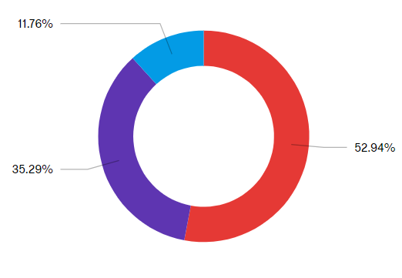

In your opinion, do you consider services your library offers to students and faculty to be innovative?

Slide 8

Innovative services
(selected examples)
Making resources available electronically, online services, technologies
Courses and reference resources for users
Engaging with patrons
Facilities
Library management
Working with other libraries
Libraries using social media
Subject and expert librarians
Accessibility accommodations

Slide 9
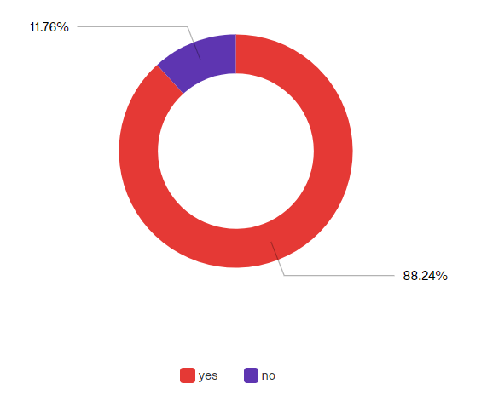

Do you consider the facilities of your library to be conducive to innovation?

Slide 10
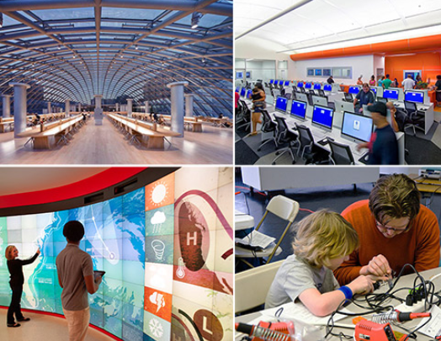
Innovative facilities
(selected examples)
Modernized library facilities
Spacious rooms
Computer labs
Reading rooms (for specific
departments)

Slide 11
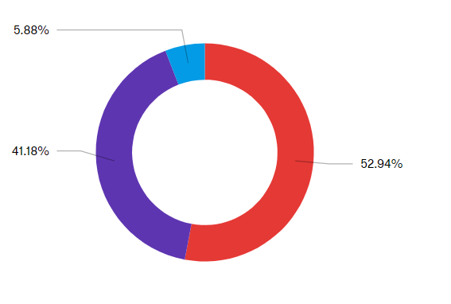

Do you consider technologies used in your library to be innovative?

Slide 12
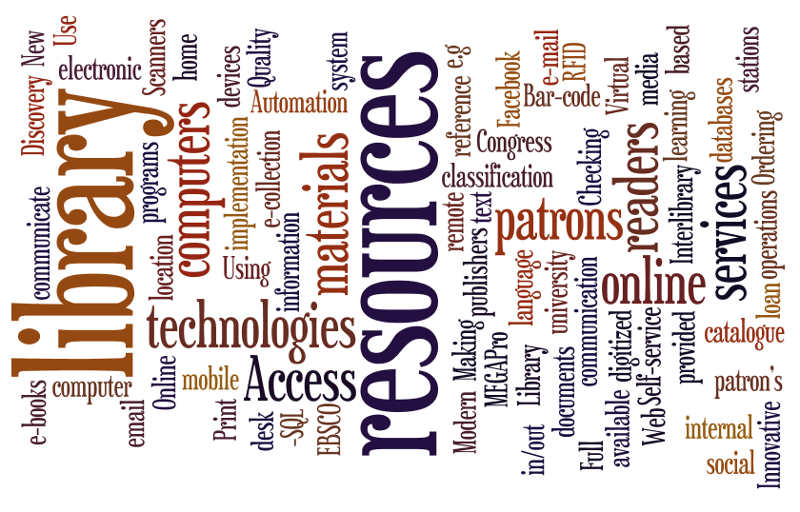
Innovative technologies
(selected examples)
Automated services
Electronic databases
Remote online access to services and catalogues
Social media
Electronic interlibrary loan
RFID technologies

Slide 13

What’s needed?
Highly qualified staff
Innovative managers
Continuous improvement
Funding, resources, and infrastructure
Policies and regulations supporting innovation
Innovative projects and initiatives
Improvement in catalogue in Kazakhstan
Access to databases

Slide 14
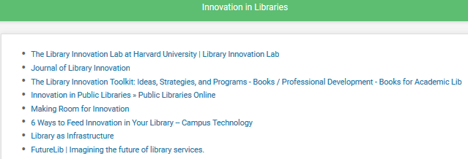
Diigo collection
Resources available to all
Prepared by Dr Dina Vyortkina

Slide 15
Living innovation
It is not just about technology
Maker spaces, 3D printing tools for collaboration
Hiring people with fresh perspectives and new ideas
Culture of forgiving failure and rewarding innovative ideas
  (e.g., giving staff student interns to assist in new projects)
Technology partners can become innovation partners
May need additional fundraising
Make technology accessible and use it to connect people: students to faculty, faculty to faculty
    Show off technology, don’t hide it
Flagship projects need an inspirational narrative
https://campustechnology.com/Articles/2017/04/19/6-Ways-to-Feed-Innovation-in-Your-Library.aspx

Slide 16
Summary
Indicators of Changing Culture
Your thoughts?
Indicator of growth
Indicator of creativity
and adaptability
Indicator of renewal
Indicator of efficiency
Indicator of stability
[Adapted from O’Donnell, Kramar & Dyball (2009)]

Slide 17
References
O'Donnell L., Kramar R. and Dyball, M., 'Human Capital Reporting: Should It Be Industry Specific?' Asia Pacific Journal of Human Resources. Vol. 47 (3), 2009.
Turner, D. and Crawford, M., Change Power: Capabilities That Drive Corporate Renewal, Allen & Unwin, 1998.
6 way to feed innovation in your library (accessed 25 May, 2017)

