Slide 1
Zhenis Otarbay, MS student
Development and Control of a Shoulder Joint for Humanoid Robotics Application
Department of Robotics and Mechatronics
School of Engineering and Digital Sciences
Nazarbayev University
Notes:
Good afternoon everyone, My name is Zhenis Otarbay and the topic of my presentation is Development and Control of a Shoulder Joint for Humanoid Robotics Application.

Slide 2
Supervisory committee
Lead Supervisor
  Michele Folgheraiter, Associate Professor,
    Nazarbayev University, School of Engineering and Digital Sciences, Robotics
Co-Supervisor
  Berdakh Abibullaev, Assistant Professor,
    Nazarbayev University, School of Engineering and Digital Sciences, Robotics
Co-Supervisor
  Mohamad Mosadeghzad, Associate Professor,
    Nazarbayev University, School of Engineering and Digital Sciences, Robotics
Notes:
I would like thank my supervisor, co-supervisor, second co-supervisor for supporting and providing me with valuable and useful feedbacks.

Slide 3
Outline
Part 1 – Importance and aim of the project, research question and literature review
Part 2 – Design and implementation
Part 3 – Articulatio spheroidea model and simulation
Part 4 – Testing, results, analysis, evaluation
Part 5 – Conclusion and future work
Notes:
This is the outline of my presentation. First of all, I will talk about the importance and aim of the project, research question and Literature review. Then I will talk about Design and implementation. After that I will introduce the Shoulder Joint model and simulation. Thereafter, I will be talking about Testing, results, analysis, and evaluation. Finally, I will draw the conclusions and indicate possible future work.

Slide 4
1. Introduction
www.nu.edu.kz
Notes:
Let’s start from introducing the research field.

Slide 5
1.1. Introduction
Humanoid robotics aims at developing robotics systems that manipulate objects and move in the environment in a similar way humans can do.
In most of the systems developed so far, a sequence of revolute joints is used to reproduce the mobility of complex articulations present in the human body.
In this thesis work, we developed a tendon actuated spherical joint that can reproduce the behavior of the humerus-glenoid cavity present in the human shoulder.
Notes:
Humanoid robotics aims at developing robotics systems that manipulate objects and move in the environment in a similar way humans can do.
In most of the systems developed so far, a sequence of revolute joints is used to reproduce the mobility of complex articulations present in the human body.
In this thesis work, we developed a tendon actuated spherical joint that can reproduce the behavior of the humerus-glenoid cavity present in the human shoulder.

Slide 6
1.2. Research objective
To develop a shoulder joint for the future of applications in the field of humanoid robotics.
Goals to achieve with help of actuation system:
  More natural movement
  SImplified design and
  Lighter wight
  Faster movements
  Displacing bigger payloads.
Notes:
The problem we intend to solve is very important for the future applications in the field of humanoid robotics.
An actuated spherical joint will allow the robot to move more naturally
and to simplify its design.
Due to the fact that the actuation system will be installed before the joint, the upper arm will be lighter and therefore capable to move faster and to displace bigger payloads.

Slide 7
1.2. Research Questions
What are the improved methods of making spherical joint?
How can individuals control this spherical joint so that it would be safe and convenient?
3. Is this model theoretically, in simulation and as a real porotype proven?
Notes:
The problem we intend to solve is very important for future applications in the field of humanoid robotics.
An actuated spherical joint will allow the robot to move more naturally
and to simplify its design.
Due to the fact that the actuation system will be installed before the joint, the upper arm will be lighter and therefore capable to move faster and to displace bigger payloads.

Slide 8
1.2. Introduction – Brain Interface
Open research question: possibility to integrate EEG signals into the control architecture of the artificial shoulder
Importance of the research:
using brain signals to assist the control of the shoulder motion may be beneficial for many people who lost their limb and need a more natural control of their prosthetic arm.
tele-operation purposes, facilitating the operation of an exoskeleton (master-arm).
reduction of the stiffness of the exoskeleton
more natural operation due to predicting the motion of the operator arm
Notes:
The possibility to integrate the EEG signals into the control architecture of the artificial shoulder represents an important open research question.
Using brain signals to assist in controlling the shoulder motion may be beneficial for many people who lost their limb and need a more natural control of their prosthetic arm.
The system can also be used for tele-operation purposes, facilitating the operation of an exoskeleton (master-arm).
Predicting the motion of the operator arm could be used to reduce the stiffness of the exoskeleton and to allow a more natural operation.

Slide 9
1.4. Literature review
Included only application papers.
All of the papers were theoretically proven, most of them were based on modeling in CAD.
Some papers used a tendon-driven mechanism, for example, Lims-ambidex 2 and some other scientific publications that were compared and contrasted.
Notes:
The literature listed in this work includes only application papers.
All of the papers have a theoretical background, most of them were based on models developed in CAD.
Some papers described tendon-driven mechanisms, for example, the Lims-ambidex 2.

Slide 10
Hand authors | Mass | Nominal size | Number of actuators | Number of tendons/cables | Number of sensors | Number of DOF
Kim et al (2018) | Shoulder: 4.17 kg | Small size ( not enough information) | ~5+ | ~12 in one shoulder or wrist joint | ~6 sensors for shoulder (10-15 sensors for whole robot) | 3
Ball et al (2017, August) | No information | No information | ~5+ | 4+ | No information | 3
Buongiorno et al (2018) | ~4.7kg (WRES + driverbox) | Standard man’s wrist side hand size | ~3+ | 3+ | 6+ | 3
Jiang et al (2019) | No information | No information | ~3+ | 6+ | No information | 7
Ball et al (2017, September) | 115 kg (Actuators and exoskeleton ) | exoskeleton | ~5+ | 5+ | 3+ | 5
Folgheraiter and Otarbay* (planned to send for publishing in 2020-2021) | ~2.4kg | Radius ~ 140mm and the height is about 300mm | 4 | 3-4 | 7 (3 force, 4 magnetic encoders) | 2-3
Notes:
In particular, six publications were chosen to be compared and contrasted. Ball et al presented relatively robust and rehabilitation aimed exoskeletons. Tendon-based actuation is comprehensive and a bit more robust for shoulder or wrist joint substitute purposes. SImilarly to some of the works we reviewed here, we also applied the simulation techniques for the shoulder joint before we tested each of the movements in the real prototype.

Slide 11
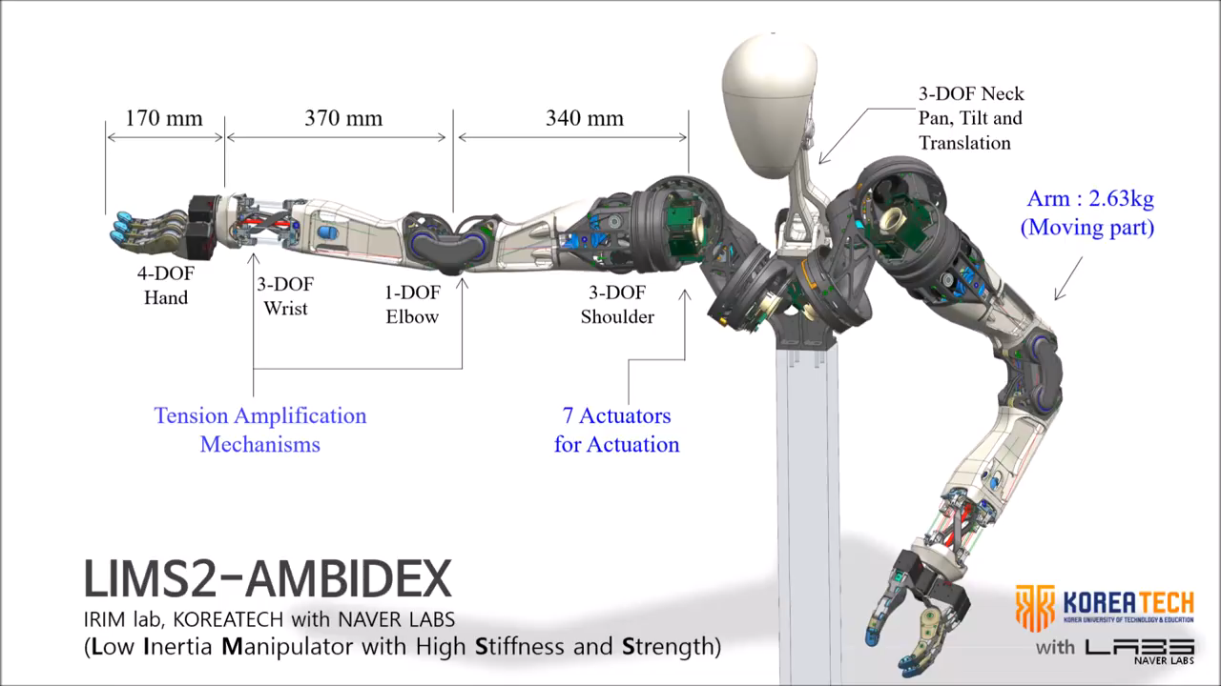
1.4.1. Literature review: Humanoid arm
The mechanical design and the electronics part of this paper represent the core of my thesis.
The design of our shoulder joint initially was aimed to operate using tendons such as humanoid arm’s shoulder designed by Kim et al.[8].
Figure 1. [8] Kim, Y. J., Kim, J. I., & Jang, W. (2018, October). Quaternion Joint: Dexterous 3-DOF Joint representing quaternion motion for high-speed safe interaction. In 2018 IEEE/RSJ International Conference on Intelligent Robots and Systems (IROS) (pp. 935-942). IEEE.
Notes:
The mechanic al design and the electronics part represent the core of my thesis.
The design of our shoulder is aimed to operate using tendons such as the humanoid arm’s shoulder designed by Kim et al.[8].
Additionally, this paper uses the quaternion representation of the shoulder joint kinematics and implements the forward and inverse kinematics.

Slide 12
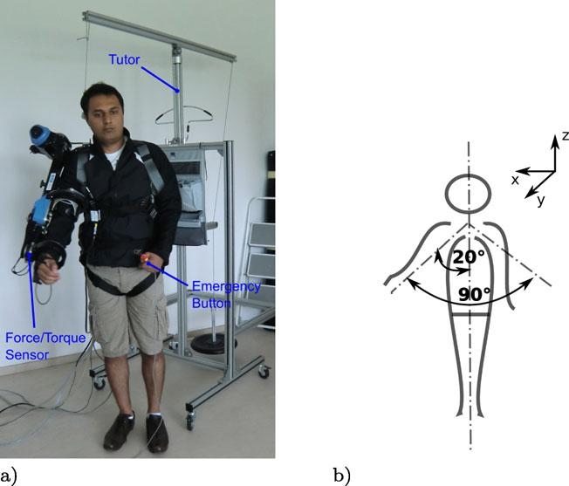
1.4.3. Literature review: EEG Integration
In [1],: design of EEG integrated with 9 DOF shoulder joint.
These are used to predict 300 ms in advance the intention of movement of the user and to trigger the exoskeleton actuation system.
Figure 1-4: [4] Folgheraiter, M., Jordan, M., Straube, S. et al. Measuring the Improvement of the Interaction Comfort of a Wearable Exoskeleton. Int J of Soc Robotics 4, 285–302 (2012).
Notes:
This design suggests a robust electronics and safe operation thanks to its software.
The voltage and the available power of the hardware were also designed to be safe in any condition.
This research presents teleoperation-based hardware and software based on movement prediction techniques which is important for my thesis work.

Slide 13
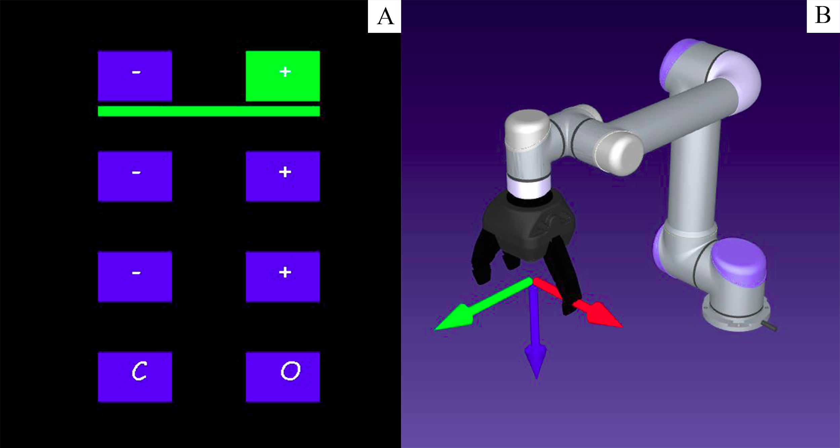
1.4.3. Literature review: Humanoid Arm
In [11]: control of the the robotic arm UR5 with help of the EEG signals acquired from the brain.
The accuracy of classification to control left and right or up and down movements achieved for 7 different subjects is about 75.9% on average.
Figure 1-3: [11] Saduanov, B., Tokmurzina, D., Kunanbayev, K., & Abibullaev, B. (2020, February). Design and Optimization of a Real-Time Asynchronous BCI Control Strategy for Robotic Manipulator Assistance. In 2020 8th International Winter Conference on Brain-Computer Interface (BCI) (pp. 1-5). IEEE.
Notes:
This is lower than real-time control requirement. It can make the subjects tired, so that makes this control mechanism not suitable for our purposes.

Slide 14
1.5. Knowledge gap (What is missing?)
Disadvantages and weaknesses of the current research
Lack of works that would employ a spherical joint in the shoulder, most of them use a sequence of revolute joints.
Limitations of the payload is generally especially in the tendon-driven systems.
Lack of accuracy in the systems, reports of just simulated models.
Very few examples of integration of EEG signals in the control architecture.
Notes:
Most of the research works that I listed in the literature review are not employing a spherical joint in the shoulder, but a sequence of revolute joints.
The payload is generally limited, especially in the tendon-driven systems.
Different systems are also not accurate or report just simulated models.
Very few examples are available that integrate EEG signals in the control architecture.

Slide 15
2. Design and implementation
Notes:
Let's now talk about Design and implementation

Slide 16
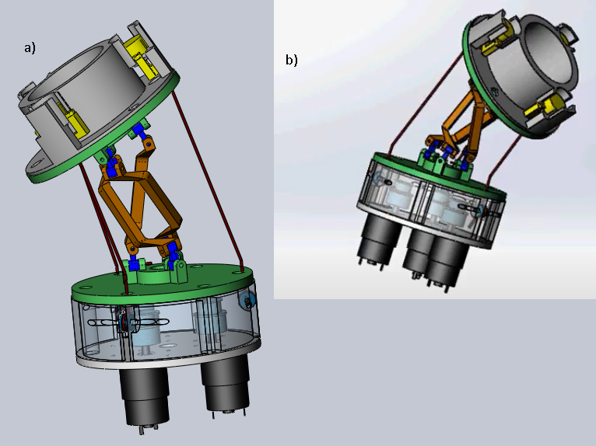
2.1. Mechanical design (Computer-Aided Design)
Solidworks => design of the prototype and conduction of the first simulations.
After the V-REP model was implemented, constraints were added to the V-REP model, such as max force, max motor speed, and max torque.
Figure 2-1: a) Views of the shoulder joint in Solidworks that resembles the functionality of the articulatio humeri assembly, b) Shoulder joint bent to the target position.
Notes:
The symmetric orientation of the platform compared to the base makes 60 degrees.

Slide 17
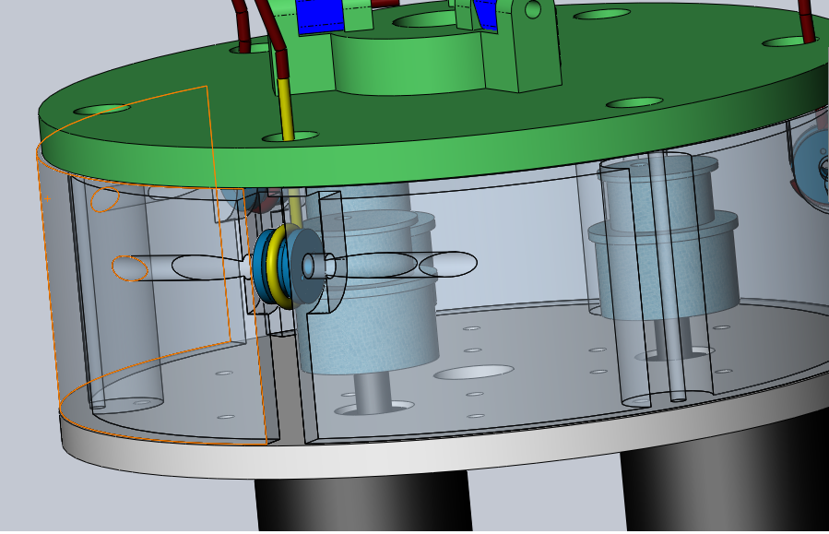
2.1. Mechanical design (Computer-Aided Design)
The Figure demonstrates how the tendon actuation in our shoulder joint works.
The tendon is loosen and tighten thanks to a small pulley attached to the motor.
The yellow part shows how the tendon is rotated toward the head of the actuator.
Figure 2-2. Tendon actuation
Notes:
So, when an actuator is rotated clockwise and anticlockwise, the tendon is tightened and loosened. For the tendon not to go outside of the limits we increased the notch(выемка) in the motor shaft

Slide 18
2.1. Mechanical design (Computer-Aided Design)
The table shows the shoulder joint part materials, approximate dimensions, and their quantity.
The actual 3D printed shoulder joint reproduce accurately the CAD model.
Table 2.1: Parts of SPM
Notes:
The table shows the shoulder joint part materials, approximate dimensions, and their quantity.
The actual 3D printed shoulder joint reproduce accurately the CAD model.

Slide 19
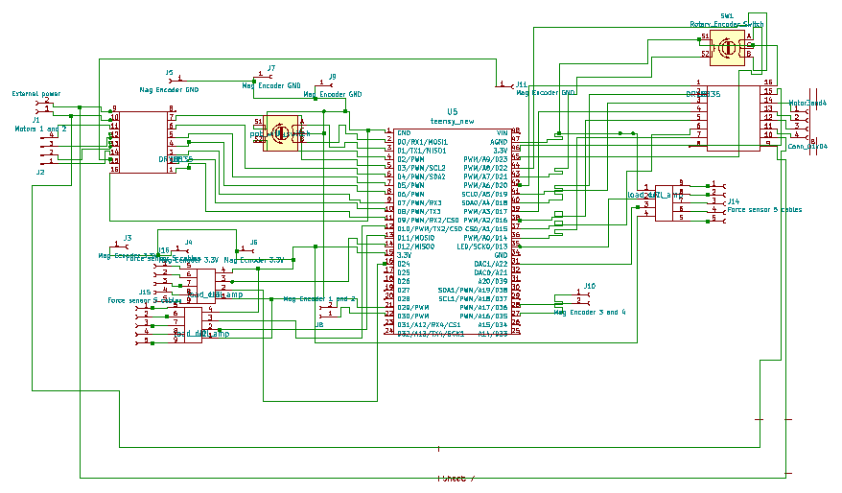
2.2. Electrical design
The Figure shows the schematics of the circuit of the motherboard that reads the sensory information, controls the actuation system and communicates with the PC where the GUI is running.
Figure 2-3. Circuit schematics design in KiCAD.
Notes:
The Figure shows the schematics
of the circuit of the motherboard that reads the sensory information, controls the actuation system and communicates with the PC where
the GUI is running.

Slide 20
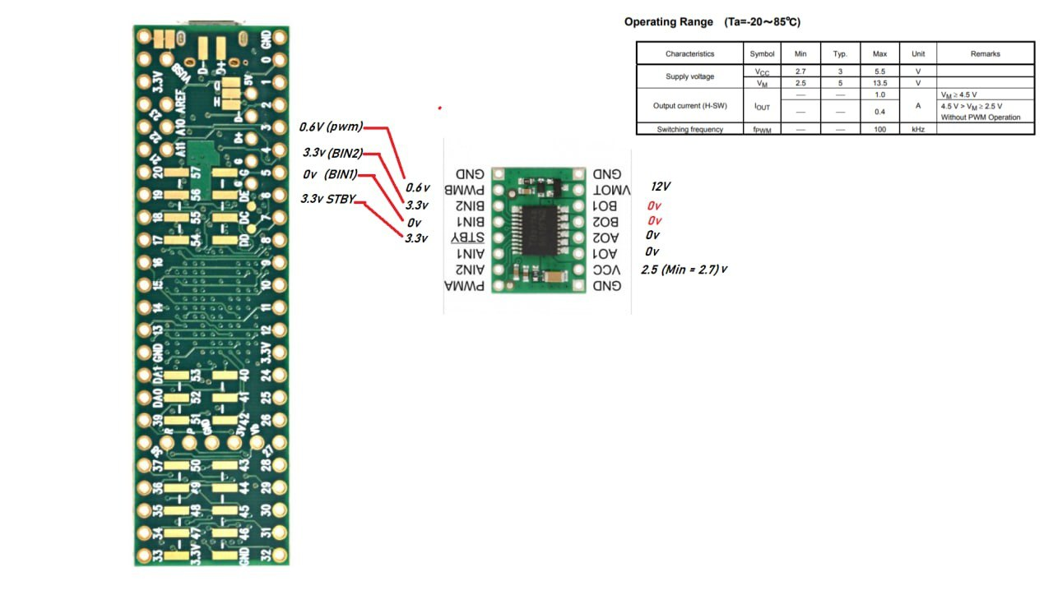
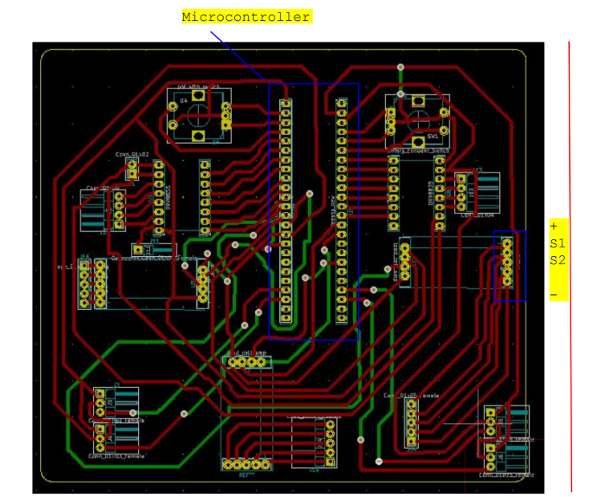
2.2. Electrical design
Figure 2-4. Teensy and motor driver pins, data-sheet is from driver chip’s website
Figure 2-5. PCB design in KiCAD
Notes:
I have made a KiCAD model to engrave the PCB for the shoulder joint.
The figure reports the KiCAD PCB of the motherboard where all the necessary electronic components and the additional electronics boards can be mounted.
The PCB was built to reduce the number of required wires to connect to the sensors and actuators.
The KiCAD model is flipped for all components which allows checking the Teensy 3.5 pins easily by looking at its numbered side. This is one of the unusual sides of the design. However, this does not affect the functionality. Also, the reset button of Teensy 3.5 can be used in implementing some control function.

Slide 21
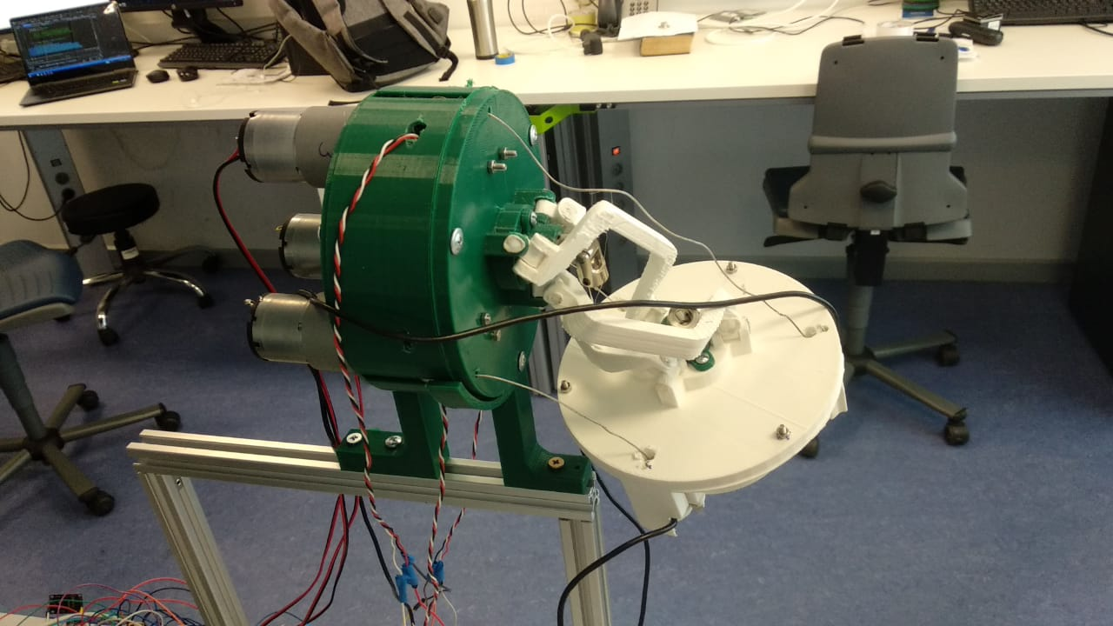
2.3. Manufacturing and assembly
The Figure shows the built prototype of our tendon-driven joint which is intended to replicate the functionality of the human's shoulder joint.
At the moment it is limited to 2 DOFs as long as we are using only 3 tendons.
Tendons
Motors
With Pulleys
Figure 2-6. Proof of concept for a 3-DOF shoulder joint (only two actuated) realized in PLA
Notes:
However, it can be extended to include 3 DOFs if we implement the YAW rotation using an additional motor whose shaft can pass through the center of the joint. Each of the three actuators winds the tendons and thread through holes of the platforms. And the next end of the tendons is fixed to the moving platform. The angle between each tendon is 120 degrees. There are included two rotary encoders for a real-time (with Teensy constraints) testing of the shoulder joint motion manually.
Also, 4 magnetic encoders sense the rotation of the actuators in clockwise and anticlockwise directions and send the measurement to the Teensy as a PWM signal.

Slide 22
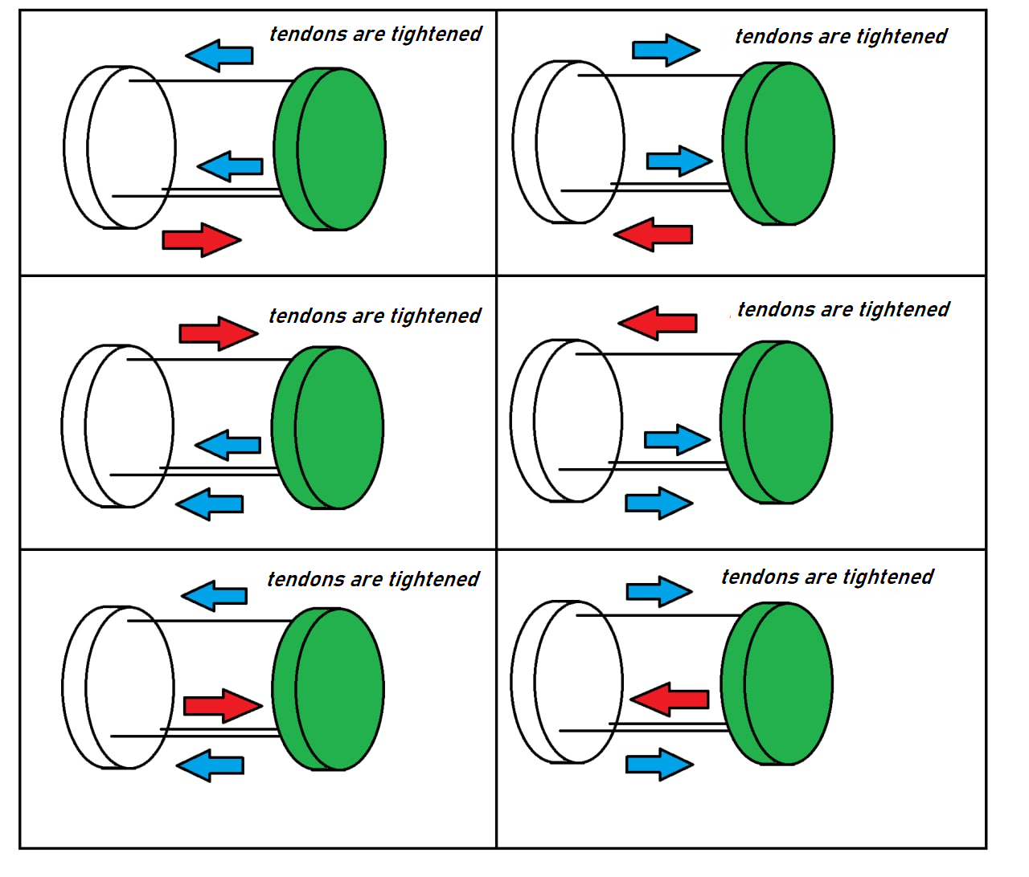
2.3. Manufacturing and assembly
Three tendons work in parallel, in order to have motion, the force that is applied to the actuated tendon should be opposite compared to the other two tendons that have to loosen/tighten.
Figure 2-7. Concept explanation
Notes:
To make the best movement, it was decided to make all tendons tightened at first, and coordinate them according to the motion we wanted to realize

Slide 23
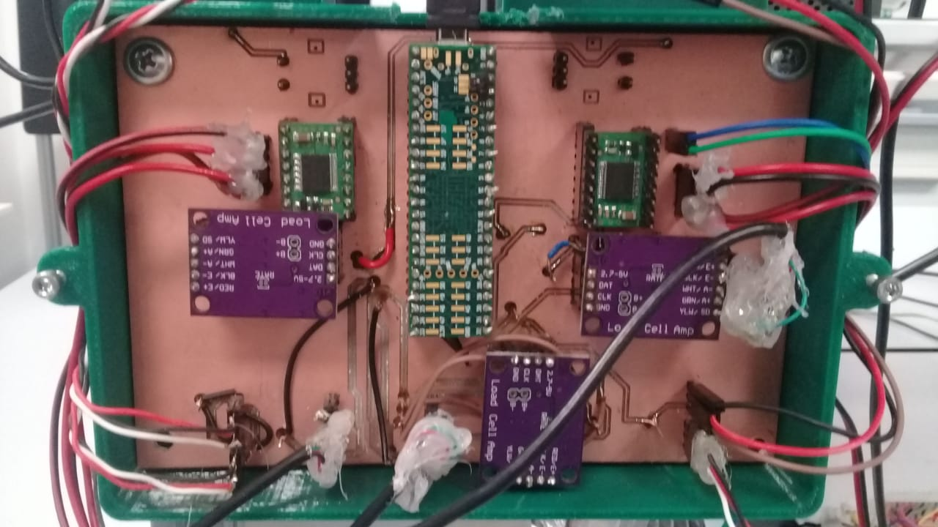
2.3. Manufacturing and assembly
In the Figure the motherboard is shown.
It includes the microcontroller, the motor boards and all the wires necessary to connect the force sensors and the position encoders.
Figure 2-8 Motherboard which incorporates a Teensy 3.5, force sensors amplifiers, motor controllers, and rotary encoders
Notes:
The PCB plate contacts have been tested with a multi-meter to detect short-circuits or discontinuities. The motor boards and the Teensy 3.6 were mounted using male \& female connectors in a way to easily substitute them if required. In particular, the female connectors where soldered on the mother-board while the male connectors on the Teensy 3.6 and the motor boards. After seeing that it is working as expected, each component was soldered one after another and the correct integration with the Teensy 3.6 verified.

Slide 24
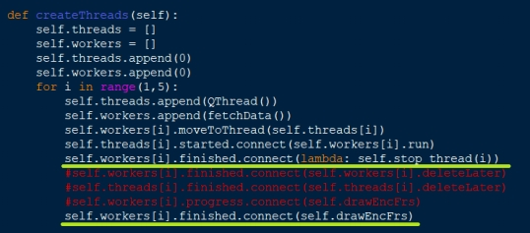


2.4. Software part and GUI to control the joint. Interrupt method (Threads)
Notes:
One of the problems that was encountered when reading from the Serial port real-time data, was that the Main Program was busy, and the GUI was not responding. To solve this, 4 threads were created, one for each motor. Maybe it was, to some extent, more than necessary because there is only one Com Port for reading and sending data, but it made each process less dependent on the others. Here reported an example of creating 4 threads when the Main Program is initialized, also notice that worker and thread objects of PyQt5 are not deleted (deletion is commented) to be able to start the process again if we send a new command.

Slide 25
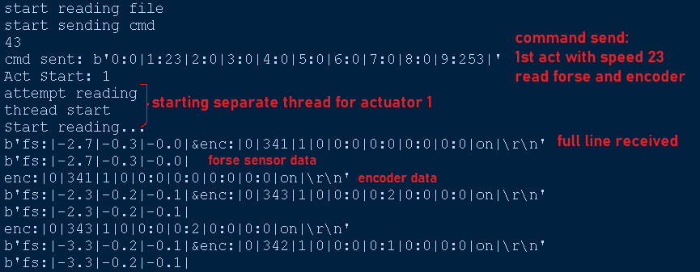
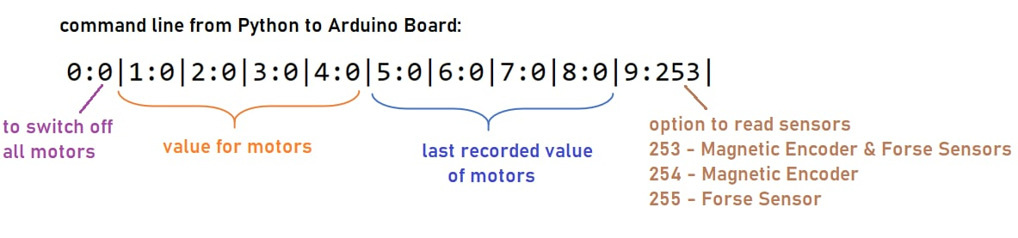
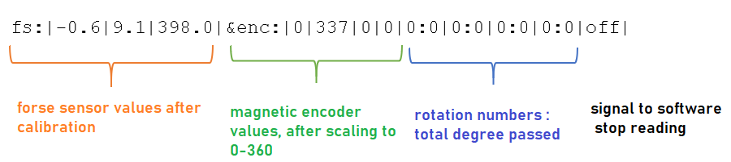
2.4. Software part and GUI to control the joint. Command codes from Python to Arduino
Notes:
Control command is sent to Teensy and Command in one line below programmed to send back to GUI application that are parsed from input. If bytes are sent and received separately, it creates chance of data loss .

Slide 26
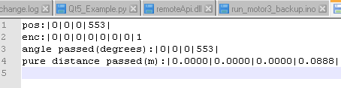
2.4. Software part and GUI to control the joint.
The current position is always saved in a text file.
Start of the program => setting of the counters to the positions stored in the control text file.
The encoder decrements according to the direction => increments from that point => the calibration procedure.
Figure 11: Position is saved on a text file
Figure 2-23: Position is saved on a text file
Notes:
The current position is always saved in a text file.
When the program starts, counters are set to the positions stored in the control text file.
The encoder decrements according to the direction and then increments from that point.
This implement the calibration procedure.

Slide 27
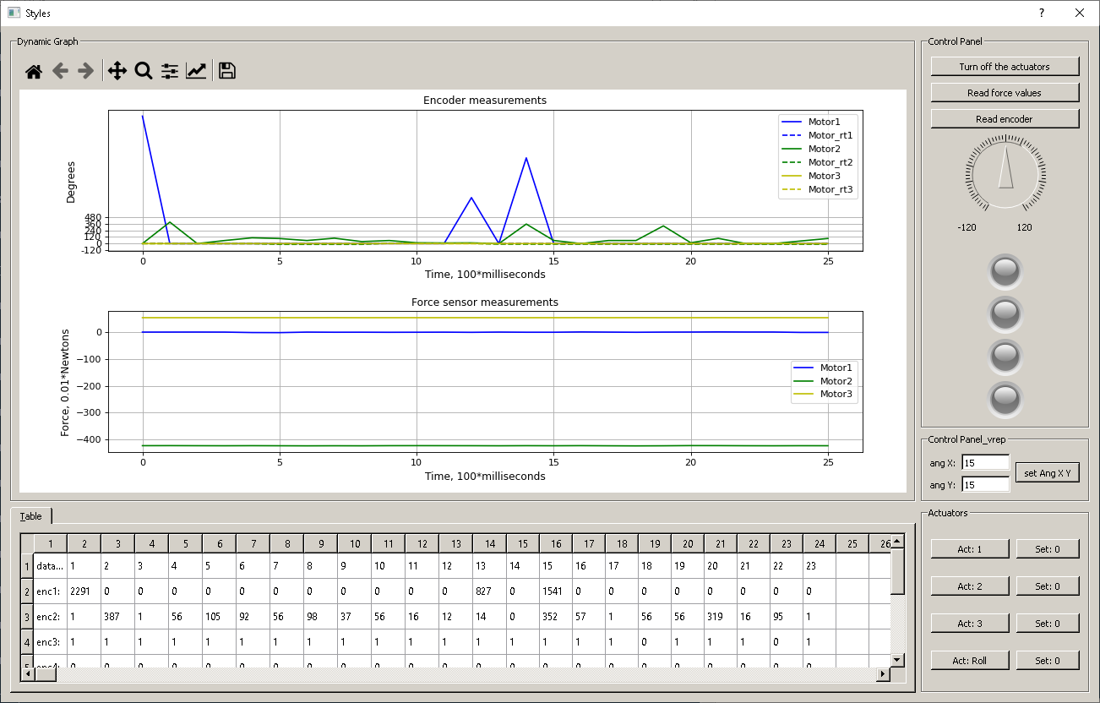
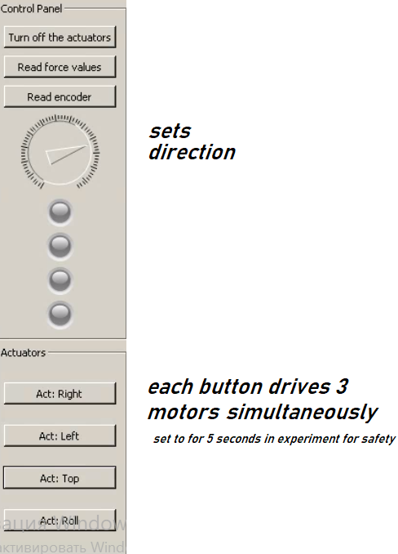
2.4. Software part and GUI to control the joint.
Figure 2-18: Dynamic position and force measurements in GUI
Notes:
Up to now the interface works as expected and can control the shoulder joint.
The dial in the interface is used to represent the negative and positive values from -220 to 220. The button "send the value" is used to send the values in the dial. "Turn off the actuators" is used to turn off all the actuators. "Actuator 1" actuates actuator 1 and deactivates it back. "Actuator 2" actuates the actuator 2 and deactivates back and so on. And the red indicator is turned on when one of the actuators is activated. The graph for the encoder represents the corresponding position values received from each of the magnetic encoders that are installed over the head of the actuators such that the encoder can increase or decrease its values depending on the direction of the motor rotation.

Slide 28
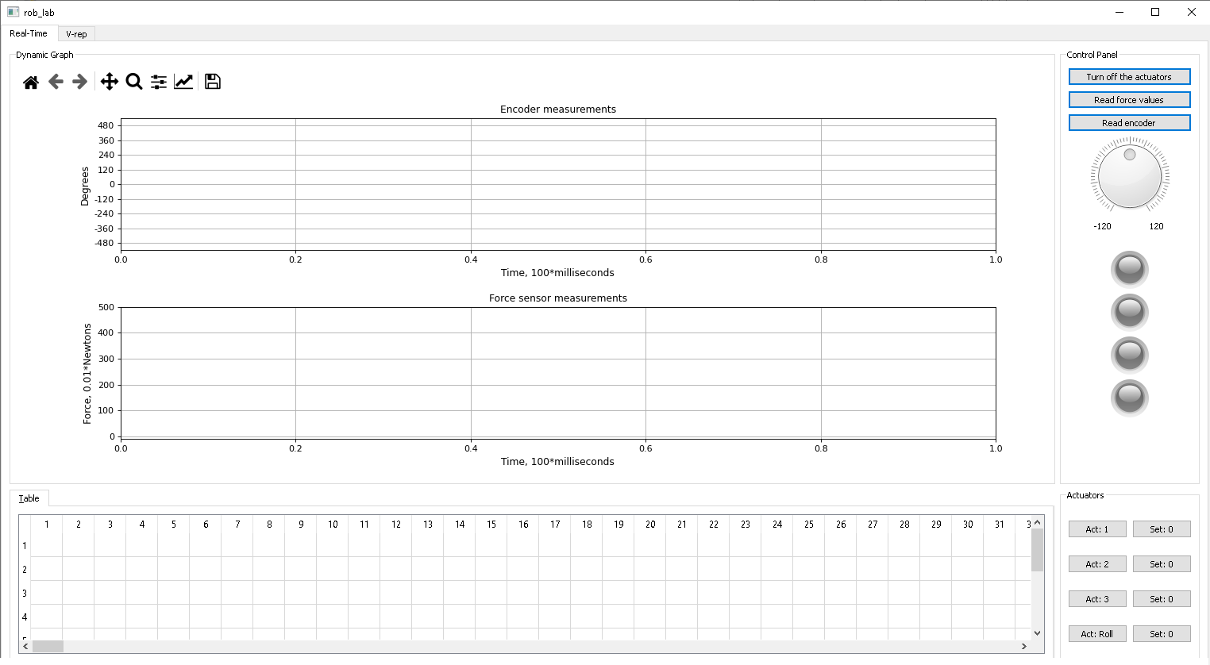
2.4. Software part and GUI to control the joint
The main program is organized in such a way, that pressing GUI buttons and accessing GUI Dial object, generate command line self.cmd.
Figure 2-18. GUI, tab1, shoulder joint control
Notes:
The main program is organized in such a way, that pressing GUI buttons and accessing GUI Dial object, generate command line self.cmd.

Slide 29
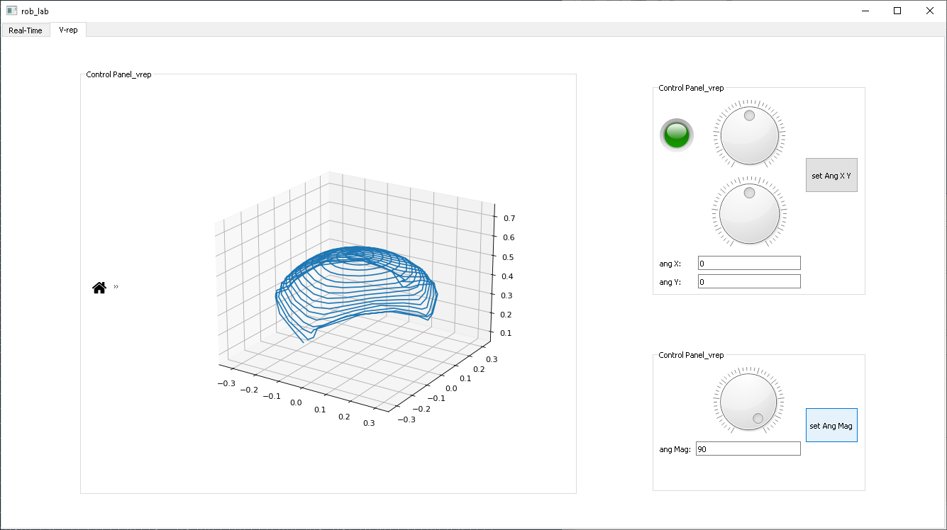
2.4. Software part and GUI to control the joint
This is the second page of the GUI and it is working as expected.
Other fields were added to the GUI, thus AngX and AngY, to control also the V-REP.
Figure 2-19: GUI, tab2, V-REP control
Notes:
This is the second page of the GUI and it is working as expected.
Other fields were added to the GUI, thus AngX and AngY, to control also the V-REP.
Also the button "set 0” was added.
When the motor is installed in default position, this button refreshes the configuration file to pos:0|0|0|0|.

Slide 30
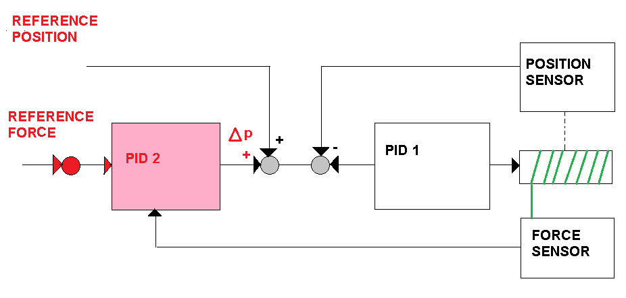
2.5. Force and position control
Figure 2-22. Force and position control
Notes:
This represents the overall control scheme based on a cascade of two PIDs, however only the position control loop was implemented.

Slide 31
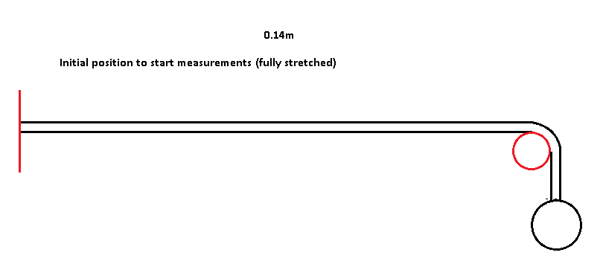
2.5 Position control with updated design
The length of the tendon - about 0.14m.
There is a correlation between:
position encoder measurements, rotation counts,
voltage on the actuators
Figure 2-20. Position or angle relationship
Notes:
The length of the tendon is about 0.14m.
The relationship between position encoder measurements, rotation counts, voltage on the actuators are correlated.

Slide 32
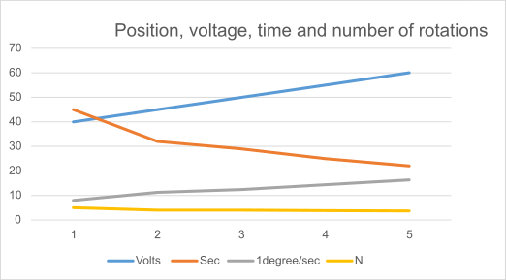
2.5. Position control with an updated design
dial value | sec | degree/sec | N
40 | 45 | 8 | 5
45 | 32 | 11.25 | 4
50 | 29 | 12,4137931 | 4,027778
55 | 25 | 14,4 | 3,819444
60 | 22 | 16,36363636 | 3,666667
Figure 17. Position and angle
relationship
(N: # of turns)
Table 2.2: Position voltage-time and supply power-torque linear coefficient N
Figure 2-21. Position, voltage, time and number of rotations
Notes:
Position, voltage, time, and number of rotations
N is the linear dependency between supply power and torque (supply current is constant)
Right now the motor rotates from -514 to 514 degrees.
It takes approximately 3 rotations.

Slide 33
3. Articulatio spheroidea model and simulation

Slide 34
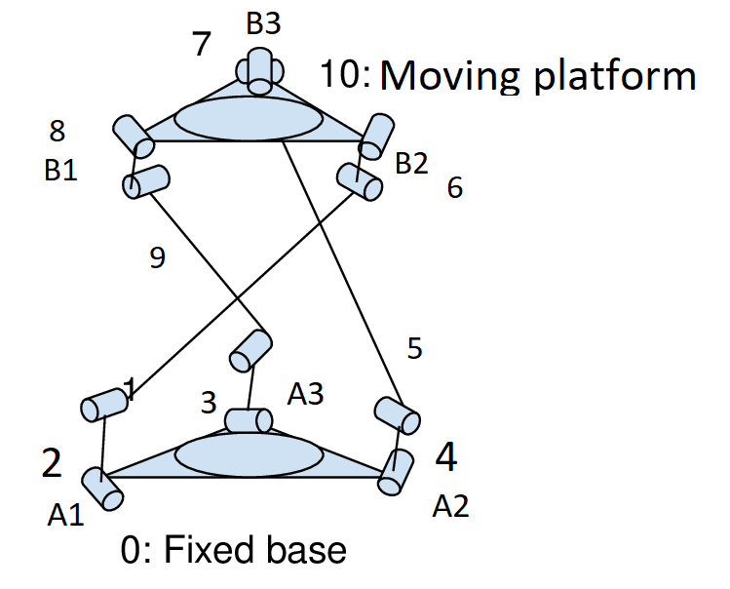
3.1 Detailed design of 3D of freedom manipulator
L is the # of independent loops in the closed kinematic chain,
n=11 is the # of links including the fixed and moving base,
and j=12 is the number of binary joints.
L=j-n+1
L=12-11+1=2
& for any PM the number of limb:
m=L+1=2+1=3
Figure 3-1. Architecture of parallel kinematic mechanism with rotational joints.

Slide 35
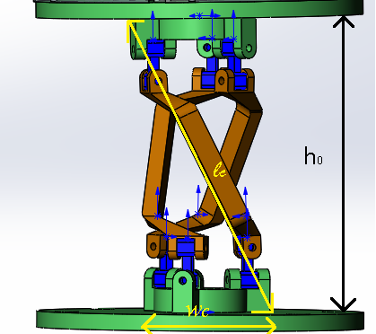
3.2. Kinematics for the primary limb
For this parallel manipulator, w_{c}=47.44mm, l_{c}=109.25mm, h₀=128.32mm
Our assumption: each leg is an open kinematic chain=> the screw method can be used to formalize the forward model.
Introduce antiparallelogram:
Figure 3-2. Joint part dimensions

Slide 36
3.2. Kinematics for the primary limb
We used the successive screw method to formalize the DK.
Starting from a reference
frame we can define the four screws as the table.
s_{i} | s_{oi}
(1, 0, 0) | (a₀,0,0)
(0, 1, 0) | (a₀,0,a₁)
(0, 1, 0) | (a₀,0,a₁+a₂)
(1, 0, 0) | (a₀,0,2a₁+a₂)
Table 3-1: Screw method table
Figure 3-3: Screw method

Slide 37




3.2. Kinematics for the primary limb
A₄=
A₁=
A₂=
A₃=
Notes:
Kinematics of PM using Successive Screw Method

Slide 38
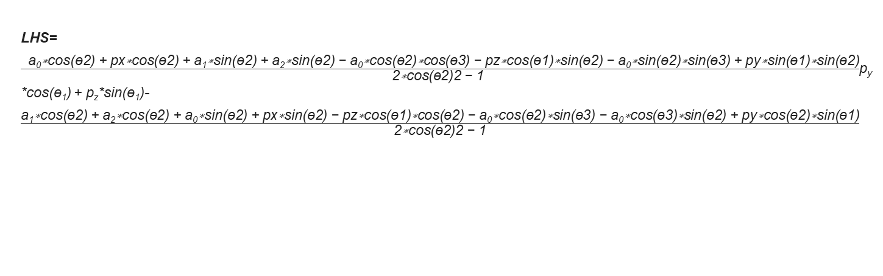
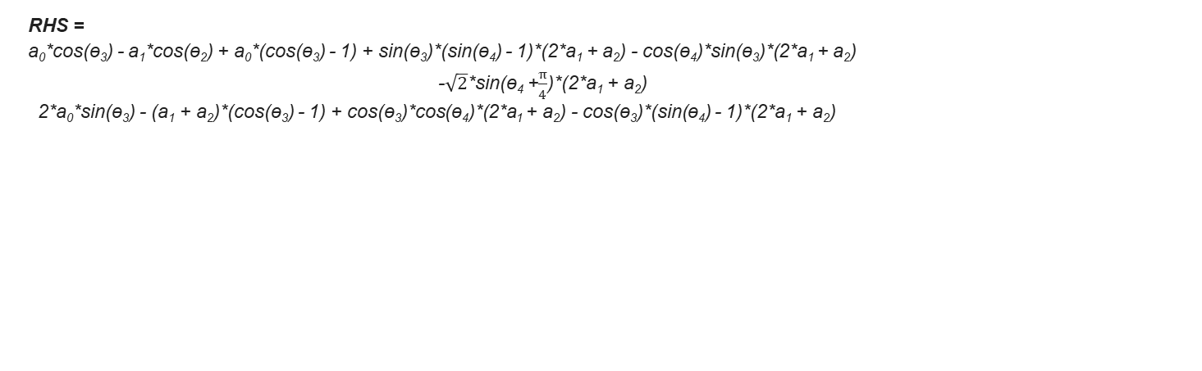
3.3. Single Limb Inverse Kinematics

Slide 39
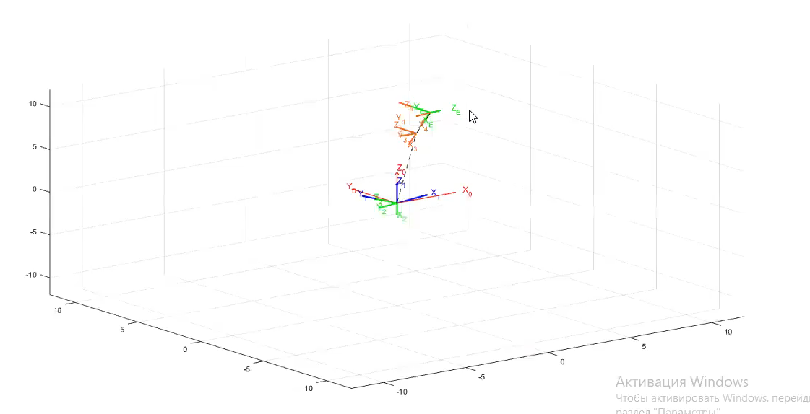
3.5. MatLab simulation of PM
We have simulated one limb of the parallel manipulator in MatLab as it can be seen in the video.
When one leg is moved the other two legs follow.
Notes:
By changing the angle of the first two joints in the first leg it is possible to change the position and orientation of the end-effector, thus the parallel structure has only two DOFs

Slide 40
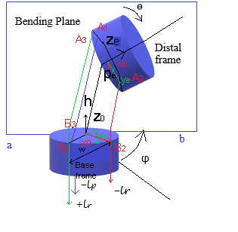
3.6. Inv. Kinematics Planar Case – Geom. Method
Adapted from Kim et al.
The Figure shows the kinematic model of the shoulder joint that included:
a moving platform,
fixed base,
a central limb that allows a rolling motion.
Figure 3-7. Geometry of movement
Notes:
The moving platform is considered as spatially oriented, thus, it will be analyzed as three extensible limbs connected to the moving platform at points 𝐵_{𝑖} and the fixed base at points 𝐴_{𝑖}
Pulleys across the platform can be used to vary the lengths L of the robe to control the motion of the moving platform

Slide 41
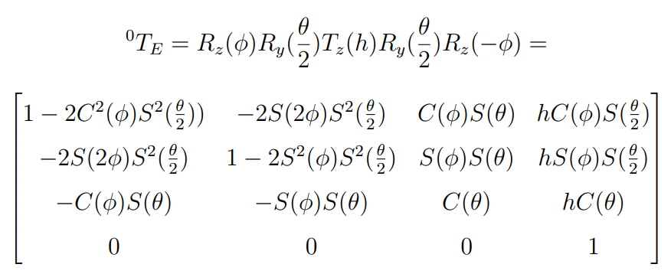
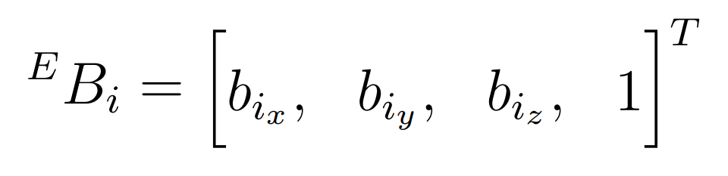

3.6. Inv. Kinematics Planar Case – Geom. Method
For analysis, two Cartesian coordinate systems O(x₀,y₀,z₀) and E(x₁,y₁,z₁) are attached to the fixed base and they move platform respectively.
The origin of the platform is chosen to be at the center of an additional limb.
The transformation from the moving frame E to the fixed frame O is described by a 4x4 transformation
matrix ^{O}T_{E}.
Notes:
The initial orientation of the moving frame E
coincides with the fixed frame O and the final
displacement is obtained by performing a rotation of
an angle ɸ about the z-axis, followed by a second rotation of "ɵ"₂
about the y-axis, followed by a translation of a quantity h along the
z-axis, a rotation of "ɵ" /2 about the y-axis and finally a rotation of an
angle ɸ about the z-axis. The resulting transformation matrix is given by equation ⁰T_{e}, adapted from Kim:2018 et al.

Slide 42
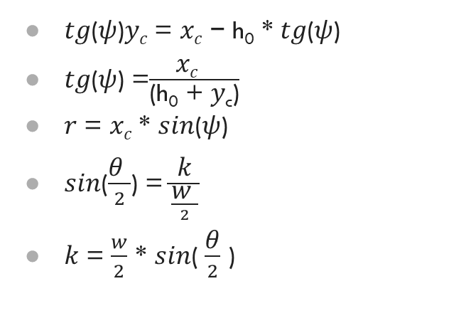
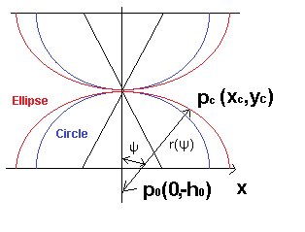
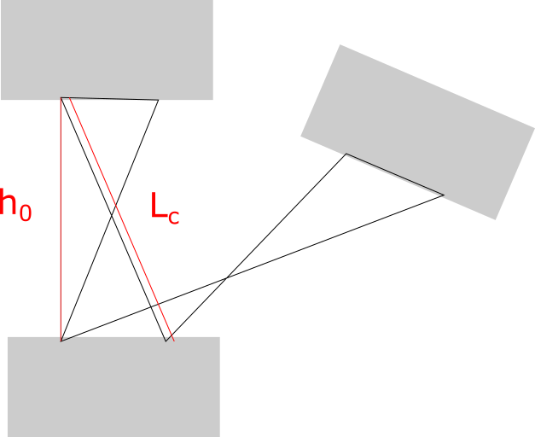
3.6. Inv. Kinematics Planar Case – Geom. Method
Figure 3-6. Formulation of dependency
Figure 3-7: Geometry of movement

Slide 43
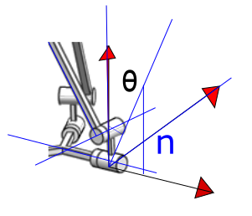
3.6. Inv. Kinematics Planar Case – Geom. Method
𝑧₀ = 𝑥_{𝑎} = 𝑓 + 𝑠₂ * 𝑚 + 𝑠₃𝑛 − f
𝑥₀ = 𝑦_{𝑎} = 𝑠₁ * 𝑛 + 𝑠₄ * k
𝑦₀ = 𝑧_{𝑎} = 𝑐₄ * 𝑛 + 𝑐₂ * 𝑚 + 𝑠₃ * 𝑛 + 𝑐₄ * k
Figure 3-7: Geometry of movement

Slide 44
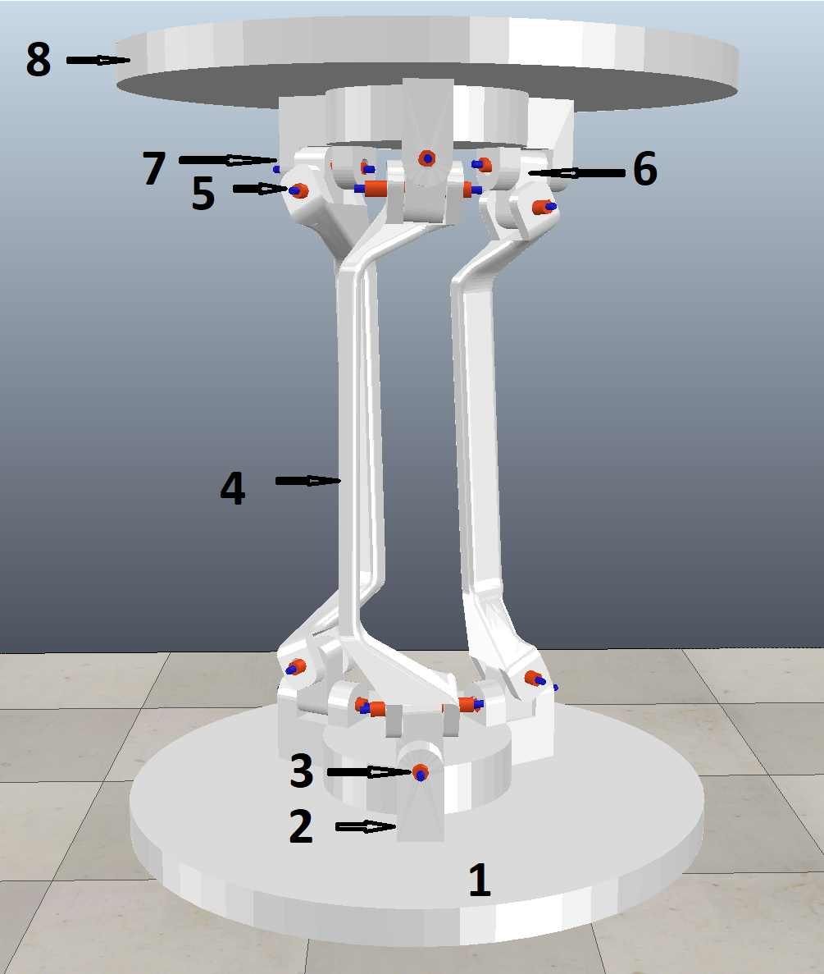
3.6. 3D design components of PM
1 - fixed base,
2 - base and limb connection,
3 - rotational joint,
4 - link,
5 - rotational joint,
6 - union,
7- platform and limb connection,
8 - moving platform.
Figure 3-13. V-REP simulation

Slide 45
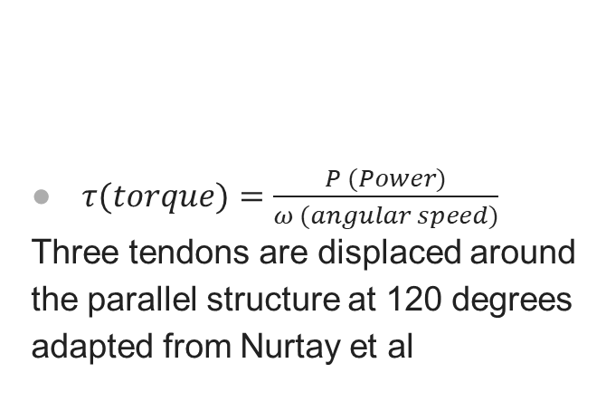

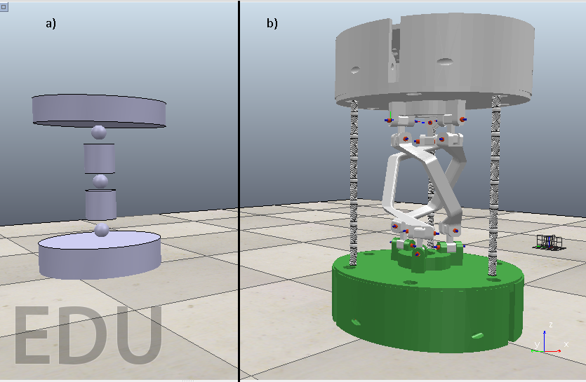

3.6. 3D design components of PM
Figure 3-12. V-REP simulation, a) the model which is controlled with x and y angles b) shoulder joint
Notes:
The V-REP model was simulated using universal joints with spring constants by means of Hooks law,
Theta x and Theta y are bending angles, K – spring constant, T1, T2, T3 – torques that must be applied to tendons.
We can see here that both angles depends on Theta 3. If we take Theta 3 as constant value, we still can achieve balance controlling T1 and T3.
Second formula is the dependency between torque and physical characteristics of the motor.
𝜏 is the torque applied to tendons, where P is the power of the actuator which depends on supply power, 𝜔 is the angular speed or velocity of actuators.
at first, we tried to imitate flexible tendons that were bending at equally divided positions. But it was computationally expensive.

Slide 46
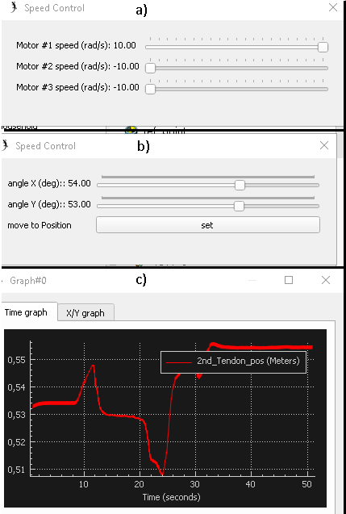
3.7. 3D design components of PM
The Figure 3-13. V-REP simulation,
a) speed control of the tendon activates the shoulder joint simulation
b) speed control of the model which is controlled with x and y angles
c) graph which is obtained from the shoulder joint simulation
Notes:
V-REP simulation, a) speed control of the model which is controlled with x and y angles b) speed control of the tendon actuated shoulder joint simulation c) graph which is obtained from shoulder joint simulation d) the model which is controlled with x and y angles is bent to a target location e) simulation of the tendon actuated shoulder joint where it is bent to a target location

Slide 47
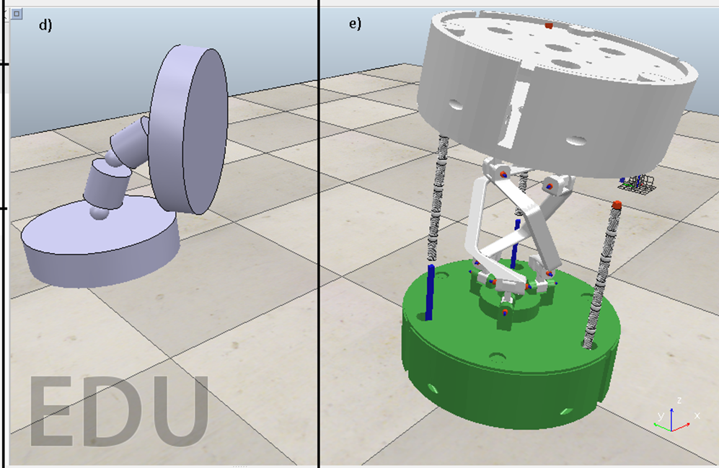
3.7. 3D design components of PM
Figure 3-14. d) the model which is controlled with x and y angles is bent to a target location
e) simulation of the tendon actuated shoulder joint where it is bent to a target location
Notes:
Figure 3-14. d) shows the model which is controlled with x and y angles is bent to a target location
e) simulation of the tendon actuated shoulder joint where it is bent to a target location

Slide 48
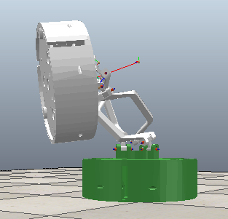
3.7. 3D design components of PM
The Figure shows an approach to imitating the spherical joint.
Due to the difficulty of replicating the tendon in V-REP, we have built a V-REP model which is a simulation of the real hardware.
However, the workspace shows that the imitation model differs from the real hardware.
Figure 3-15. A V-REP model which imitates the spherical joint bent to 90 degrees
Notes:
The Figure shows an approach to imitating the spherical joint.
Due to the difficulty of replicating the tendon in V-REP, we have built a V-REP model which is a simulation of the real hardware.
However, the workspace shows that the imitation model differs from the real hardware.

Slide 49
3.8. EEG Control System Setup
EEG integration part:
a motor imagery dataset is used to pars the shoulder movements and their duration time (in the source code they are stated as x, y, z directions) and
2) this information is used to control actuators 1, 2, and 3 correspondingly to move the shoulder joint.
So, firstly we can test the system without EEG with the motor imagery dataset and when we can make it work we will use EEG to directly do the control.
In the code I adapted, for example, we will only have a com port for the shoulder teensy 3.5, because the IP address is there was for the UR5.
Notes:
For the EEG integration part, it is possible to use a motor imagery dataset to pars the shoulder movements and their duration time (in the source code they are stated as x, y, z directions) and then to use this information to control actuators 1, 2, and 3 correspondingly to move the shoulder joint.
So, firstly we can test the system without EEG with the motor imagery dataset and when we can make it work we will use EEG to directly do the control.
In the code I adapted, for example, we will only have a com port for the shoulder teensy 3.5, because the IP address is there was for the UR5.

Slide 50
4. Testing and results
Notes:
Let’s talk about Testing and results

Slide 51
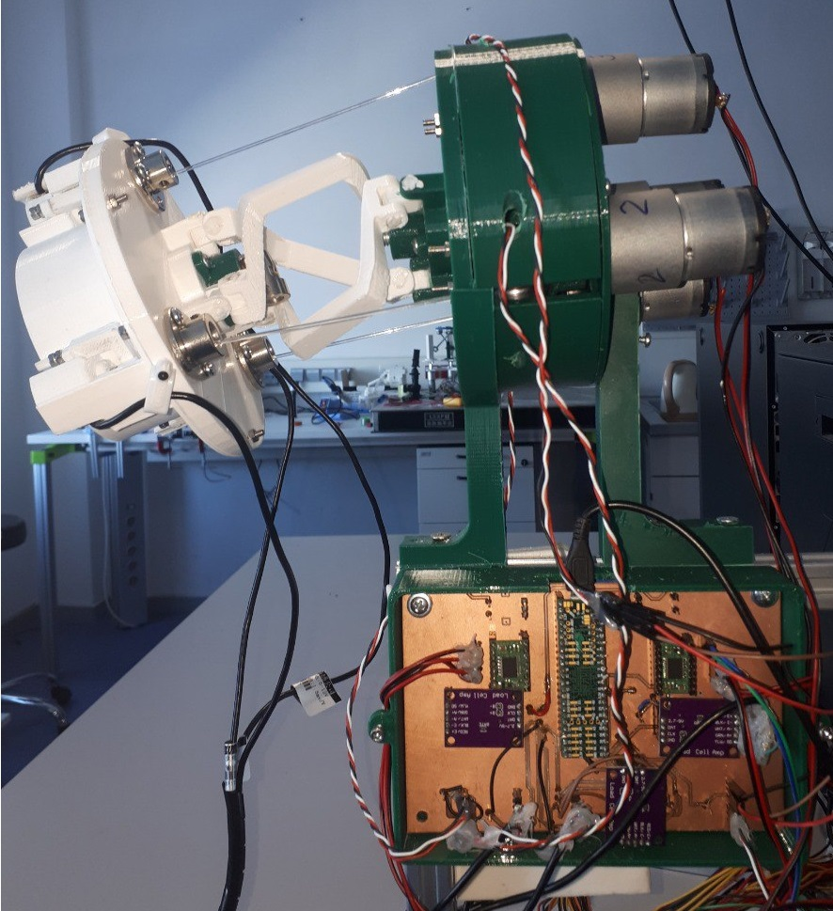
4. Testing and results
Figure 4-1. Proof of concept for a 3-DOF shoulder joint with an elastic tendon (only two actuated) realized in PLA.
The shoulder joint is bent to the target position.
Notes:
The Figure 4-1 shows proof of concept for a 3-DOF shoulder joint with an elastic tendon (only two actuated) realized in PLA.
The shoulder joint is bent to the target position.

Slide 52
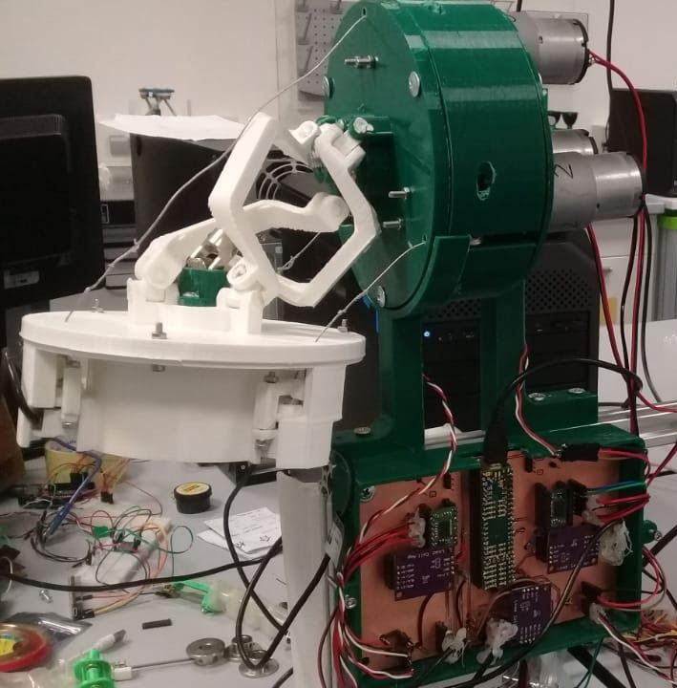
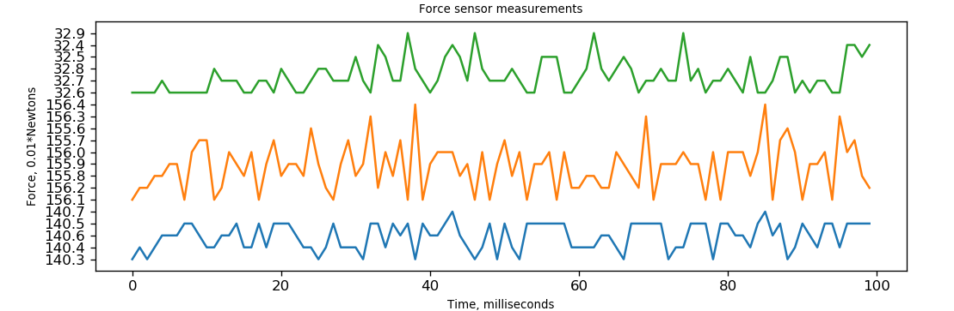
4.1. Force sensor experiment results
Figure 4-2. а) Act bottom (or act top – 90 degrees)
In this experiment we moved the real prototype in all the possible directions while monitoring the value of the tensions in the three tendons.
This is required to coordinate the tendons in order to avoid over-constrained configurations.
a:
a:

Slide 53
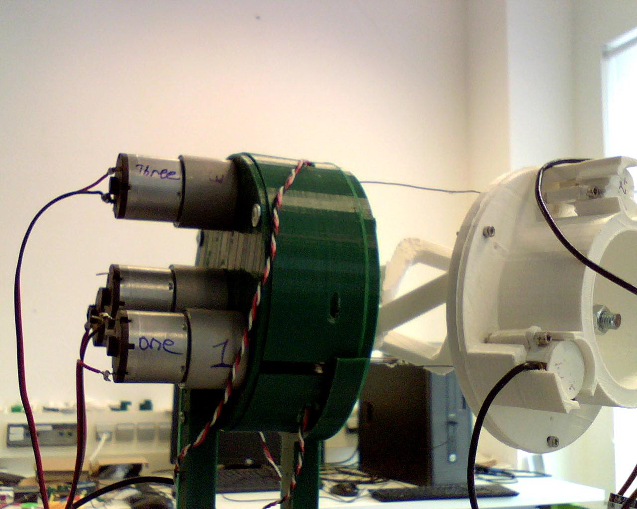
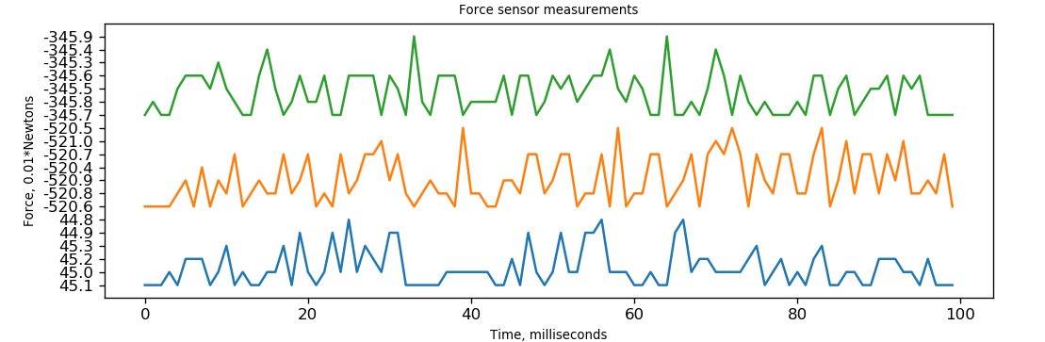
4.1. Force sensor experiment results
Figure 4-3. Act right 90 degrees.
The green line on the plot corresponds to the 1st motor which experiences the highest tension in the tendon
b:
b:

Slide 54
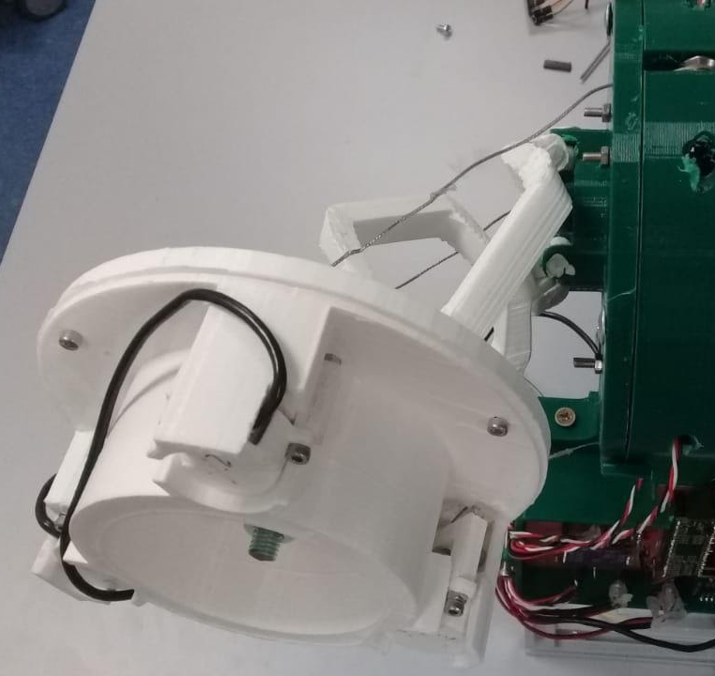
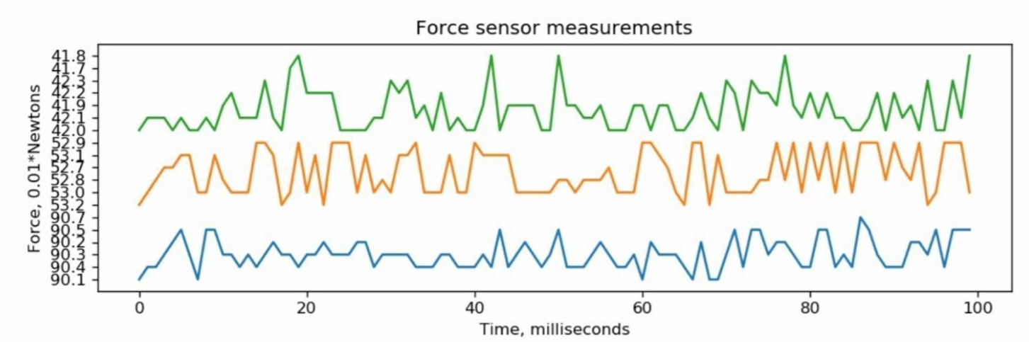
4.1. Force sensor experiment results
Act left about 90 degrees (the blue force sensor in the interface experiences the highest tension in the tendon, the force sensor value should be multiplied by 10 m Newton or by 0.01 Newton)

Slide 55
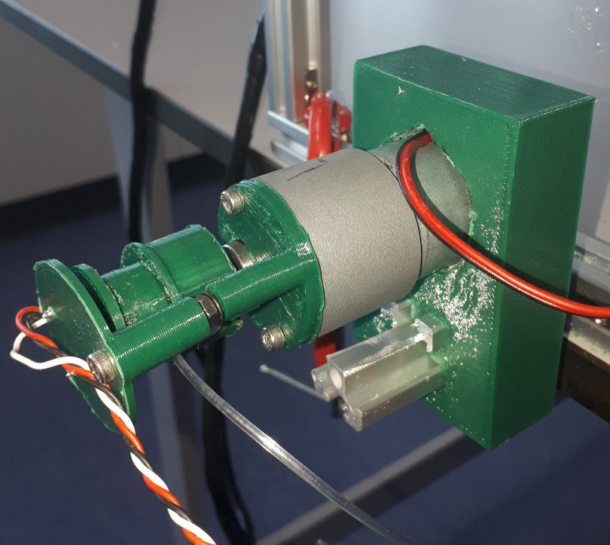
4.2. Position encoder experiment results
In order to measure the absolute position of the tendons a counter mechanism was installed to allow measuring rotation of the motor from 0 to 360×3 degree.
This required to store the last position of the motor before shutting down the system.
Figure 4-9. Position encoder experimental setup
Notes:
To observe the behavior of the pulley while winding and unwinding the tendon we build a small motor setup, see figure

Slide 56
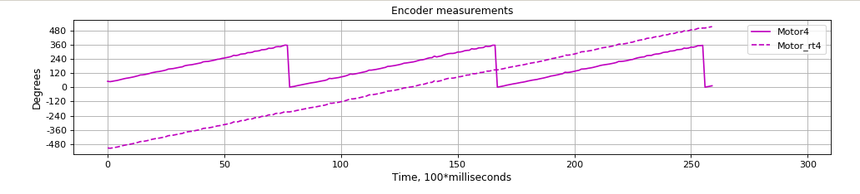

4.2. Position encoder experiment results.
Position encoder on forward direction continuous line, we can see the position of the encoder increasing from the last recorded position to 360 degrees then resetting to zero and increasing again.
On the dashed line we can see the absolute pulley position ranging from -480 to +480 degrees.
Figure 4-10. Position sensor experiment results.
Figure 4-11: Position encoder on reverse direction

Slide 57

4.3.Workspace Measurements
The workspace resembles the surface of a sphere: its radius is equal to the diameter of one of the two spheres that represent the rolling motion.
In the Figure the workspace of the shoulder joint is in the 3D space.
Figure 4-14. GUI, tab 2, Workspace Measurements
Notes:
In this experiment the model of the robot was moved in order to cover different points of the workspace.
In particular, the two angles defined the orientation of the moving platform were range in the interval 0-90 degrees.
The Figure shows the second tab of the interface, the workspace can be drawn according to the angle of the rotation given to the moving platform.

Slide 58


Slide 59


Slide 60
5. Conclusion and future work

Slide 61
Conclusion and future work
In this work a shoulder joint was developed for application in humanoid robotics.
The mechanism has a parallel kinematic structure with three limbs that allow a total of 2DOFs.
The shoulder joint is actuated with three tendons that are controlled by revolute motors.
Magnetic encoders were installed to estimate the lengths of the tendons and therefore the orientation of the moving platform.
In addition force sensors were installed to measure the tension of the tendons and therefore the forces applied to the moving platform.

Slide 62
Conclusion and future work
Development of a kinematic model to allow controlling the robot.
Development of a realistic kinematic-dynamic model in V-REP software.
Design of graphical interface in order to monitor all the sensory data and conduct a series of experiments on the model and the real prototype.

Slide 63
Conclusion and future work
The workspace of the shoulder joint was measured by controlling the lengths of the tendons within their maximum range. Overall, we have achieved full control of tendon actuated shoulder joint. The kinematic model we developed is based on the simplifying assumption that one limb moves and the other two limbs follow the first one.
The geometric method finds the length d_{i} of the manipulator which gives us the position and orientation of the moving platform.
This method requires further investigation and research in the future.

Slide 64
References

Slide 65
References
[1] Ball, S. J., Brown, I. E., & Scott, S. H. Medarm: a rehabilitation robot with 5dof atthe shoulder complex.IEEE/ASME international conference on Advanced intelligentmechatronics, 2007.
[2] Bhattacharyya, S., Konar, A., & Tibarewala, D. N. . Motor imagery, p300 and error-related eeg-based robot arm movement control for rehabilitation purpose.Medical& biological engineering & computing, 52(12):1007–1017, 2014.
[3] Buongiorno, D., Sotgiu, E., Leonardis, D., Marcheschi, S., Solazzi, M., & Frisoli, A.Wres: a novel 3 dof wrist exoskeleton with tendon-driven differential transmissionfor neuro-rehabilitation and teleoperation.IEEE Robotics and Automation Letter.,3(3):2152–2159, 2001.[4] Graimann, B., Allison, B., & Pfurtscheller, G. . Brain-computer interfaces: A gentleintroduction.In Brain-computer interfaces, pages 1–27, 2009.[5] Hussein, M. E. . 3d printed myoelectric prosthetic arm.(Thesis Bachelor degreeEngineering (Mechatronics), pages 1–87, 2014.[6] Jiang, H., Zhang, T., Xiao, C., Li, J., & Guan, Y. Modular design of 7-dof cable-driven humanoid arms.In International Conference on Intelligent Robotics andApplications, pages 680–691, 2019, August.[7] Kim, Y. J., Kim, J. I., & Jang, W. Quaternion joint: Dexterous 3-dof joint rep-resenting quaternion motion for high-speed safe interaction.In 2018 IEEE/RSJInternational Conference on Intelligent Robots and Systems (IROS), pages 935–942,2018, October.[8] Saduanov, B., Tokmurzina, D., Kunanbayev, K., & Abibullaev, B. . Design andoptimization of a real-time asynchronous bci control strategy for robotic manipu-lator assistance.In 2020 8th International Winter Conference on Brain-ComputerInterface (BCI), pages 1–5, (2020, February).[9] Al-Quraishi, M. S., Elamvazuthi, I., Daud, S. A., Parasuraman, S., & Borboni,A. Eeg-based control for upper and lower limb exoskeletons and prostheses: Asystematic review.Sensors, 18(10):3342, 2018.[10] Bhagat, N. A., Venkatakrishnan, A., Abibullaev, B., Artz, E. J., Yozbatiran, N.,Blank, A. A., ... & Francisco, G. E. Design and optimization of an eeg-based brainmachine interface (bmi) to an upper-limb exoskeleton for stroke survivors.Frontiersin neuroscience, 10(122), 2016.
[11] A.D. Biryukov. Development of software for contactless control of an anthropomor-phic robot (doctoral dissertation, south ural state university).dspace.susu.ru, pages1780–1785, 2017.[12] Filimonov, S. A. . Development of a methodology for designing a robotic arm usingapplication software packages.Visnik of the Cherkasy State Technological University.Series: Technic Sciences, 1:27–32, 2015.[13] Folgheraiter, M., Jordan, M., Straube, S., Seeland, A., Kim, S. K., & Kirchner, E.A. Measuring the improvement of the interaction comfort of a wearable exoskeleton.International Journal of Social Robotics, 4(3):285–302, 2012.[14] Frolov, A.A., Biryukova, E.V., Bobrov, P.D., Kurgan, M.E., Pavlova, O.G., Kondur,A.A., ... & Kotov, S. V. The effectiveness of complex neurorehabilitation of pa-tients with post-stroke paresis of the hand using the brain-computer + exoskeletonneurointerface.Almanac of Clinical Medicine, 44(3), 2016.[15] Fu, M. J., Daly, J. J., & Cavusoglu, M. C. Assessment of eeg event-related desynchro-nization in stroke survivors performing shoulder-elbow movements.In Proceedings2006 IEEE International Conference on Robotics and Automation, pages 3158–3164,2006, May.[16] Guger, C., Allison, B. Z., Großwindhager, B., Prückl, R., Hintermüller, C., Kapeller,C., ... & Edlinger. How many people could use an ssvep bci?Frontiers in neuro-science, 6:169, 2012.[17] Lew, E. Y., Chavarriaga, R., Silvoni, S., & Millán, J. D. R. . Single trial predictionof self-paced reaching directions from eeg signals.Frontiers in neuroscience, 8(222),2014.[18] Luu, T. P., Nakagome, S., He, Y., & Contreras-Vidal, J. L. Real-time eeg-basedbrain-computer interface to a virtual avatar enhances cortical involvement in humantreadmill walking.Scientific reports, 7(1):1–12, 2017.[19] Marakhin, E. Yu., & Belyaeva, A. S. Increasing the speed of the positional controlof the movement of the robot arm.PROBLEMS OF MODERN SCIENCE ANDEDUCATION, 29, 2015.[20] Nurtay, B., Suranshy, T., & Folgheraiter, M. Development of a semi-rigid tendonactuated limb for robotics applications.In 2020 5th International Conference onRobotics and Automation Engineering (ICRAE), 5:31–35, 2020.[21] Z. Otarbay, I. Assylgali, A. Yskak, and M. Folgheraiter. Development of a teachpendant for humanoid robotics with cartesian and joint-space control modalities. In2019 28th IEEE International Conference on Robot and Human Interactive Com-munication (RO-MAN), pages 1–6, 2019.[22] Popov, L.A. . Anthropomorphic robot by means of 3d printing.In COLLECTIONOF ARTICLES FORTY-SEVENTH INTERNATIONAL SCIENTIFIC CONFER-ENCE "TECHNOKONGRESS", 217:14, 2019, October 07.[23] S. S. Ryumkin. Adaptive control of a robotic arm.LBC 32.965 AND 74 EDITORIALBOARD, page 30, 2018.
[24] Shcherbak, D. Yu., Ignatiev, V. V., Leshchenko, S. A., & Ignatieva, A. S. Solution ofthe problem of control of a robot-manipulator with the help of fuzzy logic.ComputerScience, Computer Science and Engineering Education, 1:41–53, 2018.[25] Stienen, A. H., Hekman, E. E., Van Der Helm, F. C., & Van Der Kooij, H. . Self-aligning exoskeleton axes through decoupling of joint rotations and translations.IEEE Transactions on Robotics, 25(3):628–633, 2009.[26] Tursynbek, I., & Shintemirov, A. . Infinite torsional motion generation of a sphericalparallel manipulator with coaxial input axes.In 2020 IEEE/ASME InternationalConference on Advanced Intelligent Mechatronics (AIM), pages 1780–1785, 2020,July.[27] Tursynbek, I., Niyetkaliye, A., & Shintemirov, A. . Computation of unique kine-matic solutions of a spherical parallel manipulator with coaxial input shafts.In2019 IEEE 15th International Conference on Automation Science and Engineering(CASE), pages 1524–1531, 2020, December.[28] Vorobiev, A. A., Petrukhin, A. V., Zasypkina, O. A., & Krivonozhkina, P. S. Ex-oskeleton - new opportunities for abilitation and rehabilitation (analytical review).Questions of reconstructive and plastic surgery, 2(53), 2015.[29] Zakirov, R.I., Aliev, M.I., & Morozov, A.I. . Determination of kinematic charac-teristics of a delta-robot by given parameters of the working area.Electrical andinformation complexes and systems, 14:4, 2018.[30] E. D. Zavyalov. Development of a robotic platform for ultrasonic testing of weldedseams: master’s thesis in the field of training: 15.04.Mechatronics and Robotics,15(4), 2018.[31] Zavyalova, T.V. The problem of optimal stabilization of the speed of the angle ofrotation of the robotic arm.In Mathematical Modeling and Information Technologies,pages 123–128, 2016.

