Slide 1
Assessment of Hybridization Ratio for a Small Hybrid-Electric Business Jet
Arailym Alibek
2nd Year Master in Mechanical and Aerospace Engineering
Supervisor: Associate Professor Basman Elhadidi
Co-Supervisor: Professor Essam Shebab

Slide 2








Outline
Introduction
Literature Review
Research Gap
Aim & Objectives
Methodology
Results
Discussion
Future Perspectives

Slide 3
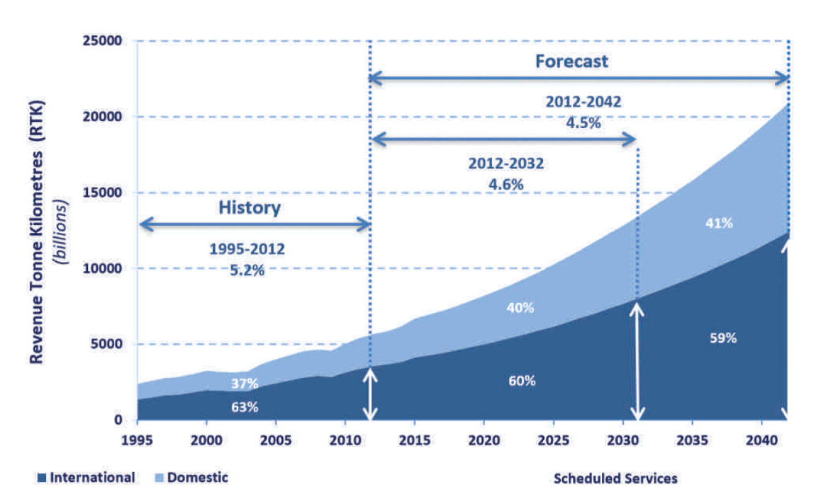

Introduction
Next 20 years
3 % of global CO2, NOx, other particles
x 7
x 2
After applicating MEA concept
reduced
Footprint 70-75%
Weight x 9
Operating cost x 5
Design complexity

Slide 4

MEA propulsion systems
Sized according to:
the fuel power;
conventional
series hybrid electric
EM
electric power.
fuel
ICE
generator
EM
fuel
ICE
generator
EM
electrical
mechanical
EM
battery
all-electric
parallel hybrid electric
EM
battery
EM
fuel
ICE
generator
EM
+
EM
+
battery

Slide 5
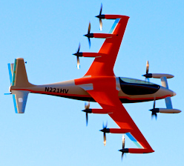
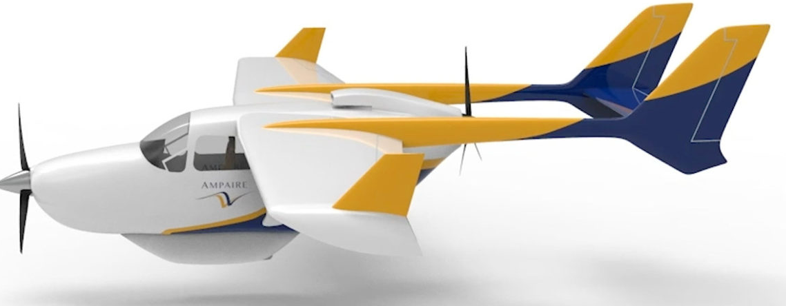
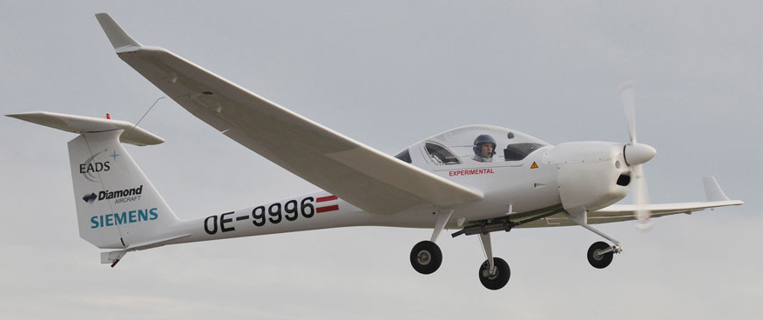
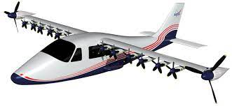
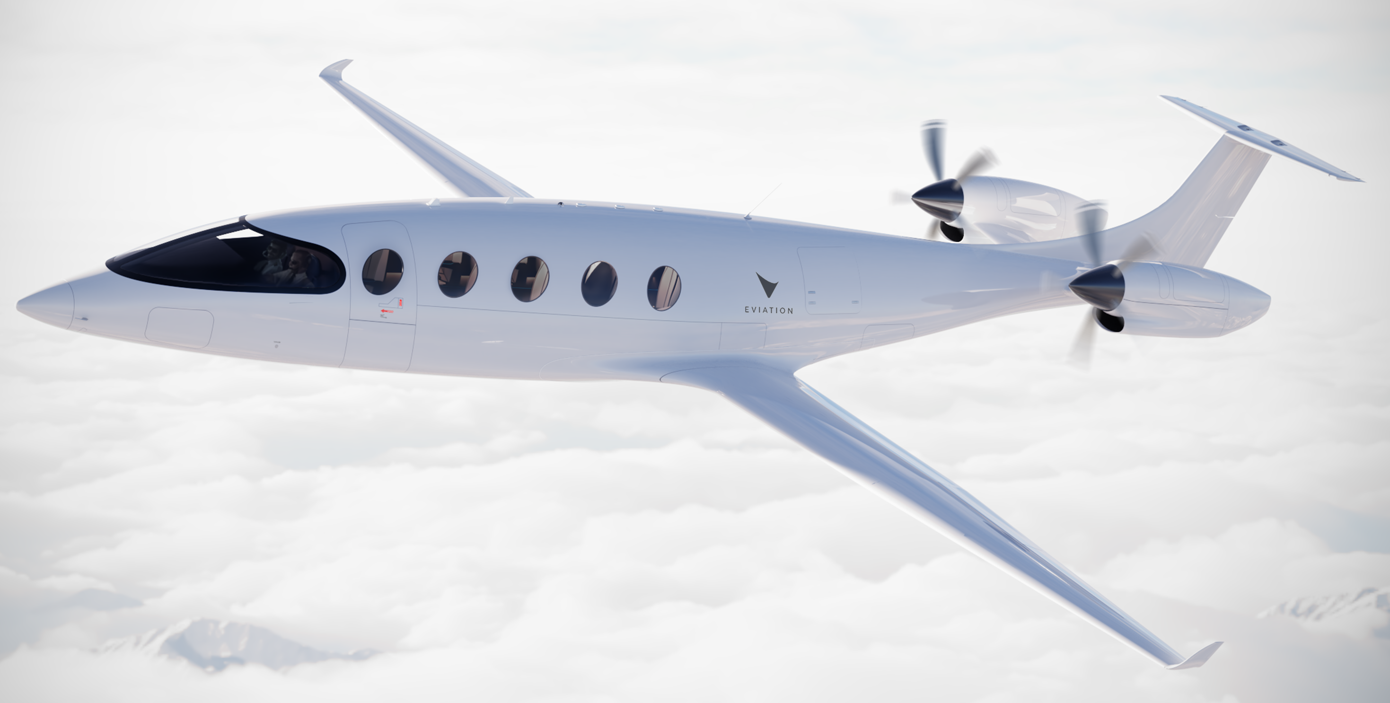
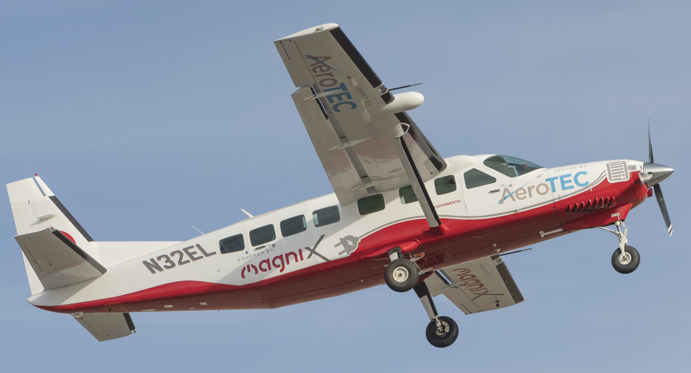
Top successful hybrid-electric aircraft cases
Ampaire Electric EEL
Kitty Hawk Heaviside
NASA X-57 Maxwell
Dimond DA36 E-Star
Magnix Ecaravan
Eviation Alice

Slide 6
Summary of Literature Review
20 % fuel saved [22]
Guarantee powerful performance reducing emission and fuel [23]
Weight of aircraft reduced [24,25]
Middle-scale aircraft is an ideal problem [26]
All electric HEPS show reduction in 3 parameters [27].
Regional aircraft is more feasible than general [14-17]
Application of range equations [18,19]
Constant fuel consumed independent to flight characteristics [20]
Flight speed and altitude is crucial in assessing HEP [21]
Full mission profile is important [23]
Aircraft
electrification
Feasibility
Sizing of aircraft
Optimization
Techniques
Integrated sizing methodology [24,25]
Conventional sizing methodology [22]
Preliminary design [27]
Preliminary suitable sizing method [31]
Rule-based EMS [32]
Global optimization EMS [33]
Instantaneous optimization EMS [34]

Slide 7

Research gap analysis
Flight mission
1 mission profile
short mission target
Non-considered optimization:
charging and discharging battery,
one flight mode,
small battery ratio
Propulsion systems (PS):
No comparison between PS,
one or two HEPS,
average parameters except optimal
All these gaps are fulfilled by the thesis, treating them as starting directions

Slide 8

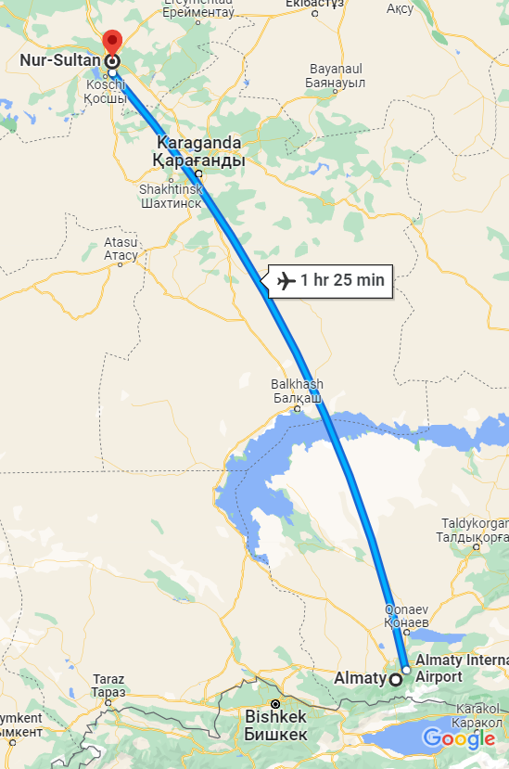
The aim and objectives
The thesis is aimed to assess the hybridization ratio for a medium range aircraft.
951 km
Key objectives are to:
Investigate the airframe of the considered aircraft`s propulsion system
Assess its power supply strategy for series, parallel HEPS, all electric, all ICE and for quiet takeoff and landing scenarios.
Establish the optimal hybridization ratio after acquiring weight distribution of hybrid-electric energy sources for series, parallel HEPS and quiet takeoff and landing.

Slide 9
Research methodology
Research problem formulation
Literature Review and Organization
Aircraft performance evaluation
Simulation
Airframe assessment
Estimation of fuel and battery weight
1
2
3
4
5
6
Analysis of the recent studies and actual problems to solve;
Research gap analysis
Found literature is organized according to the research questions;
Literature is critically reviewed.
Equations for Aircraft Performance according to mission flight
To estimate important parameters such as Cd, Cl and etc.
Equations
Apply 4 propulsion system types:
series, parallel, all-electric and ICE.
Assumptions:
battery discharge limit till 30%
battery is used for short flights
Using Matlab platform
Power-based conceptual sizing methodology
Considering full mission profile: from climb to landing

Slide 10
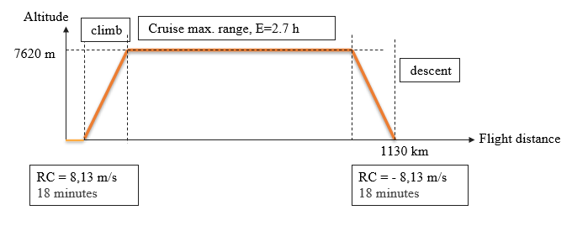
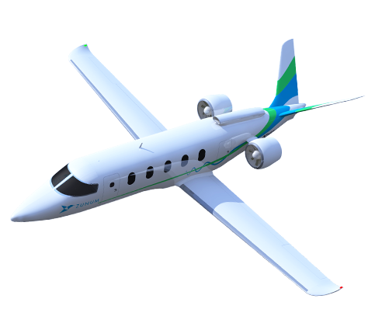





Mission profile and power distribution
Zunum Aero ZA10
Power, kW
fueled
electrified
545,62
$$m_{ICE}$$
516,11
$$m_{EM}$$
$$m_{gen}$$
232
$$m_{f}$$
$$m_{b}$$

Slide 11
Pure ICE scenario
Electric power
ICE power
EM
Pure ICE:
fuel
ICE
generator
EM
Weight distribution for pure ICE
Mass of fuel | 413.6 kg
Mass of ICE | 212.2 kg
Mass of generator | 104 kg
Mass of EM | 104 kg
EM
Sized according to the maximum power
Power, kW
545,62
516,11
232
time, h
0,3
2,1
0,3

Slide 12
Pure electric scenario
Electric power
ICE power
Pure electric:
EM
$$m_{b}=\frac{1}{0,7}{(\frac{P_{climb} t_{climb}+P_{cruise} t_{cruise}+P_{landing} t_{landing}}{e})}$$
battery
EM
EM
Weight distribution for pure EM
Mass of battery | 4 202 kg
Mass of EM | 104 kg
Sized according to the maximum power
Power, kW
545,62
516,11
232
time, h
0,3
2,1
0,3

Slide 13
Series Hybrid scenario
EM
fuel
ICE
generator
EM
EM
Sized according to the power for takeoff
Sized according to the 75-200 % of power for cruise
battery
Power, kW
545,62
516,11
Electric power
232
ICE power
SOC
time, h
100%
30%
time, h
0,3
2,1
0,3

Slide 14
Results
30% of MTOW

Slide 15
Quiet TO & LA
Electric power from charged battery
Electric power
ICE power
Power, kW
545,62
516,11
232
time, h
0,3
2,1
0,3
30% of MTOW
SOC
100%
30%
time, h
0,3
2,1
0,3

Slide 16
Parallel Hybrid scenario 1
Parallel HEPS starting from 134% fueled cruise flight (1st case)
fuel
ICE
generator
+
Electric power from charged battery
EM
Power, kW
+
Electric power
battery
545,62
ICE power
516,11
232
Excess power of cruise for charging the battery
time, h
SOC
100%
30%
time, h
0,3
2,1
0,3

Slide 17
Parallel Hybrid scenario 2 (Military case)
Parallel HEPS starting from 135,5% fueled cruise flight (2nd case)
Power, kW
545,62
516,11
232
time, h
SOC
Electric power from charged battery
Electric power
100%
ICE power
30%
time, h
0,3
2,1

Slide 18
Discussion
Conventional and all-electric
Series HEPS
Quiet TO & LA
Parallel HEPS
30% of MTOW

Slide 19

Conclusion
Parallel HEPS
Quiet Takeoff and Landing
Quiet Attack
Payload maximization
CO2 reduction to almost 20%
Series HEPS
CO2 reduction to almost 40%
Feasible > 140% of cruise power
Increase in HR leads to reduction of payload capacity, CO2 emission and rise in weight of aircraft propulsion system;
HEPS is feasible for small HR;
Rapid charging reduces the effect of HR;
Large HR cause reduction in range and endurance.

Slide 20

Future directions
Contribution
Preliminary design of HEPS;
Comparison of HEPS in same mission profile and speed parameters;
Identify the influence of HR on aircraft propulsion weight;
Enhance the performance of the aircraft during takeoff and landing.
Testing with actual specification of the aircraft;
Multi-disciplinary optimization;
Other aircraft model, missions and range;
Other battery and engine types;
Maintenance cost and safety.

Slide 21
References
[1] NASA. Global Climate Change: Vital Signs of the Planet. https://climate.nasa.gov/vital- signs/ carbon-dioxide/
[2] European Aviation Safety Agency (EASA). European Aviation Environmental Report 2019. Online; accessed 19 September 2019. 2019. url: https://www.easa.europa.eu/eaer/system/files/usr_uploaded/219473_EASA_EAER_2019_WEB_HI-RES_190311.pdf
[3] M. Lukic, P. Giangrande, A. Hebala, S. Nuzzo and M. Galea, "Review challenges and future developments of electric taxiing systems", IEEE Transactions on Transportation Electrification, vol. 5, no. 4, pp. 1441-1457, Dec. 2019. https://doi.org/10.1109/TTE.2019.2956862
[4] A. W. Schäfer et al., "Technological economic and environmental prospects of all-electric aircraft", Nature Energy, vol. 4, no. 2, pp. 160-166, Feb. 2019. http://dx.doi.org/10.1038/s41560-018-0294-x
[5] J. A. Rosero, J. A. Ortega, E. Aldabas and L. Romeral, "Moving towards a more electric aircraft", IEEE Aerospace and Electronic Systems Magazine, vol. 22, no. 3, pp. 3-9, Mar. 2007. https://doi.org/10.1109/MAES.2007.340500
[6] W. Cao, B. C. Mecrow, G. J. Atkinson, J. W. Bennett and D. J. Atkinson, "Overview of electric motor technologies used for more electric aircraft (MEA)", IEEE Transactions on Industrial Electronics, vol. 59, no. 9, pp. 3523-3531, Sep. 2012. https://doi.org/10.1109/TIE.2011.2165453
[7] O. Bottauscio, G. Serra, M. Zucca and M. Chiampi, "Role of magnetic materials in a novel electrical motogenerator for the more electric aircraft", IEEE Transactions on Magnetics, vol. 50, no. 4, pp. 1-4, Apr. 2014. http://dx.doi.org/10.1109/TMAG.2013.2284937
[8] J. Serafini, M. Cremaschini, G. Bernardini, L. Solero, C. Ficuciello, and M. Gennaretti, “Conceptual All-Electric Retrofit of Helicopters: Review, Technological Outlook, and a Sample Design,” IEEE Transactions on Transportation Electrification, vol. 5, no. 3, pp. 782–794, 2019. https://doi.org/10.1109/TTE.2019.2919893
[9] F. Kelch, Y. Yang, B. Bilgin and A. Emadi, "Investigation and design of an axial flux permanent magnet machine for a commercial midsize aircraft electric taxiing system", IET Electrical Systems in Transportation, vol. 8, no. 1, pp. 52-60, Mar. 2018. http://dx.doi.org/10.1049/iet-est.2017.0039
[10] NAP, 2016. Commercial Aircraft Propulsion and Energy Systems Research: Reducing Global Carbon Emissions. Washington, D.C: The National Academies Press. Available at: https://doi.org/10.17226/2349
[11] A. Adib et al., “E-Mobility - Advancements and Challenges,” IEEE Access, vol. 7, pp. 165226–165240, 2019. https://doi.org/10.1109/ACCESS.2019.2953021
[12] National Academies of Sciences, Engineering, and Medicine and others, Commercial aircraft propulsion and energy systems research: reducing global carbon emissions. National Academies Press, 2016 https://nap.nationalacademies.org/read/23490/chapter/2

Slide 22
References
[13] A. Misra, “Energy Storage for Electrified Aircraft: The Need for Better Batteries, Fuel Cells, and Supercapacitors,” IEEE Electrification Magazine, vol. 6, no. 3, pp. 54–61, 2018. https://doi.org/10.1109/MELE.2018.2849922
[14] B. J. Brelje and J. R. Martins, "Electric hybrid and turboelectric fixed-wing aircraft: A review of concepts models and design approaches", Progress in Aerospace Sciences, vol. 104, pp. 1-19, 2019. https://doi.org/10.1016/j.paerosci.2018.06.004
[15] T. S. Dean, G. E. Wroblewski and P. J. Ansell, "Mission Analysis and Component-Level Sensitivity Study of Hybrid-Electric General-Aviation Propulsion Systems", Journal of Aircraft, vol. 55, no. 6, pp. 2454-2465, 2018. http://dx.doi.org/10.2514/1.C034635
[16] M. Voskuijl, J. van Bogaert and A. G. Rao, "Analysis and design of hybrid electric regional turboprop aircraft", CEAS Aeronautical Journal, vol. 9, no. 1, pp. 15-25, 2018. https://doi.org/10.1007/s13272-017-0272-1
[17] G. E. Wroblewski and P. J. Ansell, "Mission Analysis and Emissions for Conventional and Hybrid-Electric Commercial Transport Aircraft", Journal of Aircraft, vol. 56, no. 3, 2019. https://doi.org/10.2514/1.C035070
[18] R. de Vries, M. F. M. Hoogreef and R. Vos, "Range Equation for Hybrid-Electric Aircraft with Constant Power Split", Journal of Aircraft, vol. 57, no. 3, pp. 552-557, 2020. https://doi.org/10.2514/1.C035734
[19] B. Yang, F. Lou and N. Key, "Conceptual Design of a 10-passenger Thin-haul Electric Aircraft", AIAA Propulsion and Energy 2020 Forum American Institute of Aeronautics and Astronautics, pp. 08242020 http://dx.doi.org/10.2514/6.2020-3589
[20] P. G. Juretzko, M. Immer and J. Wildi, "Performance analysis of a hybrid-electric retrofit of a RUAG Dornier Do 228NG", CEAS Aeronautical Journal, vol. 11, no. 1, pp. 263-275, 2020. https://doi.org/10.1007/s13272-019-00420-2
[21] Y. Liu, H. Wang, J. Zhang, T. Jiang and Y. Zheng, "Retrofit and New Design of Regional Aircraft with Hybrid Electric Propulsion," 2021 AIAA/IEEE Electric Aircraft Technologies Symposium (EATS), 2021, pp. 1-12, https://doi.org/10.23919/EATS52162.2021.9704854
[22] Q. Zhu, A. Forsyth and R. Todd, "Investigation of Hybrid Electric Aircraft Operation on Battery Degradation," 2018 IEEE International Conference on Electrical Systems for Aircraft, Railway, Ship Propulsion and Road Vehicles & International Transportation Electrification Conference (ESARS-ITEC), 2018, pp. 1-6, https://doi.org/10.1109/ESARS-ITEC.2018.8607617

Slide 23
References
[23] R. Glassock, M. Galea, W. Williams, and T. Glesk, "Hybrid Electric Aircraft Propulsion Case Study for Skydiving Mission," Aerospace, vol. 4, no. 3, doi: 10.3390/aerospace4030045.
[24] R. de Vries, M. Brown, and R. Vos, "Preliminary Sizing Method for Hybrid-Electric Distributed-Propulsion Aircraft," Journal of Aircraft, vol. 56, no. 6, pp. 2172-2188, 2019/11/01 2019, doi: 10.2514/1.C035388.
[25] C. E. D. Riboldi, "An optimal approach to the preliminary design of small hybrid-electric aircraft," Aerospace Science and Technology, vol. 81, pp. 14-31, 2018/10/01/ 2018, doi: https://doi.org/10.1016/j.ast.2018.07.042.
[26] Y. Xie, A. Savvarisal, A. Tsourdos, D. Zhang, and J. Gu, "Review of hybrid electric powered aircraft, its conceptual design and energy management methodologies," Chinese Journal of Aeronautics, vol. 34, no. 4, pp. 432-450, 2021/04/01/ 2021, doi: https://doi.org/10.1016/j.cja.2020.07.017.
[27] E. Fornaro, M. Cardone, and A. Dannier, "A Comparative Assessment of Hybrid Parallel, Series, and Full-Electric Propulsion Systems for Aircraft Application," IEEE Access, vol. 10, pp. 28808-28820, 2022, doi: 10.1109/ACCESS.2022.3158372.
[28] Q. Zhu, A. Forsyth, and R. Todd, "Investigation of Hybrid Electric Aircraft Operation on Battery Degradation," in 2018 IEEE International Conference on Electrical Systems for Aircraft, Railway, Ship Propulsion and Road Vehicles & International Transportation Electrification Conference (ESARS-ITEC), 7-9 Nov. 2018 2018, pp. 1-6, doi: 10.1109/ESARS-ITEC.2018.8607617.
[29] M. Factory. Zunum Aero ZA10: Hybrid-Electric Regional Airliner Aircraft [2022] [Online] Available: https://www.militaryfactory.com/aircraft/detail.php?aircraft_id=2028
[30] D. Finger, C. Braun, and C. Bil, An Initial Sizing Methodology for Hybrid-Electric Light Aircraft. 2018.

Slide 24
Thank you for your attention!

