Slide 1
COVID-19 Classification in CT Images with Convolutional Neural Network-based ensemble learning
School of Engineering and Digital Sciences
Master of Science in Data Science
Student: Dina Kushenchirekova
Lead Supervisor: Min-Ho Lee | Assistant Professor of Computer Science
Co-Supervisor: Adnan Yazici | Department Chair, Full Professor
26.04.2022

Slide 2
Presentation Outline
Introduction
Motivation
Problem statement
Problem objectives
2. Methodology
Datasets
CNN Architectures
Ensemble learning algorithm
Evaluation
3. Results
4. Limitations
5. Conclusion
6. Future work
7. Reference

Slide 3
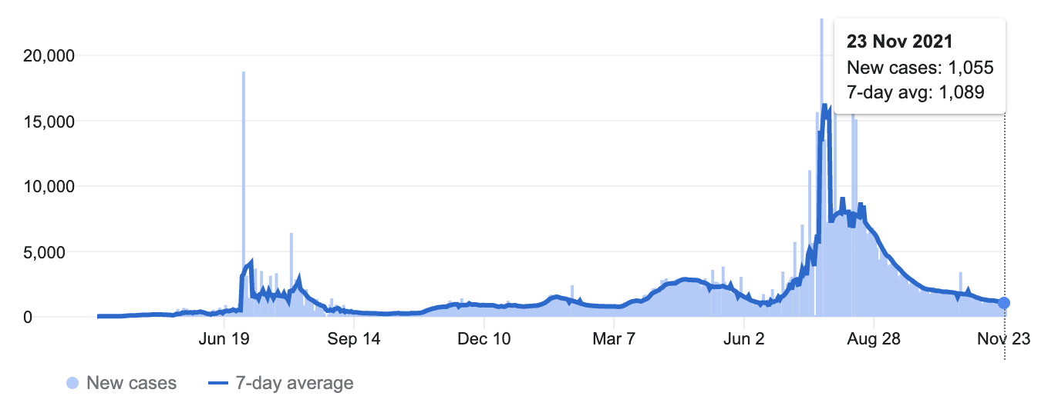
Introduction
More than 506 million cases and 6.2 million deaths globally.
Specifically in Kazakhstan number of detected COVID-19 cases reached over 1.3 million cases.
Early detection of COVID-19 cases play an important role in providing emergency help for the affected people.
Deep Learning provides tools to create time efficient method for COVID-19 disease.
Figure 1. Worldwide statistics for COVID-19 cases.

Slide 4
Introduction
Motivation:
Detection diseases at an early stage will help reduce the number of deaths and may also create new devices in medicine for detecting defects in medical images.
The task of working with medical images has always been difficult and time-consuming for even experienced specialists.
Many CNN models were proposed for COVID-19 classification, but they give inconsistent results.
Problem statement:
The problem of inconsistency might be the specific structure of each of the CNN architecture.
Problem objectives:
Finding the Most Effective and Accurate Model for COVID-19 CT Scan classification.
Train 8 architecture in 3 dataset.
Running ensemble model with fine-tuning.
Provide visualization and explainability to the models.

Slide 5
Literature review
Publications |  |  |  | Performance evaluation
 | Year | Imaging | Classes | CNN architecture | Accuracy
S. El-Bana et al. [1]A multi-task pipeline with specialized streams for classification and segmentation of infection manifestations in COVID-19 scans. | 2020 | CXR | 2,C,N | InceptionV3 | 0.96
P.Lacerda et al. [2] Hyperparameter optimization for covid-19 pneumonia diagnosis based on chest ct. | 2021 | CT | 2,C,N | VGG16 | 0.88
C.Fang et al. [3] Deep learning for predicting covid-19 malignant progression, Medical image analysis. | 2021 | CT | 2,C,P | 3D ResNet+ | 0.88
H.Quan et al. [4] Dense capsnet: Detection of covid-19 from x-ray images using a capsule neural network. | 2021 | CXR | 3,N,P,C | DenseCapsNet | 0.91
K. Rangarajan et al. [5] Artificial intelligence–assisted chest x-ray assessment scheme for covid-19. | 2021 | CXR | 2,C,N | CovidAid V2 | 0.92

Slide 6
Literature review contd.
Publications |  |  |  | Performance evaluation
 | Year | Imaging | Classes | CNN architecture | Accuracy
L. Wang et al. [6] Covid-net: A tailored deep CNN design for detection of covid-19 cases from chest x-ray images. | 2020 | CXR | 3, C,N,P | COVID-Net | 0.93
Z.Zhu et al. [7] Automated Deep Transfer Learning-Based Approach for Detection of COVID-19 Infection in Chest X-rays. | 2020 | X-Ray | 3, C,N,P | ResNet50 | 0.93
D. Dansana et al. [8] Early diagnosis of covid-19 affected patients based on. x-ray and computed tomography images using deep learning algorithm. | 2020 | CXR | 3, C,N,P | VGG-16+ | 0.91
E. H. Lee,et al. [9] Deep covid detect: an international experience on covid-19 lung detection and prognosis using chest ct. | 2021 | CT | 2,C,N | 3D-CNN | 0.88
Ziwei Zhu et al. [10] Classification of covid-19 by compressed chest ct image through deep learning on a large patients cohort. | 2021 | CT | 2,C,N | ResNet50 | 0.95

Slide 7
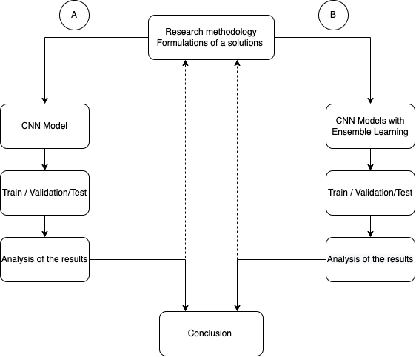
Methodology [1/13]
Methodology included:
A. Standalone CNN models:
  8 CNN architectures were used: VGG-19, VGG-16, MobileNetV2, Xception, ResNet50V2, DenseNet201, Inception-V3, and EfficientNetB3.
B. Ensemble of CNN models:
  Ensemble Learning Algorithm stacks several neural network architectures into one. The logic behind the method is to extract features from the images using several of the above-mentioned models and combine the features into a "stack".
Figure 2. Proposed research formulation.

Slide 8
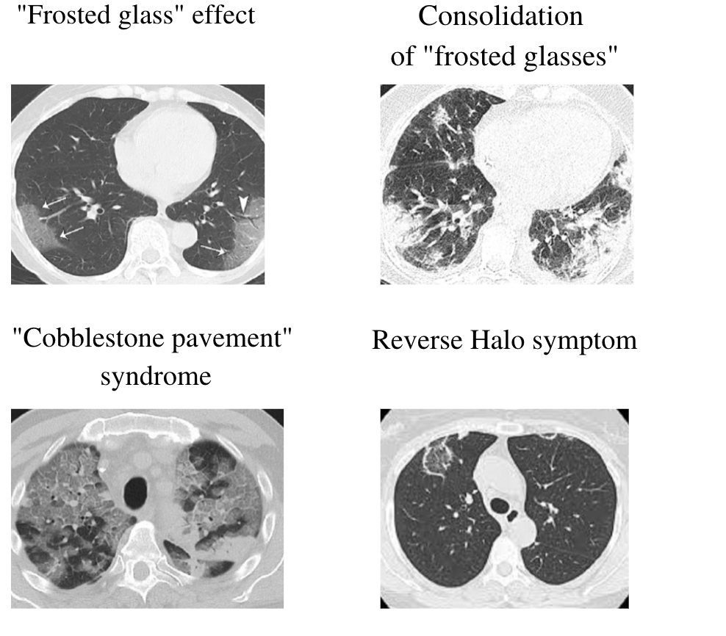
Dataset - CT Findings
Methodology [2/13]
CT is a highly modified X–ray, which represents a computerized imaging device mounted inside of rotating "bagel".
With the help of special computer processing reconstruction methods, we get a three-dimensional data set: a set of very thin cross-sections of the human body, from which we can then arbitrarily rebuild any other planes.
The following are examples of what the lungs look like on a CT-scan of a coronavirus infection. Patients with inflammation caused by coronavirus infection, tomograms show a characteristic radiological sign, which can be viewed in Figure 1.
Figure 3. Characteristic of radiological signs of coronavirus infection.

Slide 9
Dataset
Methodology [3/13]
For the implementation of the CT scan classification problem we used 3 datasets:
Aim of this data collection is to encourage artificial intelligence research and development for determining whether a patient is diagnosed with SARS-CoV-2 by monitoring his or her computed tomography scans.
Each dataset includes collection of labeled computer tomography scans.
Dataset were divided into train, validation and test, approximately 70/15/15.
Datasets consist of two classes:
  C - Covid, N - NonCovid.
Table 1. Dataset samples.
Dataset | Samples | Classes | Train | Test | Validation
COVIDX CT [9] | 18354 | C,N | 12847 | 2753 | 2754
UCSD COVID-CT [7] | 425 | C,N | 297 | 63 | 65
SARS-COV-2 CT [8] | 2482 | C,N | 1737 | 372 | 373

Slide 10
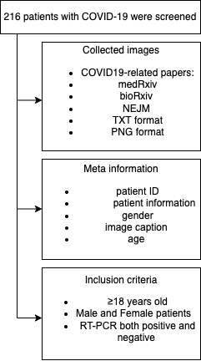
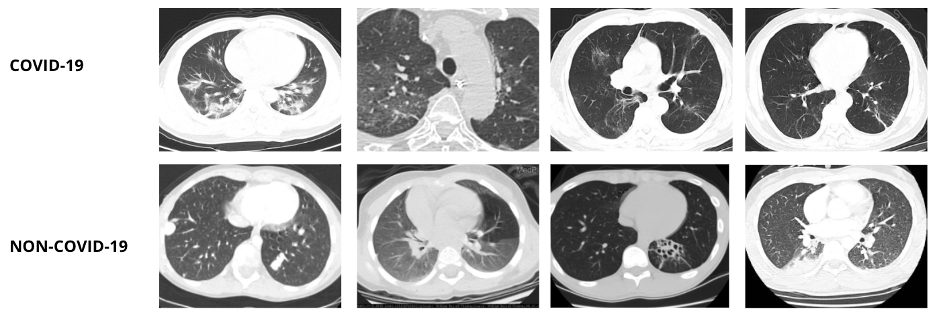
Dataset - UCSD COVID-CT [11]
Methodology [4/13]
Figure 4. COVID-CT images from the UCSD COVID-CT Dataset.

Slide 11
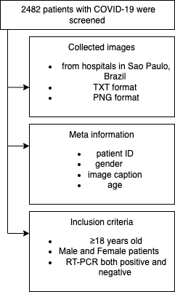
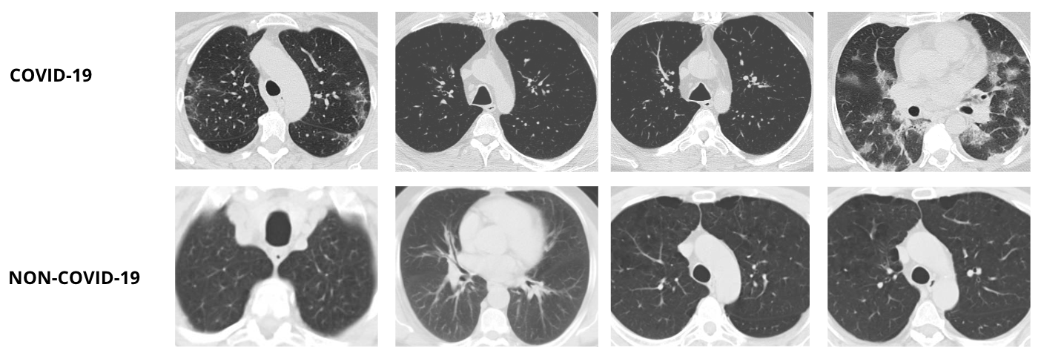
Dataset - SARS-COV-2 CT [12]
Methodology [5/13]
Figure 5. COVID-CT images from the SARS-COV-2 CT Dataset.

Slide 12
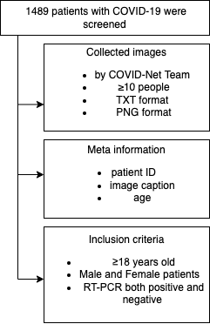
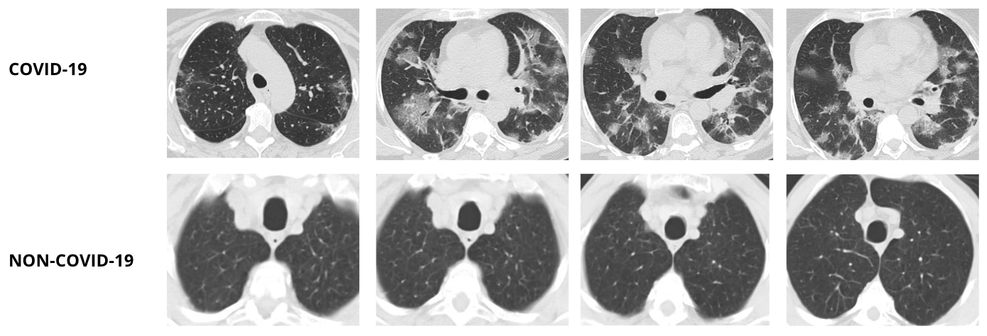
Dataset - COVIDX CT [13]
Methodology [6/13]
Figure 6. COVID-CT images from the COVIDX CT Dataset.

Slide 13
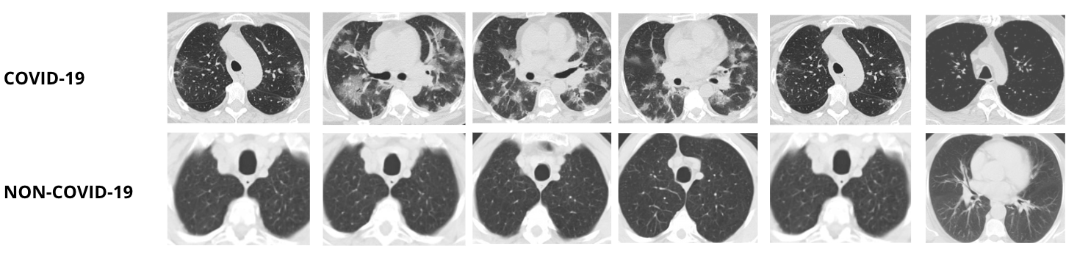
Dataset
Key characteristic:
Methodology [7/13]
Explicit choice of datasets with different quality, distribution and size of samples.
Large dataset had to be used to get the best possible result for our models.
Data went through multiple stages of preprocessing and augmentation before training.
Figure 7. COVID-CT images examples of COVID-19 cases and NON-COVID cases.

Slide 14
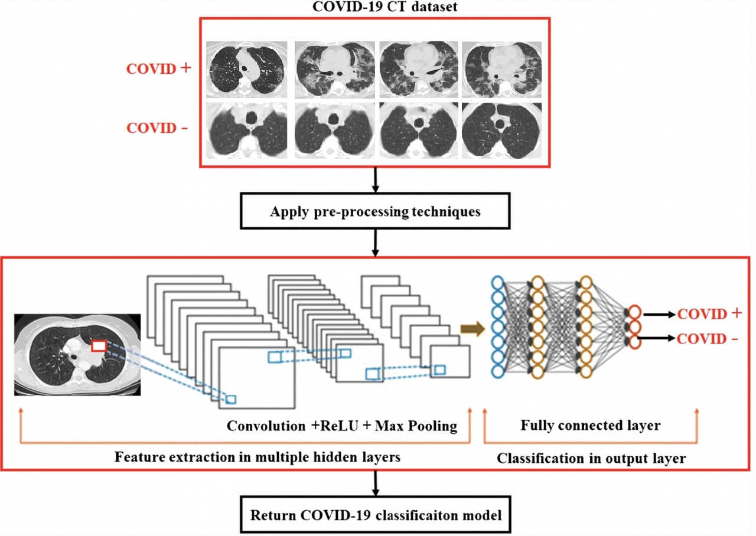
Why Convolutional neural network?
Methodology [8/13]
Compared to other image processing methods, CNN automatically identifies the relevant features without any human supervision
Equivalent representations, sparse interactions, and parameter sharing.
CNN makes it possible to construct wider and deeper networks.
Figure 8. An example of CNN architecture for image classification

Slide 15
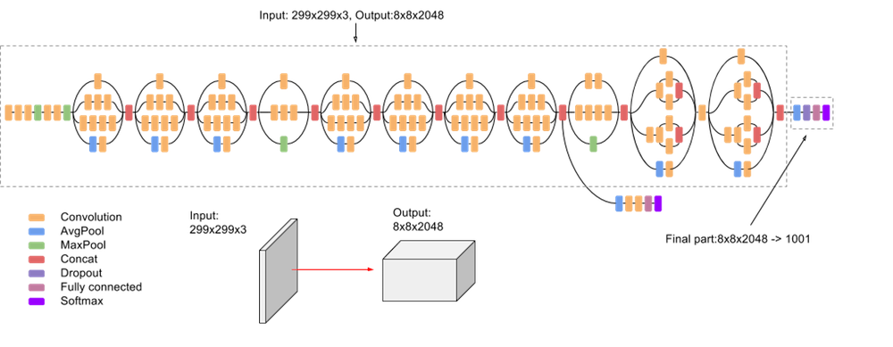
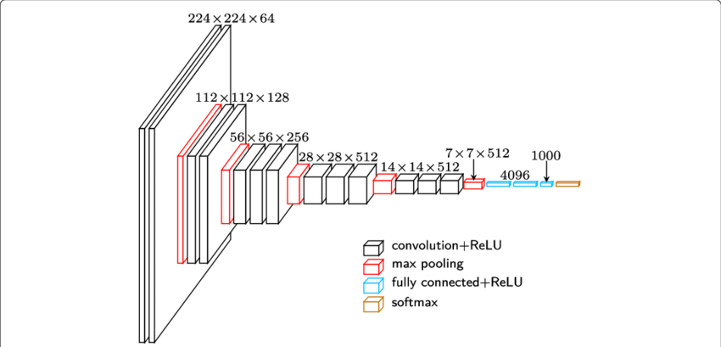
Methodology [9/13]
CNN Architectures
Table 2. Number of trainable parameters in each network architecture.
Model | Trainable param
MobileNetV2 | Total params: 14,613,250
InceptionV3 | Total params: 22,491,834
Xception | Total params: 21,985,194
VGG-16 | Total params:119,440, 343
VGG-19 | Total params: 134,260,552
Figure 9. Architecture Inception-v3 model. [14]
Figure 10. Architecture VGG-16 model. [15]

Slide 16
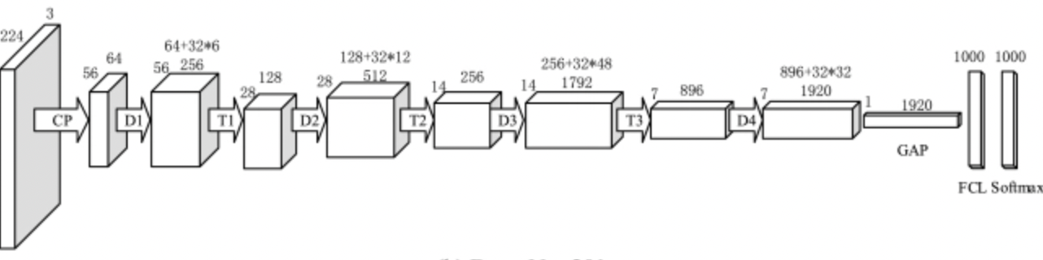
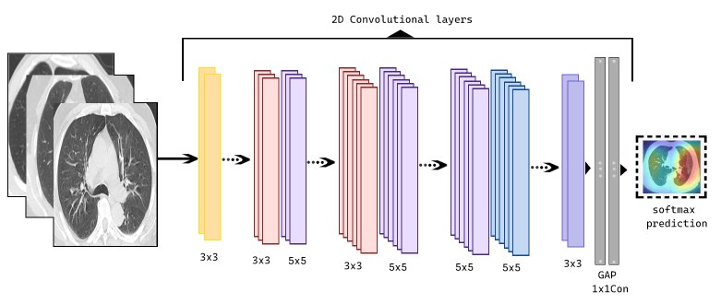
Methodology [10/13]
CNN Architectures
Table 3. Number of trainable parameters in each network architecture.
Model | Trainable param
ResNet-50 | Total params: 24,122,070
InceptionV3 | Total params: 22,491,834
Xception | Total params: 21,985,194
DenseNet201 | Total params: 24,690,050
EfficientNetB3 | Total params: 12,291,764
Figure 11. DenseNet201 model. [16]
Figure 12. Architecture of EfficientNet-B3 model.

Slide 17
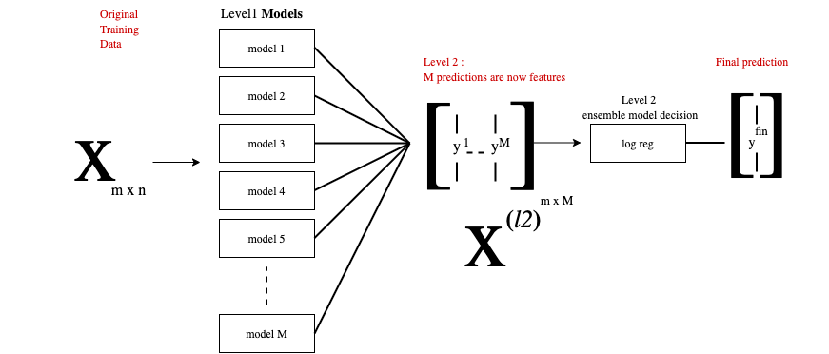
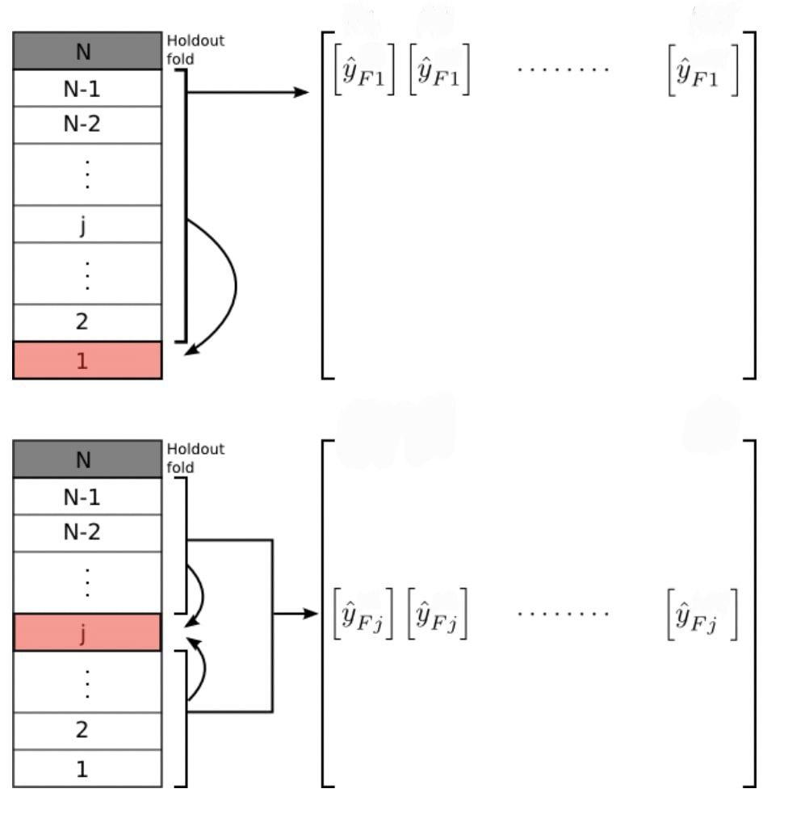
Ensemble learning
Methodology [11/13]
Ensemble Algorithm works by combines several models to get the better result and performance.
Provides better predictive performance than from any of constituent learning algorithms alone.
Eliminate potential errors made by any individual classifier, thereby improving the performance of the model.
Figure 13. Ensemble learning methods structure.

Slide 18
Stacking the features
Methodology [12/13]
Multiple pre-trained Convolutional Neural Network models and fine-tuned their convolutional layers using 3 of the described datasets are taken.
Fine-tuning process we used the Categorical Cross-Entropy loss function.
Fine-tuning is done by freezing the convolutional layers to fine-tune only convolution blocks.
The stacked features were used as an input to the Logistic Regression.

Slide 19
Stacking the features
Methodology [13/13]
The loss function that was used was Categorical Cross Entropy
𝑜𝑢𝑡𝑝𝑢𝑡𝑠𝑖𝑧𝑒
𝐿𝑜𝑠𝑠 = − ∑︁ 𝑦𝑖 · 𝑙𝑜𝑔(𝑦ˆ𝑖) (1)
𝑖=1
We used multiple pre-trained Convolutional neural network models.
We used Logistic regression to classify the stacked features. 𝑦=𝑙𝑜𝑔( 𝑝 ) / ( 1−𝑝)
1
5
3
2
4
→
Then we fine-tuned their convolutional last layers using 3 of the described datasets.
This was done using trainable feature.
Then we extracted features using fine-tuned models and stacked them together.

Slide 20
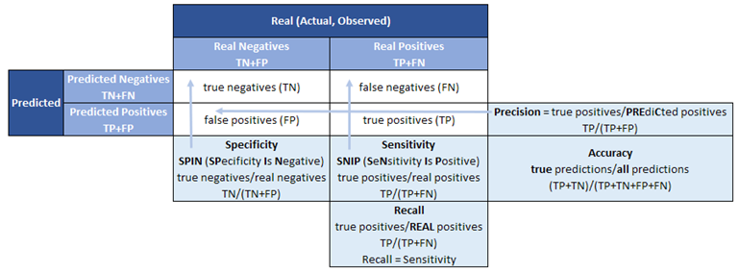
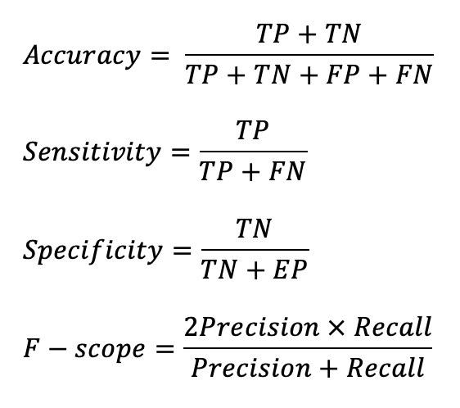
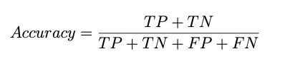

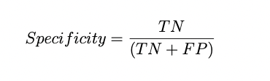

Evaluation [1/3]
Main metrics include:
Figure 14. Model performance metrics. [17]

Slide 21
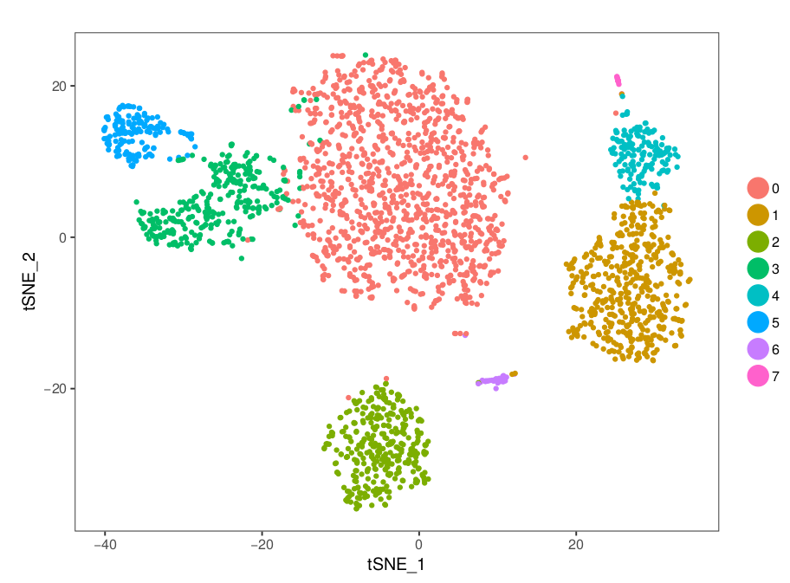
Evaluation [2/3]
T-distributed Stochastic Neighbor Embedding (tSNE)
Aims to solve the problems of PCA:
  Non-linear scaling to represent changes at different levels
  Optimal separation in 2-dimensions
Projection:
  Normally 2D, but can be any number of dimensions
  Randomly scatter all points within the space
Figure 15. Example of t-SNE visualization. [18]

Slide 22
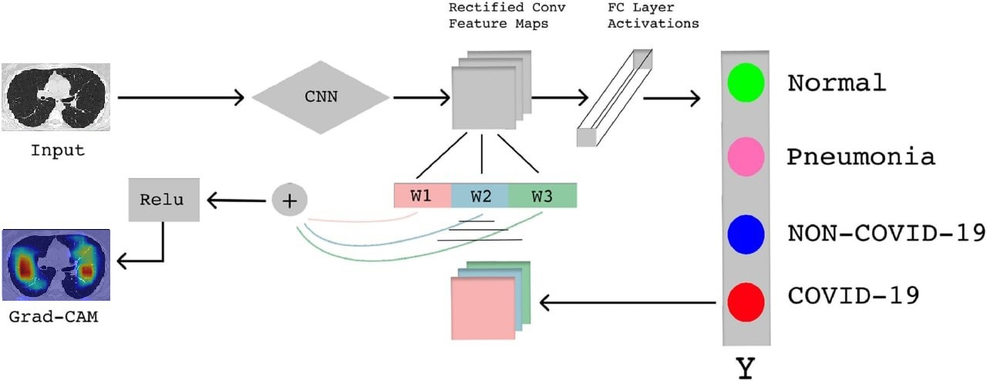
Evaluation [3/3]
Grad-CAM: Visualize class activation maps
Reason of use
Easy in use
Universally applicable to various imaging tasks
Provides insights on prediction process
If the network is not activating around the proper patterns\objects in the image, then we know:
Our network hasn’t properly learned the underlying patterns in our dataset
Our training procedure needs to be revisited
We may need to collect additional data
Figure 16. A simple explanatory diagram of Gradient Weighted Class Activation Mapping (Grad- CAM). [19]

Slide 23
Performance comparison of the proposed CNN models
Results [1/7]
Table 4. Performance comparison of the proposed Ensemble based CNN models.
Dataset
CNN architecture | UCSD COVID-CT acc|sensitivity|specificity|f-score | SARS-COV-2 CT acc|sensitivity|specificity|f-score | COVIDX CT acc|sensitivity|specificity|f-score
ResNet50v2 | 0.88| 0.87|0.86|0.87 | 0.95|0.94|0.92|0.92 | 0.96|0.95|0.96|0.96
VGG-16 | 0.92| 0.93|0.93|0.91 | 0.95|0.94|0.93|0.93 | 0.97|0.96|0.97|0.97
VGG-19 | 0.94|0.94|0.93|0.93 | 0.97|0.97|0.97||0.96 | 0.95|0.94|0.95|0.93
InceptionV3 | 0.92|0.93|0.90|0.91 | 0.96|0.95|0.94|0.95 | 0.97|0.98|0.97|0.96
Xception | 0.77|0.73|0.74|0.76 | 0.93|0.92|0.92|0.93 | 0.94|0.95|0.93|0.94
MobileNetV2 | 0.88|0.87|0.87|0.85 | 0.94|0.94|0.93|0.94 | 0.96|0.96|0.96|0.95
DenseNet201 | 0.91|0.92|0.91|0.90 | 0.97|0.96|0.96|0.95 | 0.97|0.95|0.96|0.96
EfficientNet-b3 | 0.94|0.93|0.90|0.91 | 0.76|0.77|0.77|0.76 | 0.81|0.83|0.81|0.82
ensemble model –fine tuning + NN | 0.9867|0.9855|0.9729|0.9828| | 0.990|0.9886|0.9754|0.9932 | 0.9777|0.9821|0.9765|0.9822
ensemble model –fine tuning + SVM | 0.9643|0.9751|0.9544|0.9754 | 0.9820|0.9901|0.9888|0.9883 | 0.9943|0.9933|0.9912|0.9925
Table 3: Performance comparison of the proposed CNN models.

Slide 24
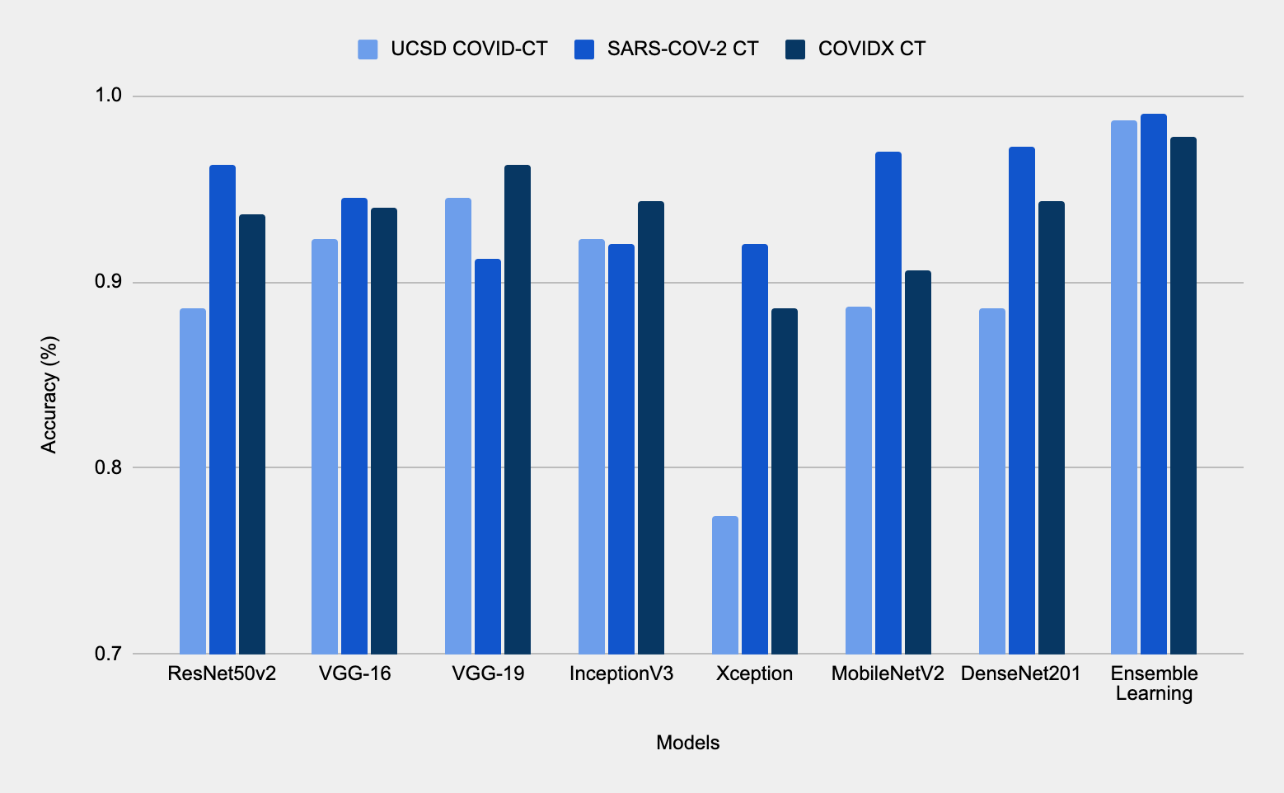
Results - Performance comparison of the proposed Ensemble model
Results [2/7]
Figure 17. Performance comparison of the proposed Ensemble model.

Slide 25
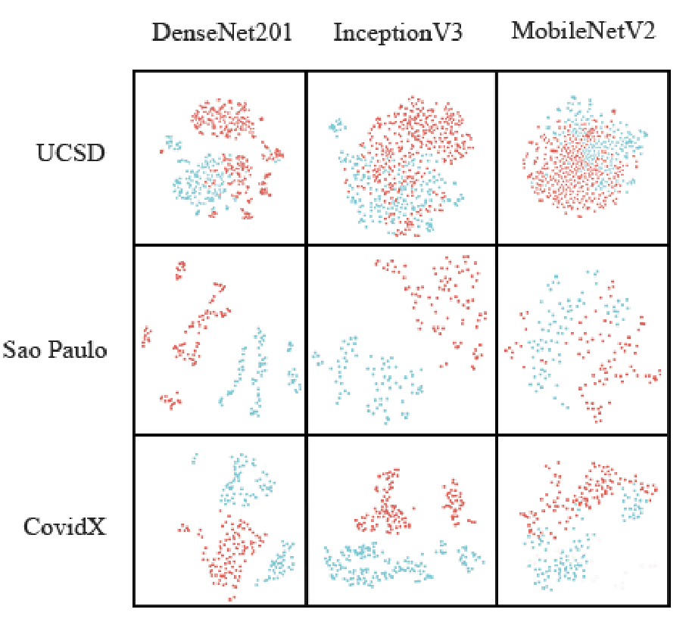
TSNE (t-distributed stochastic neighbor embedding)
Results [3/7]
Provides transparency to the models’ decision making process.
T-SNE is based on the conversion of the resemblances of data instances to the probabilities.
It relies on the minimization of the discrepancy within low- and high-dimensional set of instances.
The two classes were accurately separated into two clusters, which suggest that the models interpret the data correctly.
Sao Paulo and CovidX datasets are more linearly separable than UCSD dataset.
Among the models, InceptionV3 is best to provide a cluster separation.
Figure 18. TSNE for CT scan dataset.

Slide 26
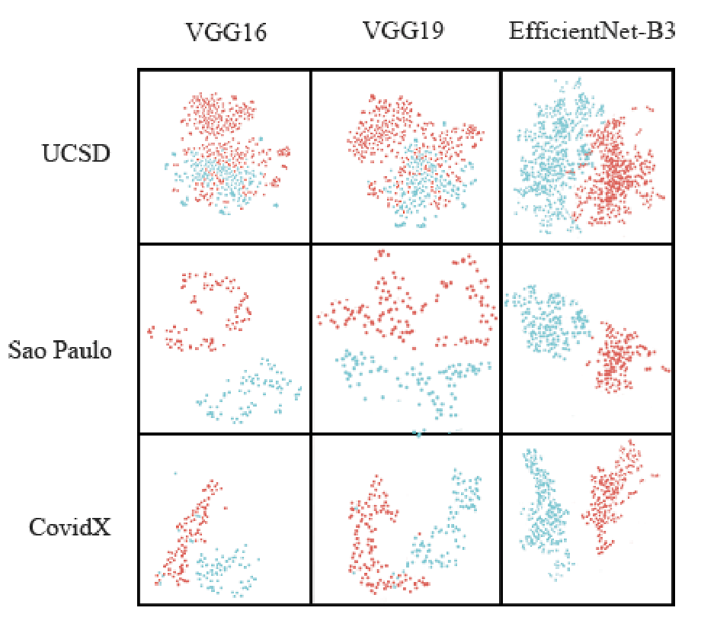
TSNE (t-distributed stochastic neighbor embedding) contd.
Results [4/7]
VGG16, VGG19 and EfficientNet-B3 also does accurately separate COVID-19 Non-COVID images into clusters.
As with previous models, Sao Paulo and CovidX datasets are more linearly separable than UCSD dataset.
Among these 3 models, EfficientNet-B3 is best to divide data samples into clusters.
Figure 19. TSNE for CT scan dataset.

Slide 27
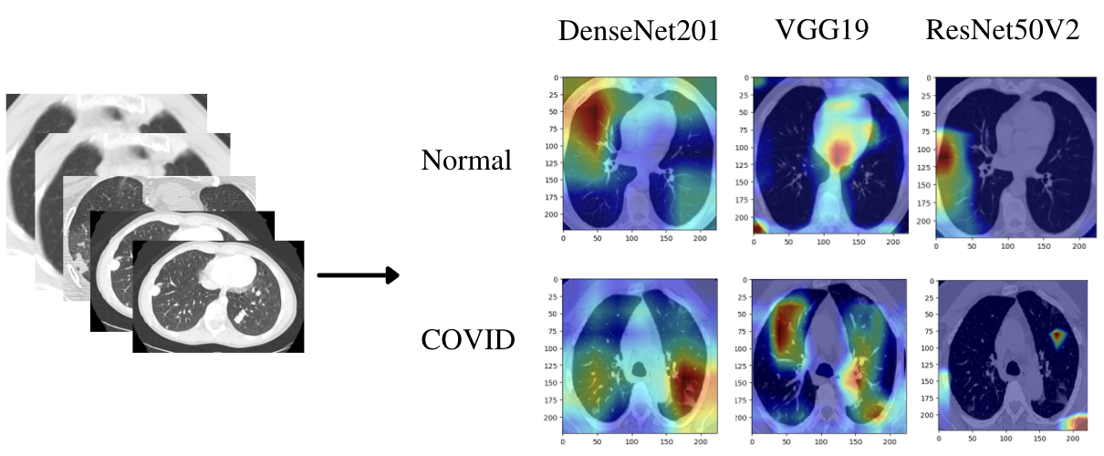
GradCAM heatmap
Results [5/7]
Figure 20. Predicting through GradCAM. Heatmap of Normal and Covid CT-scan images of models.
2D representation of the GradCAM heatmap evaluated on a CT scan of an individual patient with highlighted disease spots on the lung region.
CAM framework allows us to combine data from a variety of sources to create an accurate demonstration of NN models using individual examples from each class and dataset.

Slide 28
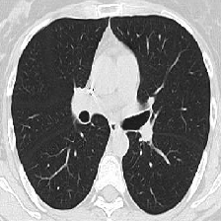
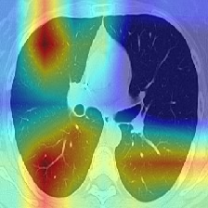
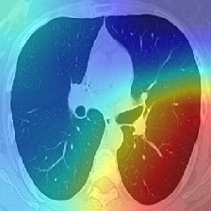
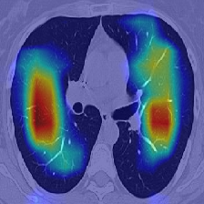
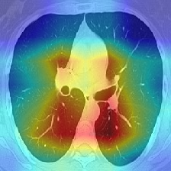
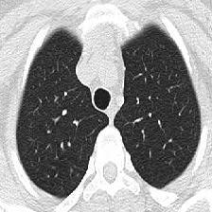
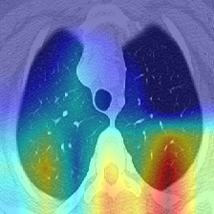
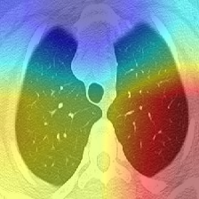
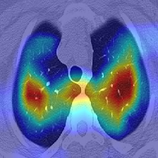
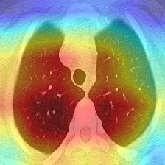
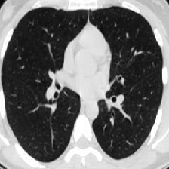
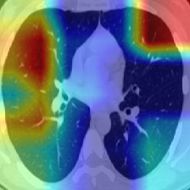
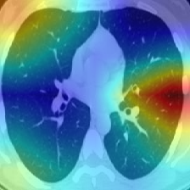
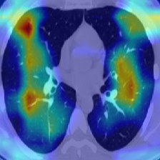
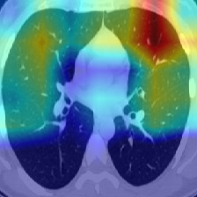
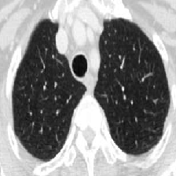
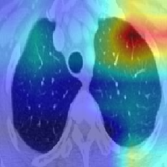
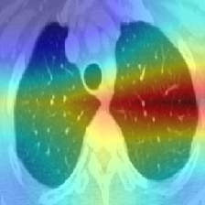
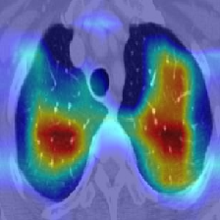
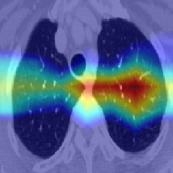
Results [6/7]
Heatmap visualization
DenseNet201
InceptionV3
VGG-19
MobileNetV2
Figure 21. Predicting through GradCAM. Heatmap of Covid CT-scan images of models.

Slide 29
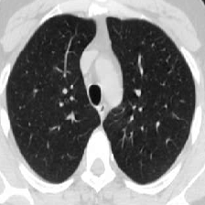
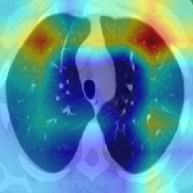
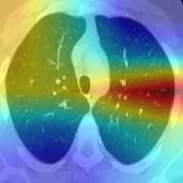












Results [7/7]
Heatmap visualization
DenseNet201
InceptionV3
VGG-19
MobileNetV2
Figure 22. Predicting through GradCAM. Heatmap of Covid CT-scan images of models.

Slide 30
Limitations
Low availability of balanced datasets.
Typically for medical images, CT scans may have some noises in the datasets:
  Labels on the images.
  Notes on the images.
Non-uniform image sizes.

Slide 31
Conclusion
The purpose of the current study was:
Finding the Most Effective and Accurate Model for COVID-19 CT Scan classification.
Running ensemble model with fine-tuning.
The results of this investigation show that:
Artificial Intelligence can play a crucial role in medicine and fight against COVID-19.
The results suggested that the most accurate CNN model was VGG-19.
In every case the performance and accuracy of the Ensemble model were superior to the same metrics achieved by CNN architectures. (Table 4)
We can leverage deep learning to automatically learn the best ways to do previously difficult tasks in computer vision.

Slide 32
Future work
Future work will focus on:
Generative Adversarial Networks (GANs).
Classify not only the lungs, but all organs and for various diseases.
Visualize all results in 3D format for better understanding how various diseases evolve.

Slide 33
Thank you for your attention!

Slide 34
Reference
[1] El-Bana, Shimaa, Ahmad Al-Kabbany, and Maha Sharkas. "A multi-task pipeline with specialized streams for classification and segmentation of infection manifestations in COVID-19 scans." PeerJ Computer Science 6 (2020): e303.
[2] P.Lacerda, B.Barros, C.Albuquerque, A.Conci, Hyper parameter optimization for covid-19 pneumonia diagnosis based on chest ct, Sensors 21 (6) (2021) 2174..
[3] C.Fang, S.Bai, Q.Chen, Y.Zhou, L.Xia, L.Qin, S.Gong, X.Xie, C.Zhou, D.Tu, etal., Deep learning for predicting covid-19 malignant progression, Medical image analysis 72 (2021) 102096.
[4] H.Quan,X.Xu,T.Zheng,Z.Li,M.Zhao,X.Cui,Densecapsnet:Detectionofcovid-19fromx-rayimagesusingacapsuleneuralnetwork, Computers in biology and medicine 133 (2021) 104399.
[5] K. Rangarajan, S. Muku, A. K. Garg, P. Gabra, S. H. Shankar, N. Nischal, K. D. Soni, A. S. Bhalla, A. Mohan, P. Tiwari, et al., Artificial intelligence–assisted chest x-ray assessment scheme for covid-19, European radiology (2021) 1–10.
[6] L. Wang, Z. Q. Lin, A. Wong, Covid-net: A tailored deep convolutional neural network design for detection of covid-19 cases from chest x-ray images, Scientific Reports 10 (1) (2020) 1–12.
[7] Z.Zhu, Z.Xingming, G.Tao, T.Dan, J.Li,X.Chen, Y.Li, Z.Zhou, X.Zhang, J.Zhou, etal., Classification of covid-19 by compressed chest ct image through deep learning on a large patients cohort, Interdisciplinary Sciences: Computational Life Sciences 13 (1) (2021) 73–82.
[8] D. Dansana, R. Kumar, A. Bhattacharjee, D. J. Hemanth, D. Gupta, A. Khanna, O. Castillo, Early diagnosis of covid-19-affected patients based on x-ray and computed tomography images using deep learning algorithm, Soft Computing (2020) 1–9.
[9] E. H. Lee, J. Zheng, E. Colak, M. Mohammadzadeh, G. Houshmand, N. Bevins, F. Kitamura, E. Altinmakas, E. P. Reis, J.-K. Kim, et al., Deep covid detect: an international experience on covid-19 lung detection and prognosis using chest ct, NPJ digital medicine 4 (1) (2021) 1–11.

Slide 35
Reference
[10] X. Wang, X. Deng, Q. Fu, Q. Zhou, J. Feng, H. Ma, W. Liu, C. Zheng, A weakly-supervised framework for covid-19 classification and lesion localization from chest ct, IEEE transactions on medical imaging 39 (8) (2020) 2615–2625.
[11] UCSD COVID-CT Dataset https://github.com/UCSD-AI4H/COVID-CT
[12] SARS-COV-2 Ct-Scan Dataset. https://www.kaggle.com/plameneduardo/sarscov2-ctscan-dataset.
[13] COVIDX CT Dataset https://www.kaggle.com/hgunraj/covidxct
[14] C. Szegedy, V. Vanhoucke, S. Ioffe, J. Shlens and Z. Wojna, "Rethinking the Inception Architecture for Computer Vision," 2016 IEEE Conference on Computer Vision and Pattern Recognition (CVPR), 2016, pp. 2818-2826, doi: 10.1109/CVPR.2016.308.
[15] E.F.Ohata et al., "Automatic detection of COVID-19 infection using chest X-ray images through transfer learning," in IEEE/CAA Journal of Automatica Sinica, vol. 8, no. 1, pp. 239-248, January 2021, doi: 10.1109/JAS.2020.1003393.
[16] M. Shaha and M. Pawar, "Transfer Learning for Image Classification," 2018 Second International Conference on Electronics, Communication and Aerospace Technology (ICECA), 2018, pp. 656-660, doi: 10.1109/ICECA.2018.8474802.
[17] Classification Metrics, Medium(https://medium.com/@m.virk1/classification-metrics-65b79bfdd776)
[18] S. Arora, W. Hu and P. K. Kothari, An analysis of the t-sne algorithm for data visualization, 2018.
[19] Selvaraju, Ramprasaath R., Michael Cogswell, Abhishek Das, Ramakrishna Vedantam, Devi Parikh, and Dhruv Batra. "Grad-cam: Visual explanations from deep networks via gradient-based localization." In Proceedings of the IEEE international conference on computer vision, pp. 618-626. 2017.

