Slide 1
Research Methods Databases
Margaret Spires
Senior Expert, Reference, Library at Nazarbayev University

Slide 2
Research Methods Library of Alexandria

Slide 3
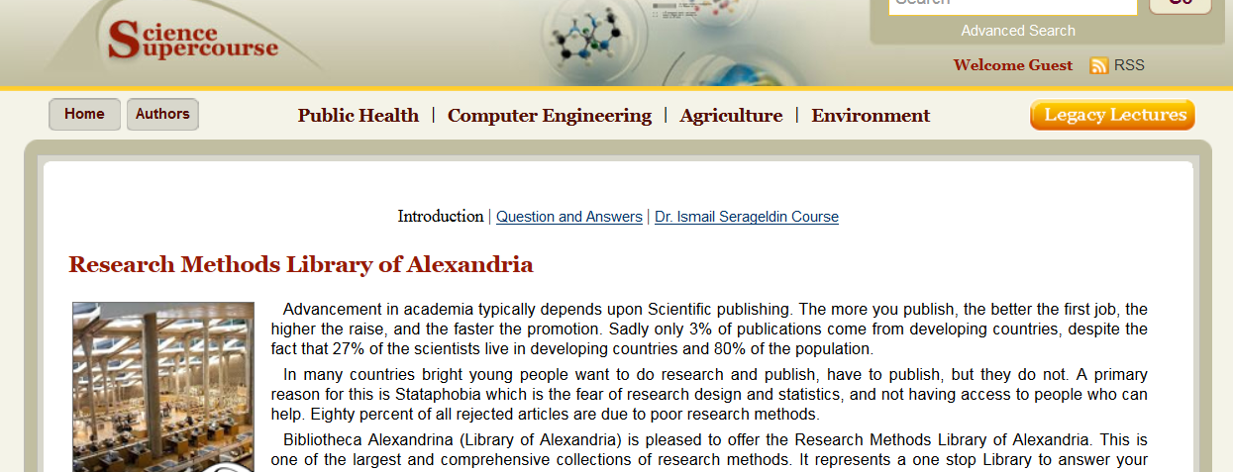
Purpose
Screenshot of the Research Methods Library of Alexandria homepage. This segment focuses on its purpose

Slide 4
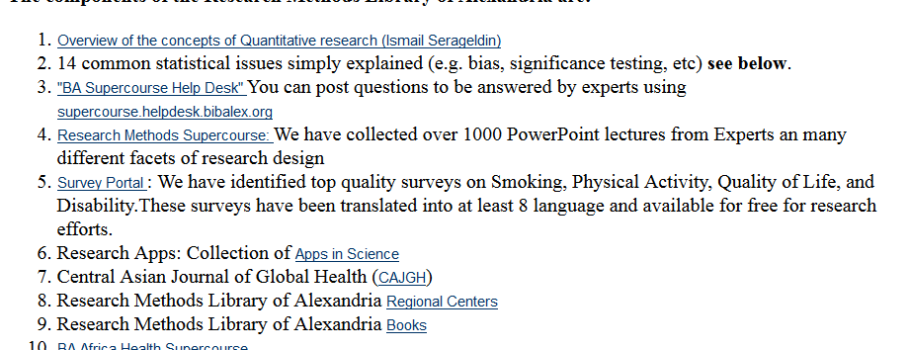
Courses
Screenshot of the Research Methods Library of Alexandria homepage. This segment shows links to various courses.

Slide 5
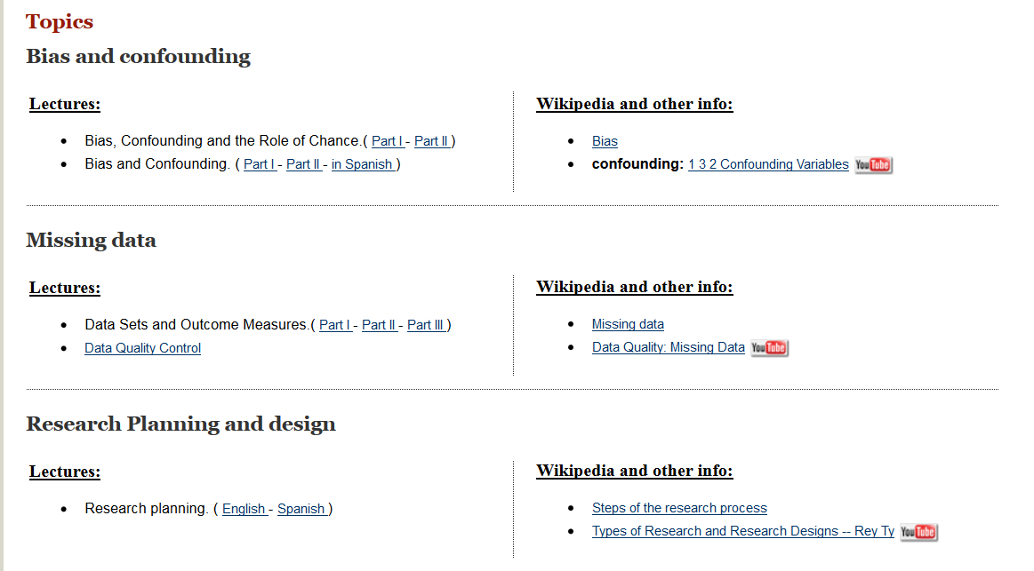
Topics
Screenshot of the Research Methods Library of Alexandria homepage. This segment shows links to resources on various topics.

Slide 6
SAGE Research Methods

Slide 7
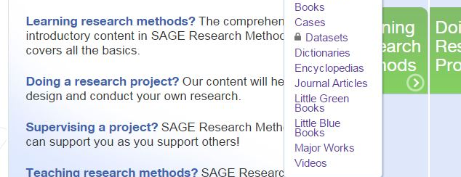
Variety of sources
Information from:
Books
  Dictionaries
  Encyclopedias
Case studies
Journals
SAGE series
  Little Blue Books (qualitative)
  Little Green Books (quantitative)
Videos

Slide 8
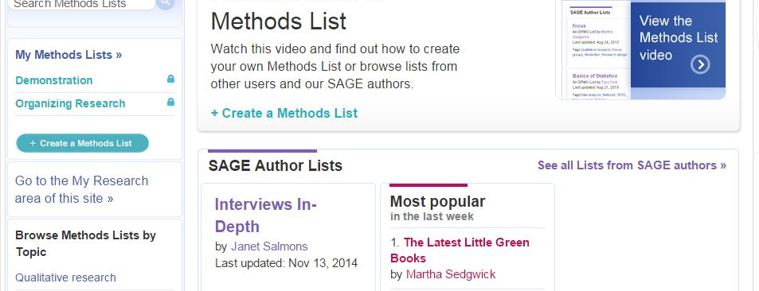
Methods Lists
Create (and share) personal lists of favorite resources
Browse lists others have created

Slide 9
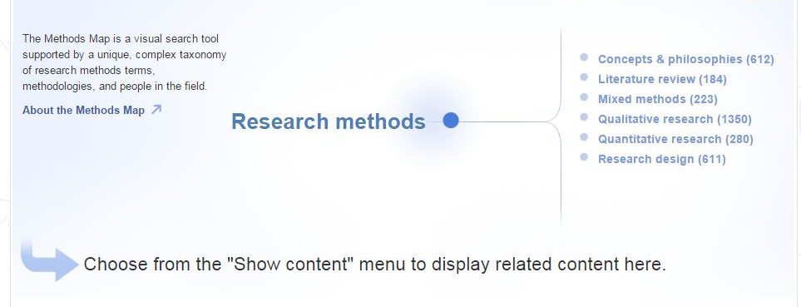
Methods Map
See how concepts connect while browsing different categories and methodologies

Slide 10
Demonstration

Slide 11
Thank you!
Спасибо Большое
Рахмет

