Slide 1
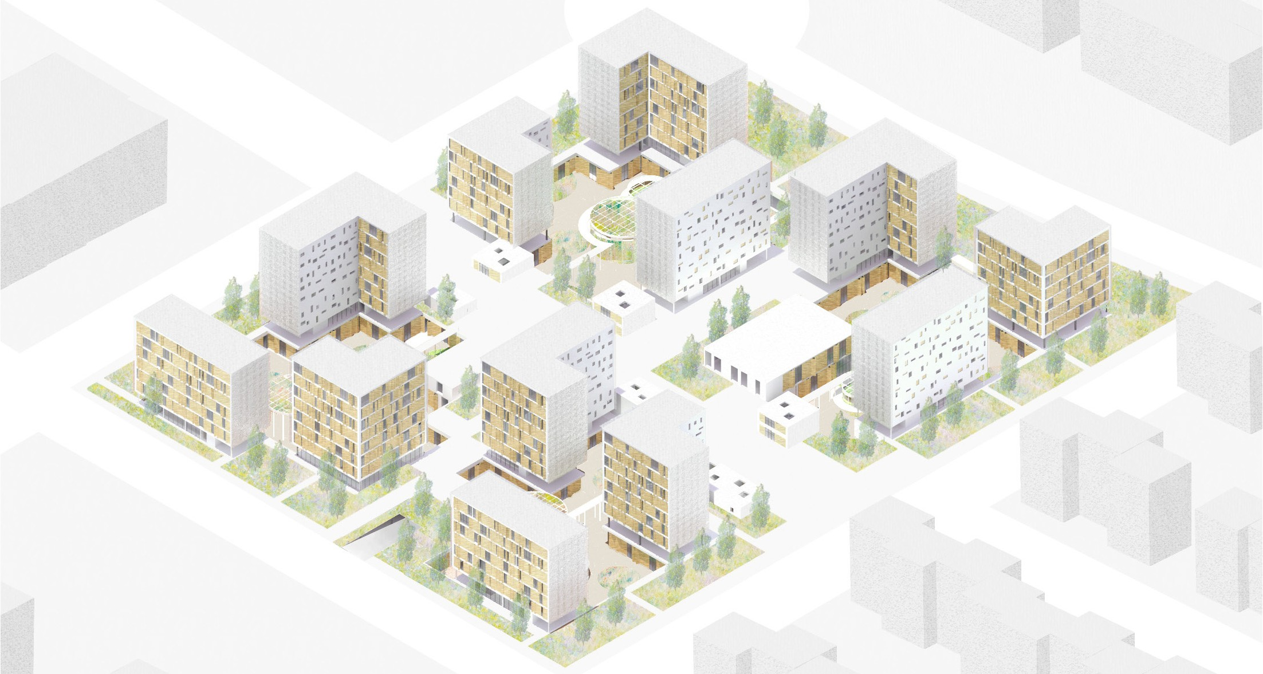

Baqsh’Astana
Interiority as a sustainable strategy
LAMBOTTE Sophie / LI Xiang
FRANCE ENSA-PARIS MALAQUAIS

Slide 2
Design concept

Slide 3
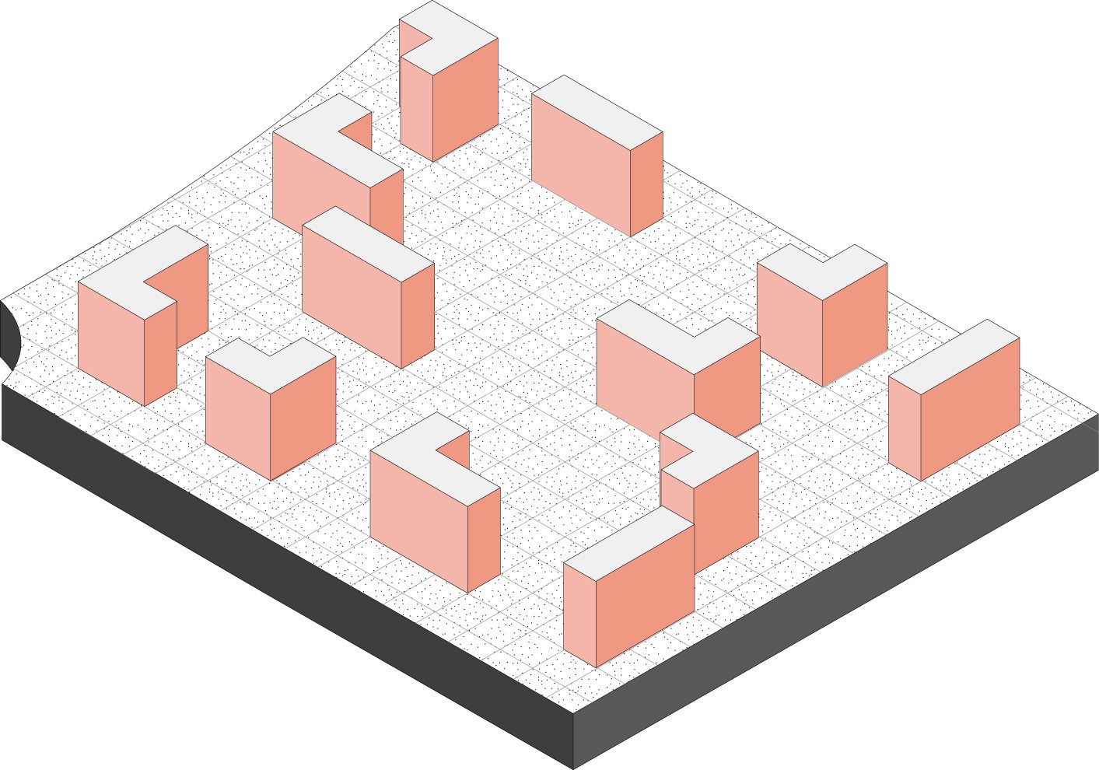
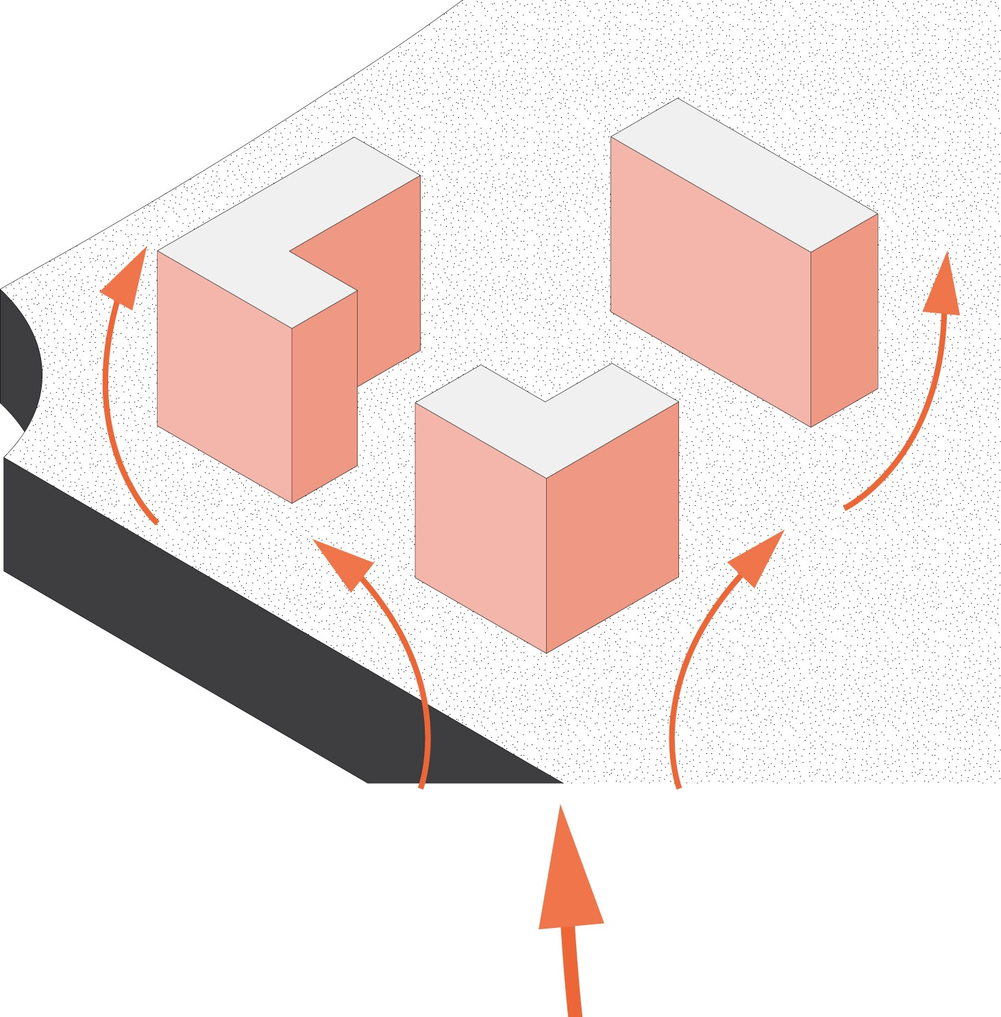
DIVISION
of the program’s volume in 12 buildings
OPTIMISATION
of views from the dwellings, solar orientation and reduction of wind’s speed

Slide 4
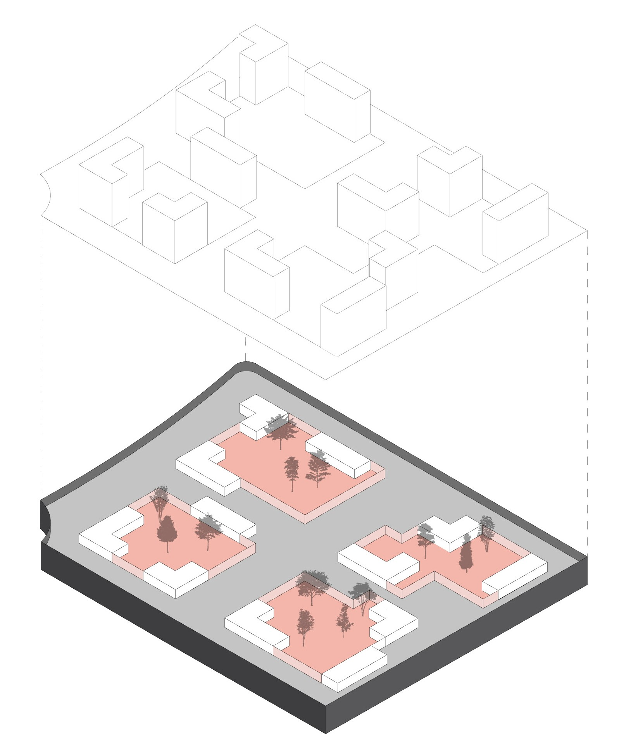
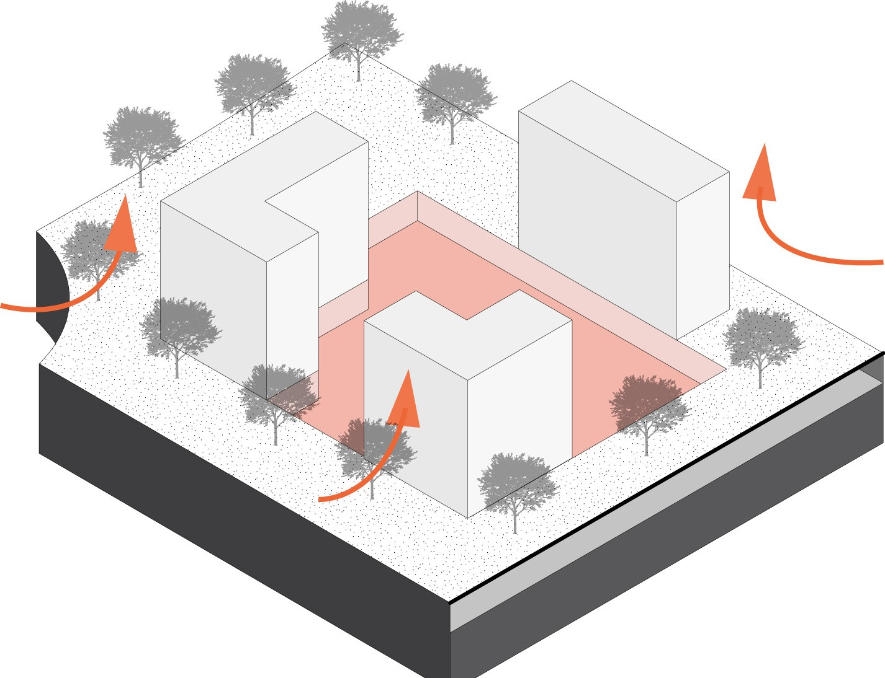
DIG
ground’s depth to install patios and car park space
PATIOS
as intimate and protected collective spaces for the inhabitants

Slide 5
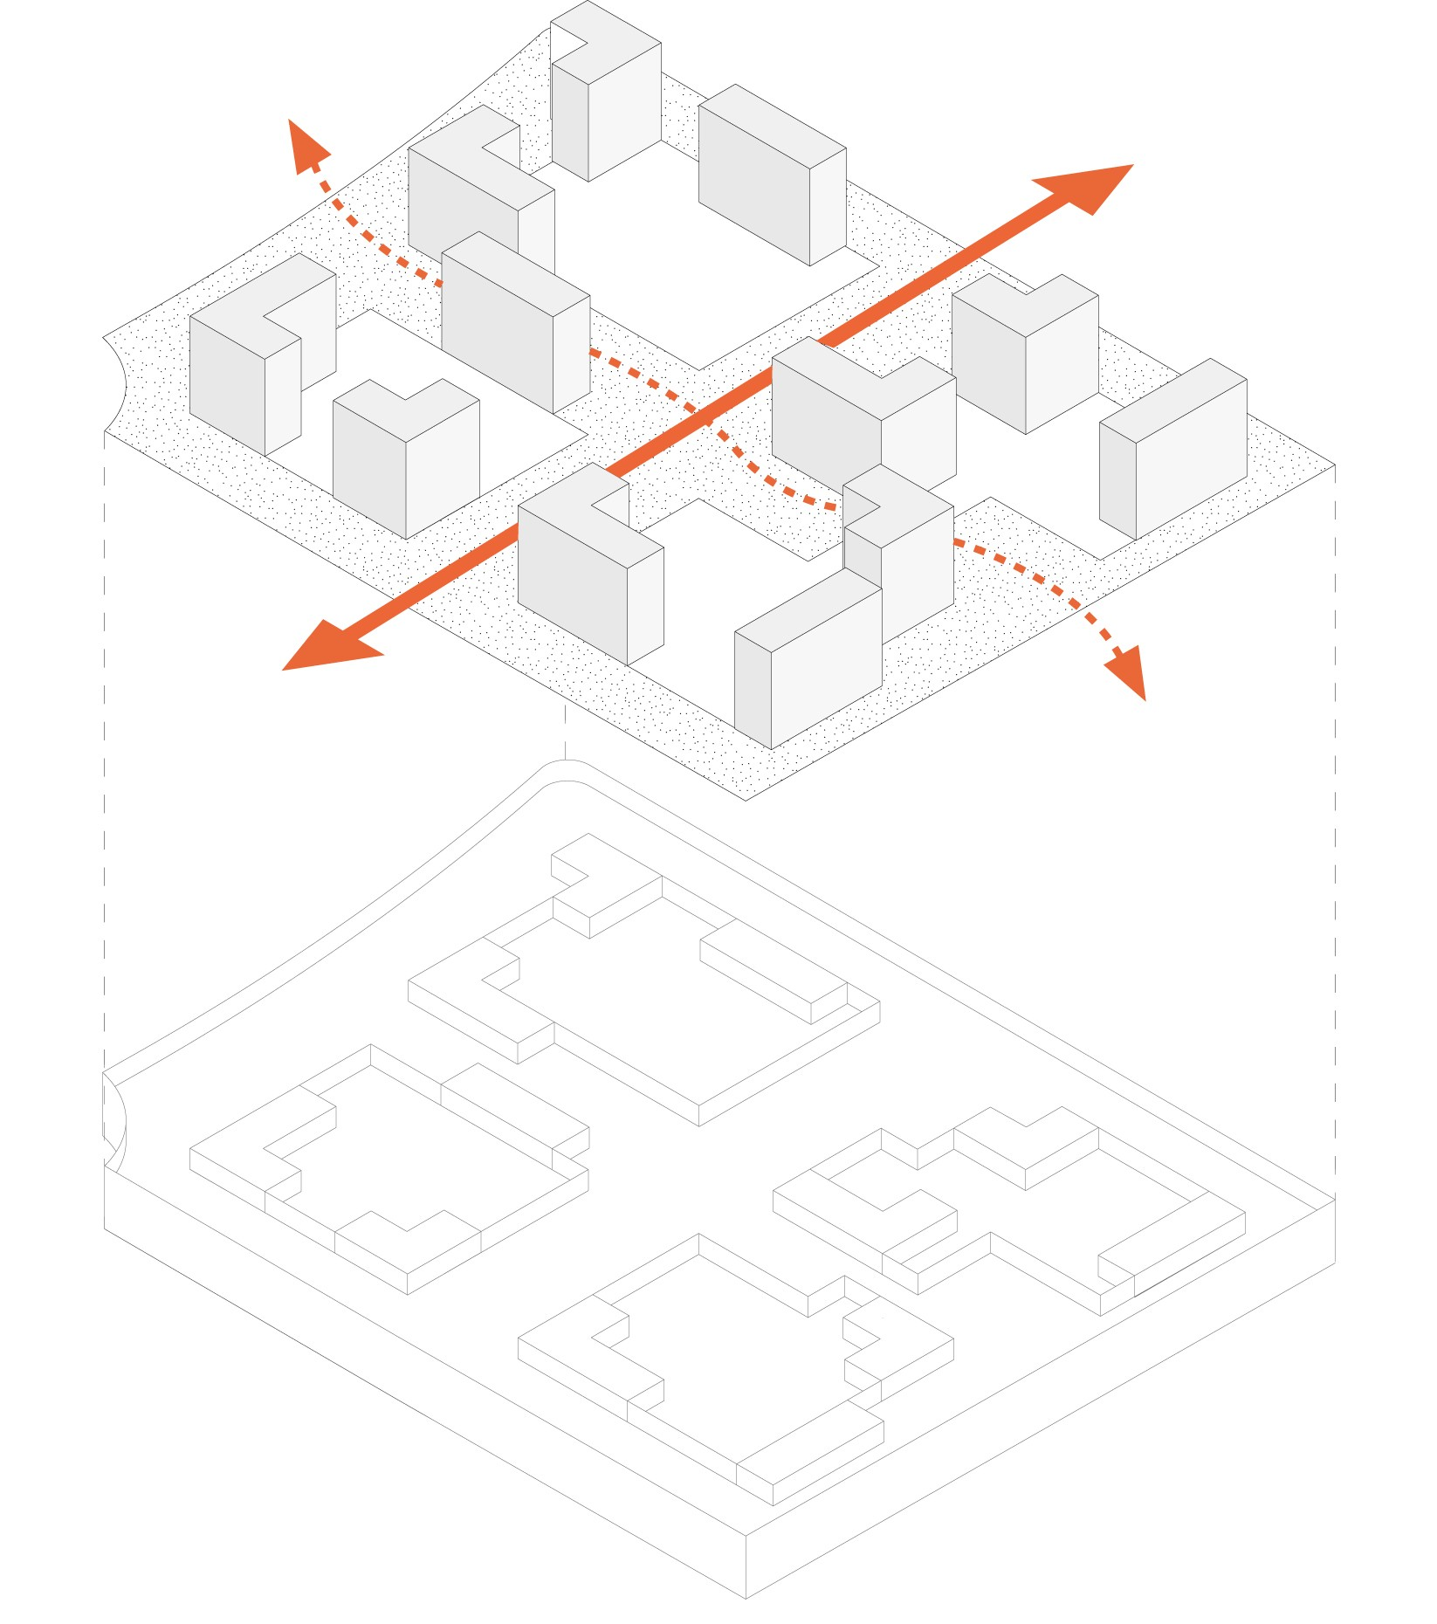
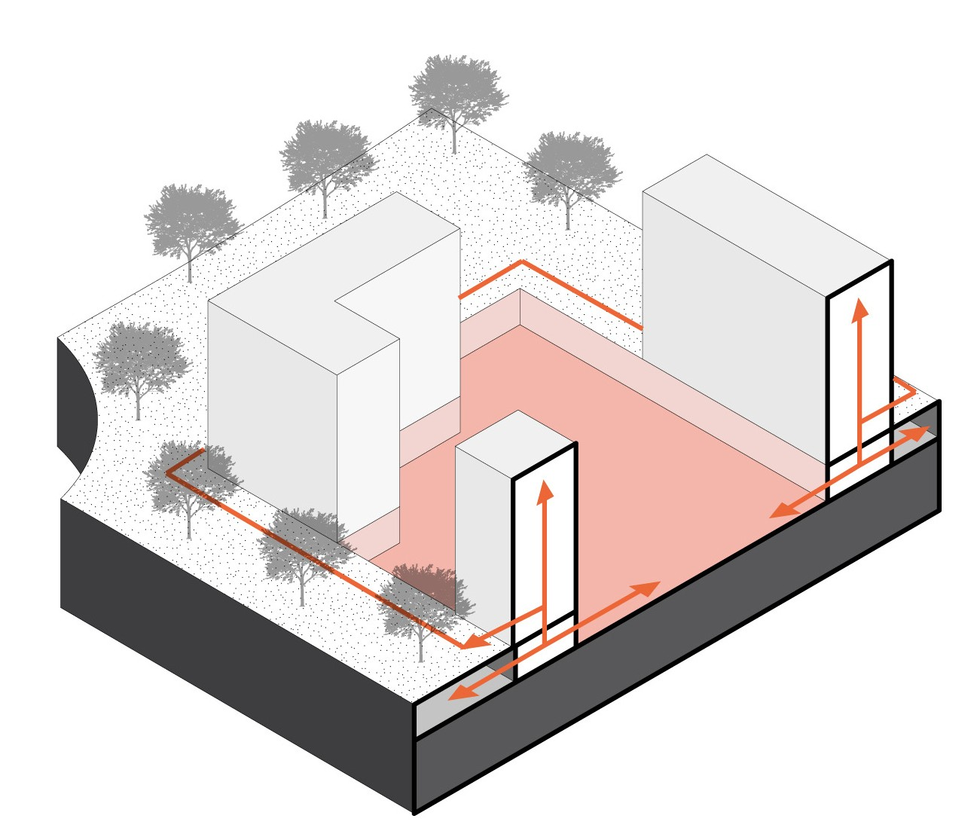
PUBLIC CIRCULATION
along two major axis
PRIVATE AND SEMI-PRIVATE CIRCULATION
through horizontal and vertical smaller distribution systems

Slide 6
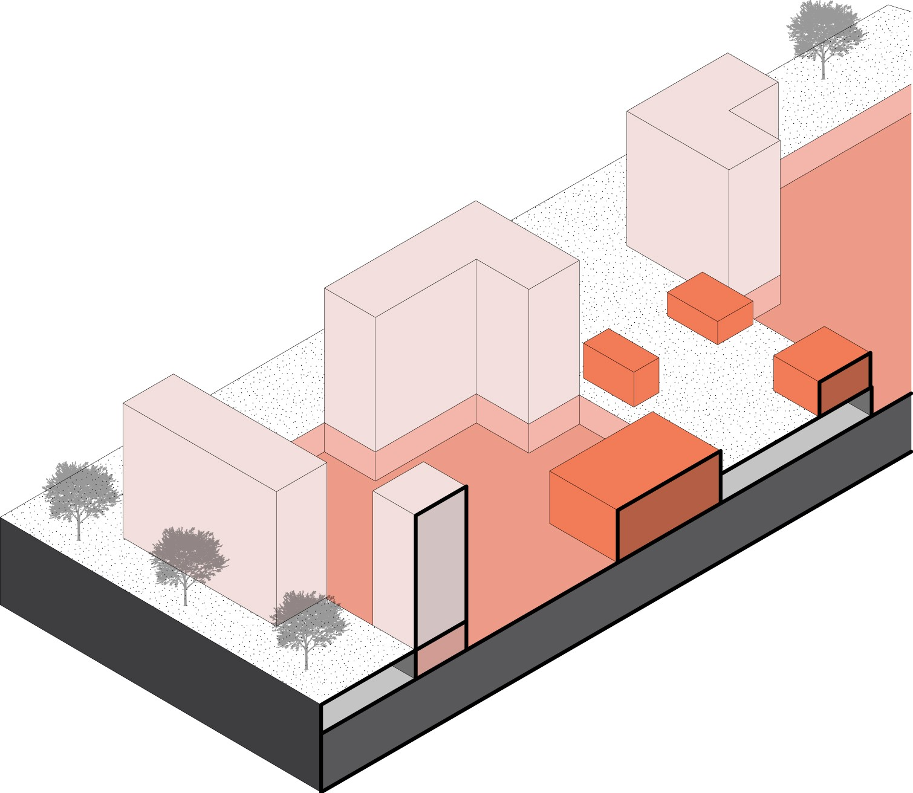
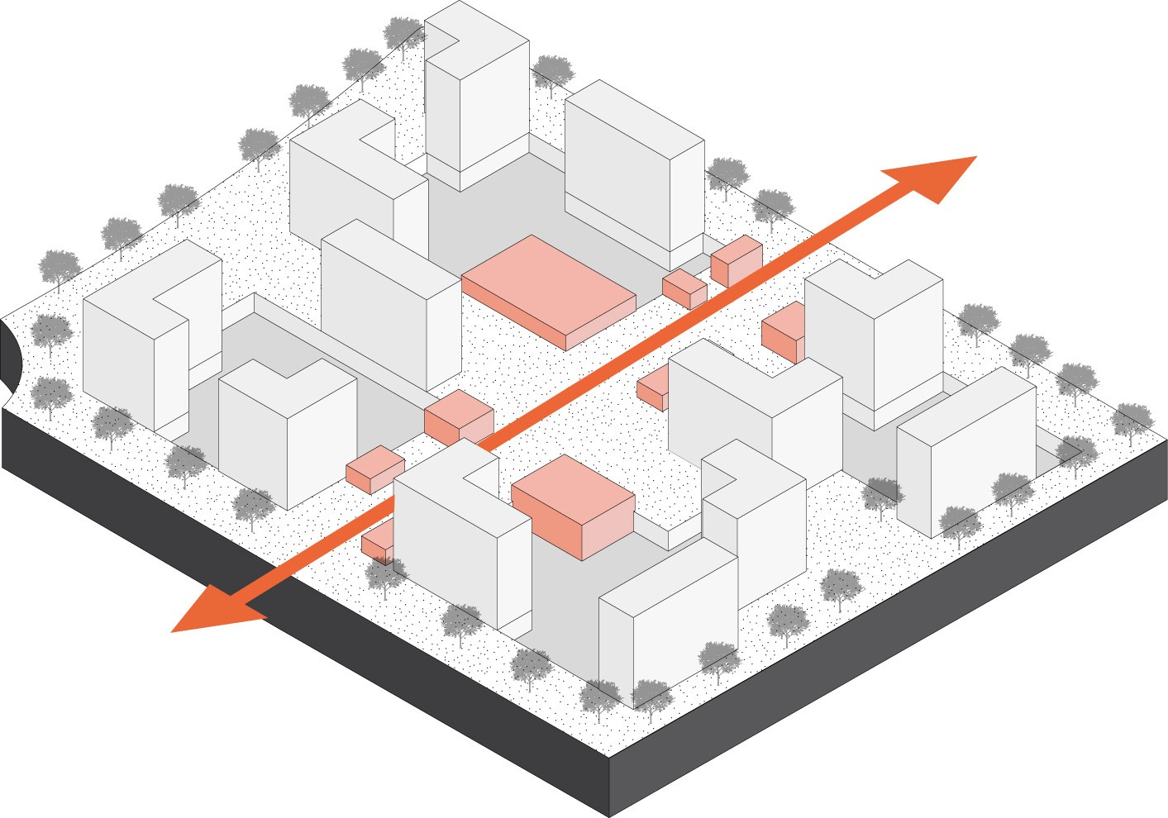
STIMULATION
of the public space thanks to public amenities along the public way
DIFFERENT SHADES OF SPACE
from public to private, from outside to inside

Slide 7
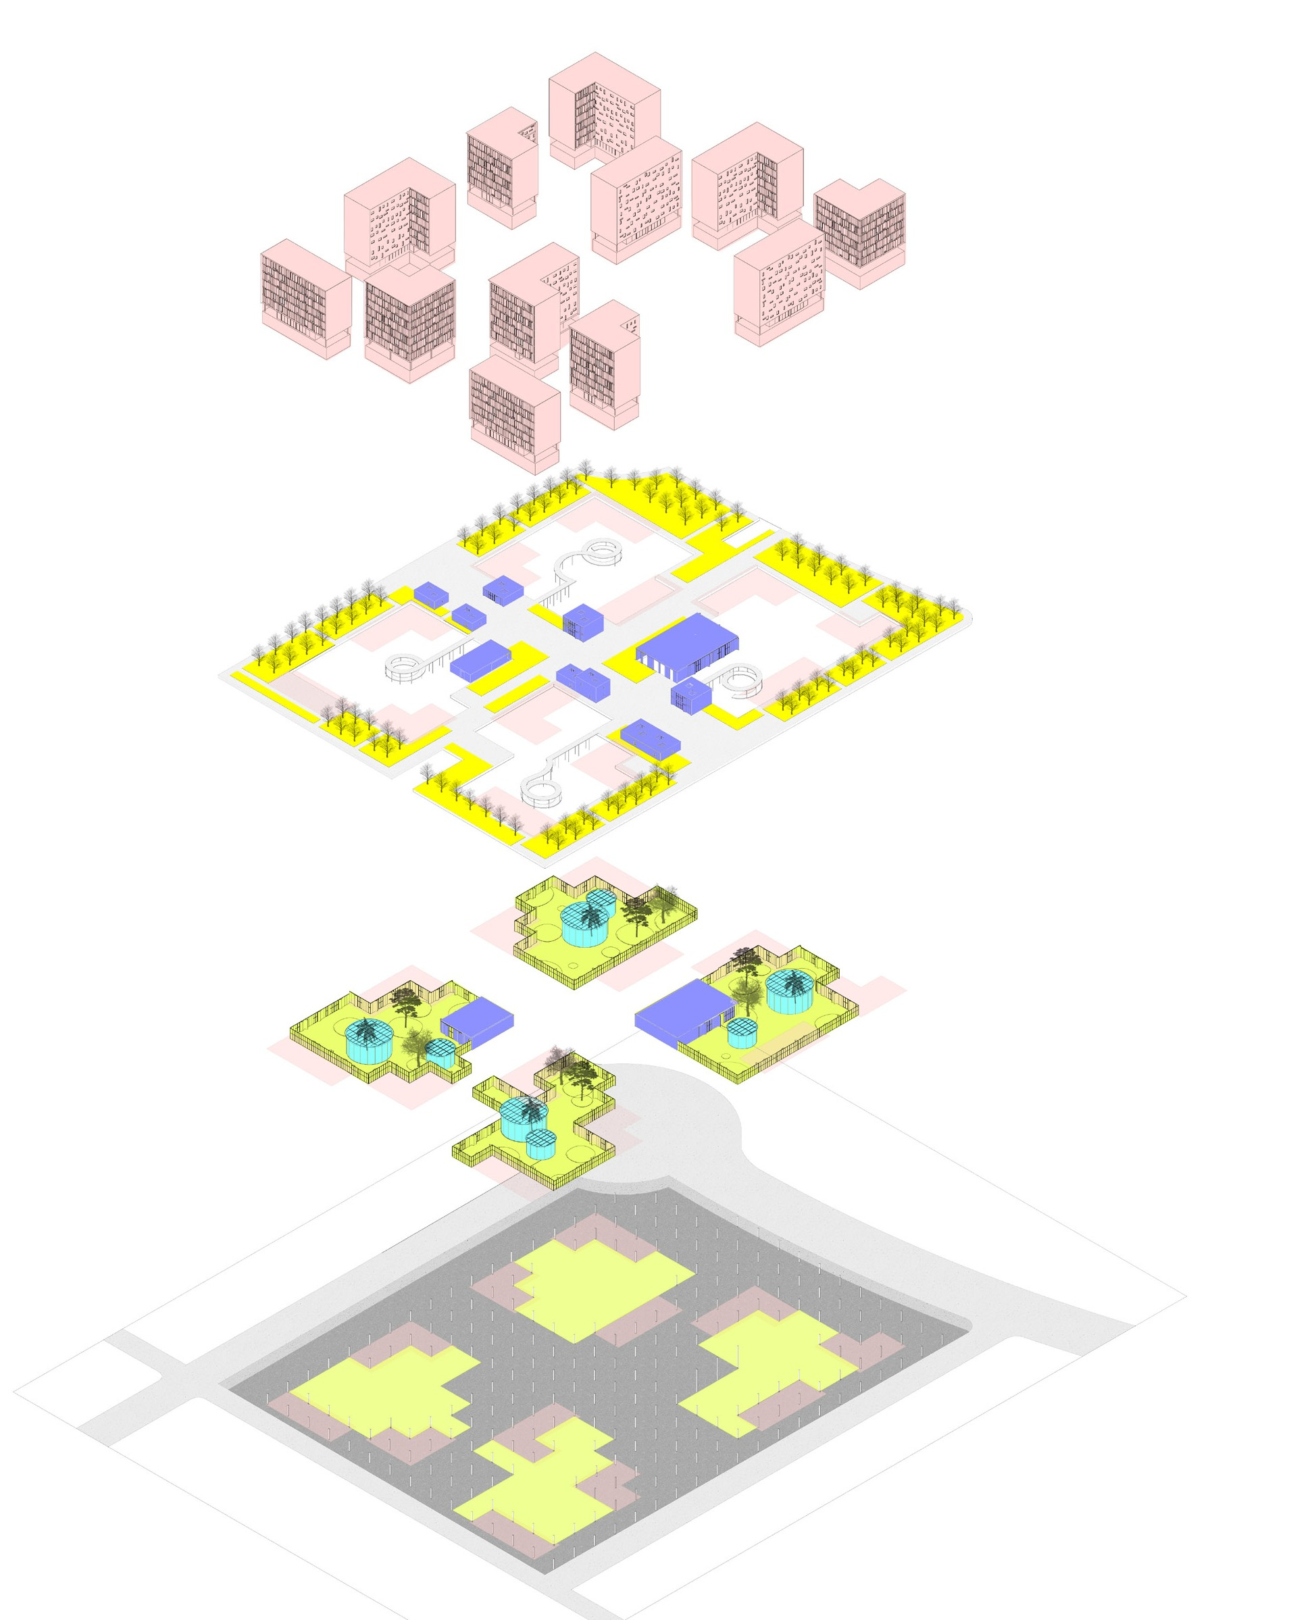
A vertically stacked program
Level
+1 to +8
Housing
12 buildings
322 dwellings (from T2 to T4)
Ground surface area : 3900 sqm
Total gross floor area : 30116 sqm
Level 0
Public amenities
Public bath : 1200 sqm Retail shops : 665 sqm Restaurant : 580 sqm Total gross floor area : 1555 sqm
Level -1
Patios
Botanic greenhouses
Vegetable garden greenhouses Children playgrounds
Green space areas
Density
Total ground surface built area : 5500 sqm
Ratio : 0.18
Level -1
Parking
400 car park spaces 5000 sqm

Slide 8
Architectural design
Site implantation

Slide 9
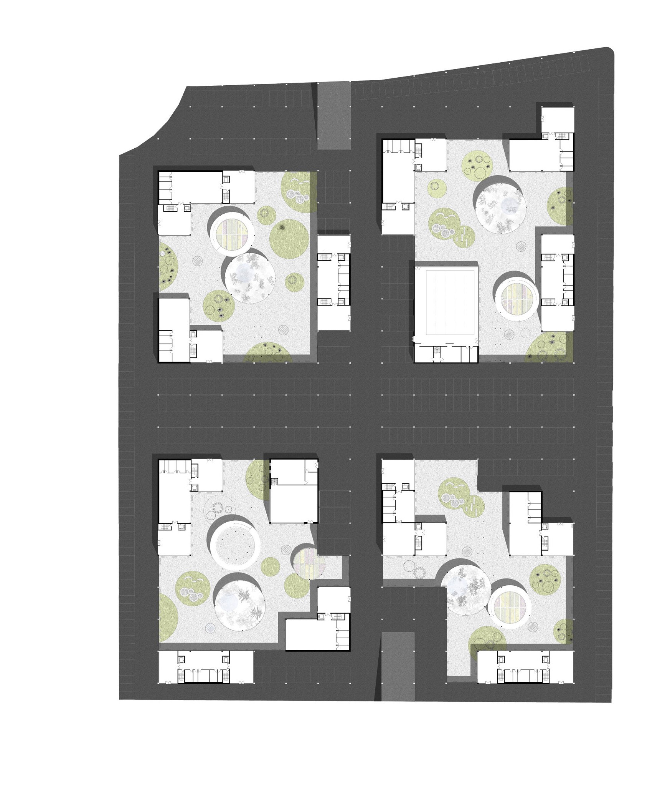
Basement floor plan
Parking access
PARKING
Parking access

Slide 10
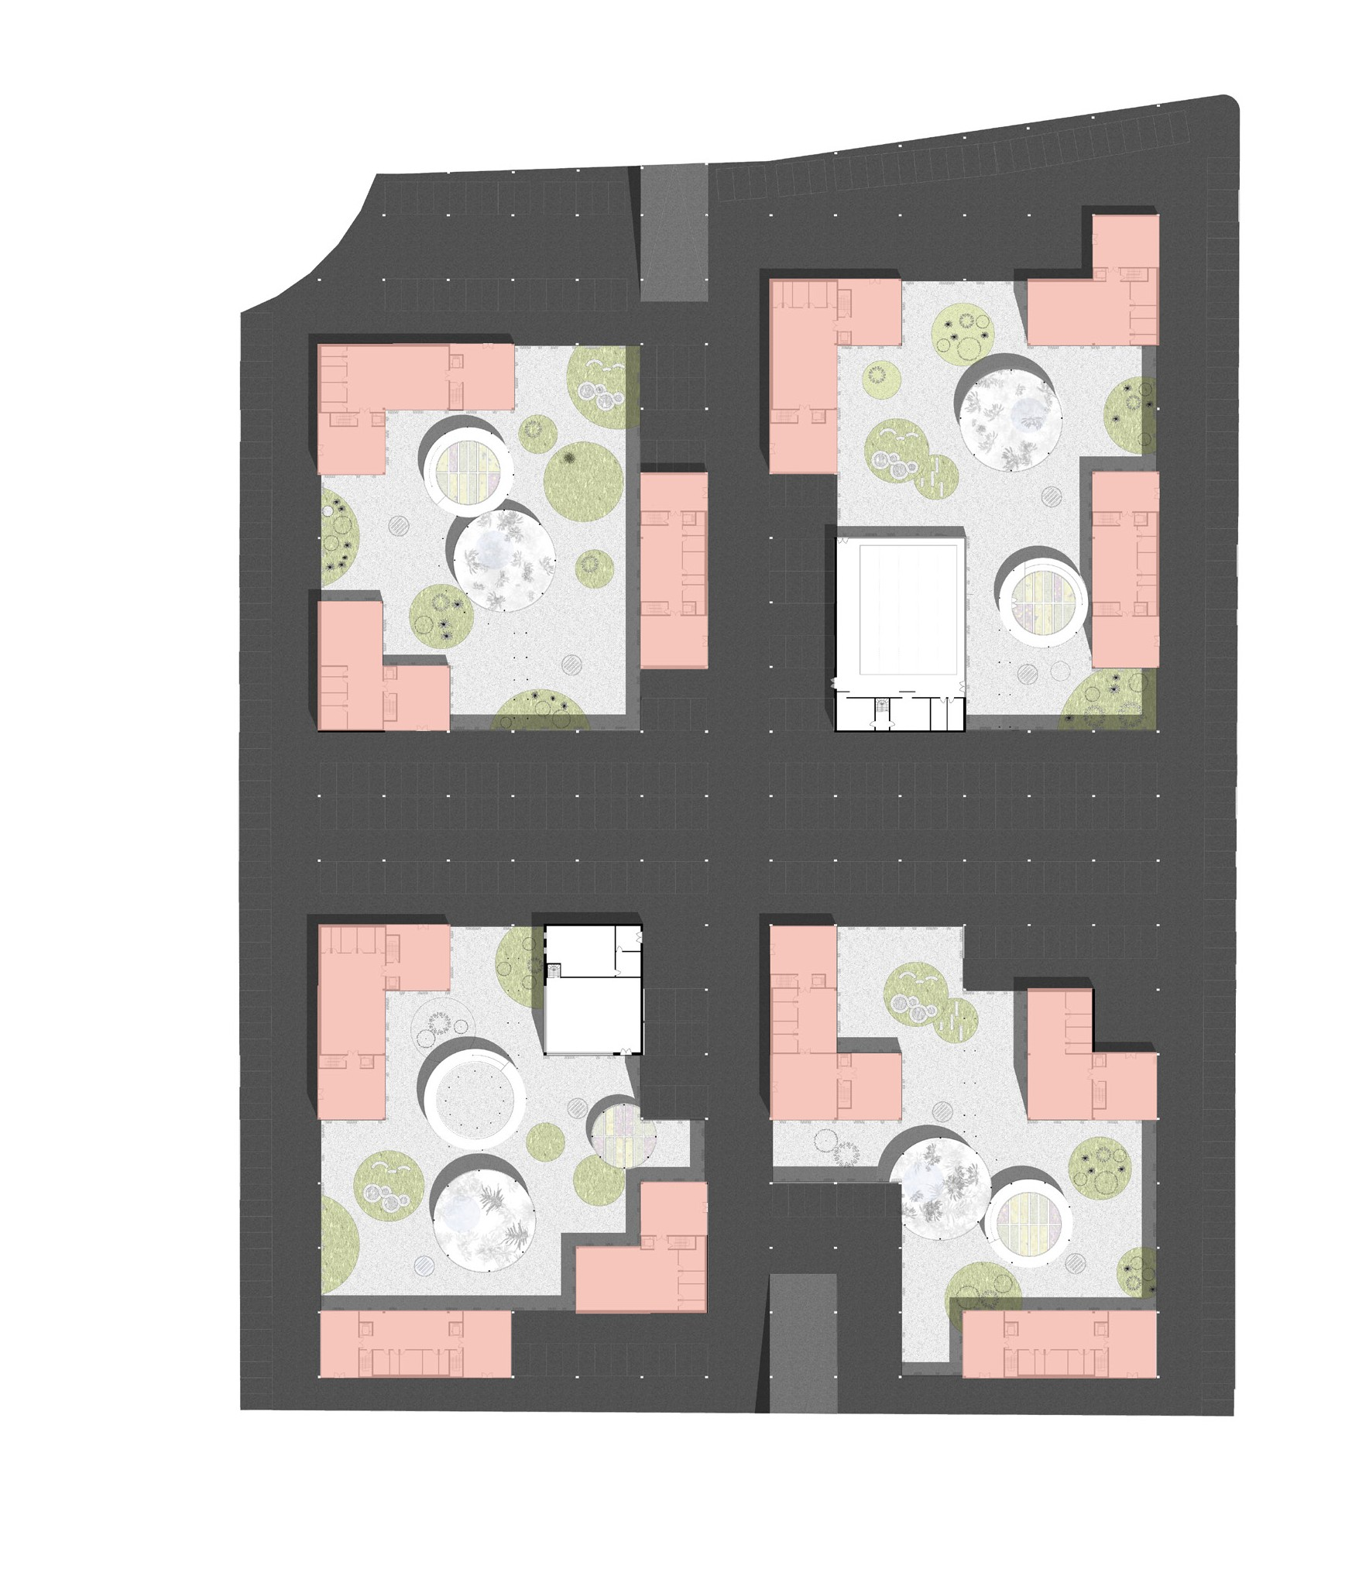
PARKING
BUIDING’S FOOTPRINT
Basement floor plan

Slide 11
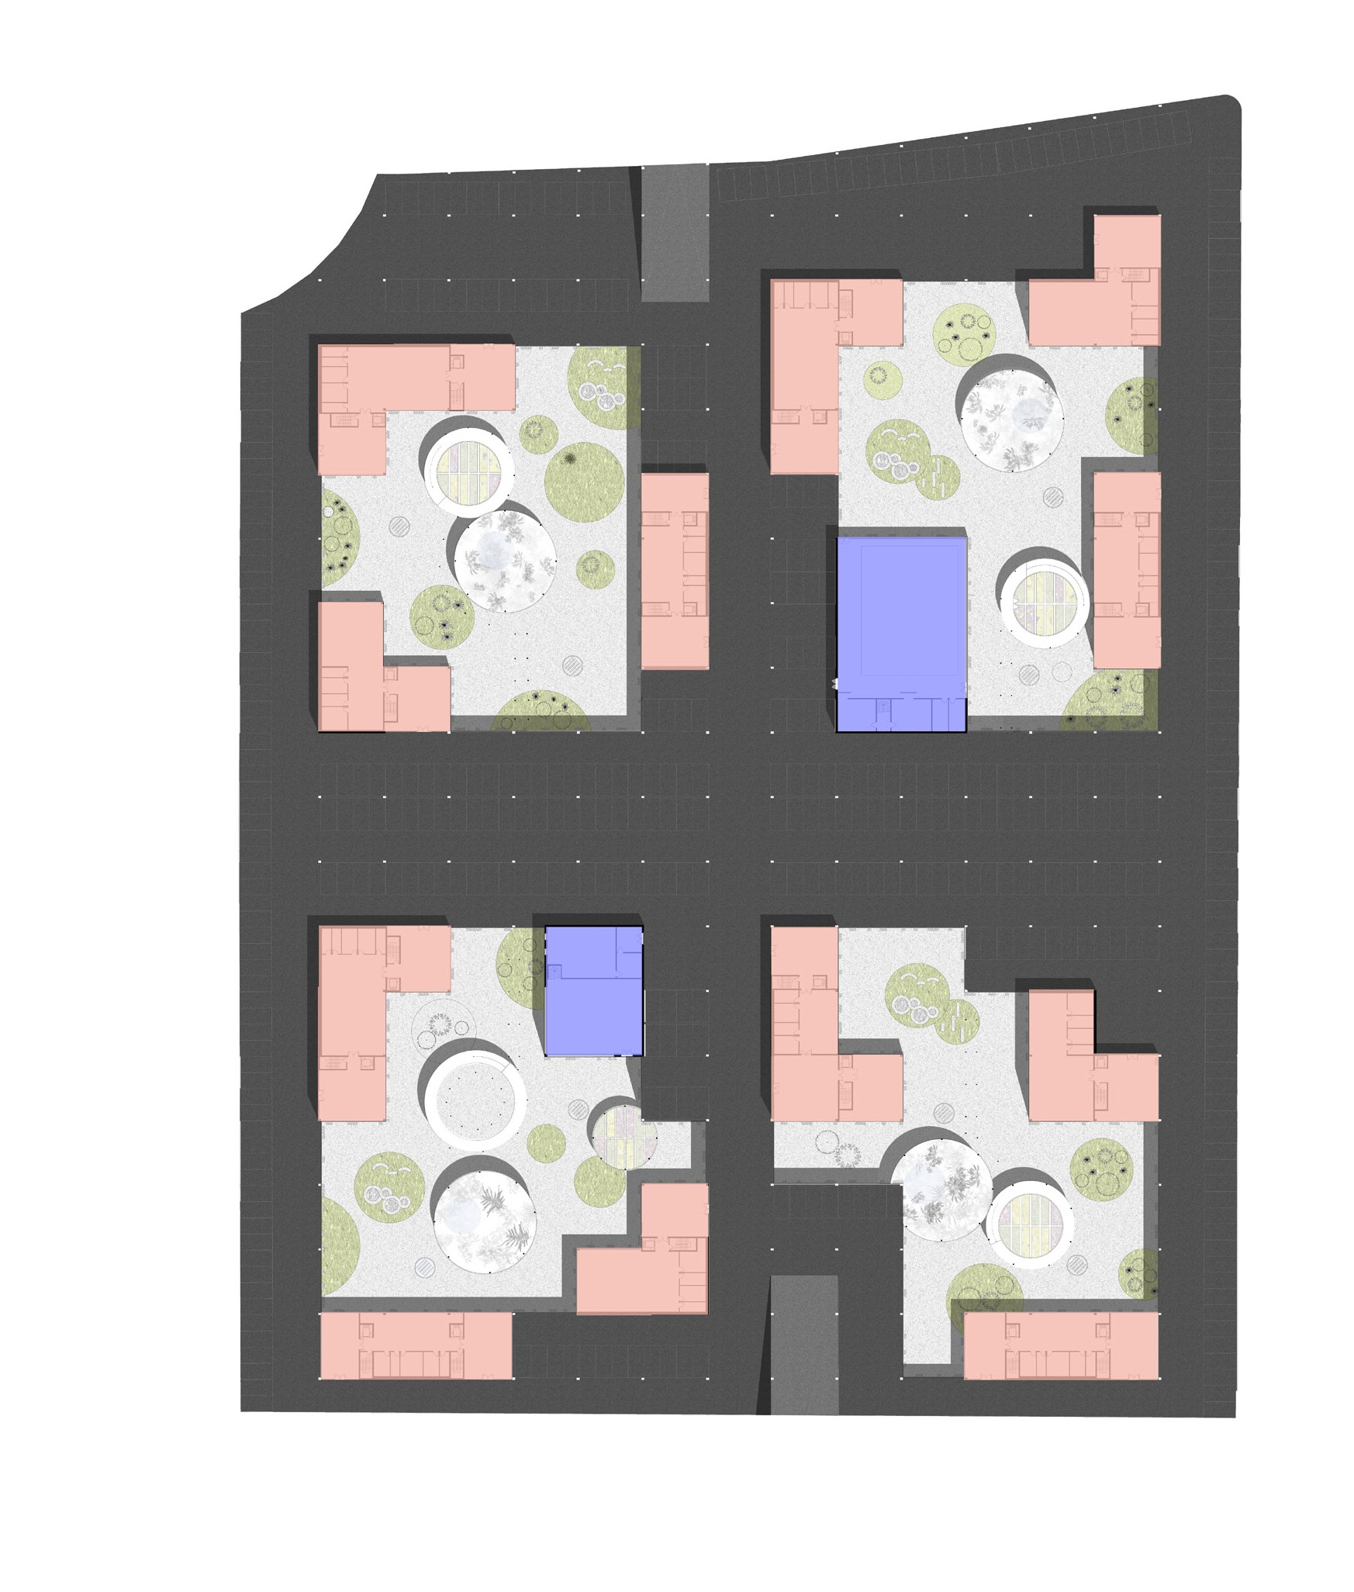
PARKING
BUIDING’S FOOTPRINT
PUBLIC AMENITIES
Basement floor plan

Slide 12
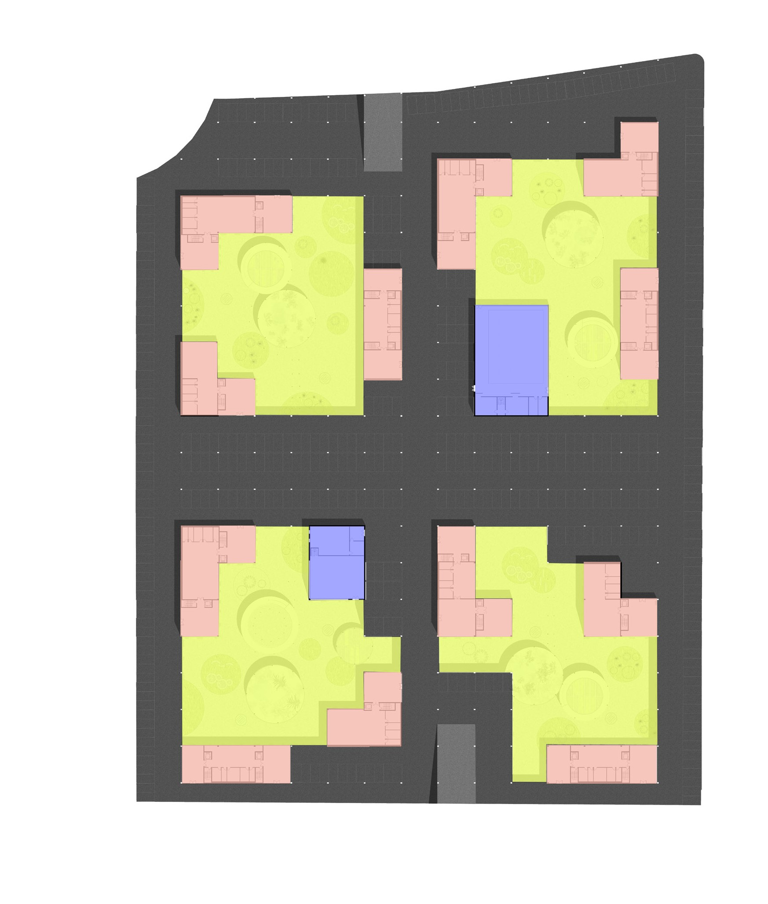
PARKING
BUIDING’S FOOTPRINT
PUBLIC AMENITIES PATIOS
Basement floor plan

Slide 13
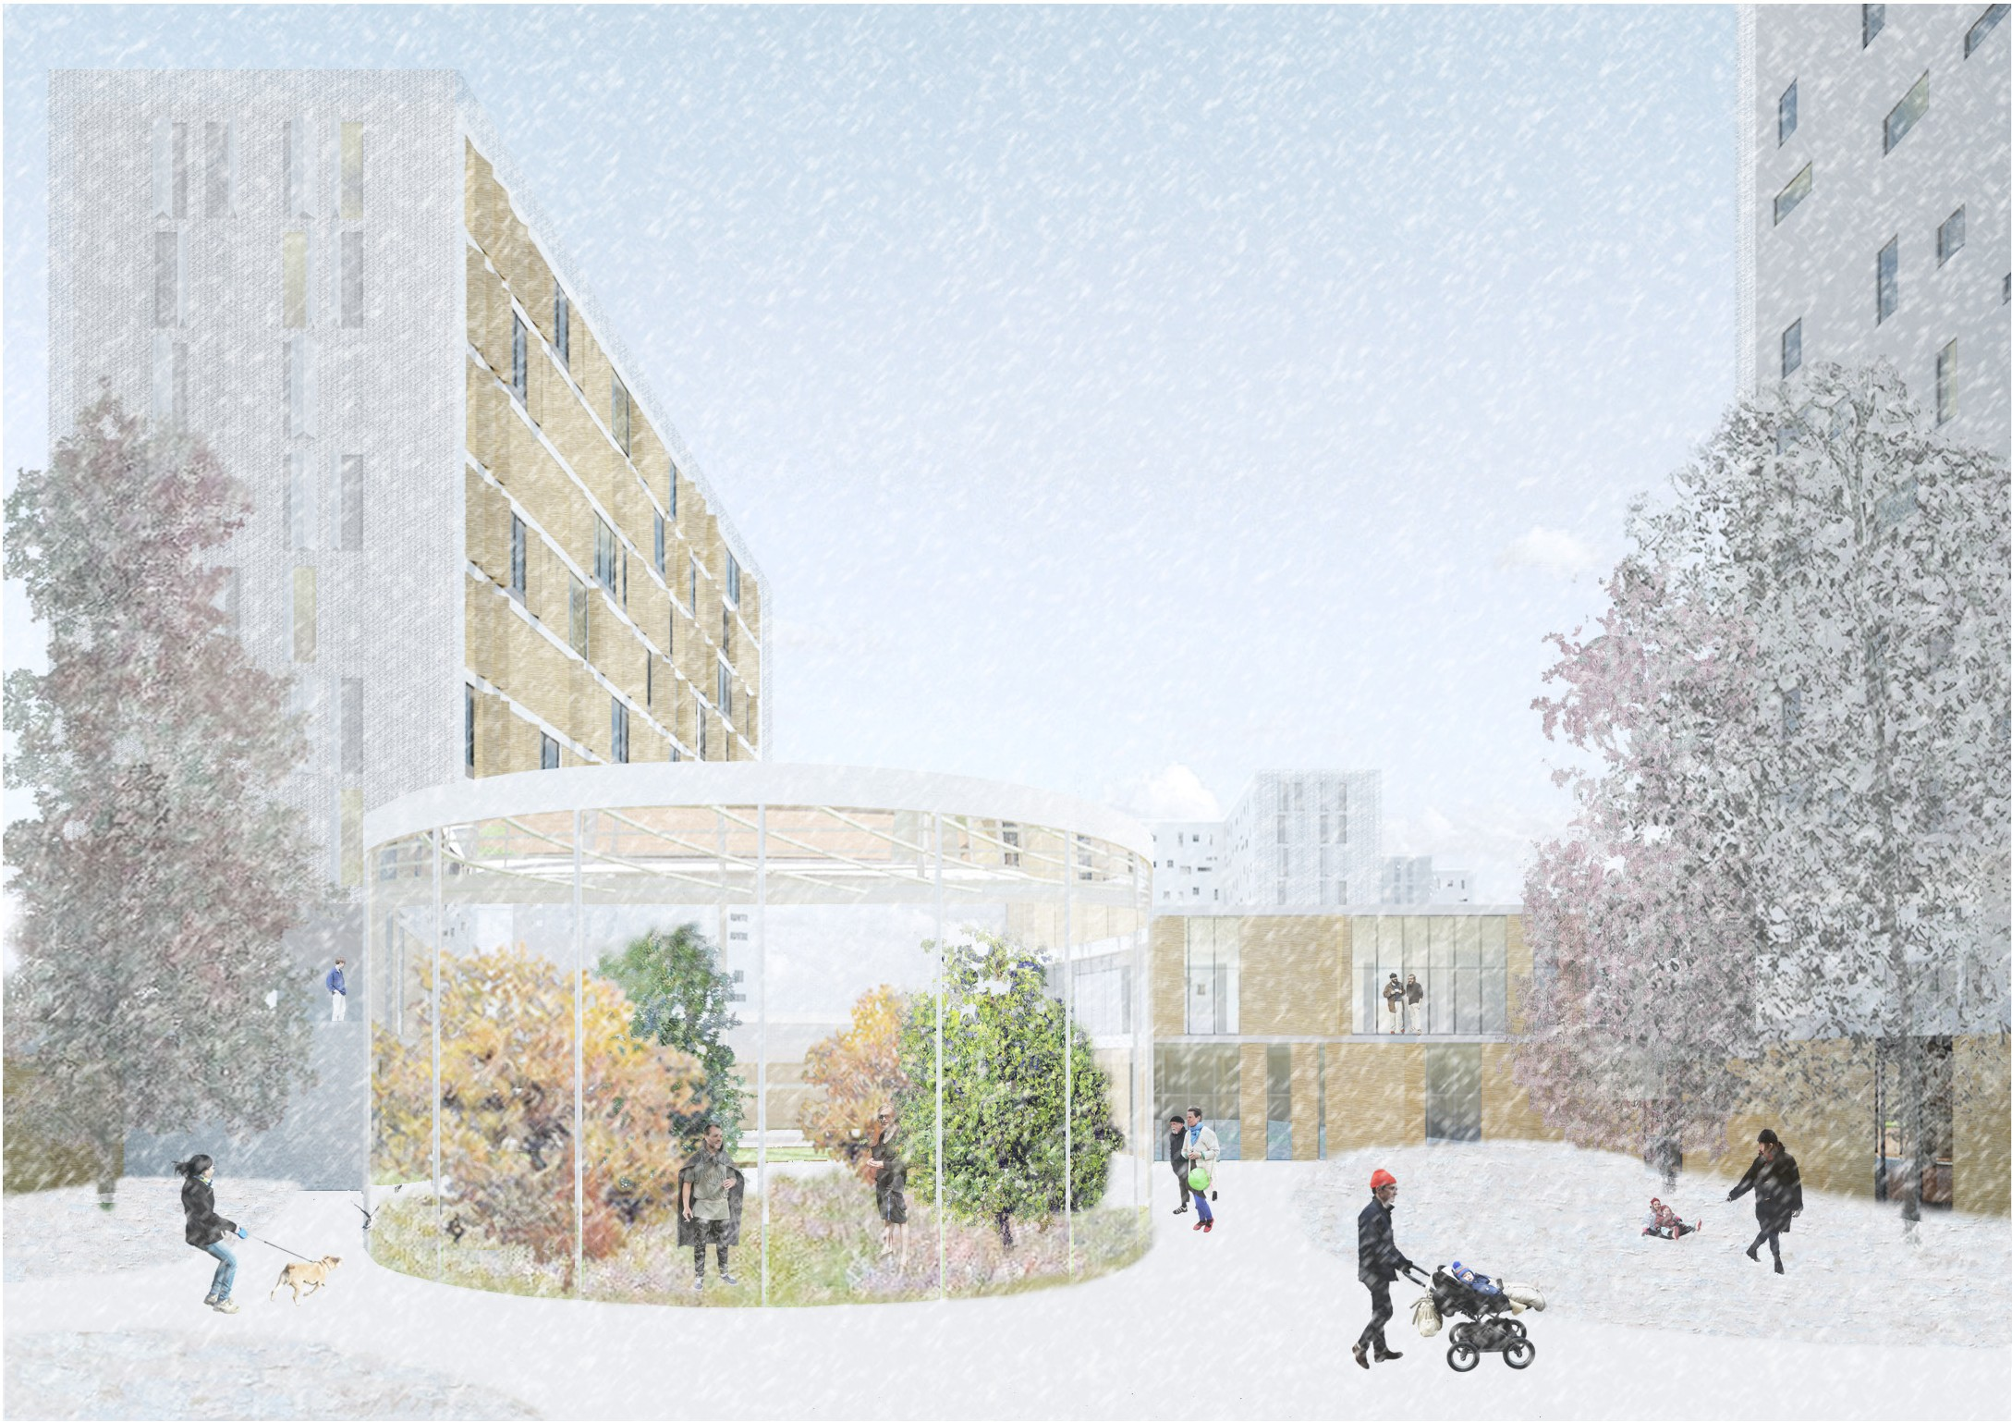
View from a patio

Slide 14
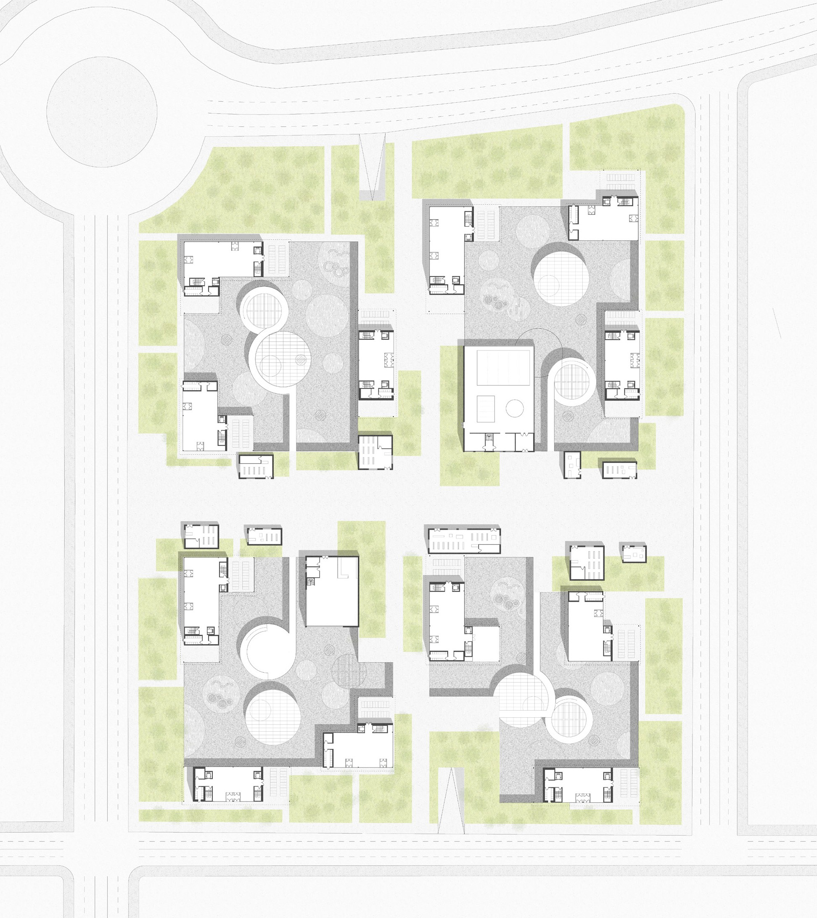
Ground floor plan

Slide 15
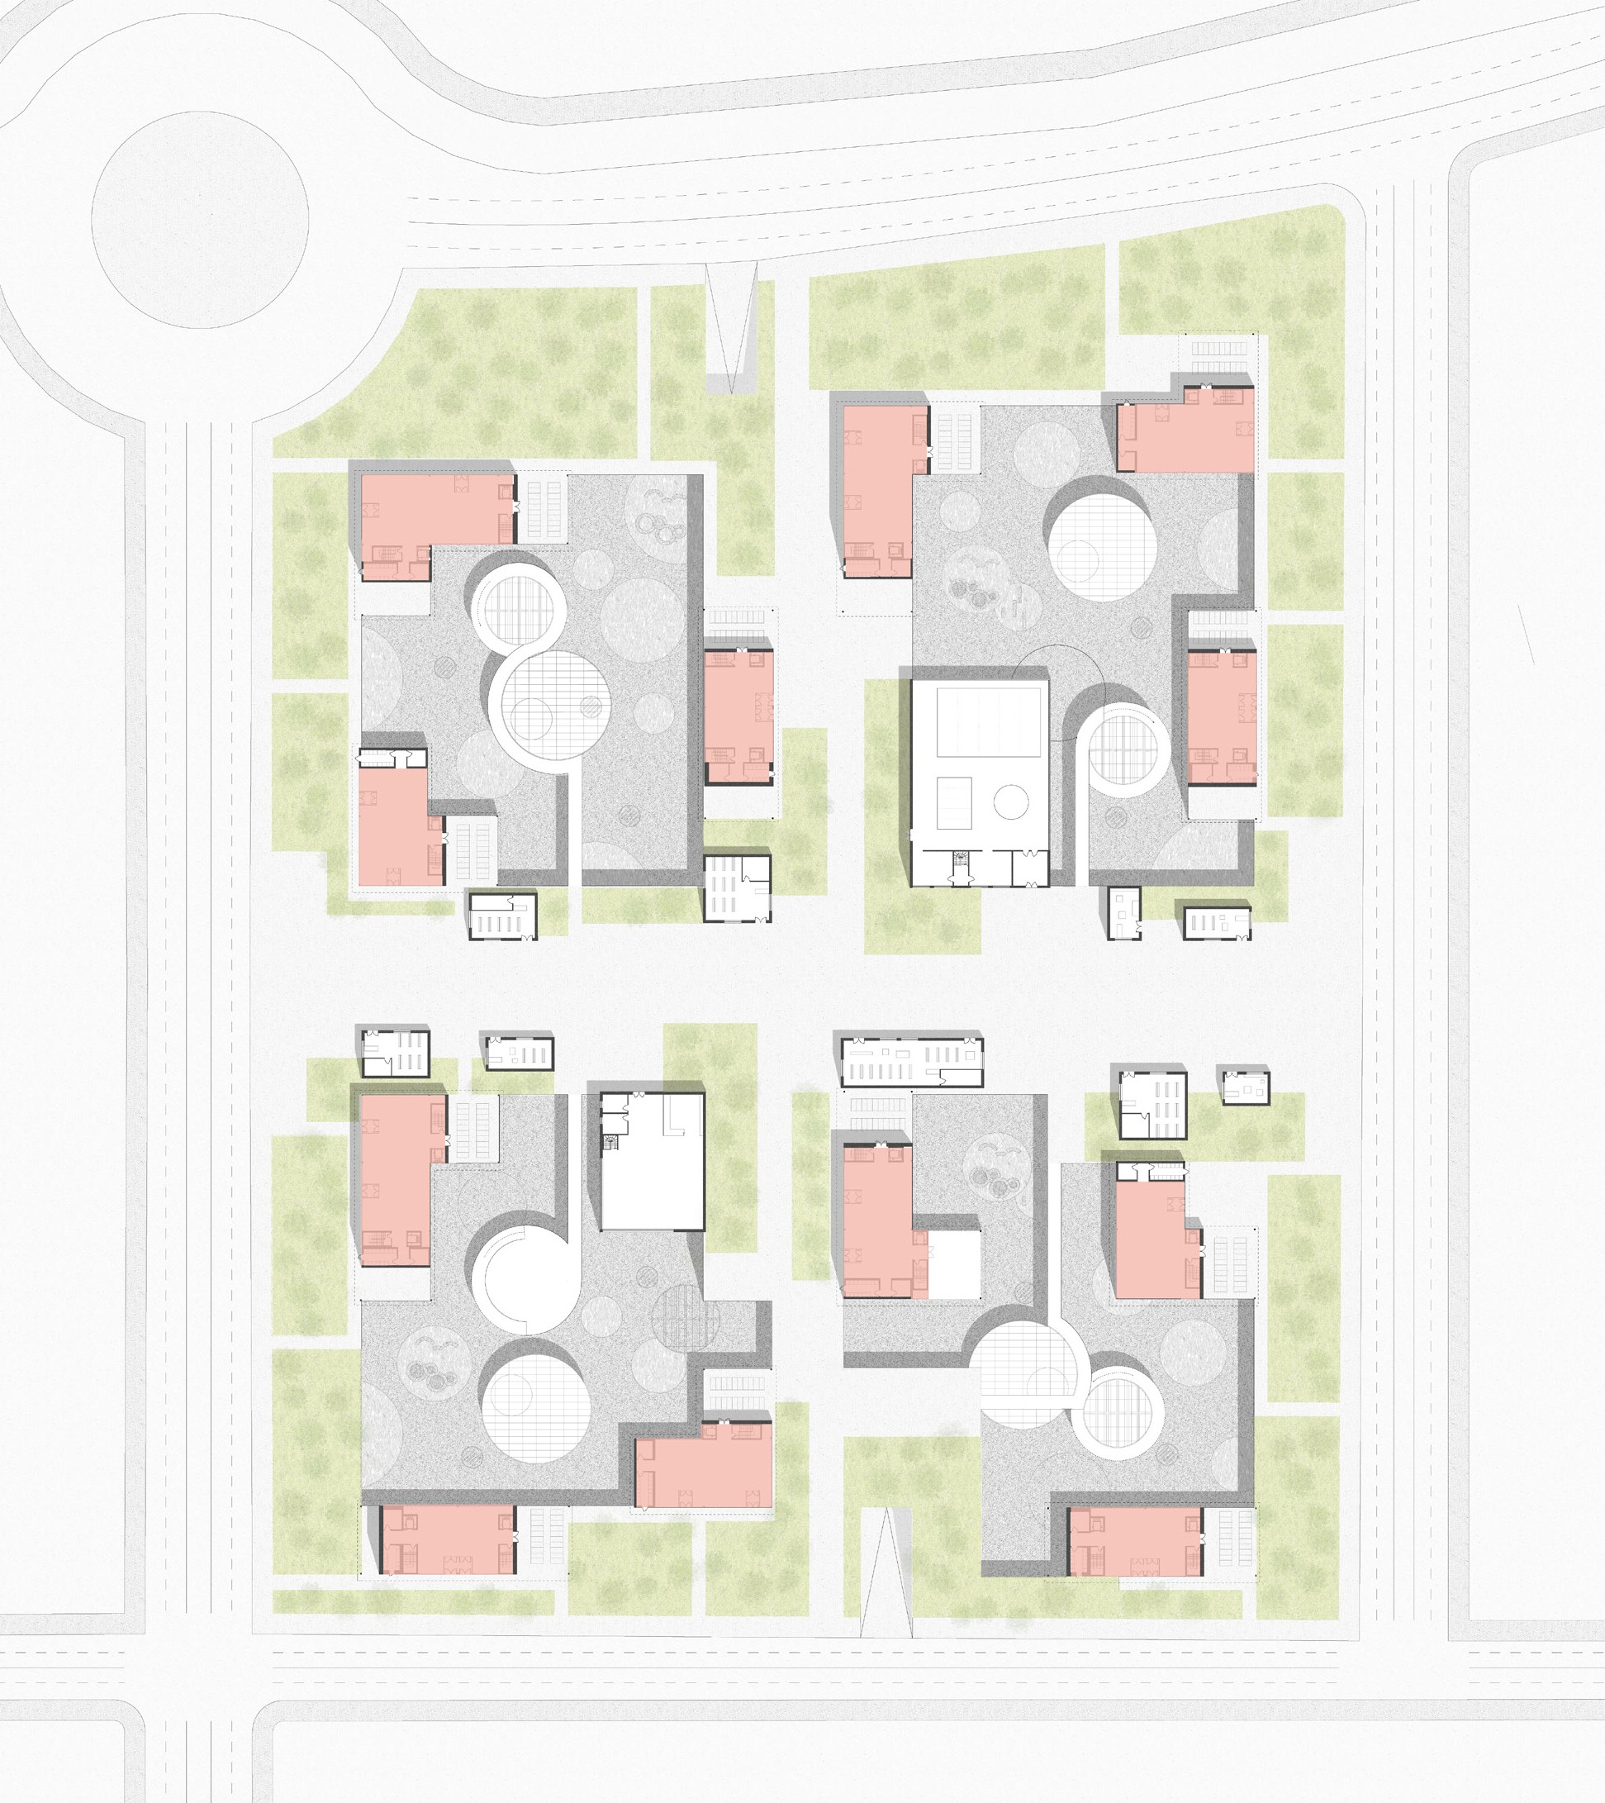
BUILDING’S FOOTPRINT
Ground floor plan

Slide 16
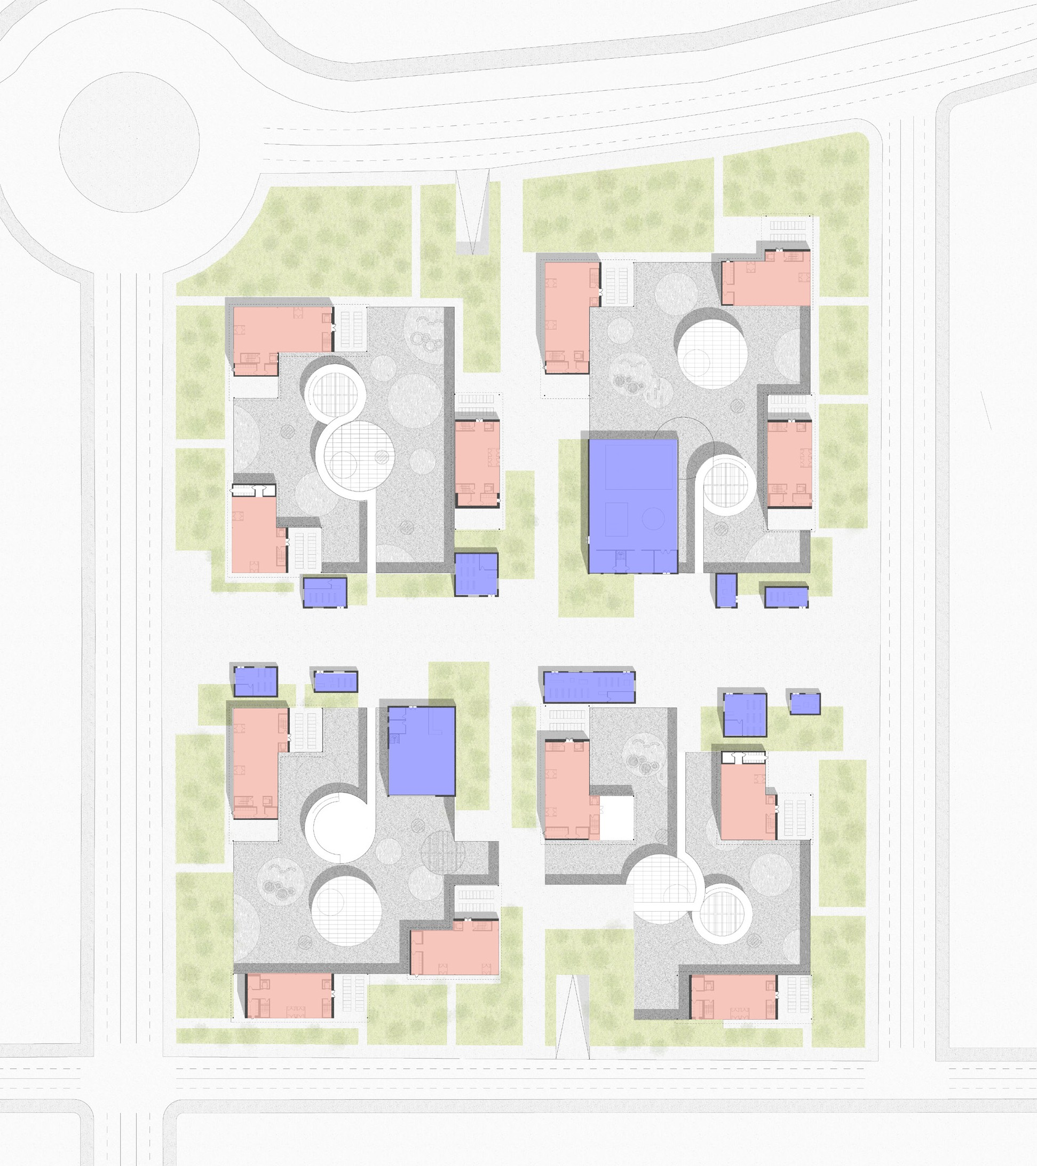
BUILDING’S FOOTPRINT
PUBLIC AMENITIES
Ground floor plan

Slide 17
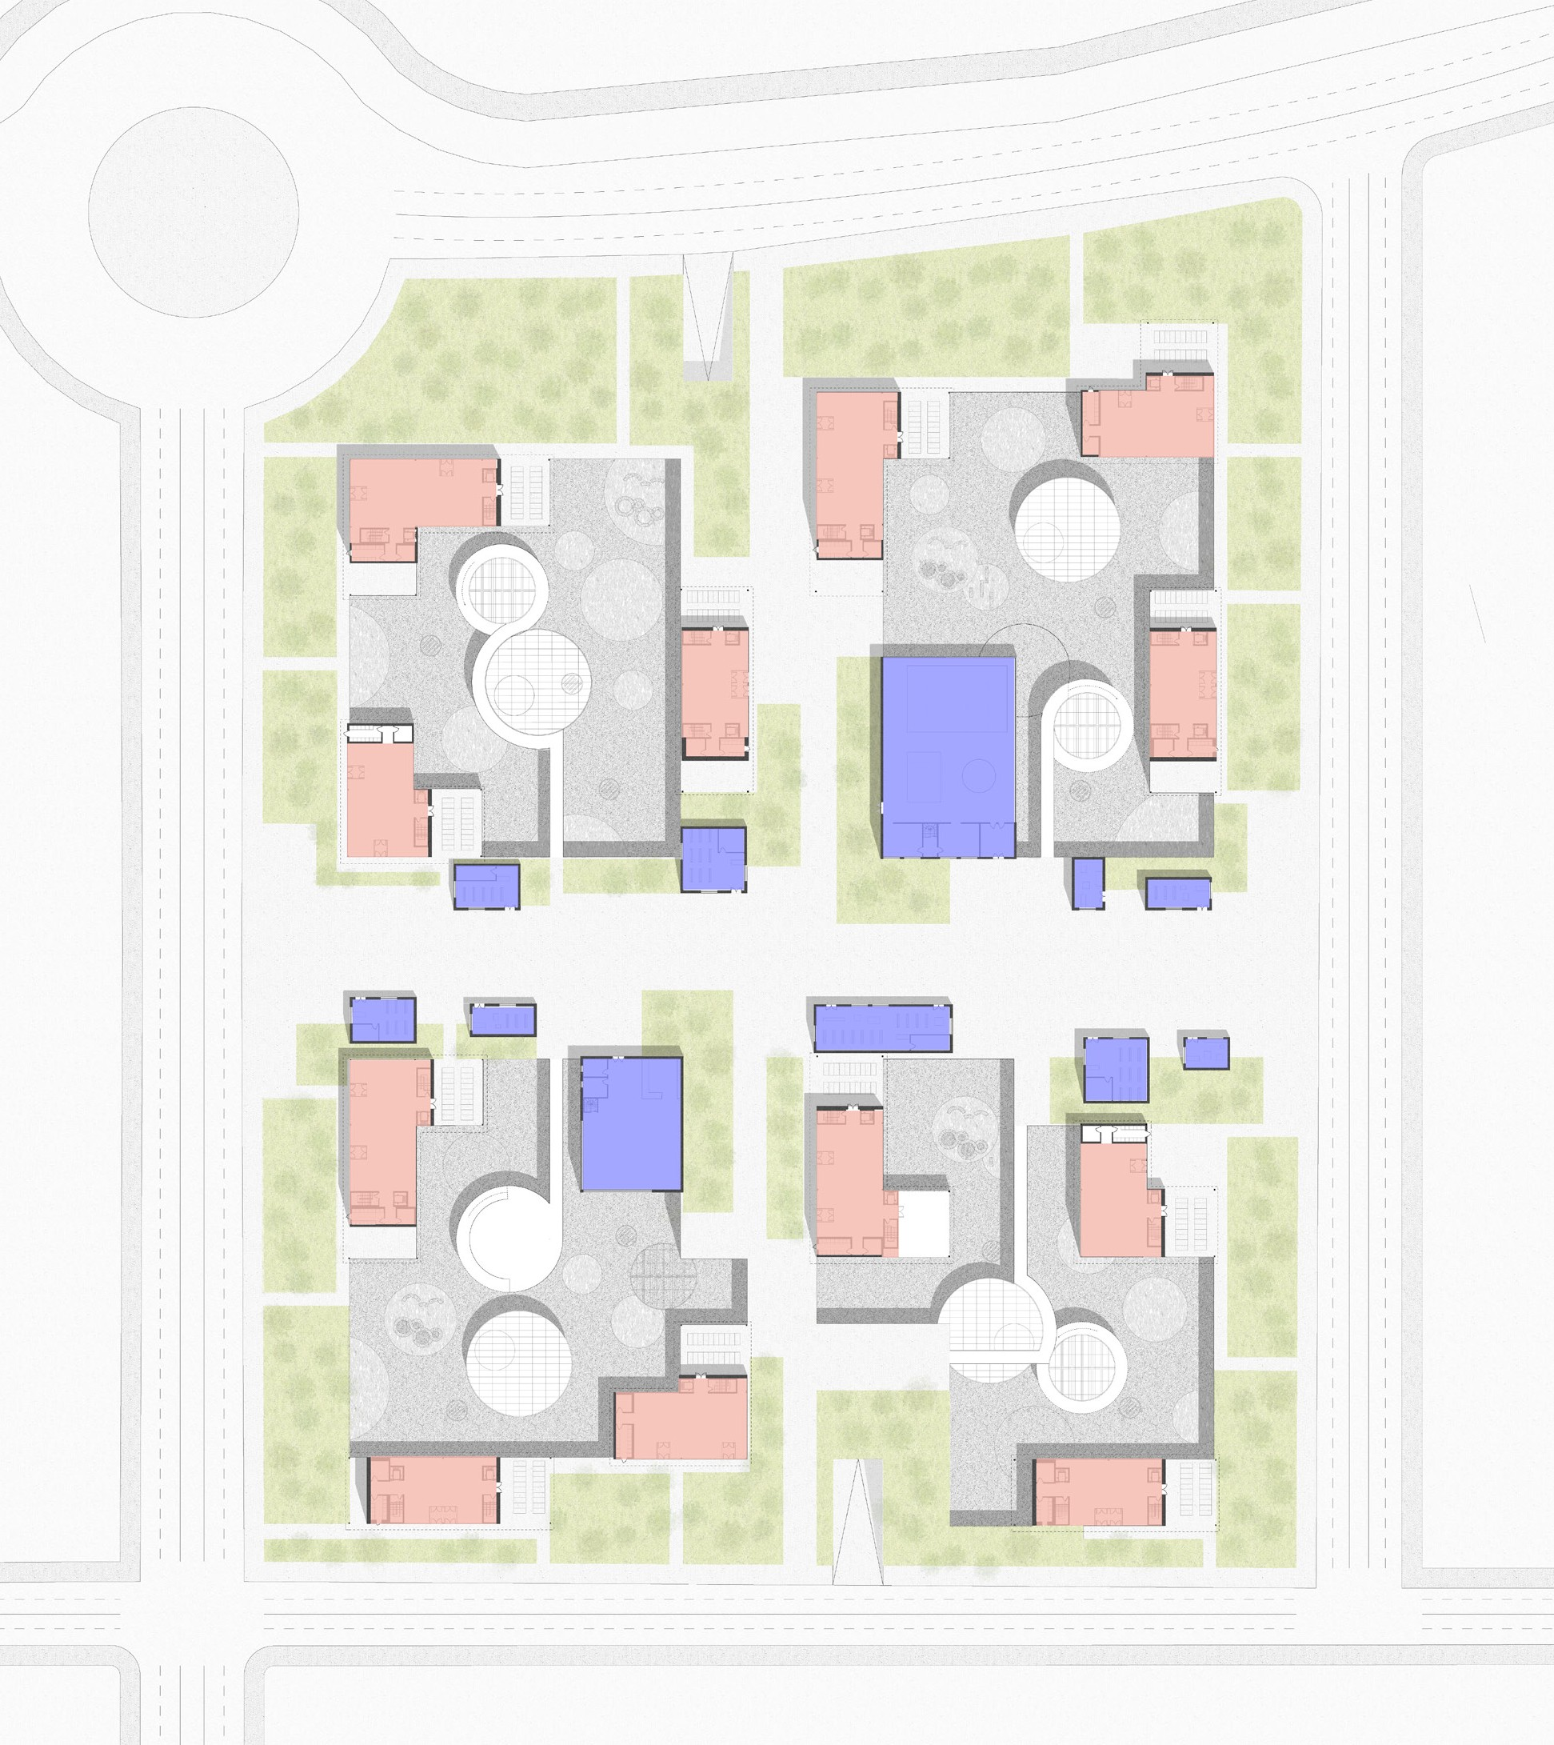
BUILDING’S FOOTPRINT
PUBLIC AMENITIES
CIRCULATION
Ground floor plan

Slide 18
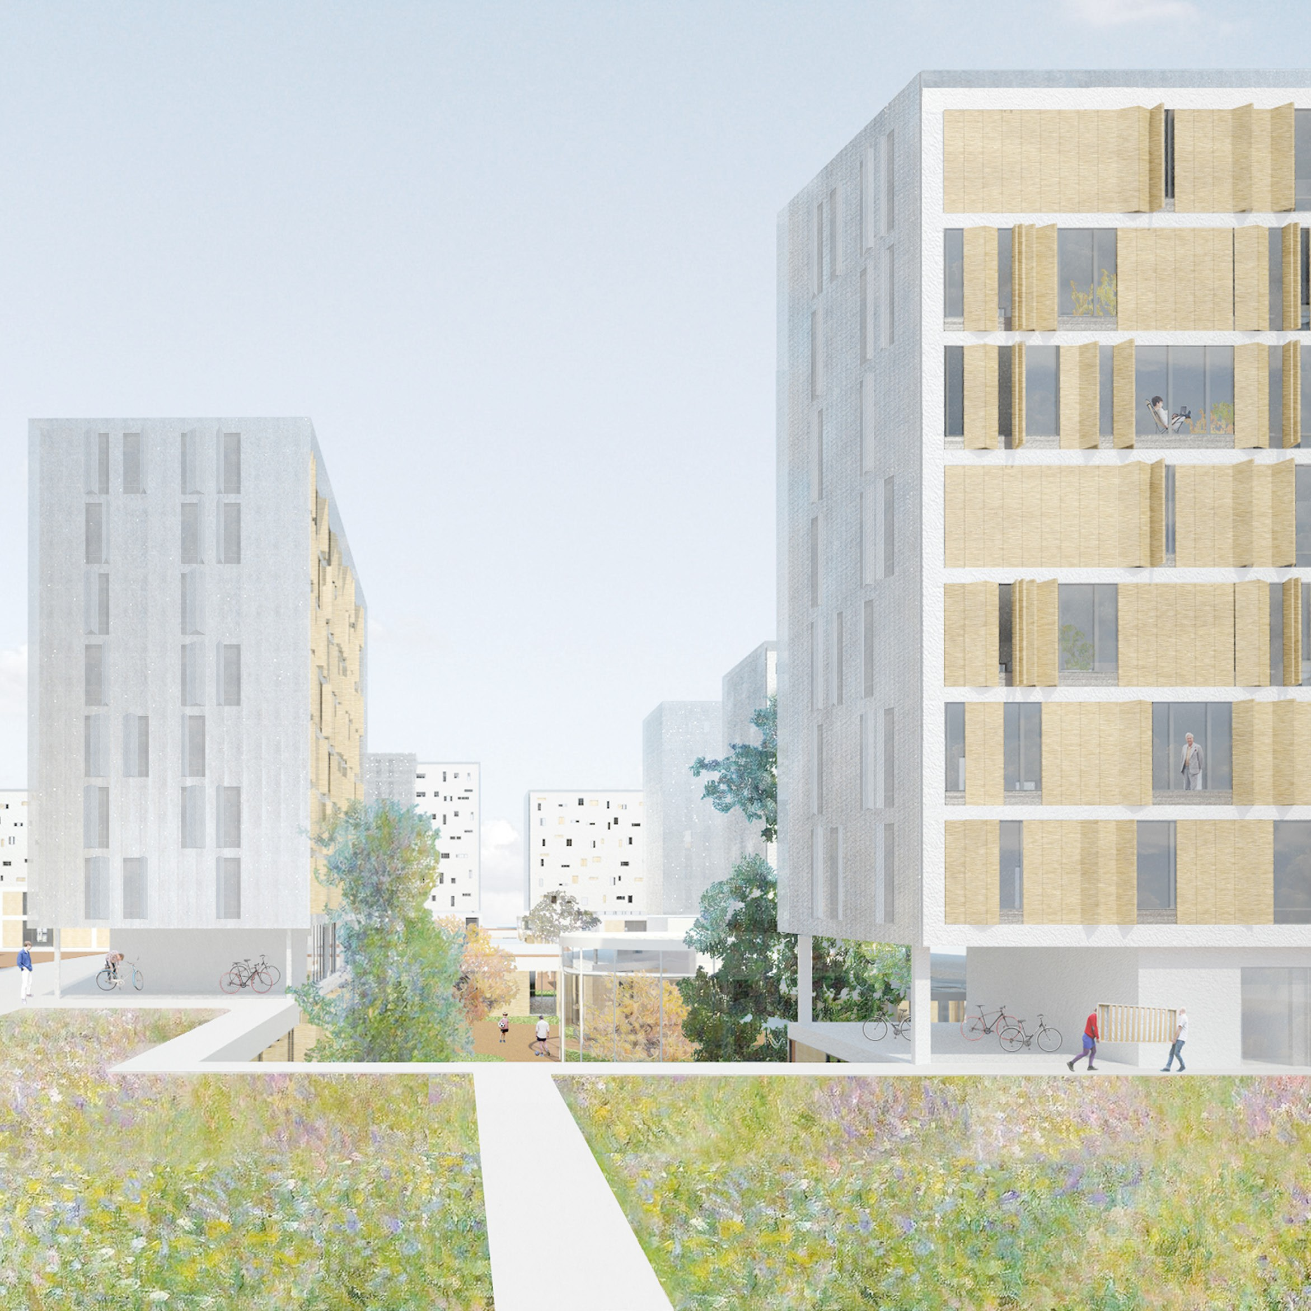
View from a lane

Slide 19
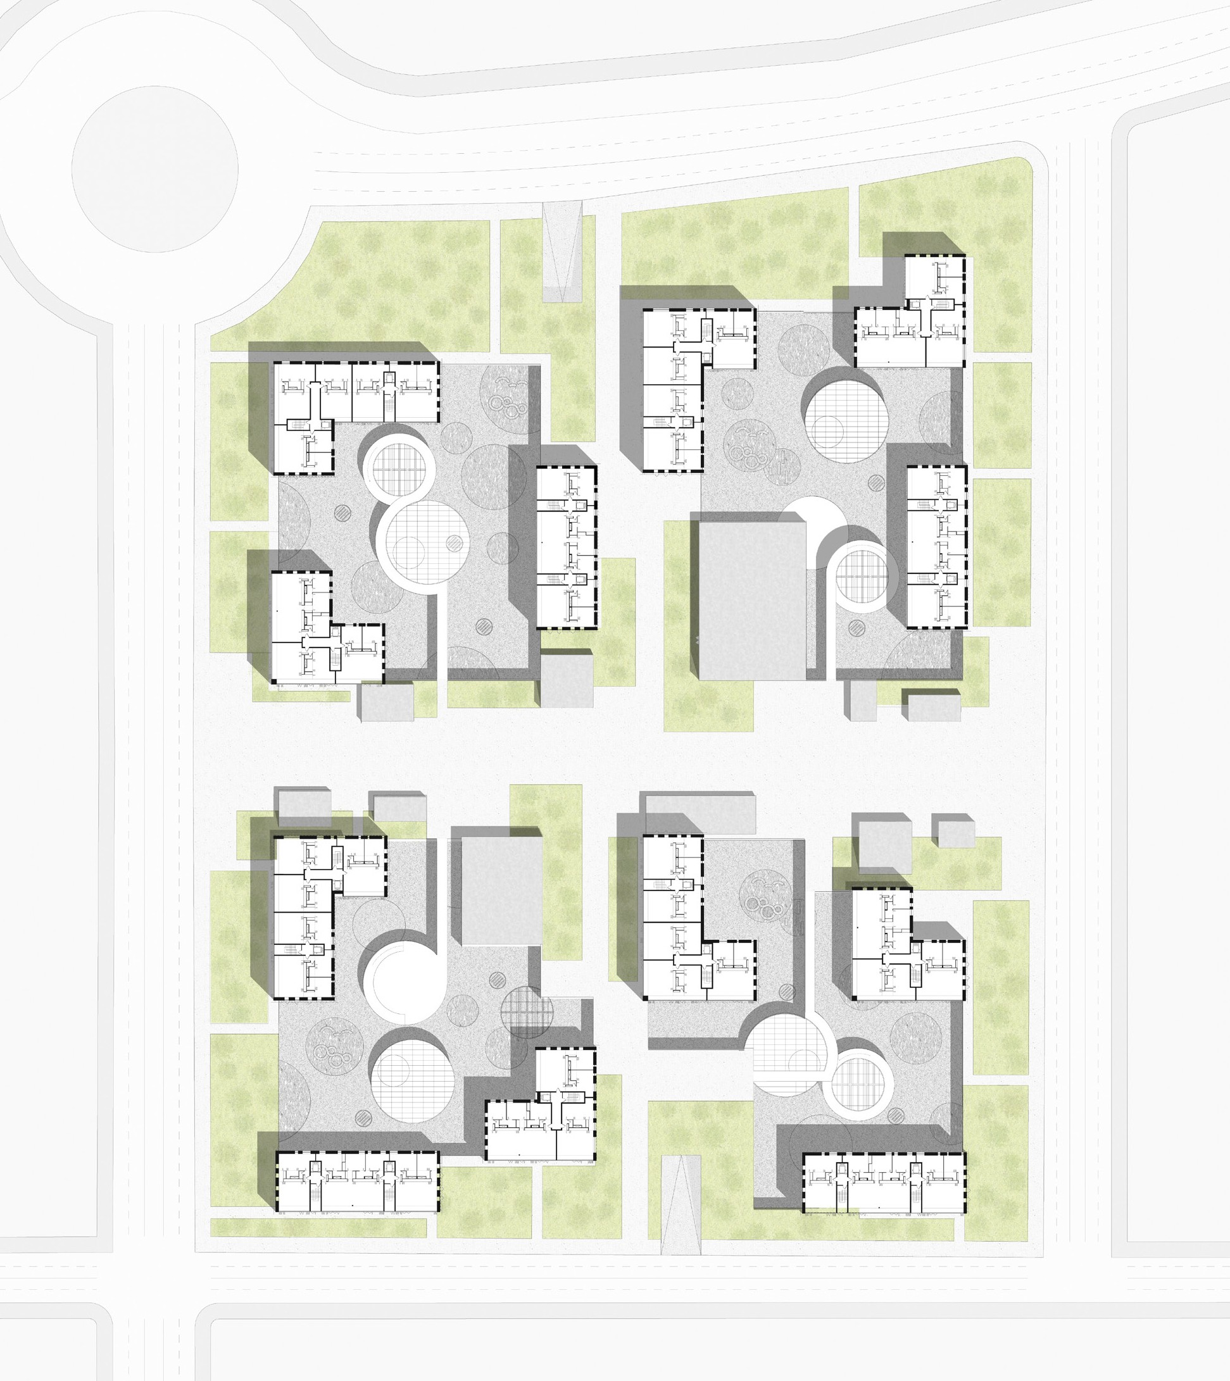
Common floor plan

Slide 20
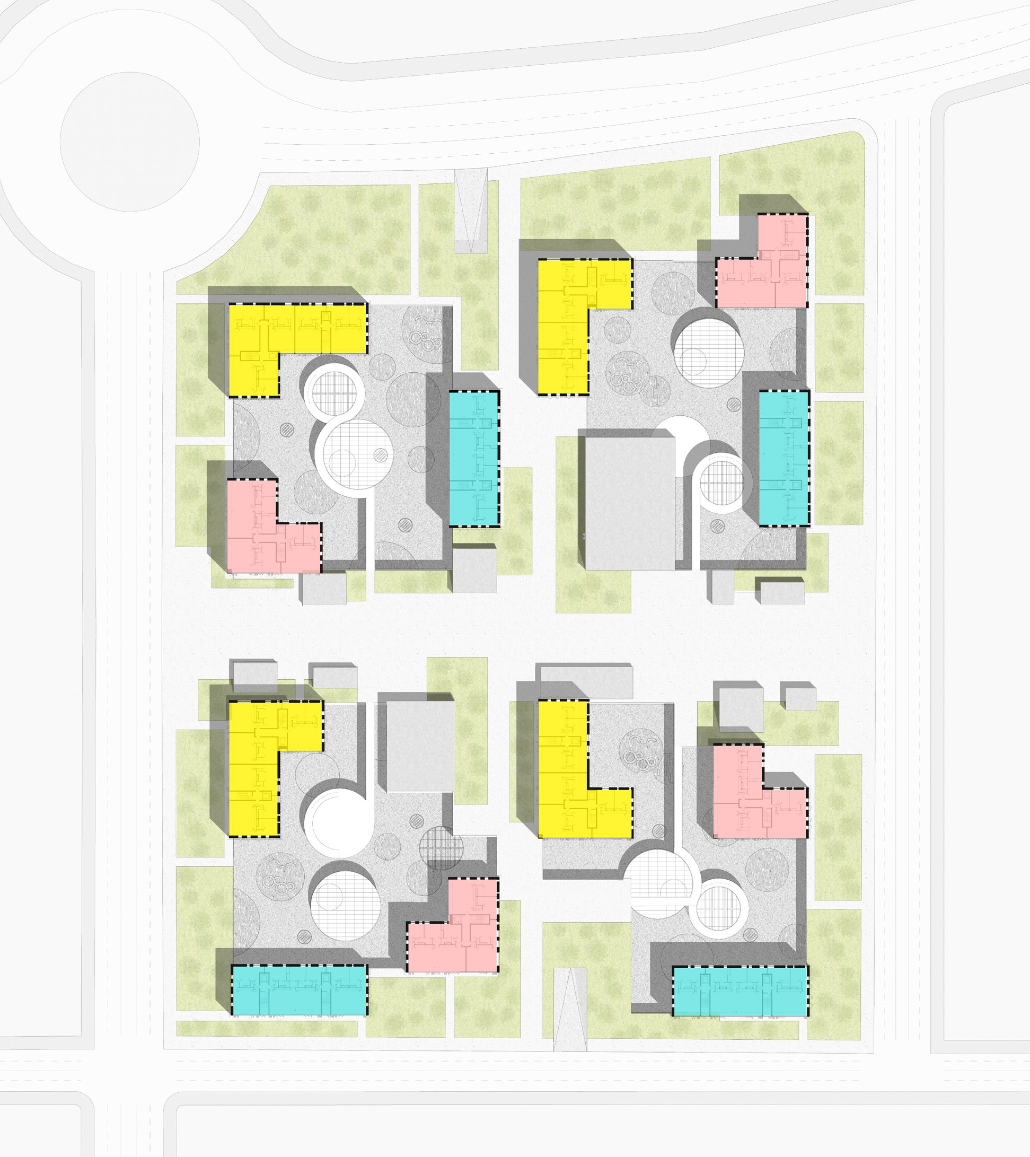
TYPE A
TYPE B
TYPE C
Common floor plan

Slide 21
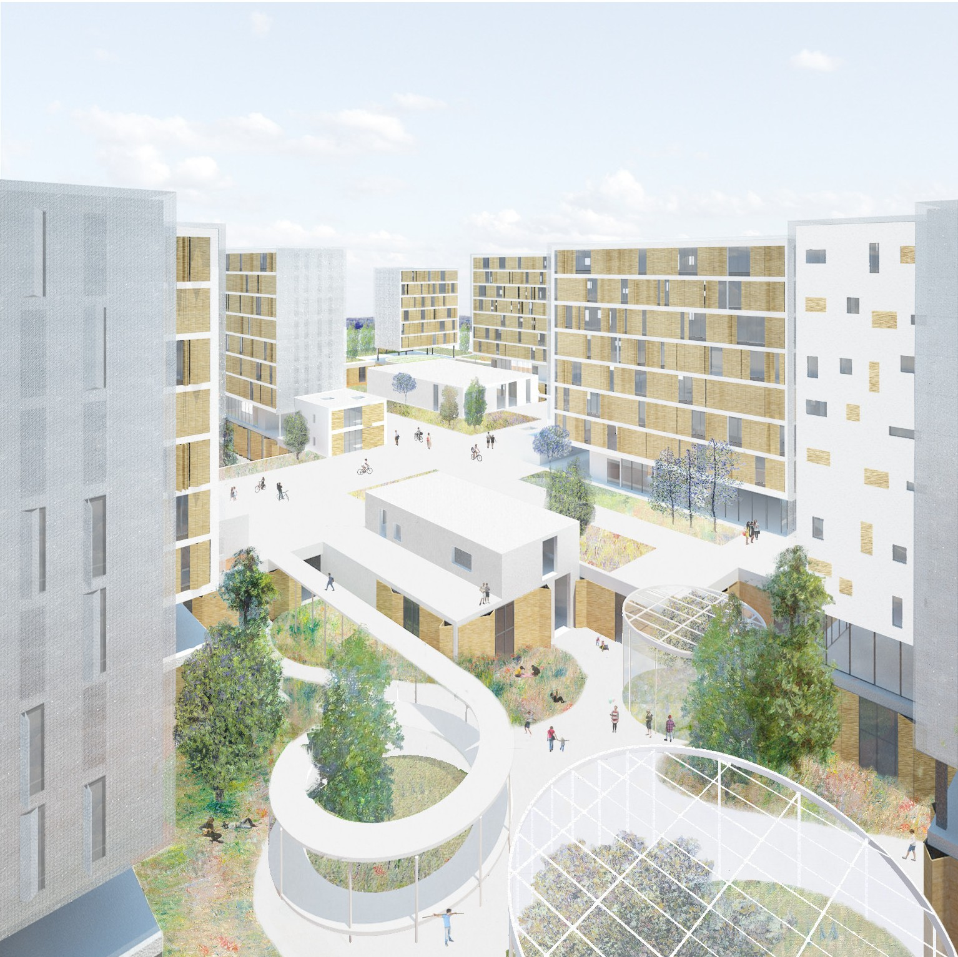
View from a dwelling

Slide 22
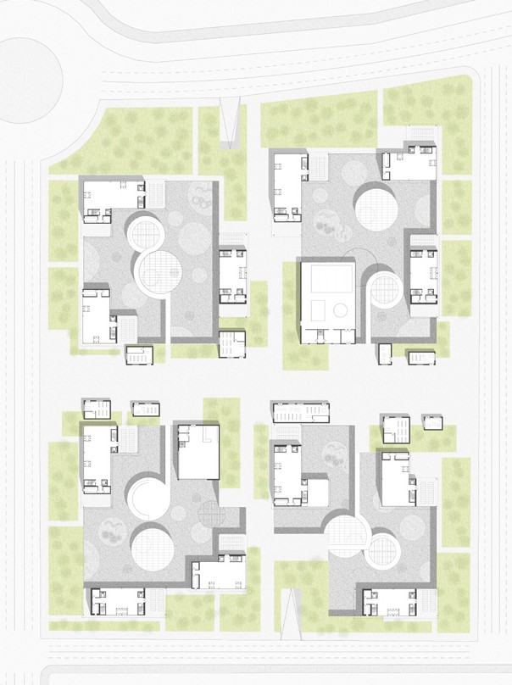
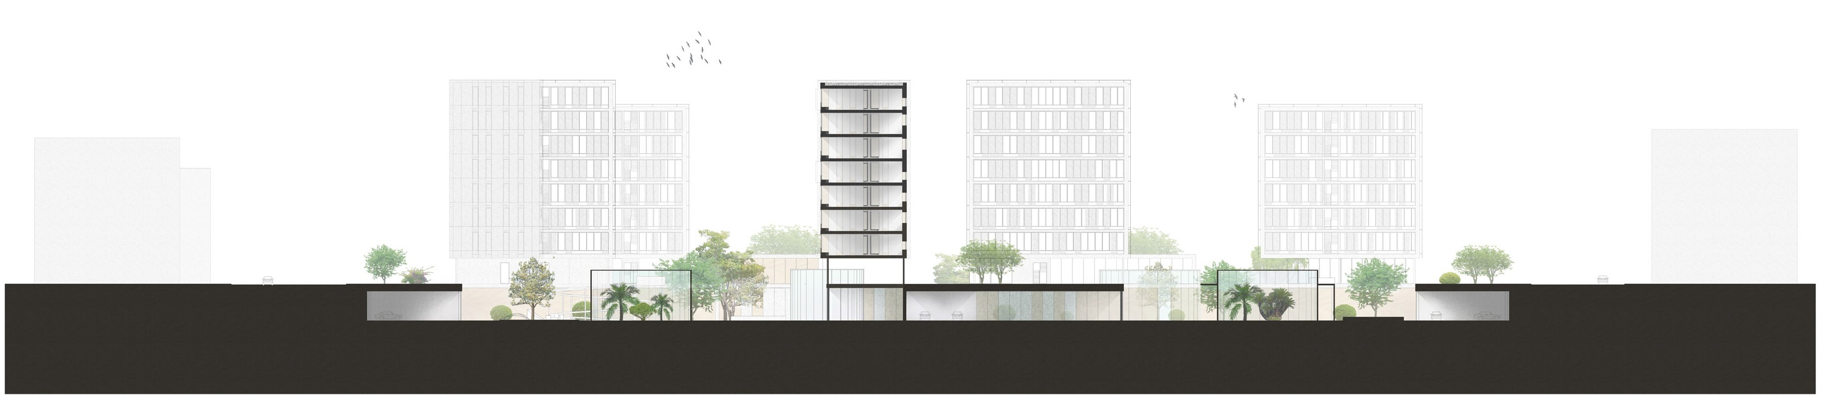
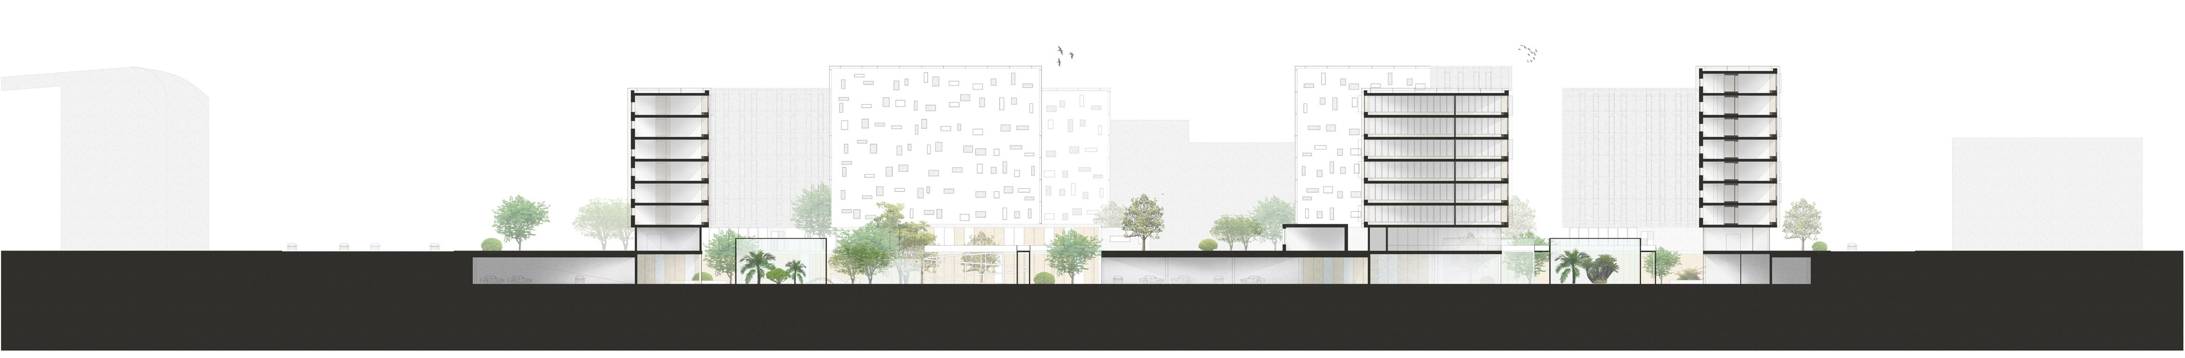
B
A
A
A Cross section
B
B Longitudinal section

Slide 23
Architectural design
The building

Slide 24
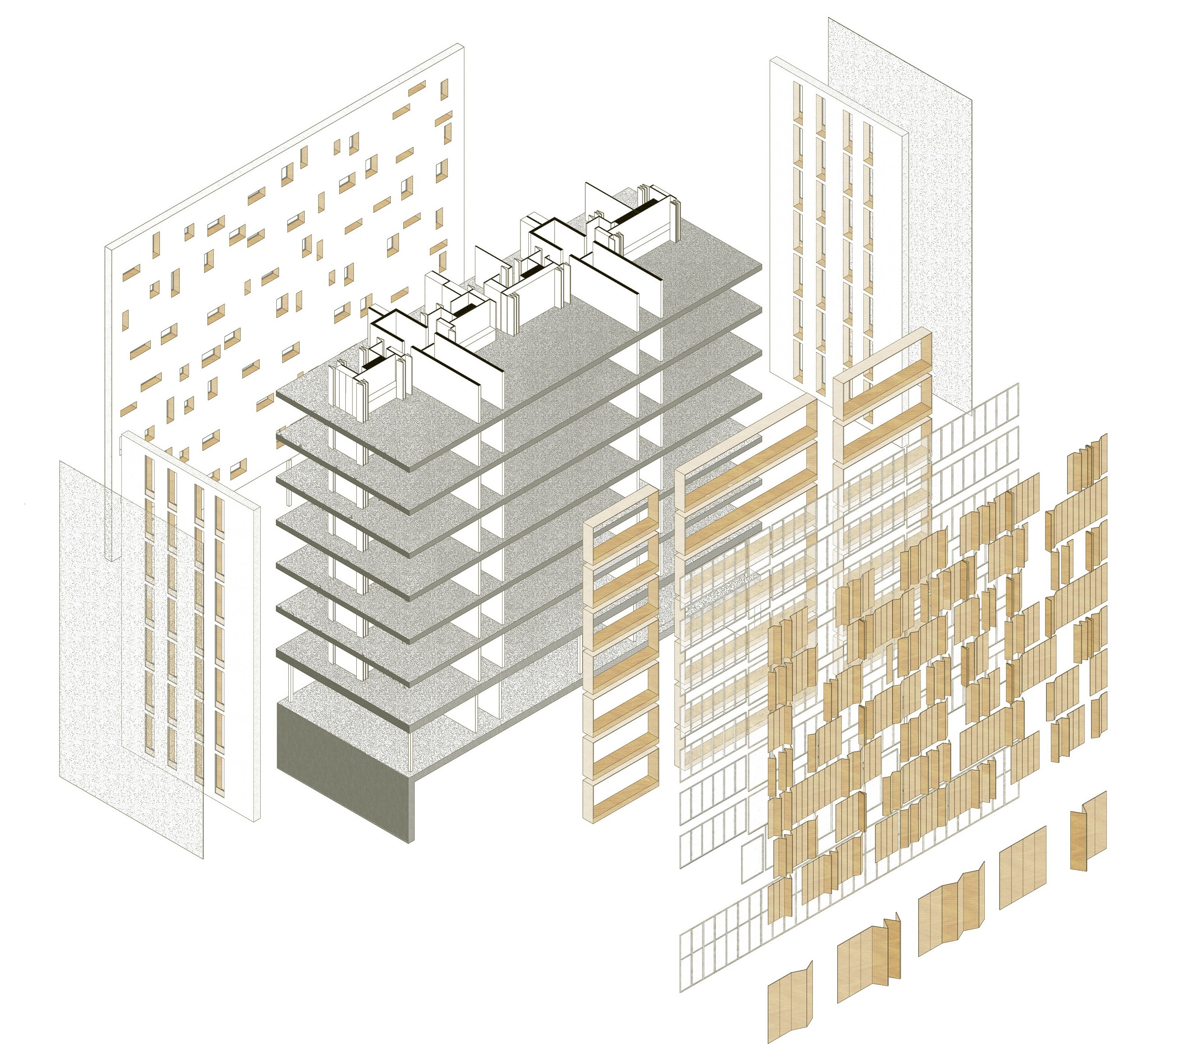
building shell
Composition of the
N
Different layers according to the orientation
Opaque and high insulated wall with triple-glazing win-
dows
Glazing area : 99 sqm
Built-in furnishing
Triple glazing bay windows Glazing area : 295 sqm
Opaque concrete wall with vertical triple-glazing windows
Glazing area : 33 sqm
Perforated steel sun louvers
Sliding wooden sun louvers
S
Total glazing area : 460 sqm
Daylight autonomy : 67 %

Slide 25
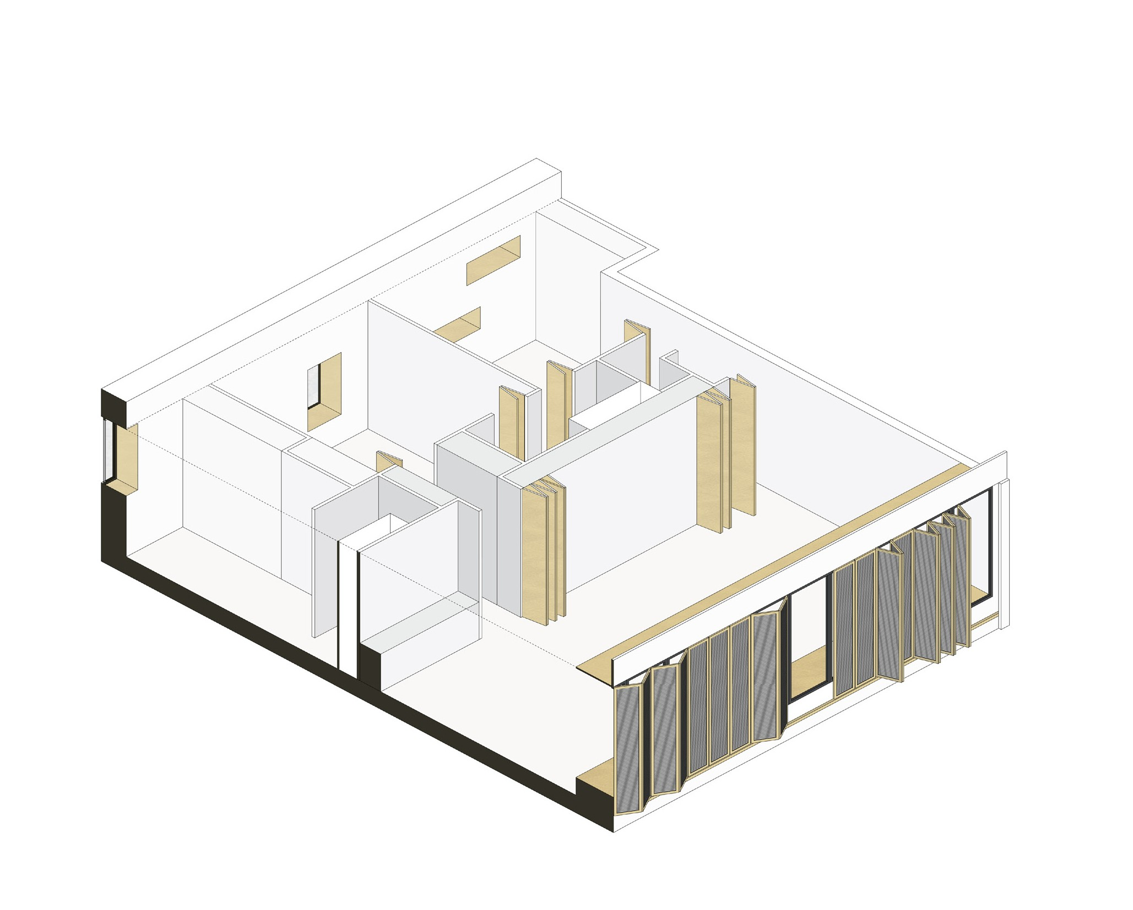
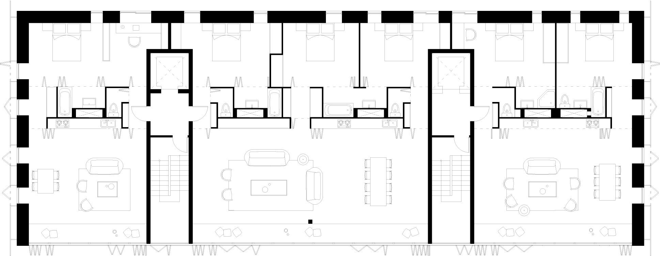
Axonometry of a dwelling
Common floor plan for building type A

Slide 26
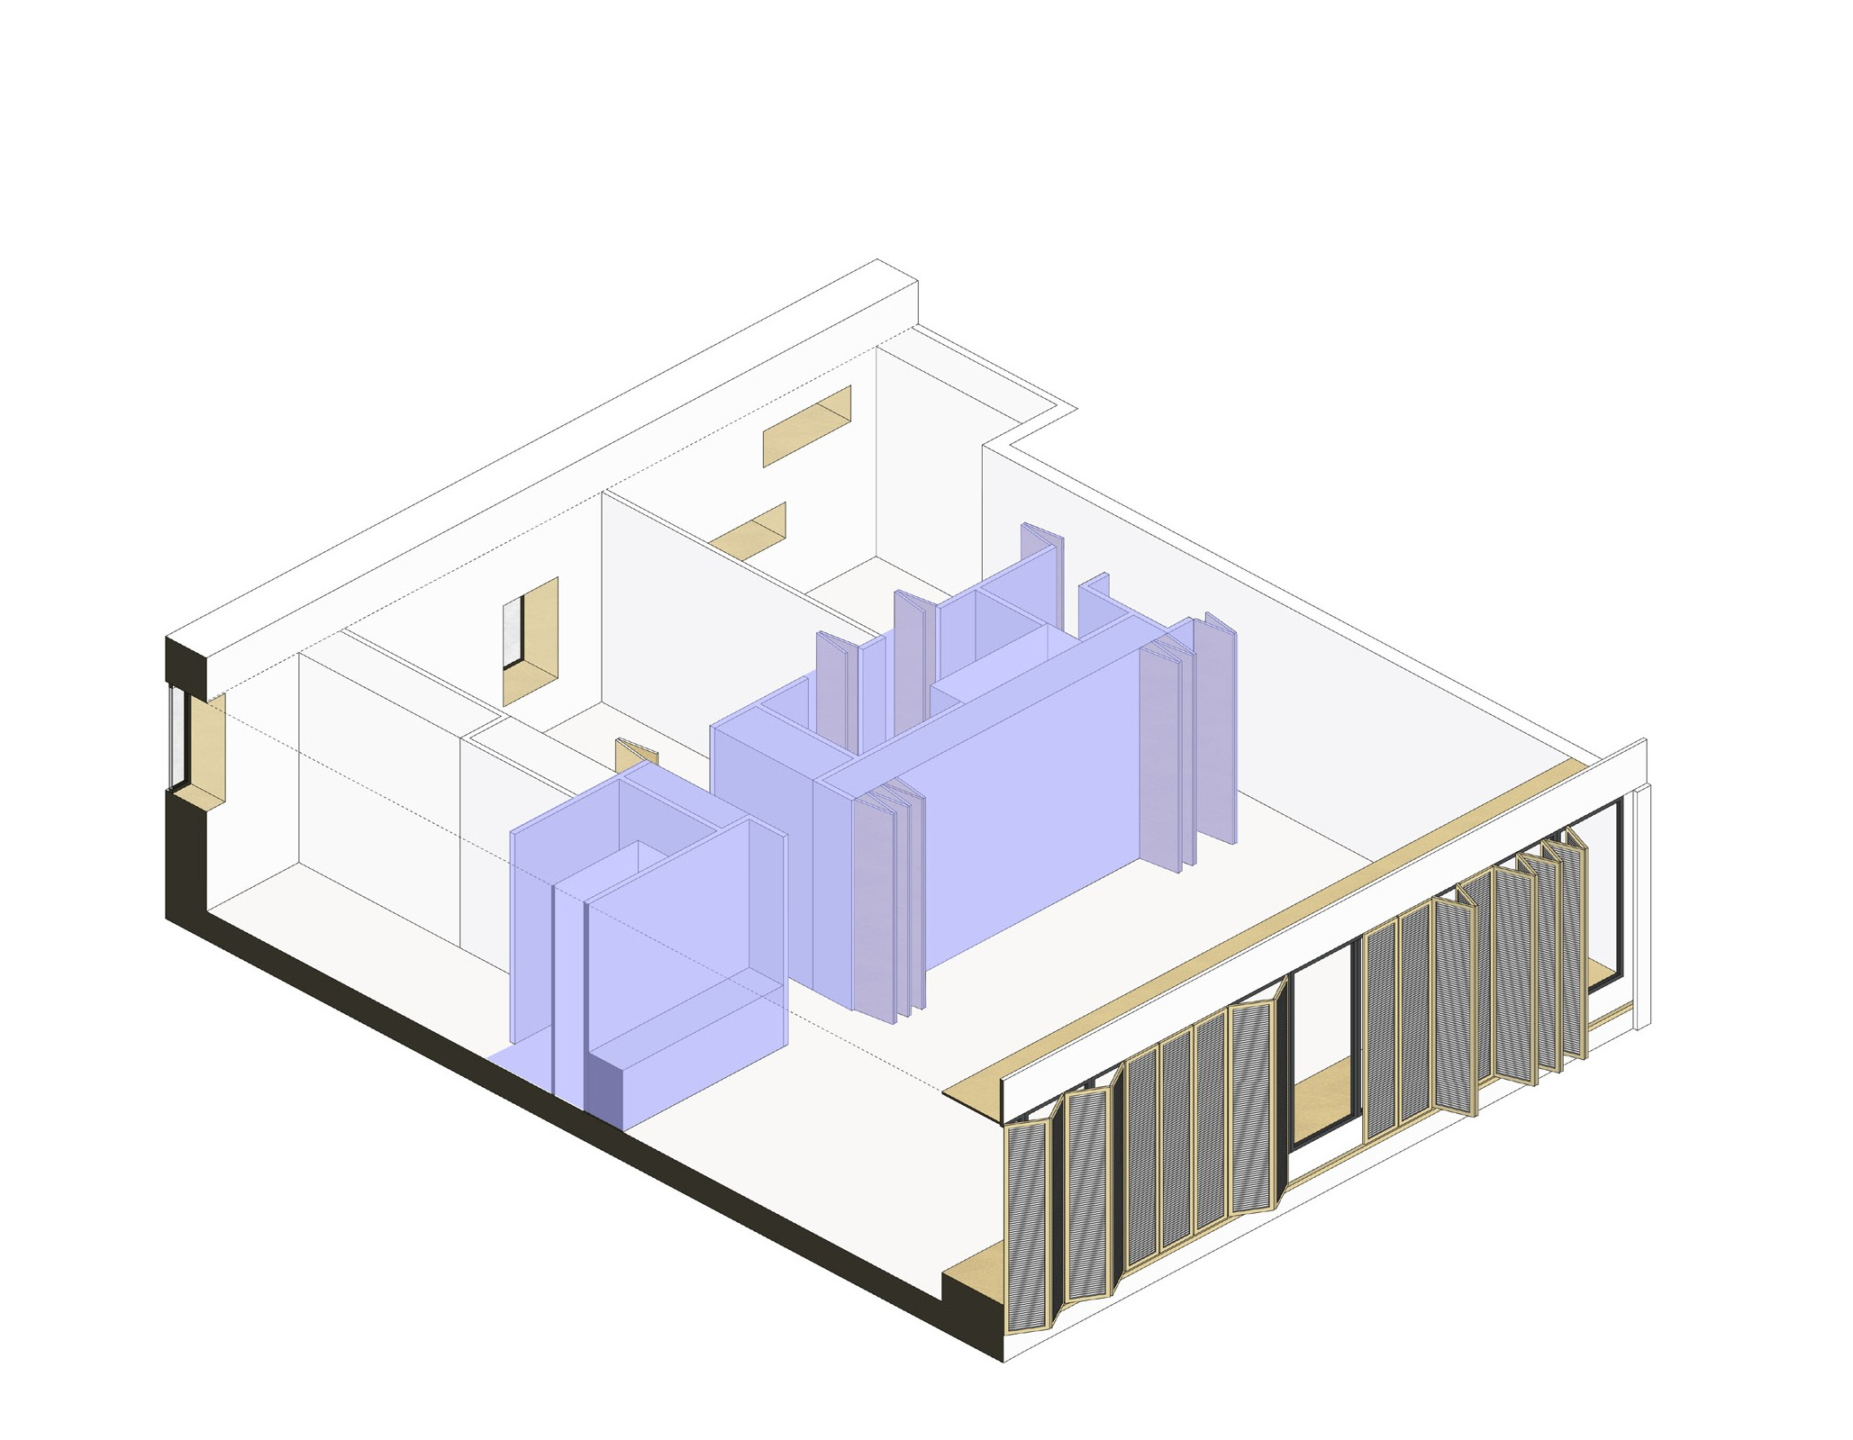
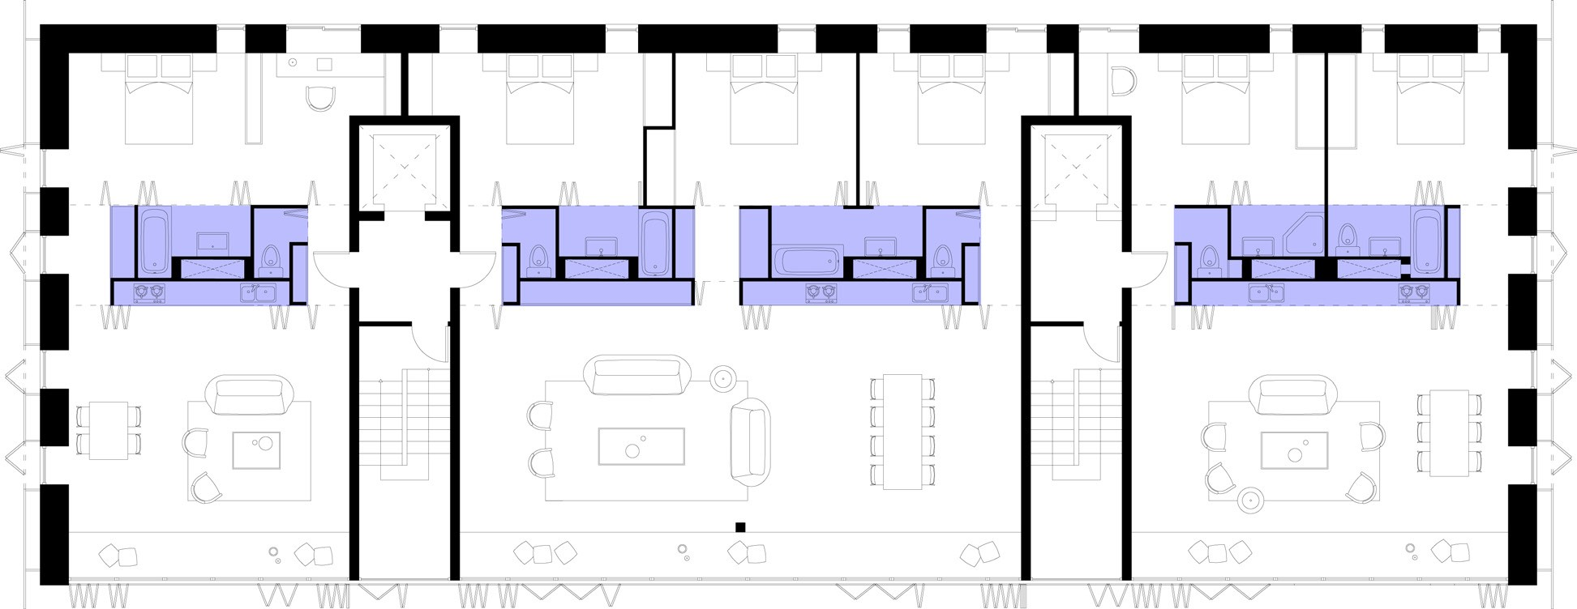
CENTRAL BLOCK
Common floor plan for building type A
Axonometry of a dwelling

Slide 27
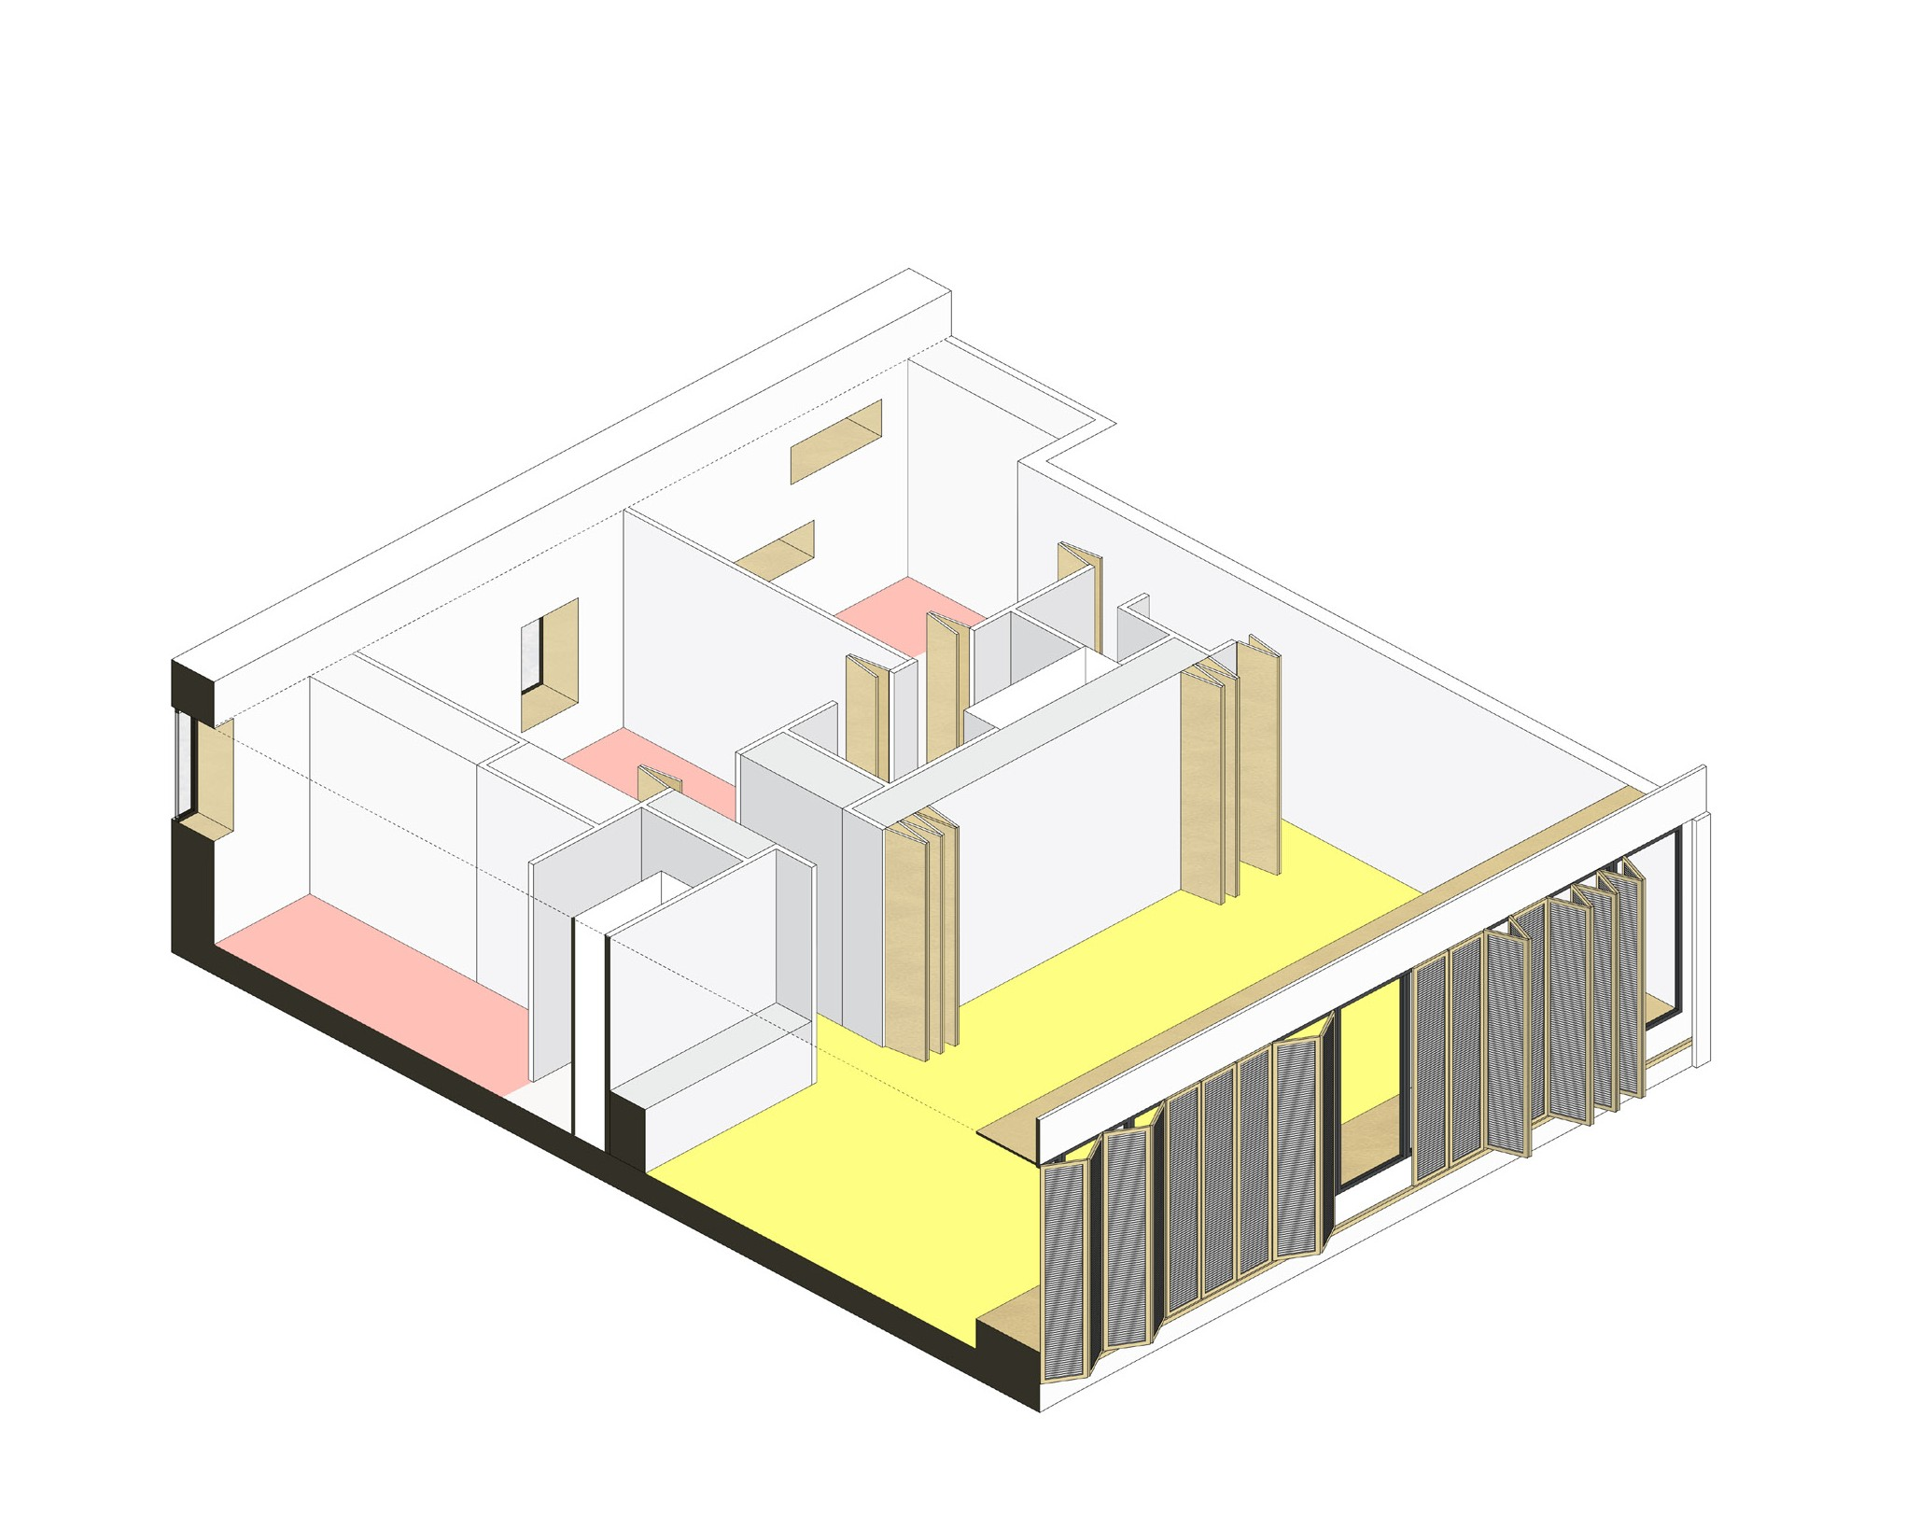
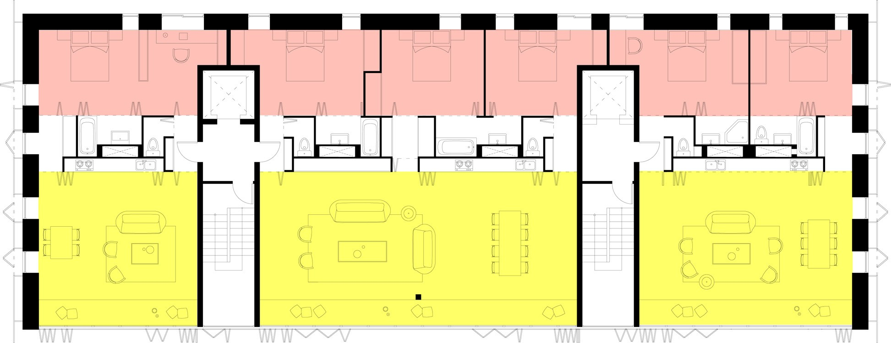
DAY / SOUTH
NIGHT / NORTH
Common floor plan for building type A
Axonometry of a dwelling

Slide 28
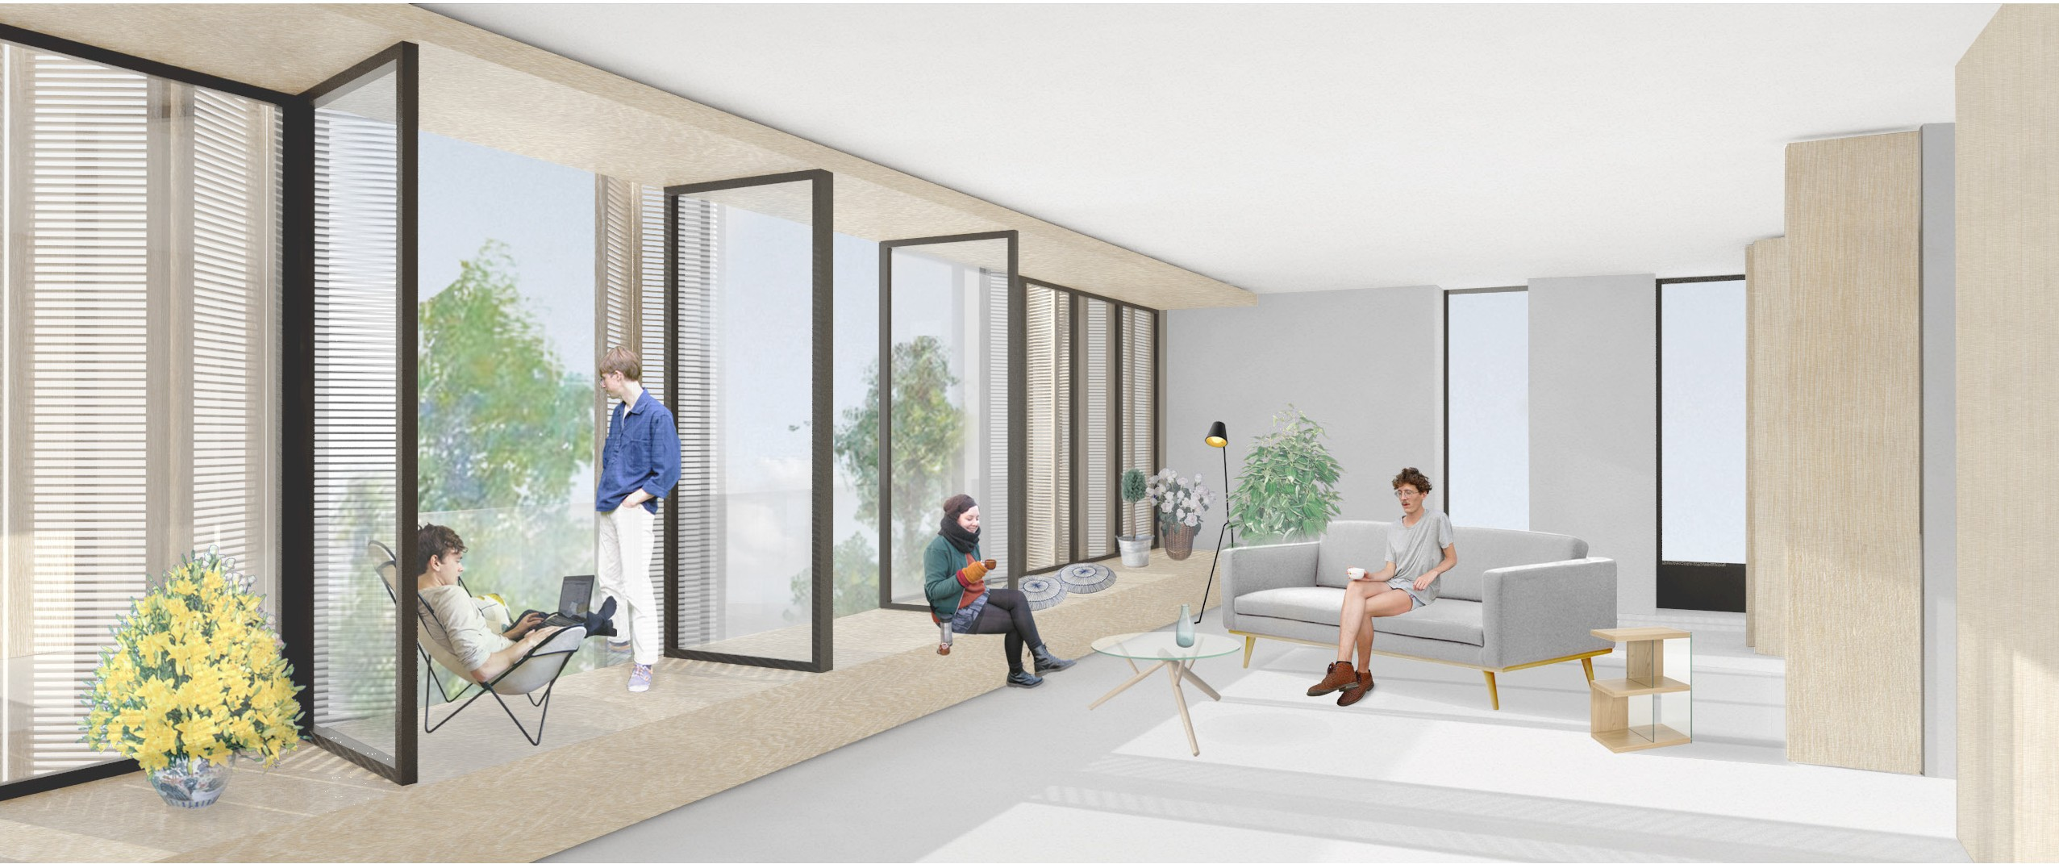
View from the living room

Slide 29
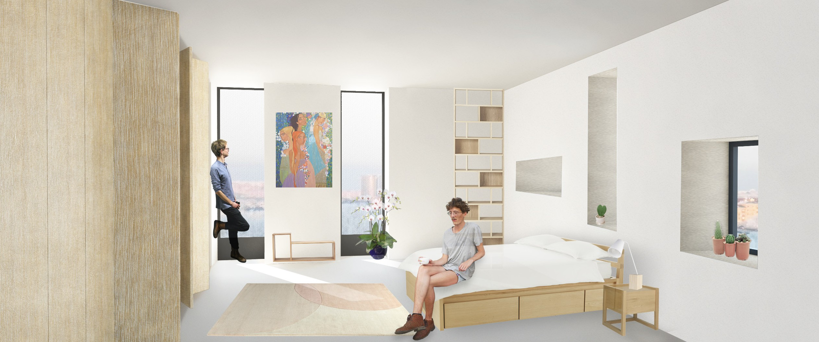
View from the bedroom

Slide 30
Technical strategies

Slide 31
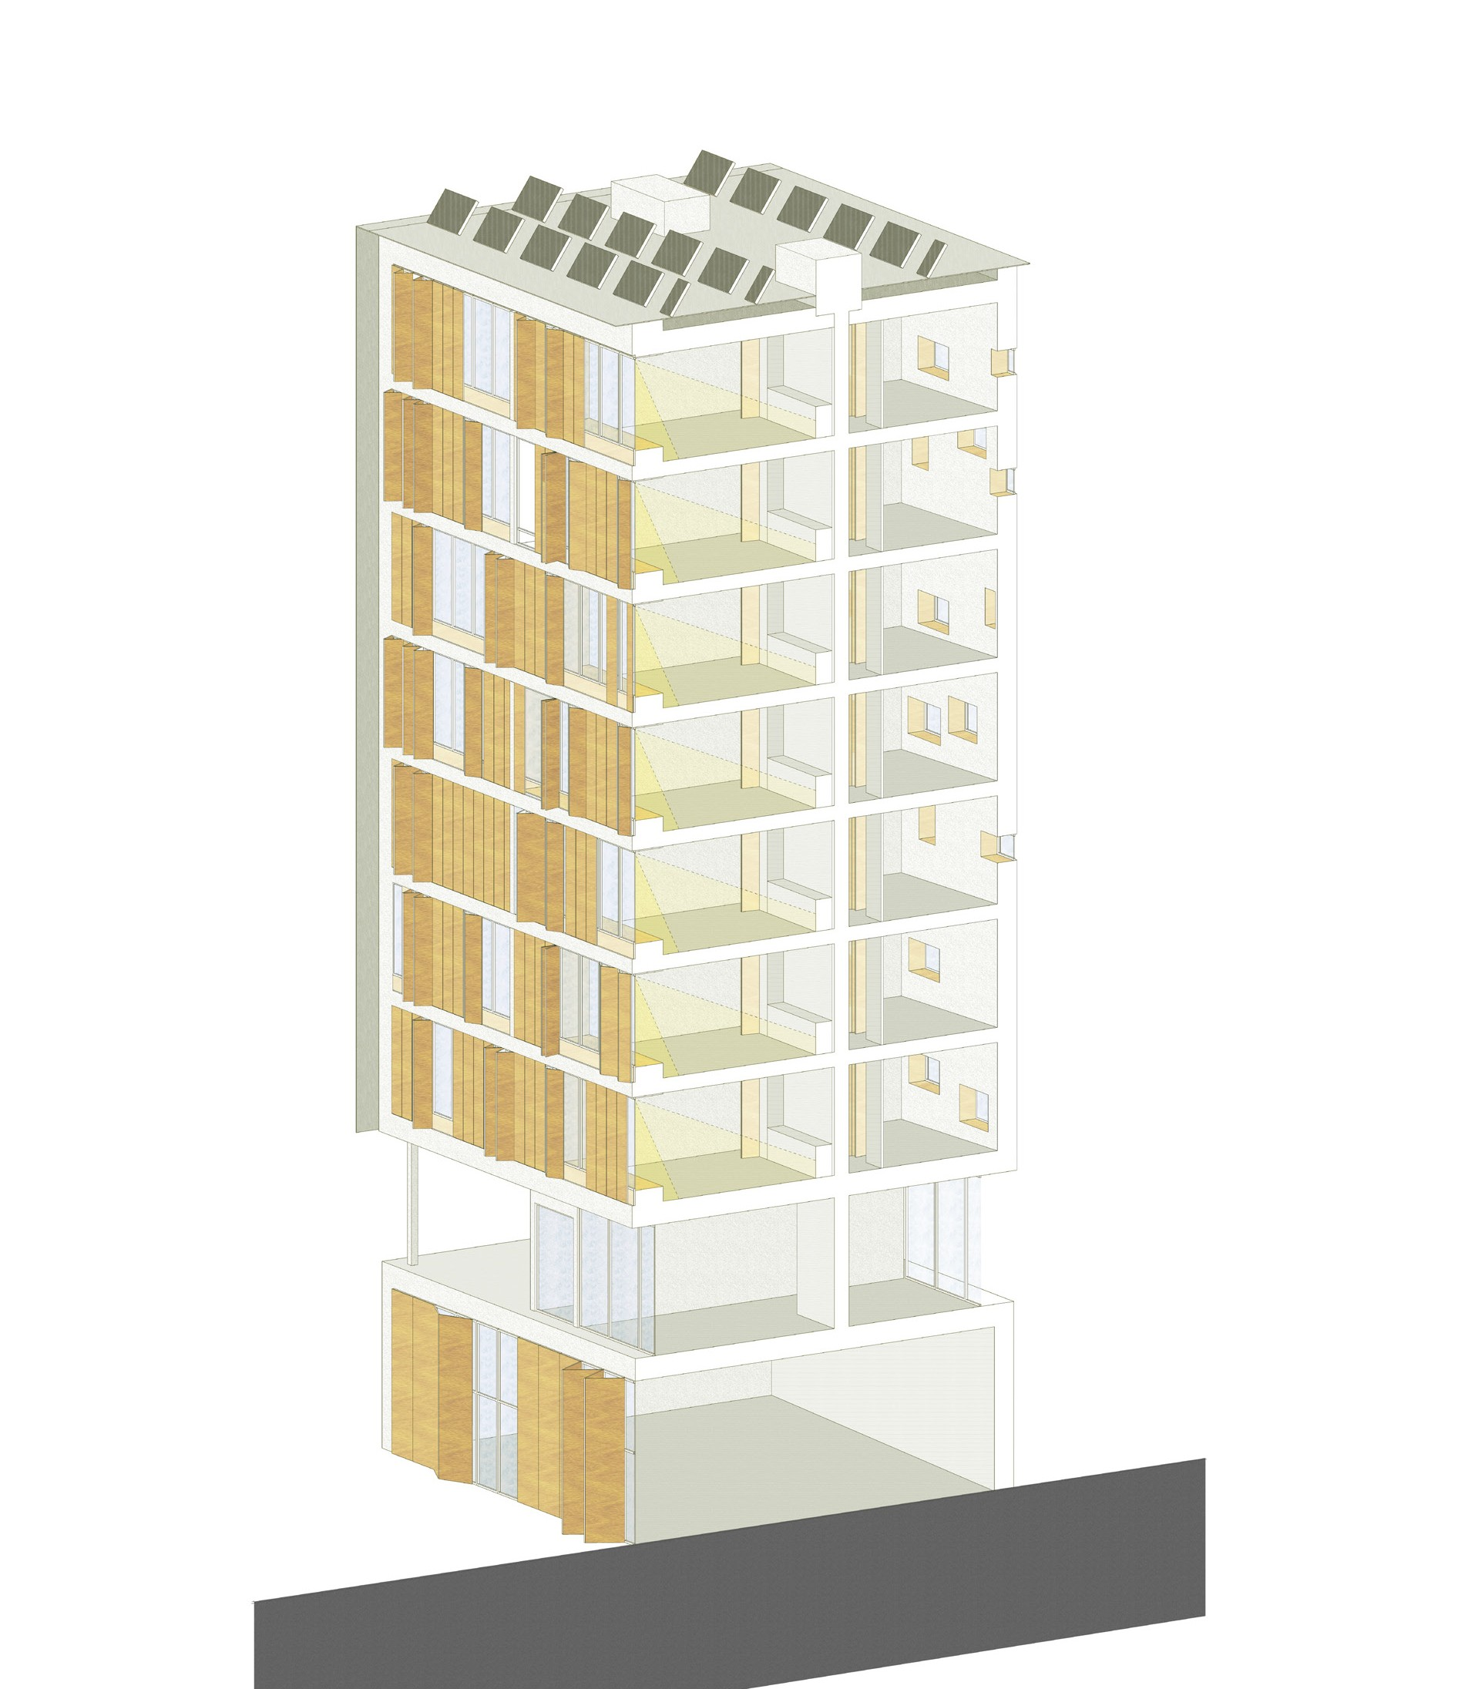
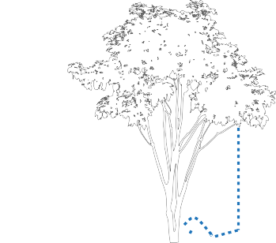
Overall sustainable strategies
Rainwater collection
Use of photovoltaïc
solar panels
as a supplementar source of
electricity
Dual flow ventilation
with heat recovery and by/pass system for summer
Heat recovery system : 95 % Airflow ventilation rate : 300 mc per hour to reach a low level of CO2 concentration
South facade
Porosity to maximise natural sunlight and sun’s
heating energy
North facade
High insulated for minimal heat loss
Re-use of grey water,
including rainwater for watering gardens and green-
houses

Slide 32
Thermal strategies
WINTER
SUMMER
Airtightness of 0.6 V/h guaranteed by impermability of ISOVER VARIO KM
Duplex membrane
Airtightness of 0.6 V/h guaranteed
by permability of
ISOVER VARIO KM
Duplex membrane
NATURAL CROSS VENTILATION
using south-west wind speed
A
DUAL FLOW VENTILATION
integrated into the central technical block
PASSIVE HEATING
by solar gains
PASSIVE COOLING
by wooden sun louvers
B
Low heat conductiviy of building components
High thermal capacity of building components
A / ISOVER Sillatherm WVP 1-035
λ = 0, 036 W / mK
B / ISOVER Akustic EP 3040 / TP1
λ = 0, 04 W / mK
Concrete structure
Heat capacity = 2500 Kj / m2K

Slide 33
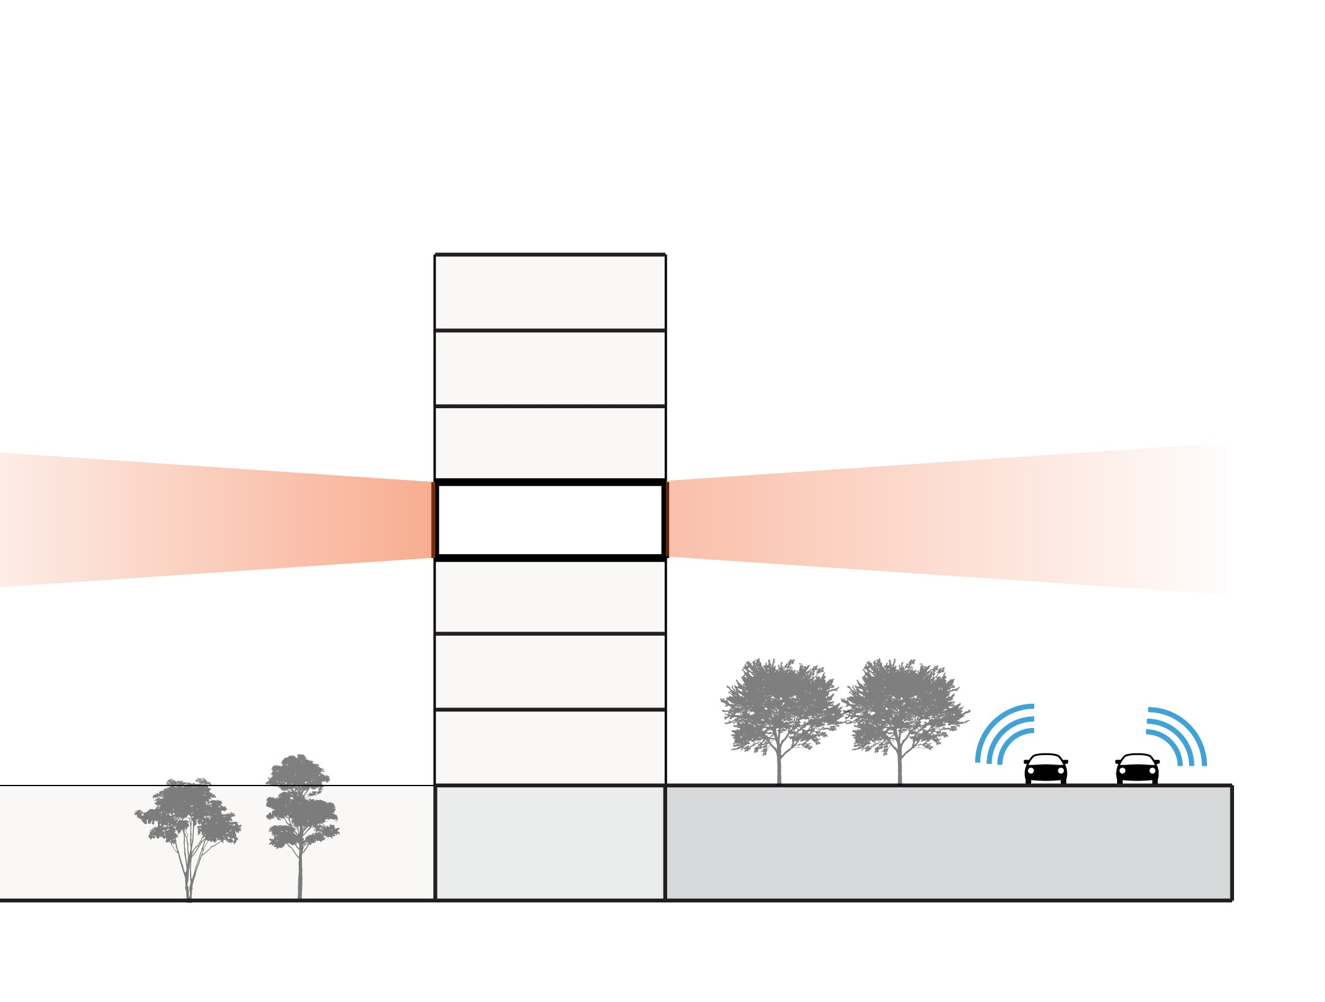
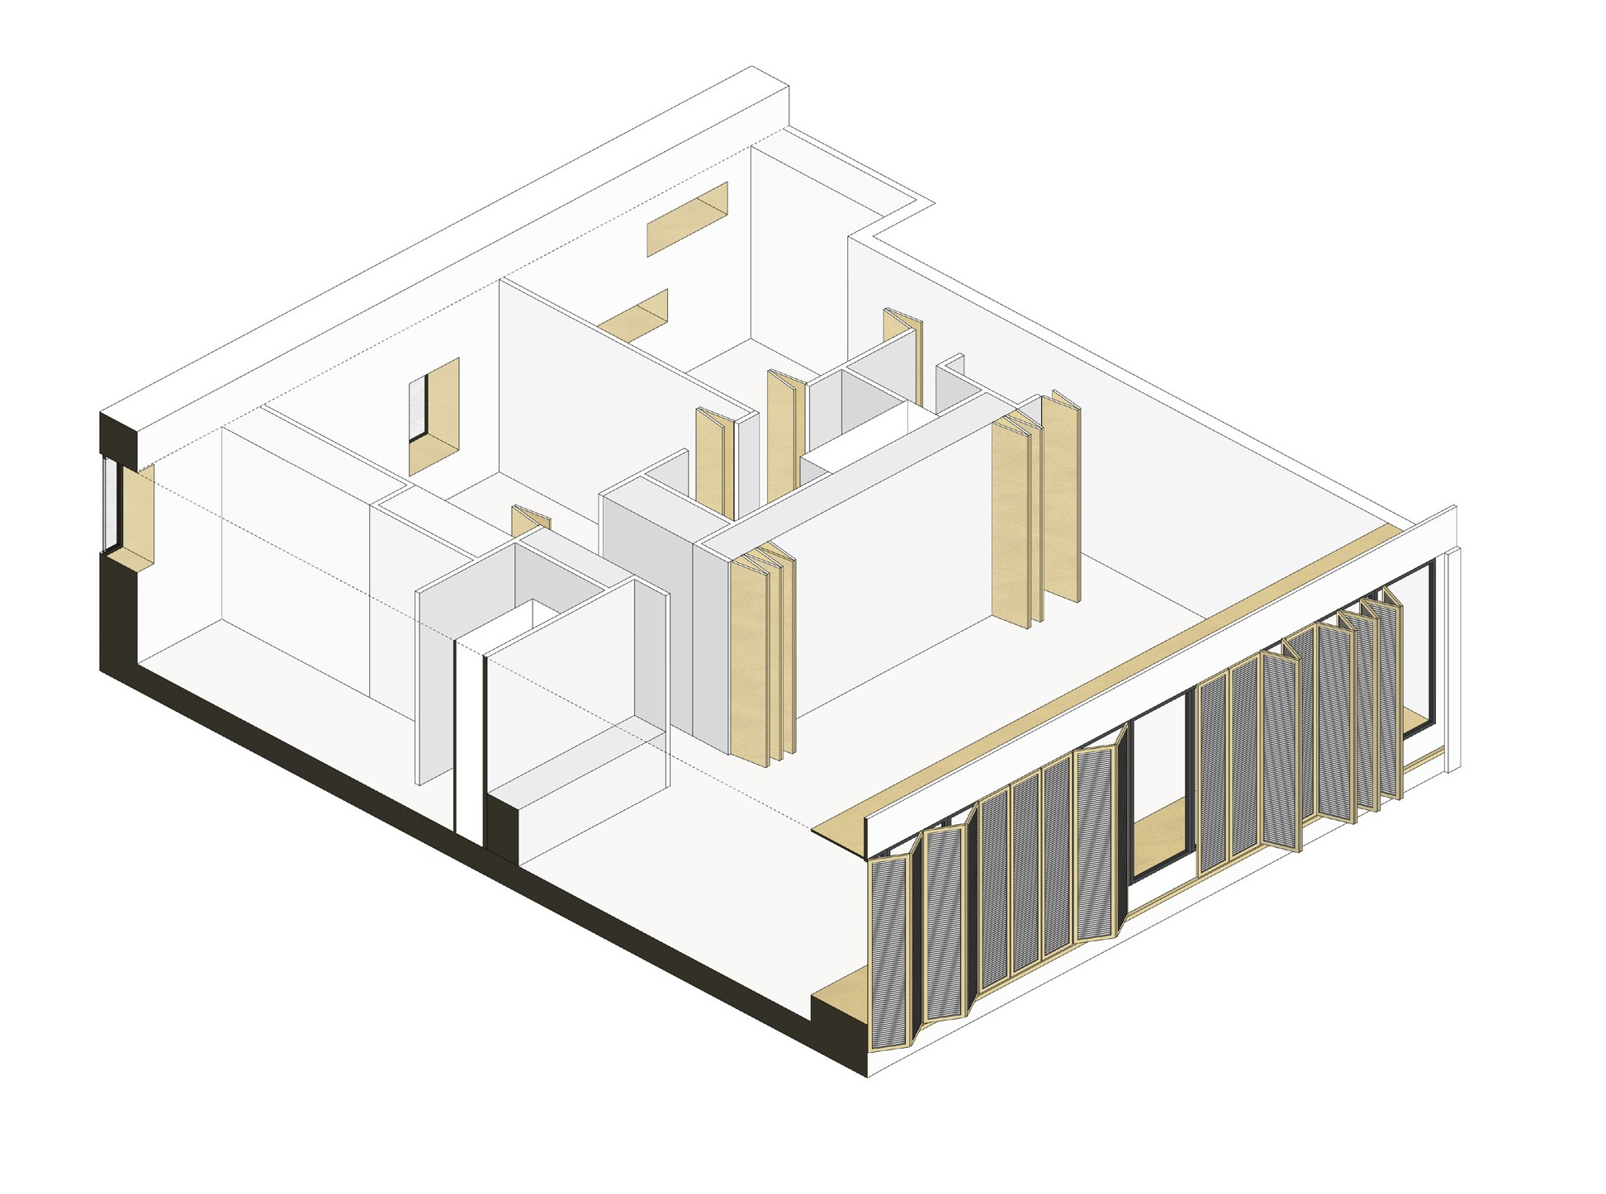
Acoustic strategies
Outdoor environment
30 dB(tr)
Dwelling unit
60 dB(tr)
D
A
E
C
HVAC Ducts
50 dB(tr)
B
Vegetation as a buffer screen for external noises
High performing sound insulation building components
A / ISOVER Akustic TP1 R = 25 db
B / ISOVER Akustic HWP 1 R = 79 dB
C / Concrete structure R= 70 dB
D / ISOVER Sillatherm WVP 1-035 R = 23 dB
E / ISOVER Gaineo R = 26 dB

Slide 34
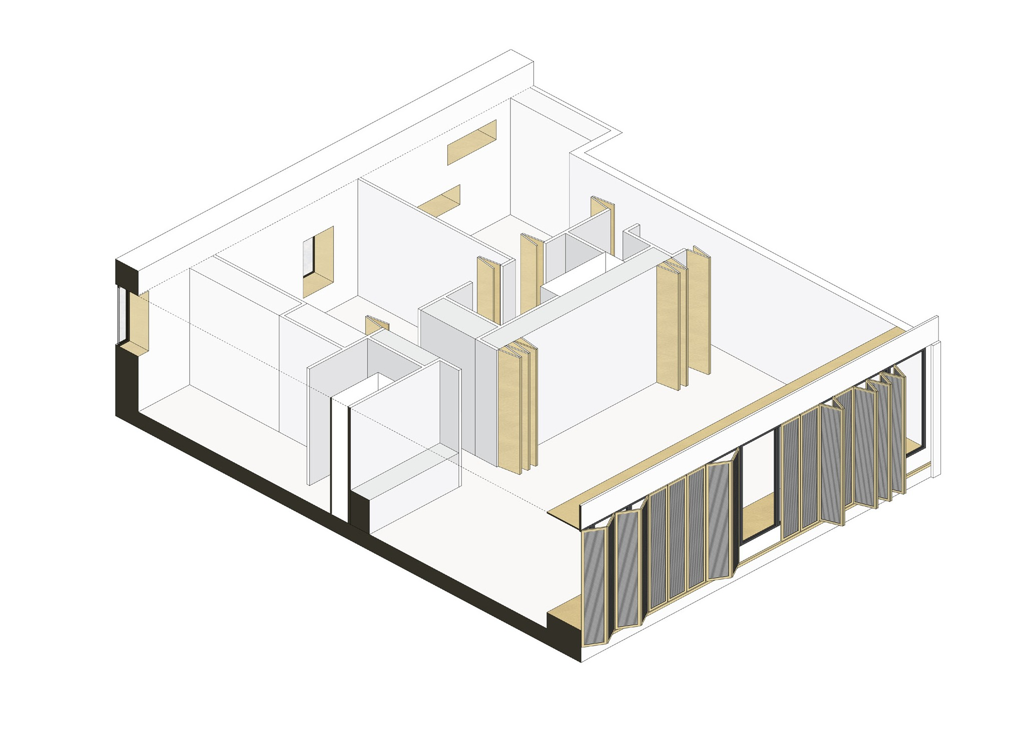
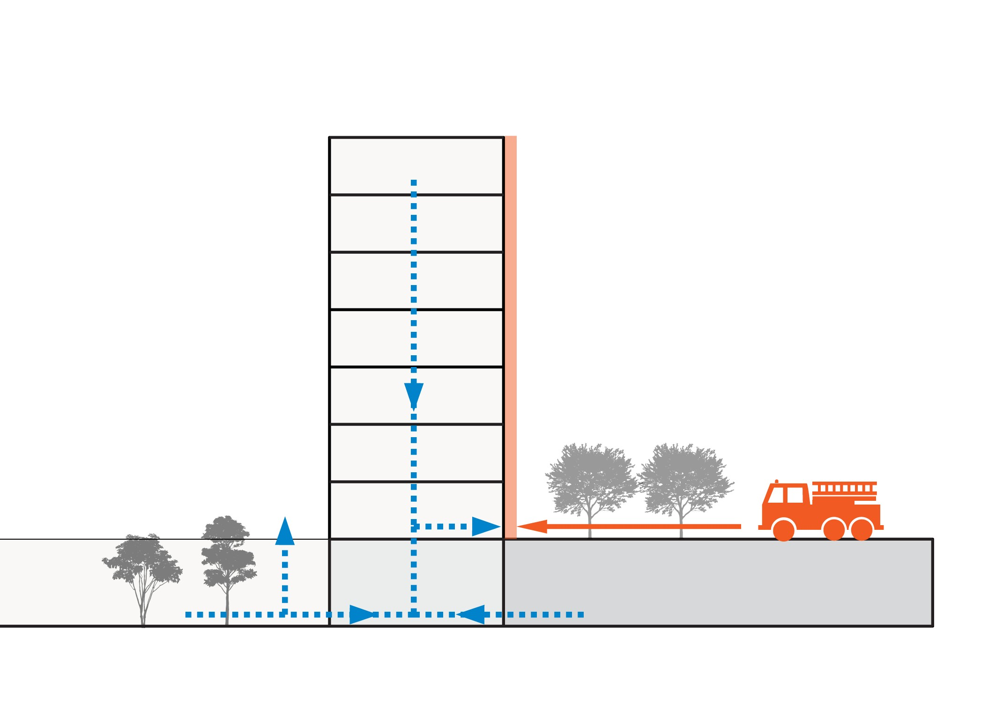
Fire security strategies
A
B
C
At least one facade accessible by a firetruck from the ground
Euroclasse values for building components Euroclasse A1 / M0 : non-combustible
Evacuation path
A / ISOVER Sillatherm WVP 1-035
B / ISOVER AKUSTIC EP 3040 TP1
C / Concrete structure

Slide 35
Technical details

Slide 36
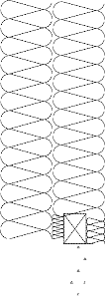
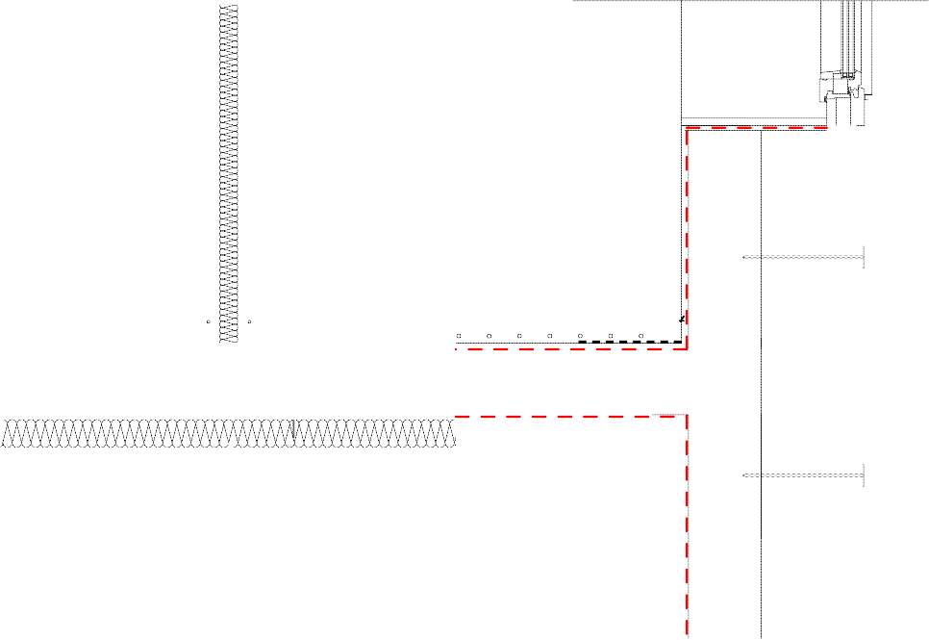
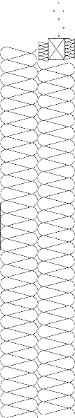
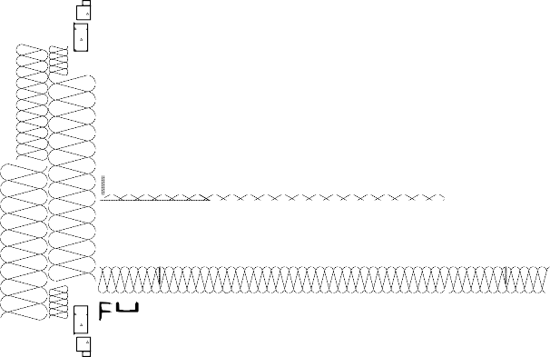
Technical detail : North - South cross section through a dwelling and connexion to the ceiling
Partition wall
Layer build-up A in cm
1.3 Interior plaster
1.3 Interior plaster
5.0 ISOVER Akustic TP 1
1.3 Interior plaster
1.3 Interior plaster
Ceiling
Layer build-up B in cm
Floor covering
5.0 Concrete screed with underfloor heating
1.5 Thermal insulation
0.2 ISOVER VARIO KM Duplex
18.0 Concrete ceiling
1.0 interior plaster
8.0 ISOVER Akustic TP 1
2.7 Rigips ceiling profile CD 60/27 as basic profile
2.7 Rigips ceiling profile CD 60/27 as suppor- ting profile
2.5 Rigips RIGIDUR H double layer
A
B
C
Exterior wall
Layer build-up C in cm
1.0 Interior plaster
0.2 ISOVER VARIO KM Duplex
20.0 Concrete
14.0 ISOVER Sillatherm WVP 1-035
14.0 ISOVER Sillatherm WVP 1-035
1.5 Thick plaster
U VALUE : 0.11 W/M2 K

Slide 37
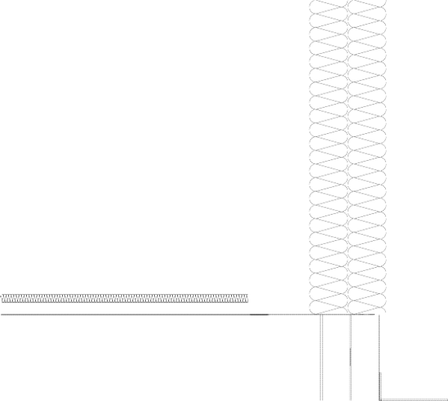
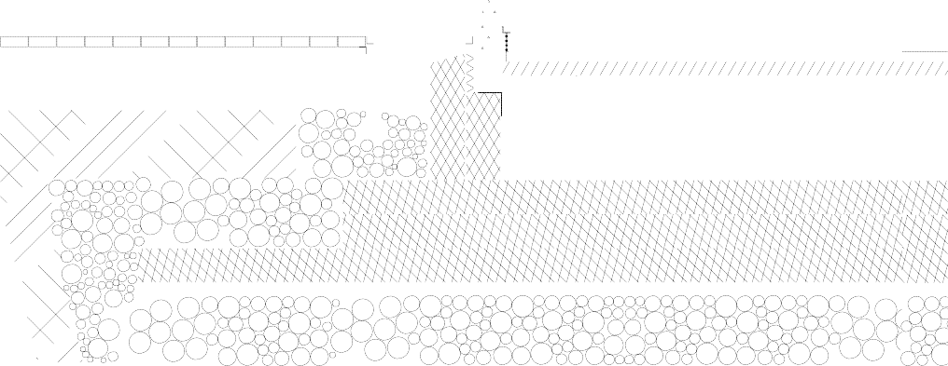

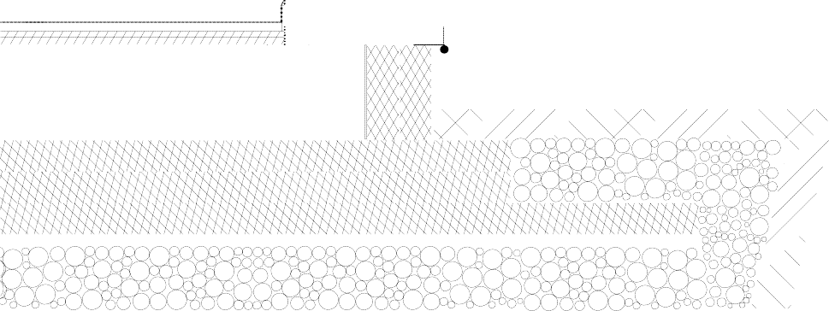
Technical details : Two types of ground connexion
Patio door / Opaque wall
Floor to ground
Layer build-up A in cm
Wall to unheated parking Layer build-up B in cm
Floor covering
5.0 Concrete screed
0.2 ISOVER VARIO KM Duplex
3.0 ISOVER Akustic EP 3 040
4.0 ISOVER Exporit EPS 100/035 as compensation for height of tube
0.5 sealing against moisture
1.3 Interior plaster
0.2 ISOVER VARIO KM Duplex
20.0 Concrete
14.0 ISOVER Sillatherm WVP 1-035
14.0 ISOVER Sillatherm WVP 1-035
1.5 Thick plaster
30.0 Concrete foundation slab Separating layer
10.0 Styrodur CS
10.0 Styrodur CS
10.0 Styrodur CS
Granular subbase
U VALUE : 0.1 W/m2K
U VALUE : 0.11 W/m2K
B
A
A

Slide 38
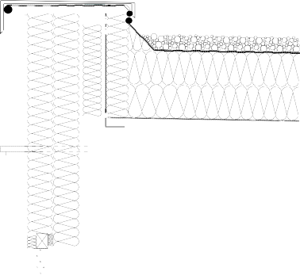
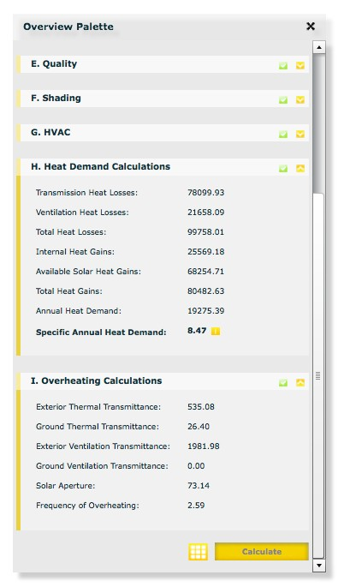




Technical detail : West facade and its connexion to the roof
A
ISOVER DESIGNER v.3.5 calculations
Annual heat demand : 8.47 kWh/m2a
Roof
Layer build-up A in cm
8.0 Pebbles
0.8 Double layer roof and sealing sheeting, bonded or scorched
18.0 ISOVER Metac FLP 1 Duratec
18.0 ISOVER Metac FLP 1 Duratec Vapour retarder
Levelling layer, bitumen perforated glass-mat sheeting
Preliminary coat bonding course
Concrete laid at inclination of at least 2 %
20.0 Reinforced concrete ceiling
0.2 ISOVER VARIO KM Duplex
1.5 Interior plaster
B
U VALUE : 0.11 W/m2 K
Exterior wall
Layer build-up B in cm
1.0 Interior plaster
0.2 ISOVER VARIO KM Duplex
20.0 Concrete
14.0 ISOVER Sillatherm WVP 1-035
14.0 ISOVER Sillatherm WVP 1-035
1.5 Thick plaster Perforated steel shutter
U VALUE : 0.11 W/m2 K

Slide 39
Baqsh’Astana
Thank you !
Sophie LAMBOTTE Xiang LI

