Slide 1
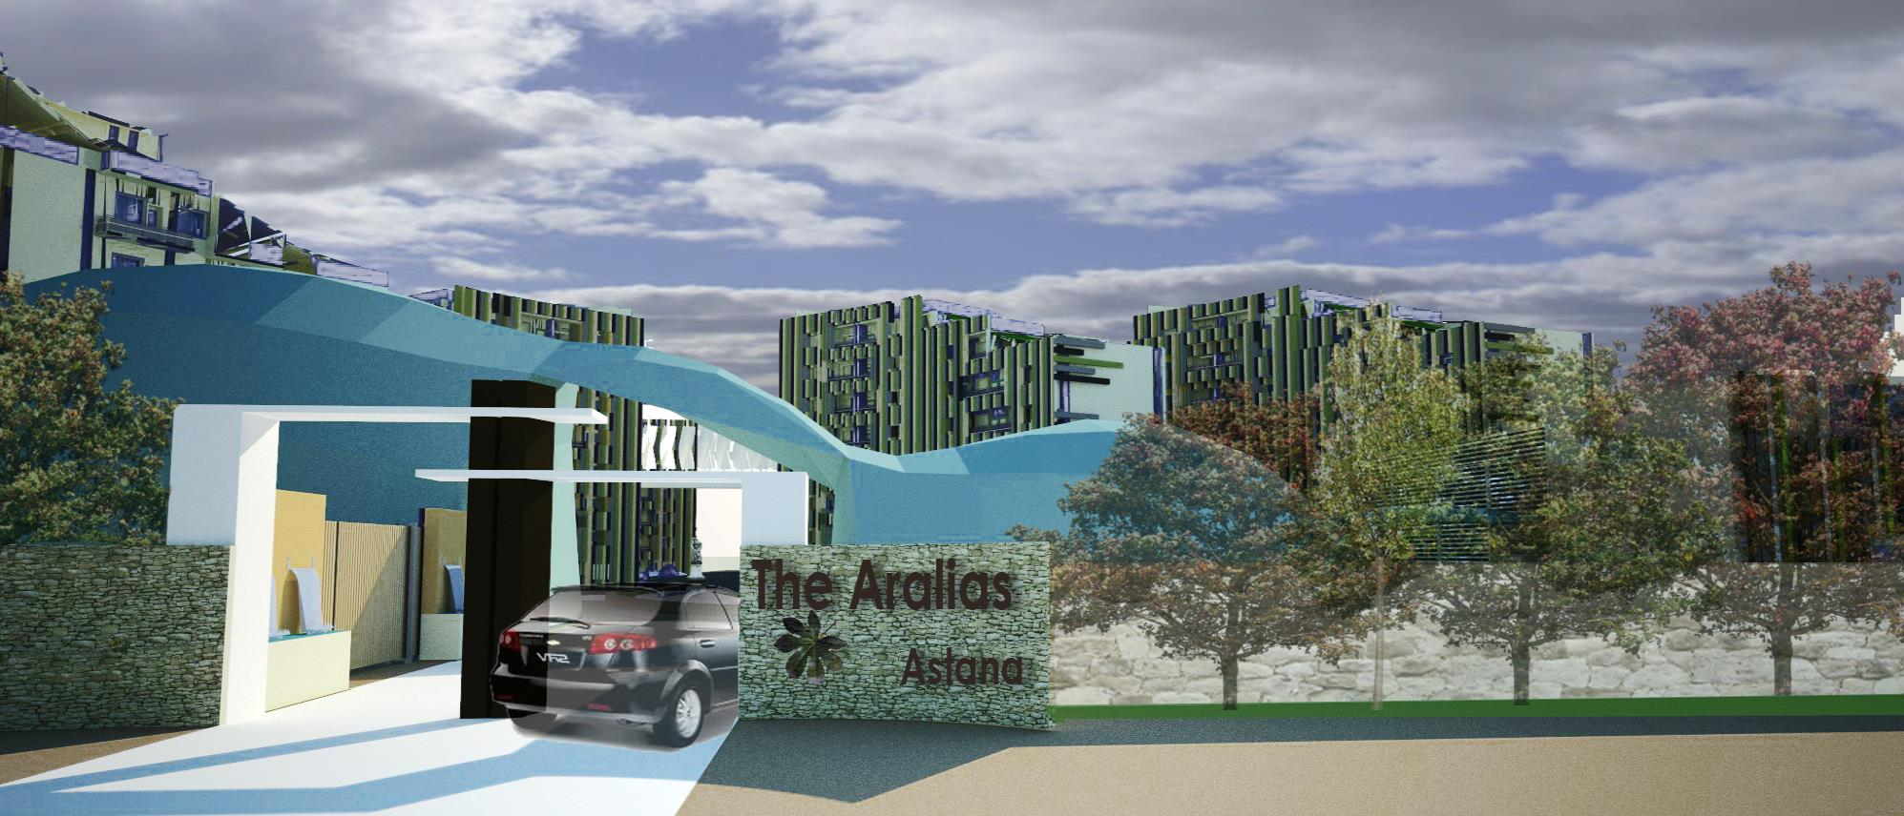



Gurleen Kaur Matharu Anuraag Saxena

Slide 2
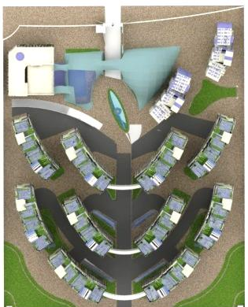
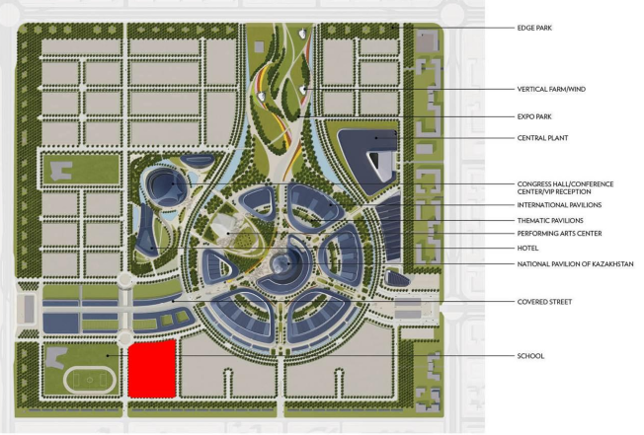
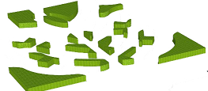


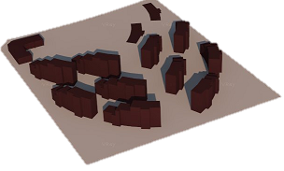

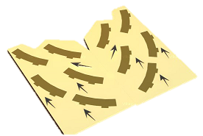
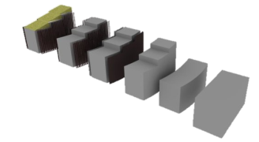
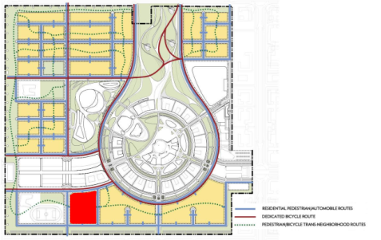
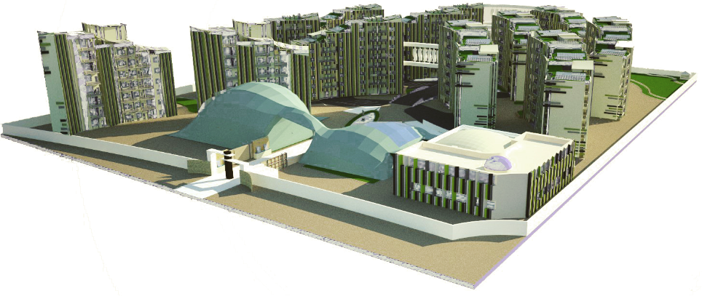
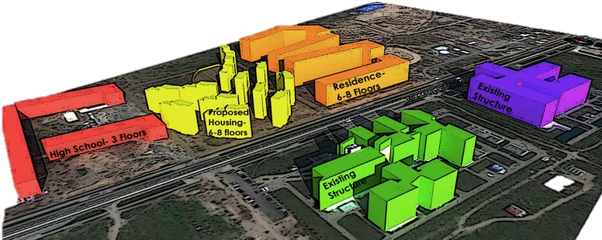
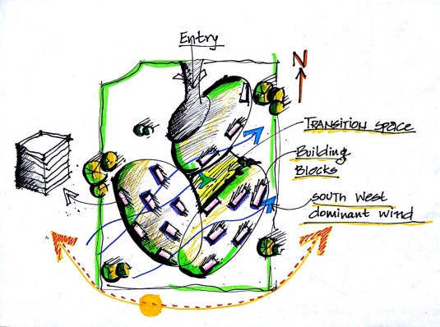
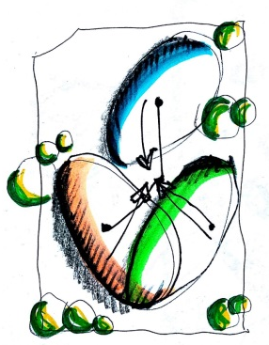
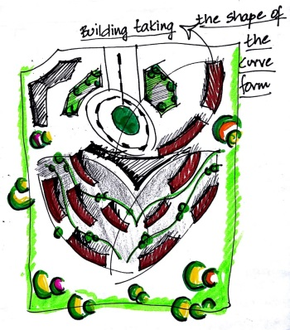
Key Design Elements
Total Area of the Site : 3.1 Hectares
Function of Site : Residential Building Cluster
Total Number of Residential towers : 12
Total Number of Flats : 332
Total Area for Residential Function : 30500 Sqm
Flats Type : 2 and 3 Bedrooms
Special Building Service Facilities : Centrally Cooled and heated.
Type of Renewables Technologies used : Solar, wind , Geothermal and Rainwater Harvesting
Site Specifications
N
THE ARALIAS- Eye of Astana
Location- Astana
51.1667° N, 71.4333° E
Concept

Slide 3
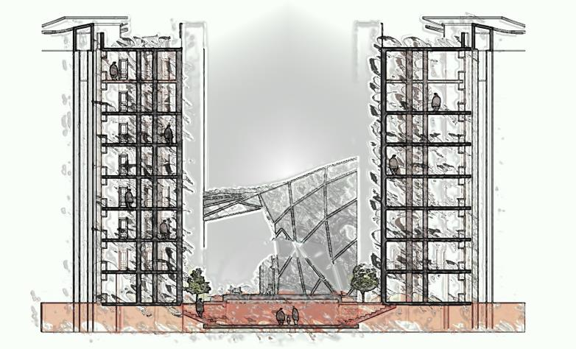
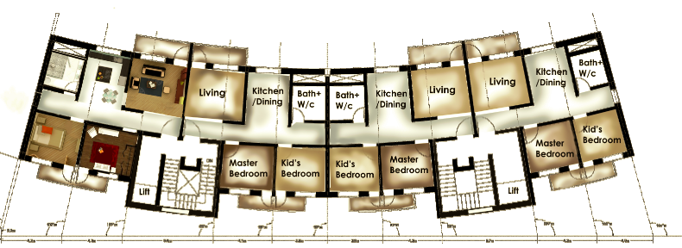
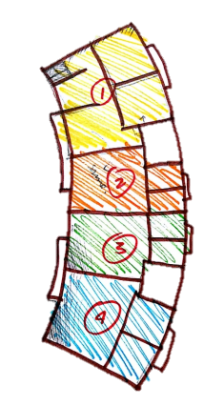
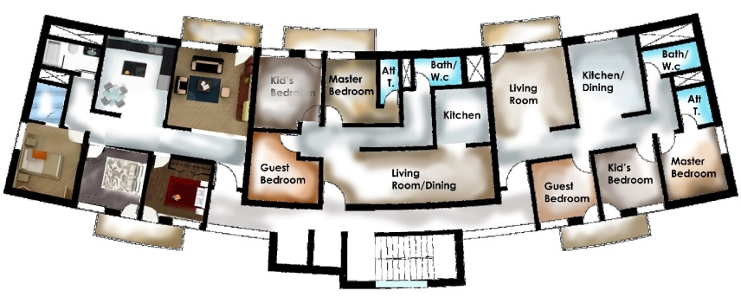
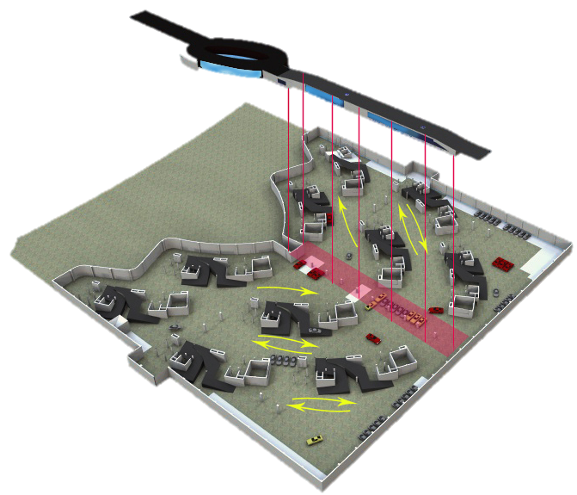
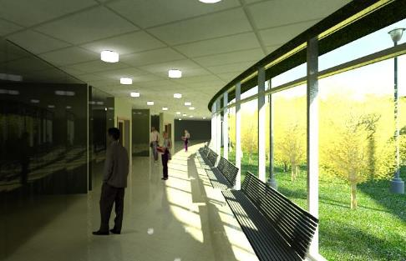
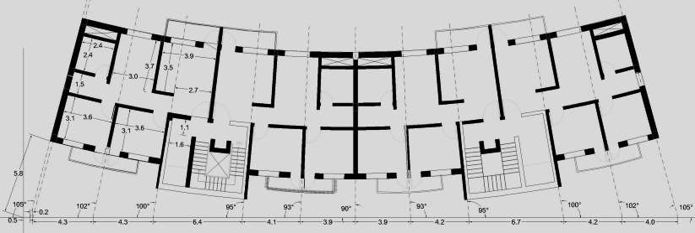
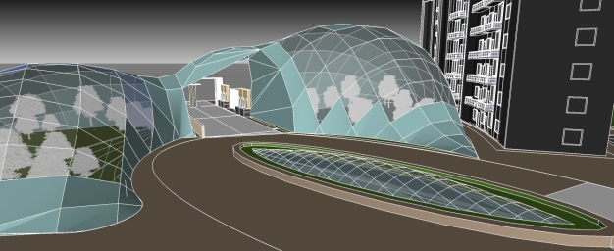
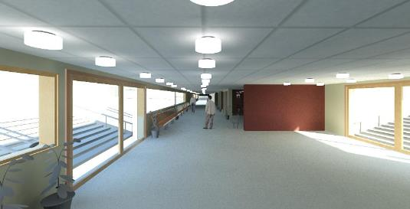
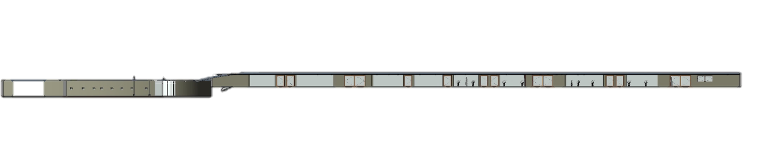
Entry to the building from ground floor
Exit from the basement
Entry to the Basement
Apartments
2 bedroom Total Floor Area – 370sqm
Ground Level
Basement Parking
Piazza/Shopping Complex
Central park is covered with tensile vault roof to resist the extreme climatic conditions. It acts as a enclosed breathing space and it connected with the underground piazza
3 bedroom Total Floor Area- 390sqm
Typical Floor Plans
Underground Piazza- the connector

Slide 4
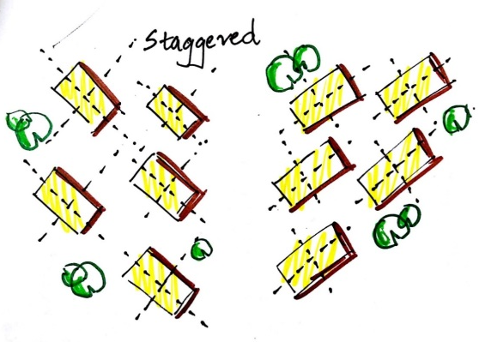
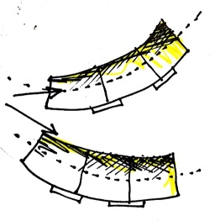
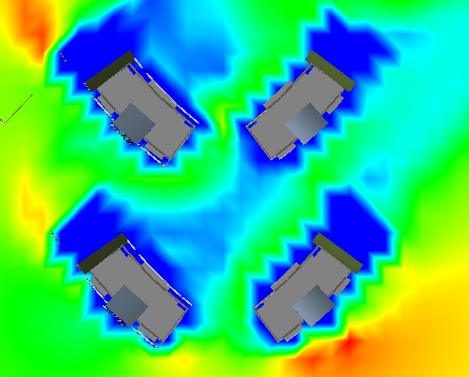
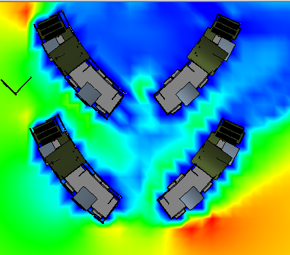
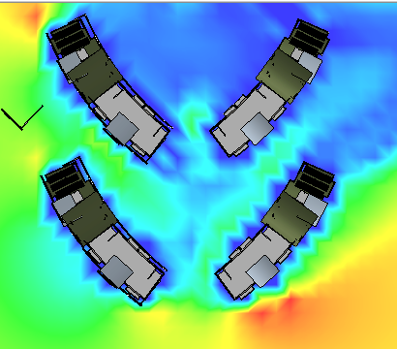
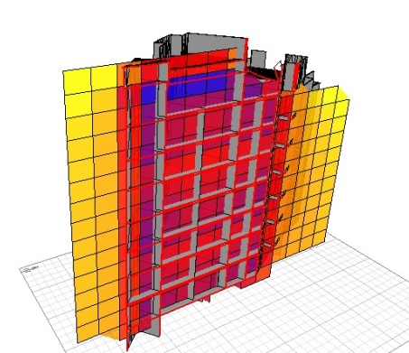
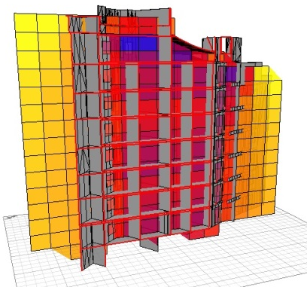
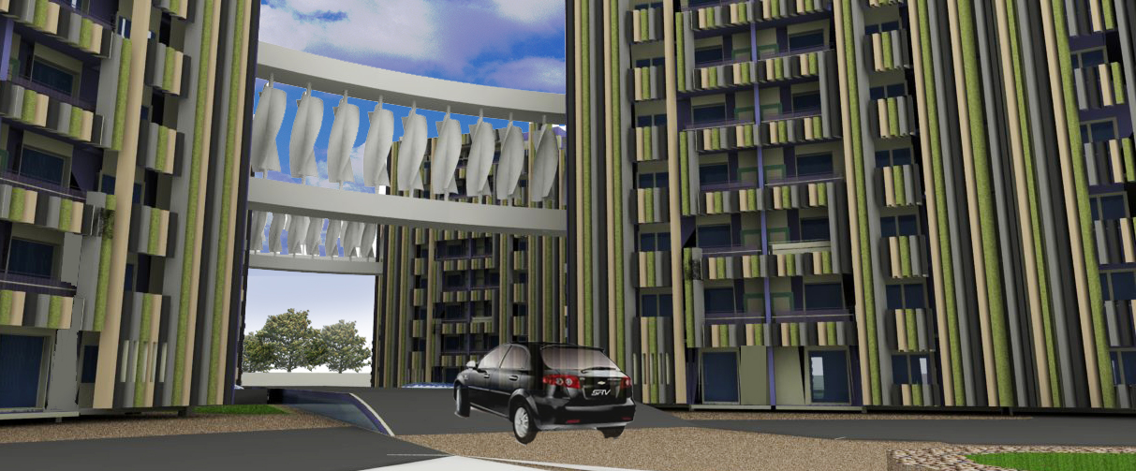
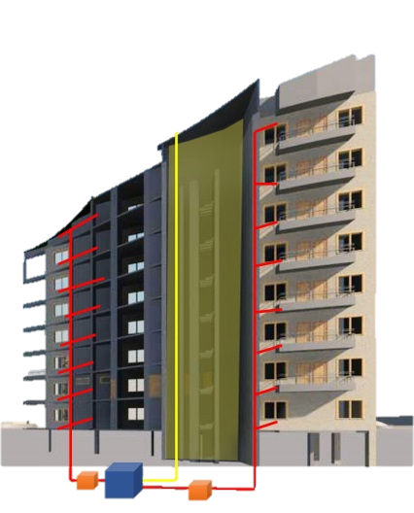
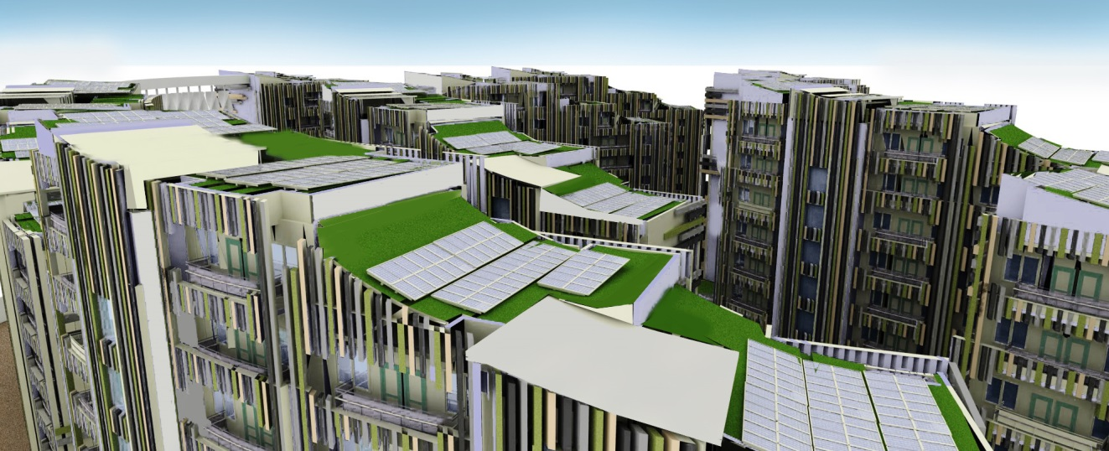
CFD Analysis
Wind Effect on the topmost level of the Turbine Placement
Wind Effect on the middle level of the Turbine Placement
Wind Effect on the lower level of the Turbine Placement
Daylighting
The staggered arrangement of the building blocks was kept such to ensure maximum amount of daylight reaching the core areas of the building. With the above Ecotect models we can see that 50-60% of the daylight is reaching the interiors.
Each Apartment unit requires 85,900L annually , a major portion of which would be catered by the rain-water harvesting (RWH) system.
Passive and Active Strategies
Rain water harvesting

Slide 5
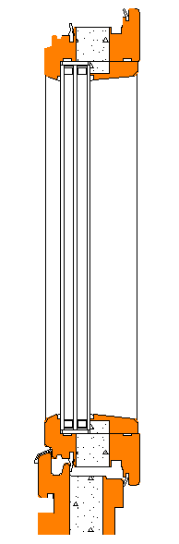
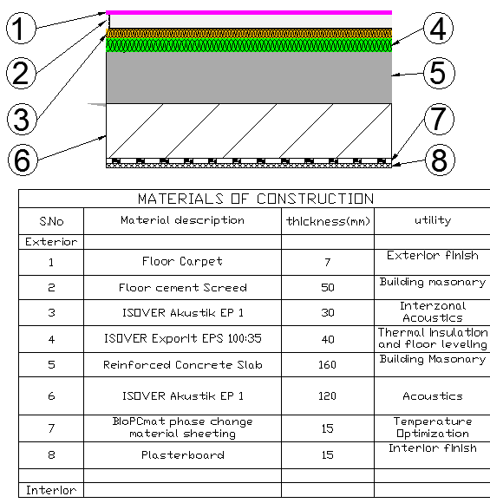
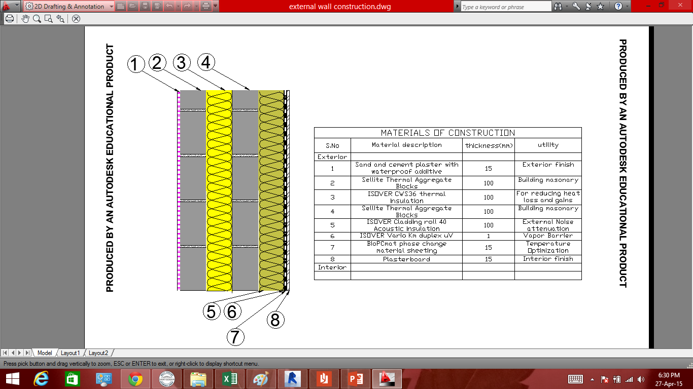
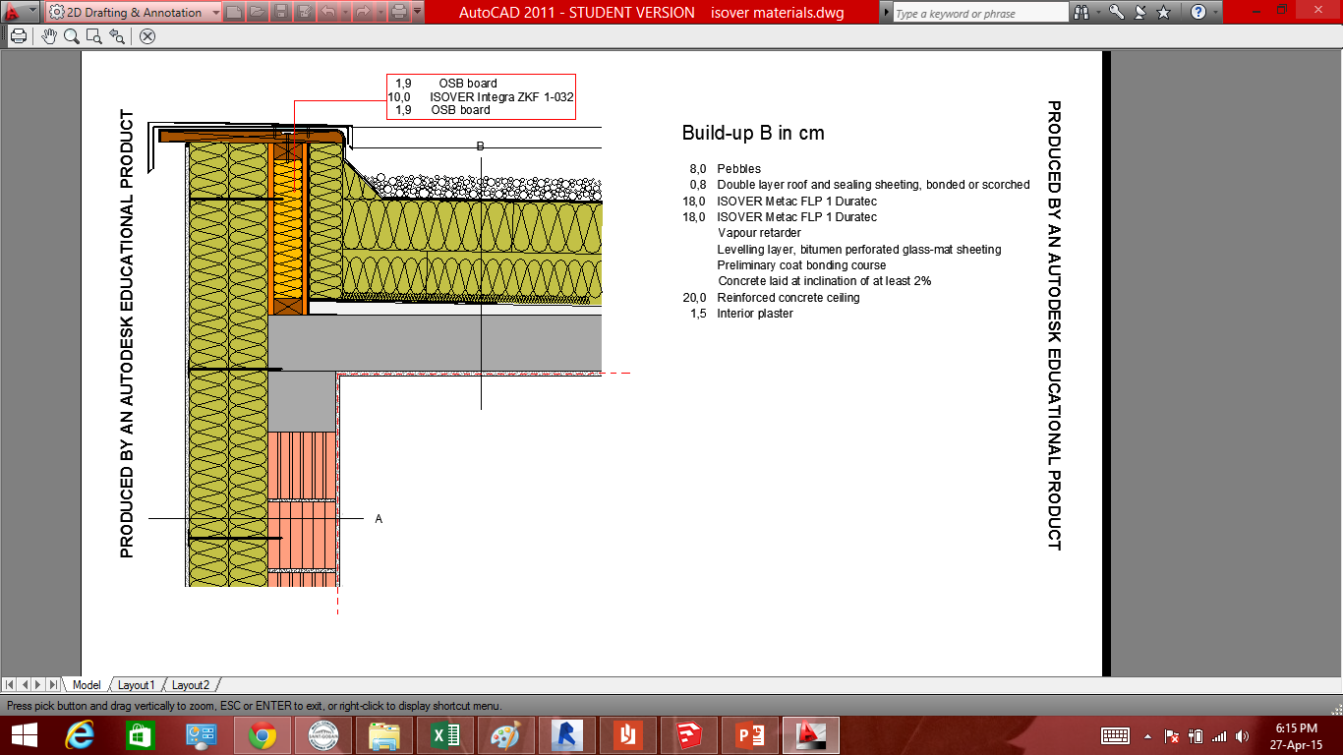
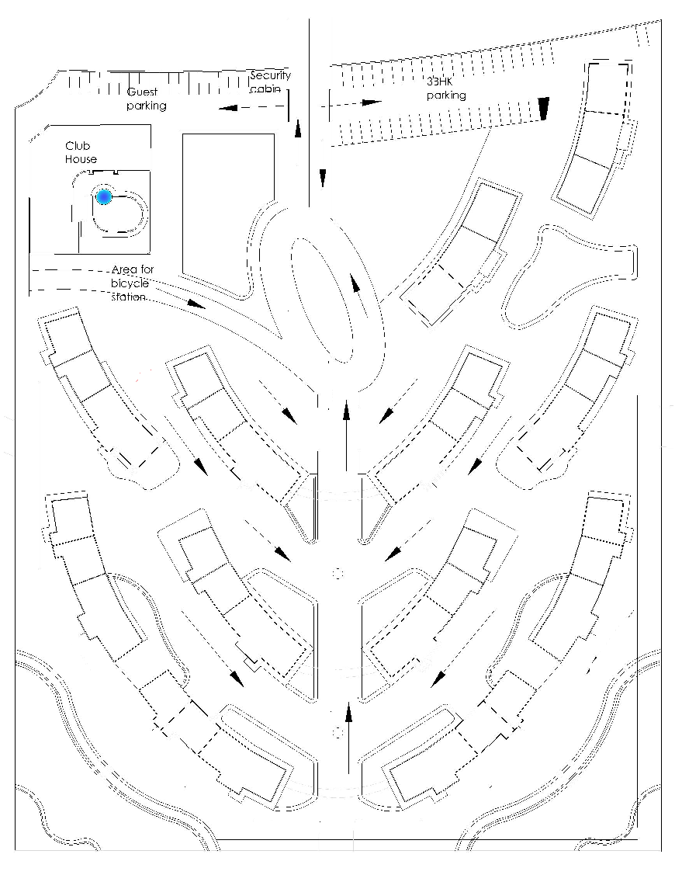
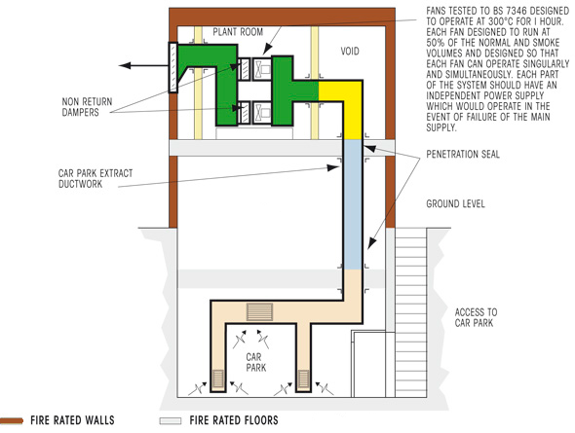
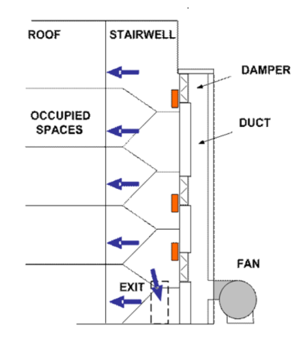
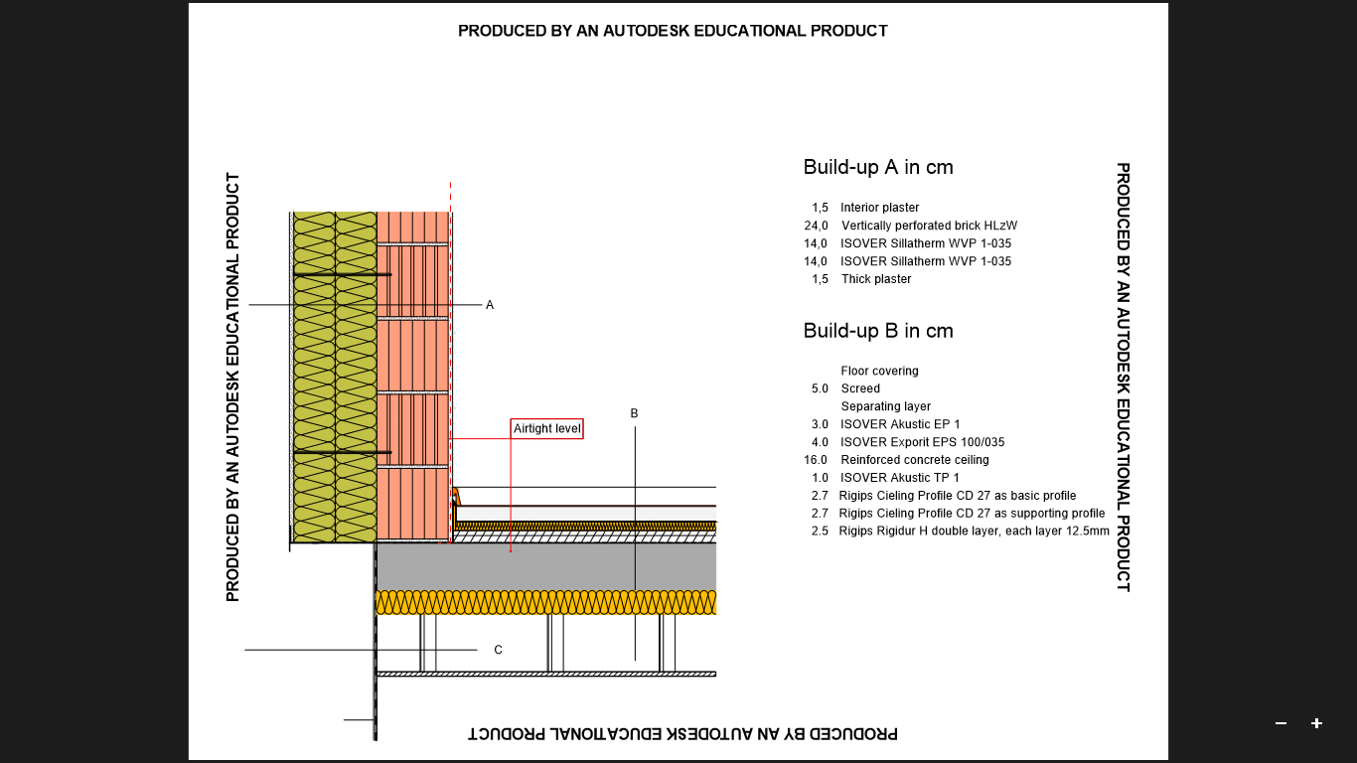
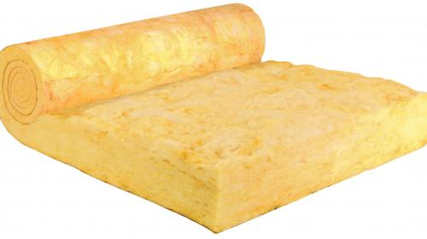

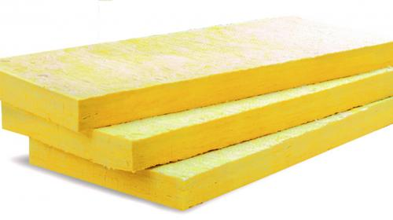

Window
External Wall
U_{wall} = 0.14W/m-K
Saint-Gobain Climatop LUX triple glazed windows
Floor Slab
U_{wall} = 0.18W/m-K
U_{win} = 0.73W/m-K
Roof
Alternative Construction that may be employed
INTEGRATED WITH PHASE CHANGE MATERIAL(PCM)
Basement Smoke Extraction
Staircase Pressurization
U_{roof} = 0.11W/m-K
Assembly Area in case of fire
SITE SAFETY PROVISIONS
Wall and the floor slab
U_{floor} = 0.11W/m-K
Usage of Fire-rated Insulation Materials
U_{slab} = 0.11W/m-K
MATERIALS OF CONSTRUCTION
Materials Considered for calculation through ISOVER designer v 3.5

Slide 6
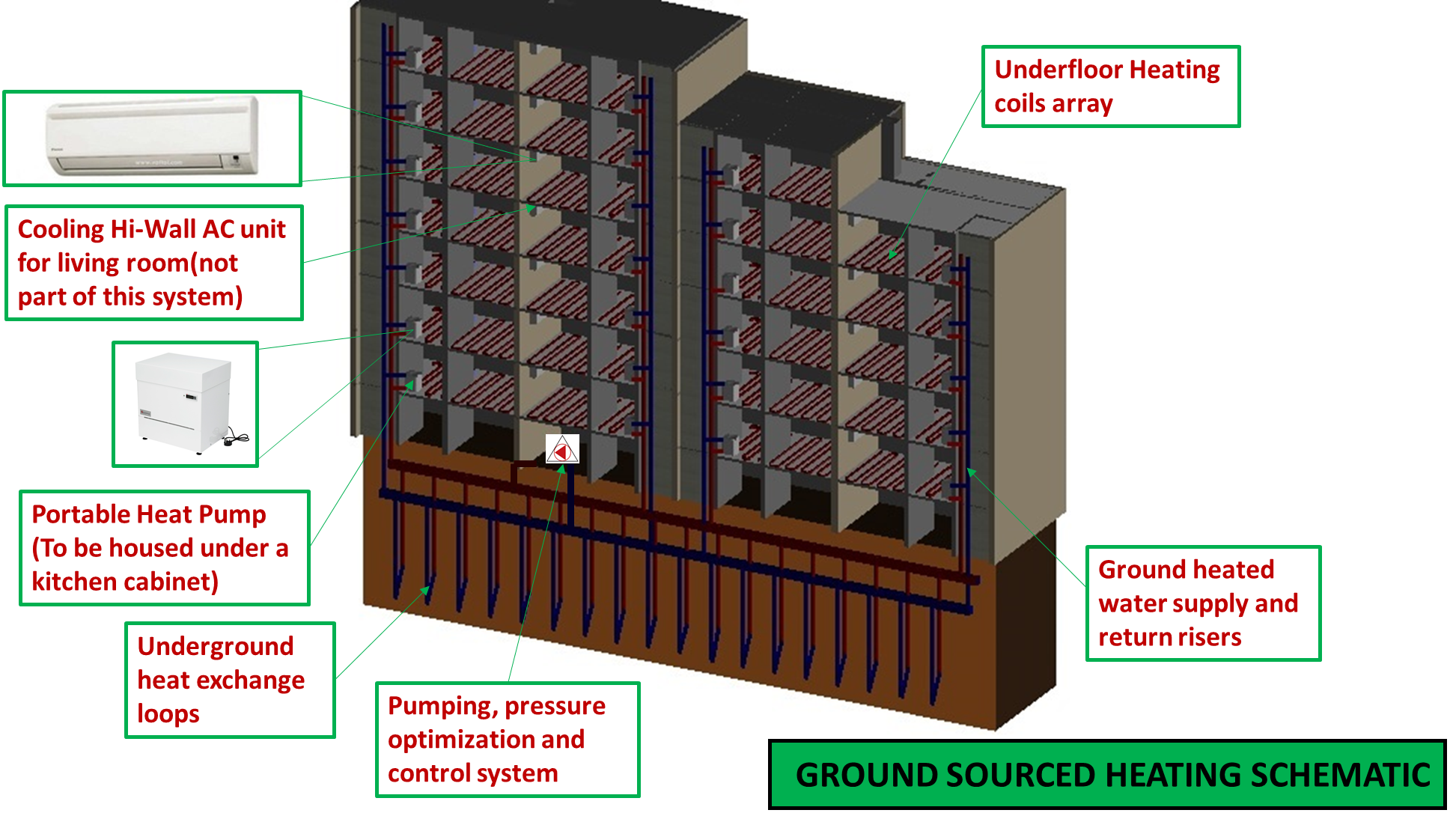
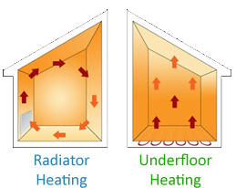
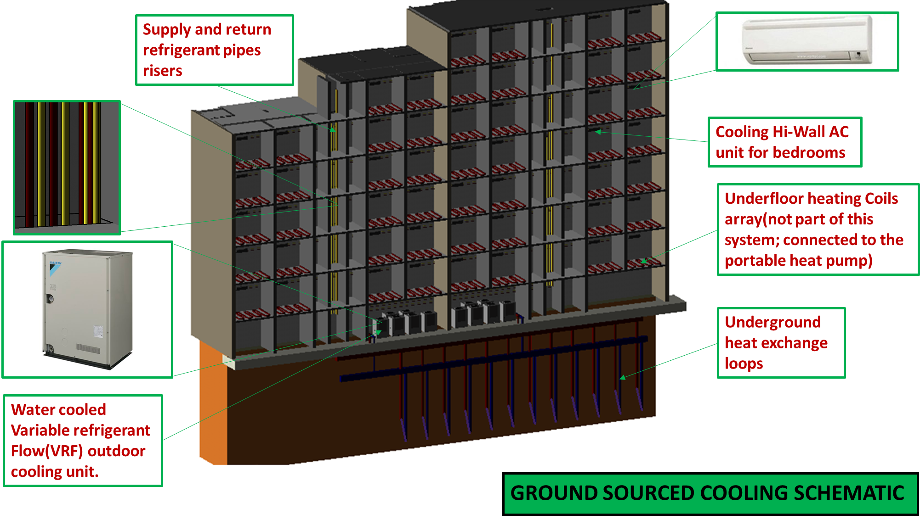

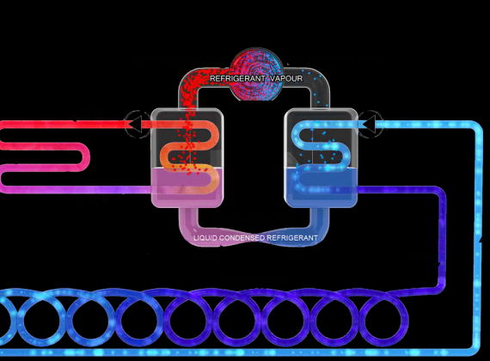
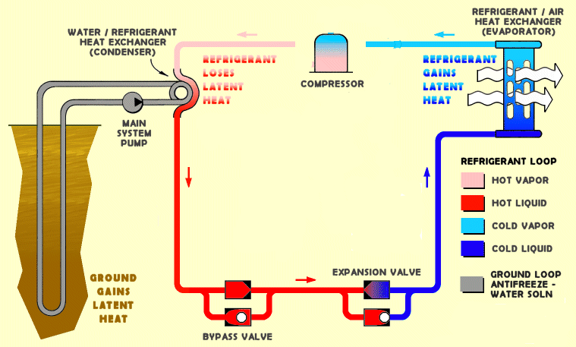


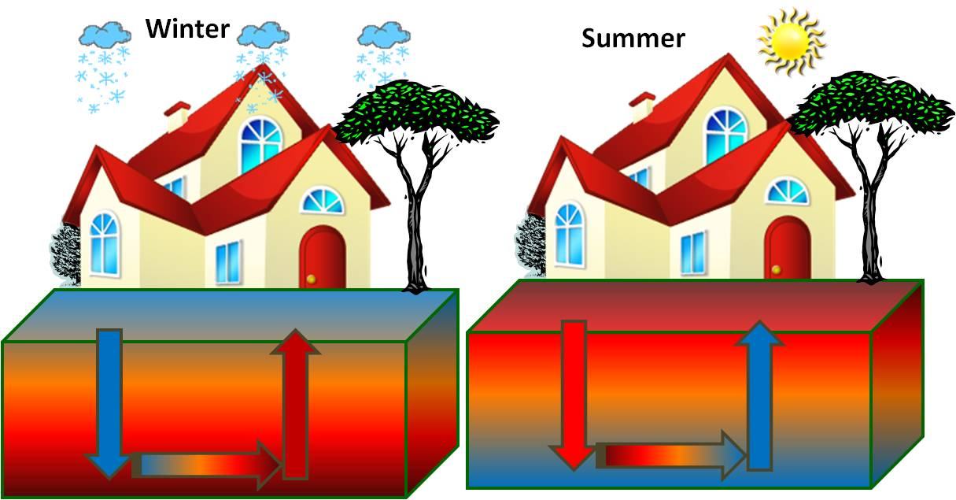
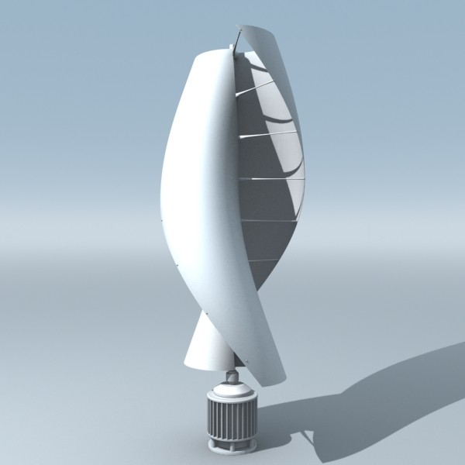



The underfloor heating has all kinds of advantages over the radiator heating except the rate of heating a space.
Basis of Operation
40-50% Energy savings over conventional DX systems
Basis of Operation
VRF+GT
Each outdoor module can be connected to 35 indoor units.
Building Space Heating
Using Diversity effectively
Building Space Cooling
Wind Energy Calculation: 14.7MWH
Required GSHP cooling and heating Energy Calculation:
Annual Heating Demand(ISOVER DESIGNER) = 375MWH
Annual Energy Required For Cooling = 450 MWH
Solar Energy Calculation: 87MWH
Space Ventilation with Heat Recovery – up to 90% efficient
System Designed for 1ACPH to ensure space CO₂ concentrations below 1000ppm
Central Toilet Exhaust Fan for each riser
Renewable Energy Systems
Building Ventilation

Slide 7


Slide 8


