Slide 1




COVID-19: Impacts on Information Organization, Transmission, and Use
Eurasian Academic Libraries Conference – 2021
“Contemporary Trends in Information Organization in the Academic Library Environment”
June 29-30, 2021
Ray Abruzzi
Publisher, Wiley Digital Archives
Wiley
Contributing Scholar, Columbia University Center for Science and Society
Columbia University
rabruzzi@wiley.com

Slide 2

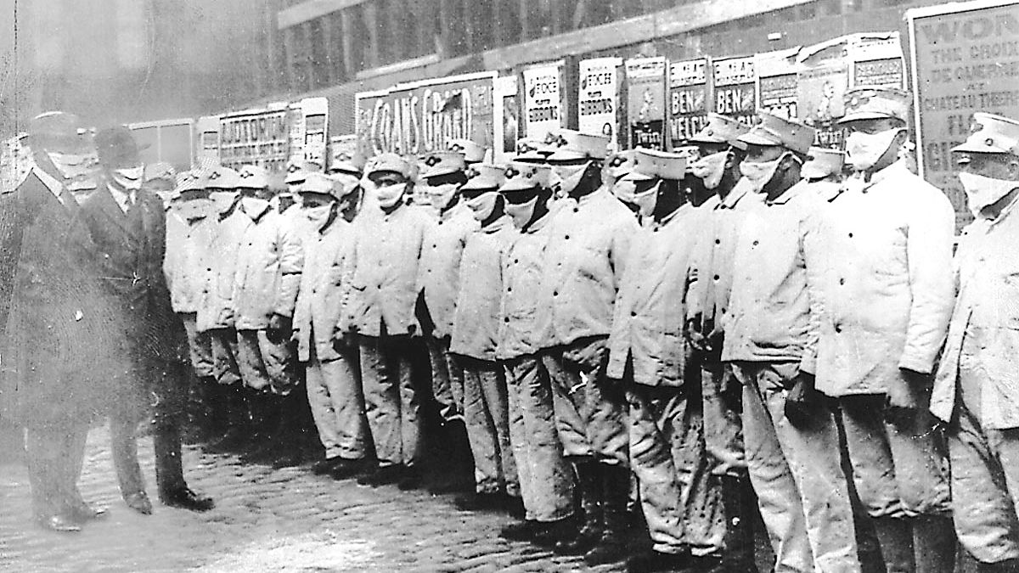
The 1918 Influenza
1918 Influenza (1918-1919), estimated to have killed between 21 and 100 million.
https://chicago.suntimes.com/coronavirus/2020/3/20/21186633/coronavirus-chicago-spanish-flu-influenza-pandemic-1918
Notes:
Before we look at COVID19 in the context of information exchange, it is useful to think about earlier pandemics in the context of information sharing, medical research, and health policies. The 1918 Influenza is estimated to have killed between 21 and 100 million people, globally. The true death toll of the influenza of 1918-1919 has been obscured by the chaos of World War I, where there was a need for the various warring nations to conceal any troop illnesses or deaths from their enemies and maintain moral within their own ranks as well as at home. How did the 1918 flu end? Was there a vaccine? Was there some other medical or scientific breakthrough that brough the virus under control? Scientists informed quarantine measures, encouraged the use of masks to avoid spreading or contraction the airborne contagion, and recommended that mayors, governors, senators, and other world leaders close schools and other institutions where people gathered en masse.

Slide 3
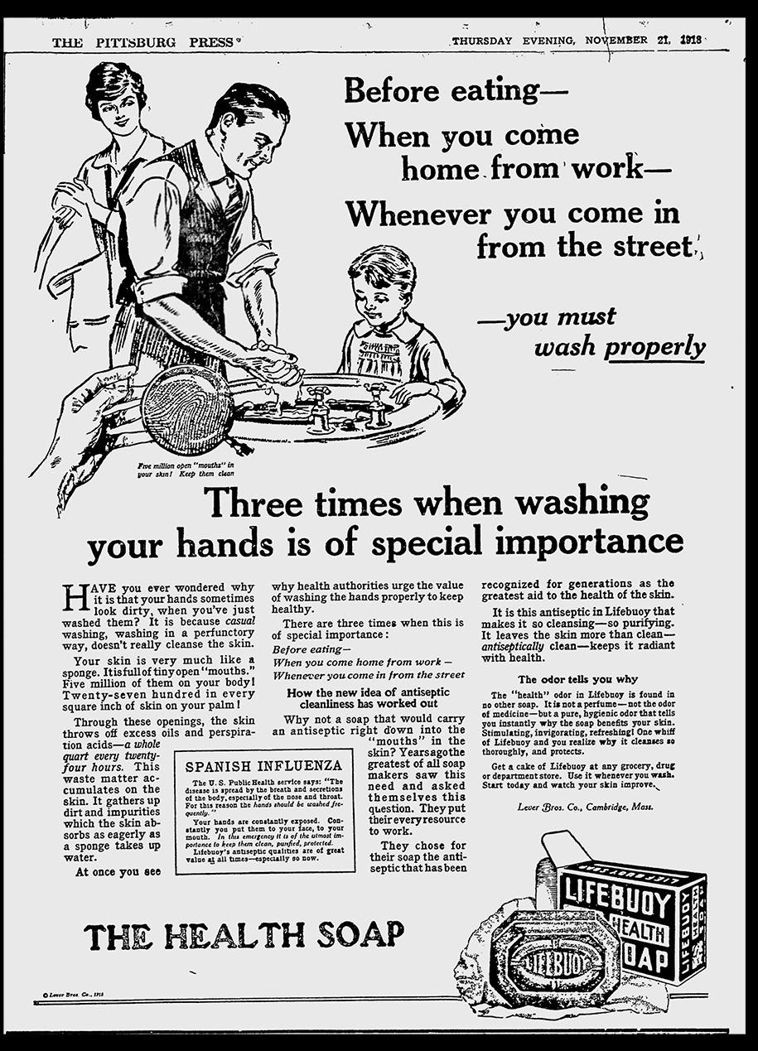
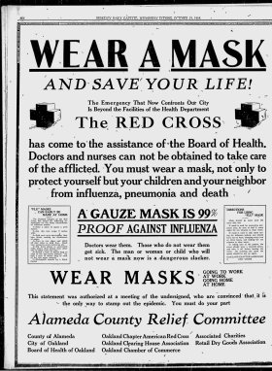
The 1918 Influenza
Quarantine, heightened sanitization protocols, and cooperation from the public in public safety measures helped to control the pandemic in many countries, though a vaccine was not developed.
https://time.com/5810695/spanish-flu-pandemic-coronavirus-ads/
Notes:
However, what is perhaps most surprising about the 1918 pandemic of influenza is that science and medicine did not develop a vaccine or other type of cure for this strain of influenza. After a year of widespread death and illness, the 1918 strain of influenza appeared to simply die out. Scientists and historians attribute the end of the pandemic to immunity developed in the remaining through surviving one of the three major waves of outbreaks, and also to quarantine measures and efforts to isolate populations and control the spread. It is thought that these efforts began to reap benefits in controlling the spread, but also that the influenza itself devolved to become less lethal.
What did become clear, at the end of this pandemic, was the need for better information sharing, and more cooperation amongst nations and institutions in responding to pandemic threats.

Slide 4
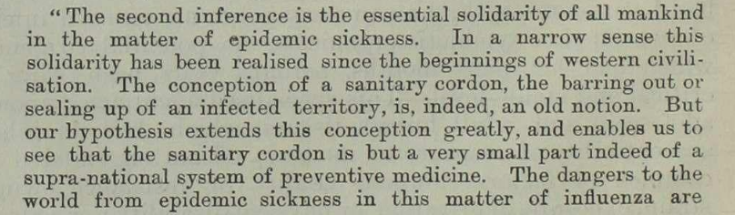
A Clarion Call for Cooperation
from the Royal College of Physicians
Newman, George. 1920. “Report on the Pandemic of Influenza, 1918-19.” RCP Library. H.M.S.O. Wiley Digital Archives: The Royal College of Physicians. Images 21-22. http://WDAgo.com/s/d936b092.
Notes:
The need to cooperate was expressed clear in a 1920 report from the Royal College of Physicians in the UK.
The first inference their report drew about the pandemic was that another pandemic in the future would be likely.
“The second inference [to be drawn from studying the 1918 flu] is the essential solidarity of all mankind in the matter of epidemic sickness. In a narrow sense this solidarity has been realised since the beginnings of western civilisation. The conception of a sanitary cordon, the barring out or sealing up of an infected territory, is, indeed, an old notion. But hypothesis extends this conception greatly, and enables us to see that the sanitary cordon is but a very small part of a supra-national system of preventive medicine. The dangers to the world in this matter of influenza are …

Slide 5
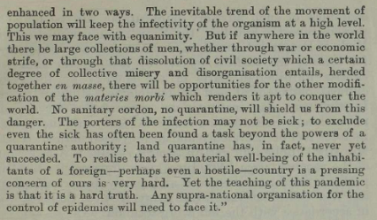
A Clarion Call for Cooperation
from the Royal College of Physicians
Newman, George. 1920. “Report on the Pandemic of Influenza, 1918-19.” RCP Library. H.M.S.O. Wiley Digital Archives: The Royal College of Physicians. Images 21-22. http://WDAgo.com/s/d936b092.
Notes:
enhanced in two ways. The inevitable trend of the movement of the population will keep the infectivity of the organism at a high level….But if anywhere in the world there be large collections of men, whether through war or economic strife, or through that dissolution of civil society which a certain degree of collective misery and disorganisation entails, herded together en masse, there will be opportunities for the other modification of the materies morbi which renders it apt to conquer the world [what we would call variants, today]. No sanitary cordon, no quarantine, will shield us from this danger. The porters of the infection may not be sick; to exclude even the sick has often been found a task beyond the powers of a quarantine authority; land quarantine has, in fact, never yet succeeded. To realise that the material well-being of the inhabitants of a foreign—perhaps even a hostile—country is a pressing concern of ours is very hard. Yet the teaching of this pandemic is that it is a hard truth. Any supra-national organisation for the control of epidemics will need to face it.”
So, the Royal College of Physicians, on the back of winning World War I with its Allies, was asking the world to cooperate, and to share information in the face of existential threats like influenza. This call is being echoed by political leaders, medical organisations, academic institutions, and others today in the face of COVID19.

Slide 6
The Case for Open Science
A definition:
“Open science encompasses unhindered access to scientific articles, access to data from public research, and collaborative research enabled by information tools, communications technologies, and incentives.
Broadening access to scientific publications and data is at the heart of open science, so that research outputs are in the hands of as many as possible, and potential benefits are spread as widely as possible.”
Open Science. Organisation for Economic Cooperation and Development. https://www.oecd.org/science/inno/open-science.htm.
Notes:
This quick visit to the historical brings us to the present day and the case for Open Science. On the surface, the idea that access to the research outputs and data of researchers working in scientific, medical, and technological fields related directly to public health, the preservation of life and of our ecological system, and the reduction of suffering and harm should be free and open to all seems to be a very straightforward case. The implicit argument for Open Science is that in this paradigm all researchers everywhere will be equally empowered and informed, collaborations across institutions, scientific fields, and borders will be fostered, duplicative efforts will be reduced, efficiencies will flourish, and that progress in these crucial areas will proceed more rapidly to the benefit of all life on Earth and even the planet itself. If Open Science were a reality, will all of these argued benefits come to pass? Could Open Science even save the world from existential threats?

Slide 7
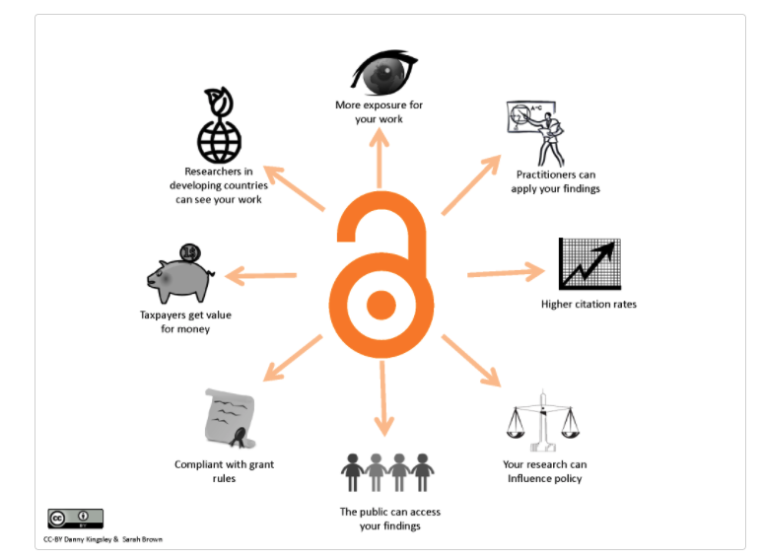
Arguments for Open Access
Halmstad University: https://halmstad-university-library.helpscoutdocs.com/article/97-arguments-for-open-access
Notes:
Arguments supporting OA are well-known at this point, and we won’t spend too much time repeating them in the short time we have together today. Essentially, many consider the economics of the Publishing ecosystem the main obstacle to OA, and transitional OA deals have become increasingly seen to lower those barriers, creating a research environment with more equitable access to published research. The value of the peer-reviewed, published version of record for a given research output has not been diminished in these transitional deals, just as the necessity for peer-review and publication has not gone away through a move to OA and transitional deals. But have these changes to OA borne the promised fruits? Have the benefits of OA implied in this diagram come to pass?

Slide 8
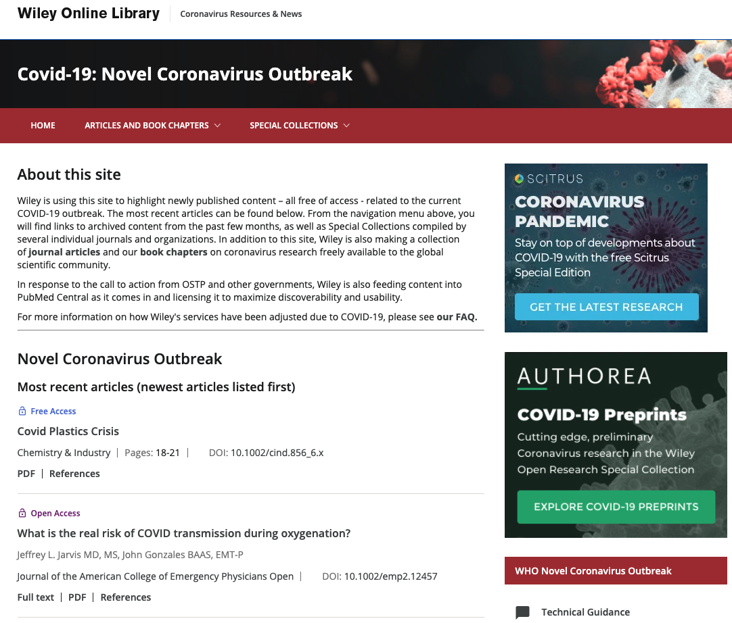
Open Access to Published COVID19 Research
https://novel-coronavirus.onlinelibrary.wiley.com/
Notes:
When the true import of the COVID19 Pandemic was recognised, publishers of relevant medical research including Wiley, Elsevier, Springer-Nature, and many others lowered their paywalls and opened access to their content in order to aid in the efforts to mitigate, control, and eventually develop vaccines for, this new strain of SARS COV2.
The traffic and usage of these sites was very high, and while I’m only able to speak definitively about Wiley’s own site it is very likely this held true for other publishers.
However, whether Open Science steps like these made measurable impacts in the speed, efficiency, safety, and efficacy of the COVID19 vaccines available today, or fostered improvements in the ways in which COVID19 is being treated is still an ongoing subject for study, and I cannot answer those questions here.
What we can do is look at what is going on in the broader publishing ecosystem as a result of COVID19’s demands for information.

Slide 9
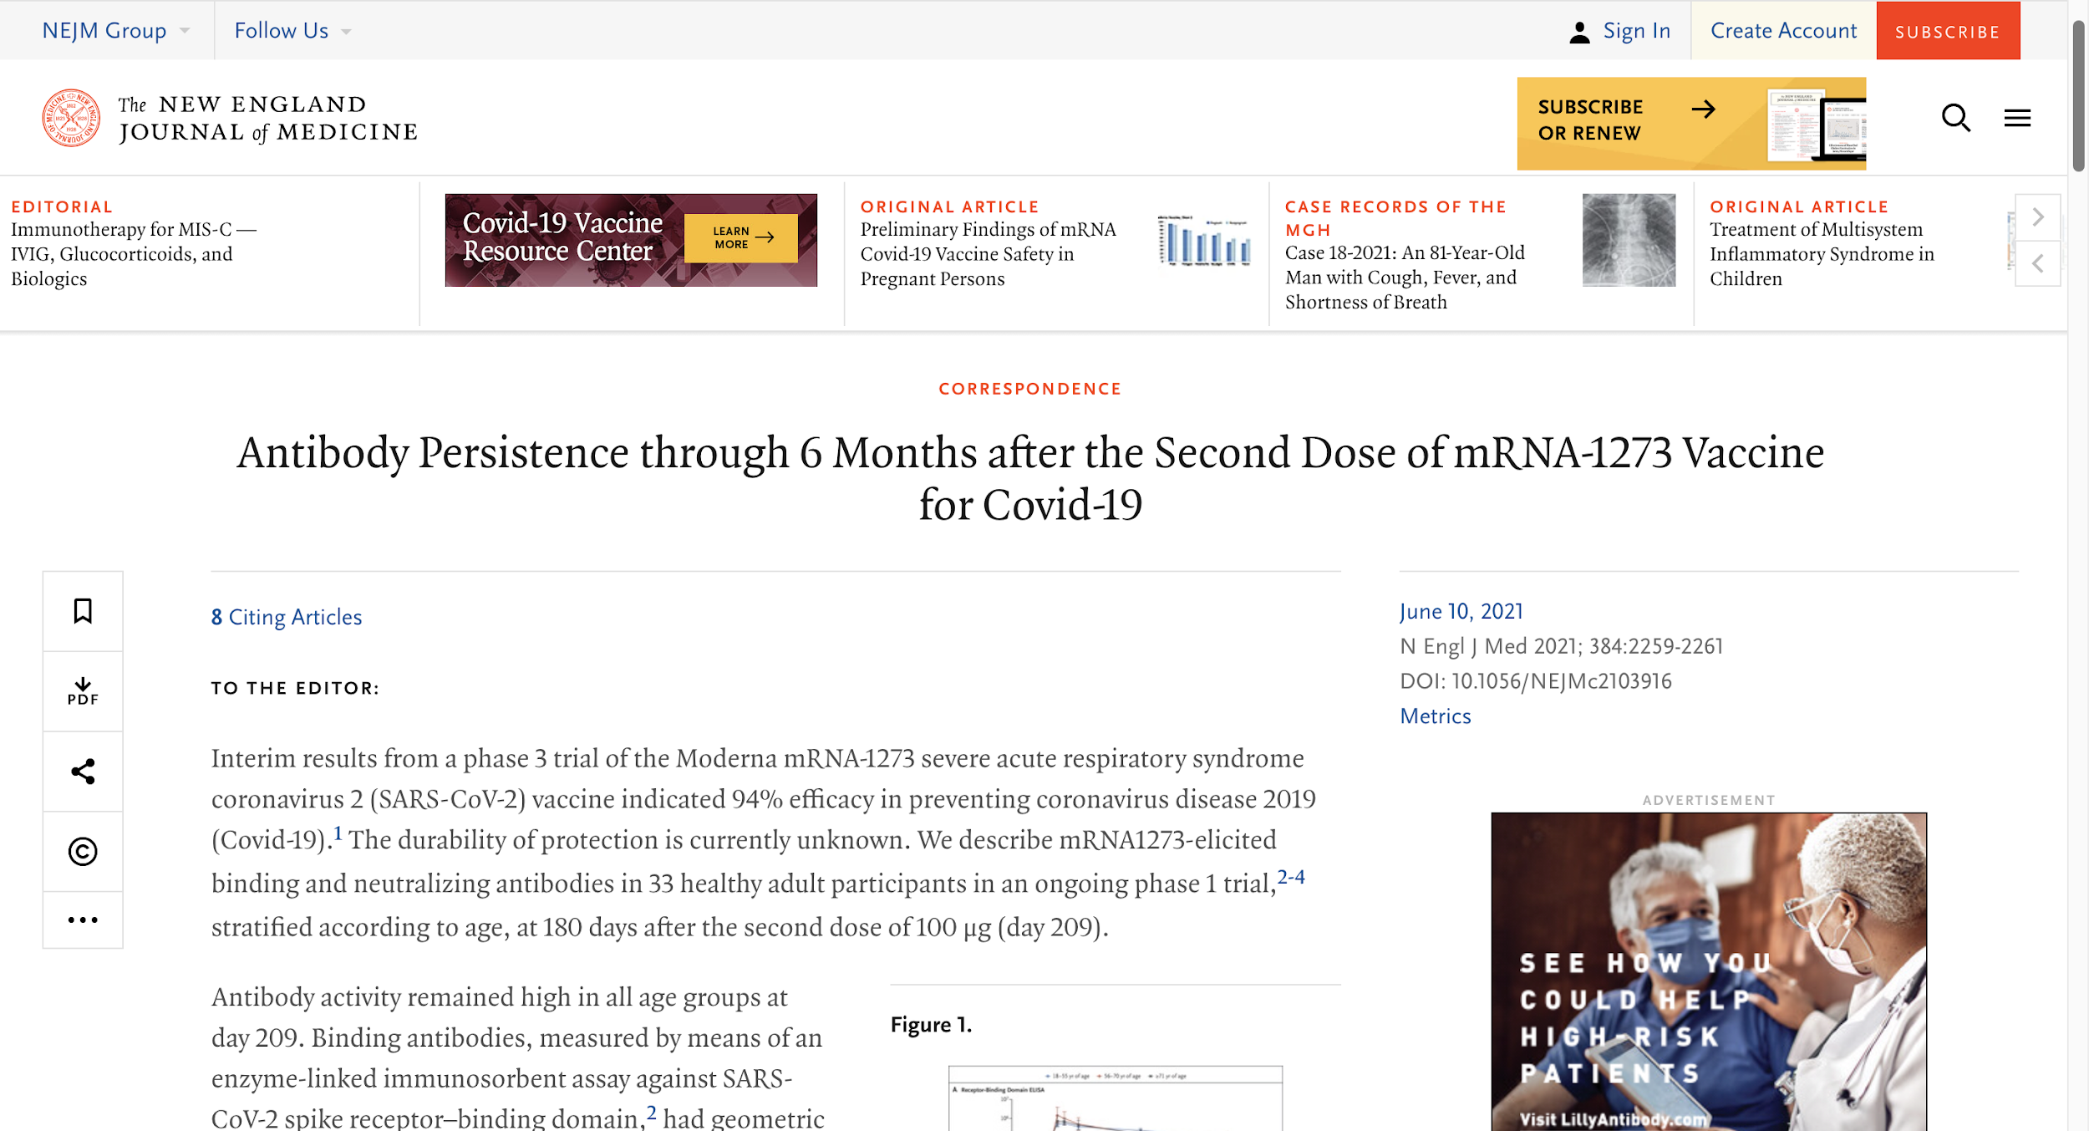
Rapid Correspondence and COVID19
Nicole Doria-Rose et al., “Antibody Persistence through 6 Months after the Second Dose of MRNA-1273 Vaccine for Covid-19,” New England Journal of Medicine. (April 6, 2021): https://doi.org/10.1056/NEJMc2103916.
Notes:
What can be said with certainty is that, in many cases, the traditional pace of those publishers engaged in peer-review and publishing for emerging COVID19 research was outmatched by the needs of the research communities for information, analysis, and data.
The critical and urgent nature of COVID19 research created, or at least increased the use of, information-sharing methods like “Rapid Correspondence,” pre-print servers, and data-sharing via social media.
I liken Rapid Correspondence to a “letter to the editor” in that the publication takes on some responsibility for publishing the letter, yet still maintains some distance as the content has not gone through the same critical process that a formally published article would.
Rapid Correspondence, like this letter published by researchers in the New England Journal of Medicine, began to show up in numerous publications, short-cutting or at least forestalling the peer-review process through which this content would have normally been subjected to.

Slide 10
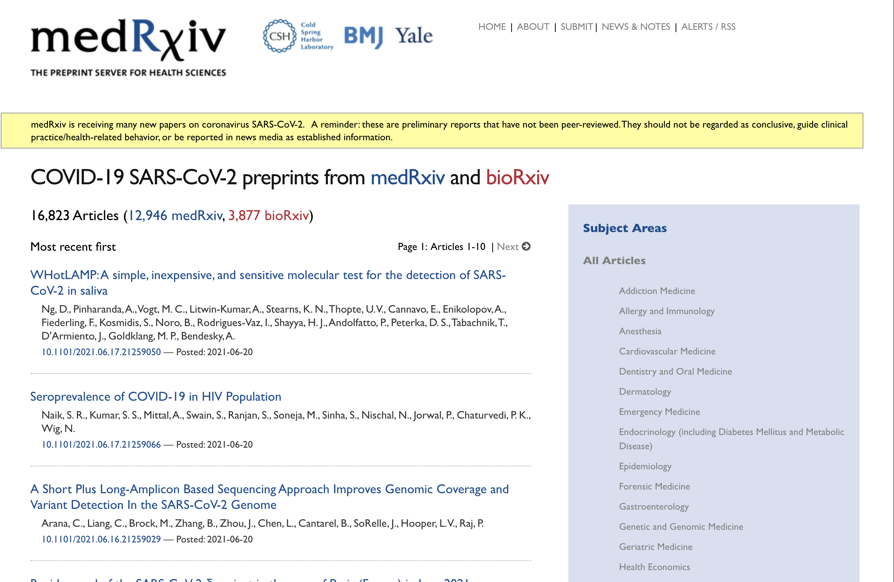
Pre-Print Servers and COVID19
https://connect.medrxiv.org/relate/content/181
Notes:
(“medRxiv is receiving many new papers on coronavirus SARS-CoV-2. A reminder: these are preliminary reports that have not been peer-reviewed. They should not be regarded as conclusive, guide clinical practice/health-related behavior, or be reported in news media as established information”)
While the caveats around the use of pre-print articles and data are very clear, the use of pre-print servers to share SARC CoV-2 research expanded so rapidly the sites like medRxIV were initially overwhelmed. medRxIV soon opened a companion site dedicated solely to COVID19, where the information and usage of this content expanded well beyond any other traffic peaks in the company’s comparatively short history.
Most researchers using pre-print data or findings are being extremely selective in what data or findings they choose to incorporate into their own research efforts and are aware of the risks. Researchers using data from pre-print servers tend to seek out content from authors they either know personally or by reputation, who have a track record of reputable work, are situated in a lab or research institution that has its own reputational value, and who have previously published articles in prestigious journals.
Also, researchers are decoupling data and findings from within an article. That is to say they are not often putting their trust into the entirety of an article’s findings but rather they are grabbing the data, or a method, or a conclusion from a process they trust, and leaving the rest for peer-review to verify and publish. Open Science of a kind is occurring, but the value of pre-print servers is still derived on the basis that the content has been accepted for publication by a journal.

Slide 11
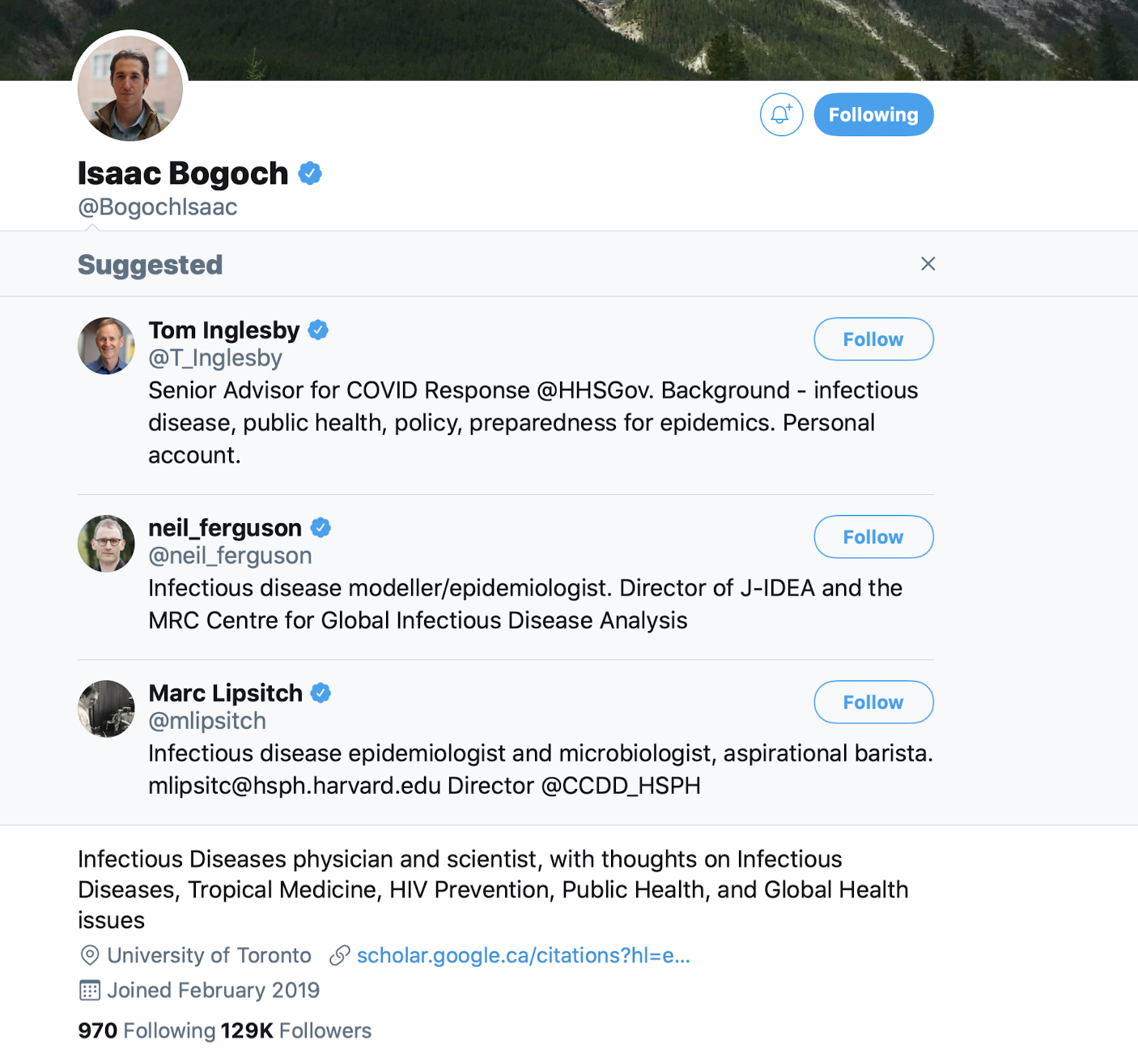
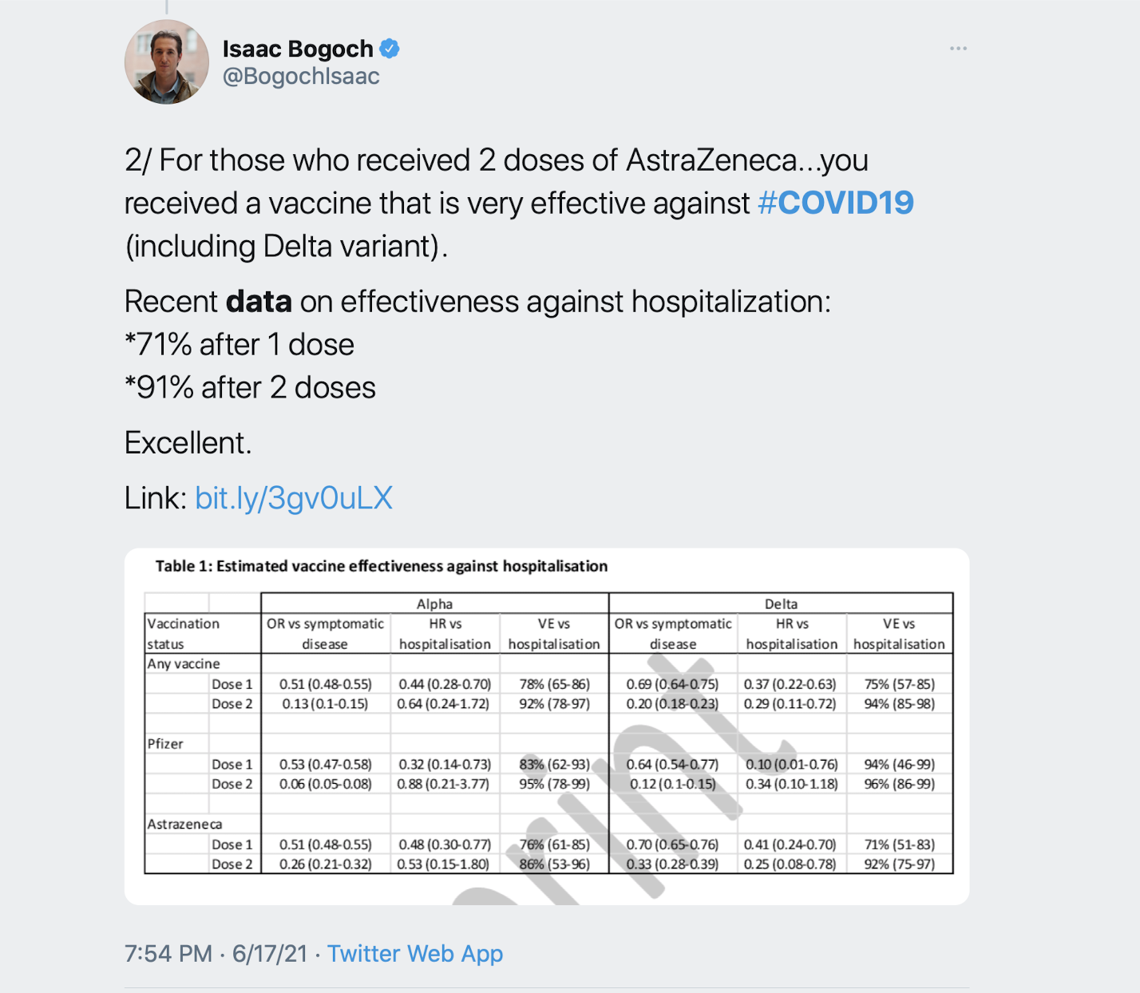
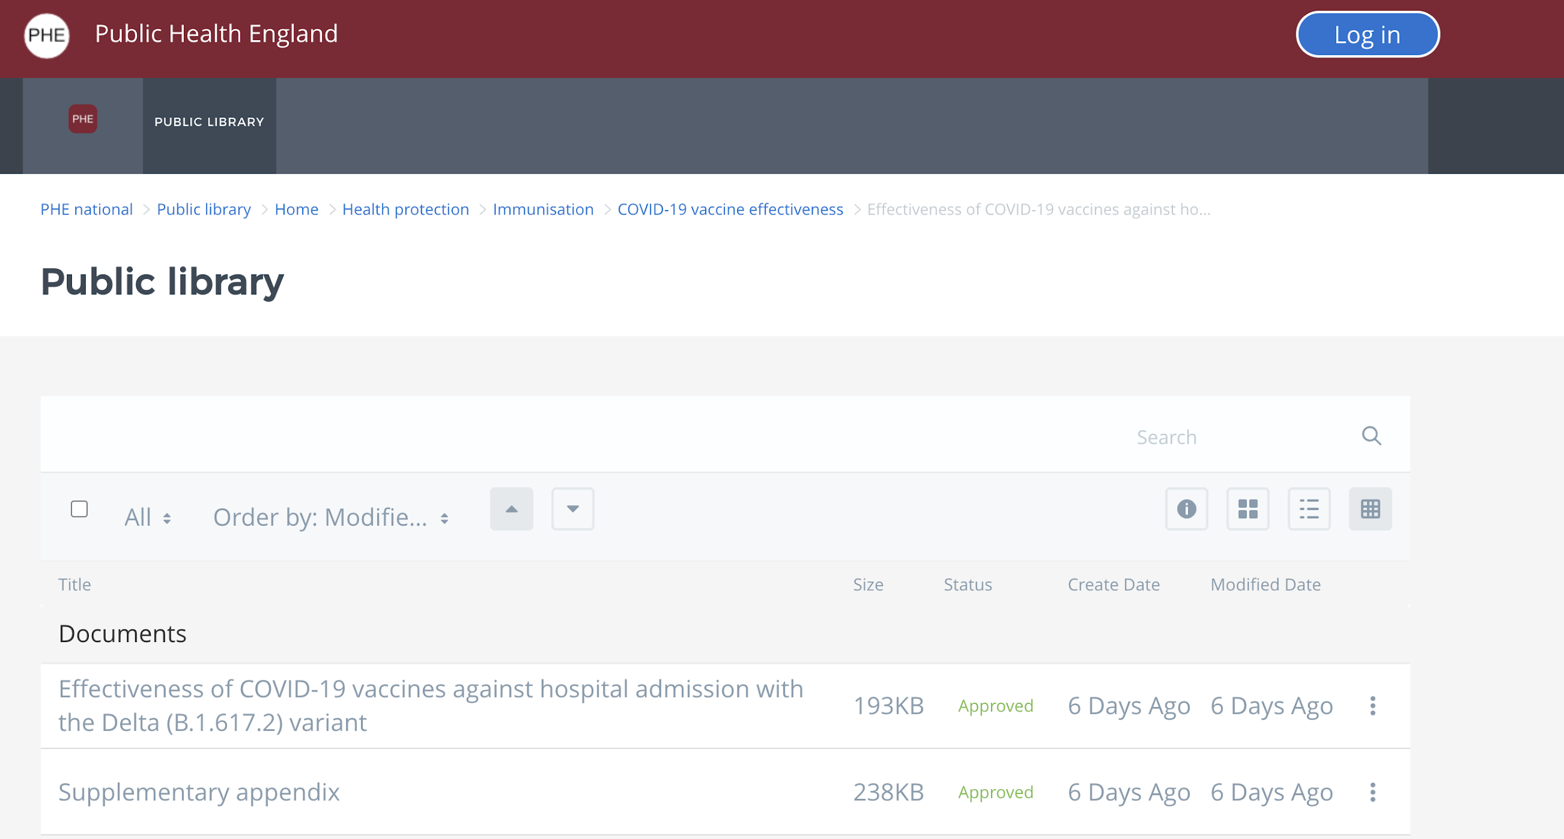
Social Media, Data, and COVID19
https://khub.net/web/phe-national/public-library/-/document_library/v2WsRK3ZlEig/view/479607266
Notes:
Lastly, the use of social media sites such as Twitter, Reddit, and Facebook to share links to emerging data increased dramatically in response to the demand for data caused by COVID19. While sharing data via social media is not necessarily new, the urgency of COVID19 and the need for data increased the amount of data shared (usually as in this image—a note, a snapshot, and a link) via social media sties, particularly among networks of researchers already connected on these sites.
(SLIDE IS ANIMATED)

Slide 12
Considerations for Librarians
Custodians of Knowledge?
Curators?
Guides to Authoritative Resources?
“Collection Management”
Research Partners!
Notes:
So, what are the considerations for librarians in the context of these shifts in information sharing and curation? Are the traditional roles changing, alongside the behaviours of librarty stakeholders and patrons?
I would like to think of the library as a research partner, rather than just a source of information, and the changes we’ve discussed here provide opportunities for the library to engage with researchers as partners.

Slide 13




THANK YOU FOR LISTENING!
Eurasian Academic Libraries Conference – 2021
“Contemporary Trends in Information Organization in the Academic Library Environment”
June 29-30, 2021
Notes:
There are numerous other barriers that inhibit the exchange of research findings and data (privatization, patents, competing interests, career pressures, national security). However, the scientific community has found new ways to share and exchange data and information related to COVID-19, that while still dependent on the peer-review and publication process, and in large part on the established reputation of these journals for validation—allowed for a much faster, much more dynamic exchange than the established publication process allows for.
Changes like these may impact the role of librarians, especially when it comes to inherent risks (remember that caveat) of using data or information found outside of authoritative resources and in some cases, outside of the peer-review process and all that process implies. What do librarians curate for their stakeholders, in these environment, and what guidance can be provided to emerging researchers and scientists at your institutions? Eat the apple but wait…not that apple!
The methods by which information is being shared are constantly evolving, as are the roles of librarians working in academic settings. While crises inevitably force change and innovation, and can even increase our tolerance for certain risks, the library needs evolve if it is to stay at the center of academic excellence in research and scholarship. Taking stock of these emerging information-sharing practices and finding ways to support researchers in their endeavors remains at the core of librarianship.
Thank you for your time and attention!

