Slide 1

Reflective Practice and Interactive Teaching
Mr. Philip Montgomery
Academic English Instructor

Slide 2
Workshop Overview
Introduction
Reflective practice
Interactive teaching
Students
Faculty
Projects and Scaffolding
Student Feedback

Slide 3

Introduction
Teachers of new formation
Creative person with the ability to reflect
Uses student-centered teaching methods
Meet modern requirements and international trends
in the development of education

Slide 4
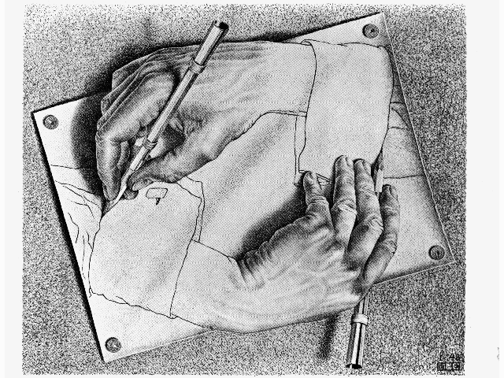
Reflective practice
Students as reflective learners
Faculty as reflective teachers

Slide 5


Reflective
Learning
“The learner, by engaging in an active process with the teacher and others through reflective dialogue, begins the journey to greater agency, autonomy and independence rather than remaining dependent and passive” (Brockbank & McGill, 2007, p. 62)
http://www.swansnatchlove.com/wp-content/uploads/2014/09/Bored-lecture.jpg
https://i.ytimg.com/vi/CkFWbC91PXQ/maxresdefault.jpg

Slide 6
Reflective Learning
What classroom activities or assignments show your students being most ACTIVE?
What skills are they developing and demonstrating in those activities?
Do you require your students to be reflective?

Slide 7
Reflective Learning
Overview of Educational Research about Learning
Early research focused only on measurable outputs → IQ test
Moved toward social constructivism →
various ways of learning
Research became less quantitative and objective.
Is now more qualitative and subjective.
(Brockbank & McGill, 2007, p. 38-40)

Slide 8
Reflective Learning
Research has focused on:
  Categories (memorizing facts, retention of knowledge, understanding meaning)
  Orientations (intrinsic/extrinsic)
  Strategies (Serialist/holist)
  Approaches (Deep/surface)
  Stages/perspectives (Received/Subjective/Procedural/Constructed knowledge)
  Levels (I/II/III → content/application/evaluation)
  Domains (cognitive/knowing, conative/doing, affective/feeling)
  Single-loop/Double-loop learning
(Brockbank & McGill, 2007, p. 40-51)

Slide 9
Reflective Learning
More recently:
By developing:
We get:
Emotion
Transformative process
Student empowerment
Autonomy
Self reflection
Critical ability
Change Agents

Slide 10
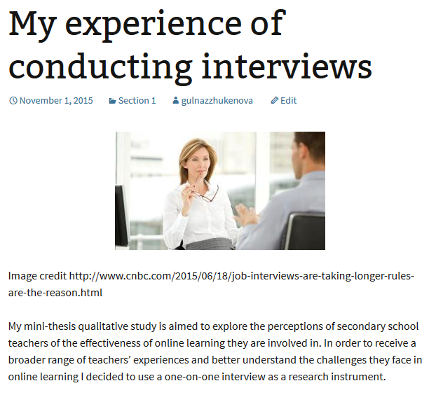
Reflective Learning
  Self evaluation →
  Journaling →
  Peer revision →
  Portfolios →

Slide 11
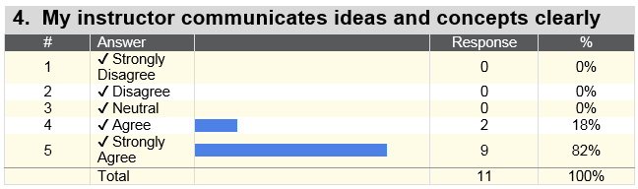
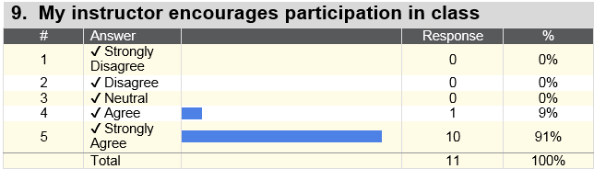
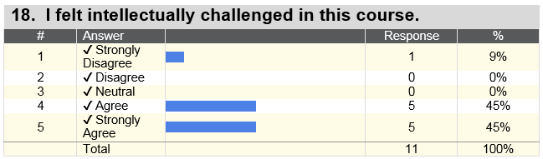
Reflective Teaching
Formal observation
Professional development seminars
Interaction
with colleagues
Student feedback

Slide 12

Questions / Break

Slide 13
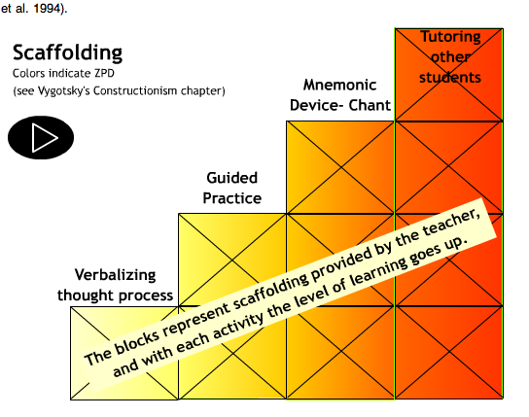
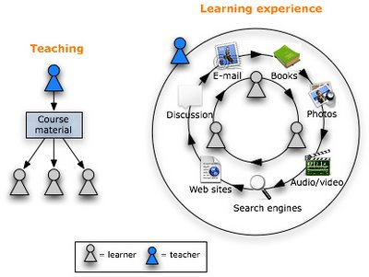
Interactive Teaching
Scaffolding:
How students interact
with the course content
Project work:
How students interact with
each other

Slide 14
Interactive Teaching
WA6 – Reflection Essay and Portfolio
Scaffolding
WA5 – Critical Review (3-5 sources)
WA4 – Argumentative Essay (2-3 sources)
WA3 – Definition Essay (2-3 sources)
WA2 – Summary from one source
WA1 – Needs Analysis (pre-course)

Slide 15
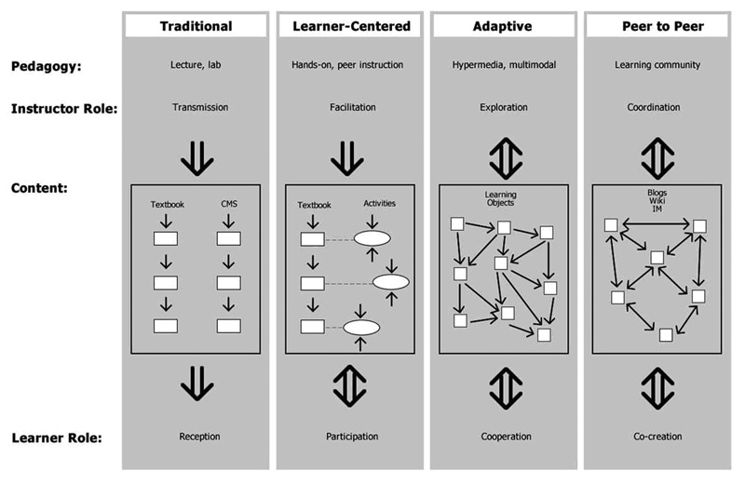
Blog writing: Pedagogy
www.amacad.org

Slide 16
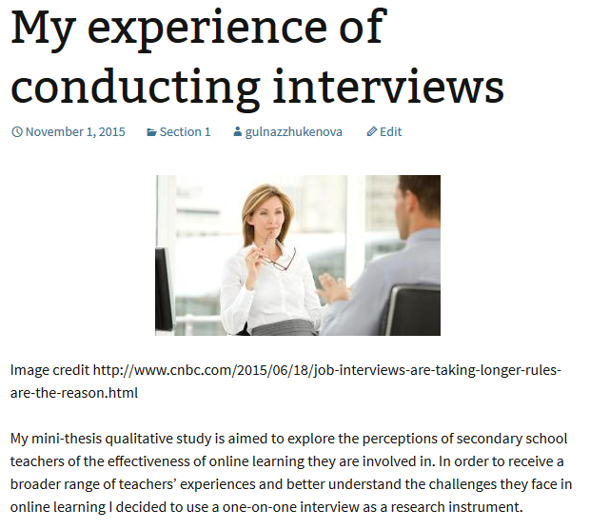
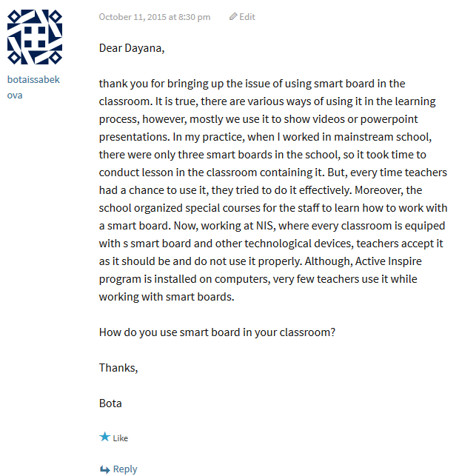
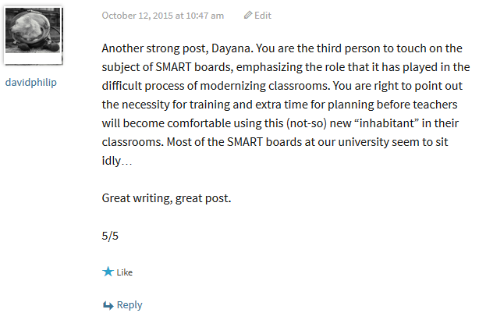
Blog writing: In Practice
nuwritersguild.wordpress.com

Slide 17
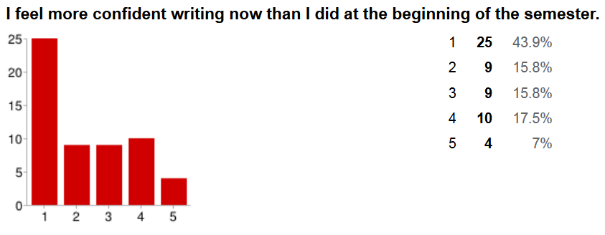
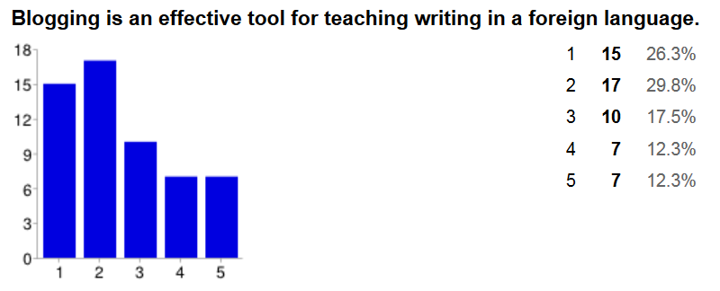
Blog writing:
Positive Results
Student
feedback:

Slide 18
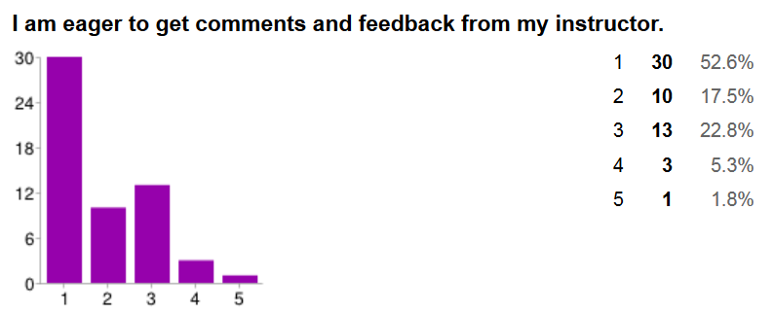
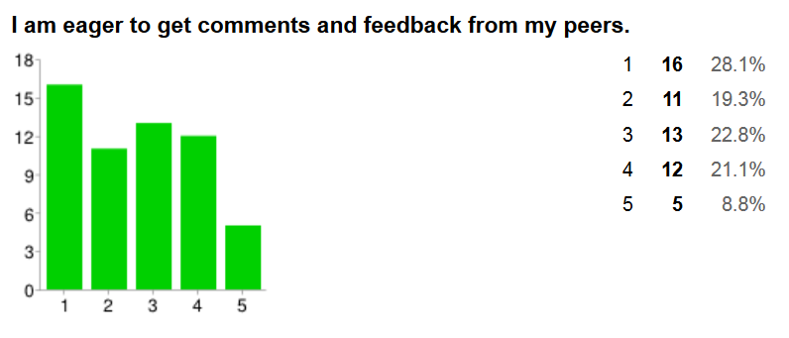
Student
feedback:

Slide 19
Task
Identify one reflective practice you already use in your classes. Share with a partner.
Identify one reflective or interactive task that you might try to introduce or improve. Share with a partner.

Slide 20
Question
How do these ideas compare to what you are discussing in your institute?

Slide 21
Final Comments
Higher education should be focusing on empowering graduates to be change agents.
To do that we need to be teaching reflective practice.
Self evaluation, journaling, peer revision, and portfolios are some ways to develop reflective learning.
Teachers especially need to be reflective in their teaching practice.
Scaffolding helps the student see the progression of increasingly difficult skills and content.
Project work like blogs and portfolios allow teachers to promote student interaction and reflection.
Student feedback is important to improve on our teaching.

Slide 22
Rferences
Brockbank, A. & McGill, I. (2007). Facilitating reflective learning in higher education. Buckingham, GBR: Open University Press.
http://www.amacad.org
http://nuwritersguild..wordpress.com

Slide 23
Thank you
Future workshops
  Academic English
  Syllabus development
  Student publications
  Using rubrics
Your ideas, questions
Let’s stay in contact (Philip.Montgomery@nu.edu.kz, aigul.aktymbayeva@nu.edu.kz)

