Slide 1
Re-envisioning Libraries: Process and Best Practices
Lesley Moyo
Associate University Librarian for Public Services

Slide 2
Presentation outline
Introduction
The need for library transformation
Engaging stakeholders in the development of a strategic framework
Applying the framework to develop and implement a change agenda:
  Rethinking service delivery model
  Library consolidation
  Facilities master planning

Slide 3
Introduction

Slide 4
Introduction
This presentation builds on a previous one given by Ed Van Gemert, the Vice Provost for Libraries at UW-Madison, during his last visit
Presentation centers on completed and current phases of transforming the UW-Madison libraries:
  Consolidation planning and implementation
  http://go.wisc.edu/consolidationreport
  Facilities master planning
  Rethinking service delivery model

Slide 5
The need for change

Slide 6
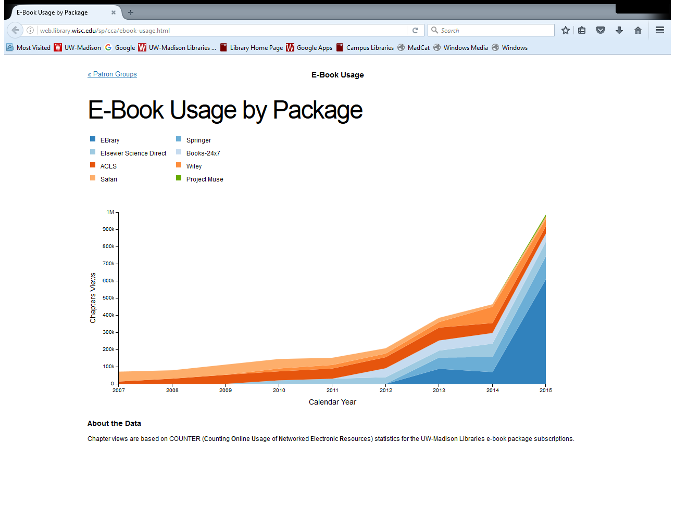
http://web.library.wisc.edu/sp/cca/ebook-usage.html

Slide 7
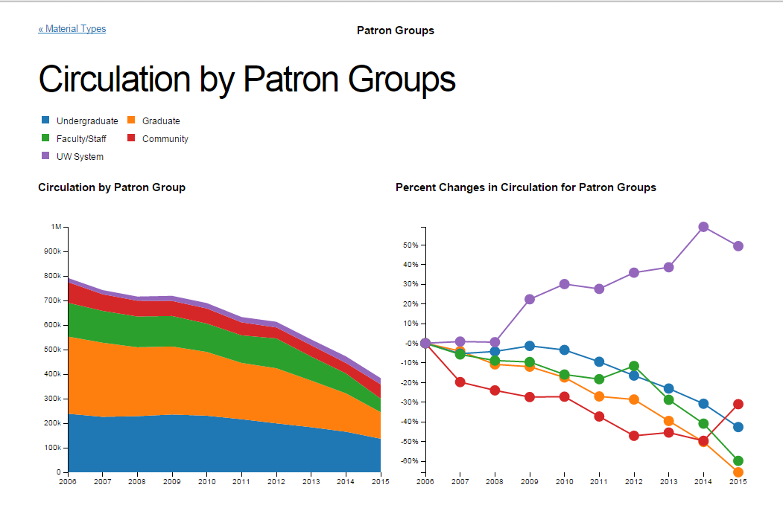
Declining print circulation
http://web.library.wisc.edu/sp/cca/patron-groups.html

Slide 8
Impetus for change in academic libraries
New trends
Changing user needs
Evolving strategic agenda
Changing technologies
Pursuit of sustainable budget models
Other higher education environment factors

Slide 9
Re-envisioning the UW-Madison libraries: process and best practices
Integrated approach
Sustained engagement with stakeholders
Visible milestones
Documenting outcomes of each phase
Keeping goal in sight
Engaging expert consultants

Slide 10
Path to a 21st Century academic and research library – Engaging the academic community in planning the transformation of UW-Madison campus libraries
Strategic Framework
Implementation Goals & Objectives
Service Delivery Model
Consolidation Implementation
Consolidation Planning
Facilities Master Planning
GOAL:
21st Century Campus Libraries
Activities
Planning
Engagement
Faculty
Outcomes
Campus Strategic Framework: A Vision for Knowledge through 2020
University admin
Professional orgs
Students
Campus/Lib staff
Surveys/Focus grps
Consultation
Benchmarking
Communication
OQI
Activities
Campus forums
Engagement
Outcomes
Print Management Strategy
Campus community
Communication
Inter-institutional collaboration
Library staff
CIC peers
Verona Shelving Facility
CIC - SPR
Activities
Using the Campus Libraries Strategic Framework to develop implementation goals
Engagement
Outcomes
Implementation goals for: (1) Assessment, (2) IT and Spaces, (3) Collections, (4) Budget
GLS Executive
Library staff forums
OQI
Communication
Activities
Interviews/Survey
Engagement
Governance groups
Outcomes
Recommended implementation plan
Data analysis
Library directors
Academic departments
Categorization of libs
Transition to implementation
Governance group (ULC) endorsement
Campus listening sessions
Communication
Dev. of recommendations
Provost endorsement
OQI
Consolidation Report
Activities
Facilities master planning
Engagement
Academic departments
PROJECTED OUTCOMES
FP&M
Engberg Anderson & brightspot
Library directors
Various stakeholders & governance grps
Reduced physical footprint of libraries
Expansion of eContent
25-year Facilities Master Plan
Updated services & progs.
Location by location consolidation implementation work
Enhanced Services & Programs
Tailored Research Support
Ubiquitous Access to eContent
Inspiring Library Spaces & Robust IT Infrastructure
Sustainable Budget Model
✔ Completed
✔ Completed
In-Progress
Projected
✔ Completed
✔ Completed

Slide 11
Engaging stakeholders in the development of a strategic framework

Slide 12
Stakeholder engagement – Outcome
Identification of stakeholders:
  Primary affiliates
  Institutional peers
  Professional associations
Summary outcome
  http://www.library.wisc.edu/wp-content/uploads/2014/07/StakeholderFeedbackSummary.pdf
Timeline
  http://www.library.wisc.edu/wp-content/uploads/2014/07/CampusLibrariesStrategicFrameworkTimeline.pdf

Slide 13
Strategic Plan
Strategic plan
  http://www.library.wisc.edu/about/administration/strategic-planning-goals-and priorities/
Integral to Plan:
  Library consolidation
  Strengthening of collections program (investment in eContent)
  Facilities master planning/renovation of spaces
  Establishment of a scholarly communications program
  Investment in developing a robust IT infrastructure

Slide 14
Applying the strategic framework to develop a change agenda

Slide 15
Rethinking service delivery model
Investment in eContent
Investment in high density storage
Virtual delivery of services
Leverage IT ecosystem to provide innovative services
New liaison roles
Expansion of eLearning portfolio
Pervasive library brand in virtual environment
Greater integration in lifecycle of research, teaching, and learning

Slide 16
Library consolidation
Concentration of print resources
Reduction of physical footprint of the library
Realignment of staff resources with services and program priorities
Redesign of library spaces
Facilities master planning
Alignment with campus priorities

Slide 17
Current and forthcoming consolidation
Chemistry Library
Geography Library
Business Library
Wendt Engineering Commons Library
Ebling Health Sciences Library
Veterinary Medicine Reading Room
School of Human Ecology Library

Slide 18
Campus libraries facilities master plan
Inventory/Space utilization and analysis
Examination of space needs for supporting disciplinary/interdisciplinary research needs across campus libraries; as well as undergraduate needs
Plans for meeting current and emerging needs, including needs for collections storage
Plan for transforming libraries into 21st Century facilities by creating innovative spaces that support a myriad of academic activities

Slide 19
Q&A

Slide 20
Thank you
Lesley Moyo
Associate University Librarian for Public Services
University of Wisconsin-Madison
General Library System
372J Memorial Library
728 State Street
Madison, WI 53706-1494
Office: 608-263-4962
Mobile: 814-777-7565
lesley.moyo@wisc.edu

