Slide 1
Attention-based deep learning model for facial expression recognition
MS Data Science Candidate: Alimzhan Kairzhanov
Supervisor: Anh Tu Nguyen,
Assistant Professor, SEDS, NU
Co-supervisor: Min-Ho Lee,
Assistant Professor, SEDS, NU

Slide 2
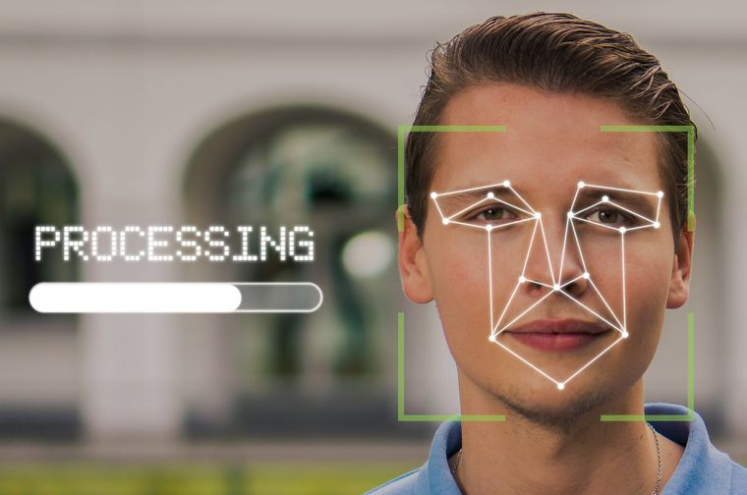
Outline
Introduction
  Background
  Motivation
  Problem statement
  Objectives
Related works
Methodology
Experiments and results
Key contributions and conclusions.

Slide 3
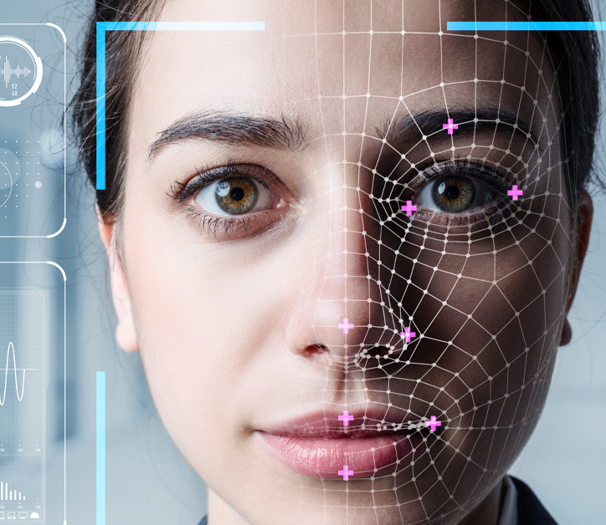
Introduction: Background
What is facial expression recognition (FER)?
Facial expression recognition is a technique that automatically extracts the features on human face to recognize the patterns of expression.
More than 90% of the human communication is nonverbal [1]. Professor Albert Mehrabian, UCLA
6 major emotions: angry, disgust, fear, happy, sad, and surprise.
This Photo by Unknown Author is licensed under CC BY-ND

Slide 4
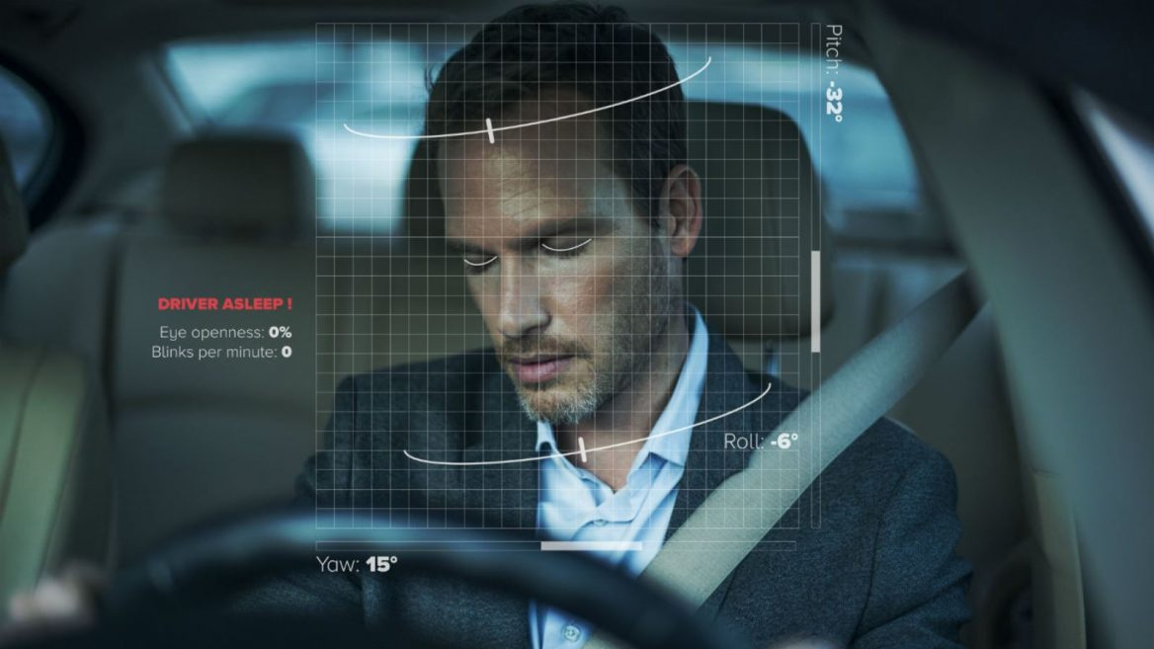
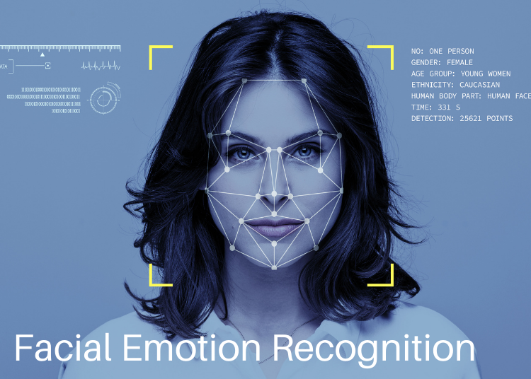
Introduction: Motivation
Why FER is important?
mental state identification;
security;
automatic counseling systems;
face expression synthesis;
lie detection;
music for mood;
automated tutoring systems;
operator fatigue detection etc.

Slide 5
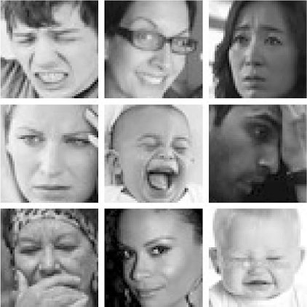
Introduction: Problem statement
FER requires large quantity of data
High intersubject variations: illumination, pose, deformation and wild environment
Lack of the empirical study for attention-based FER

Slide 6

Introduction: Objectives
The main purpose of this practical work is to investigate the use of self-attention-based deep learning model to improve the FER performance.

Slide 7
Related works
PAPERS | DATASETS | METHODS | ACCURACY
Tang, Y. (2013) [2] | MNIST, CIFAR-10, ICML 2013 | Support Vector Machine (SVM) | 87%
Dapogny, A., & Bailly, K. (2018) [3] | CK+, BU-4DFE, FG-NET FEED | Deep Neural Forests, RF | 86.4%
Ravi, A. (2018) [4] | CK+, JAFFE | SVM | 92.86%
Shan, C., Gong, S., & McOwan, P. W. (2009) [5] | CK | Local Binary Pattern (LBP), SVM | 88.9%
Chen, J., Chen, Z., Chi, Z., & Fu, H. (2014) [6] | JAFFE, CK+ | Histogram of Oriented Gradients (HOG) | 94.3% and 88.7%

Slide 8
Related works
 | Haar Cascade | LBP | SVM | HOG
+ | more robust to illumination changes; has a higher execution speed; involve less computations. | high discriminative power; computational simplicity; invariance to grayscale changes; good performance. | works well when there is a clear margin of separation between classes; relatively memory efficient; more effective in high dimensional spaces; | can be used to detect small-scaled images; requires less computational power.
̶ | not very accurate performance; not invariant over rotation. | not invariant to rotations; size of the features increases exponentially with the number of neighbors. | not suitable for large datasets; does not perform very well when the data set has more noise; no probabilistic explanation for the classification. | computation speed is tardy on large-scaled images; accuracy is not highly reliable.
Notes:
The advantage of using self-attention layers in the NLP tasks that it is less computationally expensive to perform than other operations.

Slide 9
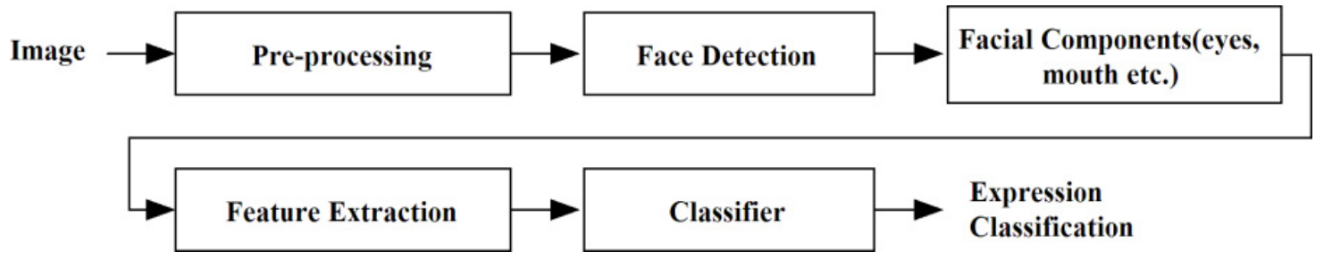
Methodology
Figure 1. The general pipeline of facial recognition systems.

Slide 10
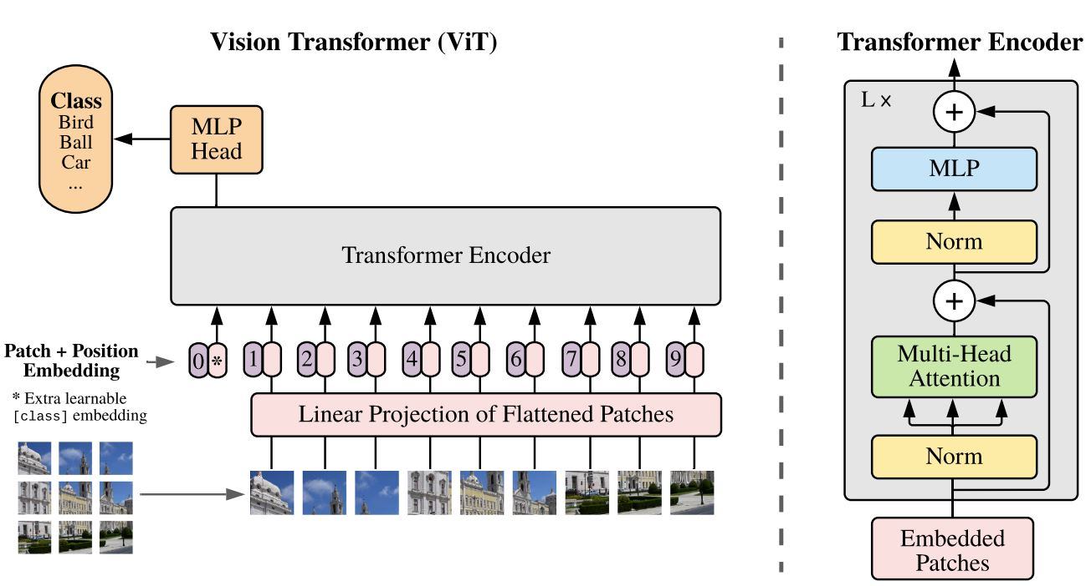
ViT architecture
Figure 2. The illustration of the Transformer encoder.(Image source: Fig. 1 in [7])

Slide 11
Attention vs Self-attention
Attention mechanism :
Attention was proposed by authors of the Encoder-Decoder network as an extension of it. It is proposed to overcome the limitation of the Encoder-Decoder model encoding the input sequence to one fixed-length vector from which to decode each output time step. This issue is believed to be more of a problem when decoding long sequences.
Self-attention mechanism:
The attention mechanism allows output to focus attention on input while producing output while the self-attention model allows inputs to interact with each other (i.e calculate attention of all other inputs with respect to one input).

Slide 12
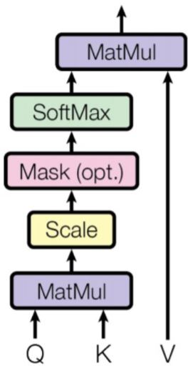
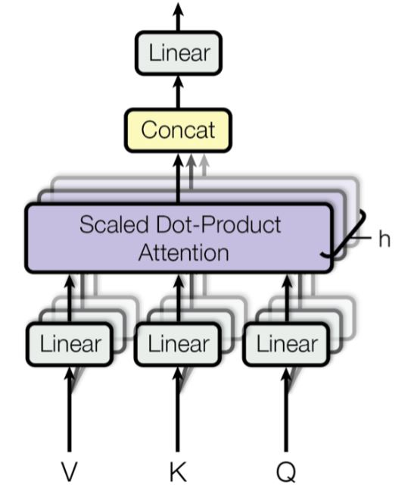

Attention mechanisms for FER
Figure 3: (left) Scaled Dot-Product Attention. (right) Multi-Head Attention consists of several attention layers running in parallel. (Image source: Fig. 2 in [7])

Slide 13
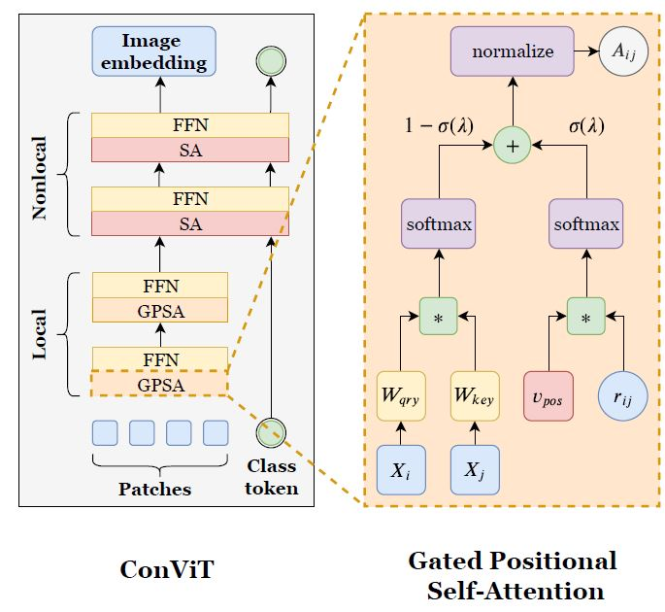
Vision Transformer models
Figure 4: Architectures of ConViT model. (Image sources: [8])

Slide 14
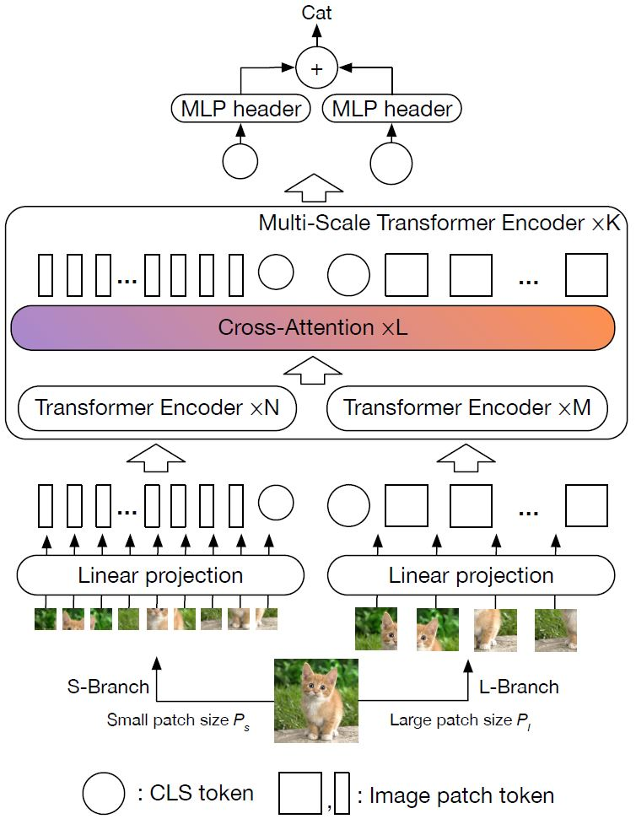
Vision Transformer models
Figure 5: Architectures of CrossViT model. (Image sources: [9])

Slide 15
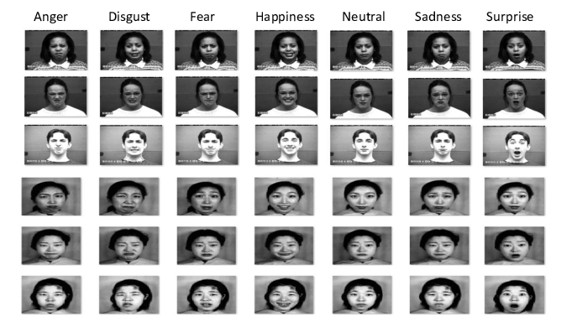
Datasets
CK+48
981 images
48x48 size
7 emotions
JAFFE
213 images
256x256 size
7 emotions
Figure 6. Sample images from CK+ and JAFFE datasets.

Slide 16
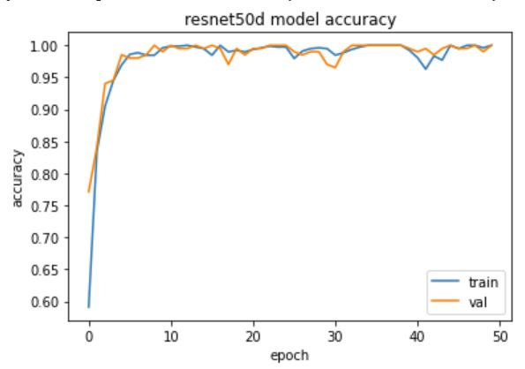
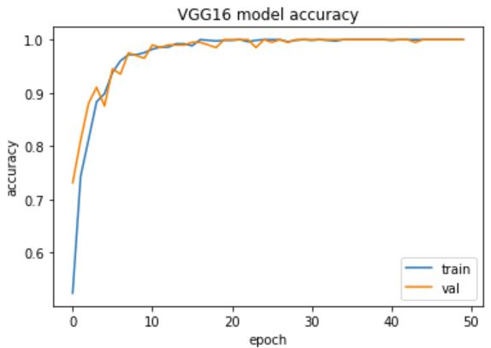
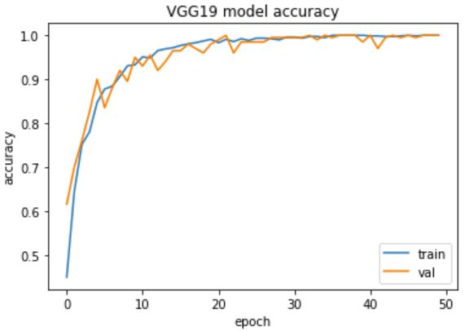
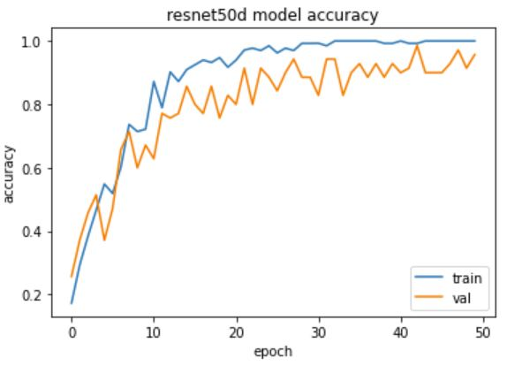
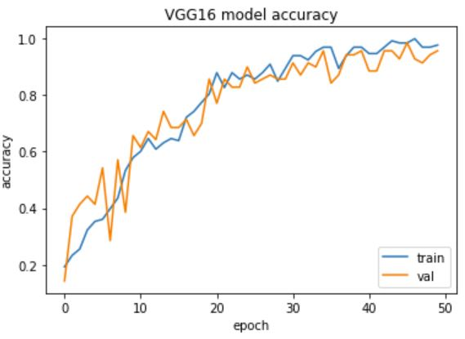
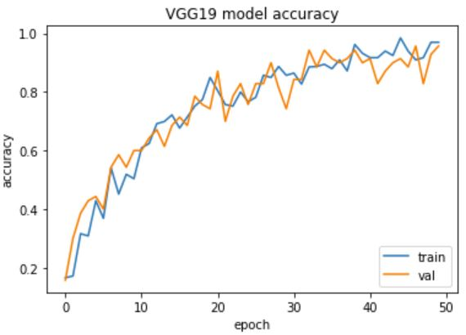
Experiments
CK+48
JAFFE
Experiments on ResNet50, VGG16 and VGG19 pre-trained models for CK+48(top) and JAFFE(bottom) datasets

Slide 17
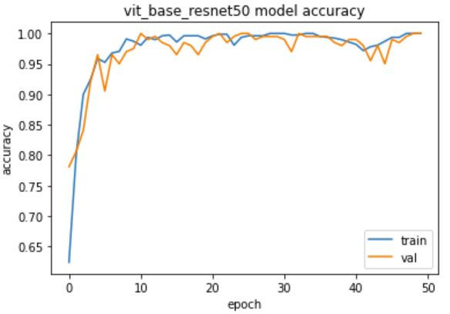
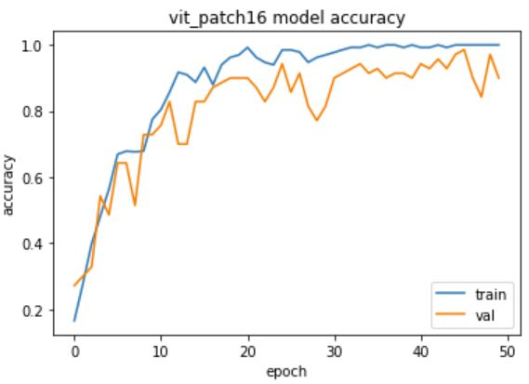
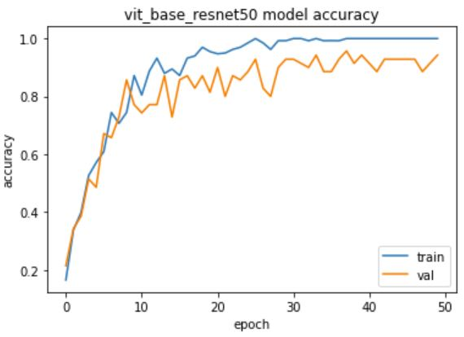
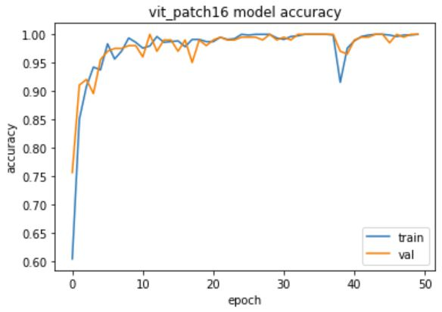
Experiments
CK+48
JAFFE
Experiments on vit_resnet50 and vit_patch16 models for CK+48(top) and JAFFE(bottom) datasets

Slide 18
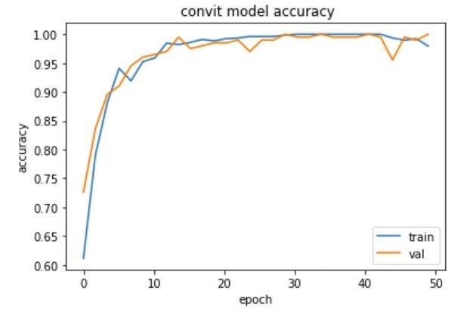
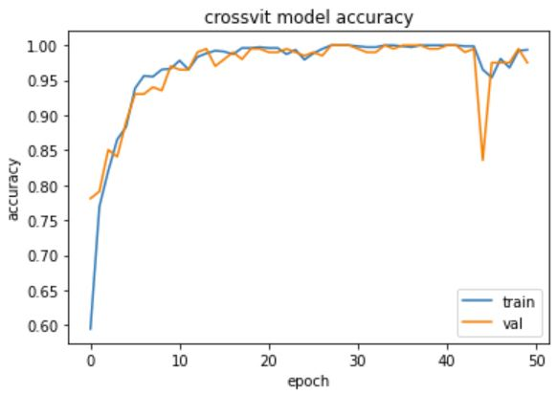
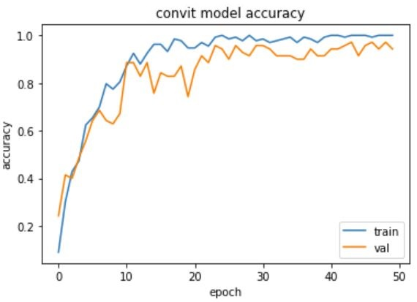
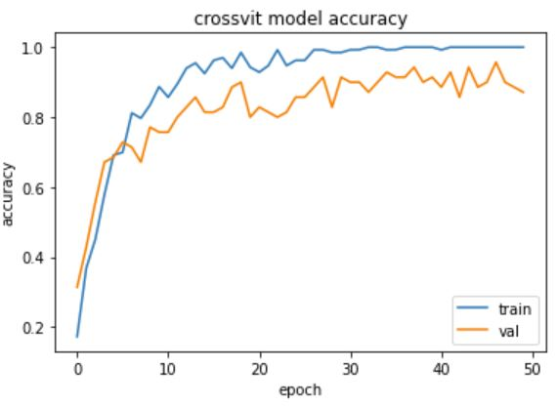
Experiments
CK+48
JAFFE
Experiments on ConViT and CrossViT models for CK+48(top) and JAFFE(bottom) datasets

Slide 19
Overall results

Slide 20
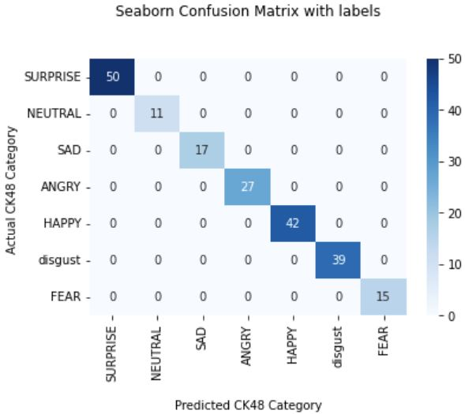
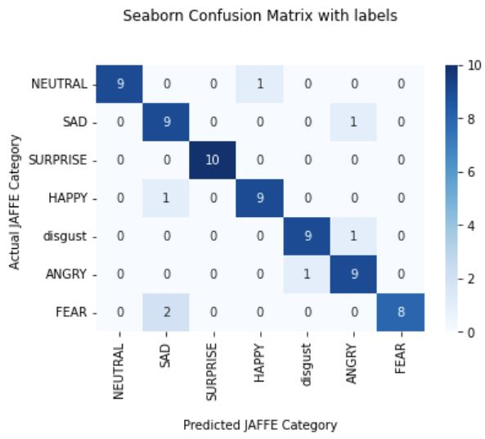
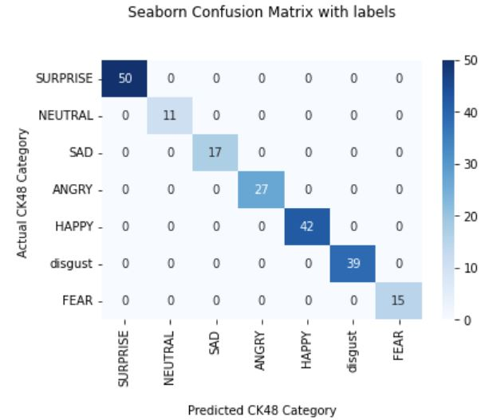
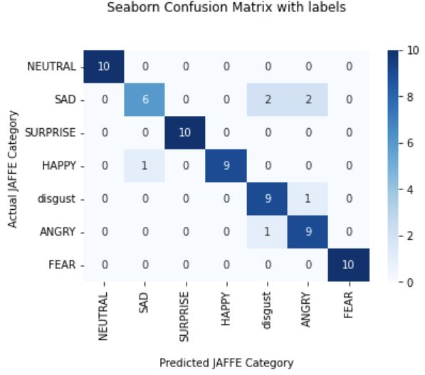
Experiments
Confusion matrices of ConViT and CrossViT models on CK+48(left side) and JAFFE(right side) datasets

Slide 21
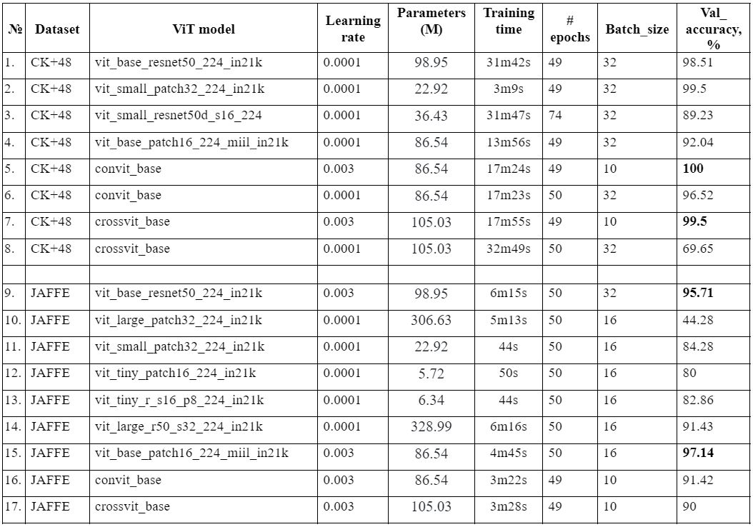
Experiments
Other experiments on ViT models for CK+48 and JAFFE datasets

Slide 22
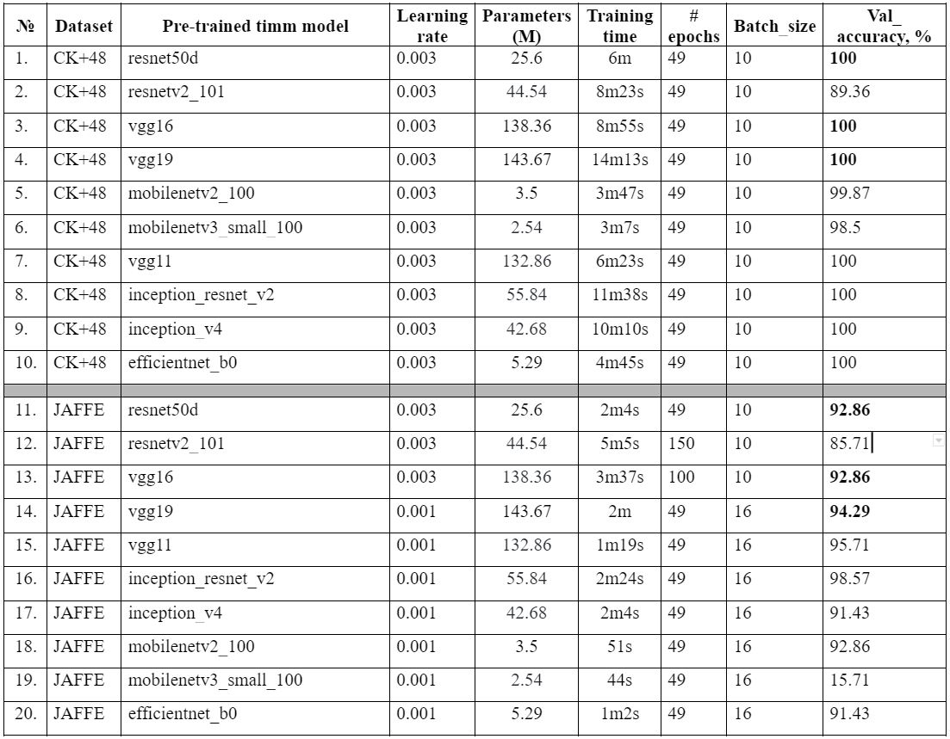
Experiments
Other experiments on ViT models for CK+48 and JAFFE datasets

Slide 23
Conclusion
The vision transformer model uses multi-head self-attention without requiring the image-specific biases.
ViT has a higher precision rate on a large dataset with reduced training time.
We tried to conduct an empirical study of different ViT models for FER:
  Best result for CK+48 dataset is 100% on Convit_base model were achieved;
  Best result for JAFFE dataset is 97.14% on Vit_base_patch16 model were achieved.
Further work
Further research can be carried out on larger datasets obtained in the wild conditions.

Slide 24
Reference
Mehrabian, A. (1971). Silent messages (Vol. 8, No. 152, p. 30). Belmont, CA: Wadsworth.
Tang, Y. (2013). Deep learning using linear support vector machines. arXiv preprint arXiv:1306.0239.
Dapogny, A., & Bailly, K. (2018, May). Investigating deep neural forests for facial expression recognition. In 2018 13th IEEE International Conference on Automatic Face & Gesture Recognition (FG 2018) (pp. 629-633). IEEE.
Ravi, A. (2018). Pre-trained convolutional neural network features for facial expression recognition. arXiv preprint arXiv:1812.06387.
Shan, C., Gong, S., & McOwan, P. W. (2009). Facial expression recognition based on local binary patterns: A comprehensive study. Image and vision Computing, 27(6), 803-816.
Chen, J., Chen, Z., Chi, Z., & Fu, H. (2014, August). Facial expression recognition based on facial components detection and hog features. In International workshops on electrical and computer engineering subfields (pp. 884-888).

Slide 25
Reference
Dosovitskiy, A., Beyer, L., Kolesnikov, A., Weissenborn, D., Zhai, X., Unterthiner, T., ... & Houlsby, N. (2020). An image is worth 16x16 words: Transformers for image recognition at scale. arXiv preprint arXiv:2010.11929.
d’Ascoli, S., Touvron, H., Leavitt, M. L., Morcos, A. S., Biroli, G., & Sagun, L. (2021, July). Convit: Improving vision transformers with soft convolutional inductive biases. In International Conference on Machine Learning (pp. 2286-2296). PMLR.
Chen, C. F. R., Fan, Q., & Panda, R. (2021). Crossvit: Cross-attention multi-scale vision transformer for image classification. In Proceedings of the IEEE/CVF international conference on computer vision (pp. 357-366).

Slide 26
Thank you for your attention!

