Slide 1
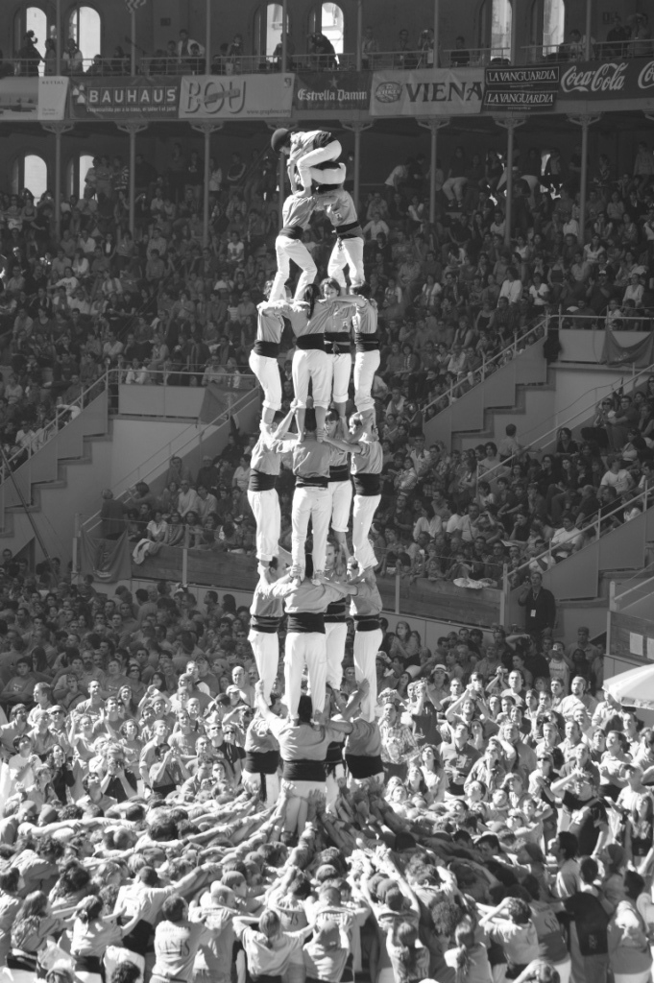



READY, SET, ACTION!
ENOEL Librarians at the crossway of Open Education
Paola Corti
pcorti@sparceurope.org
This image is a derivative of Concurs de castells Tarragona 2008 42. Castellers de Sants 4de8, by Ferran Llorens,, https://www.flickr.com/photos/vladu/263000095, CC BY-SA 2.0

Slide 2
Open = Free

Slide 3
Open = Free + permissions

Slide 4



OER
BASIC
What are open licences?
“Open licences respect the intellectual property rights of the copyright owner and provide permissions granting the public the rights to access, re-use, re- purpose, adapt and redistribute educational materials.”
From the UNESCO Recommendation on Open Educational Resources
https://tinyurl.com/openedrec
This slide is a derivative of OE benefits ENOEL slides by ENOEL, CC BY.”

Slide 5
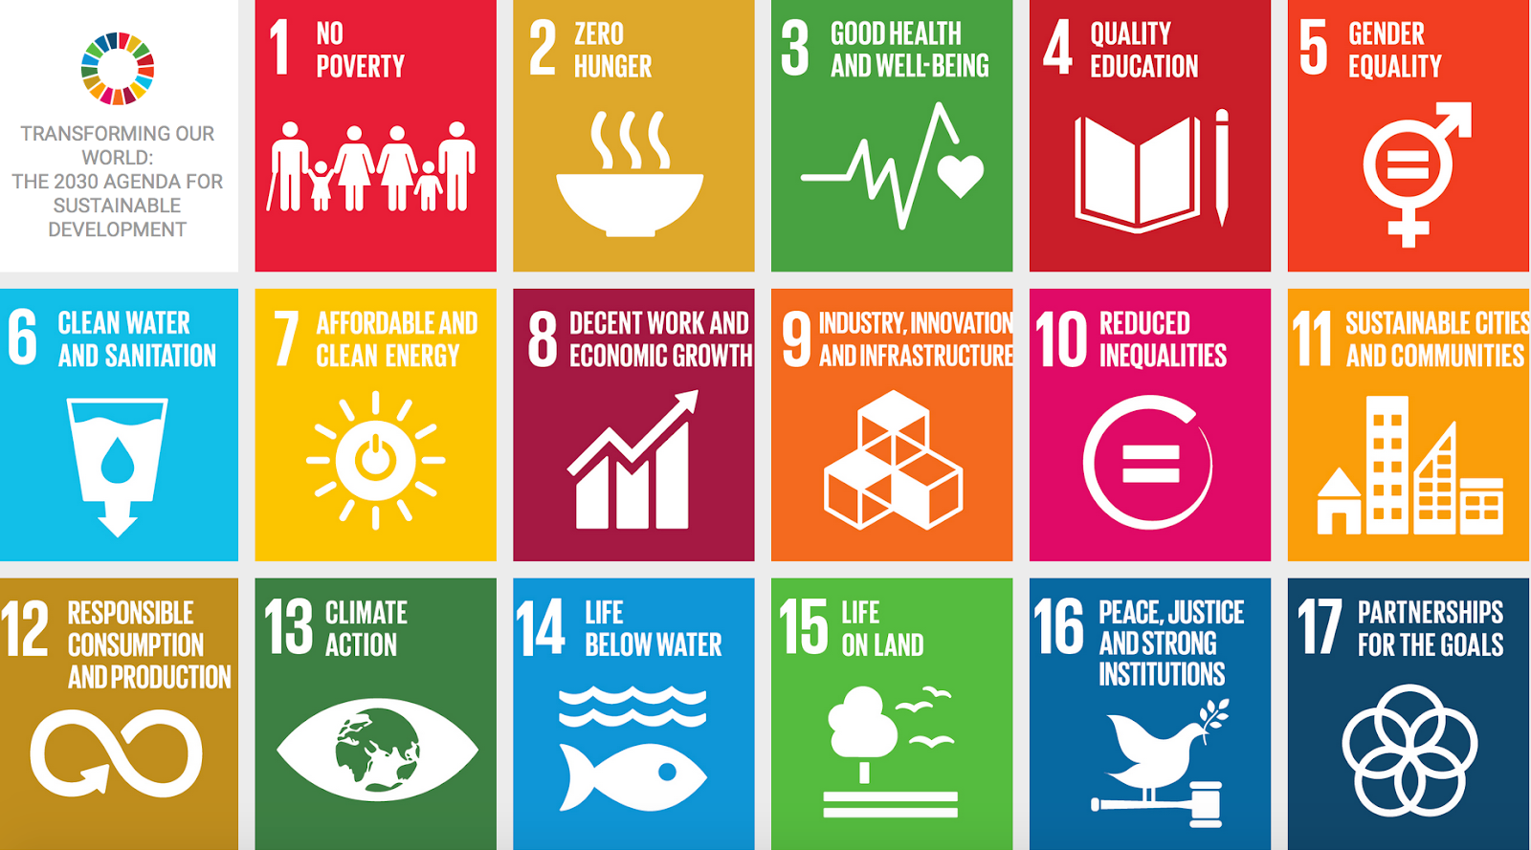

Slide 6





BY: (attribution) mention the author of the resource when it is reused;
SA: (ShareAlike) the resource derived from the original one must be shared with an identical CC license (no longer restrictive) or compatible with the original one;
NC: (NonCommercial) the resource can not be reused for commercial purposes;
ND: (NoDerivatives) it is not allowed to modify the resource in any way.
Creative Commons licenses: THE 4 ICONS
*https://creativecommons.org/licenses/?lang=en

Slide 7






CC-BY: (attribution) mention the author of the resource when it is reused;
CC-BY-NC (share-alike) the resource can be reused for not for profit purposes;
CC-BY-NC-SA: (ShareAlike) the resource derived from the original one must be shared with the same license and not for profit;
CC-BY-SA: the resource can be shared with an identical CC license (no longer restrictive) or compatible with the original one;
CC-BY-ND: (NoDerivatives) it is not allowed to modify the resource in any way;
CC-BY-NC-ND: (NonCommercial NoDerivatives) it is not allowed to modify the resource in any way and the resource can not be reused for commercial purposes.
Creative Commons licenses: 6 OPTIONS
*https://creativecommons.org/licenses/?lang=en

Slide 8


What degree of freedom?
Maximum
OER
not OER
Minimum

Slide 9
The 5 Rs: How to reuse OER?
RETAIN
You can make a copy and keep it
REUSE
You can reuse them in many ways
REVISE
You can adapt, modify and improve them according to your educational goals
You can combine two or more, yours or others, with compatible licenses
REMIX
REDISTRIBUTE
You can share with others
http://opencontent.org/definition

Slide 10
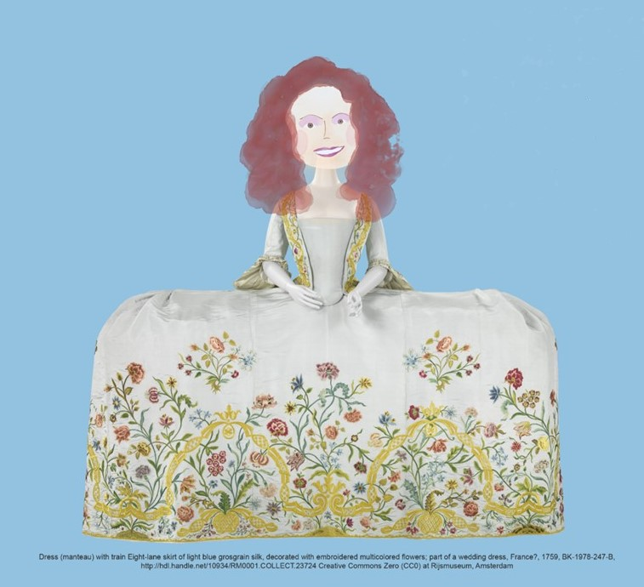
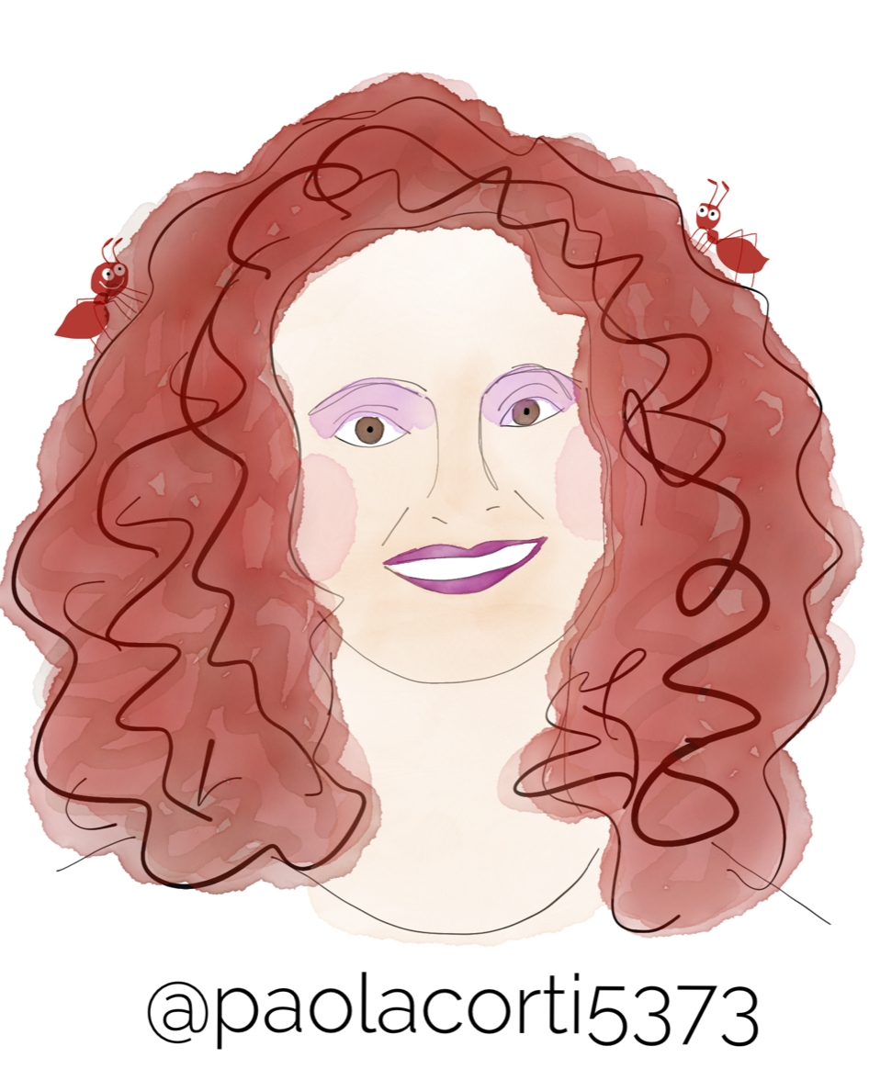
Meet me, as a remix
Me (with ants)
A gift from Chrissi Nerantzi
The dress

Slide 11
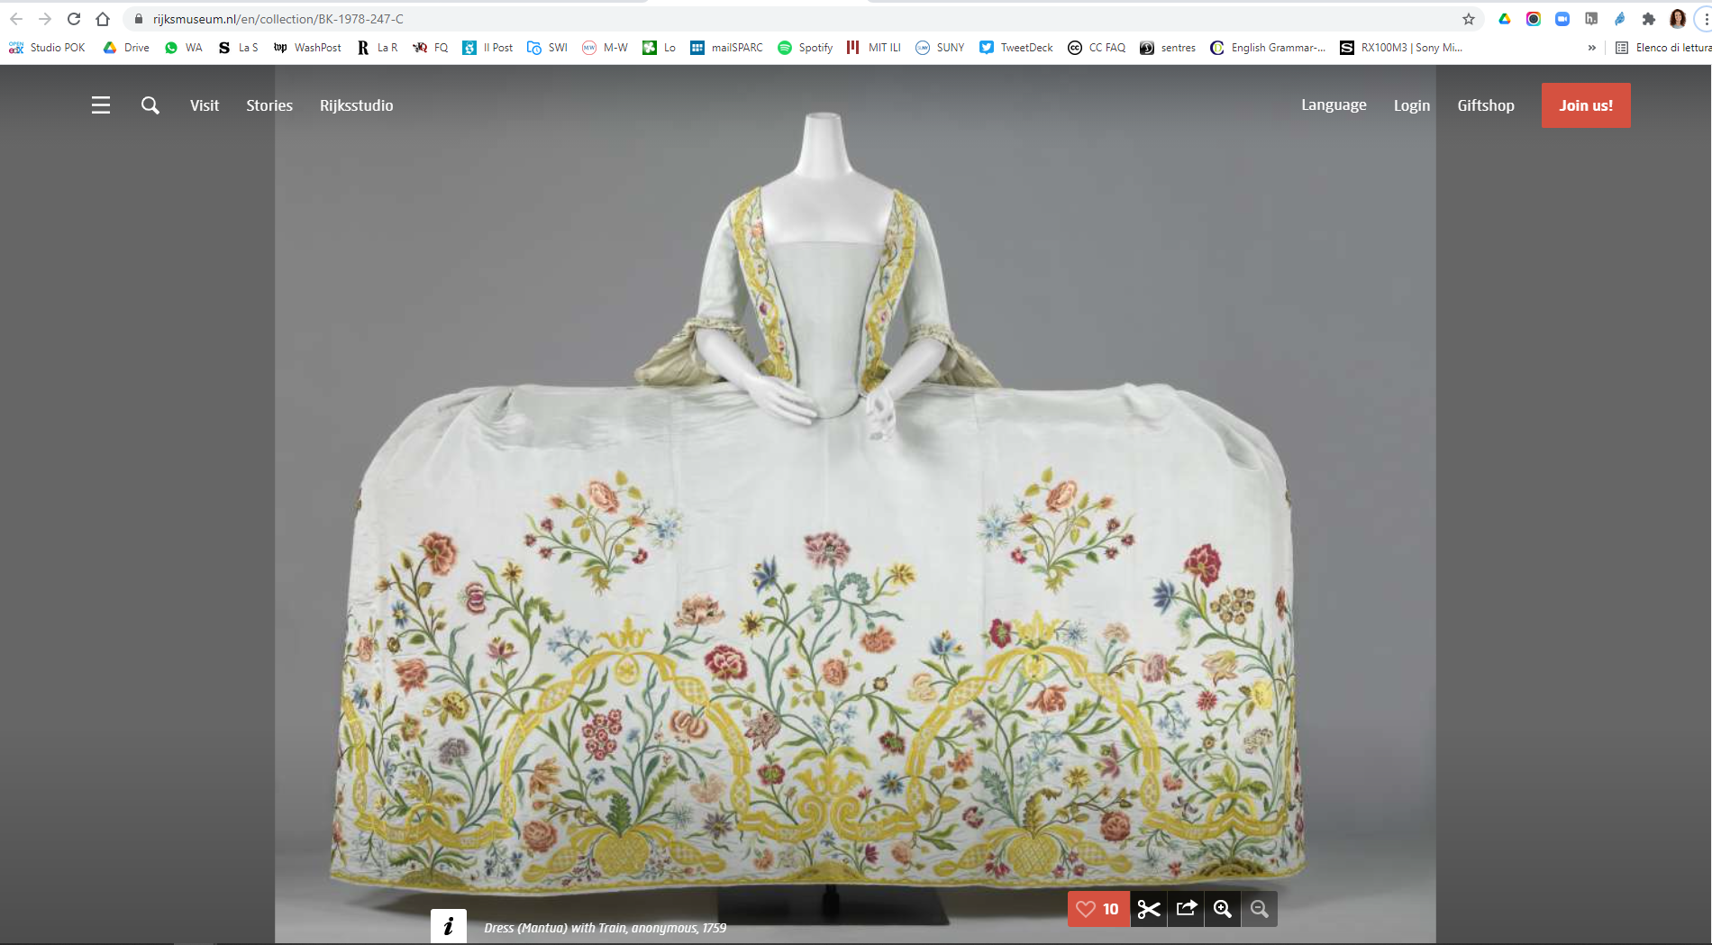

Slide 12
The UNESCO OER Recommendation
Action areas:
Building capacity of stakeholders to create access, use, adapt and redistribute OER;
Developing supportive policy;
Encouraging inclusive and equitable quality OER;
Nurturing the creation of sustainability models for OER
Facilitating international cooperation
Everyone is involved in implementing it, not only decision makers:
you are too!
https://www.unesco.org/en/legal-affairs/recommendation-open-educational-resources-oer

Slide 13
Librarians are PERFECT for OE
Often seen as a trusted partner in institution
Highly service-oriented
Facilitate access to knowledge
Roles changing from buyer to creator, curator, publisher, legal adviser, knowledge disseminator, etc.
Many already provide leadership in Open Science
Some already provide e-learning support
Increasing collaborating with other departments
Libraries as partners

Slide 14
In ENOEL we work together.
We meet monthly, record the meetings, collaboratively take notes
In ENOEL we share.
Members are willing to share experiences and ask for support from their peers beyond ENOEL activities.
In ENOEL we collaborate.
We work in subgroups with different goals at different levels, meeting both strategic and practical needs.
European Network of Open Education Librarians
https://sparceurope.org/what-we-do/open-education/enoel/

Slide 15

https://awards.oeglobal.org/awards/2022/open-collaboration/enoel/

Slide 16
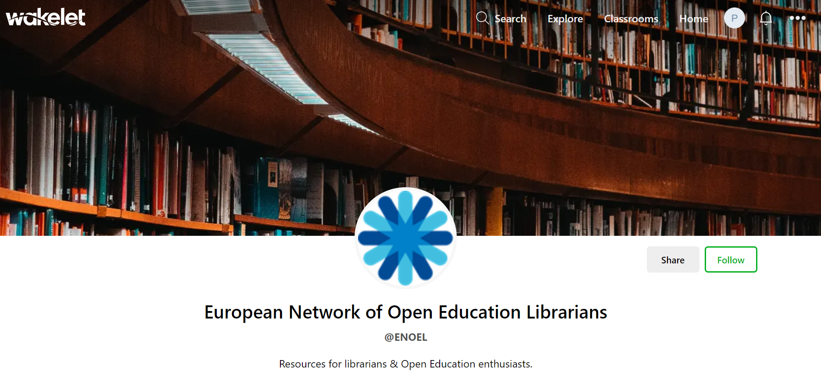
Open Education Resources from/for the Network
A Wakelet page with categories to identify resources coming from ENOEL and resources useful for its members, but also for anyone interested!
OE Resources from/for the network
Work in progress → OE Resources from/for the Network are consistently added https://wakelet.com/@ENOEL

Slide 17
REUSE AND ADAPT OUR RESOURCES!
Open = Free + permissions
THEY ARE ALL SHARED WITH AN OPEN LICENCE

Slide 18
Collaboration comes with challenges of its own
Not all librarians are comfortable with taking action at the same time
nor are they all always ready to actively contribute
or confident in formulating their thoughts in English as a second language.
These challenges can only be overcome through a welcoming and patient approach and the attitude to listen and include.
The ENOEL demonstrates this. Together we:
share ideas, problems, experiences and skills
negotiate along the way on what to do and how
pool efforts to solve common goals and challenges (busy but THERE!)
...and we enjoy our regular monthly meetings!
Challenges

Slide 19

Librarians in action for Open Education
Implementing the UNESCO OER Recommendation
Created in collaboration with ENOEL members and based on the UNESCO OER Rec.
The strategy focuses on the active role of librarians in:
helping increase awareness around OE
stimulating an OE culture
providing more support to implement Open Education in Higher Education institutions in various local contexts.
ENOEL Strategic Plan 2021-2023
May 2021
https://sparceurope.org/download/9718/

Slide 20

Open Education in European Libraries of Higher Education
The Report was published in November 2021.
Recommendations on how European librarians can support the implementation of the UNESCO OER Recommendation.
By the end of 2022 a new Report will be available.
SPARC Europe Survey 2021 Report
Nov 2021, > 1500 downloads https://zenodo.org/record/5734980

Slide 21
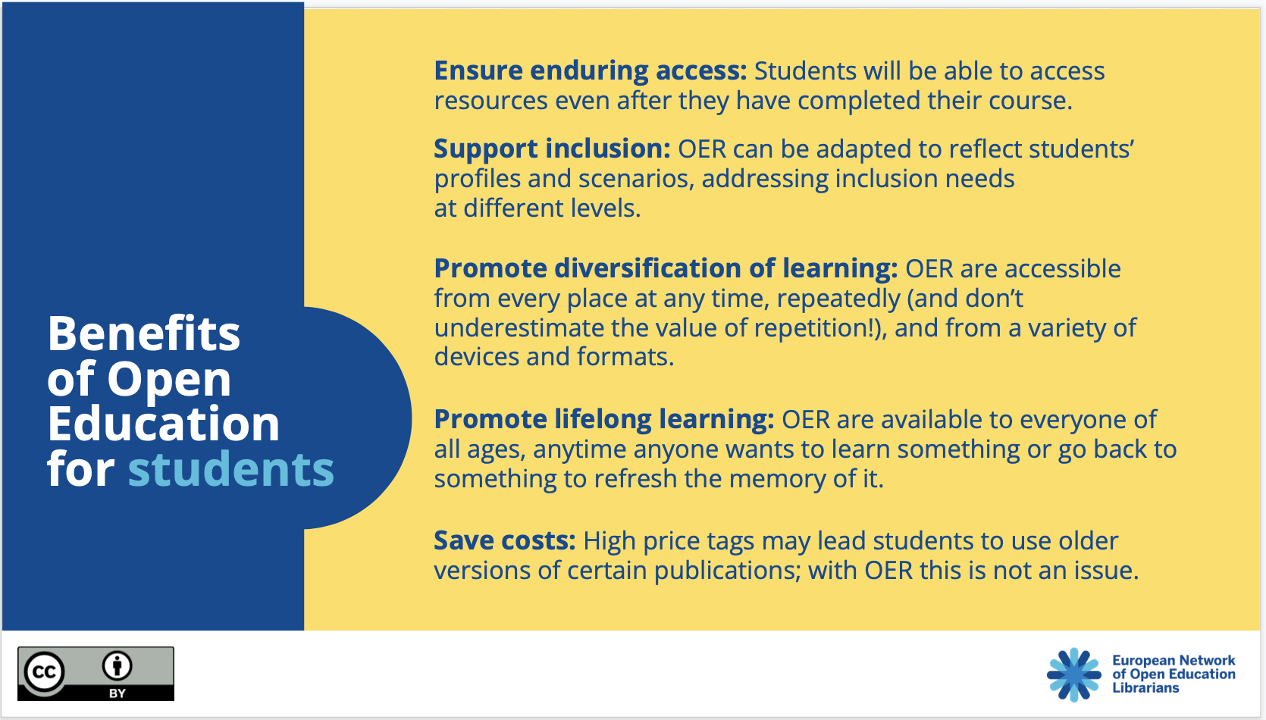
Open Education Benefits
ENOEL members created tools (Twitter cards, slides, leaflets) to be reused, adopted, adapted by the large audience (not only librarians) to advocate for open and to disseminate the UNESCO OER Recommendation.
OE Benefits
16 language versions (+ more)
> 1000 downloads, 16 languages available (+ more on the way, 2022) https://doi.org/10.5281/zenodo.5568482

Slide 22

“OE Champions” series of interviews
Key OE advocates for change and actors discuss
the importance of OE and share their experiences
in facilitating the creation of OER.
OE Champions
2022
OE Champions videos are collected in a playlist on ENOEL’s Youtube channel and added to the European Open Education Champions site https://openscholarchampions.eu/

Slide 23

“OE Café” series of online discussions
Key OE advocates for change and actors discuss
the importance of OE and share their experiences
in facilitating the creation of OER.
OE Café
2022 - Work in progress
OE Café video recordings are collected in a playlist on ENOEL’s Youtube channel here

Slide 24

“Open Mic” series of podcast episodes
In these podcast episodes ENOEL librarians dive into the UNESCO Recommendation on OER and its action areas.
Open Mic
podcast
2022 - Work in progress
OE Bite episodes are part of the Open Mic series and are collected in a playlist on ENOEL’s Youtube channel here

Slide 25

“ENOEL practitioners under the spotlight”
webinar series
ENOEL members guide us through their personal journeys with OE. It is a space for network members to ask questions, to get to know each other better and learn from one another.
Under
the Spotlight
Work in progress → 4 episodes so far (next one in Aug 22) https://www.youtube.com/channel/UC5Wtl726waSHbBgCbaHNWrQ/playlists

Slide 26
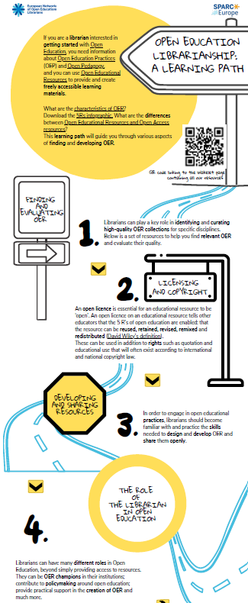
Open Education Learning path for European librarians
We need to adapt resources to our settings and take into account language-related issues.
Expected output: a curated list of resources
Plus - in time - an adaptation of some resources that speak more closely to our needs in Europe
OE learning path for EU librarians
The graphic version of the learning path was published in September 2022 https://zenodo.org/record/7051088 with a CC BY 4.0 licence

Slide 27

“OE Drops” short videos series
Very short videos explaining the basics of Open Education, to accompany newcomers while drinking a coffee, commuting, walking or taking a break.
OE Drops
Work in progress → OE Drops are collected in a playlist on the ENOEL’s Youtube channel

Slide 28
How librarians can help implement the UNESCO OER Recommendation
Capacity building
  Advocate for OE across the institution, showcase good practices and OE champions
  Share and provide access to existing OERs
  Build on optimising connected repositories
Inclusive, equitable accessible, quality OER
  Help create a multilingual federated discovery system for OER, using open standards and formats
Areas of action for librarians

Slide 29
How librarians can help implement the UNESCO OER Recommendation
Policy
  Provide an evidence base for policy-making
  Engage in policy-making (institutional & national)
Sustainability
  Optimise OER as public good through new models
  Engage with publishers/service providers to Open
Areas of action for librarians

Slide 30
SPARC (NA)
UNESCO Dynamic Coalition
OE Global
Creative Commons
Network of Open Orgs
LIBER WG on Educational Resources
The European Commission
LERU Subgroup on OE
EUA
…ARE YOU NEXT? YOU ARE WELCOME!
Collaboration

Slide 31
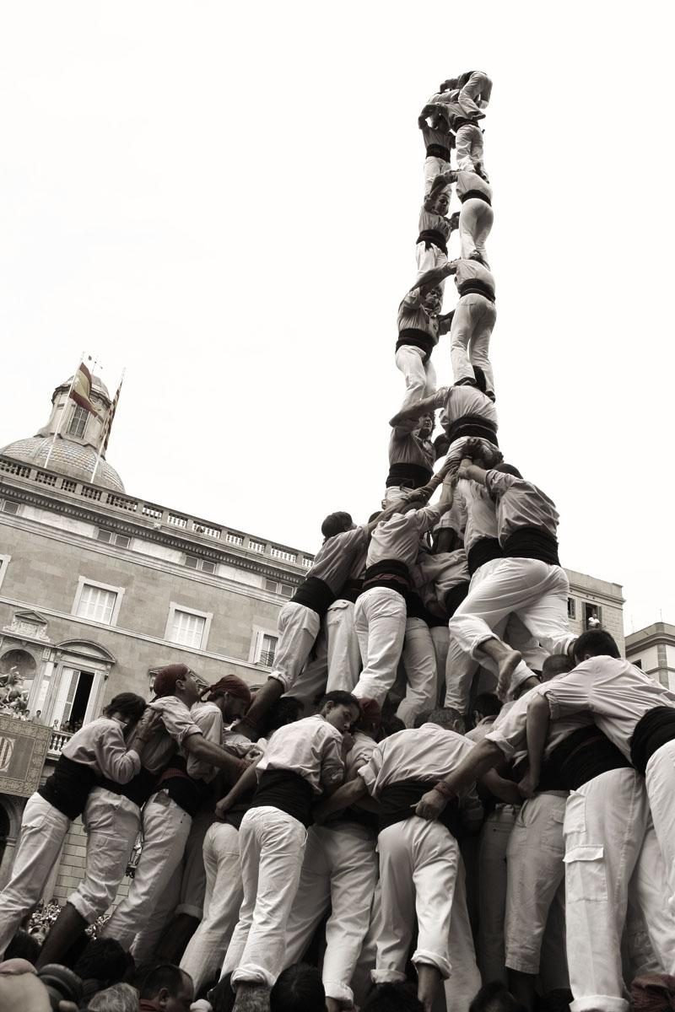
THANK YOU!
Paola Corti, SPARC Europe
pcorti@sparceurope.org
Except where otherwise noted, this work is licensed under CC BY 4.0.
Image: Building a human tower, Vlad Socaciu, https://www.flickr.com/photos/vladu/263031211, CC BY-NC-SA 2.0

