Slide 1

Equity for motherscholars: A qualitative systematic review of theses/dissertations
Zhanna Izekenova, PhD student
Almira Tabaeva, Researcher

Slide 2

Presentation outline
Contributors & Applications used
Rationale for the Study
Methodology
Data collection & Stages of Analysis
Findings - Descriptive Data
Findings - Thematic Analysis
Discussion, Limitations and Further Research
Q&A

Slide 3
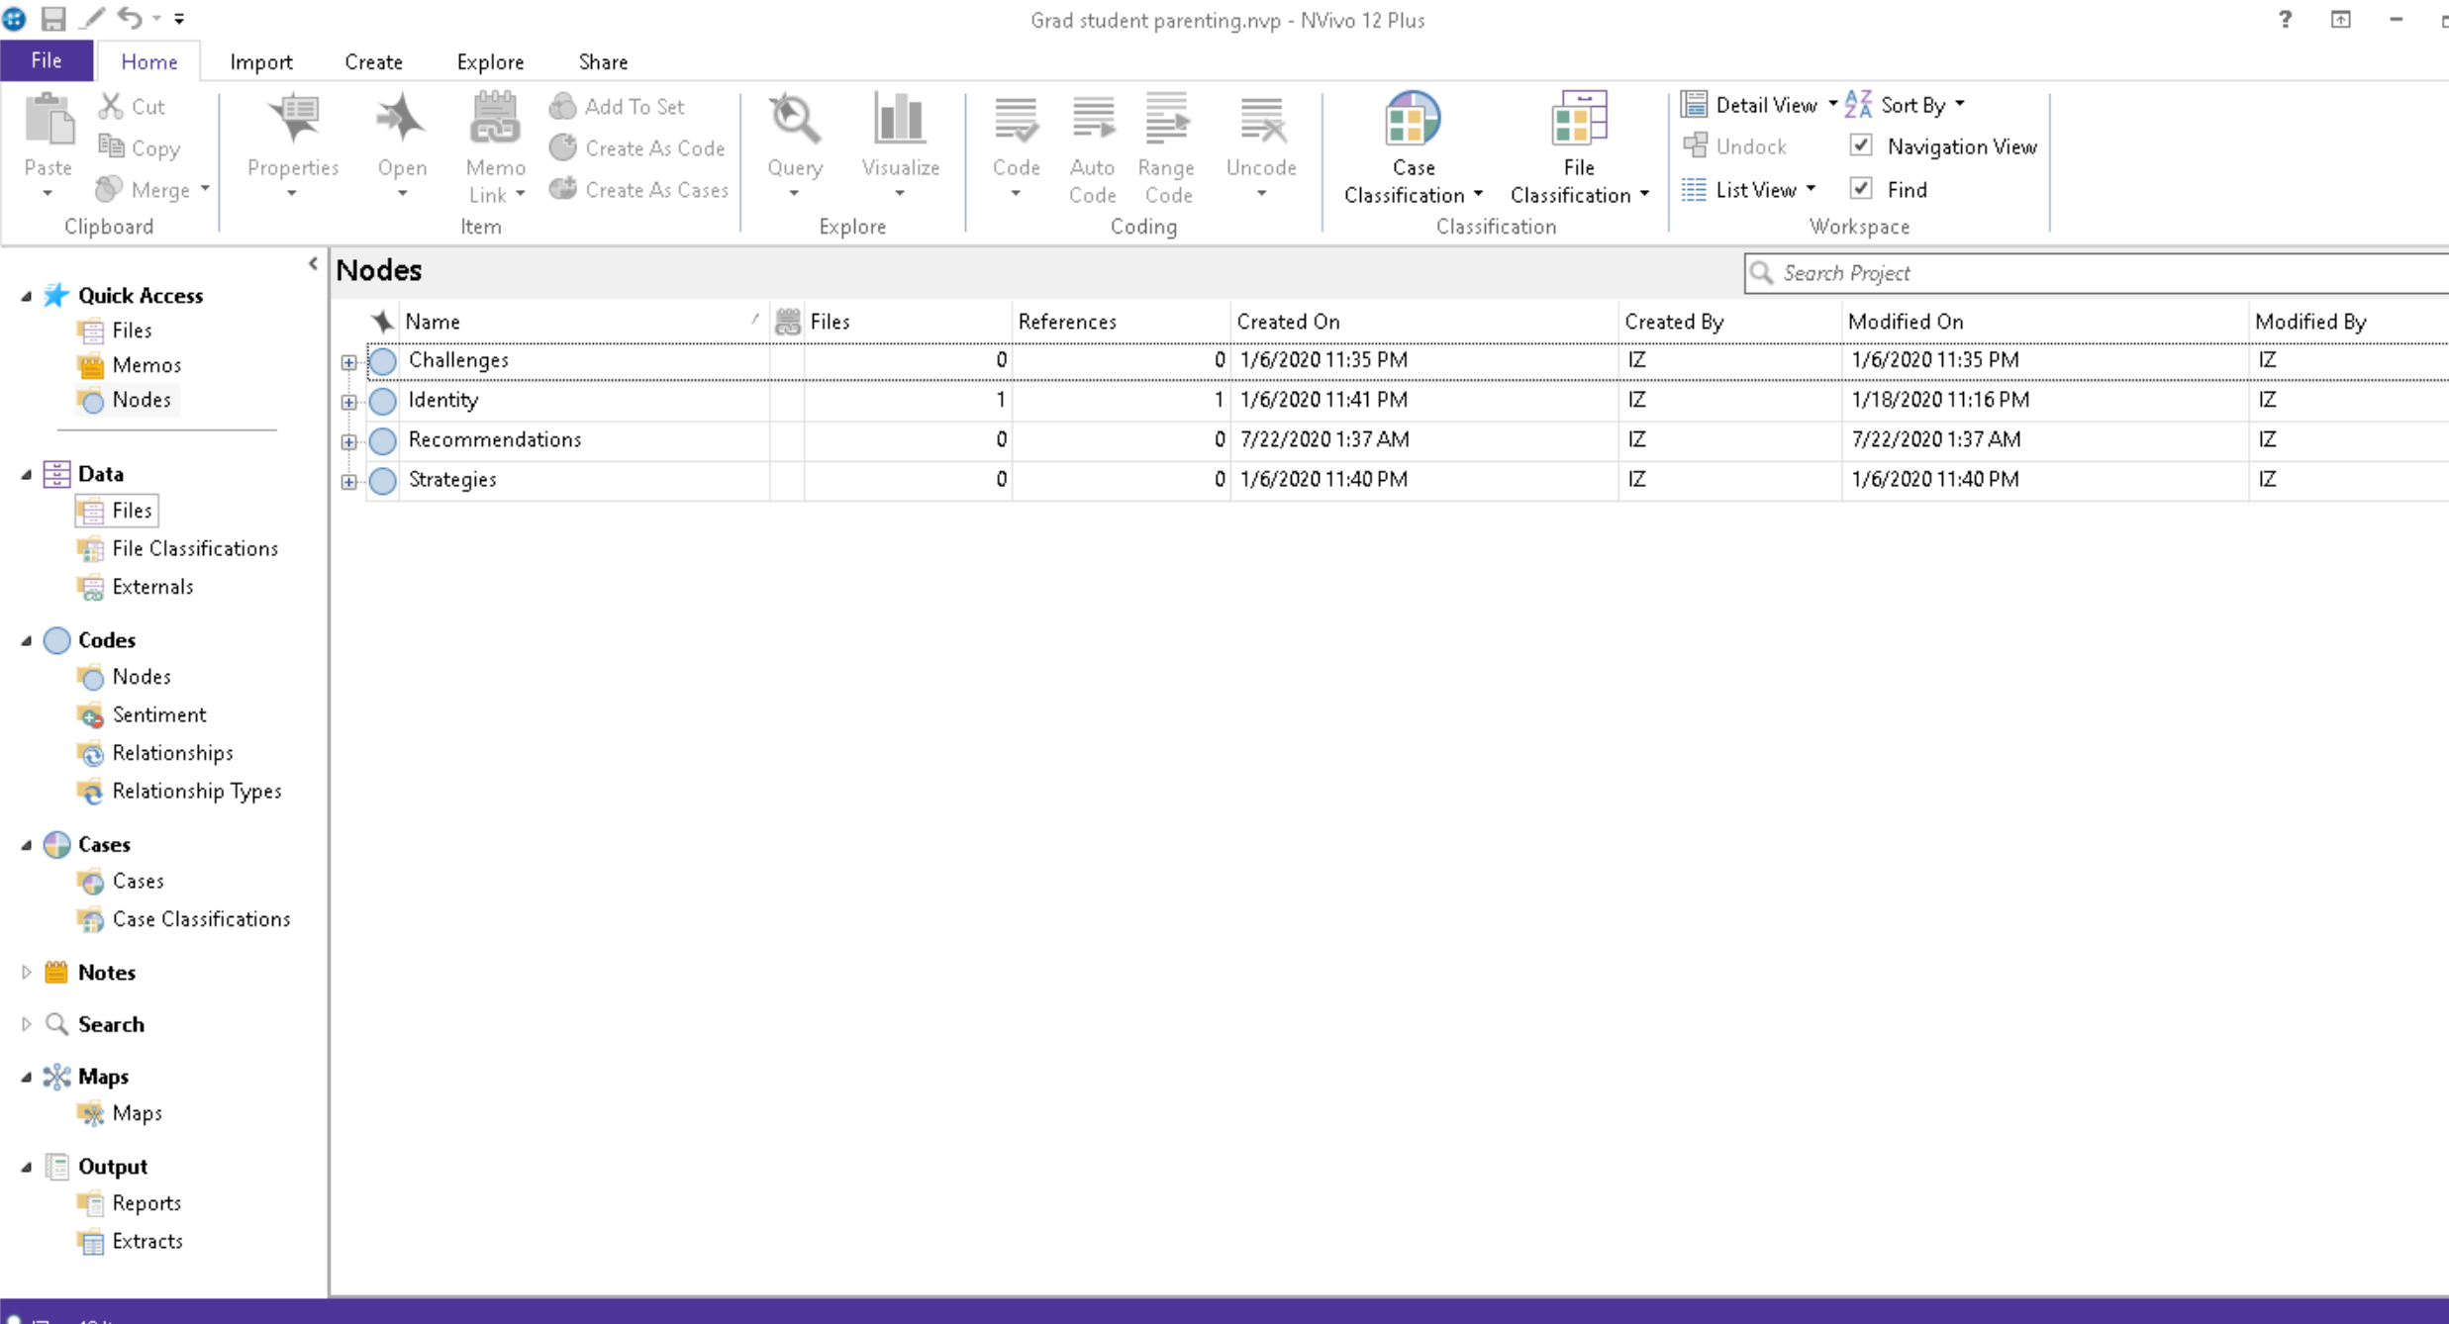
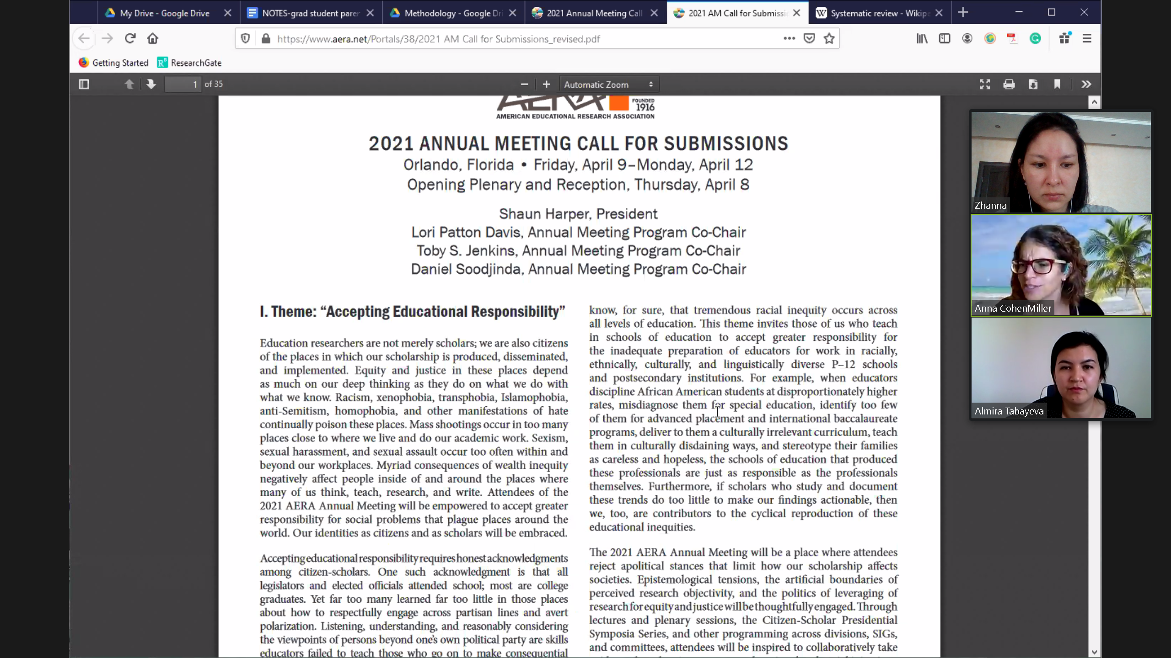
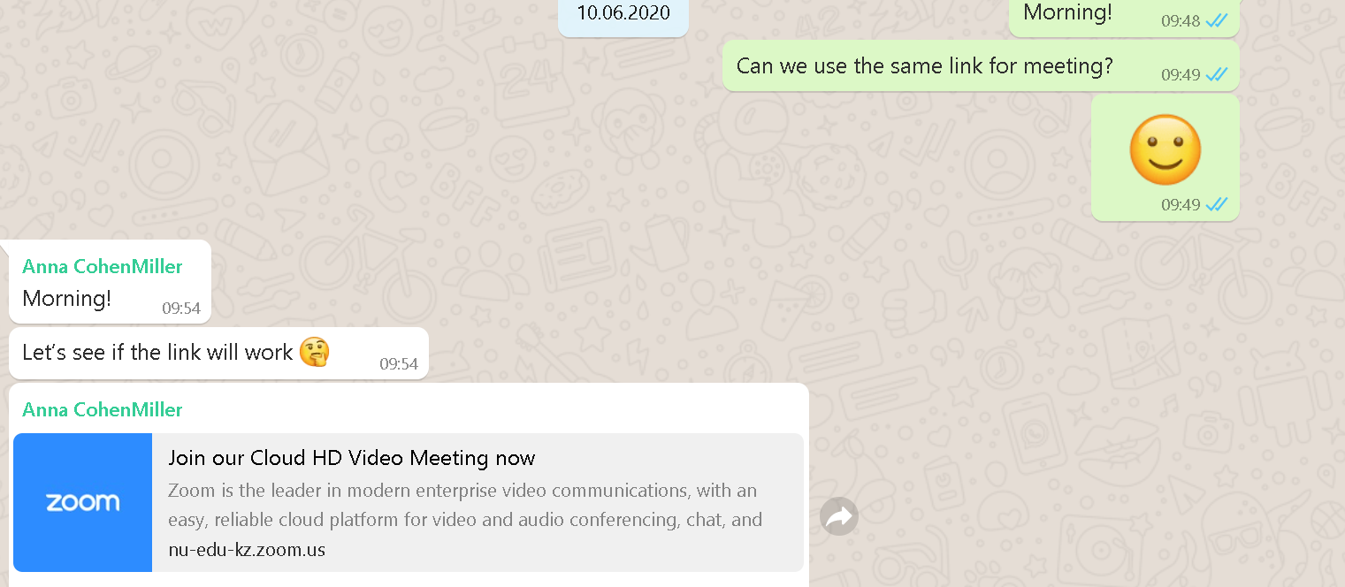
Contributors & Applications used
1. Pr. Anna CohenMiller
2. Zhanna Izekenova
3. Almira Tabaeva
WhatsApp
Zoom
Google Drive
NVivo

Slide 4
Rationale for the study
Graduate motherscholars (CohenMiller, 2014; Gabster et al., 2020)
Academic pipeline leaks, especially for graduate mother students (Main et al., 2019; Kulp, 2019)
Higher demands in academia (Curry & Lillis, 2017; Schulze-Cleven & Olson, 2017)
Reduced mobility, parental duties, and financial instability (Comer & Stites-Doe, 2006; Ward & Wolf-Wendel, 2004)
Covid-19 (O’Reilly, 2020; Willey, 2020)

Slide 5
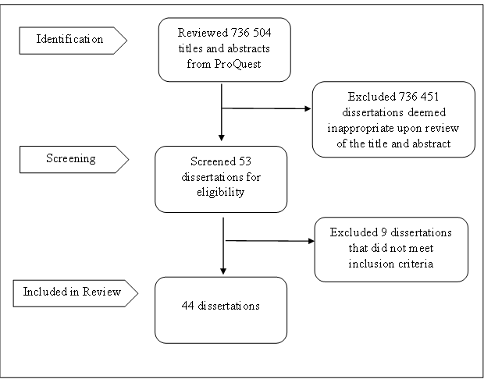
Methodology
ProQuest Theses and Dissertations Database
Key terms:
mother, motherhood, parent, parenthood, graduate, scholar, academia, student, children.
PRISMA flow chart of the search and selection process (Moher et al., 2009)

Slide 6
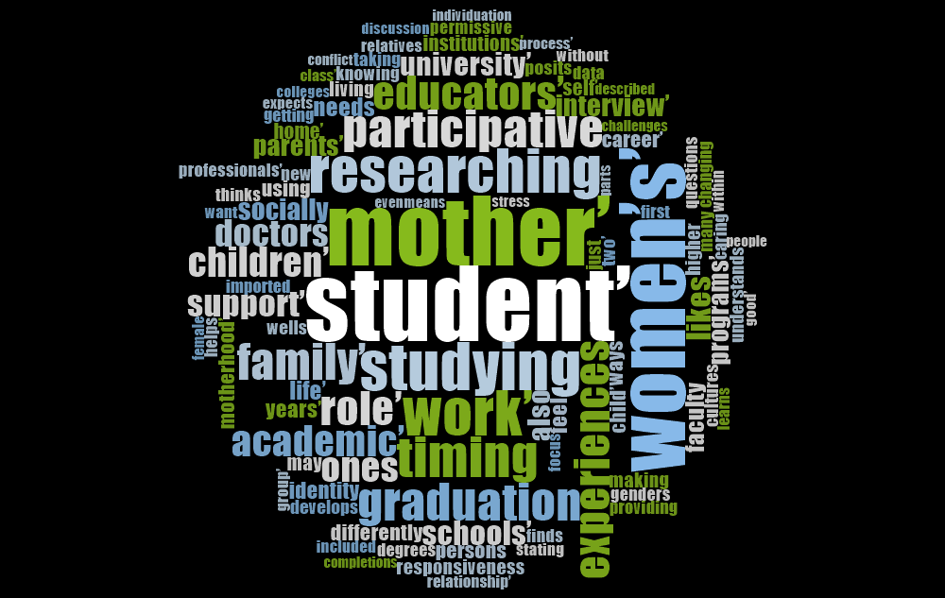
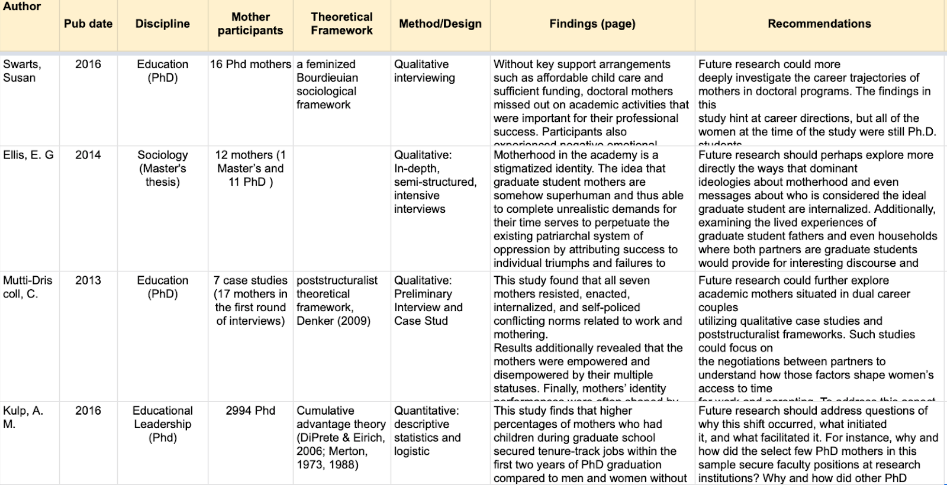
Data collection & Stages of analysis
Shared Google Sheet
NVivo Word Cloud

Slide 7

Findings - Descriptive data
Research design
Research methods and data collection
Theoretical framework
Number of participants
Participant background (e.g., marital status, racial/ethnic background) Children’s age range
Geographic location of the institution and data collection.

Slide 8
Findings - Cumulative growth of dissertations / theses from 1997-2020

Slide 9

Findings - Thematic Analysis
Theme 1: Navigating challenges internally and externally;
Theme 2: Negotiating identity
Theme 3: Developing strategies to survive in academic contexts.

Slide 10
Discussion, Limitations and Further Research
Proposed Solutions:
parental leave policies
part time options
flexible funding
health insurance coverage
systematic institutional policies
Recommendations for further research: to include
single parents
b.
non cis-gendered students
c.
from varied ethnic/racial background
d.
areas outside the US
a.

Slide 11
Thank you for attention!
Q&A

