Slide 1
Student Media and Information Literacy Competencies:
Addressing Today’s Online Risks
Lisa Janicke Hinchliffe
Professor, University of Illinois at Urbana-Champaign
ljanicke@illinois.edu
Presented during MIL Day – Hosted by Nazarbayev University Library

Slide 2
Media and Information Literacy
Empowerment of people through Media and Information Literacy (MIL) is an important prerequisite for fostering equitable access to information and knowledge and promoting free, independent and pluralistic media and information systems.
Media and Information Literacy recognizes the primary role of information and media in our everyday lives. It lies at the core of freedom of expression and information - since it empowers citizens to understand the functions of media and other information providers, to critically evaluate their content, and to make informed decisions as users and producer of information and media content.
http://www.unesco.org/new/en/communication-and-information/media-development/media-literacy/mil-as-composite-concept/

Slide 3
DEFINITION
MIL is defined as a set of competencies that empowers citizens to access, retrieve, understand, evaluate and use, create, as well as share information and media content in all formats, using various tools, in a critical, ethical and effective way, in order to participate and engage in personal, professional and societal activities.”
http://uis.unesco.org/sites/default/files/documents/global-media-and-information-literacy-assessment-framework-country-readiness-and-competencies-2013-en.pdf

Slide 4
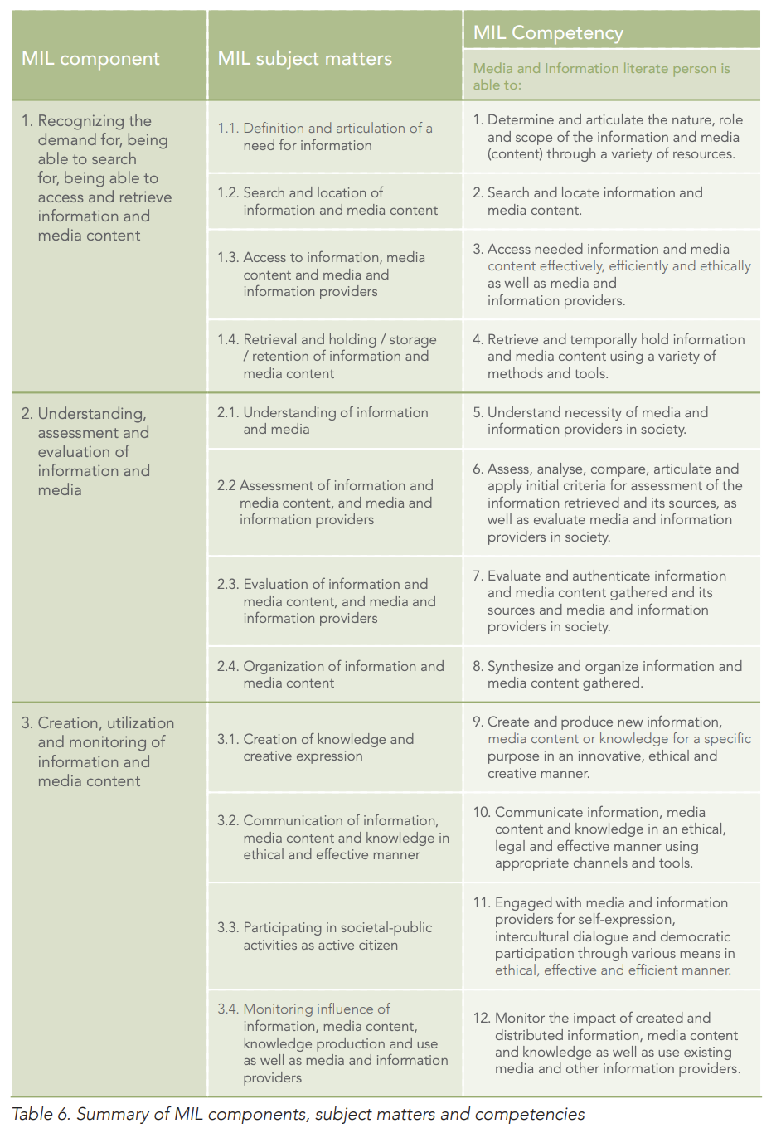
Competencies
http://uis.unesco.org/sites/default/files/documents/global-media-and-information-literacy-assessment-framework-country-readiness-and-competencies-2013-en.pdf

Slide 5
A virtue is a “mean” or “intermediate” between two extremes. The extremes are typically excess and deficiency.
Aristotle

Slide 6
MIL as Virtue
Discerning and Thoughtful
Naïve
Cynical

Slide 7
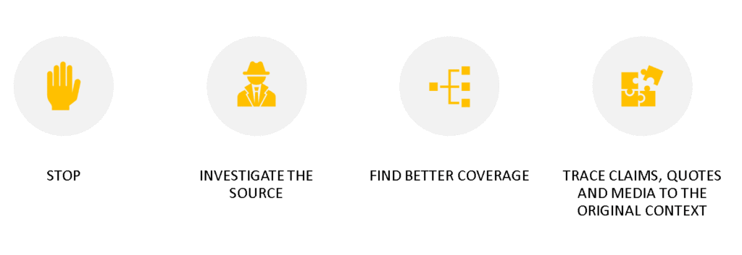
SIFT Method by Mike Caulfield
https://infodemic.blog/

Slide 8
Closing Thoughts
Learning is an Iterative Process
Requires Scaffolded Pedagogy
Do Not Trade Naïve for Cynical
MIL Alone is Insufficient

Slide 9
Thank You!
Lisa Janicke Hinchliffe
Professor, University of Illinois at Urbana-Champaign
ljanicke@illinois.edu
Presented during MIL Day – Hosted by Nazarbayev University Library

