Slide 1
A Deep Learning Approach for
Drug-Target Affinity Prediction
Presenter:
Thesis Supervisors:
Albina Li
Prof. Siamac Fazli
Prof. Ferdinand Molnár

Slide 2
Introduction

Slide 3
Introduction
Development of a de novo drugs can cost up to 2.6 billion dollars and it takes 10-17 years for it to develop a marketable drug that is approved by the FDA
Drug repurposing where approved drugs with established safety and efficacy are used for purposes they were not originally developed for becomes a great alternative
The crucial part is to identify how already established drugs may work on the target of interest
Traditional screening methods either in vivo or in vitro are expensive and time consuming, so there is a demand in the development of in silico computational methods

Slide 4
Related work
Initially methods in literature approached the problem as a binary classification - information on how strong the interaction between compound and target is neglected
Binding affinity descriptor is the strength of the binding interaction, it can be expressed by various means such as a dissociation constant (𝐾𝑑), inhibition constant (𝐾𝑖) or half maximal inhibitory concentration (IC50)
KronRLS and SimBoost
(similarity based methods)
DeepDTA
(deep learning based method)
WideDTA, MT-DTI, PADME (CNN based)
GANsDTA, DeepCDA (GAN/LSTM based)
GraphDTA, DGraphDTA (GNN based)
Figure 1. Development of drug-target affinity prediction methodologies

Slide 5
Motivation
Although the topic of drug-target affinity prediction is relatively new, it attracts a lot of attention
Most of the methods do not exploit available chemical properties enough
There is a trend of integrating additional qualitative chemical descriptors into the models, which results in the enhanced predictive performance
There are more directions to explore, in terms of experimenting with chemical or functional descriptors
Notes:
10 min

Slide 6
Methodology

Slide 7
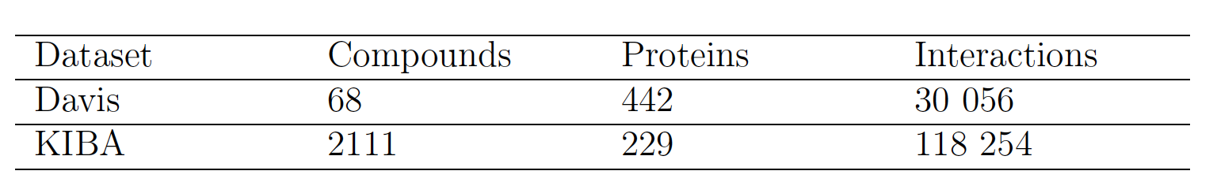
Methodology: Datasets
Davis and KIBA datasets, large-scale biochemical selectivity assays of kinase inhibitors, benchmark datasets in the field of drug-target affinity prediction
Drug-target interactions in Davis are expressed by dissociation constant (𝐾𝑑), transformed to logarithmic space (p𝐾𝑑) for numerical stability
KIBA uses a novel bioactivity score called KIBA score that statistically combines all known values in terms of dissociation constant (𝐾𝑑), inhibition constant (𝐾𝑖) or half maximal inhibitory concentration (IC50) values to normalize the mutual consistency
Table 1. Summary of Davis and KIBA datasets

Slide 8
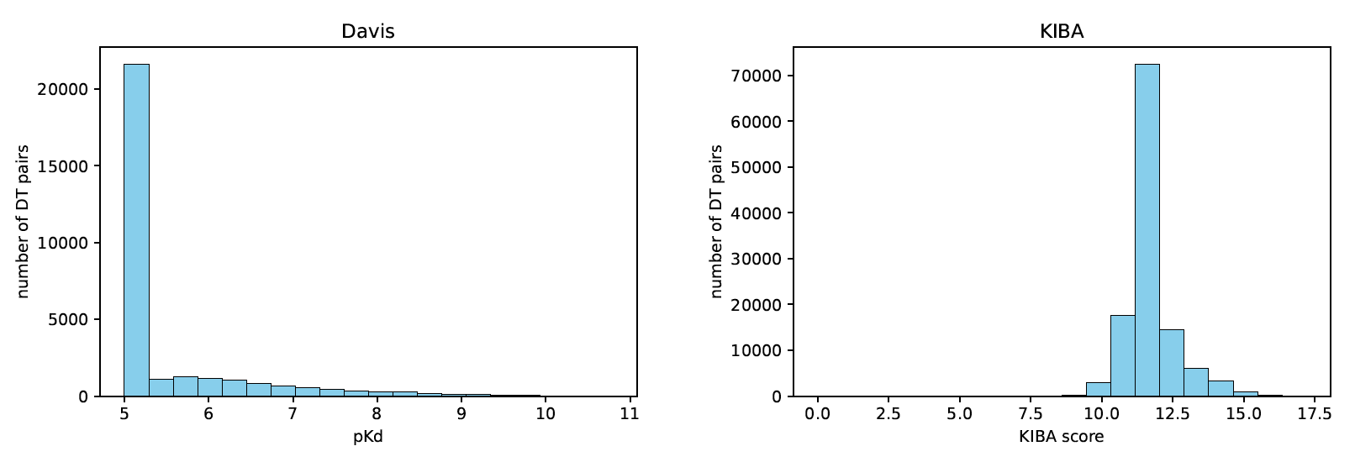
Methodology: Datasets
Figure 2. The distribution of binding affinity values dor Davis (left panel) and
KIBA (right panel) datasets

Slide 9
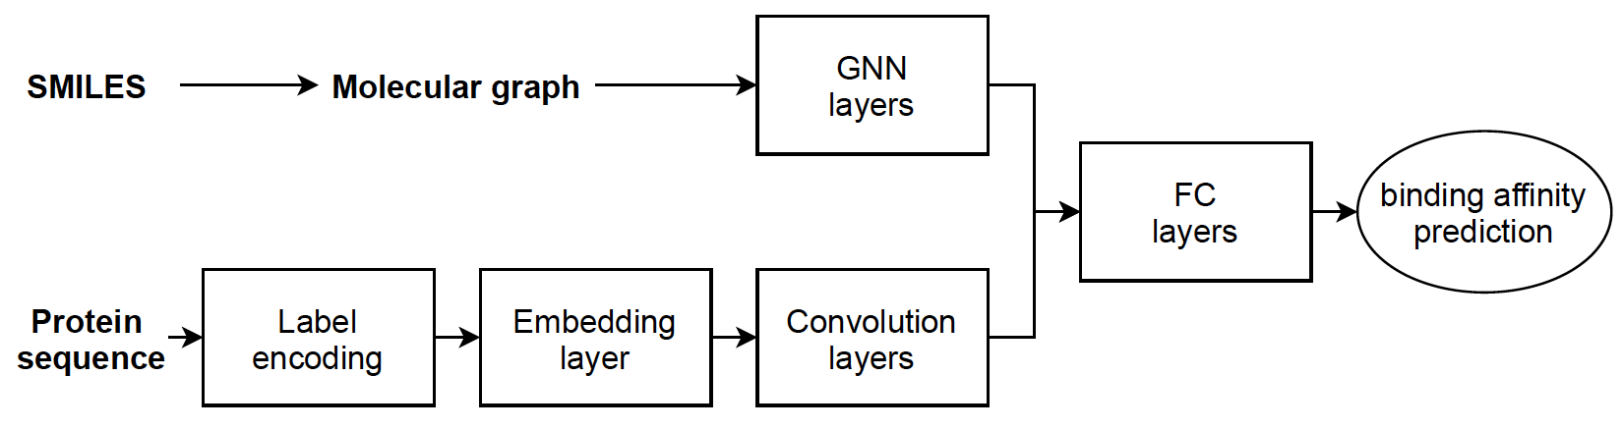
Methodology: Baseline Model
Figure 3. Baseline model (GraphDTA)

Slide 10
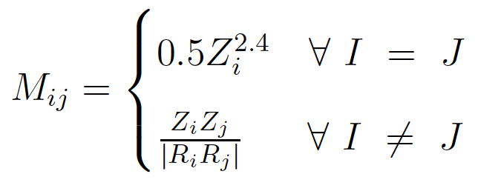
Methodology: Molecule Representation
Molecular graph
each node is described by five atomic properties: atom symbol, atom degree, total number of Hydrogen atoms, implicit value of atom, and aromaticity of atom
edges are added between any pair of atoms if there exists a bond between them
Coulomb matrix
mimics the electrostatic interaction between nuclei
requires a set of nuclear charges Z_{i} and corresponding Cartesian coordinates R_{i}
Other molecular descriptors
33 various descriptors such as exact molecular weight, number of aromatic rings, number of rotatable bonds are calculated

Slide 11

Methodology: Protein Representation
Integer/label encoding
each amino acid in a protein sequence is encoded with a distinct integer
Amino acid scales encoding
defined by a numerical value assigned to each type of amino acid
based on different chemico-physical properties of the amino acids
11 amino acid scales are used
Motifs and domains
specific regions within the protein sequence, which may be important for folding, binding, catalytic activity and thermodynamics
three-residue “words” are extracted and encoded with distinct integers

Slide 12
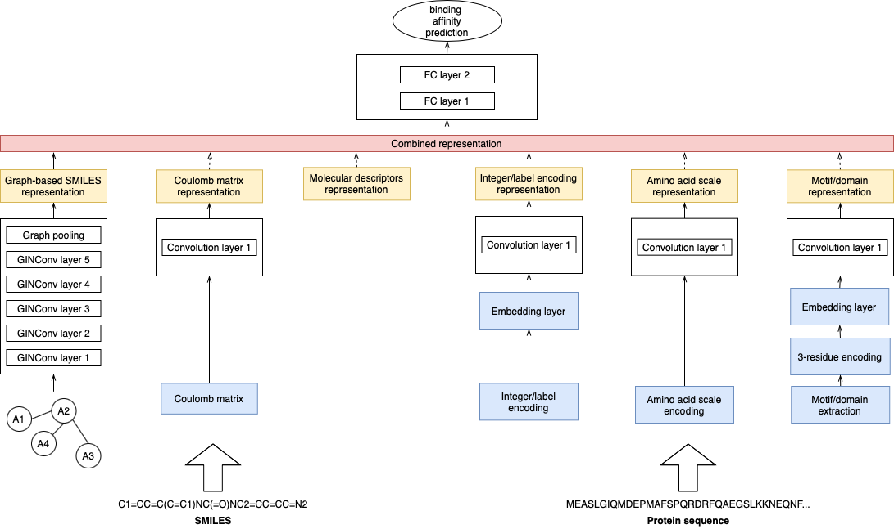
Methodology: Proposed Model
Figure 3. Proposed model architecture
Notes:
why embedding

Slide 13
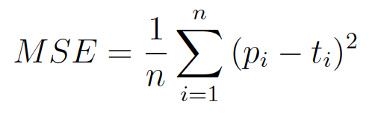
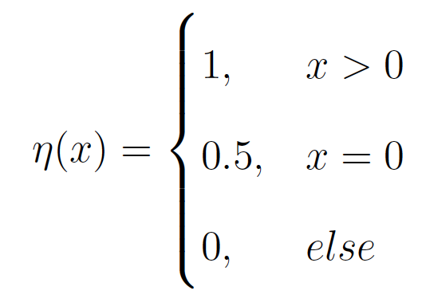
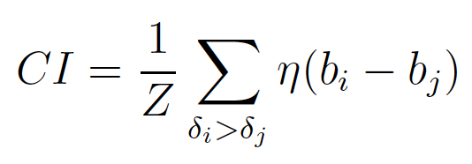
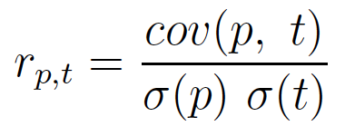
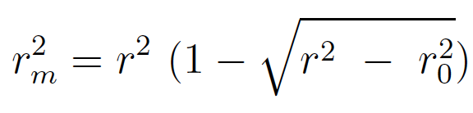
Methodology: Performance Evaluation Metrics
Mean Squared Error:
Concordance Index: ;
Pearson Correlation Coefficient:
Squared Correlation Coefficient:
Notes:
15 min

Slide 14
Experiments and Results

Slide 15
Experimental Setup
68%-16%-16% split into training, validation and holdout test sets
Adam optimization with constant learning rate 0.0005
Trained for 100 epochs with a batch size 512 for the weight update
Early stopping with patience 15
Overall 7 experiments with different input combinations were tested out: graph-based, Coulomb matrix and molecular descriptor representation for compounds, integer/label encoding, amino acid scale encoding, motifs/domains representation for proteins

Slide 16
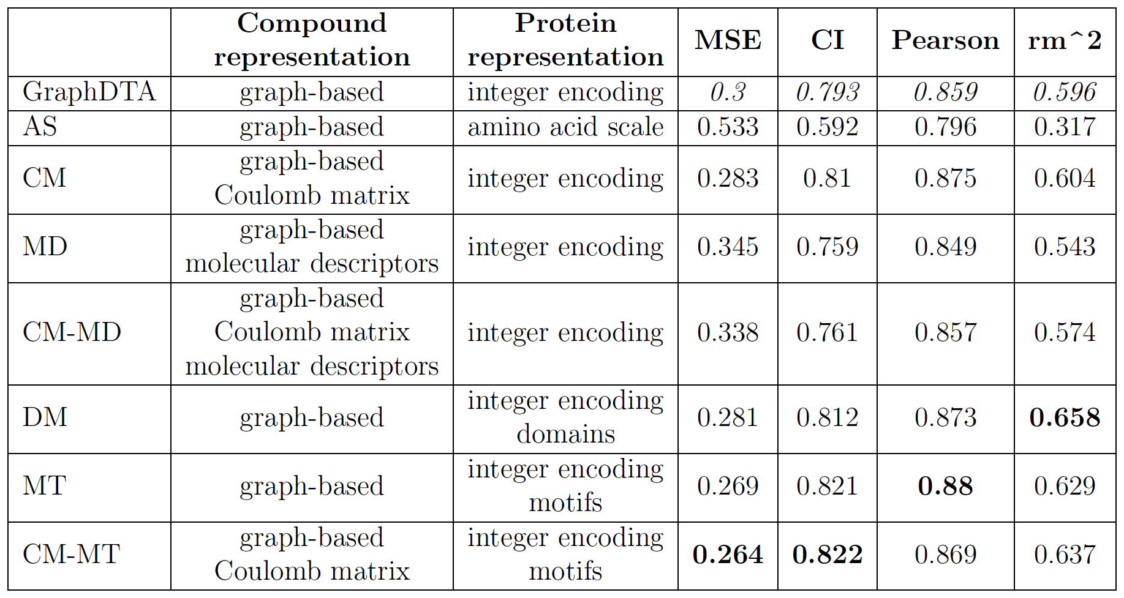
Results
Table 2. MSE, CI, Pearson correlation coefficient, and r_{m}² scores
of the test set of Davis dataset

Slide 17
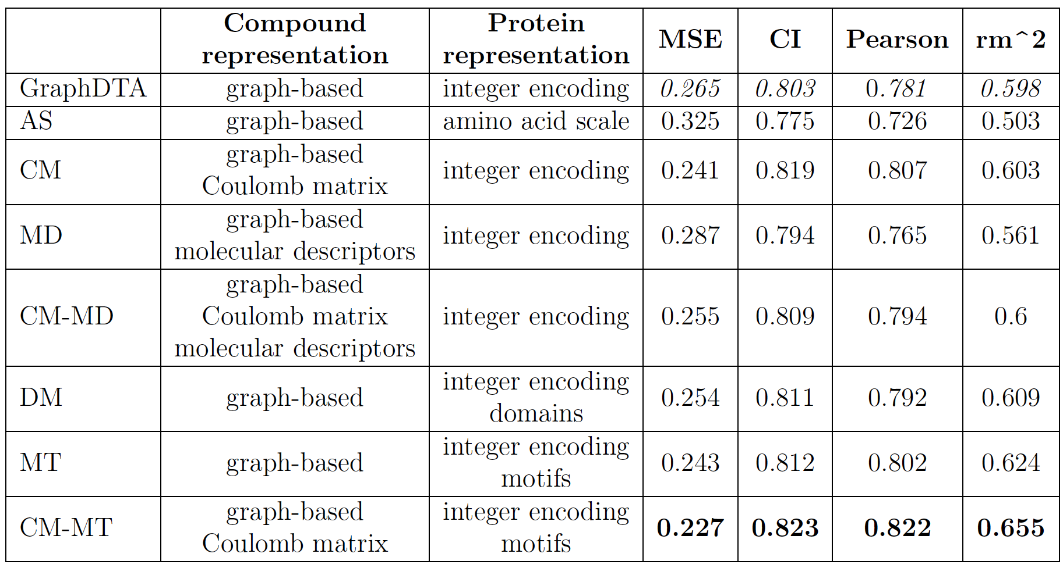
Results
Table 3. MSE, CI, Pearson correlation coefficient, and r_{m}² scores
of the test set of KIBA dataset

Slide 18
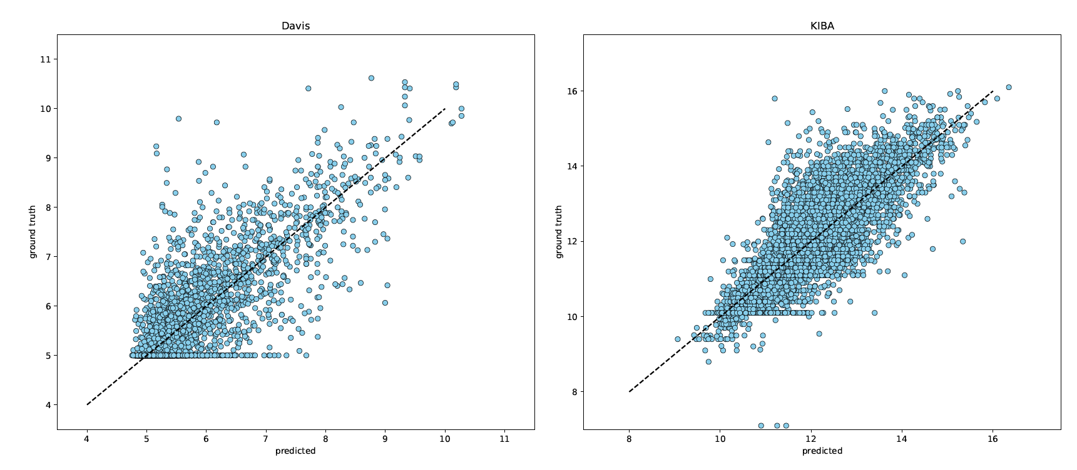
Results
Figure 4. Predicted against ground truth values for Davis (left panel) and
KIBA (right panel) datasets

Slide 19
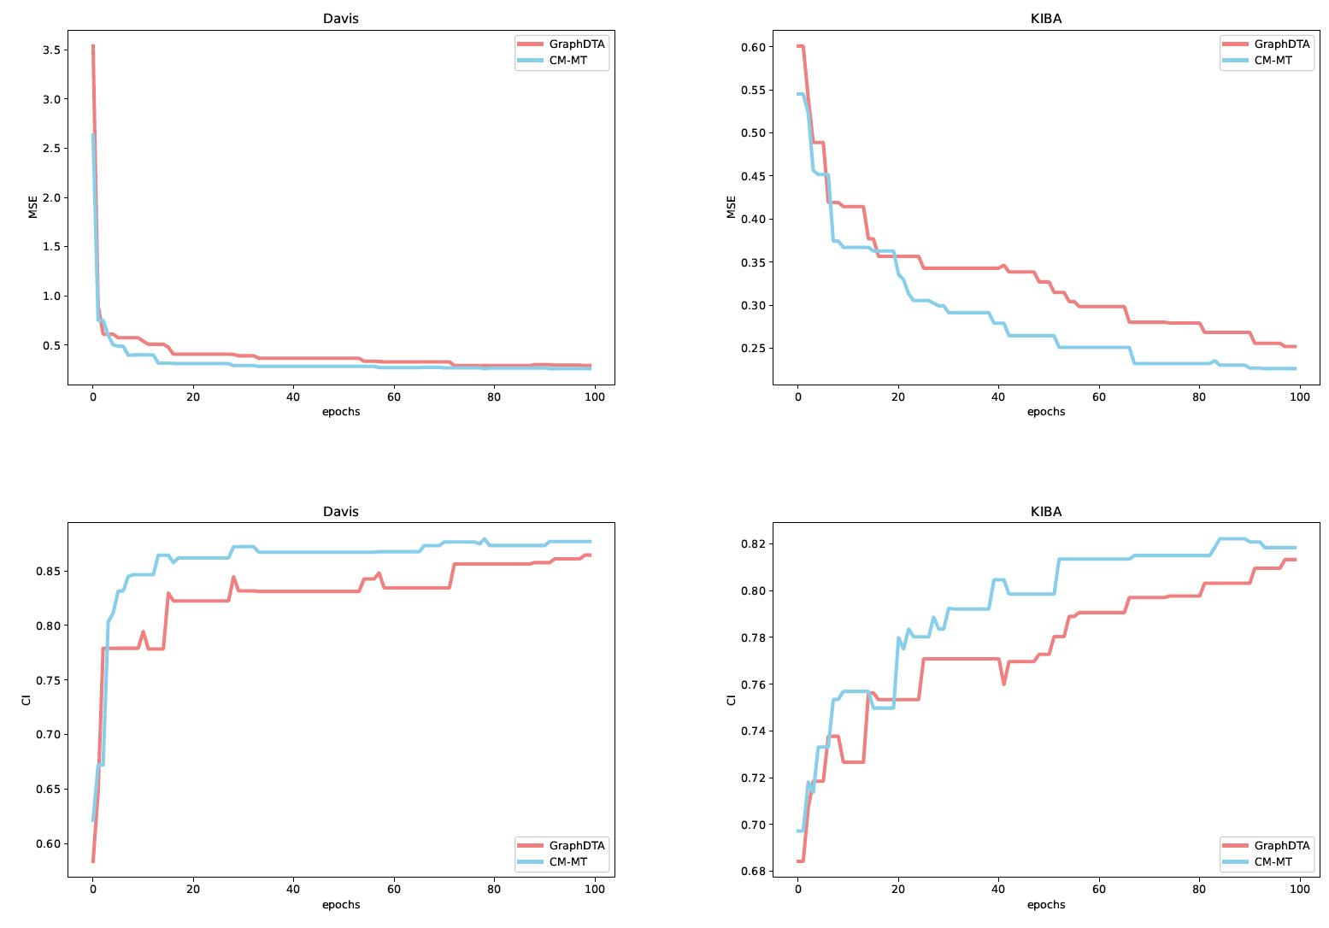
Limitations
Models based on molecular descriptors compound representation and amino acid scale protein representation performed poorly
Towards the end of training the MSE and CI values for proposed and baseline models seem to converge - the proposed model starts to overfit
Both limitations are due to the sub-optimal underlying architecture
Figure 5. MSE (first row) and CI (second row) trends over 100 epochs for Davis (left panel) and KIBA (right panel) datasets

Slide 20
Conclusion
The proposed model superseded the performance of state-of-the art baseline method on four evaluation metrics
Results confirm the practical advantage of integrating additional chemical and functional information into the development of drug-target affinity prediction models
Closer look into the performance reveals the limitation of the current architecture
Optimization of the architecture will be addressed in the future work alongside with other possible feature representation improvements

