Slide 1
Building a global knowledge commons based on the network of open access repositories
Kathleen Shearer
Executive Director, COAR
@KathleeShearer | @COAR_eV www.coar-repositories.org

Slide 2
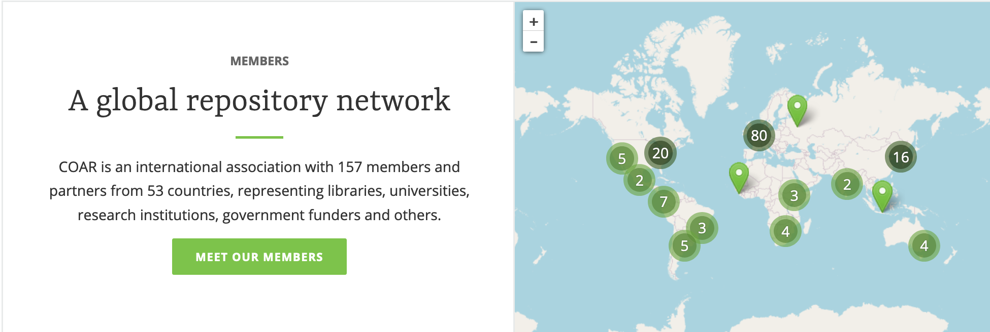
About COAR
COAR is an international association that brings together individual repositories and repository networks in order to build capacity, align policies and practices, and act as a global voice for the repository community.
Launched in 2009
Offices based in Germany / Portugal
Over 150 members and partners on 5 continents

Slide 3
Our vision
To position repositories as the foundation for a distributed, globally networked infrastructure for scholarly communication, on top of which layers of value added services will be deployed, thereby transforming the system, making it more research-centric, open to and supportive of innovation, while also collectively managed by the scholarly community.

Slide 4
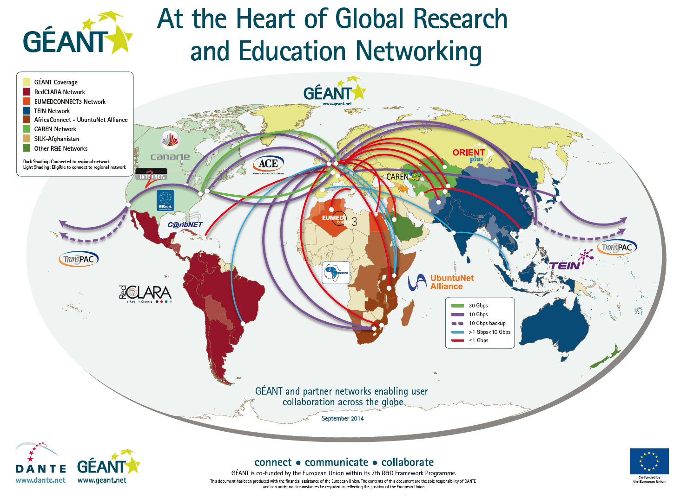
Research is global!

Slide 5
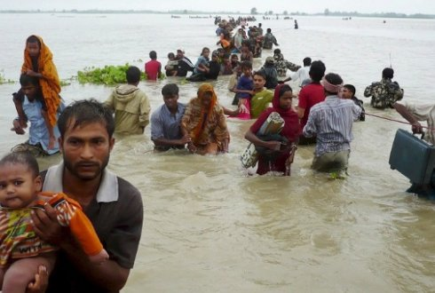
Many of the worlds most critical challenges must be addressed globally!

Slide 6
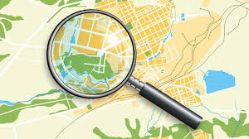
...but research is also local
Research priorities
Language(s)
Different workflows
Access to resources
And so on...

Slide 7

Our challenge
How can we balance these two elements?
Local
Develop localized infrastructures
Adopt community governance
Nurture communities of practices
Global
Harmonization of metadata
Data sharing across networks
Co-designing technologies and services
Knowledge sharing
Common behaviours/functionalities

Slide 8
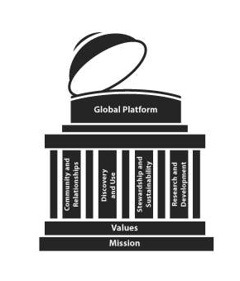
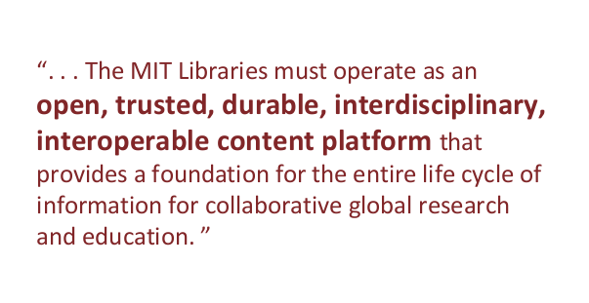
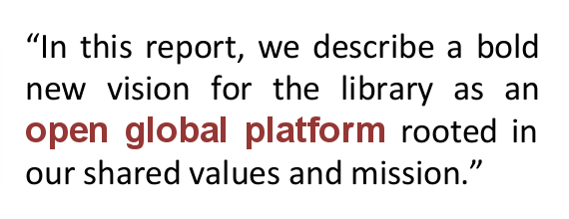
Open repositories play a key role in supporting open science
MIT Future of Libraries Report
Domain
Repositories
Data
Repositories
Institutional
Repositories
Preprint
Repositories
And so on

Slide 9
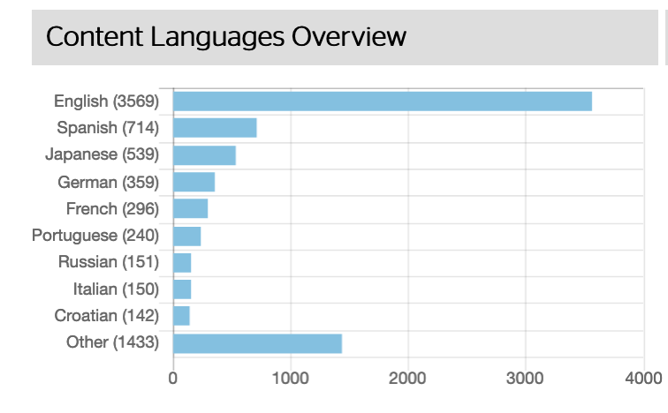
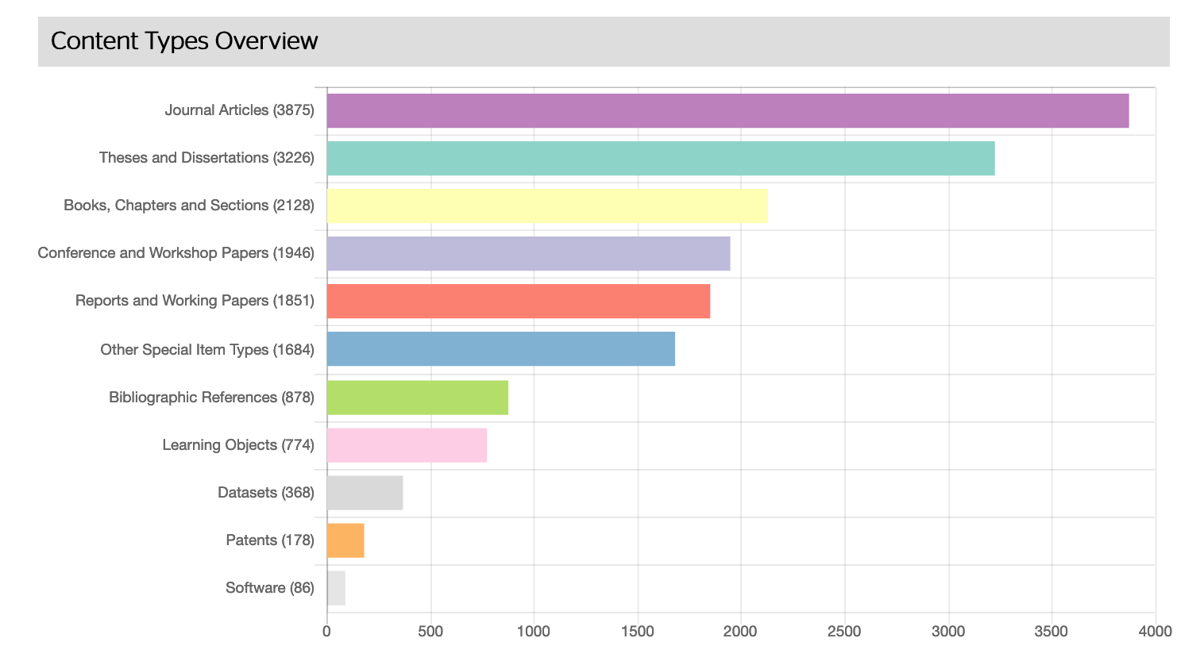
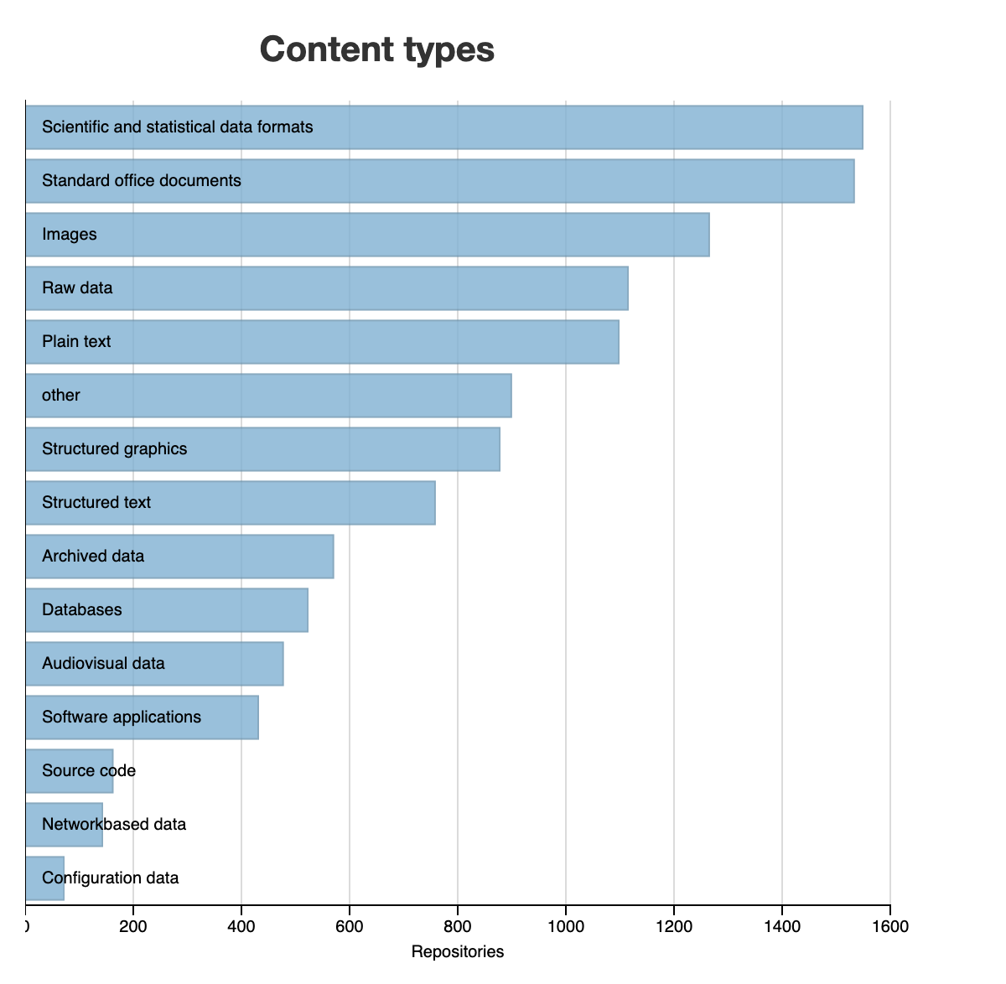
OpenDOAR and Re3data
There are approximately 5k-6k research repositories around the world

Slide 10
Testimonials from DASH Harvard Repository
https://dash.harvard.edu/
Kenya: “I am from Nairobi Kenya, and a student at university. Thank you for this access. I can not be able to buy access individually, and the papers aid me in assignments, understanding my syllabus and personal development.”
Argentina: “I am working on a research project about human capital accumulation, institutional improvements and long term economic growth in Argentina. (This article is a) fundamental reference.”

Slide 11
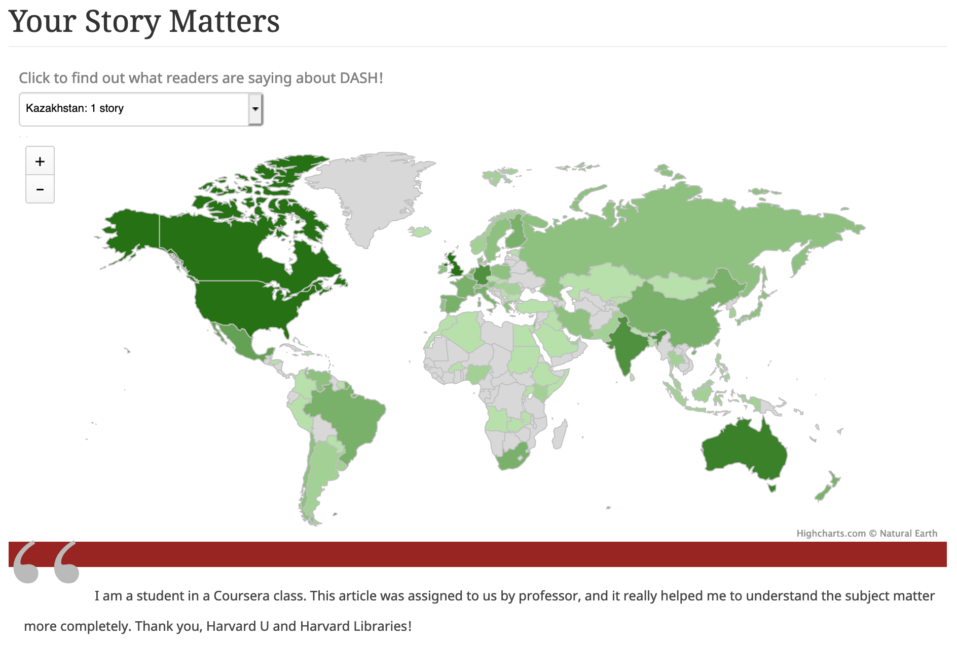

Slide 12
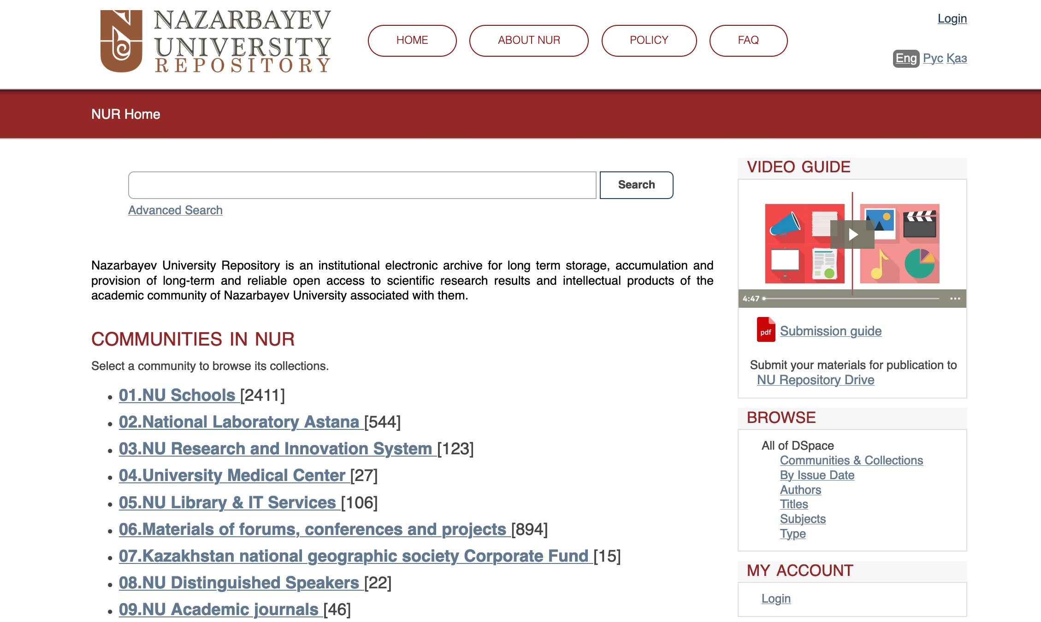

Slide 13
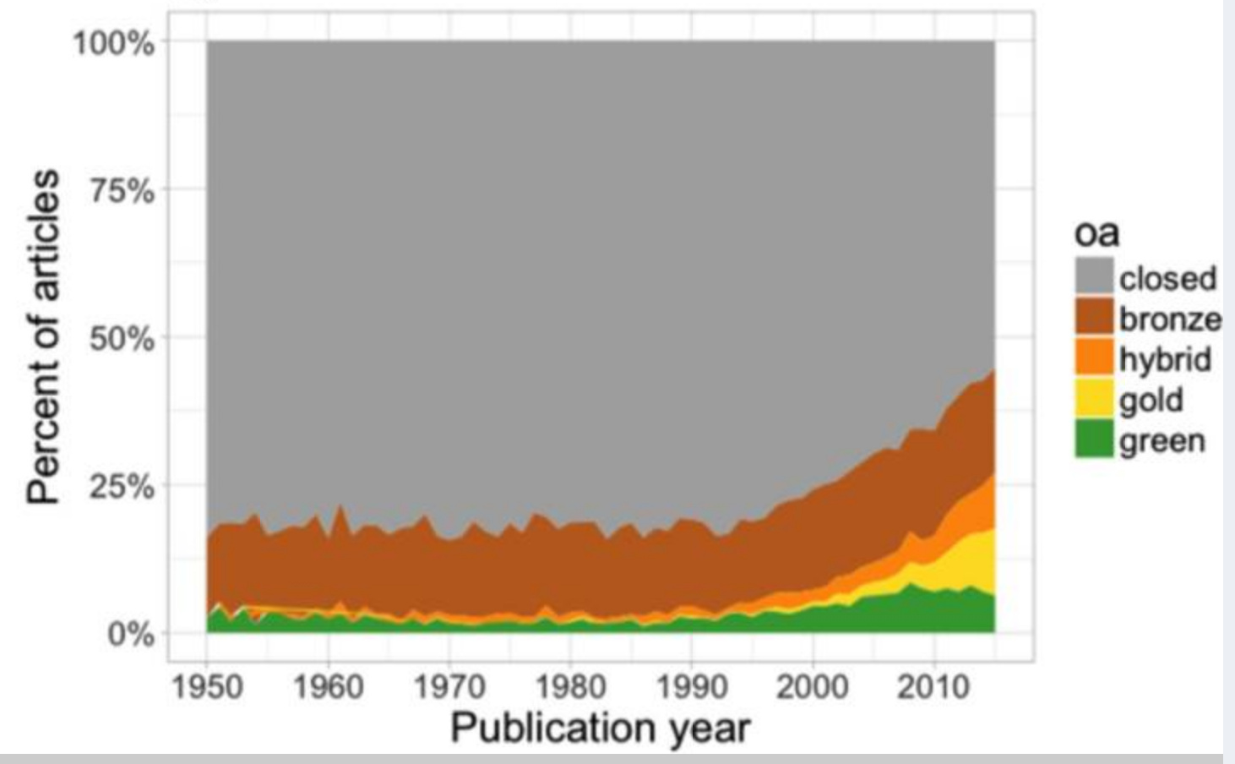
Slow but steady growth of open access in last 20 years
Piwowar H, Priem J, Larivière V, et al. The state of OA: a large-scale analysis of the prevalence and impact of Open Access articles. PeerJ. 2018;6:e4375. Published 2018 Feb 13. doi:10.7717/peerj.4375

Slide 14
Enter COVID-19

Slide 15
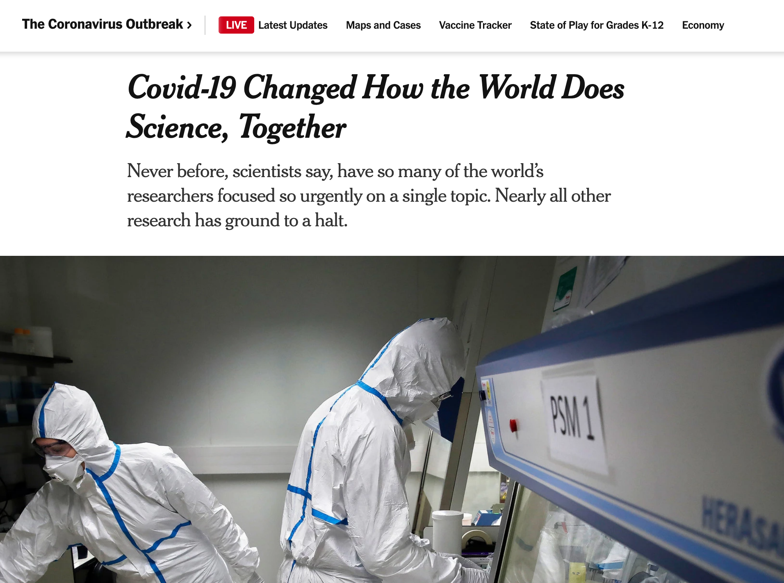

Slide 16

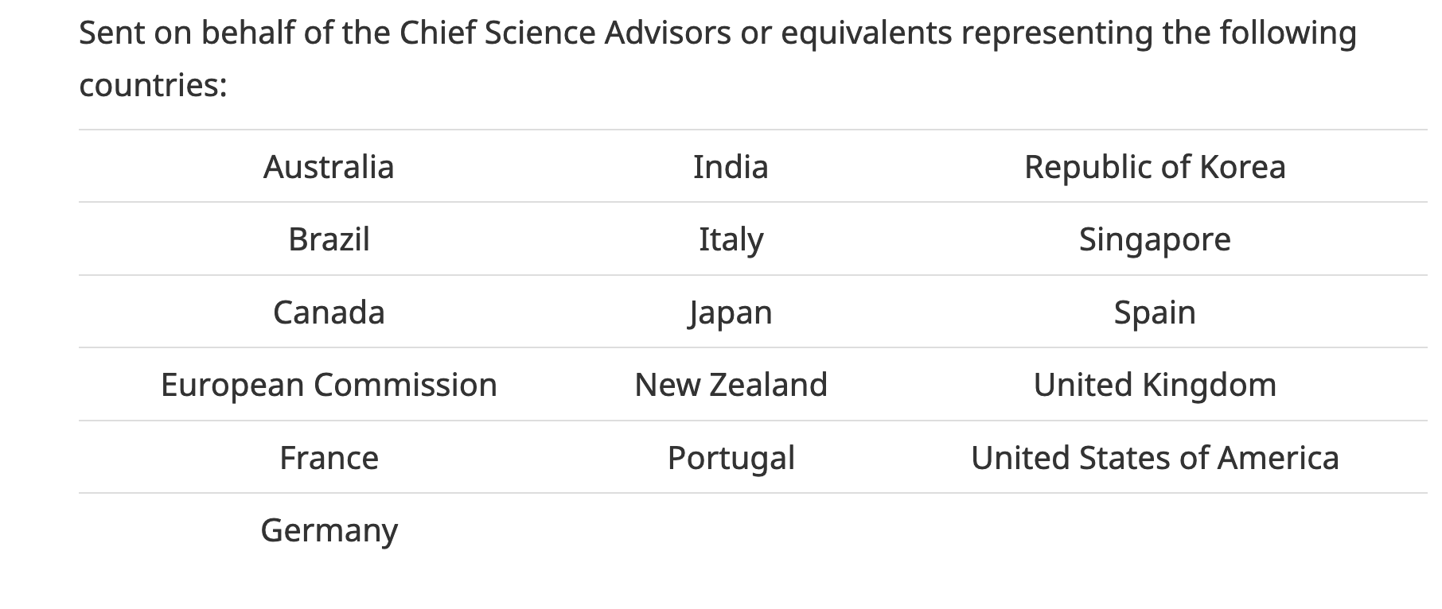
The countries listed below urge publishers to voluntarily agree to make their COVID-19 and coronavirus-related publications, and the available data supporting them, immediately accessible in PubMed Central and other appropriate public repositories, such as the World Health Organization’s COVID data base, to support the ongoing public health emergency response efforts.

Slide 17
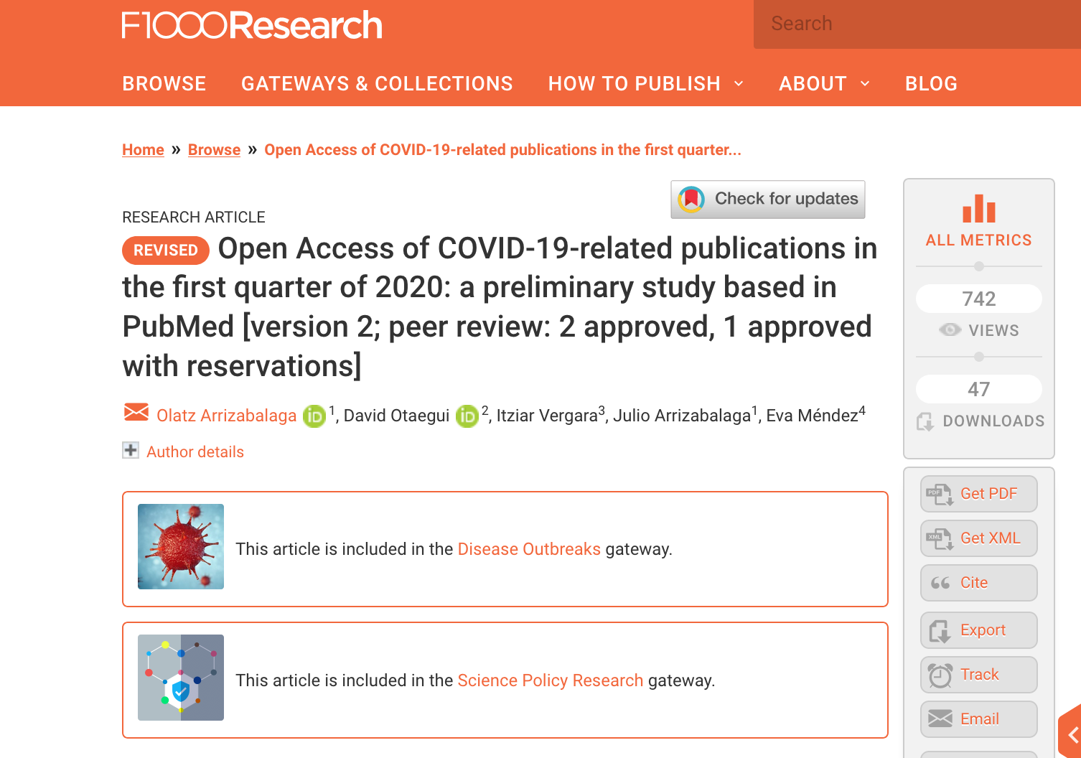
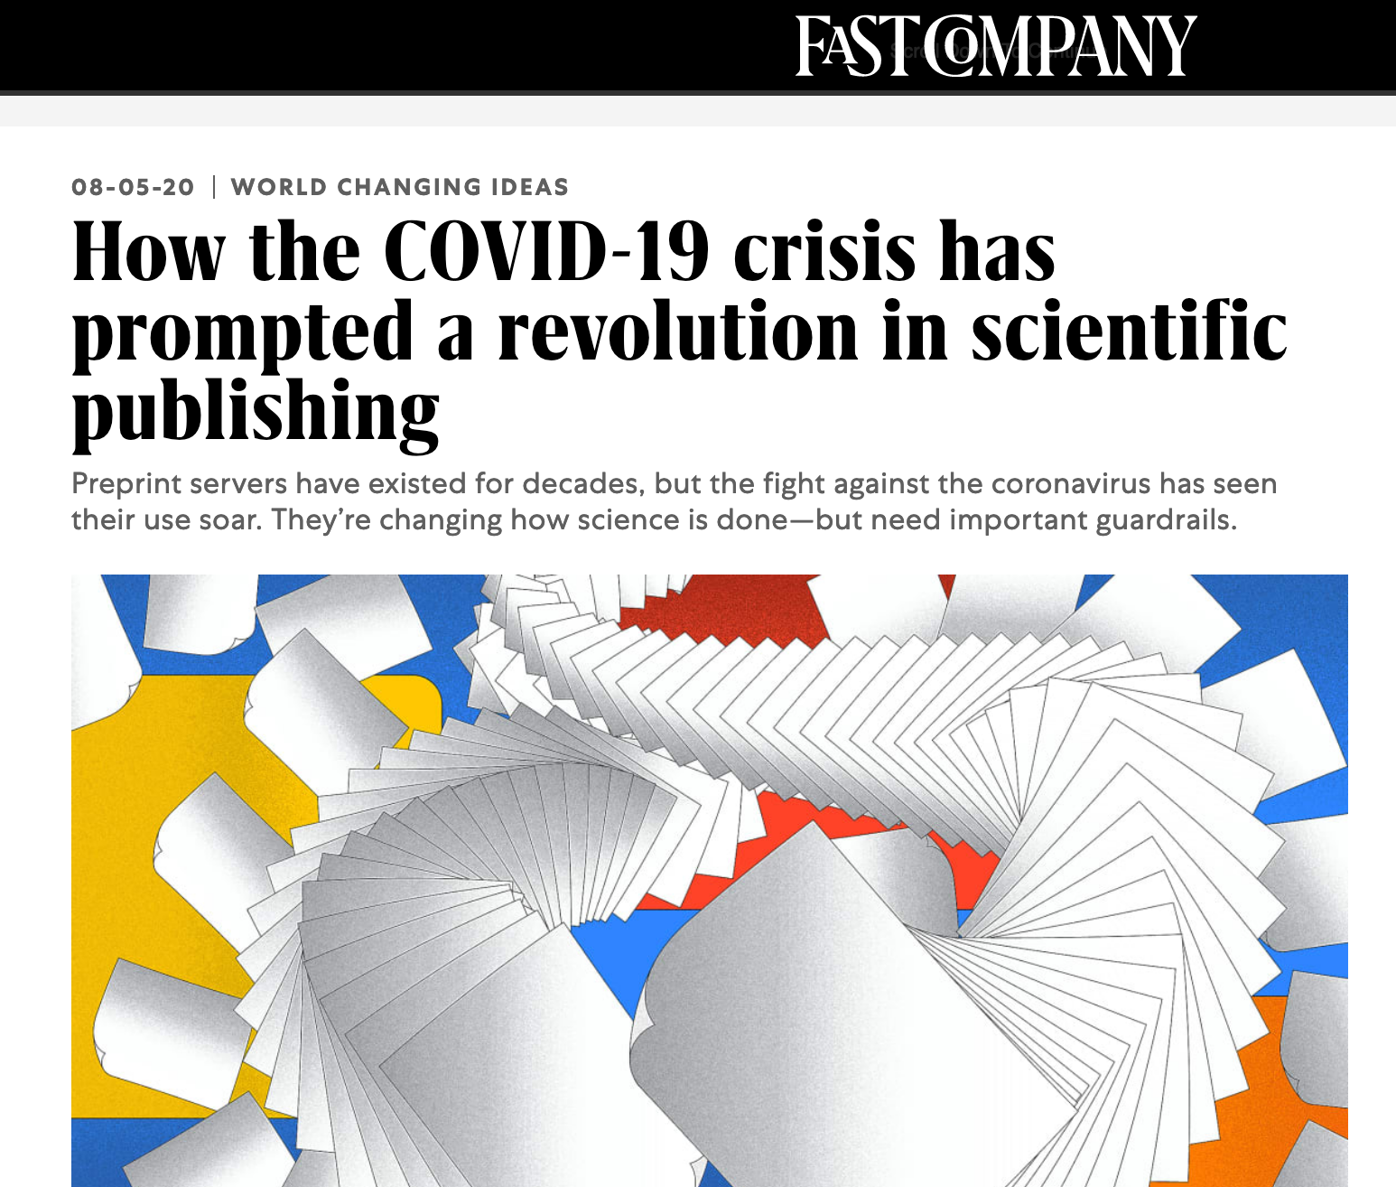
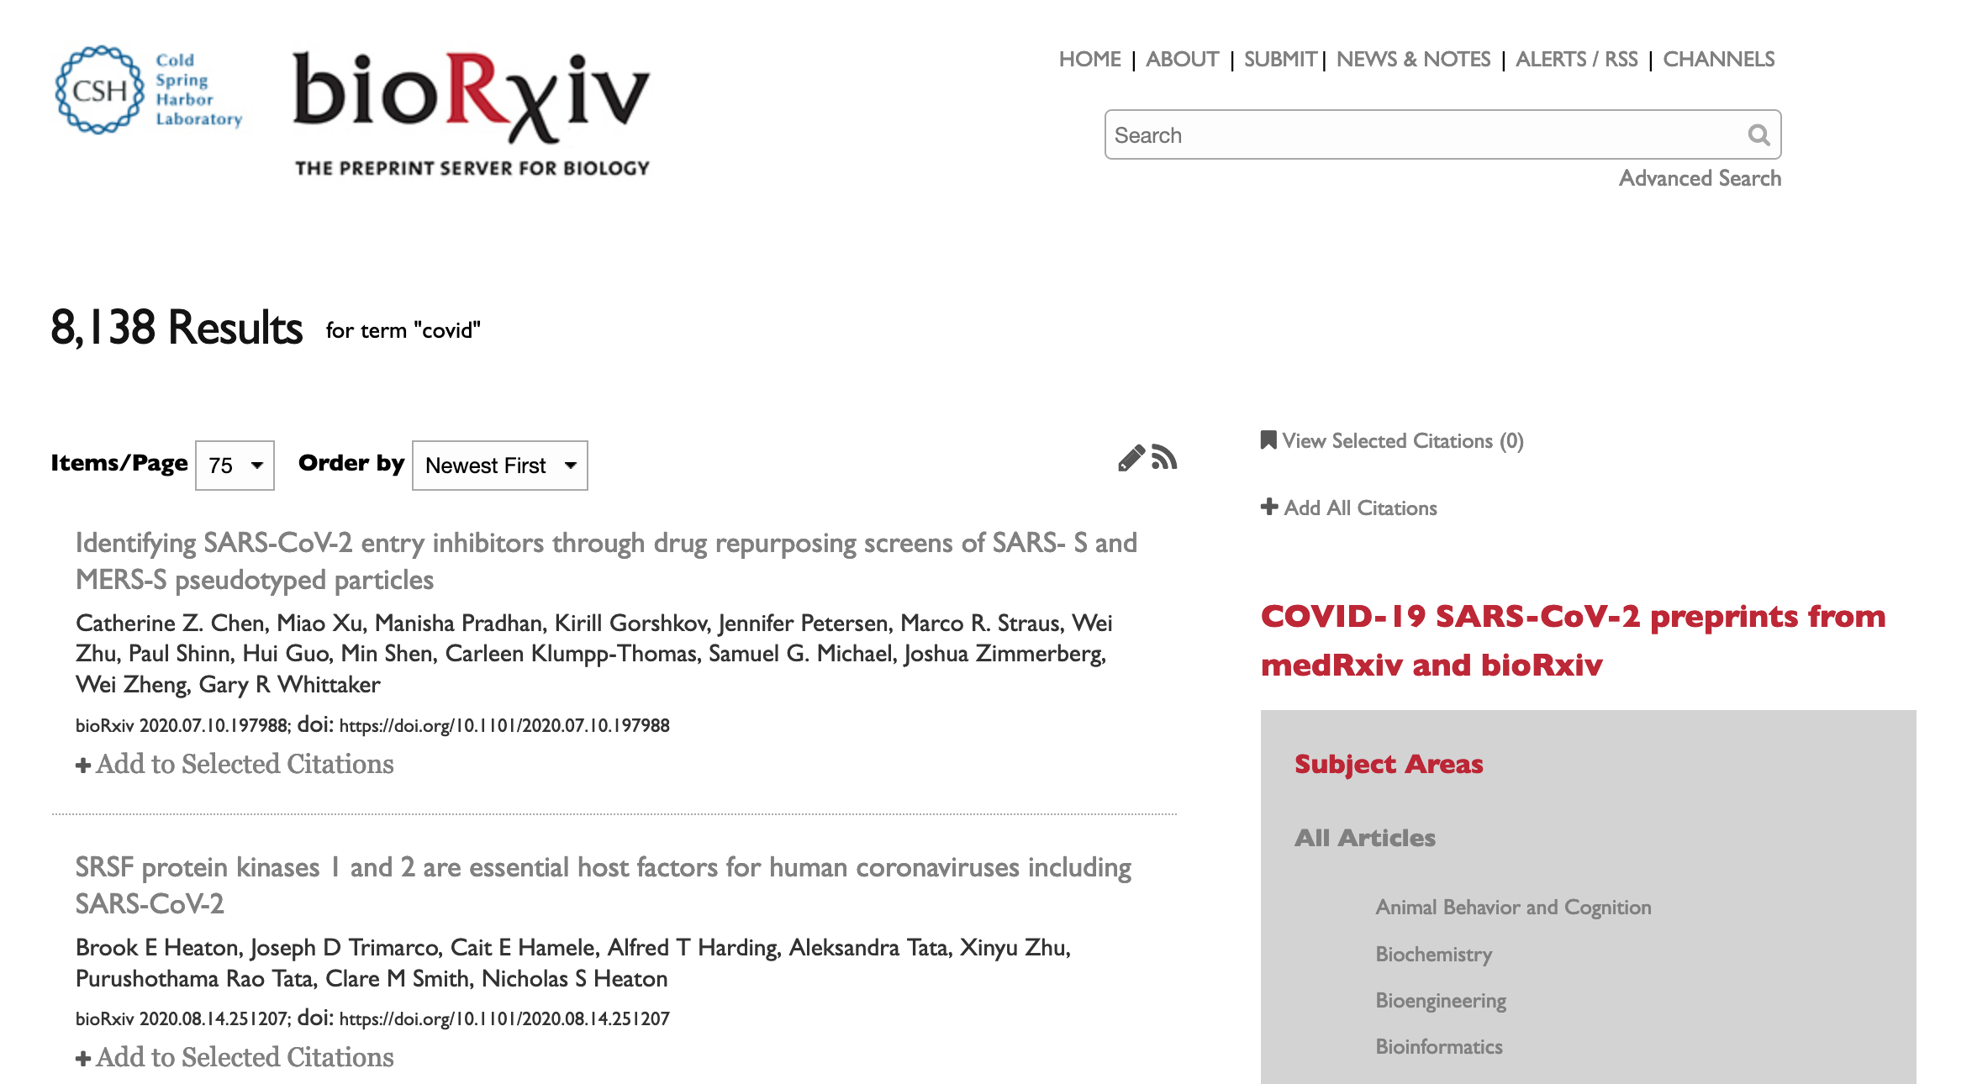
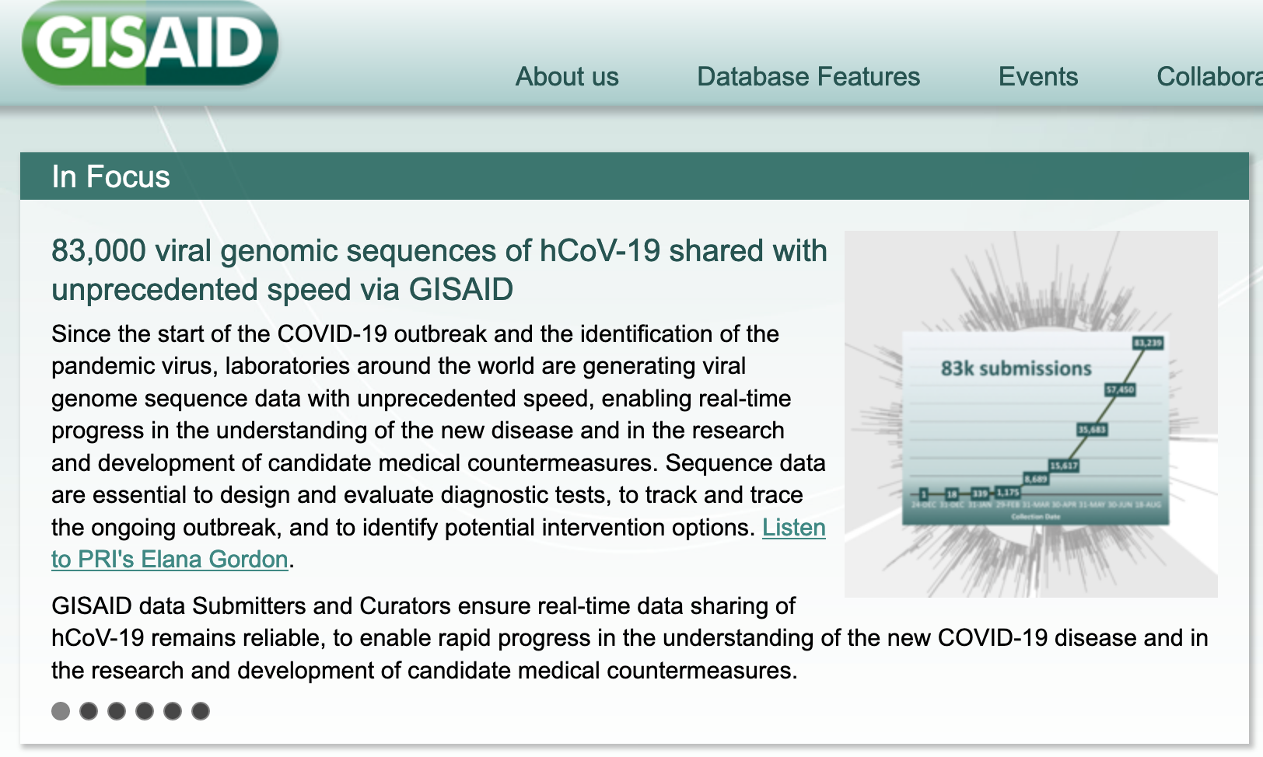

Slide 18
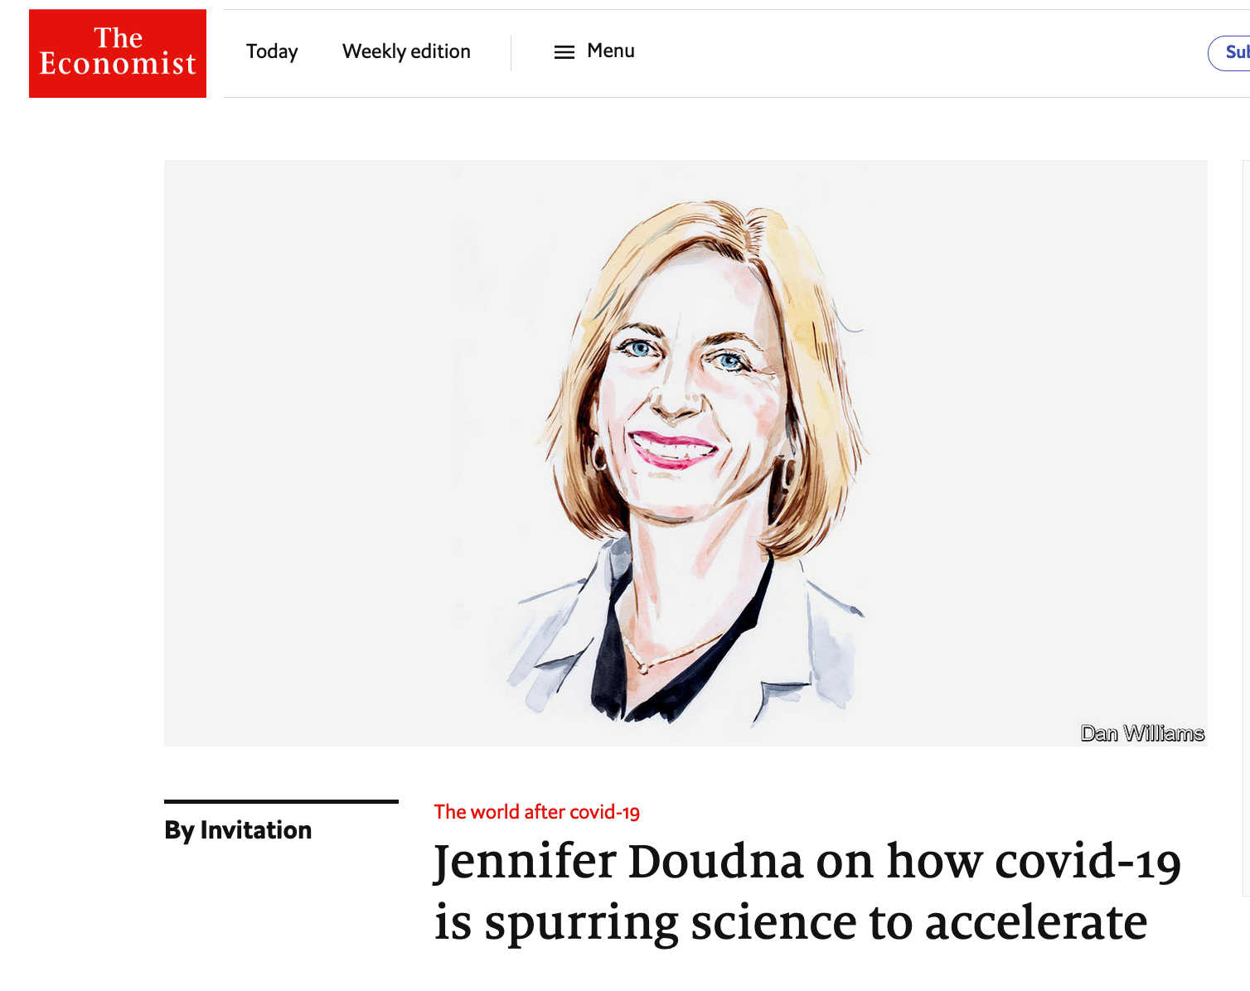
Three ways science will never be the same because of covid-19:
Greater public appreciation for science
Better and faster communications, and
Greater scientific collaboration
Notes:
Three ways

Slide 19
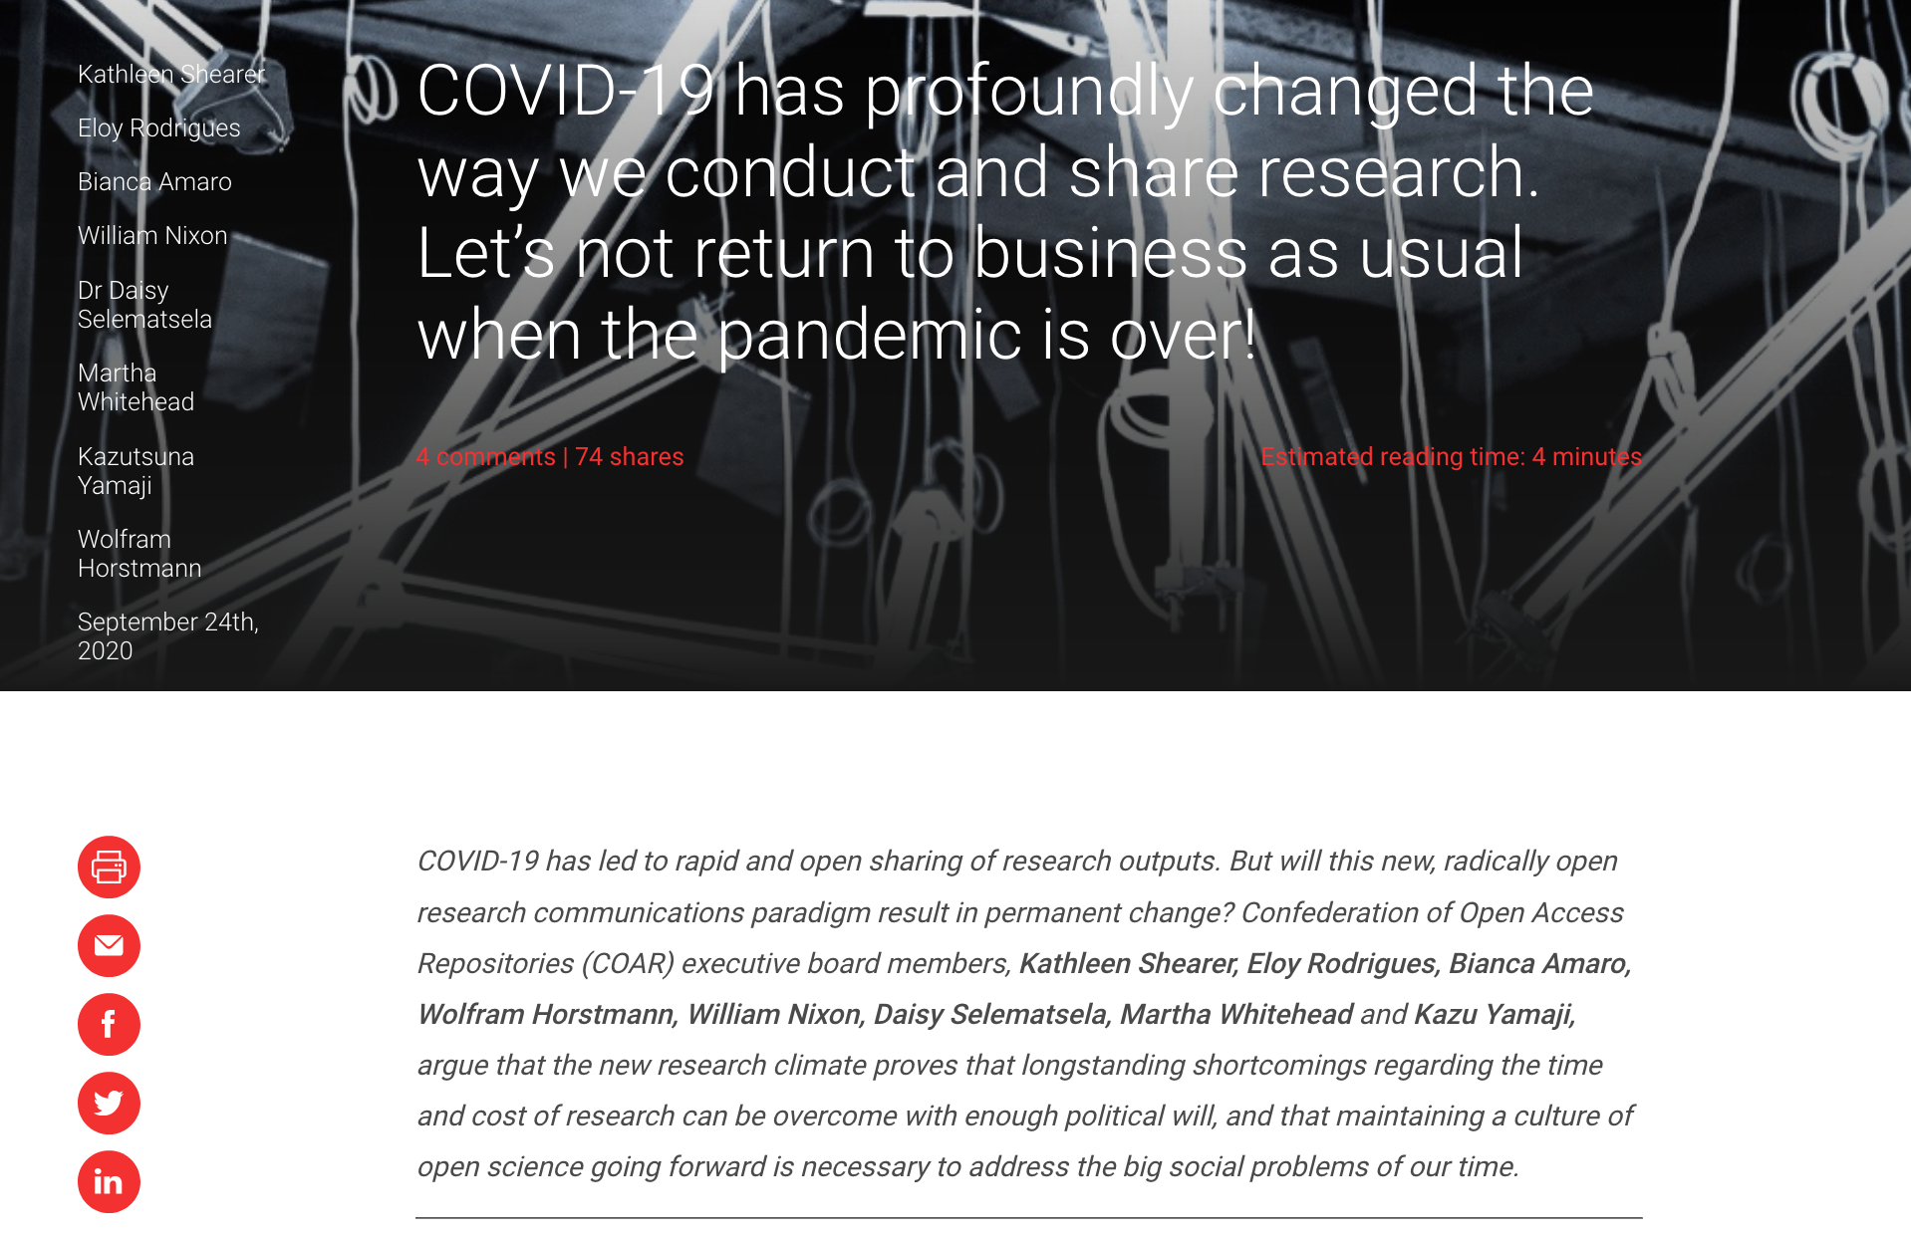
https://blogs.lse.ac.uk/impactofsocialsciences/2020/09/24/covid-19-has-profoundly-changed-the-way-we-conduct-and-share-research-lets-not-return-to-business-as-usual-when-the-pandemic-is-over/

Slide 20
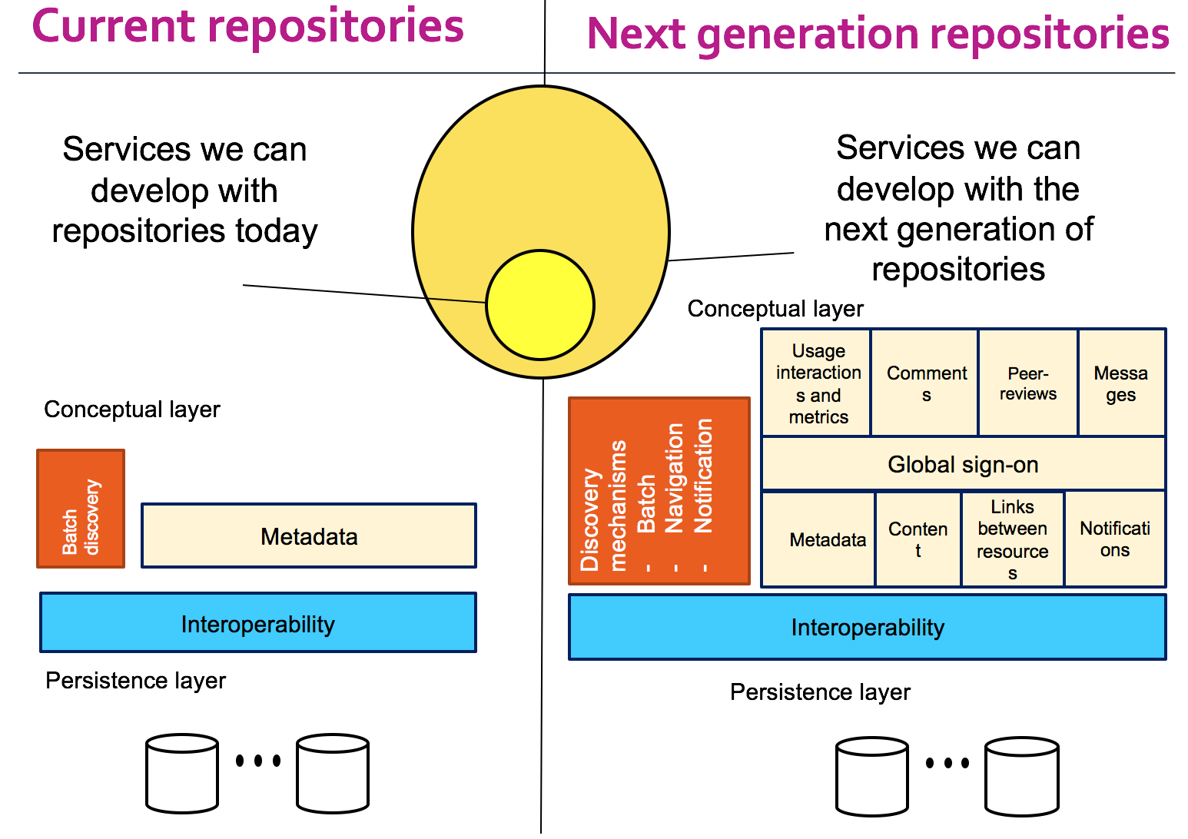
Future Trends for Repositories
Breaking down the silos across content types
Developing overlay peer review and assessment services
Integrating better and standardized usage metrics
Relationships across content in distributed network

Slide 21
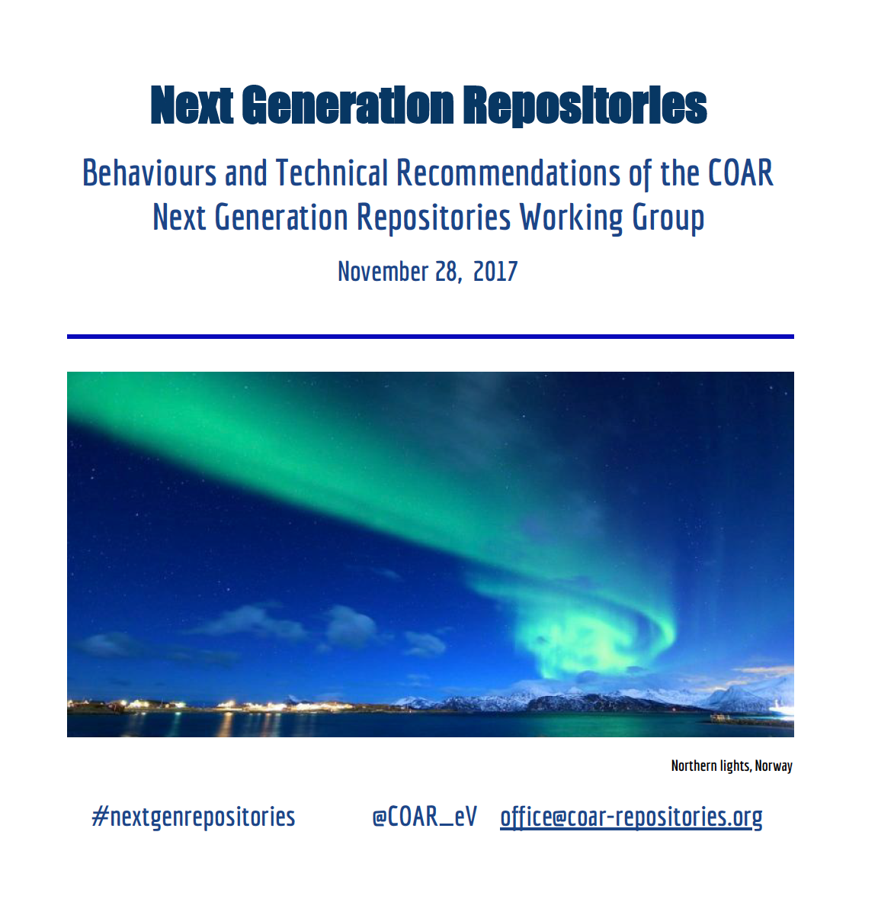
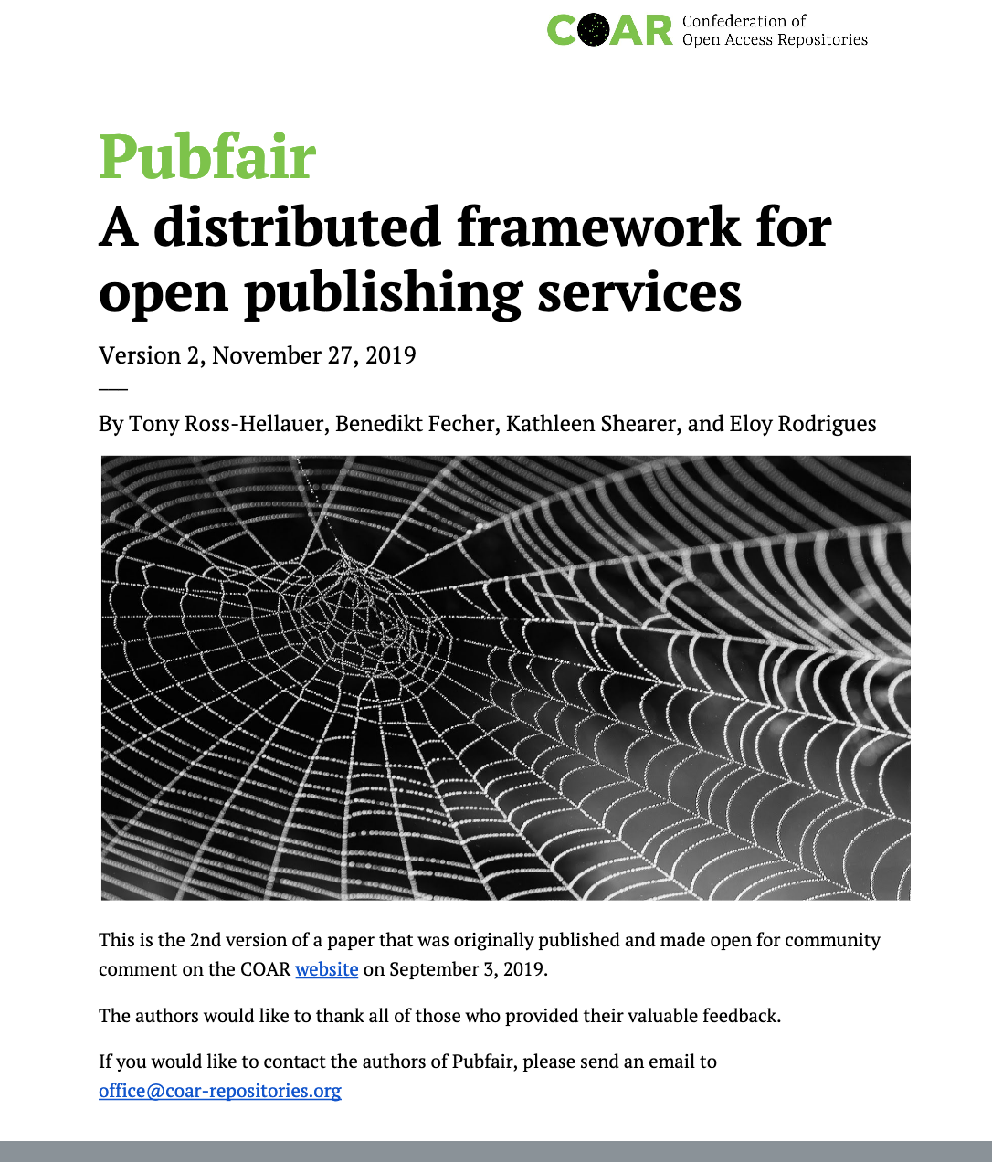
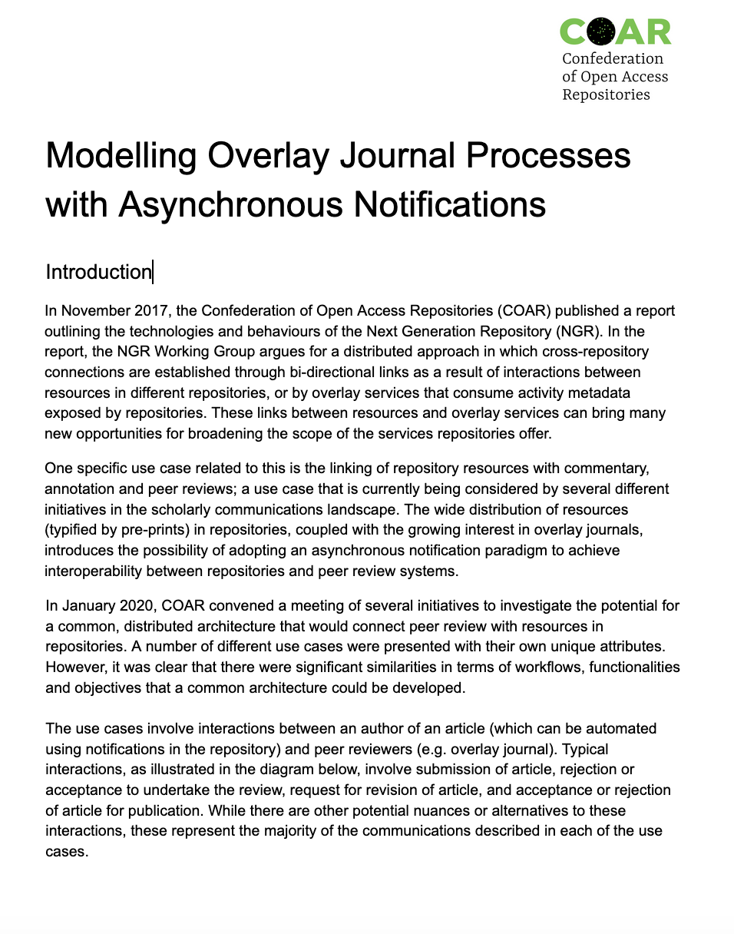
Advancing new roles and functions for repos

Slide 22
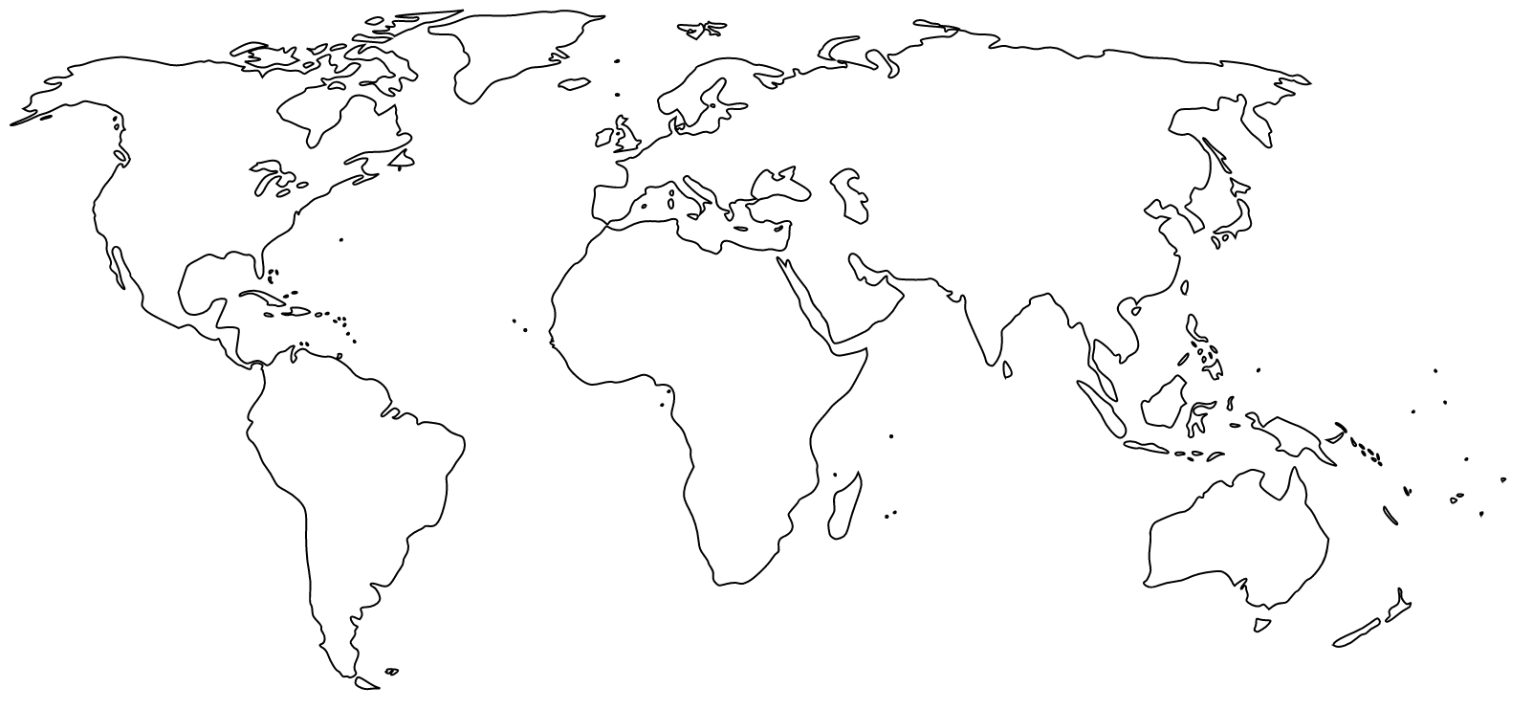









Working through our members and with regional networks
LIBSENSE

Slide 23
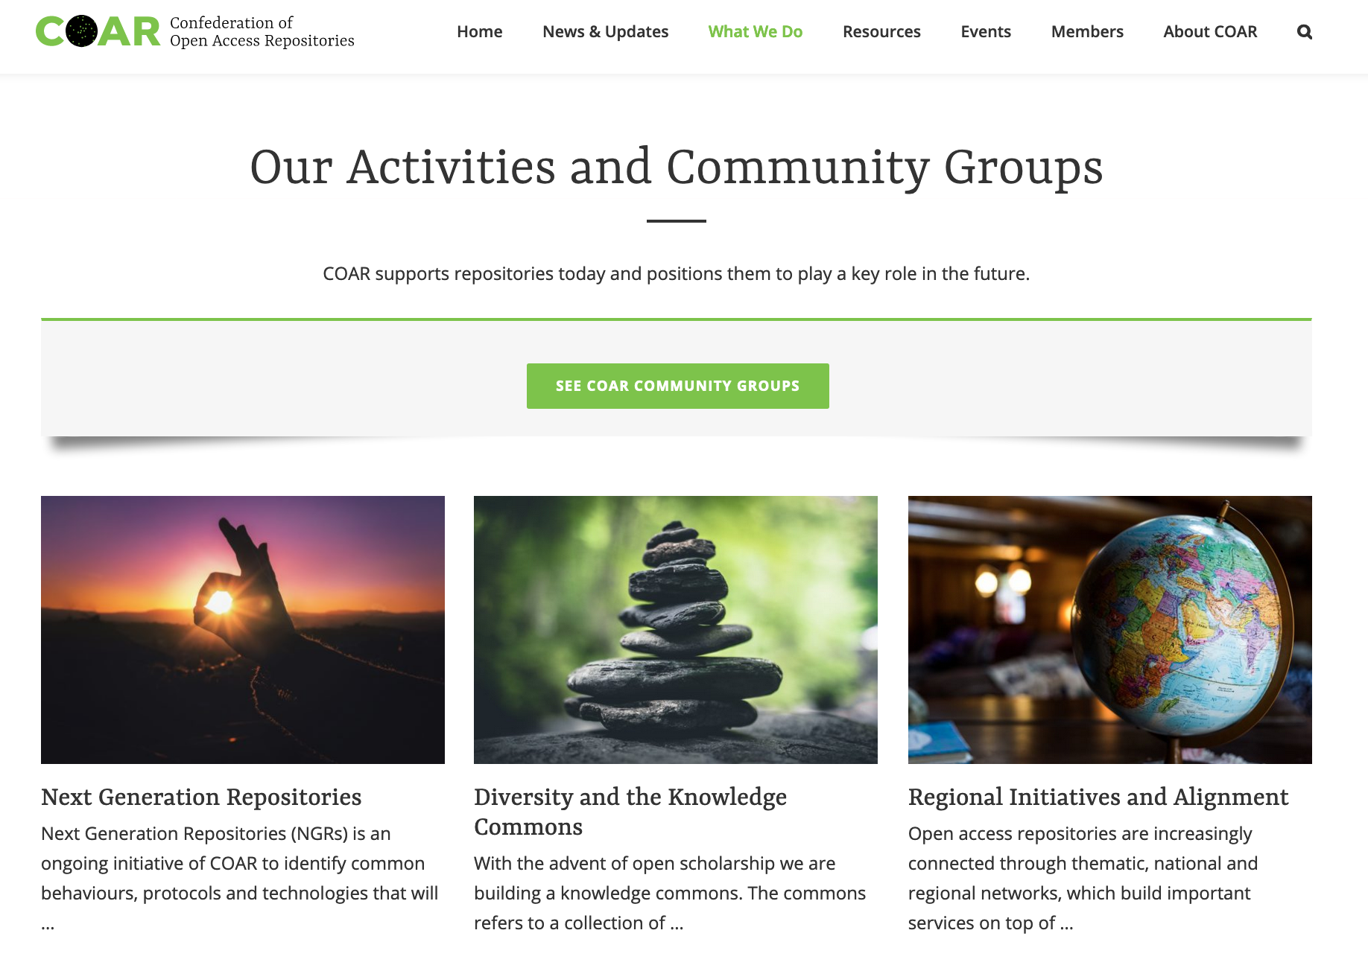

Slide 24
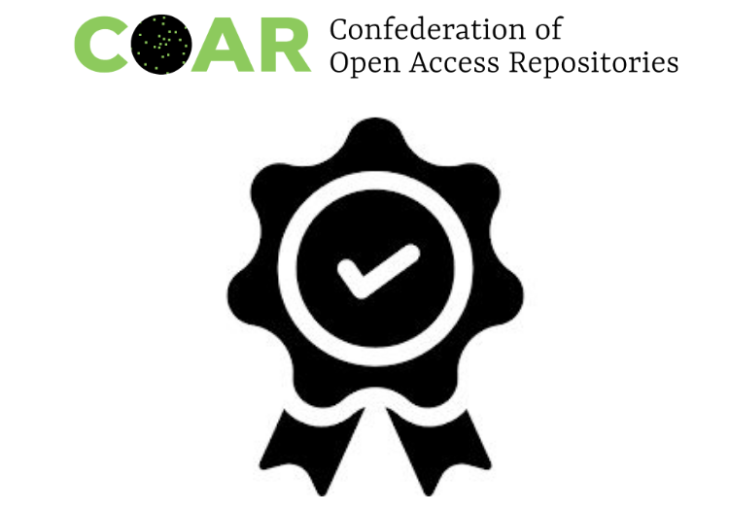
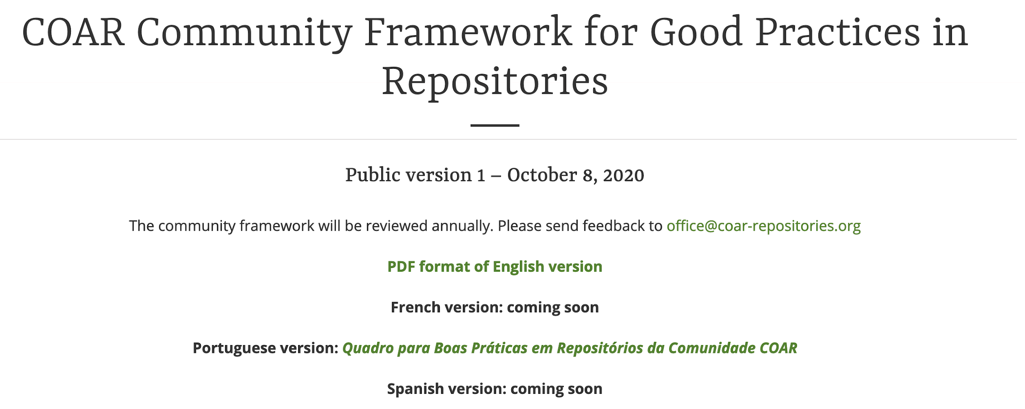
https://www.coar-repositories.org/coar-community-framework-for-good-practices-in-repositories
/

Slide 25
Thanks and questions?
Kathleen Shearer
Executive Director, COAR
@KathleeShearer | @COAR_eV www.coar-repositories.org

