Slide 1


Experimental Investigation on Seismic Performance of Unreinforced Masonry Walls Strengthened with Lightweight Engineered Cementitious Composites.
BY: Chukwuwike Mike Ogwumeh
Supervisors: JONG KIM, Dichuan Zhang

Slide 2
Outline:
Introduction
Conclusion
Recommendations
References
Experimental Program
Results
Literature Review

Slide 3
Introduction

Slide 4
Masonry Structures under Seismic Load
The use of URM structures can be found in every region of the world, especially in developing countries but they exhibit poor performance to seismic load, causing the loss of numerous lives and properties [3], [4].
Due to this seismic inadequacy, URM structures are most liable to experience serious damage or even collapse in the occurrence of an earthquake [5].
This inadequacy can be attributed to the material characteristics of URM structures, which include low ductility, poor tensile strength, poor shear strength, and poor energy dissipation capacity [4], [5].
S. M. Renuka et. al., stressed the need for the evaluation of relevant structural measures for strengthening these URM structures [1].
In-plane response is fundamental to improving the seismic resistance of building elements because these structural elements are often vital for maintaining structural reliability [2].

Slide 5
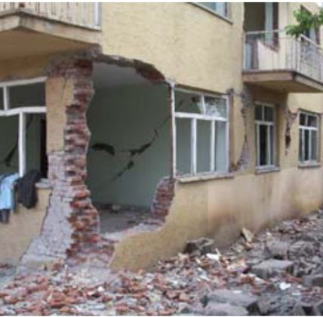
Effect of Earthquake Hazard in Almaty Region
Frequent and catastrophic earthquakes within Kazakhstan's south and southeast regions [8].
Almaty region is in a high seismic region.
One-third of the structures in the region are URM structures characterized for being susceptible to damage at the occurrence of lateral loads caused by an earthquake.
A significant portion are brick masonry buildings built 30-50 years ago without any form of seismic design expected to have brittle responses under earthquakes [8].
Failures of the masonry building in Almaty

Slide 6
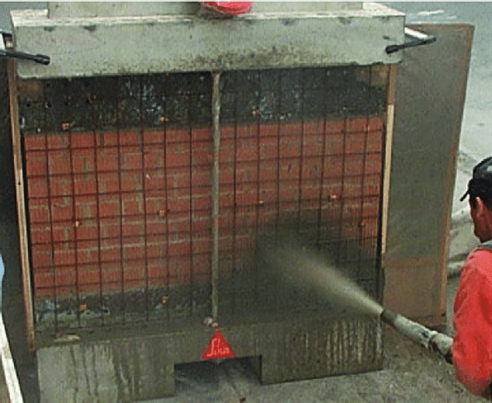
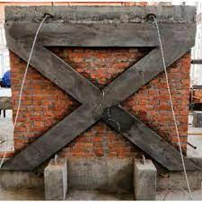
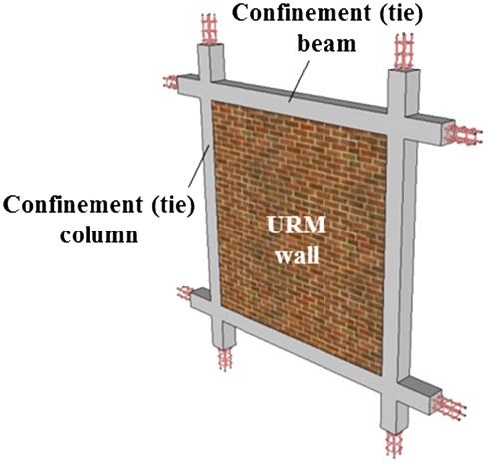
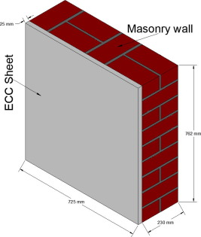
Potential Retrofitting Technology for URM Walls
Shotcrete overlay with a layer of a steel wire mesh
Fiber-reinforced (FRP)
Textile Reinforced Mortar (TRM)
Post-Tensioning
Confinement
Engineered Cementitious Composites (ECC)
Lightweight Engineered Cementitious Composites

Slide 7
Potential Retrofitting Technology for URM Walls
Lightweight Engineered Cementitious Composites
  Chosen method due to the potential for a significant increase in deformation capacity
  possesses good multifunctional properties of lightweight, low thermal conductivity, and high sound absorption.

Slide 8
Research Hypothesis
Research Objectives
In comparison to unreinforced masonry walls, the use of LWECC in the retrofitting of URM walls is anticipated to improve its seismic performance when subjected to seismic activity by enhancing:
    Wall deformation capacity,
    Lateral strength, and
    Displacement ductility
Examine the structural response of unreinforced masonry walls exposed to in-plane cyclic loadings.
Investigate the structural response of unreinforced masonry walls strengthened with lightweight ECC when subjected to in-plane cyclic loadings.
Identify the effect of lightweight ECC strength on the effectiveness of seismic retrofitting of unreinforced masonry walls

Slide 9
Literature Review

Slide 10
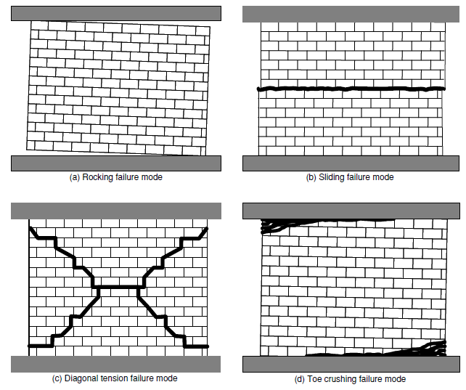
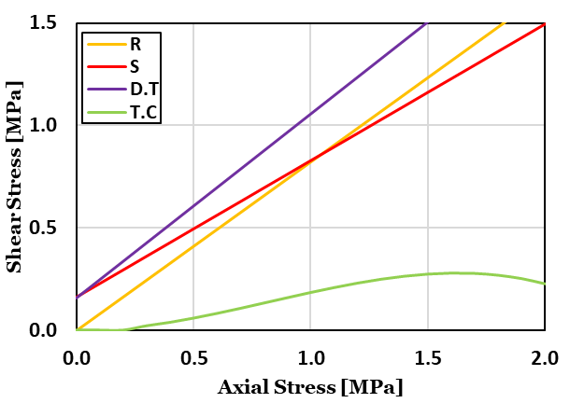
Masonry Walls Failures modes
Aspect ratio = 0.5
Axial stress and shear strength relationship to URM wall failure modes
Failure modes of URM wall
R = Rocking failure, S = Sliding failure
D.T = Diagonal tension failure, T.C = Toe-crushing failure

Slide 11
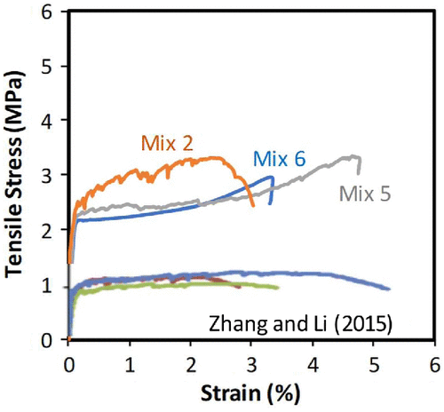
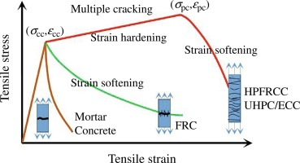
ECC
LWECC
  A synthetic fiber-reinforced cementitious composite that when under tension exhibits strain-hardening behavior and when subjected to compression, has adequate toughness properties [4].
  Typically, a mixture of water, cement, fibers, and some additives to minimize the water to cement.
  Possess multiple cracking, high ductility, tensile strength, and self-healing properties.
ECC integrated with the use of different lightweight technologies, such as glass micro-hollow bubbles, air-entrainment admixture, lightweight perlite, etc.
Possess densities between 900 and 1600 kg/m³
Possesses high ductility and exceptional crack control which provides shear cracking resistance, therefore enhancing durability and extending the service life of a structure.
Typical stress-strain curve of ECC
Typical stress-strain curve of LWECC

Slide 12
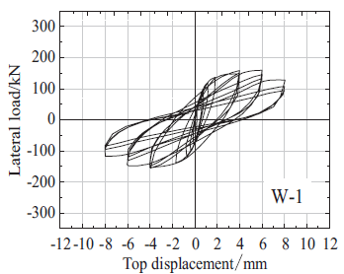
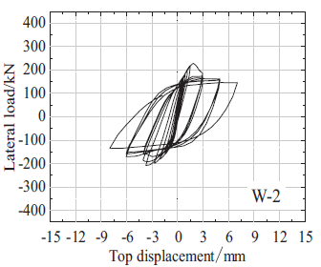
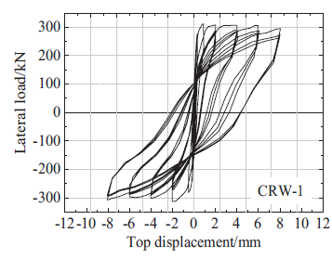
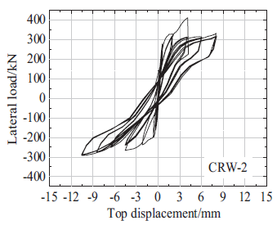
Use of ECC in Strengthening Masonry Walls
Research has been done recently that focuses on the use of ECCs in earthquake-resistant URM buildings because of their tensile-strain hardening response and high damage tolerance.
Research by Deng and Yang showed that trowelling ECC coating on both surfaces of brick walls increases its maximum lateral strength by 61%-99% but with a low increase in the displacement capacity by 3.21%-19.00% [5].

Slide 13
Experimental Program

Slide 14
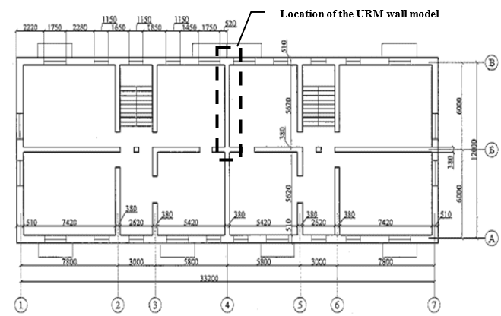
Prototype structure and Scaling
A prototype building was selected to represent a typical non-earthquake-resistant 4-story residential masonry building found in Almaty, Kazakhstan built within the year, 1957 to 1967.
The wall represents an interior load-bearing URM wall on the first story of the 4-story building, build on a solid precast reinforced concrete foundation with minimum brick-and-mortar strength of 7.5 MPa & 4.6 MPa, respectively (SNiP RK 2-03-30-2006).
The prototype wall was scaled down to 1/3 of its original size for the construction of the wall specimens.
Floor plan of prototype building

Slide 15
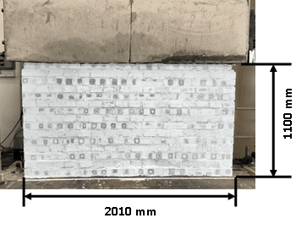
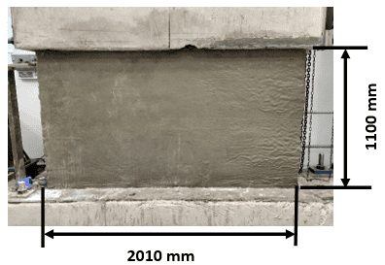
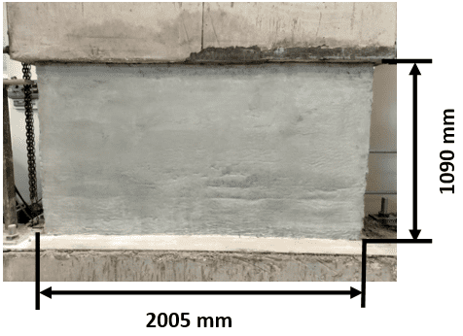
Wall specimens
Testing program
Un-retrofitted masonry wall (URW)
LWECC retrofitted wall (RW-1)
LWECC retrofitted wall (RW-2)

Slide 16
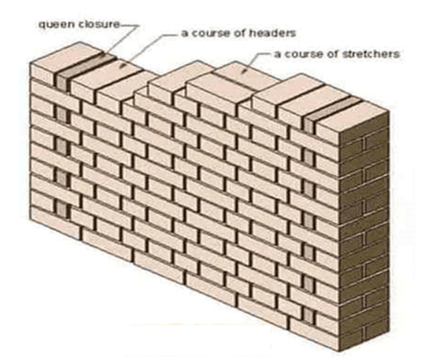
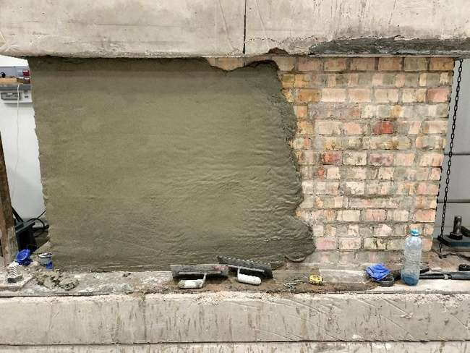
Construction of Masonry Walls
The walls were built to a dimension of 2m x 1.2m x 245mm, a 1:3 scale of the original prototype wall (6m length & 3m height).
The walls were built on a 700 mm thick reinforced concrete foundation anchored firmly to the ground.
Walls were assembled in the English bond configuration.
15mm thick layers of LWECC were applied on both surfaces of the wall specimens by trowelling the composites on a moistened brick wall face.
Retrofitting of wall specimens RW-1 and RW-2 with LWECC of two different compressive strengths.
Pattern of the wall construction
Application of LWECC retrofit layers over wall specimens

Slide 17
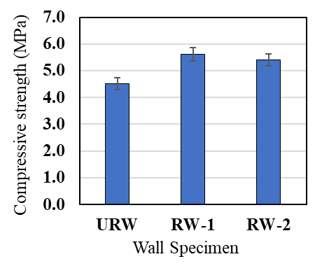
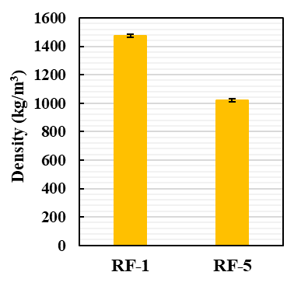
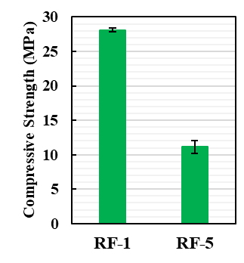
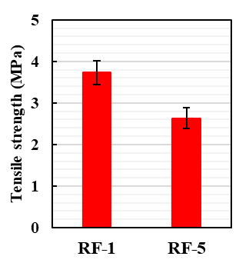
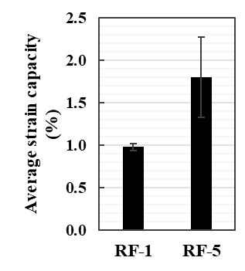
Material Properties
Clay bricks
Mortar
LWECC

Slide 18
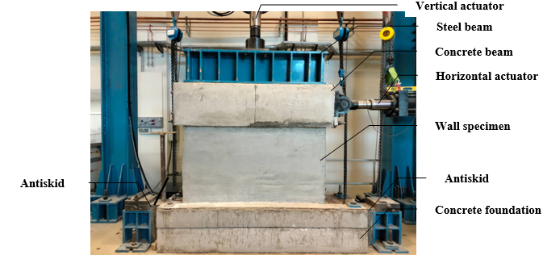
Wall Test setup
Large-scale In-plane masonry wall testing was carried out on all three wall specimens.
The foundation beams for the walls were fastened to the laboratory’s strong floor.
High-strength Reactive Powder Concrete antiskid positioned at both sides of the footing.
Concrete and steel beams placed on each wall specimen for effective transfer of loads from both actuators.
Setup for In-plane cyclic load Test

Slide 19
In-plane wall test loading protocol
Application of a constant gravity load of 248kN on wall specimen inducing an approximate average compressive stress of 0.51MPa
Using the horizontal actuator, cyclic lateral loads are applied to the top left end of the wall through the concrete beam.
First cycle of lateral load moving under load-controlled steps at a 1 kN/sec loading rate, loaded to 40 kN.
The loading switched to displacement-controlled steps, first loading one cycle per displacement step up to ±2 mm and three cycles per displacement step until failure.
Loading Protocol

Slide 20
Wall Instrumentation
String potentiometers 1 & 2 measure transverse deformations.
String potentiometers 3 & 4 to quantify the uplifts at both sides of each wall.
LVDT 1 & 2 measure uplifts at both ends of the wall toes induced by the rocking failure.
LVDTs 3 & 4 monitor any possible foundation beam sliding during the wall test.
LVDT 5 measures the horizontal top displacement of each wall specimen.
Instrumentation setup for wall specimens before conducting wall test

Slide 21
Results

Slide 22
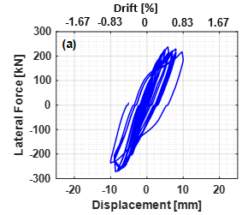
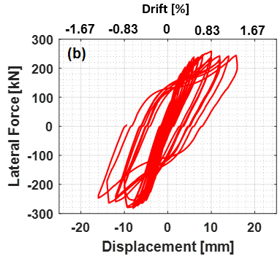
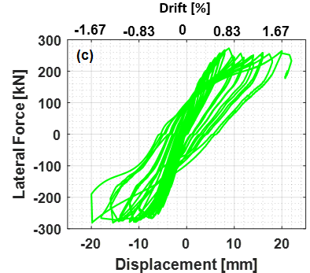
Force-displacement response
(a) URW
(b) RW-1
(c) RW-2
URW exhibited elastic behavior until 0.25% drift, plastic behavior from 0.25% drift to 0.42% drift when the wall achieved maximum lateral load, and large deformations exhibited by large hysteresis loops until ultimate failure at 0.83% drift.
RW-1 exhibited elastic behavior until 0.25% drift, with an extended plastic region to 0.83% drift at the point of maximum lateral load with large hysteresis loops indicating large deformations until ultimate failure at 1.35%drift.
RW-2 exhibited elastic behavior until 0.67% drift when the wall achieved maximum lateral load before switching to plastic behavior exhibiting expanded hysteresis loops until ultimate failure at 1.85% drift.

Slide 23
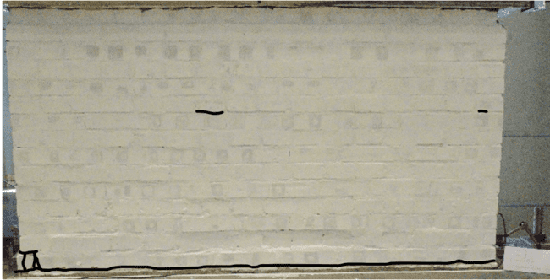
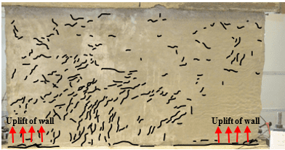
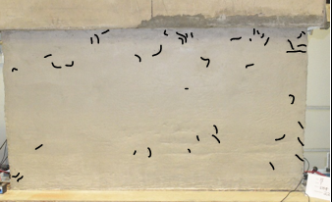
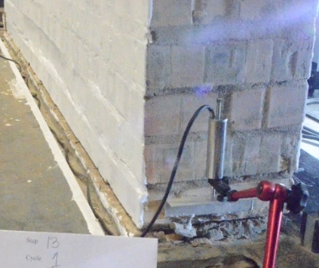
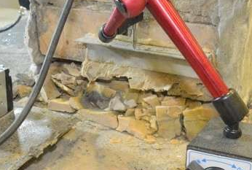
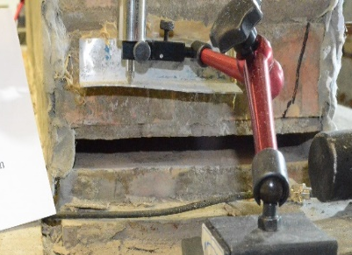
Failure mode
URW
RW-1
RW-2
URW experienced an initiated rocking failure, followed by crushing at the left toe. At a large wall drift, in-plane sliding was observed around the toe which resulted instability from out-of-plane movement.
RF-1 with the higher strength LWECC experienced limited rocking behavior, crushing of both toes, with a spread-out damage cracks across the wall’s body
RF-2 with the lower strength LWECC exhibited similar rocking behavior as the URW, followed by toe damage at a much larger drift and few shear cracks across the wall.

Slide 24
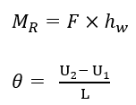
Displacement-rotation response
θ = wall and toe rotations
U₁ and U₂ = wall and toe uplifts at the west and east of the walls respectively
L = length of wall specimens
RW-1 showed less rotation at each displacement compared to URM verifying the limited rocking behavior of the wall while RW-2 showed larger rotation verifying the concentrated rocking behavior of the wall.
URW & RW-1 showed large changes in the rotation due to toe-crushing failure while RW-2 showed no sudden change in rotation with a uniform displacement-rotation slope, indicating a pure rocking failure behavior.
RW-2 also showed no sudden change in displacement confirming the absence of sliding within the wall.

Slide 25
Moment-rotation response
F = lateral force
h_{w} = height of wall
In comparison to URW, RW-1 experienced a little increase in rotation at the same applied moment to the wall.
RW-2 had a more significant increase in rotation at the same applied moment to the wall compared to other walls.

Slide 26

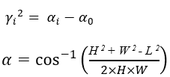
Shear deformation
F = lateral force applied at the time of stress determination
A_{s} =surface area of load application
H =vertical height of diagonal string potentiometer
W = horizontal length of diagonal string potentiometer
L = diagonal length of the string potentiometer
Shear stress vs. shear deformation graph
RW-1 showed more shear deformation than other walls due to diagonal shear stresses that created more spread-out shear cracks across the wall.
RW-2 had more shear deformation compared to URM from a few shear cracks shown on the wall but less than RF-1 due to the rocking failure experienced by the wall.

Slide 27

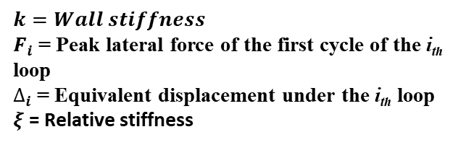

Stiffness Degradation
$${k_{s}}_{i}= \frac{\left(\left|+F_{i}\right|+\left|−F_{i}\right|\right)}{\left(\left|+∆_{i}\right|+\left|−∆_{i}\right|\right)}$$
$$ξ= k_{i}−k_{0}$$
$k=Wall stiffness$
$F_{i}$ = Peak lateral force of the first cycle of the i_{th} loop
$∆_{i}$ = Equivalent displacement under the i_{th} loop
$ξ$ = Relative stiffness
Increased initial wall stiffness by 58.44% and 24.45% and reduced rate of stiffness degradation for the retrofitted walls.
At the same displacement, the retrofitted walls had a lower reduction in stiffness invariably causing an increase in the displacement capacity.
RW-1 had higher initial stiffness, increasing the wall’s resistance to the flexural stresses generated at the bottom of the walls, resulting in the creation of distributed shear stress across the wall.

Slide 28
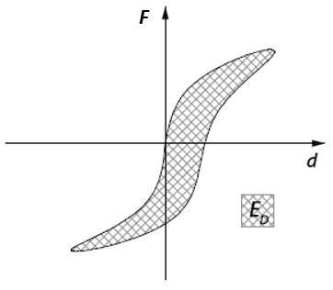
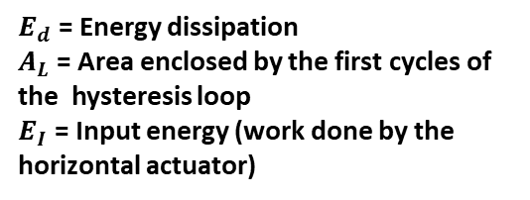

Energy dissipation capacity
$$E_{d}= \frac{A_{L}}{E_{I}}$$
$E_{d}$ = Energy dissipation
$A_{L}$ = Area enclosed by the first cycles of the hysteresis loop
$E_{I}$ = Input energy (work done by the horizontal actuator)
Schematic diagram on the determination of dissipated energy
Cumulative energy dissipation curves of wall specimens
The retrofitted walls experienced lower energy dissipation compared to URW due to LWECC overlay absorbing part of the stresses witnessed by the walls.
RW-1 showed more energy dissipation as compared to RW-2 due to the spread-out damage cracks observed across the wall’s body.
RW-2 showed the least energy dissipation resulting from rocking failure experienced by the wall with the wall rotating about its toes.

Slide 29
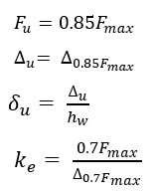
Backbone curve
Backbone curve of wall specimens
Idealization of backbone curve
Backbone curves are drawn by connecting the maximum points of the first cycle of each loading step.
The ultimate displacement capacity of each wall is idealized from the backbone curve to be the displacement where there is a 15% reduction in the maximum lateral load.
The effective stiffness of each wall is determined as the slope of each backbone curve at 70% of the maximum lateral load.

Slide 30
In-plane wall responses parameters for wall specimens
Wall Specimen |  | F_{max} (kN) | F_{u} (kN) | ∆_{u} (mm) | δ_{u} (%) | K_{e} (kN/mm) | ∆_{e} (mm) | µ [-] | % increase in F_{u} | % increase in ∆_{u} | % increase in K_{e} | % increase in µ
URW | + | 238 | 202 | 9.2 | 0.77 | 63.3 | 3.2 | 2.9 | - | - | - | -
 | - | 272 | 227 | 9.0 | 0.76 | 46.6 | 4.9 | 1.9 | - | - | - | -
RW-1 | + | 259 | 220 | 15.0 | 1.25 | 94.5 | 2.3 | 6.5 | 8.8 | 63.1 | 49.2 | 123.6
 | - | 281 | 239 | 16.0 | 1.33 | 78.3 | 3.1 | 5.2 | 5.6 | 76.4 | 67.7 | 180.2
RW-2 | + | 273 | 232 | 22.0 | 1.85 | 76.6 | 3.0 | 7.3 | 14.7 | 139.1 | 20.9 | 151.9
 | - | 281 | 239 | 18.7 | 1.57 | 59.8 | 4.0 | 4.7 | 5.6 | 106.5 | 28.0 | 150.4
Low increase in wall shear capacity within 5.60% - 14.69%.
Increase in the ultimate displacement capacity of RW-1 and RW-2 by 69.78% and 122.78% respectively.
RW-1 and RW-2 achieved an average increase in ductility capacity by 150%.

Slide 31
conclusion
The failure of the URW initiated with rocking, followed by toe damages. In-plane sliding was observed near the toe region at a large wall drift. This sliding also causes out-of-plane instability and failure of the wall.
Application of the LWECC prevented toe sliding and out-of-plane instability. Therefore, the wall can undergo more drift without significant strength reduction and becomes more ductile.
When the strength of applied LWECC is as low as 11 MPa, the wall exhibited similar rocking behavior as the URW, followed by toe damages at a much larger drift.
For the wall retrofitted with a higher strength (28MPA) LWECC, the rocking is limited by the higher tensile strength of the LWECC. More spread-out damage cracks were observed across the wall’s body, which indicates a mixed diagonal shear and rocking behavior. Although this behavior has a lower deformation capacity of the wall, it shows much more plastic response and energy dissipation as compared to the wall retrofitted with the lower strength LWECC.
The LWECC retrofitting was only applied to the wall surface without proper anchoring to the foundation since it was not feasible to realize. Therefore, the strength of the retrofitted walls has only a slight increase as compared to the URW.

Slide 32
Recommendations for further research
Development of a new wall aspect ratio and axial load combination for consideration of the performance of the LWECC to diagonal shear failure.
Conduction of further testing with the LWECC having much better anchoring into the foundation to have improved performance to flexural stress at the wall’s base.
Testing of the LWECC seismic performance in retrofitting other structural elements such as slab and columns.
Further study on the seismic performance of building elements retrofitted with green LWECC made from sustainable industrial byproducts.

Slide 33
References
[1] S. M. Renuka and I. P. Mervin Sanjith, “Strengthening of Damaged Masonry Walls Using Engineered Cementitious Composites: Experimental and Numerical Analysis,” Advances in Civil Engineering, vol. 2022, p. 6343179, May 2022.
[2] L. Gambarotta and S. Lagomarsino, “Damage models for the seismic response of brick masonry shear walls. Part I: the mortar joint model and its applications,” Earthquake engineering & structural dynamics, vol. 26, no. 4, pp. 423–439, 1997.
[3] S. M. Dehghan, M. A. Najafgholipour, A. R. Kamrava, and M. Khajepour, “Application of Ordinary Fiber-Reinforced Concrete Layer for In-plane Retrofitting of Unreinforced Masonry Walls: Test and Modeling,” Scientia Iranica, vol. 0, no. 0, pp. 0–0, Jan. 2018, doi: 10.24200/sci.2018.20164.
[4] M. Deng, Z. Dong, and P. Ma, “Cyclic loading tests of flexural-failure dominant URM walls strengthened with engineered cementitious composite,” Engineering Structures, vol. 194, pp. 173–182, Sep. 2019, doi: 10.1016/j.engstruct.2019.05.073.
[5] M. Deng and S. Yang, “Cyclic testing of unreinforced masonry walls retrofitted with engineered cementitious composites,” Construction and Building Materials, vol. 177, pp. 395–408, Jul. 2018, doi: 10.1016/j.conbuildmat.2018.05.132.
[6] L. S. Wijanto, “Seismic assessment of unreinforced masonry walls,” 2007.
[7] M. Tomaževič, Earthquake-resistant Design of Masonry Buildings. in Series on innovation in structures and construction. Imperial College Press, 1999. [Online]. Available: https://books.google.kz/books?id=uOhmaZWJ7wIC
[8] P. Davy and P. Cobbold, “Indentation tectonics in nature and experiment. 1. Experiments scaled for gravity,” Bull. Geol. Inst. Univ. Uppsala, vol. 14, pp. 129–141, 1988.
[9] F. Aslani, L. Wang, and M. Zheng, “The effect of carbon nanofibers on fresh and mechanical properties of lightweight engineered cementitious composite using hollow glass microspheres,” Journal of Composite Materials, vol. 53, no. 17, pp. 2447–2464, 2019.

Slide 34


