Slide 1
Exploring Classification
on Autonomously Generated Dataset
by Sultan Bauyrzhanuly
Thesis Supervisor: Martin Lukac
Submitted to the Data Science Department
in partial fulfillment of the requirements for the degree of
Master of Science in Data Science at the
NAZARBAYEV UNIVERSITY

Slide 2
Table of contents
01
02
03
Introduction
Theoretical Background
Methodology
The purpose of the thesis & overview of the paper
The methods used
for the research
The context of the research
04
05
Results
Conclusion
The results of the experiments
The summary of findings & future work possibilities

Slide 3
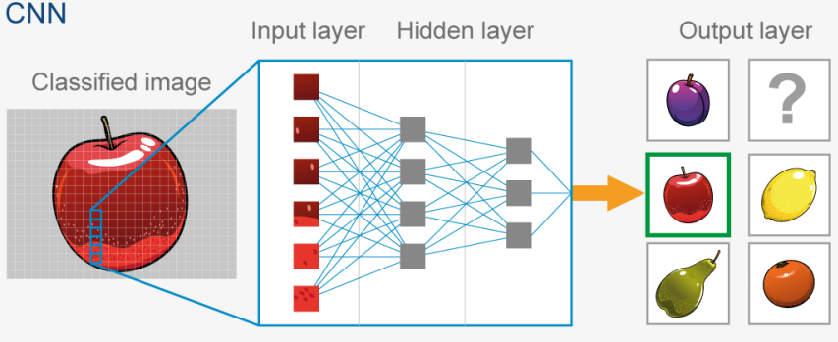

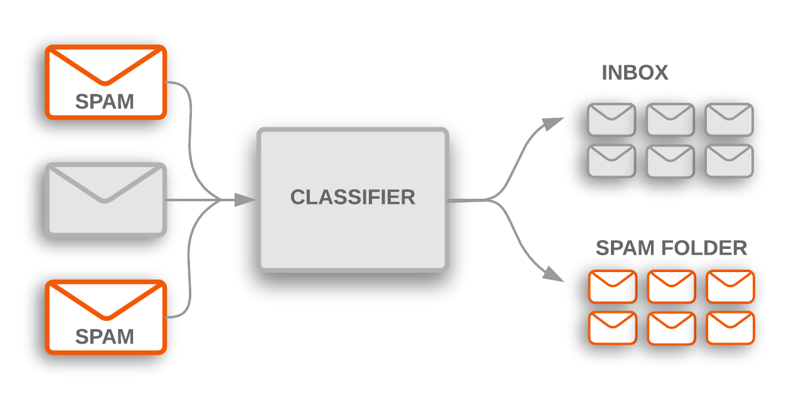
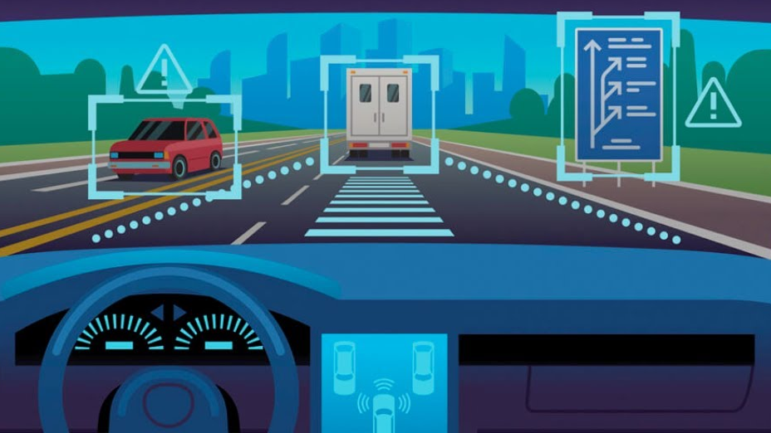
Introduction
Machine Learning algorithms have demonstrated impressive performances in different scenarios.
Problem Statement:
Machine Learning algorithms require large amounts of labeled data in order to effectively train the model.
Motivation:
The primary objective of this thesis is to investigate the influence of three distinct clustering techniques on the performance and outcomes of a classification model applied to an autonomously generated dataset

Slide 4
Introduction
Problem Statement:
Machine Learning algorithms require large amounts of labeled data in order to effectively train the model.
Autonomously generated datasets are getting more attention because of their properties of being collected and/or labeled without human intervention (Cicco et al., 2017, Kulkarni et al., 2020).

Slide 5
Introduction
Problem Statement:
Machine Learning algorithms require large amounts of labeled data in order to effectively train the model.
Autonomously generated datasets are getting more attention because of their properties of being collected and/or labeled without human intervention (Cicco et al., 2017, Kulkarni et al., 2020).
Motivation:
The primary objective of this thesis is to explore the performance and outcomes of a classification model that was trained on autonomously generated datasets using three distinct clustering techniques.

Slide 6
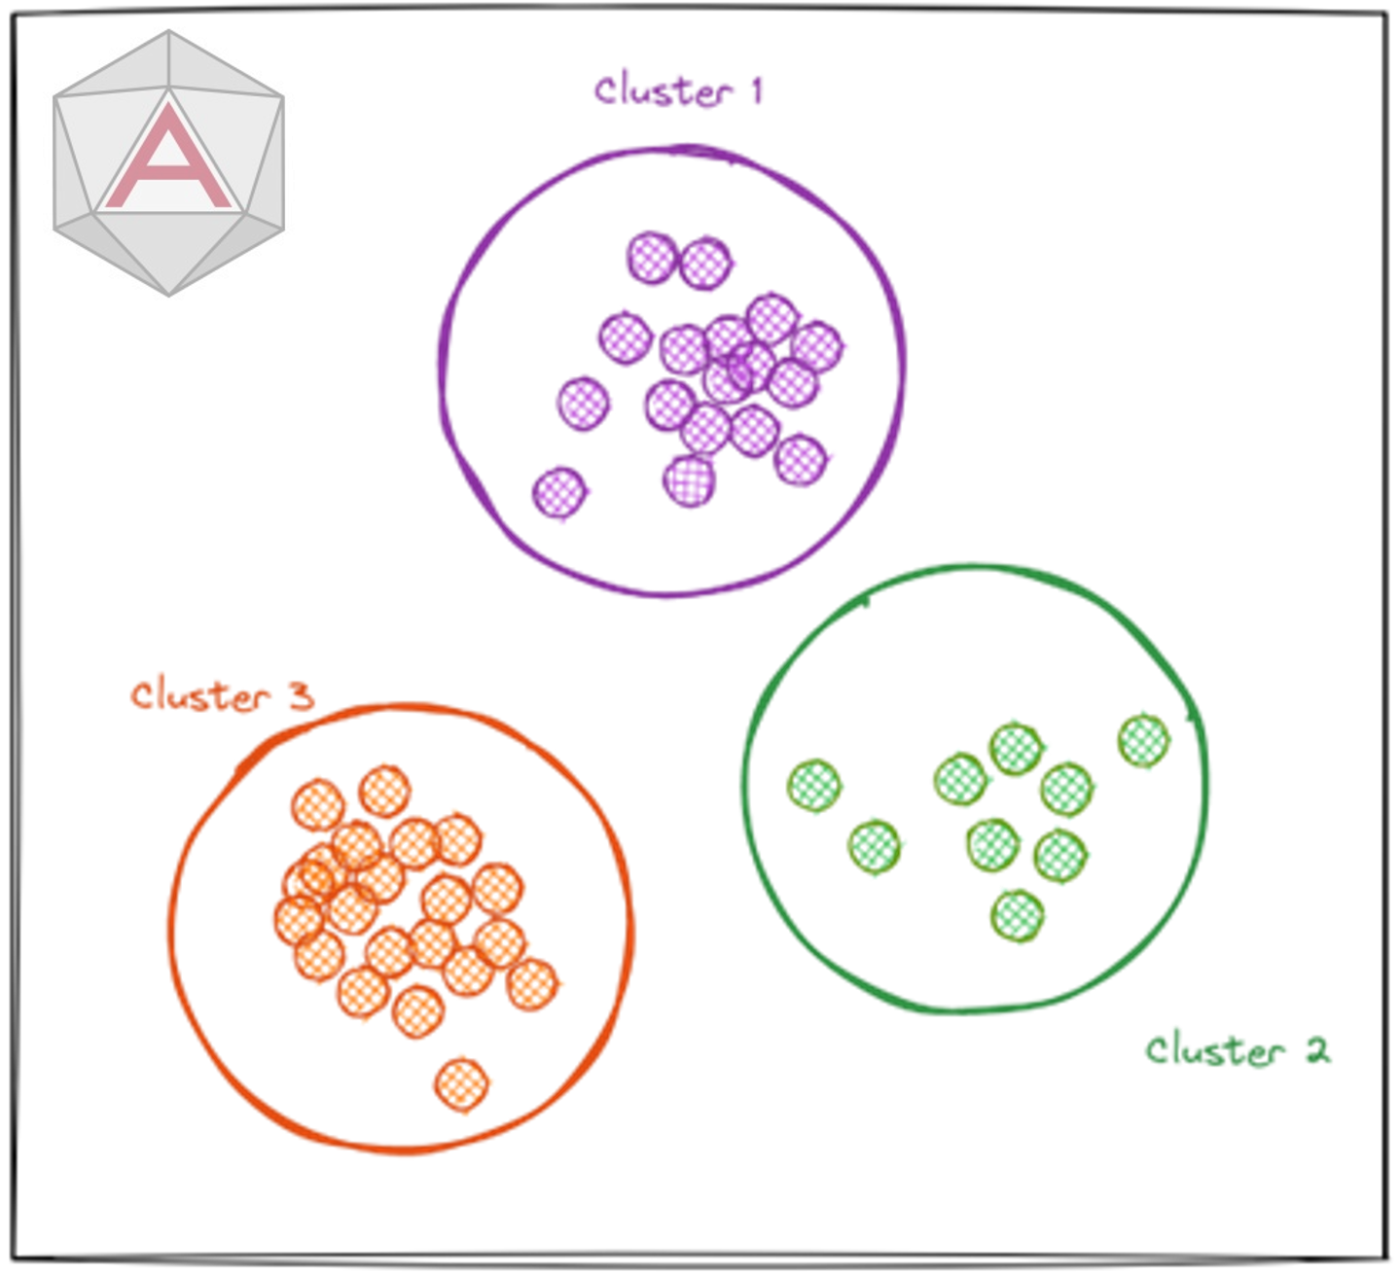

Theoretical Background
Clustering
Algorithms
Data examination:
  Machine Learning
  Pattern Identification
  Information Retrieval
Active area of research (Gan, 2013),(Min and Kai-fei, 2015), (Murtagh and Legendre, 2014)

Slide 7
Theoretical Background
Clustering
Algorithms
Similarity-based
Density-based
Model-based
K-Means
DBSCAN
GMM

Slide 8
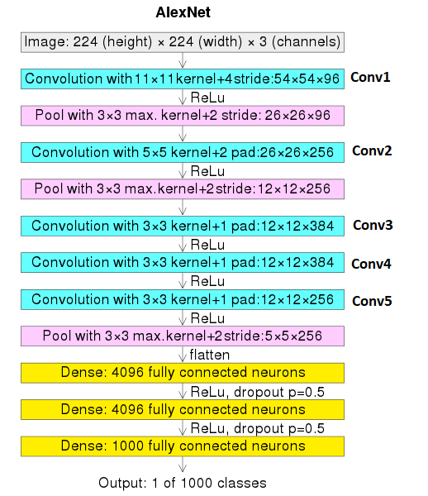
Theoretical Background
Krizhevsky et al. (2012)
ImageNet Visual Recognition Challenge Winner

Slide 9
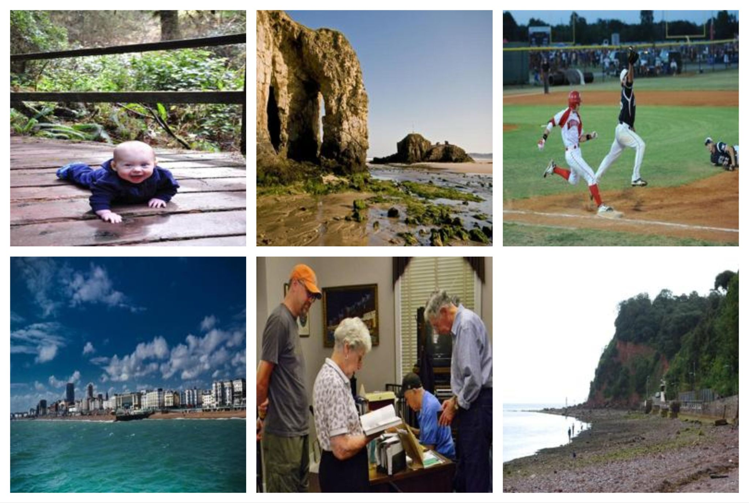
Methodology - Dataset
Places365-Standard
Characteristics:
  1.8 mln images for training (36,500 valid, 328,000 test)
  256x256
A subset of 145,000
  train-valid-test: 80%-10%-10%
Places365 (Zhou et al, 2017)

Slide 10
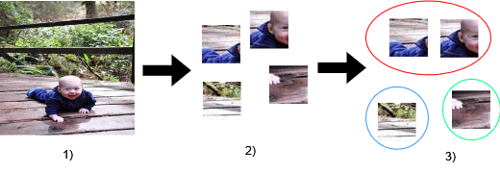
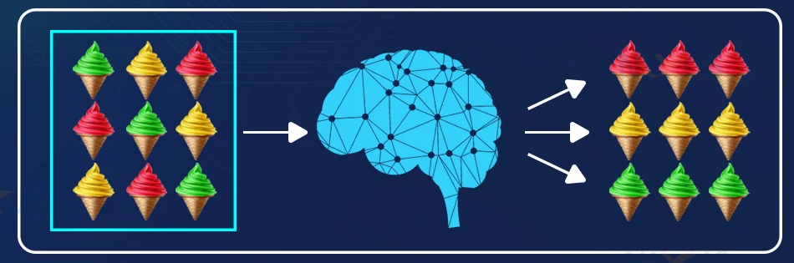
Methodology - Steps
For each Image (1) in Dataset:
Image partitioning (2)
  4 samples of 40x40
Dataset Clustering (3)
Classification

Slide 11
Methodology - Clustering
Dataset Clustering
  Feature Extraction: Conv 1-5
  1152 low level features

Slide 12
Methodology - Clustering
Dataset Clustering
  Feature Extraction: Conv 1-5
  1152 low level features
Special parameters:
For K-Means and GMM:
  K-value: 4 & 10
For DBSCAN:
  Epsilon value

Slide 13

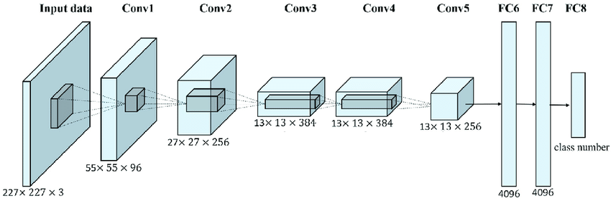
Methodology - Classification
Dataset Classification
  Adam optimizer
  NLLLoss
Class number: 4 and 10

Slide 14
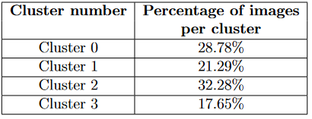
Results - K-Means
Clustering results:
4 classes
10 classes
Classification results

Slide 15
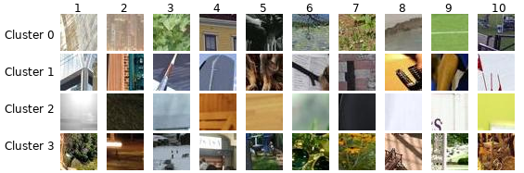
Results - K-Means
Clustering results:
4 classes
10 classes
Classification results

Slide 16
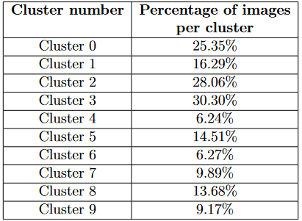
Results - K-Means
Clustering results:
4 classes
10 classes
Classification results

Slide 17
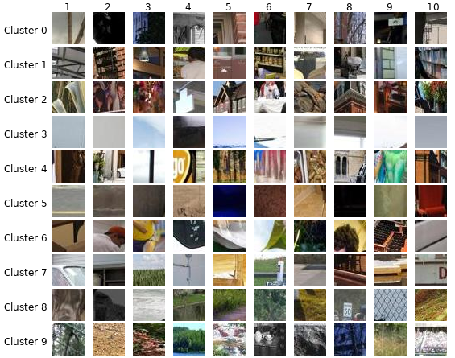
Results - K-Means
Clustering results:
4 classes
10 classes
Classification results

Slide 18
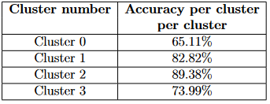
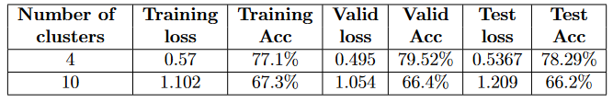
Results - K-Means
Clustering results:
4 classes
10 classes
Classification results

Slide 19
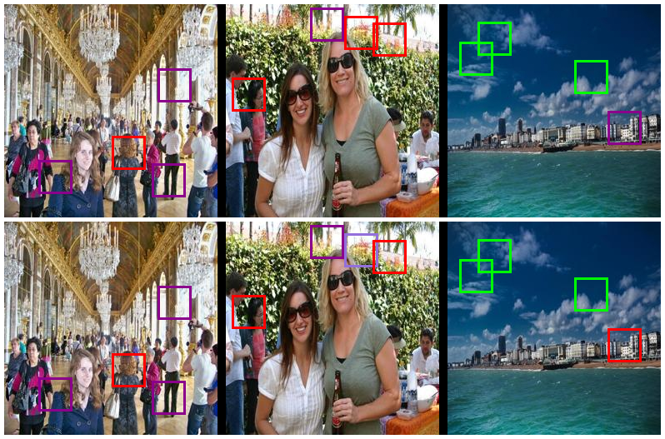
Results - K-Means
Clustering results:
4 classes
10 classes
Classification results
Color | Cluster
Violet | 0
Dark Magenta | 1
Lime | 2
Red | 3

Slide 20
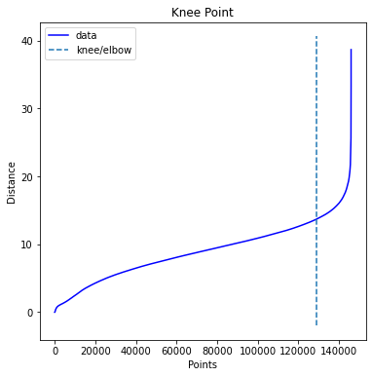
Results - DBSCAN
Eps = 13.68
Clustering results:
4 classes
Classification results

Slide 21
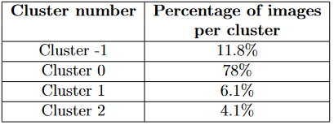
Results - DBSCAN
Clustering results:
4 classes
Classification results

Slide 22
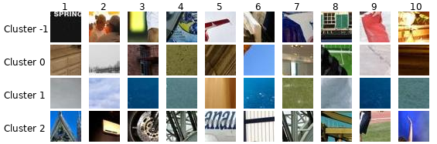
Results - DBSCAN
Clustering results:
4 classes
Classification results

Slide 23
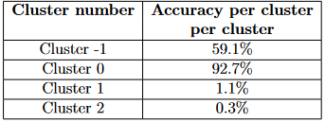

Results - DBSCAN
Clustering results:
4 classes
Classification results

Slide 24
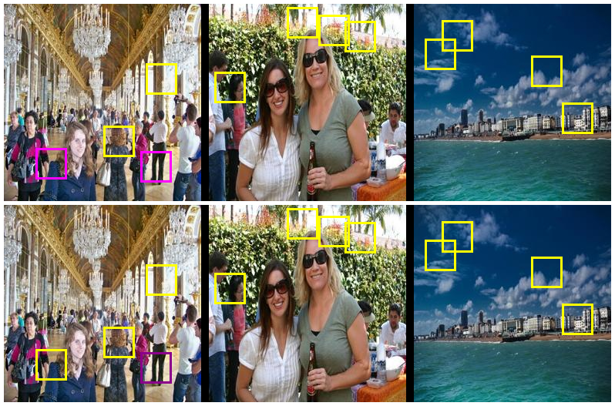
Results - DBSCAN
Clustering results:
4 classes
Classification results
Color | Cluster
Yellow | 0
Magenta | -1
Lime | 1
Red | 2

Slide 25
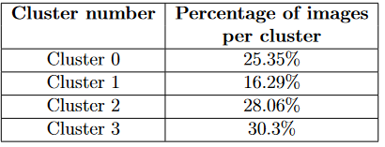
Results - GMM
Clustering results:
4 classes
10 classes
Classification results

Slide 26
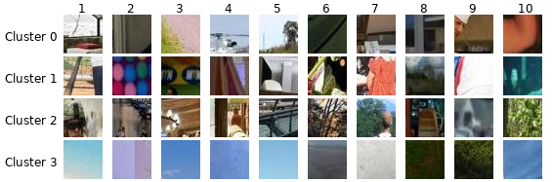
Results - GMM
Clustering results:
4 classes
10 classes
Classification results

Slide 27
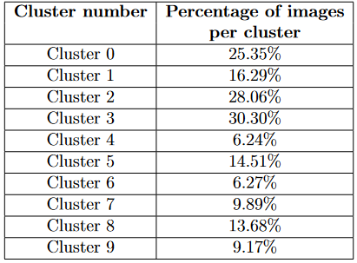
Results - GMM
Clustering results:
4 classes
10 classes
Classification results

Slide 28
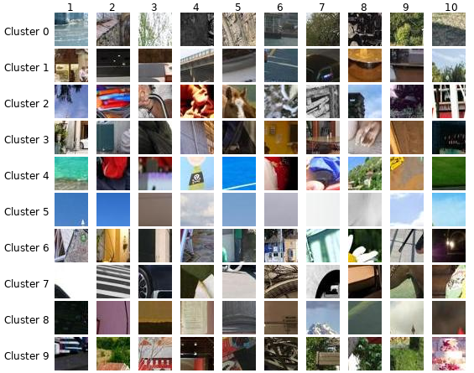
Results - GMM
Clustering results:
4 classes
10 classes
Classification results

Slide 29
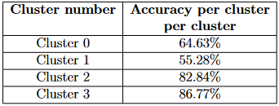
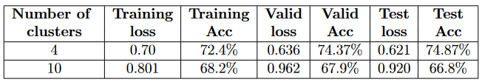
Results - GMM
Clustering results:
4 classes
10 classes
Classification results

Slide 30
Results - GMM
Clustering results:
4 classes
10 classes
Classification results

Slide 31
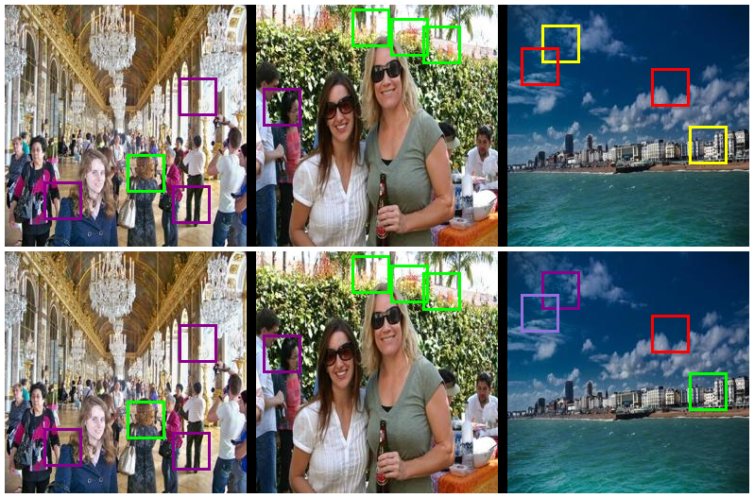
Results - GMM
Clustering results:
4 classes
10 classes
Classification results
Color | Cluster
Yellow | 0
Dark Magenta | 1
Lime | 2
Red | 3

Slide 32
Conclusion
The study explored the clustering results of 3 algorithms and classification accuracy when trained on generated datasets.
K-Means and GMM can be used to effectively cluster autonomously generated datasets. However, DBSCAN demonstrated poorer outcomes.
K-Means and GMM algorithms had visually distinguishable patterns in most of their clusters.
For the future work:
  Other modifications and algorithms
  Feature extraction and Dimensionality reduction

Slide 33
References
Alex Krizhevsky, Ilya Sutskever, and Geoffrey E Hinton. Imagenet classification with deep convolutional neural networks. Communications of the ACM, 60(6):84–90, 2017.
Bolei Zhou, Agata Lapedriza, Aditya Khosla, Aude Oliva, and Antonio Torralba. Places: A 10 million image database for scene recognition. IEEE Transactions on Pattern Analysis and Machine Intelligence, 2017
Maurilio Di Cicco, Ciro Potena, Giorgio Grisetti, and Alberto Pretto. Automatic model based dataset generation for fast and accurate crop and weeds detection. In 2017 IEEE/RSJ International Conference on Intelligent Robots and Systems (IROS), pages 5188–5195, 2017.
Sayali Kulkarni, Sheide Chammas, Wan Zhu, Fei Sha, and Eugene Ie. Aquamuse: Automatically generating datasets for query-based multi-document summarization. arXiv preprint arXiv:2010.12694, 2020.
Haitao Gan, Nong Sang, Rui Huang, Xiaojun Tong, and Zhiping Dan. Using clustering analysis to improve semi-supervised classification. Neurocomputing, 101:290–298, 2013.
Zhang Min and Duan Kai-fei. Improved research to k-means initial cluster centers. In 2015 Ninth international conference on frontier of computer science and technology, pages 349–353. IEEE, 2015.
Fionn Murtagh and Pierre Legendre. Ward’s hierarchical agglomerative clustering method: which algorithms implement ward’s criterion? Journal of classification, 31:274–295, 2014.

Slide 34
Thank you for your attention!

