Slide 1
MASTER THESIS
Multimodal Authentication Systems:
A Consideration of System Integrity, Availability and
Resilience Against Spoofing Attacks
Students: Aitore Issadykova, Lead Supervisor: Michael Lewis
Assem Kussainova

Slide 2
Outline
Project Motivation and Goals
Joint Work Motivation
Literature Review
Model Origin
Datasets
Data Preprocessing
06. Model:
Architecture
Testing and Observations
Resilience
Demonstration
CIA Analysis
07. Limitations and Future work

Slide 3
Project Motivation and Goals
Thesis motivation:
Data science in Cyber Security
Biometric Authentication
Main objective - identification of the methods that will be used in the project scope: biometric type, model architecture, morphing techniques

Slide 4
Project Motivation and Goals
Project goals:
Replication of multimodal biometric system
Validation of system on well-known datasets
Optimize parameters of system: accuracy and time-cost
Assessment of model resilience under attacks
Provide an CIA analysis for the particular architecture

Slide 5
02. Joint Work Motivation
Initial plan - two separate works:
Construction of biometric authentication model
Examination of the security and reliability of the first work through obfuscation and spoofing techniques
Potential issues - overlapping sources and description of one common system;
inconsistent narration in both documents

Slide 6
02. Joint Work Motivation
Single document:
more coherently presents the framework and examines its performance and resilience
acceptable under SEDS guidelines
Students contributions are noted in the table of contents of the thesis document.

Slide 7
03. Literature Review
250+ sources
focus area
history of biometric authentication
62 relevant recent sources
spoofing
majority sources from IEEE and ACM

Slide 8
03. Literature Review
In the scope of the project:
Unimodal biometric components (AlexNet, DWPT)
Multimodal systems
Attempts for spoofing
Tendency in the research field: highest accuracy, detection mechanisms

Slide 9
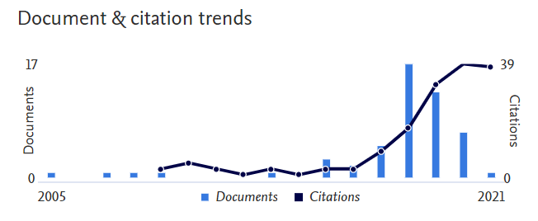
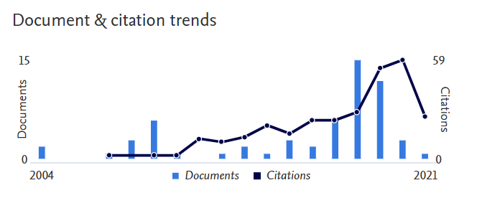
Model Origin
X. Zhang, D. Cheng, P. Jia, Y. Dai and X. Xu, “An Efficient Android-Based Multimodal
Biometric Authentication System With Face and Voice”
Journal:
IEEE Access volume 8, pages 102757 - 102772 (June 2020)
Main authors: Xinman Zhang Xuebin Xu
Xi'an Jiaotong University
Xi'an Jiaotong University

Slide 10
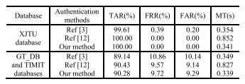
Model Origin
Strong aspects of publication:
high accuracy and low execution time
complete description of architecture
availability and simplicity of algorithms
validation on open-source datasets
Discovered limitations:
no hyperparameters values
no access to XJTU database
no information on combining TIMIT and GT_DB datasets
Cross-validation results for public databases in comparison with some state-of-the-art multimodal authentication methods by Zhang et al.

Slide 11
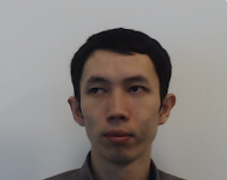
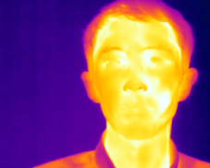
04. Datasets
SpeakingFaces sample data
Main dataset:
SpeakingFaces Dataset:
  participation in data collection process
  142 participants, 111 randomly selected: 98 users
  2 trials: 9 perspectives of RGB and thermal images, audio data from 2 mics
  missing files and misaligned images issues

Slide 12
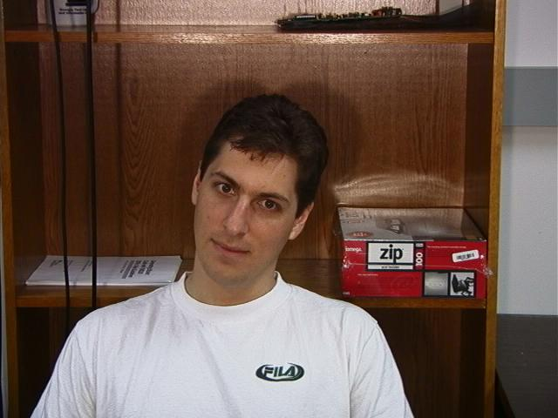
04. Datasets
Validation datasets:
TIMIT
  630 participants, 462 users in TRAIN folder
  3696 audio tracks
Georgia Tech Face Database
  50 participants
  several trials - 15 RGB images
GT DB sample data

Slide 13

05. Data Preprocessing
Data and Files Storage: Shared Google Drive
Images:
Removing aligned images
Extracting 1 image per perspective for both RGB and thermal files
9 images divides into frontal and profile: within profile dividing into right and left
Audio:
Removing recordings from 1 microphone
Dividing into train and test samples according to trials taken

Slide 14

05. Data Preprocessing
Data Downloading - 1 - 2 hour per subject
Data Extraction - 40 minutes per subject
Data Cleaning - 30 minutes per subject
Data Size per subject (in average):
Initial ~ 6.7Gb Reduced ~ 37Mb
Total Time = min 333 hours
~ 14 days
(42 business days)
Average Processing Time = 3 - 4 hours per subject
Train/Test division:
SpeakingFaces: trial 1:trial 2
TIMIT: 80:20
GT_DB: 80:20

Slide 15
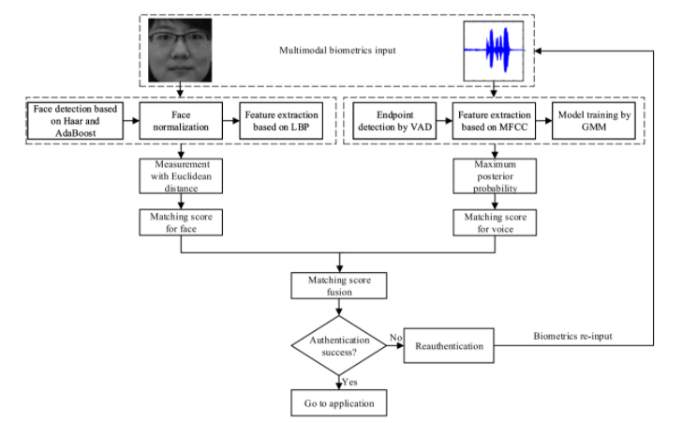
06. Model Architecture
Flow chart of the multimodal biometric authentication system by Zhang et al.

Slide 16
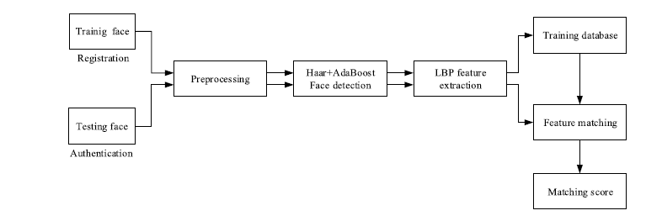

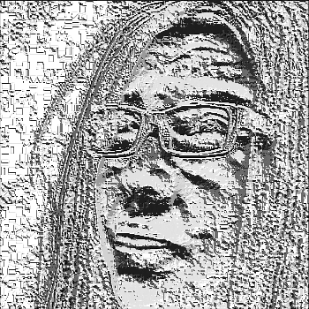
06. Model Architecture
Face Module Architecture
Face Recognition: Haar Cascades with AdaBoost
Feature Extraction: LBP feature extraction
Metrics: Euclidean, Cityblock distances
Unimodal biometric component for face recognition by Zhang et al.
Detection face area and creation feature image

Slide 17
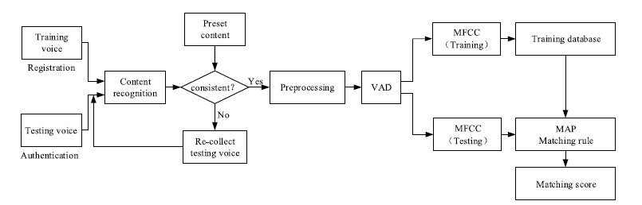
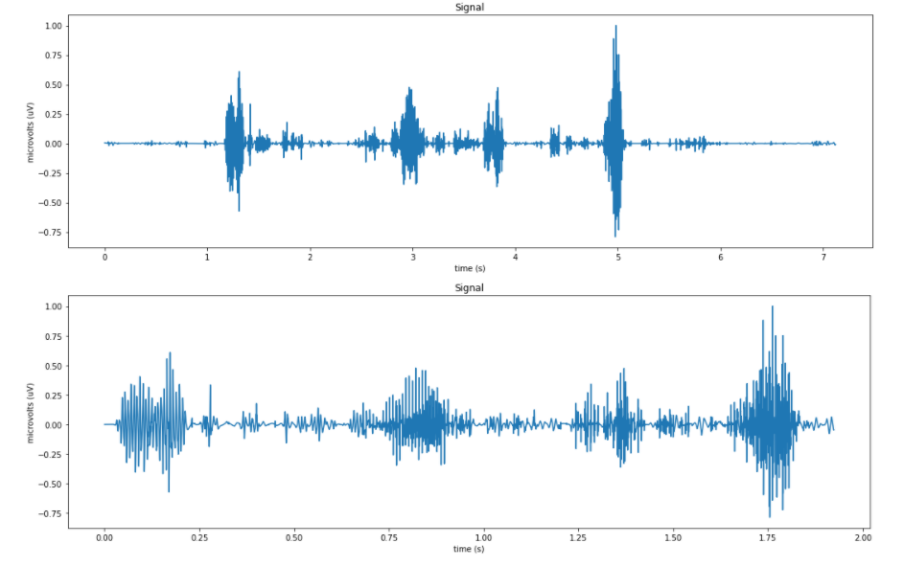
06. Model Architecture
Voice Module Architecture
Preprocessing: Discrete Wavelet Transform with Voice Activity Detection
Feature Extraction: Mel-Frequency cepstral coefficients
User Recognition: Gaussian Mixture Model
Metrics: Maximum Likelihood
Unimodal biometric component for voice recognition by Zhang et al.
Resulting signal after applying preprocessing methods

Slide 18
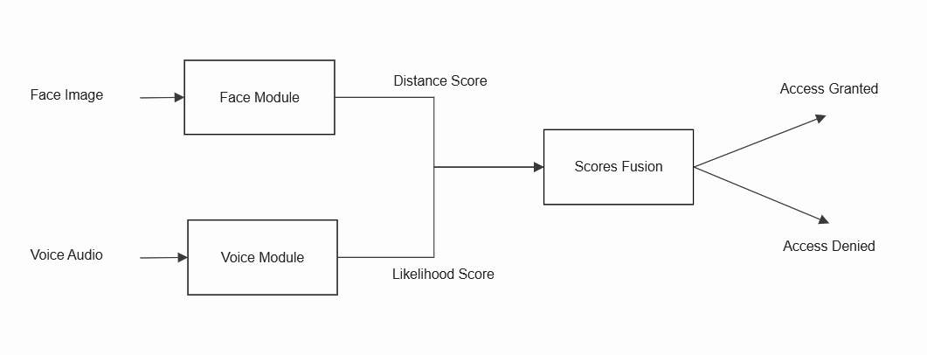
06. Model Architecture
Matching level fusions scores:
Threshold based system
Ranking based system
(By Zhang et al.)
(Proposed method)

Slide 19
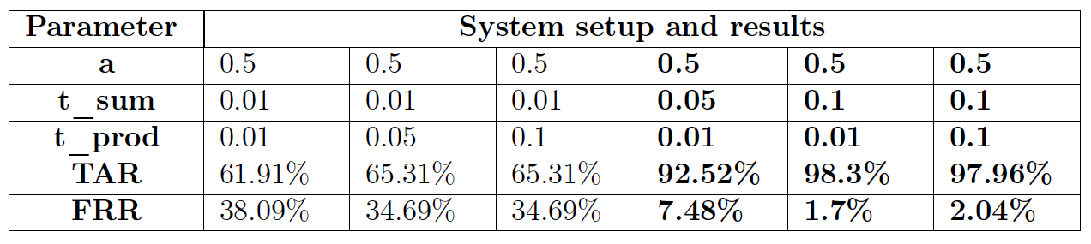
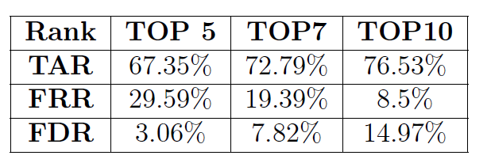
06. Model Testing and Observations
Threshold based fusion system results
Ranking based fusion system results
🔔🔔🔔
Time required:
5 months

Slide 20
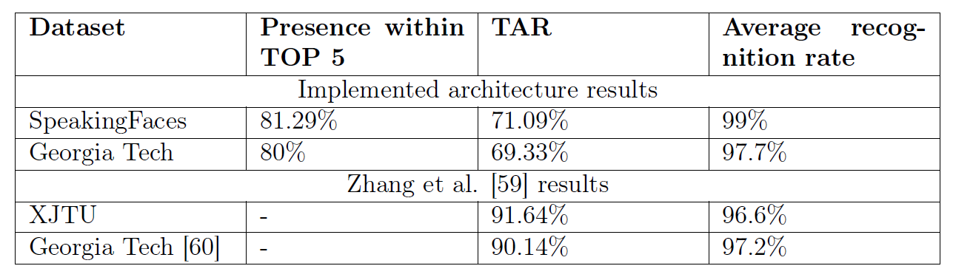
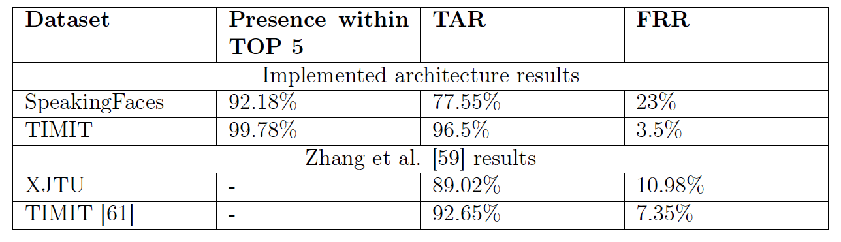
06. Model Testing and Observations
Validation of unimodal component performance GT DB and TIMIT datasets

Slide 21
06. Model Testing and Observations
Observations:
Threshold based fusion provides the highest accuracy
Weak performance of face unimodal component
Voice unimodal component outperformed results by Zhang et al.
Highest achieved accuracy - 98.3% TAR comparing to 100% for XJTU and 90.28% for joined TIMIT-GT DB achieved by Zhang et al.

Slide 22

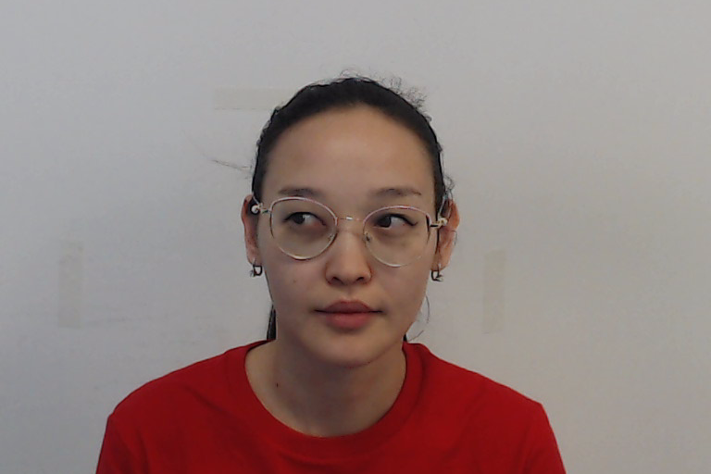
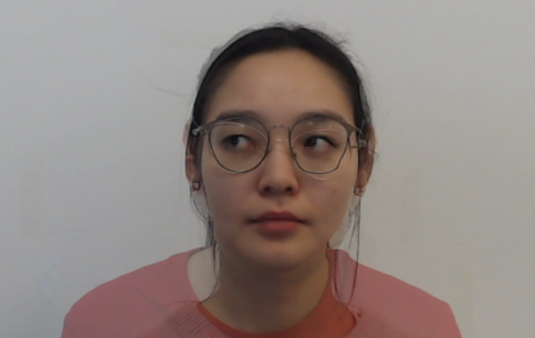
06. Model Resilience
Spoofing scenarios:
no spoofing
face only spoofing
voice only spoofing
both biometric spoofing
Intruder
Authorized User
Biometrics mimicry:
Face morphing - manual aligning with external application
Voice synthesizing - Tacotron system
Morph

Slide 23
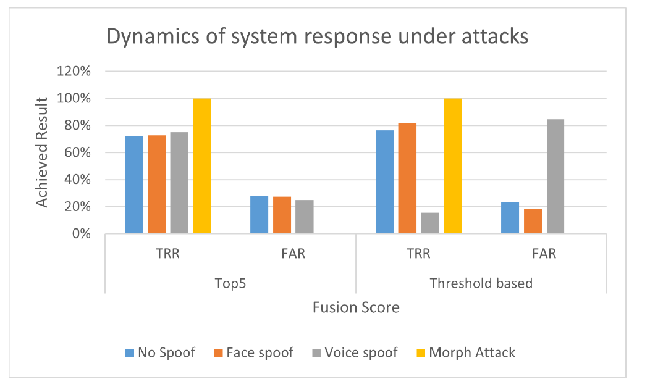
06. Model Resilience

Slide 24
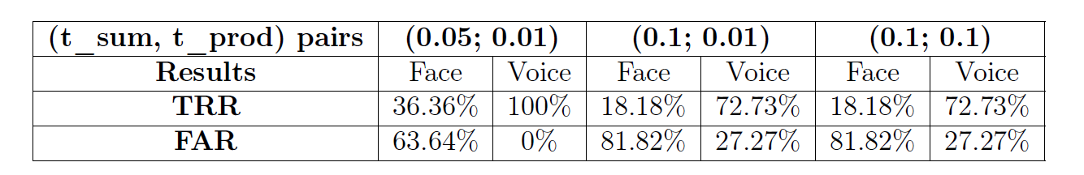
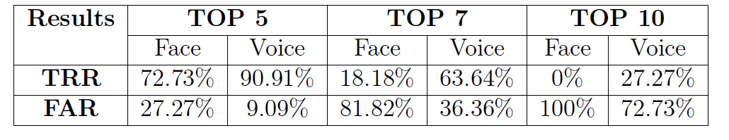
06. Model Resilience
Synthetic data quality analysis
Threshold based Fusion system
Ranking based Fusion system
According to the Ranking based Fusion system results it can be seen that all synthetic face data within top 10 of similarity to real user, while almost 73% of synthetic audio data within top 10 similarity for real user voice

Slide 25
06. Model Demonstration

Slide 26
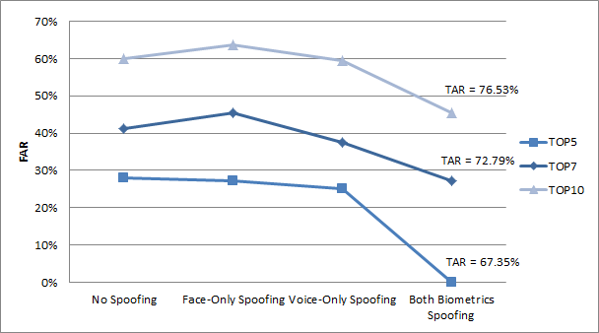
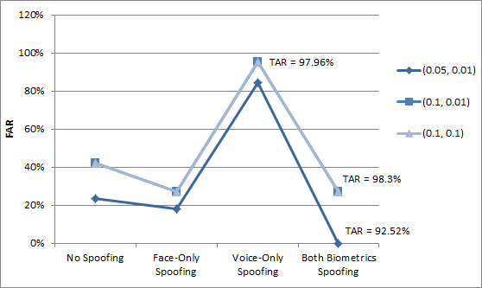
06. CIA Analysis
Confidentiality and Integrity:
Initial expectation: systems with lower thresholds and lower ranking number will provide higher security level of the biometric authentication system.
Ranking based fusion
Threshold based fusion
Both fusion systems provide adequate level of security for some scenarios; however, the possibility of unauthorized data modification is still present in both models.

Slide 27
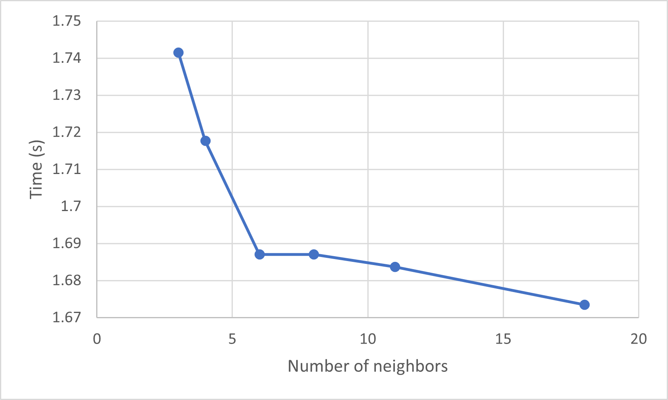
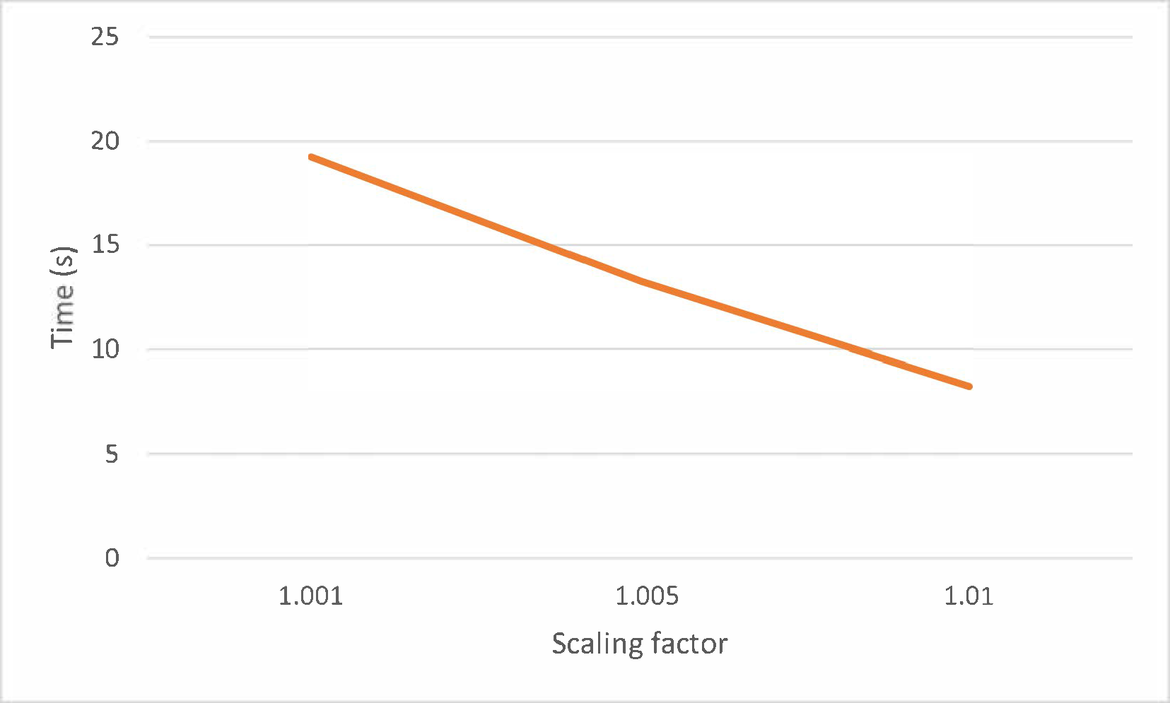
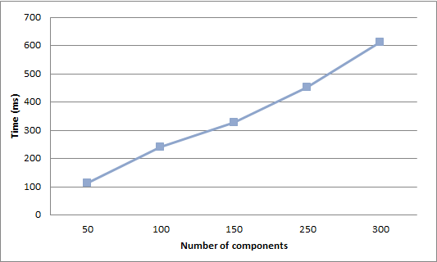
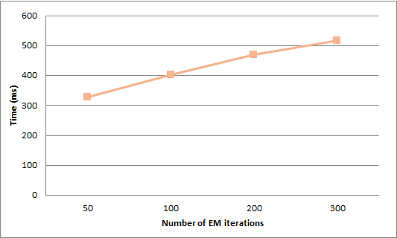
06. CIA Analysis
Availability:
User authentication time reduced by 11s with best parameters of face module
Optimizing the parameters of the voice module decreased the authentication time to 328ms
User authentication time dependence on face module parameters’ values
Effect of voice module parameters on single user authentication

Slide 28
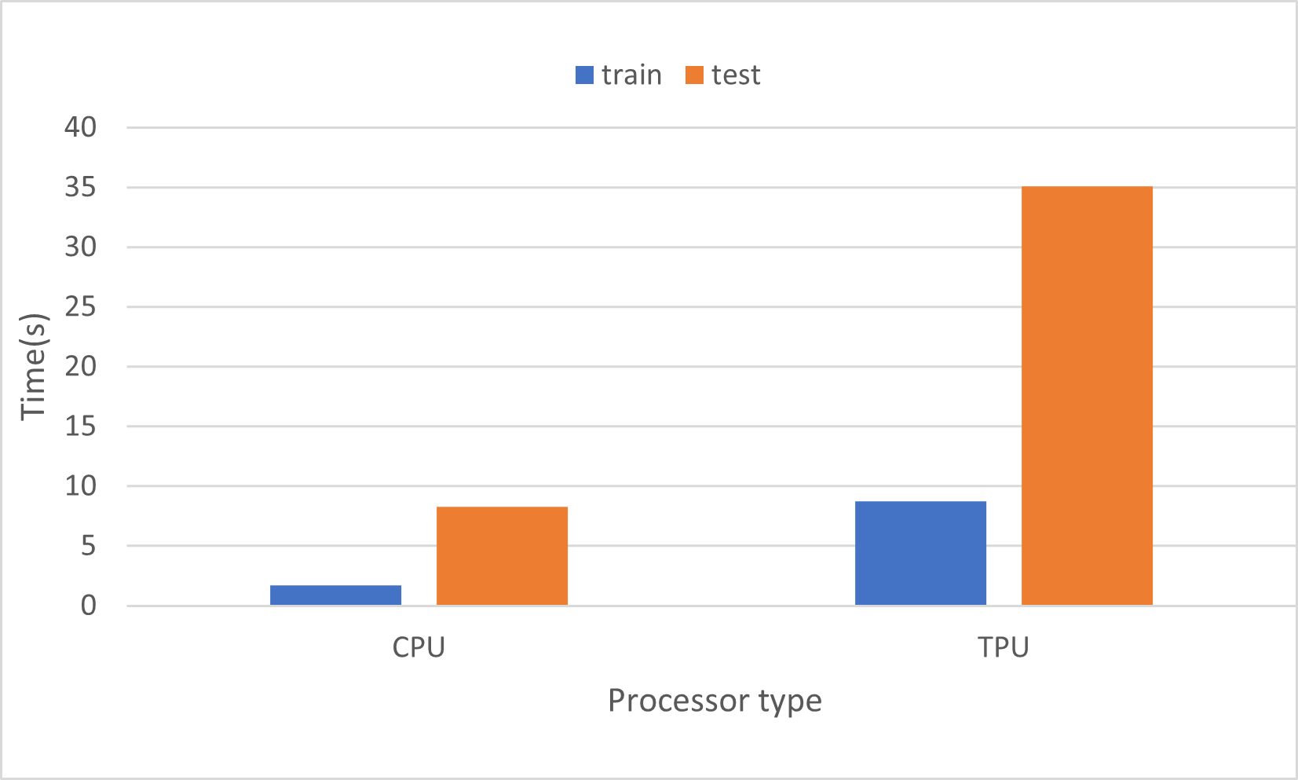
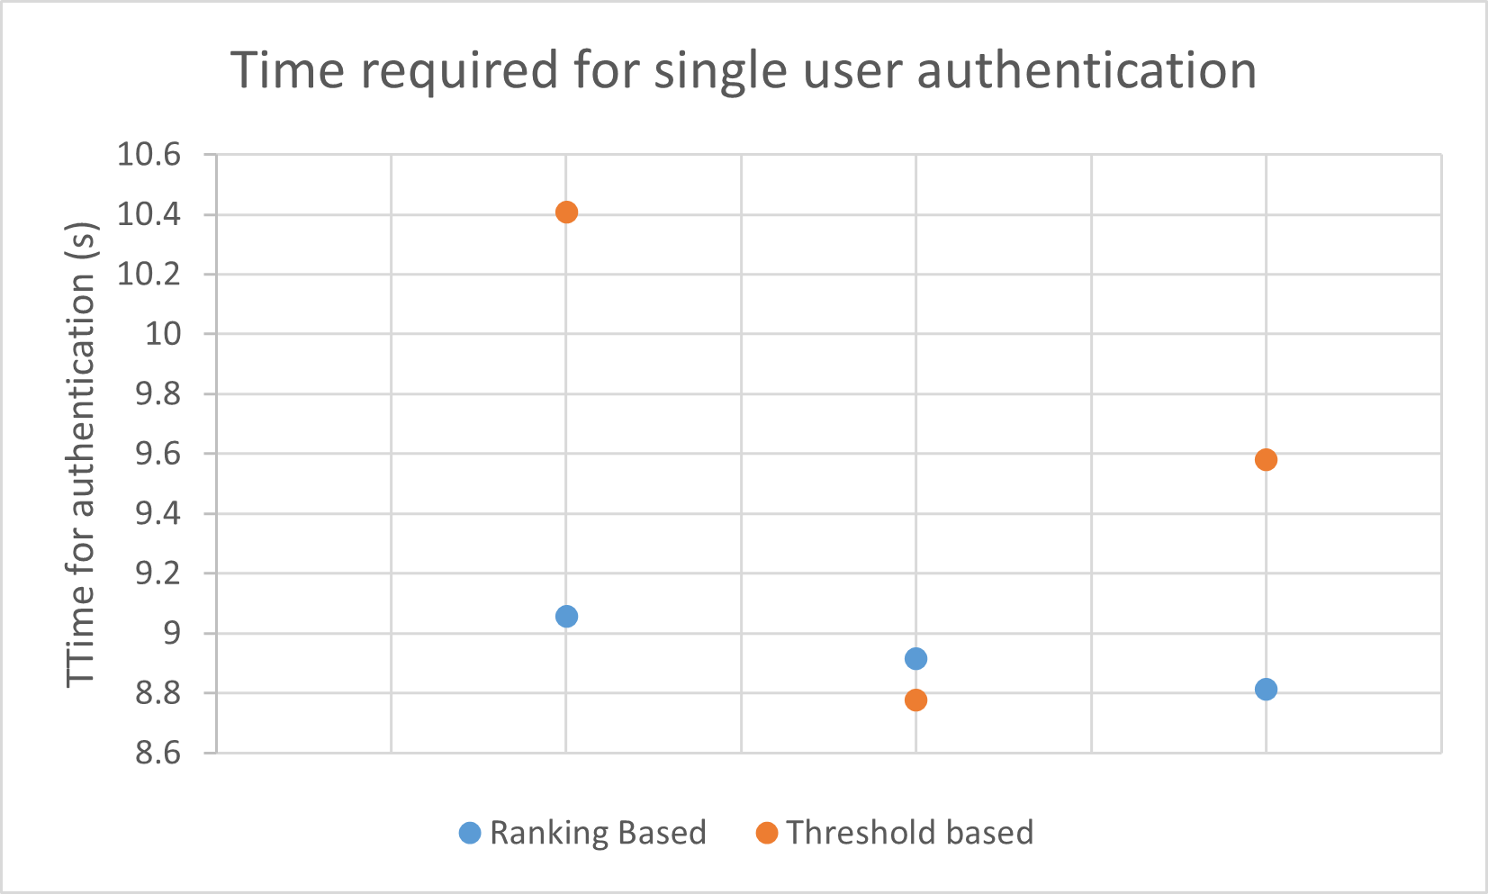
06. CIA Analysis
Effect of the processors cores type on the single user authentication
Single user authentication time analysis between two fusion systems
CPU processor type works 4 times faster than TPU core
Ranking based fusion setups generate response in 8.9s and threshold based systems average time response is 9.6s.

Slide 29
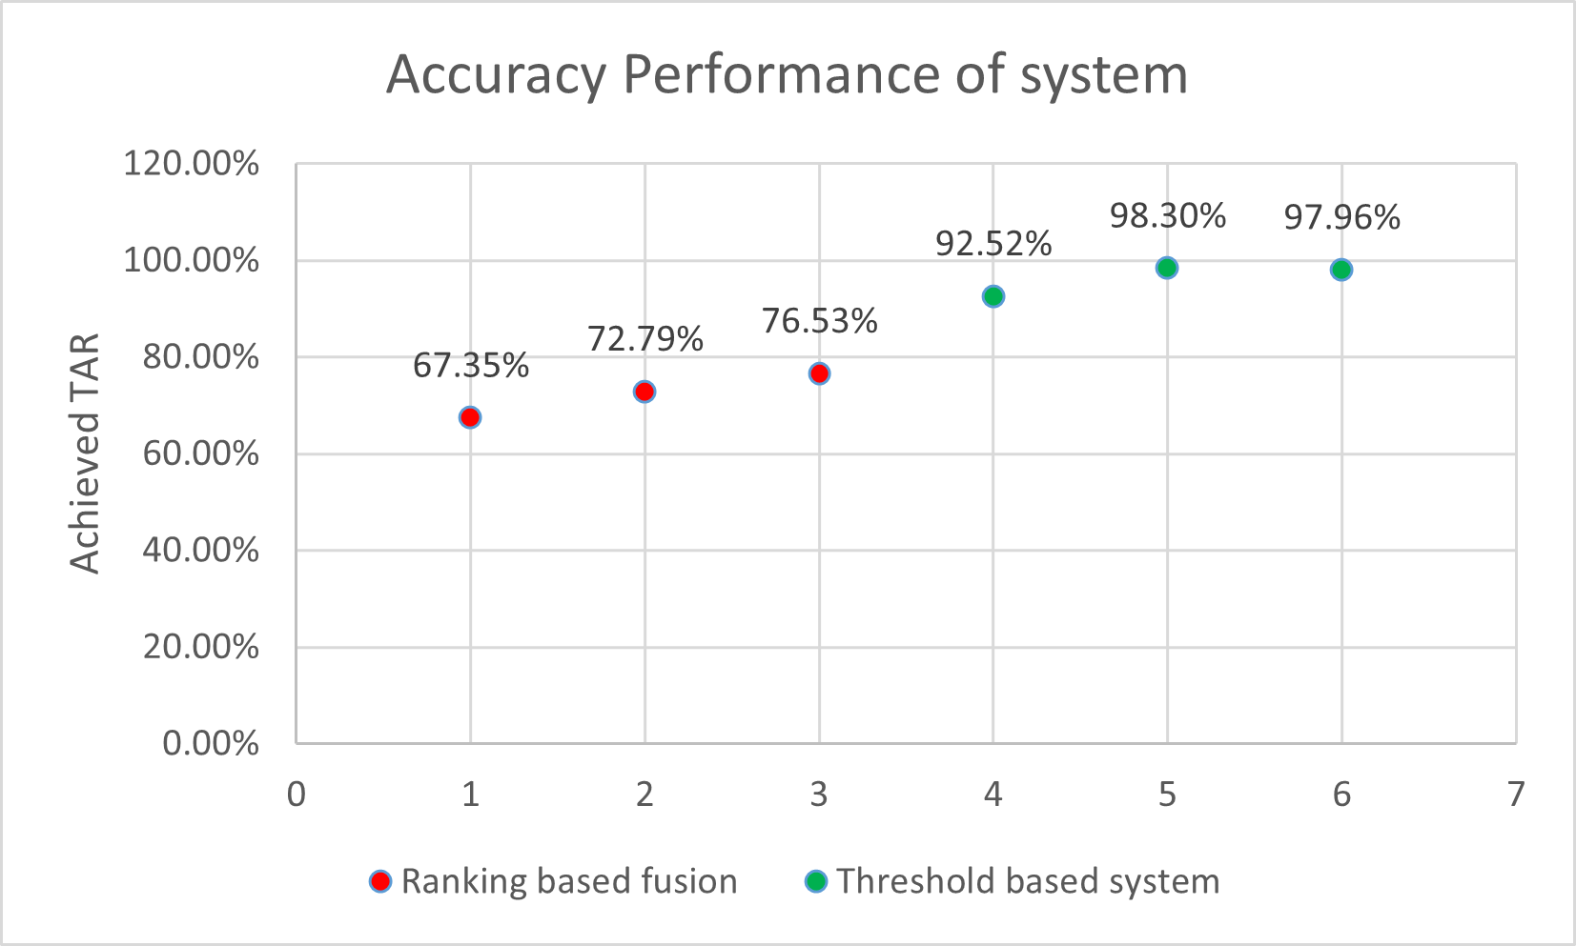
06. CIA Analysis
Best Accuracy provided by Threshold based fusion
Fastest Authentication provided by Ranking based fusion
Achieved TAR for different setups of multimodal systems

Slide 30
07. Limitations and Future Work
1
Hardware and Computational Resources
3
Model
Сomputational demands of constructed model significantly exceed the capacity of higher-end desktop systems.
The absence of parameters of the replicated model caused the non-identical design of the authentication system.
2
Dataset
4
Time
SpeakingFaces was limited to two sessions, with less consideration of the the environmental or emotional range of the subjects and some missing files and data irregularities.
The timeline for thesis completion imposed a limit on the range of scenarios and on the collection of test subjects.

Slide 31





07. Limitations and Future Work
introduce liveness detection
test other fusion systems
increase the variety of the attacks
additional preprocessing procedures
usage of more powerful
hardware systems
analyze the possibility of
data storage modification
larger amount of available data resources

Slide 32
References
A.V Nefian, M Khosravi, and MH Hayes. Real-time human face detection from uncontrolled environments. SPIE Visual Communications on Image Processing, 1997.
J. Garofolo, Lori Lamel, W. Fisher, Jonathan Fiscus, and D. Pallett. Darpa timit acoustic-phonetic continous speech corpus cd-rom. nist speech disc 1-1.1. NASA STI/Recon Technical Report N, 93:27403, 01 1993.
Madina Abdrakhmanova, Askat Kuzdeuov, Sheikh Jarju, Yerbolat Khassanov, Michael Lewis, and Huseyin Atakan Varol. Speakingfaces: A large-scale multimodal dataset of voice commands with visual and thermal video streams. arXiv preprint arXiv:2012.02961, 2020
Xinman Zhang, Dongxu Cheng, Pukun Jia, Yixuan Dai, and Xuebin Xu. An efficient android-based multimodal biometric authentication system with face and voice. IEEE Access, 8:102757–102772, 2020.

Slide 33
Thank you for your attention!

