Slide 1

Fundamentals of Electronic Resources Acquisitions
July 27th – August 21st, 2015
Anar Dautova

Slide 2
Sections
Overview
Acquisition
Access
Support and Archiving

Slide 3
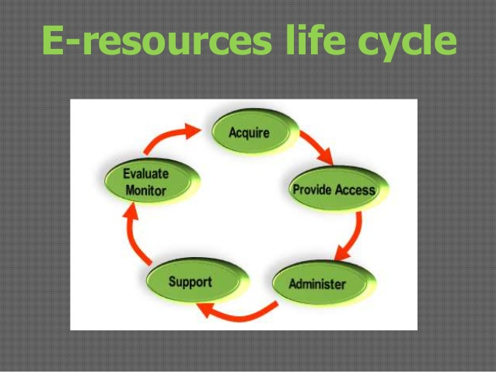

Slide 4
Acquisition
Request a trial
Announcement
Usage statistics
Subscription

Slide 5
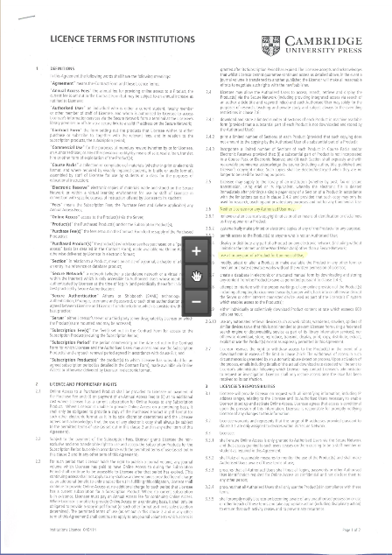
Licensing
License example
Types of Licenses
End User Agreement
Site License Agreement
Notes:
This type of agreement is the tend to be of the common license, and they will specify how a database could be utilized by a licensee. An end-user agreement may specify that a given piece of software may only be installed on a particular machine in a library, or it could alternatively specify that it could be installed on multiple workstations in the library as long as a maximum number of users (one, two, or more) have not been exceeded.
Site license agreement tend to be a more complicated, but are the kind preferred by universities, colleges and other large organizations with libraries, as they allow the campus wide usually by IP range access. Site li- censes may be fairly standard for all institutions, or they may be very particular and individualized, requiring much negotiation between the vendor and licensee. When complete, these licenses will generally set a negotiated price (frequently based on the size of an institution or con- sortium) in return for specific services from the vendor, chief among them, campus-wide access to their product, but which also may include such “extras” as usage statistics, hook-to-holdings features, table of contents notifications, use of the product for course packs, and so on.
There may also be a number of restrictions specified that the user must abide by, including copyright, interlibrary loan, installation and usage restrictions, and others. All of these items are usually negotiable, at least to some degree, with most vendors.

Slide 6
Access
IP Addresses & Remote
Passwords
Administrative logins
Coordinating access
A-Z lists and services
Linking
ERM systems

Slide 7
Support and archiving
Support
Usage statistics
Evaluation
Archiving
Shared Archiving
Open Access movement and Institutional Repositories

Slide 8

Thank you!

