Slide 1


Civil Service Reforms in the Western Balkan countries: Lessons learned through the implementation of quality standards in the civil service system in Bosnia and Herzegovina
Astana, October 2018

Slide 2
Content of the presentation
Public administration reform and CAF
Steps in the implementation process of CAF model
Learned lessons

Slide 3
Public Administration reform in BiH and CAF model
Orientation to Quality Management became a new focus of the PAR in BiH at the beginning of 2011 as a part of the Revised Action Plan 1, accompanying the PAR Strategy 2006-2014 (PARCO, 2016)
The new reform goal „Total quality management-TQM“ has defined objective „Enable institutions to use a model of total quality management –TQM (CAF, EFQM etc.)
In Bosnia and Herzegovina, CAF implementation is initiated by donor‘s support
SIGMA principle 5- Service Delivery (create citizens-oriented administration with ensuring the quality and accessibility of public services)

Slide 4
Total QM tools in use and comparaison
 | CAF | EFQM | ISO 9001
Self assessment | yes | yes | no
External consultancy | no | yes | yes
Certificate | CAF - Label | C2E; R4E | ISO certificate
Staff involvement | high | medium | low
Costs | low | medium | high
Content | 9 dimensions, processes, outcomes | 9 dimensions | Customer, products
Method | consensus SWOT | 900 points | Compare planed with status quo
Public Sector | yes | no | no
Result | PDCA Continuous improvement process | PDCA Continuous improvement process | PDCA Continuous improvement process

Slide 5
CAF Structure and its scope
The CAF aims to be a catalyst for a full improvement process within the organisation and has five main purposes:
1. to introduce public administrations into the culture of excellence and the principles of TQM;
2. to guide them progressively to a fully-fledged PDCA (PLAN, DO, CHECK, ACT) cycle;
3. to facilitate the self-assessment of a public organisation in order to obtain a diagnosis and a definition of improvement actions;
4. to act as a bridge across the various models used in quality management, both in public and private sectors;
5. to facilitate bench learning between public sector organisations

Slide 6
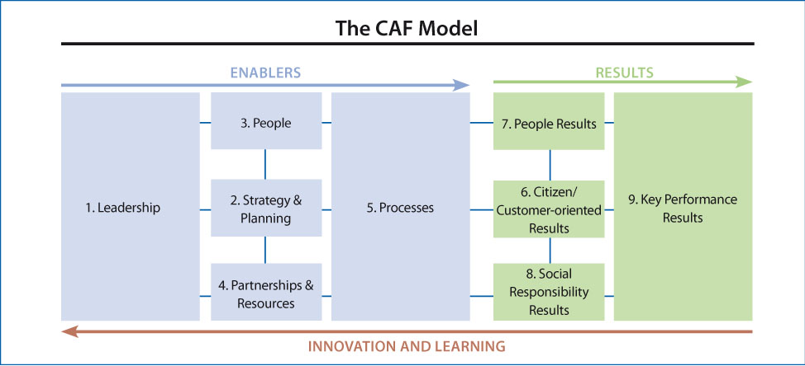

Slide 7

Important role of top management!
The general remark of almost all interlocutors were that the QM introduction requires at least 4 factors:
(political) leadership,
human resources,
financial resources and
legal and institutional framework.
Political leadership is the prime mover in bringing about alignment between capacity-building efforts of the public administration system and PAR goals. Without effective and determined leadership, it is difficult to introduce new QM systems, practices or tools in public administration.

Slide 8
Success factors in CAF implementation
To enable CAF implementation
To know CAF users
To make CAF useful
To adapt
CAF
Using existing structures
To understand CAF in practice
Notes:
8

Slide 9
Three phases of CAF process
Start CAF-programme
CAF-self assesment
CAF Team training
CAF-Improvement Plan
„Individual Self- Assessment“
Workshop Consensus
Improvement Plan-Implementation
Effective CAF-user
Self-Assessment Report
Prject design
Improvement Plan- Workshop
Initial workshop
Communication plan
CAF-adjusting
Dissemination of iInformation among employees
Selection of CAF team
Timeframe

Slide 10
Phase 1: Start
Phase 2: Self - Assessment
CAF coordinator nomination
CAF Questionnnaire adjustement
Nominating CAF Team
Decision on WG Members
Introduction training of CAF team
Conducting Self-assessment
Project Assignement
Training of new SA Group
Identify key stakeholders
Self-Assessment workshop
Communication plan
Self –Assessment Report

Slide 11
Phase 3: Improvement Plan
Action Plan (Improvement Plan)
Prioritisation
Implementation of Action plan
Implementation of Action Plan

Slide 12
Important
Self-assessment is of great importance for employees engagement
Possible resistance of some members of WG
Permanent top-down and bottom-up communication is necessary
Leadership shall be introduced in each phase of CAF implementation

