Slide 1
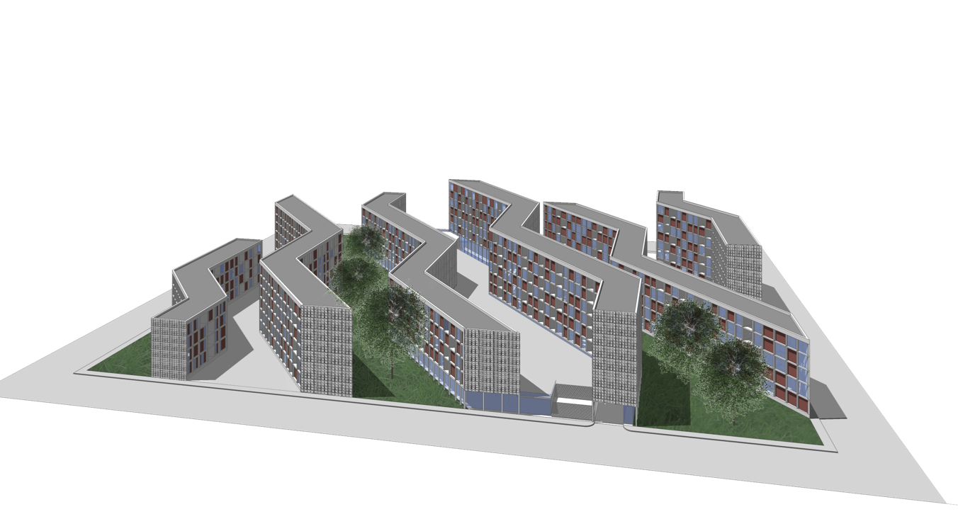

LIVING IN BETWEEN
BELGIUM 2ND PRIZE
MARIE FRIONI_LIEN RASKIN_MICHELLE VROLIX

Slide 2
MASTERPLAN
THE CONCEPT

Slide 3
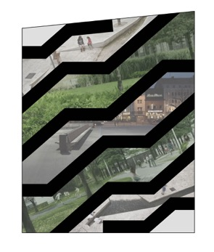
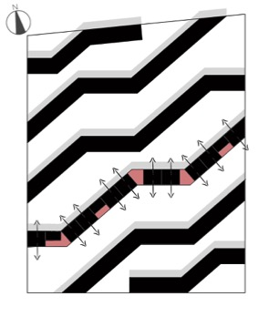
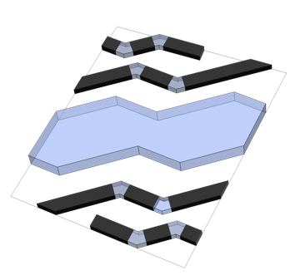
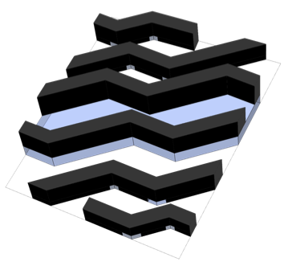
Urban vs. Natural
North vs. South
Passages & Public covered street
Apartment Blocks

Slide 4
MASTERPLAN
THE DESIGN

Slide 5
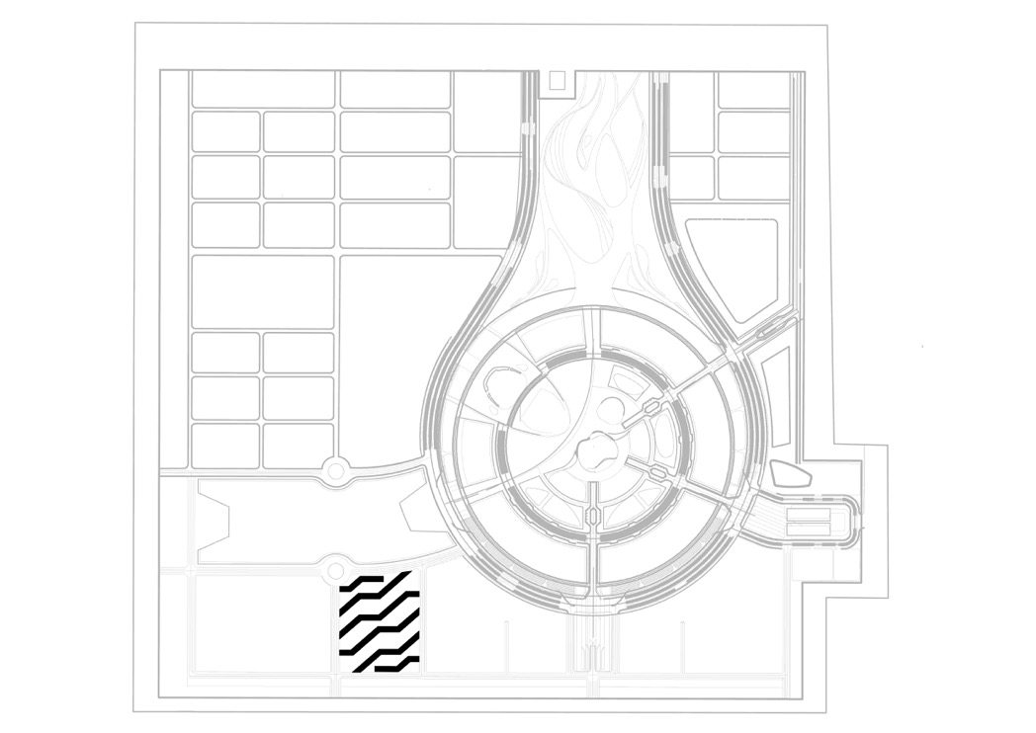
SITE PLAN

Slide 6
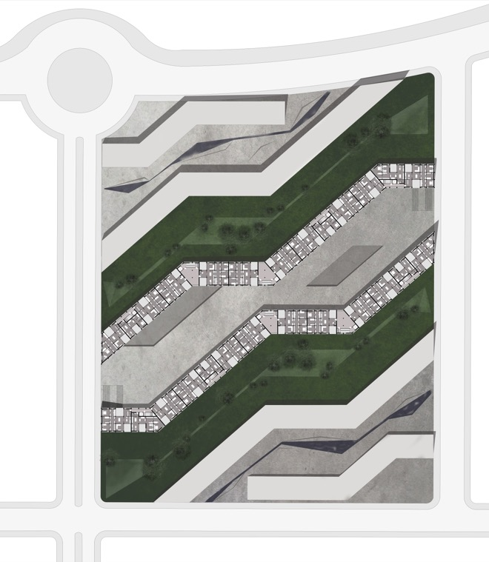
MASTERPLAN
PLAZZA
WATER FEATURE
SITTING ACCOMODATIONS
PARK AREA
PUBLIC GARDEN
RELIËFS
TREES
WATER COLLECTION
LIFTED PLAZZA
VOIDS TO PARKING

Slide 7
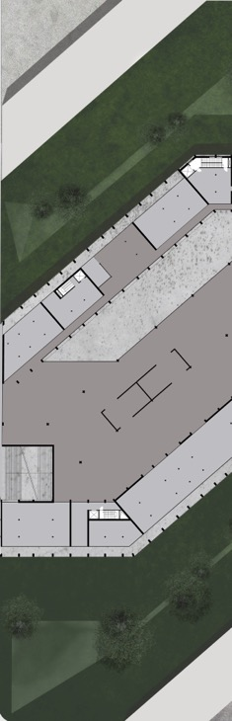
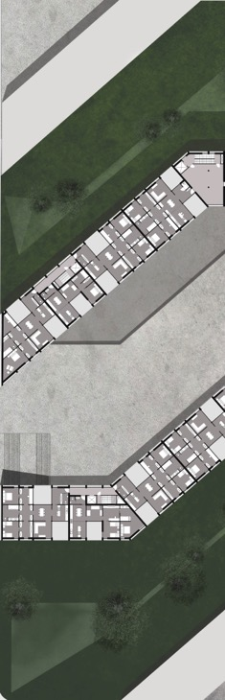
PUBLIC COVERED STREET
level 0
APARTMENTS
level +1
APARTMENTS
ORIENTATED NORTH - SOUTH
VIEW ON PARK AND PLAZA
COVERED STREET

Slide 8
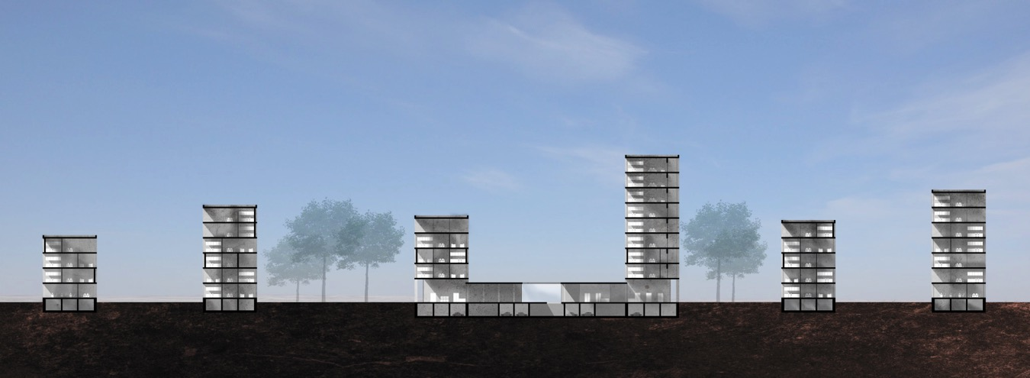
MASTERPLAN

Slide 9
APARTMENTS
THE CONCEPT

Slide 10

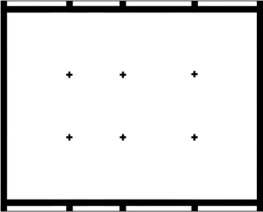
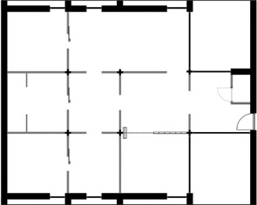
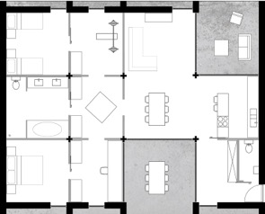
3,5 m
2,5 m
4,0 m
3,5 m
3,5 m
3,5 m
3,5 m
Grid
Fixed structure
Flexible structure
Flexible throughout the seasons

Slide 11
APARTMENTS
THE DESIGN

Slide 12
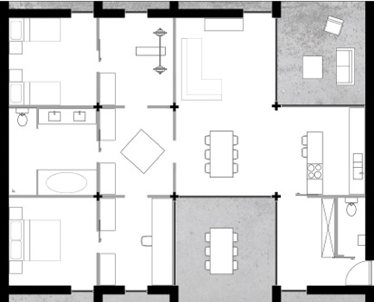
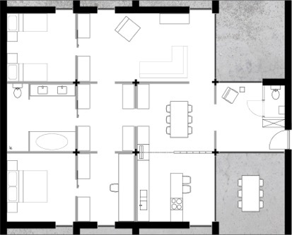
LARGE 2 BEDROOM APARTMENT
120 M²
VARIANT 1
VARIANT 2

Slide 13
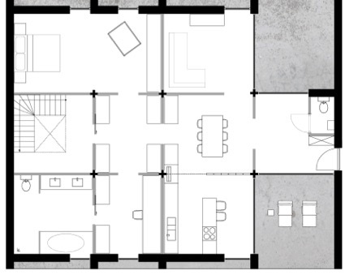
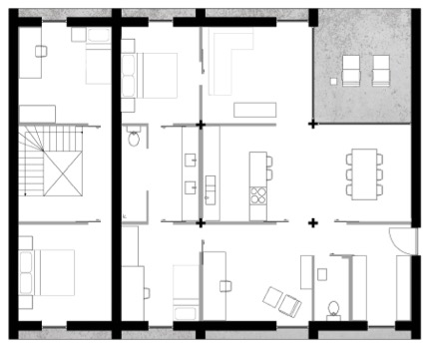
3 BEDROOM DUPLEX - SMALL 2 BEDROOM APARTMENT
156 M² - 96 M²
VARIANT 1
+0
+1

Slide 14
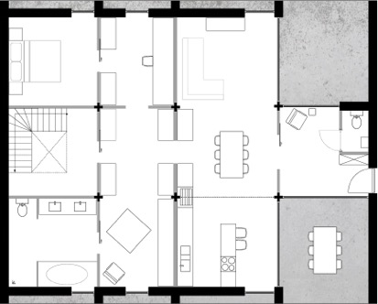
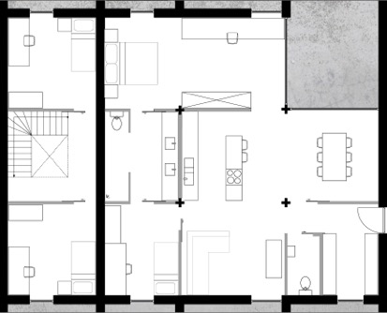
3 BEDROOM DUPLEX - SMALL 2 BEDROOM APARTMENT
156 M² - 96 M²
VARIANT 2
+0
+1

Slide 15
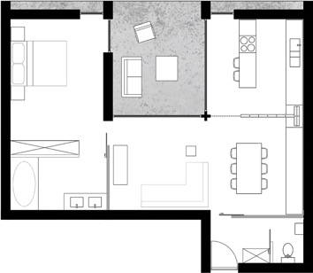
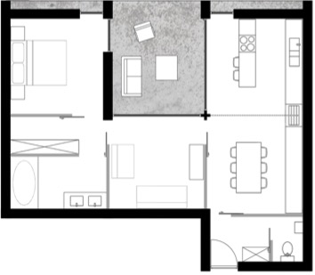
1 BEDROOM APARTMENT
65M²
VARIANT 1
VARIANT 2

Slide 16
CONSTRUCTION
MATERIALIZATION

Slide 17
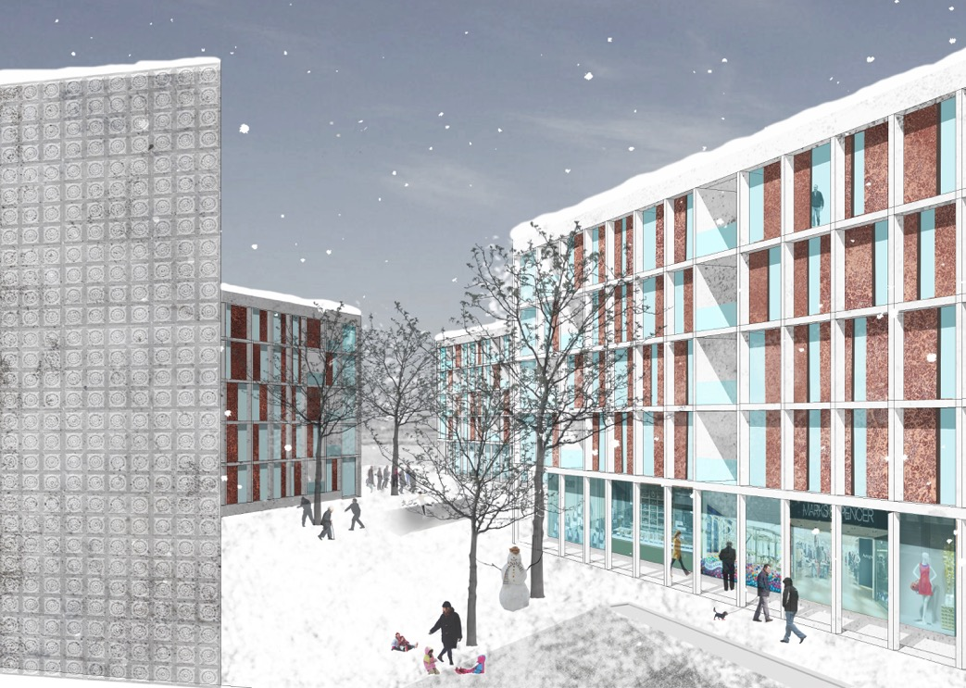

Slide 18
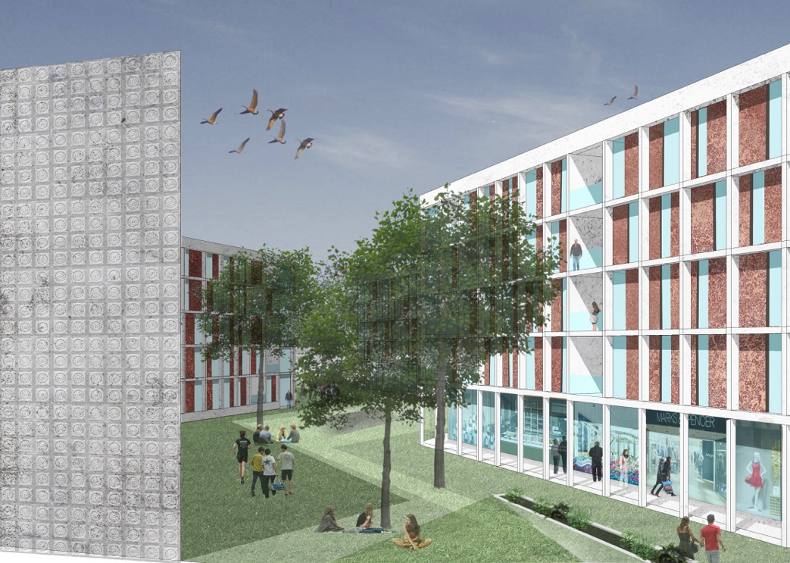

Slide 19


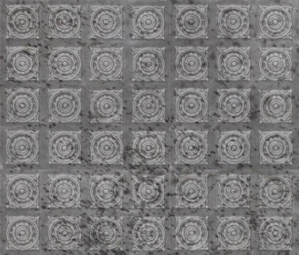

INSPIRATION: ASTANA COPPER TILES
CONCRETE
TEXTURED CONCRETE
COPPER FAÇADE PLATES

Slide 20
CONSTRUCTION
DETAILS

Slide 21
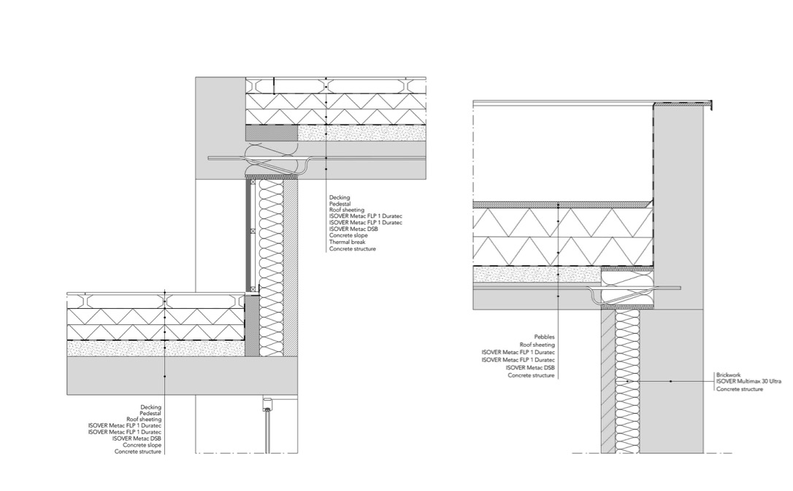
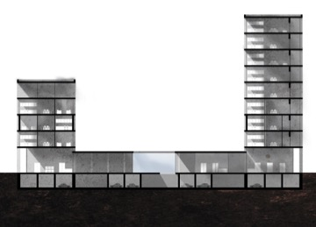
2
1
1
2

Slide 22
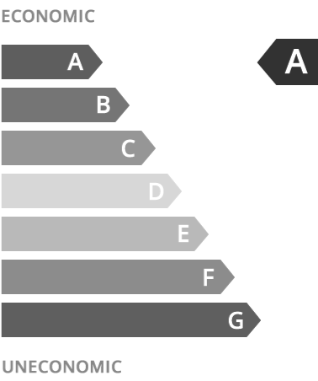
^{HEAT DEMAND CALCULATIONS}
Transmission Heat Losses 619035.61
Ventilation Heat Losses 116009.60
^{Total Heat Losses 735045.20}
Internal Heat Gains 117393.44
Available Solar Heat Gains 579980.39
^{Total Heat Gains 595879.48}
Annual Heat Demand 139165.72
SPECIFIC ANNUAL HEAT DEMAND 13.32 KWH
^{OVERHEATING CALCULATIONS}
Exterior Thermal Transmittance 4246.64
Ground Thermal Transmittance 186.43
Exterior Ventilation Transmittance 3306.18
Ground Ventilation Transmittance 0.00
^{Solar Aperture 428.18}
^{FREQUENCY OF OVERHEATING 0.00}

Slide 23
