Slide 1
Framing gender stereotypes in mass media of Kazakhstan: Case study of “Egemen Qazaqstan” and “Tengrinews”
PhD. Slamgazhy Ainur
Al-Farabi Kazakh National university
Slyamgazhy.Ainur@kaznu.kz

Slide 2
Introduction
Media plays a vital role in shaping the perception of its readers. It is through media people get the reflection of what is happening in the society and around the world. However, the role of the media is not only to inform people but also to act as a social tool for change.
Gender stereotypes are set of beliefs concerning attributes that are supposed to differentiate women and men. Like other stereotypical beliefs, gender stereotypes are consensual and exist as ideology that is socially built and shared (Rollero, Glick, & Tartaglia, 2014).
Rollero & Tartaglia (2013) stated that power and leadership roles are perceived as congruent with men, whereas care and relational roles are perceived as congruent with women.

Slide 3
In Kazakhstan the representation of women is high in media, their presence in higher level mostly the decision-making level is negligible.
The workforce in the country is heavily gendered, men are overrepresented in industry while women in the public sector.
Hence, this study tried to look after how the media portray women and men.

Slide 4
Research Objectives
To explore the Kazakhstani media coverage of the gender stereotyped contents
To find out the difference in coverage of gender stereotyped contents in newspaper and online media
To investigate the dominant frames and tones used in the newspaper and online media in Kazakhstan regarding the gender stereotypes.

Slide 5
Research question
To what extent does Kazakhstani media cover the gender stereotyped contents?
What is the difference in coverage of gender stereotyped contents in the selected newspaper and online media?
What was the tones used by the newspapers in their coverage?

Slide 6
Theoretical Framework
Study is based on Framing Theory
This approach is particularly significant for this study because it helps to understand how media works, organize or package information for their audience and media’s ability to influence to the public.
Framing theory is a useful conceptual tool to examine how the media disseminated the stereotyped news information related to gender.

Slide 7
Framing Theory
•A frame, in the context of news media, is a fundamental idea for media content that, by selection, emphasis, exclusion and elaboration, implies what the issue is and determines its context. Framing can have a significant effect on how the media’s audience understands an issue (Jeffres, 1997).
•Framing influences perception of audience members and even causes change of judgments by only giving a specific aspect of reality (Stauffacher et al., 2015; Iyengar, 1987).
•At the center of the definitions offered for framing is the medias ability to order information in diverse ways to shape the audience‘s interpretation of issues. Taking the theory in consideration, this study looks at the media’s role in framing the gender issues and the portrayal of the stereotyped information.

Slide 8
Research methodology
Sample Procedure
A purposive sampling technique was employed in the selection of the two print and online media of Kazakhstan: Egemen Qazaqstan and TengriNews
Unit of analysis: Articles, news and opinions related to the gender
Time Period: January, 2020 to January, 2021
Egemen Qazaqstan and Tengrinews

Slide 9
Literature Review
Women's political, economic, and social rights will not be extended if television screens, newspapers, magazines, and street posters continue to show disrespect for women. Very often, talk about gender equality causes people to mistakenly fear that it destroys family values and leads to the loss of national identity (Karimova, Z., & Kaldybek, S. (2021)
In the Women’s Economic Participation and Opportunity sub-index, Kazakhstan dropped in the Global Gender Gap Index from the 16th place in 2006 to the 37th position in 2019. Economic Participation and Opportunity Subindex shows the gap in jobs between the sexes. The fact that women are persistently less present in the labor market than men contributes to the Economic Participation and Opportunity gap (Khamzina et al., 2020).
Journalists pointed to some of the problems associated with working in an industry still dominated by men, such as the low priority given to coverage of ‘women’s’ issues and the male-ordered culture which can be hostile to women with family responsibilities

Slide 10
Media continue to present both women and men in stereotyped ways that limit our perceptions of human possibilities.
Typically, men are portrayed as active, adventurous, powerful, sexually aggressive and largely uninvolved in human relationships while women as sex objects who are usually young, thin, beautiful, passive, dependent, and often incompetent and dumb.
Female characters are stereotypically presented showing that they devote their primary energies to improving their appearances and taking care of homes and people. As media pervade our lives, the ways they misrepresent genders may distort how we see ourselves and what we perceive as normal and desirable for men and women.

Slide 11
Categories of News Frame
Five categories were identified in the study :
Holy mother
Self-made woman
Foreign bridge
Heroes
Tradition
Other

Slide 12
Description of News Frame
Holy mother: news where woman described as a wise wife and mother.
Self-made woman: news about woman who has achieved wealth, status, etc., through personal effort or hard work.
Foreign bridge: news about woman who got married to a foreigner.
Heroes: news about the bravery of Kazakh women who participated in the Wars.
Tradition: stories about tradition regarding woman.
Other: any other frames that do not fit into the above categories

Slide 13
News Tones
Positive
Negative
Neutral

Slide 14
Tones Cont…
•Positive : Stories that were encouraging, showing support and espousing favorable or pleasing characterization of woman.
•Negative: Stories that implies woman as passive victims or inactive reactors to the events, traitors.
•Neutral : Reflecting neither positive, nor negative, persuasive discourse

Slide 15
Analysis of the Coverage
•A total of 76 articles collected from Egemen Qazaqstan and Tengrinews were analyzed
•Egemen Qazaqstan had 27 straight news (mostly sport news)
and 15 opinions
• Tengrinews had 22 straight news and 12 opinions
•64% straight news and 36% opinion
•However, opinion were mostly interview based so it was mixed of straight news and opinion

Slide 16
News Frame: Self-made woman
Self-made Frame was most salient in both print and online media
But in Egemen Qazaqstan stories were mainly about women in sports. The commentary about achievement of women in sports was the major highlight during the review period. 64% of stories were published under this frame.
In Tengrinews 20% of stories were published under this frame, and they were mostly about women who is working or studying abroad.

Slide 17
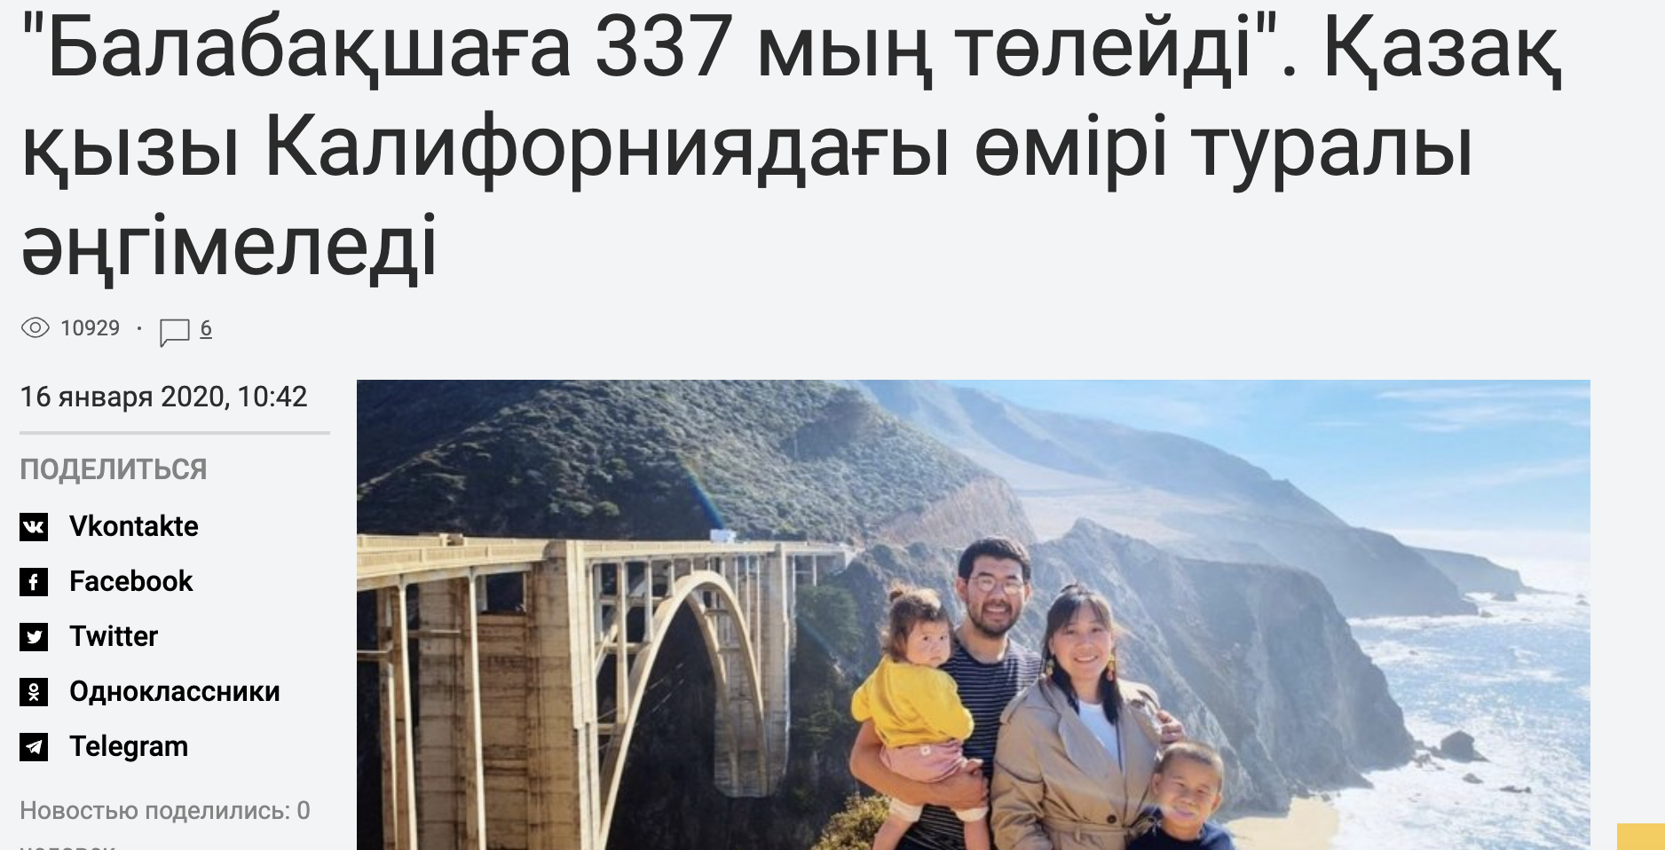
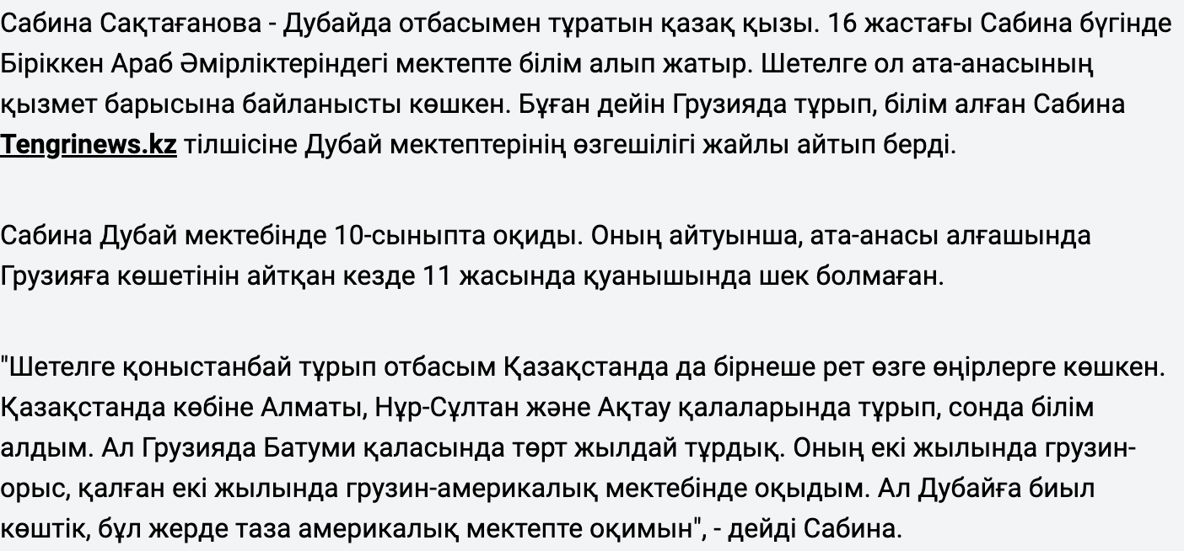

Slide 18
News Frame: Holy mother
•Holy mother Frame was the second main frame in the newspaper and fewer in online media
•Both media highlighted the parental role (caretaker of the family). This make the audience realize that women still are the ones who has the responsibility of caregiving and other household activities.
Both media contents presented the role of women mostly as mothers and housewives predominantly depicting the parental role of caregiving and doing household chores. All articles under this frame defined woman as someone's mother, sister, daughter. And great mission of woman limited with giving birth to a child, taking care of family.

Slide 19
News Frame: Foreign bridge
In Egemen Qazaqstan no stories were found under this Frame.
In Tengrinews in addition to presenting women as mothers/ housewives, they presented women mostly as bride. Of the total news published in Tengrinews, 20 % of the news presented the women as bride. Online media struggles to get maximum clickbait. If one news gets more clickbait that is considered to be a successful one as it can attract more advertisers. Getting married to foreigner is considered sensitive topic in kazakh society, so online media uses it to get more clicks.

Slide 20
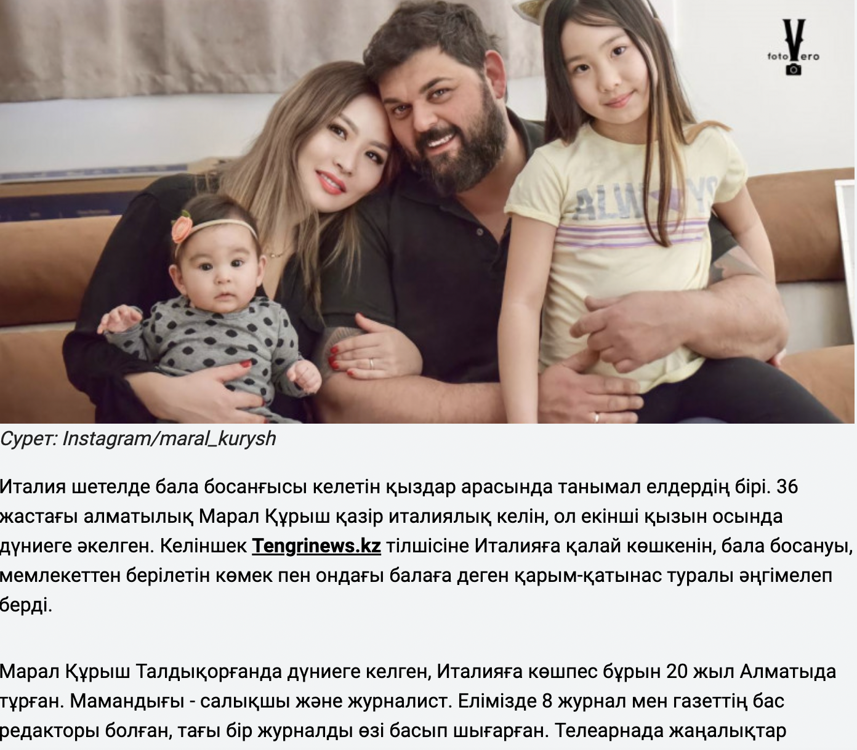
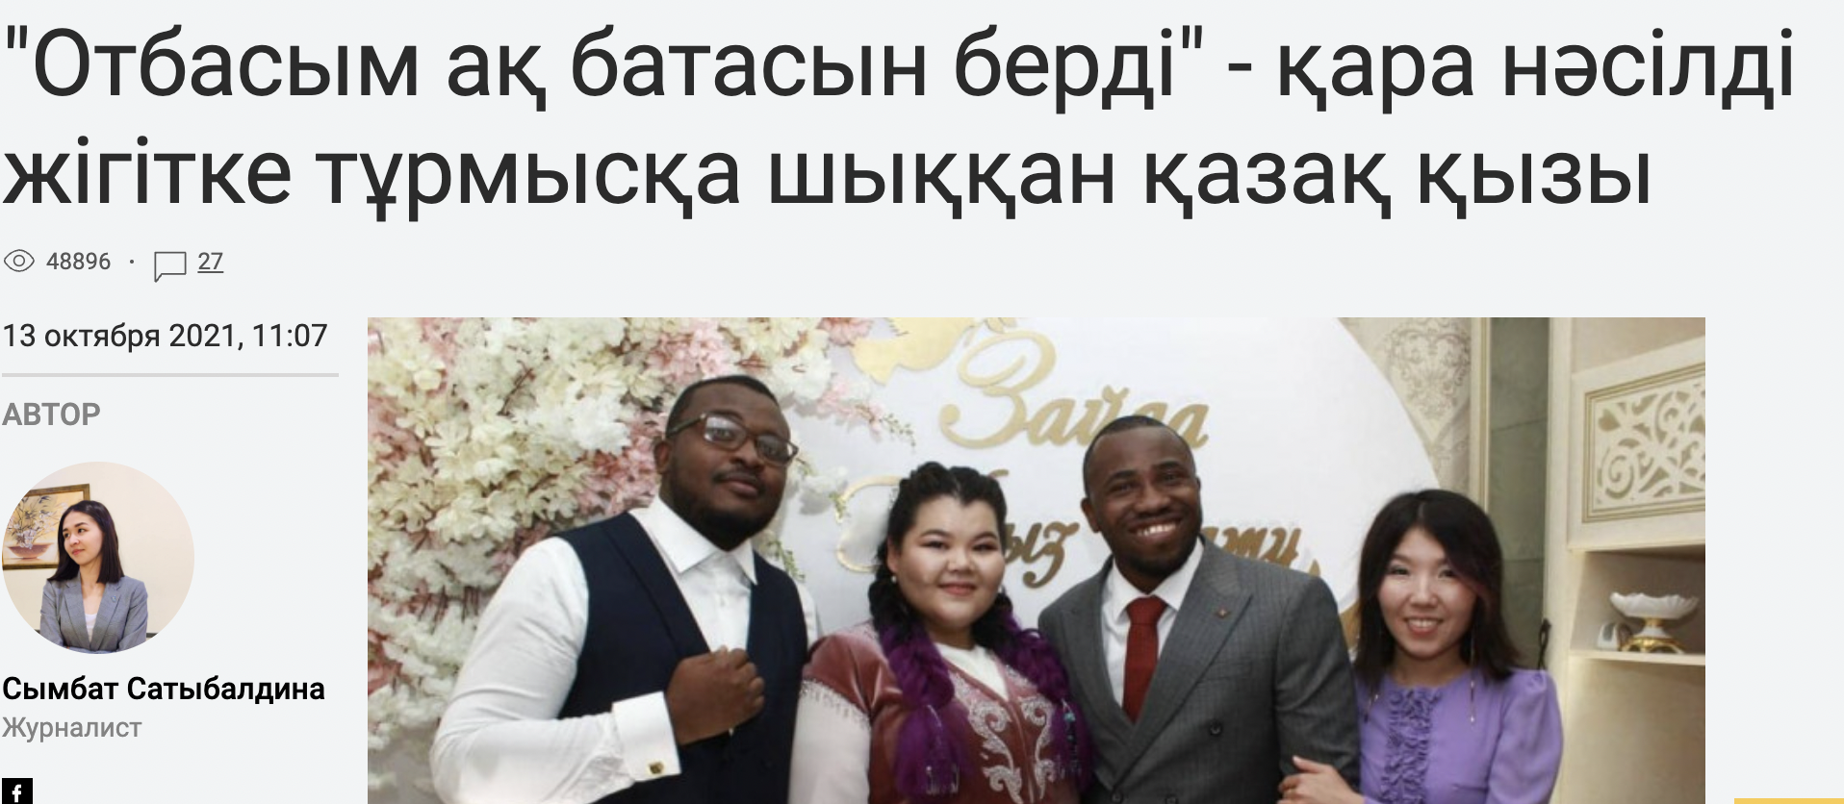
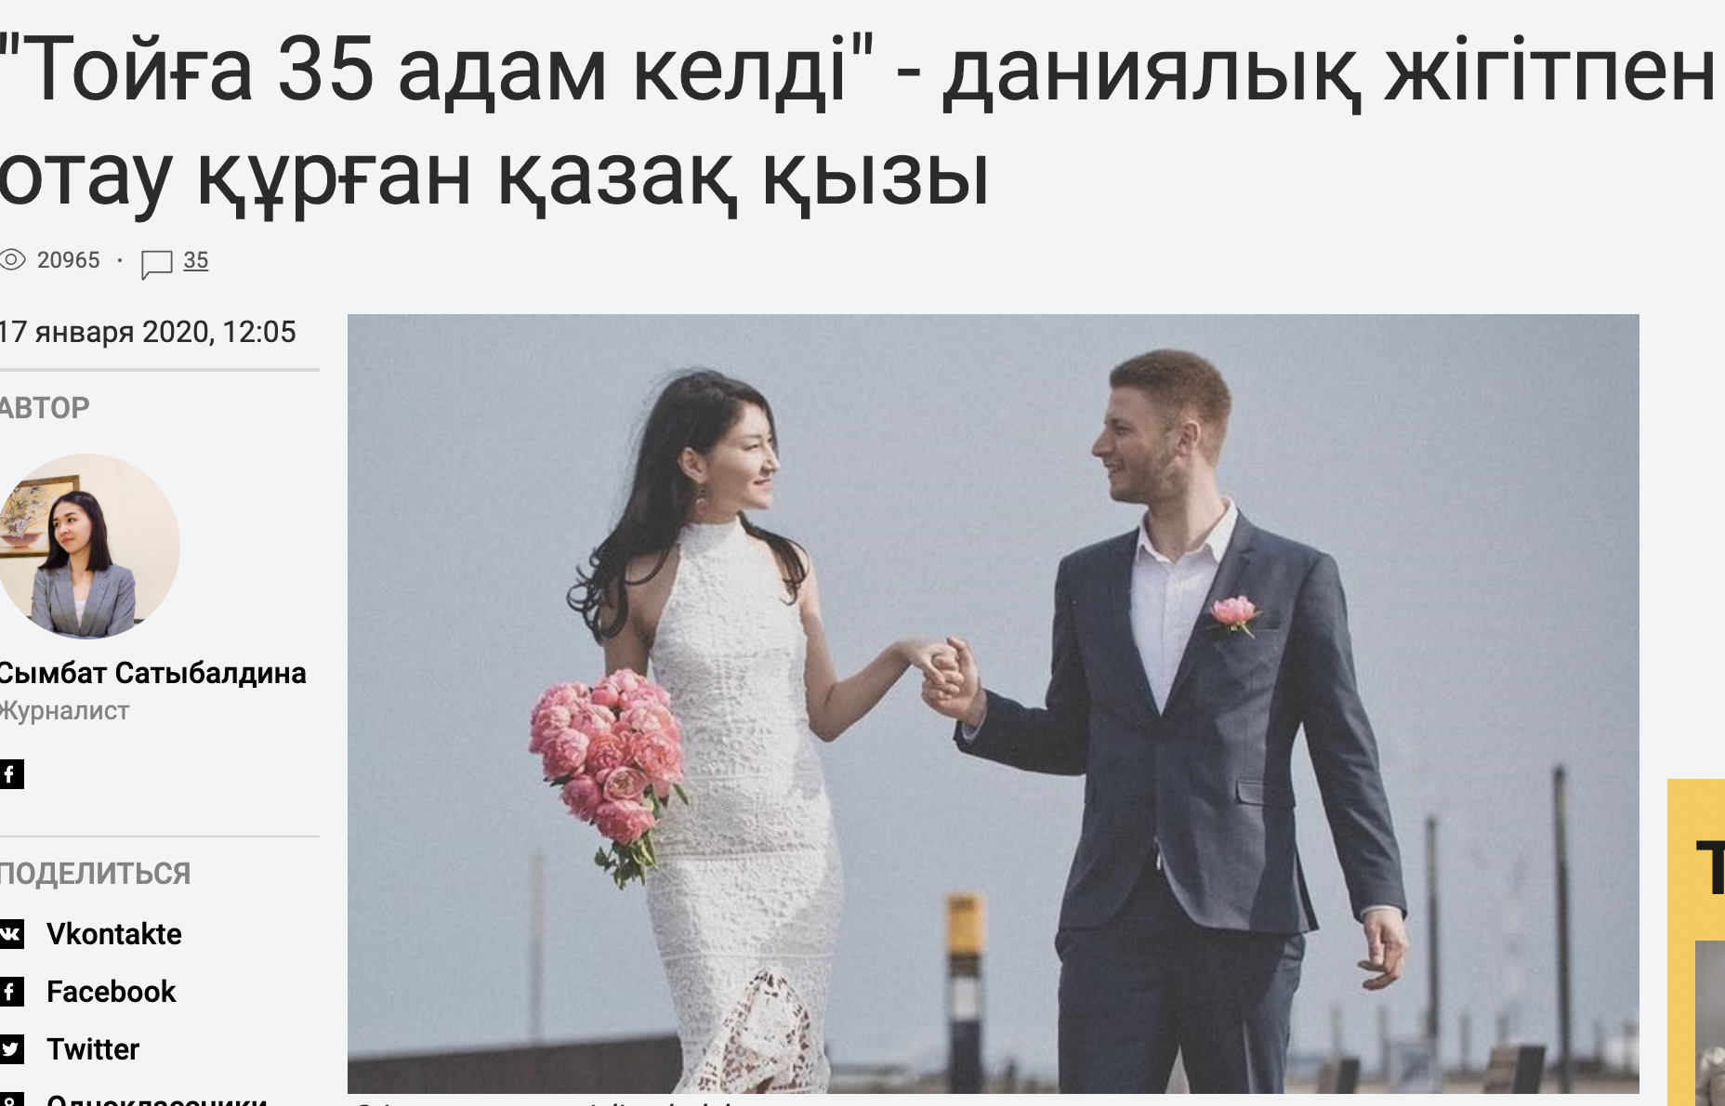

Slide 21
News Frame: Heroes
•Frame Heroes were very less covered compared to other Frames in both media. Only 10 % of the news covered by Egemen Qazaqstan were under this Frame while 15% of the news in Tengrinews were about this issue.
These articles about outstanding Kazakh women who participated in the Second World War, as well as women warriors who lived in Kazakh land. Almost all articles about historical women were positive and their courage and mind were greatly appreciated.

Slide 22
News Frame: Tradition
15% of the coverage were dedicated to the Frame of Tradition in both online and print media.
The stories were mostly about the culture of wedding in the country. In the Kazakh traditional family, the place of the daughter-in-law is very important, therefore, articles about traditions associated with the wedding specially was given the priority. The online media also published contents related to the pregnancy and the traditions one follows in the society after giving birth to a child. And 40 restrictions that girls should follow.

Slide 23
Other Frame
In Egemen Qazaqstan were not found any article under this frame.
There were 8 articles in Tengrinews which did not match these Frames and is labelled as others. This accounted to 23,5 % of the total coverage.
Last year 26,5% crime were made by women.
Woman from Aktobe is dissatisfied with the fact that those who killed her son did not receive any punishment
Woman told how she stopped eating meat

Slide 24
Tones
Egemen Qazaqstan covered news mostly positive (69%). Additionally 19% were neutral, and 12% were negative.
While Tengrinews covered predominantly neutral 38%, and 35% in positive note, 24% in negative tone.
Positive ones are achievements of women in different fields, mostly in sports.
Under negative tone were publications that women are not like in the past, they value western culture, and they are getting married to foreigners.
The online media reported more negative news mainly because of that the stories with negative tone are the ones that are read the most.

Slide 25
Discussion
Differences in the number of articles published indicates that they carried unequal weight of attention in different matters related to women. The data analysis showed that all the newspapers presented direct or event-based news as largest coverage and devoted less space for opinion pieces. Hence, we can say that the newspapers mostly performed surveillance role instead of correlation function. When straight news dominates the coverage, it leaves little room for the creativeness of journalists, resulting in top-down communication format (Van Dijk, 1988).
Even though most of the portrayal of women were neutral, the online news has more negative news that the newspaper. This shows that online news tends to attract more readers with negative portrayal of women. The findings reiterate the fact that in Kazakh society, stereotypical thinking still exists at a very high level and is perceived as a normal phenomenon.
Women were very less covered in political and economic news.
Media is also responsible to educate people through its contents. However, the data analysis showed that there were no educative materials that is intended to educate and aware people regarding gender-based violence and other issues related to women’s right, reproductive health and their participation in economic activities and how it can help in the transformation of the society.

Slide 26
Conclusion and Recommendations
The portrayal of women in the media is an issue of growing concern. The world of mass media and its role and influence in our lives is increasing at a rapid pace.
The analysis shows that it is necessary that the media in Kazakhstan should portray more positive stories in regard to women. Portraying women as role models in the media can help women become more ambitious and assertive and can help in disseminating the positive attitude regarding women in the society.
Thus, it can be concluded that overall effect of the portrayal of women in media is to reinforce rather than reduce prejudices and stereotypes. None of these women presented in both the media were self defining, powerful characters who decided for themselves and chose for themselves.
The study recommends some workshop or training for media personals who report on gender issues to enable them give a fair and factual reports and control the presentation of stereotypical contents in Kazakh media.

Slide 27
Thank you!

