Slide 1


THESIS DEFENSE
The Combined Effect of Waste Glass Sand and Glass Fiber on the Improvement of Thermal Property of Aerated Concrete
Inzhu Yerbolat, ID 201460756
Civil and Environmental Engineering Department

Slide 2
OUTLINE
Background and Introduction
Thesis Structure
Experimental Program
Test Result Analysis
Thermal Conductivity Prediction Model
Energy Saving Effect of NAAC
Feasbility of NAAC
8. Conclusion
Civil and Environmental Engineering Department

Slide 3
1. BACKGROUND AND INTRODUCTION
Civil and Environmental Engineering Department

Slide 4
1.BACKGROUND
Aerated Concrete
Lightweight
Energy-efficient
Excellent thermal insulative
Fire resistance
Reduction of supporting loads
Economy in construction of foundation/reinforcement
Reduction of energy consumption
Reduction of operation payment for heating/cooling
Types
Autoclaved Aerated Concrete | None-autoclaved Aerated Concrete
Curing under some pressure | Normal curing
Risk on environment and economy | No risk
Civil and Environmental Engineering Department

Slide 5
1.INTRODUCTION
Research Problem
Waste Glass Accumulation
World: 200 million tons/yr
KZ: 340 thousand tons/yr
8.8% - recycled
91.2% - disposed
Energy Consumption
Research Goal
Prepare Aerated Concrete, using waste glasses as aggregate
Evaluate their effect on the improvement of the thermal property
Research Hypothesis
Synergetic effect
Glass sand replacement decreases the thermal conductivity
Glass fiber replacement improves the mechanical property
Civil and Environmental Engineering Department

Slide 6
2. THESIS STRUCTURE
Civil and Environmental Engineering Department

Slide 7
2. THESIS STRUCTURE
1. Literature Review
2. Experimental Program
Non-Autoclaved Aerated Concrete
2.1 Optimization of Mixture Proportion
2.2 Material Preparation and its Characterization
2.3 Non-Autoclaved Aerated Concrete Preparation and Properties Testing
Effect of Glass Sand and Glass Fiber
Parameters
Normal Sand
Waste Glass Sand
Glass Fiber
Cement/Fly ash
Water to Cementous Ratio
Sieve Analysis – ASTM C136
Chemical Composition – ASTM C114
Aggregate Properties – ASTM C556, C127, C128
Thermal Conductivity
Compressive Strength – ASTM C39
Flexural Strength – ASTM C78
Ultrasonic Pulse Velocity – ASTM C597
Alkali-Silica Reaction – ASTM C1567
Porosity, Specific Gravity, Density – ASTM C830
3. Test Result Analysis
4. Modelling an Equation for Prediction of Thermal Conductivity: Minitab Software
5. Evaluation of Energy Saving Effect of NAAC material: Design Builder Software
6. Documentation: Thesis, Research paper, Presentation

Slide 8
3. EXPERIMENTAL PROGRAM
Civil and Environmental Engineering Department

Slide 9
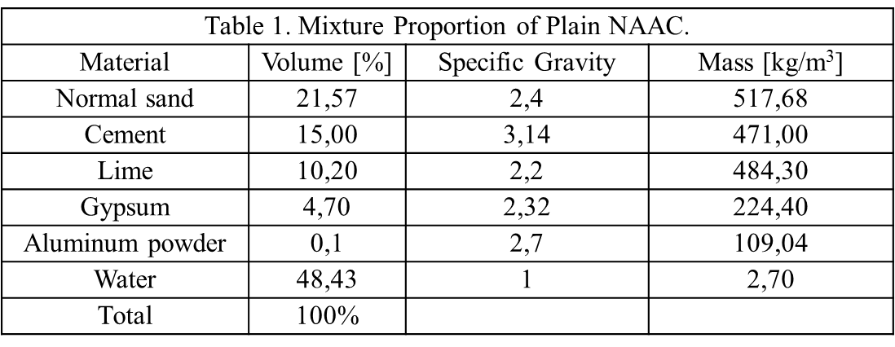
3.EXPERIMENTAL PROGRAM – MIX DESIGN
Table 2. Mixture Parameters
Series
Series 1: M1-M3, glass sand replacement
Series 2: M3-M5, fly ash replacement
Series 3: M6-M8, combination of glass sand and glass fiber
Series 4: M9-M11, combination of glass sand, glass fiber and fly ash.
No | Cement | Fly ash | Normal Sand | Waste Glass Sand | Waste Glass Fiber
M1 | 100 | 0 | 100 | 0 | 0
M2 | 100 | 0 | 85 | 15 | 0
M3 | 100 | 0 | 70 | 30 | 0
M4 | 85 | 15 | 70 | 30 | 0
M5 | 70 | 30 | 70 | 30 | 0
M6 | 100 | 0 | 70 | 30 | 1% of N. sand by volume
M7 | 100 | 0 | 70 | 30 | 2% of N. sand by volume
M8 | 100 | 0 | 70 | 30 | 3% of N. sand by volume
M9 | 70 | 30 | 70 | 30 | 1% of N. sand by volume
M10 | 70 | 30 | 70 | 30 | 2% of N. sand by volume
M11 | 70 | 30 | 70 | 30 | 3% of N. sand by volume

Slide 10
3. EXPERIMENTAL PROGRAM
Table 3. Testing Properties
Properties | # of Samples | Test Methods | Testing Date | Equipment
Thermal Conductivity | 12 | ASTM E1530 | 7/14/28 | ИТС-1 “150”
Compressive Strength + UPV | 12 + 3 | ASTM C39 | 7/14/28 | Compression Testing Machine
Flexural Strength | 12 | ASTM C78 | 7/14/28 | Compression Testing Machine
Porosity, Density, Absorption | Same samples | ASTM C830 | 7/14/28 | Weighing machine
# of samples for each batch = 39
Total # of samples = 11 batches * 39 samples = 396
Civil and Environmental Engineering Department

Slide 11
4. TEST RESULTS ANALYSIS
Civil and Environmental Engineering Department

Slide 12
4. TEST RESULTS: Thermal conductivity and mixture parameters
Figure 4.1.
(a) Thermal conductivity of NAAC containing glass sand
b) Thermal conductivity of NAAC containing fly ash.
(c) Thermal conductivity of NAAC containing glass fiber
(d) Thermal conductivity of NAAC containing glass fiber with fly ash.
(a)
(b)
(c)
(d)

Slide 13
4. TEST RESULTS: Thermal conductivity and density
Table 4.1 Relationship between thermal conductivity and density
 | 7 day | 14 day | 28 day
Overall | 58,47% | 74,56 | 0,53
Overall (except mixture 1) | 21,72% | 82,71% | 46,06%
Series 1 | 94,68 | 99,82 | 97,26
Series 2 | 31,94 | 83,84 | 96,36
Series 3 | 16,15 | 54,6 | 19,32
Series 4 | 85,13 | 99,59 | 98,29
(a)
(b)
(c)
(d)
Figure 4.2. Relationship between thermal conductivity and density (a) 7-day cured (b) 14-day cured (c) 28-day cured (d) 28-day cured except M1

Slide 14
4. TEST RESULTS: Thermal conductivity and porosity
(a)
(b)
Figure 4.3. Relationship between thermal conductivity and porosity of 7-day cured samples (a) overall (b) by series
Table 4.2 Relationship between thermal conductivity and porosity
 | 7 day | 14 day | 28 day
Overall | 76,74% | 57,93 | 14,92
Series 1 | 89,92 | 97,3 | 96,11
Series 2 | 58,96 | 79,14 | 5,39
Series 3 | 56,62 | 67,48 | 57,82
Series 4 | 91,98 | 75,87 | 97,28

Slide 15
4. TEST RESULTS: Thermal conductivity and absorption
(a)
(b)
Figure 4.4. Relationship between thermal conductivity and absorption of 14-day cured samples (a) overall (b) by series
Table 4.3. Relationship between thermal conductivity and absorption
 | 7 day | 14 day | 28 day
Overall | 75,75% | 81,55 | 62,5
Series 1 | 95,04 | 99,02 | 97,65
Series 2 | 81,91 | 76,49 | 46,64
Series 3 | 100 | 51,23 | 47,08
Series 4 | 86,42 | 75,87 | 98,14

Slide 16
4. TEST RESULTS: Thermal conductivity and curing age
(a)
(b)
(c)
(d)
Figure 4.5. The effect of curing age on thermal conductivity (a) Series 1 (b) Series 2 (c) Series 3 (d) Series 4

Slide 17
4. TEST RESULTS: Compressive Strength Development
Figure 4.6.
(a) The compressive strength of NAAC containing glass sand
b) The compressive strength of NAAC containing fly ash
(c) The compressive strength of NAAC containing glass fiber
(d) The compressive strength of NAAC containing combined glass sand, glass fiber and fly ash
(a)
(b)
(c)
(d)

Slide 18
4. TEST RESULTS: Compressive Strength an UPV
Table 4.4 Relationship between the compressive strength and UPV
 | 7-day | 14-day | 28-day
Overall | 87,83 | 87,06 | 90,26
Series 1 | 99,76 | 99,71 | 95,88
Series 2 | 100 | 95,95 | 61,08
Series 3 | 100 | 52,62 | 100
Series 4 | 91,5 | 91,74 | 98,8
Figure 4.8. The relationship between compressive strength and UPV.

Slide 19
4. TEST RESULTS: Flexural Strength Development
Figure 4.7.
(a) The flexural strength of NAAC containing glass sand
b) The flexural strength of NAAC containing fly ash
(c) The flexural strength of NAAC containing glass fiber
(d) The flexural strength of NAAC containing combined glass sand, glass fiber and fly ash
(a)
(b)
(c)
(d)

Slide 20
5. TEST RESULTS: Physical Properties
Figure 4.8 The relationship between (a) density and porosity (b) density and absorption (c) absorption and porosity
Table 4.5 Relationship between porosity and density
 | 7 day | 14 day | 28 day
 | R²
Overall | 46,24% | 63,36 | 10,09
Series 1 | 70,73 | 95,74 | 99,99
Series 2 | 0,9 | 99,63 | 17,1
Series 3 | 81,99 | 98,26 | 84,19
Series 4 | 98,82 | 81,14 | 99,88
Table 4.6. Relationship between density and absorption
 | 7 day | 14 day | 28 day
Overall | 58,07% | 69,52 | 32,89
Series 1 | 80,5 | 99,88 | 90,09
Series 2 | 27,61 | 99,68 | 28,2
Series 3 | 86,44 | 99,89 | 91,2
Series 4 | 99,97 | 81,14 | 100
Table 4.7 Relationship between porosity and absorption
 | 7 day | 14 day | 28 day
Overall | 96,17% | 86,34 | 18,45
Series 1 | 98,7 | 97,04 | 88,08
Series 2 | 63,57 | 100 | 30,46
Series 3 | 99,63 | 97,26 | 98,84
Series 4 | 99,19 | 100 | 99,92

Slide 21
5. THERMAL CONDUCTIVITY PREDICTION MODEL
Civil and Environmental Engineering Department

Slide 22
5. Thermal Conductivity Prediction Model
Multivariate Linear Regression Analysis
MINITAB Statistical Software
Table 5.1. Simulation Analysis of 14-day cured sample results
# | R² | Cp | S | Abs | ρ | P | x | NS | C | FA | GS | GF
1 | 86.2 | 4.5 | 0.012215 |  |  | x |  | x | x |  | x | x
2 | 85 | 4.8 | 0.012748 | x | x | x | x | x
3 | 84.1 | 6.2 | 0.013126 |  |  | x | x | x | x |  | x | x
4 | 83.7 | 6.3 | 0.13286 | x | x | x | x | x |  |  | x | x
5 | 85.8 | 7.1 | 0.012393 | x | x | x | x | x | x |  | x | x
6 | 79.7 | 8.1 | 0.014826 | x |  | x | x | x | x | x | x | x
7 | 80.1 | 9.0 | 0.014688 | x | x | x | x | x | x | x | x | x
Criteria:
R² – exactness coefficients – higher is better
Cp – set of terms, closer to the number of variables
S – standard error, lower is better.

Slide 23
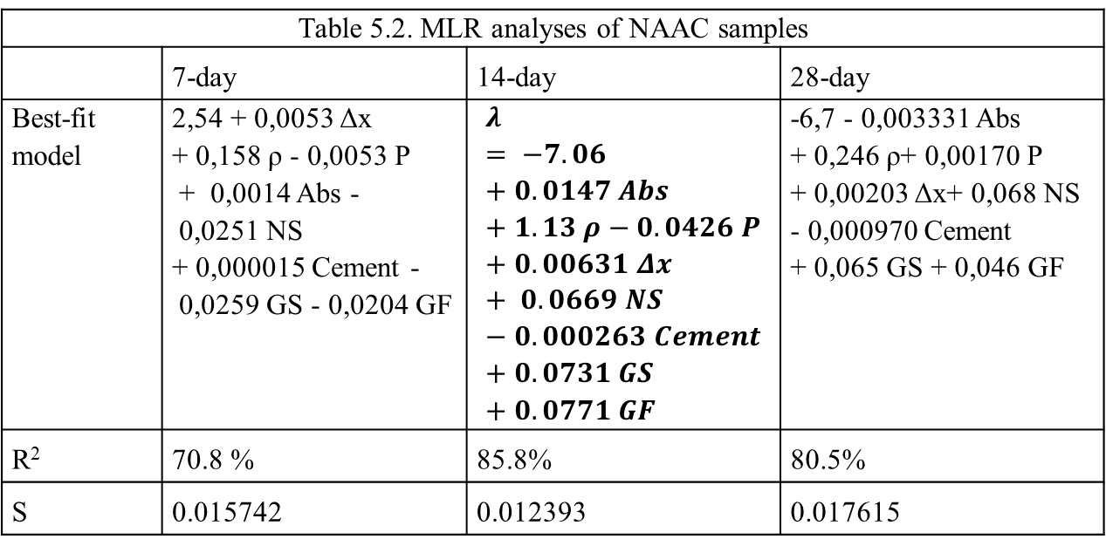
5. Thermal Conductivity Prediction Model
$λ=−7,06+0,147 Abs+1,13 ρ −0,0426 P+0,00631 ∆x+0,0669 NS$ – 0,000263 Cement + 0,0731 GS + 0,0771 GF
(eq. 1)
where, λ – thermal conductivity, Abs – absorption, ρ – density, P – porosity, Δ x – thickness, NS – normal sand, GS – glass sand, GF – glass fiber
Table 5.2. MLR analyses of NAAC samples
 | 7-day | 14-day | 28-day
Best-fit model | 2,54 + 0,0053 Δx + 0,158 ρ - 0,0053 P + 0,0014 Abs - 0,0251 NS + 0,000015 Cement - 0,0259 GS - 0,0204 GF | $$λ= −7.06+0.0147 Abs+1.13 ρ−0.0426 P+0.00631 Δx+ 0.0669 NS−0.000263 Cement+0.0731 GS+0.0771 GF$$ | -6,7 - 0,003331 Abs + 0,246 ρ+ 0,00170 P + 0,00203 Δx+ 0,068 NS - 0,000970 Cement + 0,065 GS + 0,046 GF
R² | 70.8 % | 85.8% | 80.5%
S | 0.015742 | 0.012393 | 0.017615

Slide 24
6. ENERGY SAVING SIMULATION
Civil and Environmental Engineering Department

Slide 25
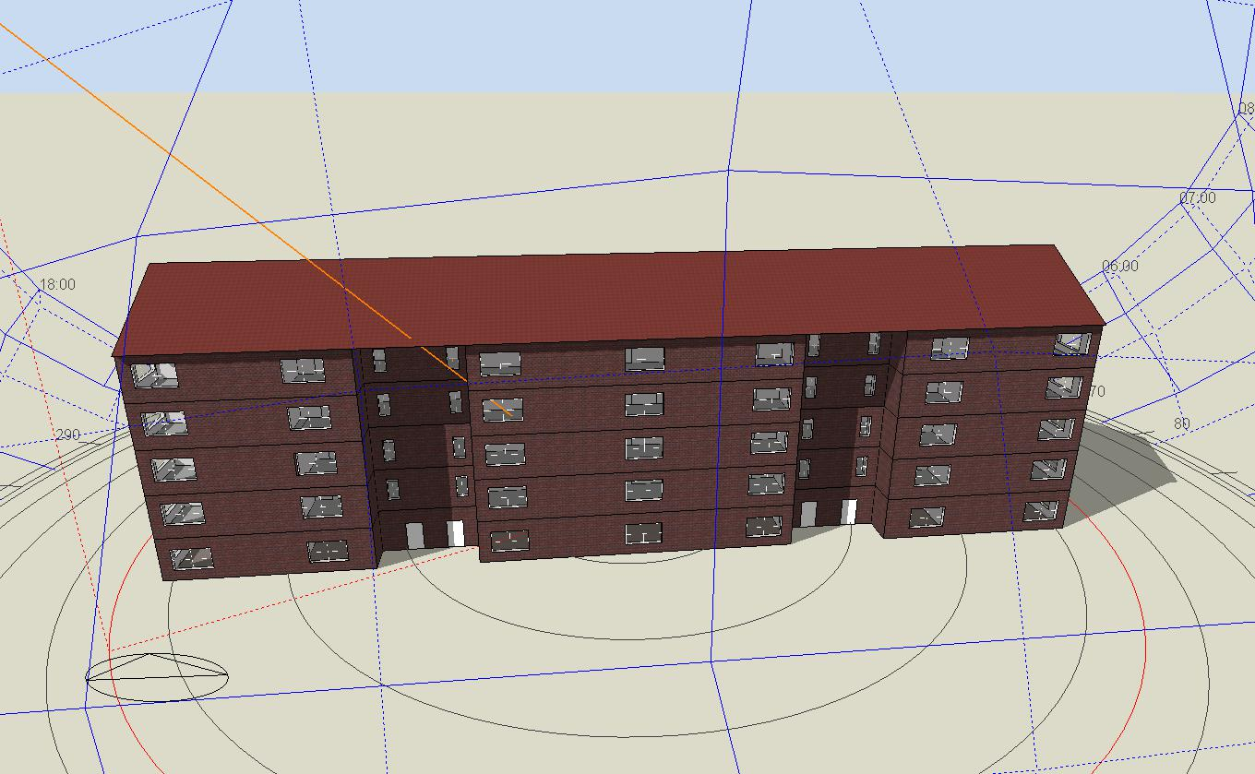
6.Evaluation of Energy Conservation
Floor: 5
1 floor area: 770,88 m2
Total area: 3854,4 m2
Table 6.1 Properties of wall structure materials
Materials | Thickness (mm) | Thermal conductivity (W/m·K) |  | Specific heat (J/kg·K) | Density (kg/m³) | Cost
Decorative Plaster | 10 | 0.33 |  | 2040 | 520 | 1.26 (GBP/m2)
Mineral Wool | 100 | 0.038 |  | 840 | 140 | 33.56 (GBP/m3)
NAAC | 300 | From Experimental Results |  |  |  | 25.61 (GBP/m3)
Cement/Plaster/Mortar | 15 | 0.72 | 840 |  | 1760 | 0.75 (GBP/m2)
Figure 6.1. 5-storey residential building model for energy simulation

Slide 26
6. Design Builder Simulation Results
Figure 6.2 Heating Load of NAAC
Figure 6.3 Cooling Load of NAAC
Table 6.2 Temperature Data
Temperature (°C)
Jan. | Feb. | March | Apr. | May | June | July | Aug. | Sept. | Oct. | Nov. | Dec.
-10,6 | -10,2 | -5,5 | 5,8 | 14,2 | 18,4 | 20,0 | 17,6 | 12,1 | 5,4 | -3,9 | -7,7

Slide 27
6. Design Builder Simulation Results
Table 6.3 Site and Source Energy Results of NAAC
Mixt. | Site Energy (kWh) | Saving (%) | Source Energy (kWh) | Saving (%)
M1 | 441951,37 |  | 1439826,96
M2 | 435181,79 | 1.53 | 1411635,35 | 1.96
M3 | 436270,53 | 1.28 | 1415997,94 | 1.65
M4 | 440145,32 | 0.4 | 1431427,23 | 0.58
M5 | 442736,82 | -0.17 | 1441666,33 | -0.13
M6 | 440805,19 | 0.26 | 1434000,91 | 0.41
M7 | 441224,13 | 0.16 | 1435729,03 | 0.28
M8 | 441814,88 | 0.03 | 1438049,840 | 0.12
M9 | 437362,03 | 1.03 | 1420350,17 | 1.35
M10 | 440353,07 | 0.36 | 1432258,39 | 0.53
M11 | 440556,22 | 0.32 | 1433059,8 | 0.47
Only glass sand replacement
Combination of glass sand and glass fiber

Slide 28
6. Comparison with conventional walls
Table 6.4 Concrete wall layer
Materials | Thickness (mm) | Thermal conductivity (W/m·K) | Specific heat (J/kg·K) | Density (kg/m³) | Cost
Decorative Plaster | 10 | 0,33 | 2040 | 520 | 1,26 (GBP/m2)
External Panel (M400 Concrete) | 80 | 1,2 | 1000 | 2400 | 21,06 (GBP/m3)
Mineral wool (PAROC WAS 35) | 180 | 0,038 | 840 | 140 | 33,56 (GBP/m3)
Internal Panel (M250 Concrete) | 140 | 0,7 | 1000 | 2400 | 17,55 (GBP/m3)
Gypsum/Cement Plaster | 15 | 0,72 | 840 | 1760 | 0,75 (GBP/m2)
Table 6.5. Comparison between two different wall layer results (annual)
Wall Layers | Heating Load (kWh) | Cooling Load (kWh) | Site Energy (kWh) | Source Energy (kWh)
NAAC M2 wall | 338676 | 24206 | 435182 | 1411635
Project Wall | 339422 | 24844 | 435505 | 1413598

Slide 29
7. Feasibility of NAAC
Civil and Environmental Engineering Department

Slide 30
7. Feasibility of NAAC
The cost of materials for 1m3 of NAAC
Machinery cost
Electricity cost
Salary for workers
Total 67$ for 1m3 of NAAC
Save from utility bills

Slide 31
8. CONCLUSION
Civil and Environmental Engineering Department

Slide 32
8. Conclusion
Successfully develop the mixture proportions
Synergetic effect of combined glass sand and glass fiber on properties of NAAC
Statistical model with high R2 was developed to predict the thermal conductivity of NAAC
Energy saving effect was proved
Recommendations:
The long-term effect of combined glass sand and glass fiber on properties of NAAC
The Alkali – Silica Reaction between the aggregate and cementitious materials
More measurements (more mixture parameters) are needed in order to precisely predict the model based on the Multivariate Linear Regression analysis.

Slide 33
REFERENCE LIST
References
[1] Jiang, Yi, Tung-Chai Ling, Kim Hung Mo, and Caijun Shi. 2019. "A critical review of waste glass powder–Multiple roles of utilization in cement-based materials and construction products." Journal of environmental management 242: 440-449.
[2] Karazi, S. M., I. U. Ahad, and K. Y. Benyounis. 2017. "Laser Micromachining for Transparent Materials."
[3] Tengri News. 2018. “New life of bottle or how to make money on glass” Received from https://tengrinews.kz/fotoarchive/1048/
[4] Narayanan N, Ramamurthy K. 2000. “Structure and properties of aerated concrete: a review”. Cement, Concrete, Composites Journal 22 (5): 321–29.
[5] Liu, Yiwei, Caijun Shi, Zuhua Zhang, and Ning Li. 2019. "An overview on the reuse of waste glasses in alkali-activated materials." Resources, Conservation and Recycling 144: 297-309.
[6] Liang, Hong, Huiying Zhu, and Ewan A. Byars. 2007. "Use of waste glass as aggregate in concrete." In 7th UK CARE Annual General Meeting. UK Chinese Association of Resources and Environment, Greenwich, vol. 15.
[7] Pehlivanlı, Zühtü Onur, İbrahim Uzun, Zeynep Pınar Yücel, and İlhami Demir. 2016. "The effect of different fiber reinforcement on the thermal and mechanical properties of autoclaved aerated concrete." Construction and Building Materials 112: 325-330.

