Slide 1

International collaborations through high-quality research output
Can universities achieve this by promoting standards in research writing and developing a better understanding of scholarly publishing?
Copyright © 2018 Enago Academy | All Rights Reserved.

Slide 2

Higher Education – Current Global Environment
Higher education is being reshaped by globalisation
Students have increasing demands and expectations of their educational experience
Students are looking for access to services and education across new technologies and more flexible delivery options
Higher influx of international students
Research impact and institutional ranking = major role in decision making
Success in high-impact international journals =
funding, tenure, collaborations, research career, global reach

Slide 3
Publishing and Research Status: CIS region
Number of citable documents (research papers) produced by Kazakhstan in comparison with other CIS countries between 1996 and 2016. Source: SCImago
Notes:
In the CIS region, Kazakhstan ranks third in terms of the number of citable research outputs after Russia and Ukraine. Source: Scimago

Slide 4
Publishing and Research Status: CIS region
During the same period, the number of citations for documents from Kazakhstan was the lowest. Source: SCImago
Notes:
In the CIS region, Kazakhstan ranks third in terms of the number of citable research outputs after Russia and Ukraine. What should also be considered that although the number of papers published by Kazakhstan are greater than Armenia, the H-index or the impact of these papers was lower.
Source: Scimago

Slide 5
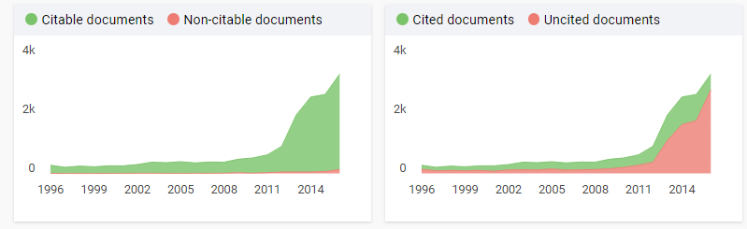
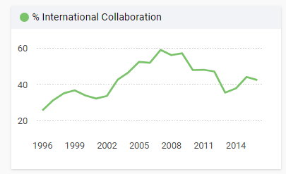
Publishing and Research Status: Kazakhstan
Most citable documents have remained uncited
Gradual increase in number of publications between 1996 and 2016
A large amount of research remained uncited between 1996 and 2016
Source: SCImago
There was also a negative trend in international collaborations
Notes:
Furthermore, although the number citable documents produced by Kazakhstan has increased over a period of time, most of them still remain uncited. The quality of research outputs also reflects on the status collaboration which is showing a negative trend after 2014.
Source: Scimago

Slide 6
Questionnaire Survey

Slide 7









About Enago
Corporate Memberships
  Assisting research authors meet publication success
  Strong reach amongst individual researchers (B2C) & Universities (B2B)
Leaders in Japan, Korea and amongst top 3 players globally.
  Provides Language editing & Publication Support Services
  A preferred partner for leading publishers, societies and universities worldwide

Slide 8
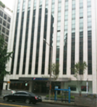

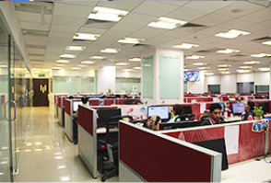
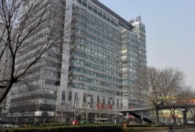
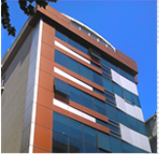
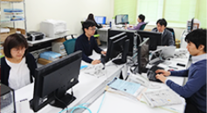
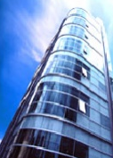
Enago Offices
Korea
China
USA
Turkey
India
Japan
Brazil
Taiwan

Slide 9





















Enago Top Clients
Publishers & Societies
Top Ranking Universities

Slide 10






Enago Top Clients
CIS Universities

Slide 11
Enago – Author Services
Scientific Translation & Editing
Author
Education Services
Translation Service
Copy Editing
Substantive Editing

Slide 12

Translation Service
Academic Translator
Bilingual
Proofreader
Native English Editor
Publication Ready Manuscript
Best Features:
The best translation quality
Subject area experts
Professional qualified translation team

Slide 13


Copy Editing Service
1
Quality-conscious ESL authors
2 Editors edit the manuscript covering all aspects of editing
2
The Enago Promise
3
Reasonably priced
Ingredients of Editing
After Sales Support
Available only with Enago
Language and Grammar Check
Language Check
Grammar Check
Punctuation check
Style and Consistency
Writing style check
References check
Figures and Tables
Technical Accuracy
Editor Q&A for 365 days
“Two-Editor” System
Native speaking Editor
Specialized Subject Area Matching
Free Add-On
Word Count Reduction
Journal Formatting
Certificate of Editing
Academy Resources
Manuscript Rate card (MRC)
Editorial Workflow
Subject and Language Expert
Proofreader and Language Review
Senior Editor Review
Quick Check l Audit

Slide 14
Substantive Editing Service
1
Top-tier premium service
2 Editors edit the manuscript covering all aspects of editing
2
The Enago Promise
3
Highest skilled editors
Ingredients of Editing
After Sales Support
Available only with Enago
Language and Grammar Check
Language Check
Grammar Check
Punctuation check
Style and Consistency
Writing style check
References check
Figures and Tables
Technical Accuracy
Structural Review
Logical Flow
Presentation
Content Enhancement
Edit Unlimited for 365 days
Editor Q&A for 365 days
“Two-Editor” System
Native speaking Editor
Specialized Subject Area Matching
Free Add-On
Word Count Reduction
Journal Formatting
Certificate of Editing
Academy Resources
Manuscript Rate card (MRC)
Editorial Workflow
Subject and Language Expert
Proofreader and Language Review
Senior Editor Review
Quick Check l Audit
Covered only in Substantive Editing

Slide 15

Enago Quality Philosophy
High
Quality
99.4%
Quality Satisfaction Ratio
99.4% of our clients are very happy with our service This is based on the client complains we receive on the quality of our service.
Reasonable Price
77%-85%
Repeat Client Ratio
Depending on different regions
Reasonable Time

Slide 16
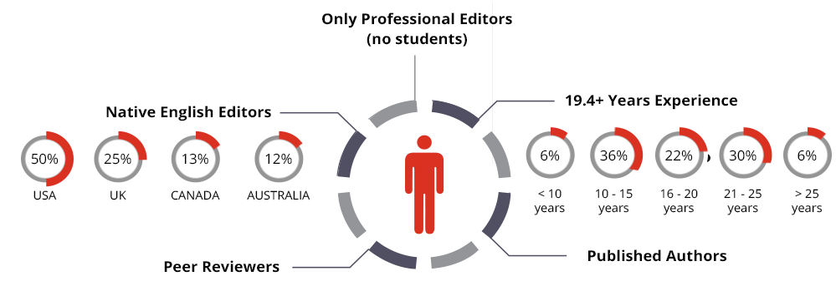






Our Editors

Slide 17
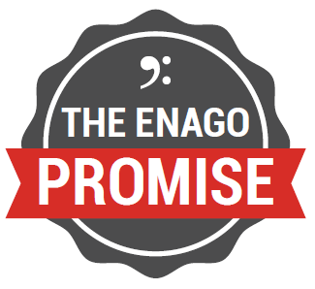

How is Enago Different?
Specialized Subject
Area Matching
The Enago
Promise
”Two Editor “
System
Edit
Unlimited
Notes:
"Two-Editor" System
Two expert editors perform quality edits on a manuscript.
1st edit -- subject and native expert.
2nd edit-- polishes and refines the manuscript
Ensures that even the smallest of grammatical mistakes are corrected and manuscript is formatted according to the target journal style guide.
Specialized Subject Area Matching:
Manuscript given to a subject matter expert.
Focus on optimizing subject and language.
Subject expert editor has incomparable technical competency in their specific field of study
The Enago Promise:
No Rejection by a journal because of language and format.
Re-edits of rejected paper with no additional cost

Slide 18
Enago’s Partnerships
Collaboration with QS (famous for its rankings): http://www.qs.com/qs-announce-new-partnership-enago
Collaboration with NCURA (National Council of University Research Administrators): http://www.ncura.edu/LinkClick.aspx?fileticket=I8RwdGa4BH8%3d&portalid=0
Collaboration with IFCU (219 catholic universities): http://fiuc.org/en/news/ifcu_partners_with_enago_to_offer_manuscript_preparation_and_author_education_services

Slide 19
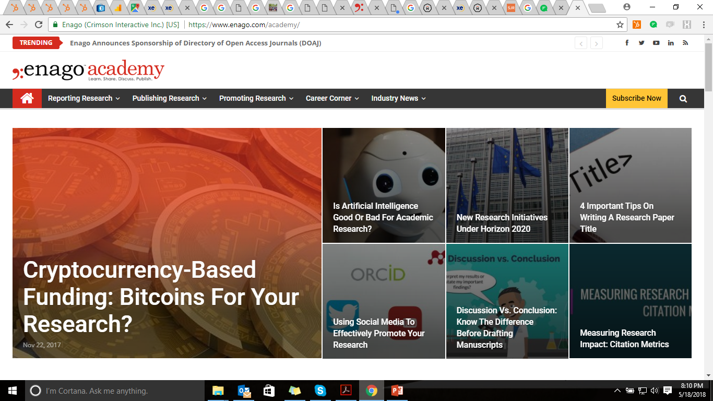
Enago Academy–Knowledge Platform
Guide Researchers/Authors at each stage of the publication cycle
Provide E-books on publication updates , checklists on how to avoid common manuscript errors, and rapidly advance your academic career
Provide online resources for researchers, publishers, authors, editors, and students
Conduct author workshops on academic publishing in ESL countries.

Slide 20
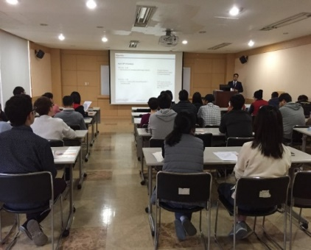
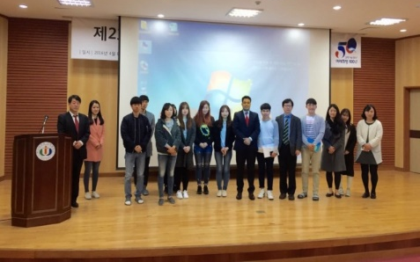
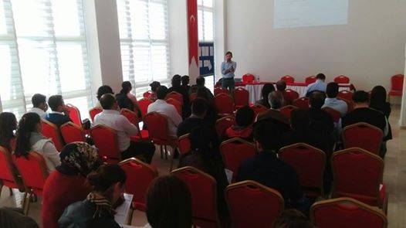
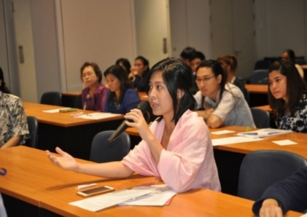
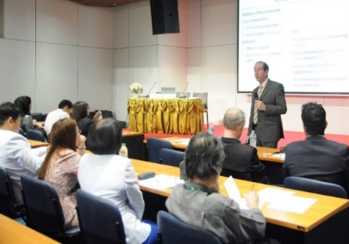
Enago Workshops
Asia Pacific | CIS | Middle East | Europe | Latin America
Japan | Russia | Kuwait | Germany | Colombia
China | Azerbaijan | Qatar | Lithuania | Mexico
Korea |  | Iran | Turkey | Chile
Taiwan |  |  |  | Brazil
Thailand
Malaysia

Slide 21

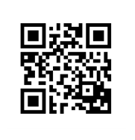
Download the Enago Academy app to get free updates on academic writing and publishing!
(Or visit: enago.com/app)
All the best for your future papers!

