Slide 1

Assortment improvement
of Magnum retail chain through e-commerce channel: A Data Analytics approach
Capstone Team 1
Prof. Dimitrios Emiris
Prof. Maria Tsakalerou
Zhantileu Segizbayev
Saida Zhunussova
Madina Baizhanova

Slide 2

Capstone team
Zhantileu Segizbayev
Madina Baizhanova
Saida Zhunussova

Slide 3

Outline
01
02
Introduction
Literature review
Project scope and aims; problem statement and motivation
Bibliographic search of recent research studies
03
04
Research methodology
Results and Discussion
The main findings of the project and discussion of the results
Approaches, tools, and techniques used in study
05
Conclusion
Summary findings and recommendations

Slide 4
01
Introduction

Slide 5
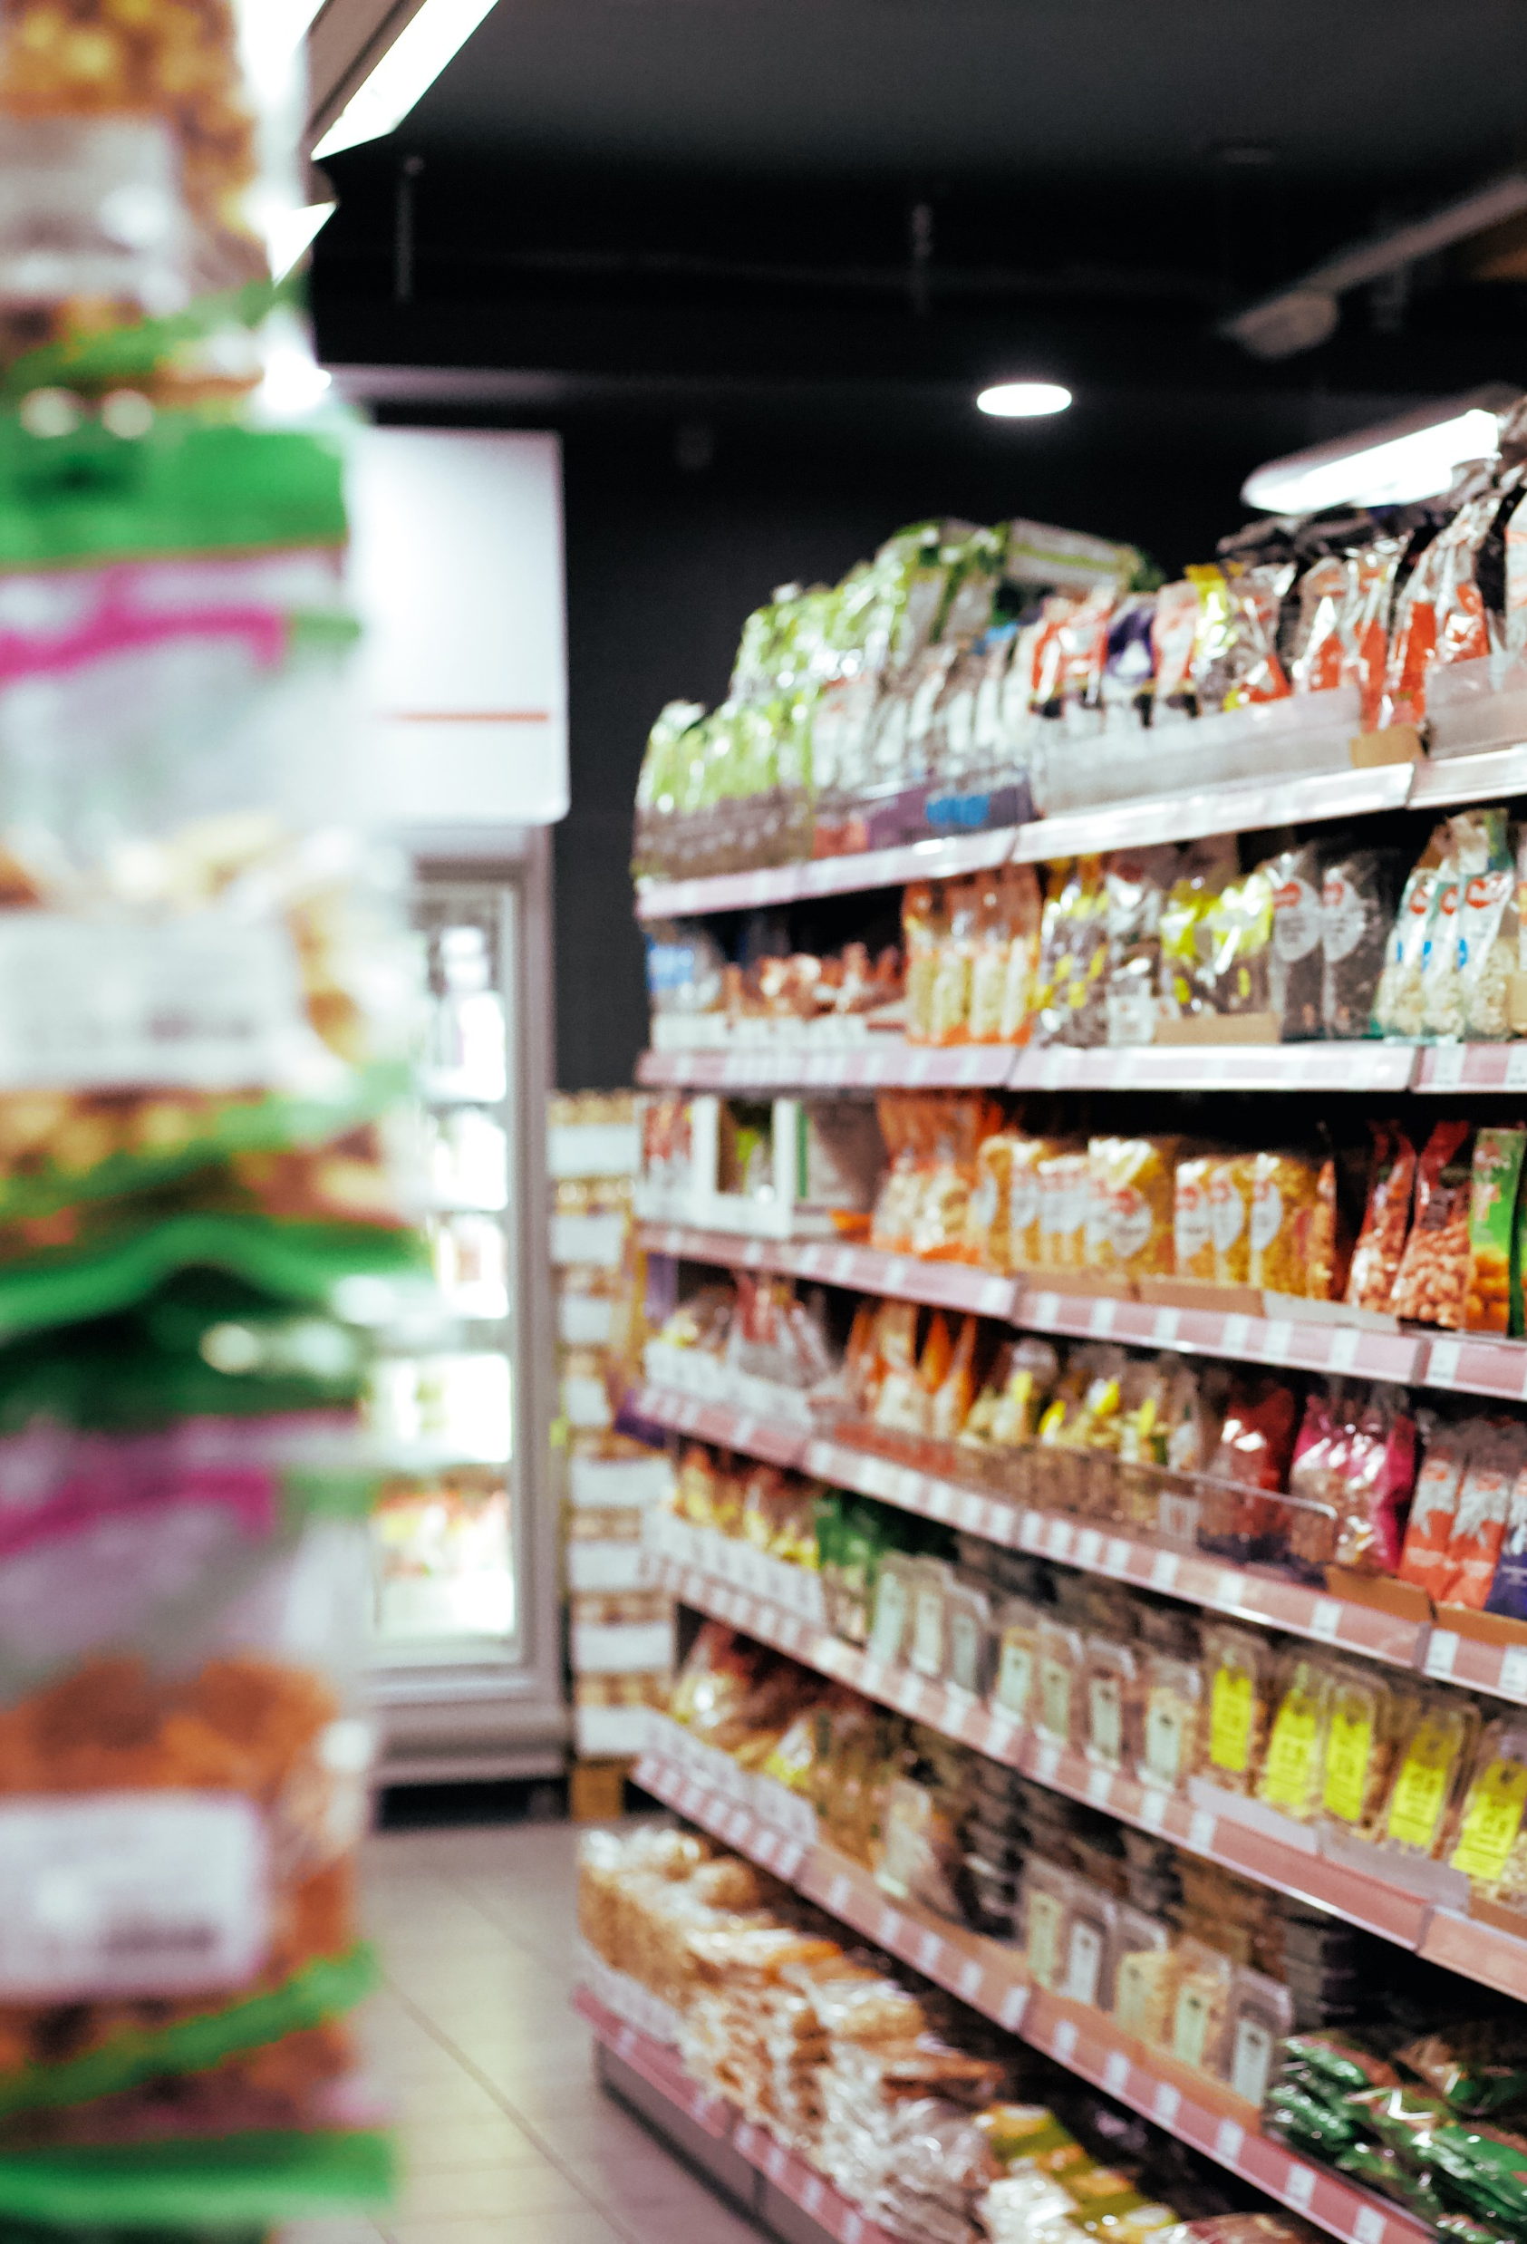

About the project
Assortment improvement of a major retail chain for newly launched e-commerce platform using Data Analytics tools and techniques

Slide 6




Background information on e-commerce
1990s
2019
COVID
2021+
The beginning of e-commerce
(Dos Santos et al., 2017; Oláh et al., 2019).
The burgeoning of online Fast Moving Consumer Goods (FMCG)
(Dillahunt et al., 2019).
The global pandemic
(Bhatti et al., 2020).
E-commerce in Kazakhstan
(Alfonso et al., 2021).

Slide 7





Company information
The largest retail chain in Kazakhstan
Magnum Club – loyalty card program
First self-checkout stations in Kazakhstan
Magnum Go - online grocery shopping platform

Slide 8



Problem statement
Offline customer
Online customer
Visit the stores
Order from their home
Product assortment for physical stores
Product assortment for e-commerce

Slide 9
Project scope and objectives
Assortment improvement of Magnum retail chain
through e-commerce channels: A Data Analytics approach
I
II
III
IV
V
Online vs. Offline
Competitor analysis and benchmarking
Categorization and listing algorithms
Mobile ergonomics
Interactive dashboard

Slide 10
02
Literature review

Slide 11
Literature review
Data analytics in e-commerce
Assortment for e-commerce platforms
40+
Categorization and listing strategies for e-commerce
Web and mobile app ergonomics

Slide 12
Data analytics in e-commerce
Akter and Wamba (2016): Implementation of BDA leads to the increase in productivity at least by 5-6%.
Le and Liaw (2017): Companies should give more priorities to data driven decisions.
Arora et al. (2020): Nearly half of the best-performing businesses apply BDA weekly or even more frequently.

Slide 13
Assortment for e-commerce platforms
He, Guo, and Chen (2019): Both too narrow and too broad assortment size can lead to low performance in sales.
Heese and Martínez-de-Albéniz (2018): Optimizing the assortment can improve the operational efficiency and fit supply with demand.
Besbes and Sauré (2016): Methods of assortment analysis: evaluation of the assortment of competitors and analysis of historical data.

Slide 14
Categorization and listing strategies for e-commerce
Holý, Sokol, and Černý (2017): Applications of product categorization: product development, product promotion, and general investigation of product dependencies.
Sysoeva and Buzukova (2019): Products need to be grouped based on the customers perceptions.
Ristoski et al. (2018): Since e-commerce stores have a variety and complexity of assortment, they need to implement modern technologies for product categorization and listing.

Slide 15
Web and mobile app ergonomics
Shorrock and Williams (2016): Ergonomics can include three critical types of constraints: accessibility, usability, and contextual.
Díaz, Rusu, and Collazos (2017): Cultural factors can be used in designing personalized user interface.
Lin (2014): User and system recommendations positively affect company’s performance in terms of sales.

Slide 16
03
Research methodology

Slide 17



Research framework and methodology
Data Collection and Preprocessing
Data processing, analysis, and inference
Data Visualization

Slide 18
Data Collection and Preprocessing
Offline vs. Online sales analysis
Competitor analysis;
categorization, listing algorithm
Mobile app ergonomics
16
10m
4 weeks
26k
Datasets
rows of data
manual data collection
sanitized products data

Slide 19
Data Analysis and Data Analytics tools
Offline vs. Online sales analysis
Competitor Analysis
Categorization and listing
Mobile app ergonomics analysis
Sales analytics by product classes, groups, categories
Average basket composition
Sales analytics by days of week, by cities
Product assortment analysis by classes groups, categories
Product group width estimation
Product group decomposition
Categorization: Magnum vs. competitors
Listing algorithm of competitors
Developing new categorization
Analyzing survey results
Analyzing testing results
Statistical analysis of UI and UX designs

Slide 20




Data Visualization and interactive dashboards
Data Visualization tools
Interactive Dashboards tool
Types of used charts

Slide 21
04
Results and Discussion

Slide 22
Results framework
Assortment improvement of Magnum retail chain
through e-commerce channels: A Data Analytics approach
Offline vs. Online
Competitor analysis
Categorization and listing
Mobile app ergonomics
Interactive Dashboard

Slide 23
Results framework
Assortment improvement of Magnum retail chain
through e-commerce channels: A Data Analytics approach
Offline vs. Online
Competitor analysis
Categorization and listing
Mobile app ergonomics
Interactive Dashboard

Slide 24
Offline vs. Online sales by product class
Food
Non-Food
In-House Production
Offline sales by product class
Online sales by product class
5%
2%
4%

Slide 25
Offline vs. Online sales by product class
Food
Non-Food
In-House Production
Offline sales by product class
Online sales by product class
5%
2%
4%
Offline sales by product class, in million tenge
Online sales by product class, in million tenge
87%
95%
86%
87%
87%
94%
93%
20 020
20 403
29 915
21 343
95%
314
232
123
167
October
November
December
January
October
November
December
January
5%
2%
2%
4%
4%
1 836
4%
2%
2%
5.0
992
1 050
1 025
2.4
2.7
4.7
October
November
December
January
October
November
December
January
9%
9%
8%
9%
4%
5%
4%
4%
2 182
2 120
2 696
2 272
7.7
12.4
11.6
4.6
October
November
December
January
October
November
December
January

Slide 26
Offline vs. Online sales in Food class
Magnum offline sales in Food product class by group, (in million tenge)
≈70% of sales
Sales
10 252
9 944
9 709
9 477
9 008
6 264
Share of total sales, %
12%
11%
11%
5 043
11%
10%
3 951
3 210
3 178
7%
2 852
2 769
2 619
2 585
1 800
1 795
6%
4%
4%
4%
1 238
1 003
995
919
3%
3%
3%
3%
2%
2%
1%
1%
1%
1%
103
0%
Pastry and candy
Dairy Products
Pantry Staples
Eggs, cheese, sausages
Vegetables, fruits, berries, mushrooms
Hygiene products
Soft drinks
Household chemicals
Tea, coffee, cocoa
Strong alcohol
Cosmetics, perfume, pharmac-s
Beer and light alcohol drinks
Canned goods
Frozen products
Tobacco products
Wine
Baby food
Bread & bakery
Goods for pets
Household goods
Elite alcohol
Magnum online sales in Food product class by group, (in million tenge)
≈70% of sales
Sales
111
95
87
79
67
58
Share of total sales, %
14%
53
52
12%
11%
10%
31
30
8%
7%
7%
6%
27
23
18
17
4%
4%
3%
3%
14
13
13
10
8
5
0
2%
2%
2%
2%
2%
1%
1%
1%
0%
Dairy Products
Pantry Staples
Vegetables, fruits, berries, mushrooms
Eggs, cheese, sausages
Hygiene products
Household chemicals
Pastry and candy
Soft drinks
Tea, coffee, cocoa
Frozen products
Canned goods
Baby food
Cosmetics, perfume, pharmac-s
Strong alcohol
Wine
Beer and light alcohol drinks
Goods for pets
Household goods
Tobacco products
Bread & bakery
Elite alcohol

Slide 27
Offline vs. Online in Non-Food class
Magnum offline sales in Non-Food product class by product group, (in million tenge)
≈70% of sales
Sales
1 262
Share of total sales, %
26%
612
578
369
307
283
256
13%
12%
8%
188
140
109
107
6%
6%
5%
4%
3%
2%
2%
72
71
70
69
66
65
48
33
2%
1%
1%
1%
1%
1%
1%
1%
Household products
Party supplies &crafts
Goods for kids
Electronics
Hosiery and tights
Home textile
Automotive goods
Stationary products
Small-wares
Underwear
Garden & Tools
Footwear
DIY products
Household appliances
Tourism, picnic
Entertainment products
Bath, sauna products
Clothing
Sports goods
Magnum online sales in Non-Food product class by product group, (in million tenge)
Offline vs. Online
≈70% of sales
Sales
5,1
Share of total sales, %
34%
1,8
12%
1,0
1,0
0,7
0,6
7%
7%
5%
4%
0,4
0,4
0,4
0,3
0,2
0,2
0,2
0,1
0,1
0,1
0,1
0,0
0,0
3%
3%
3%
2%
1%
1%
1%
1%
1%
0%
0%
0%
0%
Household products
Electronics
Stationary products
Goods for kids
Home textile
Automotive goods
Garden & Tools
Bath, sauna products
Party supplies &crafts
Tourism, picnic
DIY products
Household appliances
Hosiery and tights
Small-wares
Sports goods
Clothing
Footwear
Underwear
Entertainment products

Slide 28
Offline vs. Online sales in In-house production
Magnum offline sales in In-house product class by product group, (in million tenge)
>70% of sales
Sales
4 199
Share of total sales, %
46%
1 568
1 065
946
894
17%
12%
10%
10%
270
3%
97
47
20
13
4
1%
1%
0%
0%
0%
Meat products
Cookery
Bakery
Candies production
Salads
Semi-finished products
Fish production
Cafeteria
Raw materials for prod.
Bistro
Food for staff
Magnum online sales in In-house product class by product group, (in million tenge)
Offline vs. Online
>70% of sales
Sales
26,7
Share of total sales, %
80%
2,0
1,7
1,0
0,9
0,5
0,4
0,1
0,0
0,0
0,0
6%
5%
3%
3%
1%
1%
0%
0%
0%
0%
Meat products
Bakery
Cookery
Salads
Candies production
Semi-finished products
Fish production
Raw materials for prod.
Bistro
Cafeteria
Food for staff

Slide 29
Offline vs. Online sales
Pastry and candy
Pantry staples
Vegetables, fruits, berries
Soft drinks
Household chemicals
Frozen products
Dairy products
Eggs, cheese and sausages
Hygiene products
Meat products
Other
Offline basket composition, in %
Online basket composition, in %
Offline vs. Online

Slide 30
Offline vs. Online by day of week and by city
Average offline weekly sales by day of week (in million tenge)
Peak sales
988
900
827
849
858
837
757
14%
14%
14%
14%
16%
15%
13%
Monday
Tuesday
Wednesday
Thursday
Friday
Saturday
Sunday
Average online weekly sales by day of week (in million tenge)
Offline vs. Online
7.2
8.0
7.3
7.5
7.3
6.9
6.7
13%
14%
16%
13%
14%
15%
14%
Monday
Tuesday
Wednesday
Thursday
Friday
Saturday
Sunday

Slide 31
Offline vs. Online by day of week and by city
Average offline weekly sales by day of week (in million tenge)
Offline sales by cities, in %
Peak sales
988
900
1%
827
849
858
837
757
14%
14%
14%
14%
16%
15%
13%
Monday
Tuesday
Wednesday
Thursday
Friday
Saturday
Sunday
Almaty
Shymkent
Other cities
Nur-Sultan
Petropavl
Average online weekly sales by day of week (in million tenge)
Online sales by cities, in %
Offline vs. Online
7.2
8.0
7.3
7.5
7.3
0%
6.9
6.7
13%
14%
16%
13%
14%
15%
14%
Monday
Tuesday
Wednesday
Thursday
Friday
Saturday
Sunday
Almaty
Shymkent
Nur-Sultan
Petropavl

Slide 32
Results framework
Assortment improvement of Magnum retail chain
through e-commerce channels: A Data Analytics approach
Offline vs. Online
Competitor analysis
Categorization and listing
Mobile app ergonomics
Interactive Dashboard

Slide 33






Competitors’ assortment analysis: Food vs Non-Food
Number of SKUs per each class
42 079
34 817
15%
Non-Food
33 431
Food
12%
29 475
36%
23%
85%
88%
11 468
9 352
64%
77%
10%
6%
90%
94%
Number of groups per each class
6
(29%)
5
(25%)
3
(33%)
10
(30%)
21
(53%)
48%
(19)
15
(56%)
12
(44%)
15
(71%)
15
(75%)
6
(67%)
23
(70%)

Slide 34


Competitors’ assortment analysis: Food
Number of SKUs per each group in Food class
PANTRY STAPLES
2.645
3.201
3.245
2.894
2.284
COSMETICS, PERFUME, PHARMACEUTICS
2.591
4.685
2.366
3.216
HYGIENE PRODUCTS
2.127
3.322
2.701
1.783
1.169
PASTRY AND CANDY
2.041
3.326
2.540
2.061
EGGS, CHEESE, SAUSAGES
1.623
1.839
2.491
1.468
1.429
DAIRY PRODUCTS
1.344
1.511
1.927
1.163
542
1.238
HOUSEHOLD CHEMICALS
1.248
1.929
1.464
SOFT DRINKS
1.003
CANNED GOODS
1.355
1.129
500
TEA, COFFEE, COCOA
1.574
1.748
FROZEN PRODUCTS
1.331
1.723
1.349
WINE
1.353
1.238
3
STRONG ALCOHOL
0
BEER AND LIGHT ALCOHOL DRINKS
BABY FOOD
1.424
516
HOUSEHOLD GOODS
458
GOODS FOR PETS
4.821
1.640
429
VEGETABLES AND FRUITS
438
1.073
BREAD & BAKERY
TOBACCO PRODUCTS
23
0
0
2
ELITE ALCOHOL
43
0
0
0

Slide 35
Competitors’ assortment analysis: Non-food
Number of SKUs per each group in Non-Food class
HOME TEXTILE
2.644
2.264
HOUSEHOLD PRODUCTS
1.635
1.582
1.167
PARTY SUPPLIES & CRAFTS
1.375
0
UNDERWEAR
1.362
69
HOSIERY & TIGHTS
1.039
CLOTHING
FOOTWEAR
0
ACCESSORIES
ENTERTAINMENT PRODUCTS
0
1
0
GOODS FOR KIDS
STATIONERY PRODUCTS
0
SPORTS GOODS
TOURISM, PICNIC
GARDEN & TOOLS
0
0
0
0
BATH, SAUNA PRODUCTS
AUTOMOTIVE GOODS
ELECTRONICS
0
1
0
0
0
HOUSEHOLD APPLIANCES
216
0
DIY PRODUCTS
198
0
0

Slide 36
Competitor analysis
The number of SKUs presented in the Canned goods group
1.355
1.129
Magnum
Perekrestok
Utkonos
Lenta
Arbuz
Lentochka
SKUs distribution by categories in the Canned goods group (in %)
Magnum
Perekrestok
Utkonos
Lenta
Arbuz
Lentochka
6,5%
1,8%
2,1%
2,4%
Canned vegetables
Canned fruits and berries
Canned fish and seafood
Canned meat
Canned diary

Slide 37
Results framework
Assortment improvement of Magnum retail chain
through e-commerce channels: A Data Analytics approach
Offline vs. Online
Competitor analysis
Categorization and listing
Mobile app ergonomics
Interactive Dashboard

Slide 38



New categorization
Restructuring groups and categories
Removing groups and categories
Proper naming

Slide 39
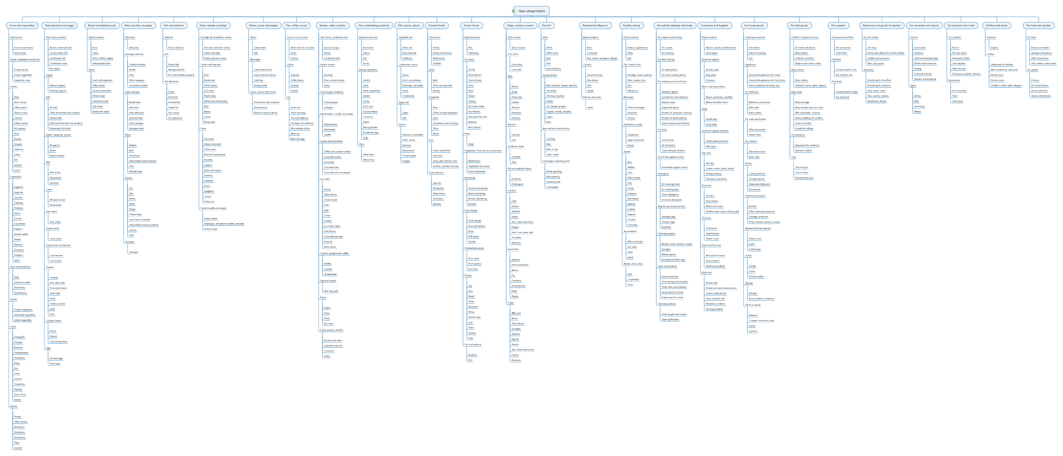
New categorization

Slide 40
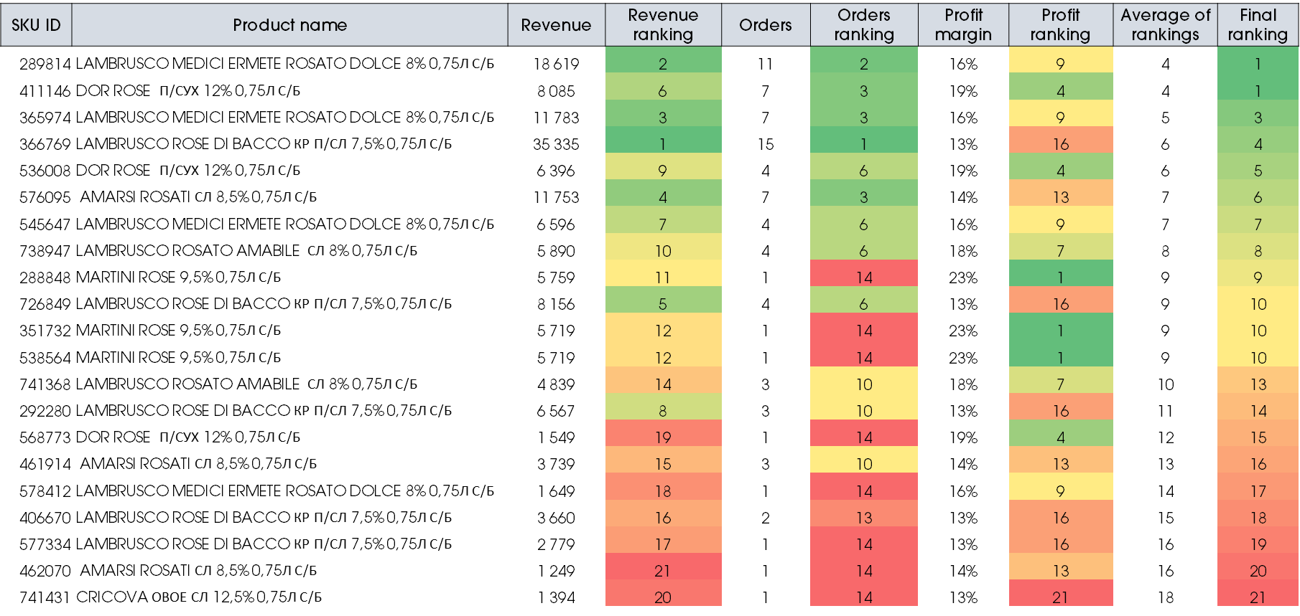
New listing algorithm

Slide 41
Results framework
Assortment improvement of Magnum retail chain
through e-commerce channels: A Data Analytics approach
Offline vs. Online
Competitor analysis
Categorization and listing
Mobile app ergonomics
Interactive Dashboard

Slide 42




Mobile app ergonomics survey structure
Functionality
Aesthetics
Information
Subjective quality
Performance
Navigation
Gestural design
Graphics
Layout
Visual appeal
Quality
Quantity
Visual info
Worth recommending
Overall rating

Slide 43
Survey results
Functionality
Aesthetics
Information
Subjective quality

Slide 44
Results framework
Assortment improvement of Magnum retail chain
through e-commerce channels: A Data Analytics approach
Offline vs. Online
Competitor analysis
Categorization and listing
Mobile app ergonomics
Interactive Dashboard

Slide 45
Interactive dashboard

Slide 46
05
Conclusion

Slide 47
Conclusion
Assortment improvement of Magnum retail chain
through e-commerce channels: A Data Analytics approach
I
II
III
IV
V
Online vs. Offline
Competitor analysis and benchmarking
Categorization and listing algorithms
Mobile ergonomics
Interactive dashboard

Slide 48

Contribution
01
Comprehensive analytical foundation for improving Magnum Go e-commerce channel
02
Tools for data-driven strategic decisions
03
Industry benchmarking in e-commerce
04
Major areas of improvements for mobile app

Slide 49

Future works
01
Compare forecasting with the actual data
02
Test new categorization and listing
03
Create effective design of mobile app
04
Omnichannel customer experience

Slide 50

Lessons learned
01
Preprocess, analyze, and draw an inference from the big data sets
02
Visualized data by using advanced tools
03
Gained a deep knowledge about the retail e-commerce
04
Practiced assessment of mobile app ergonomics

Slide 51
Thank you!

Slide 52
Reference list
Akter, S. and Wamba, S. F. (2016). Big data analytics in E-commerce: a systematic review and agenda for future research. Electronic Markets, 26(2), 173-194.
Arora A., Boudet J., Bucy M., Khan H., Montilla R., Smaje K. (2020). Think Fast: How to accelerate e-commerce growth. McKinsey Digital. [online] Available at:https://www.mckinsey.com/business-functions/mckinsey-digital/our-insights/think-fast-how-to-accelerate-e-commerce-growth# [Accessed 27 Feb. 2021].
Besbes, O. and Sauré, D., 2016. Product assortment and price competition under multinomial logit demand. Production and Operations Management, 25(1), pp.114-127.
He, Y., Guo, X. and Chen, G., 2019. Assortment Size and Performance of Online Sellers: An Inverted U-Shaped Relationship. Journal of the Association for Information Systems, 20(10), p.2.
Heese, H.S. and Martínez-de-Albéniz, V., 2018. Effects of assortment breadth announcements on manufacturer competition. Manufacturing & Service Operations Management, 20(2), pp.302-316.
Holý, V., Sokol, O. and Černý, M., 2017. Clustering retail products based on customer behaviour. Applied Soft Computing, 60, pp.752-762.
Le, T. M. and Liaw, S. Y. (2017). Effects of pros and cons of applying big data analytics to consumers’ responses in an e-commerce context. Sustainability, 9(5), 798.
Lin, Z., 2014. An empirical investigation of user and system recommendations in e-commerce. Decision Support Systems, 68, pp.111-124.
Ristoski, P., Petrovski, P., Mika, P. and Paulheim, H., 2018. A machine learning approach for product matching and categorization. Semantic Web, 9(5), pp.707-728.
Shorrock, S.T., Williams, C.A., 2016. Human factors and ergonomics methods in practice: three fundamental constraints. Theor. Issues Ergon. Sci. 17, 468–482.
Stoyanov, S.R., Hides, L., Kavanagh, D.J., Zelenko, O., Tjondronegoro, D. and Mani, M., 2015. Mobile app rating scale: a new tool for assessing the quality of health mobile apps. JMIR mHealth and uHealth, 3(1), p.e27.
Sysoeva, S. and Buzukova, E., 2019. Category management. Assortment management in retail. 2nd ed. Saint Petersburg: Piter, pp.160-161.

