Slide 1
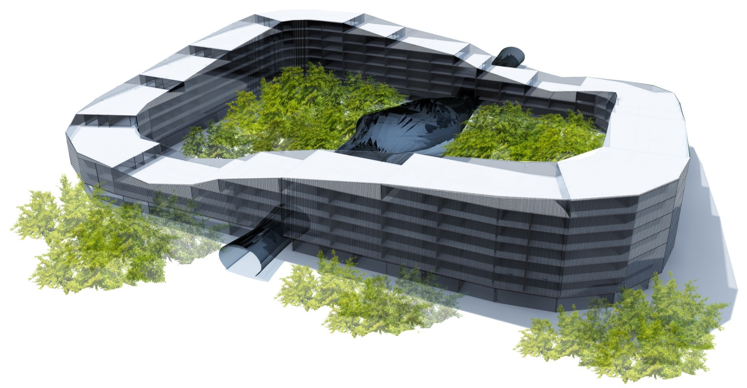

URBAN JUNGLE
CROATIA
2nd Prize
Folnegović Valentina, Galac Antonija, Korpar Petra

Slide 2
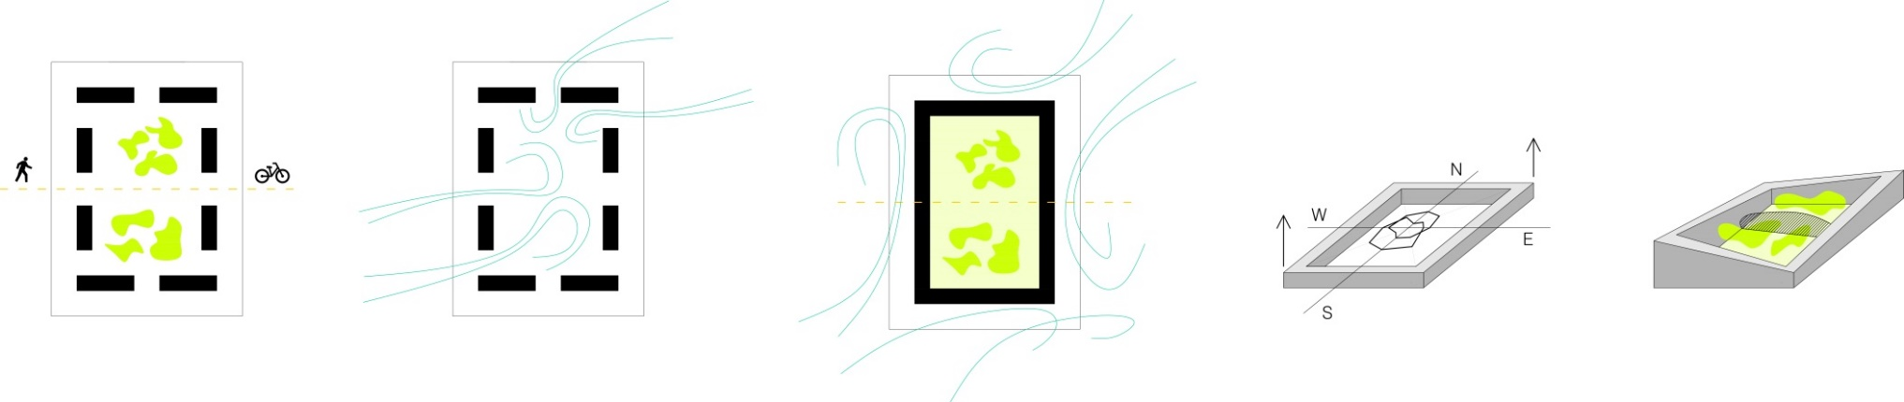
CONCEPT

Slide 3
CONCEPT

Slide 4
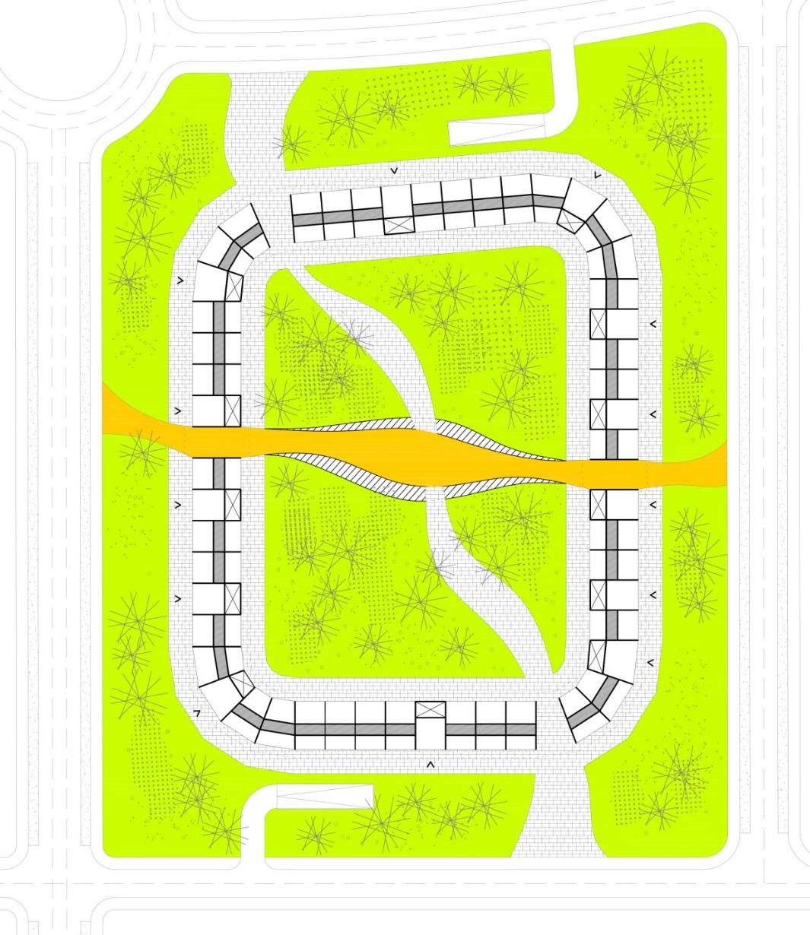
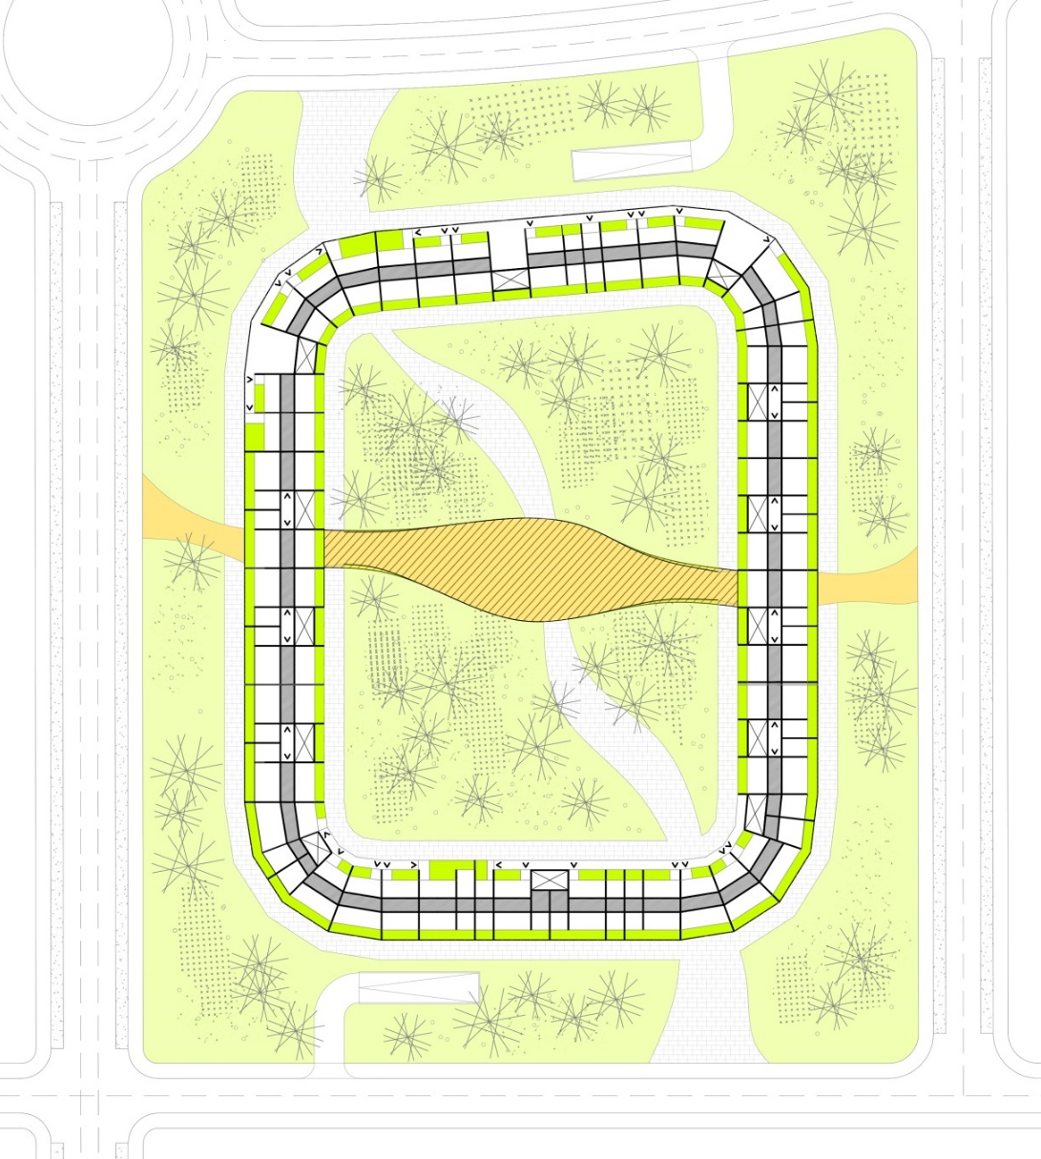
MASTER PLAN
GROUND FLOOR PLAN
CHARACTERISTIC FLOOR PLAN

Slide 5
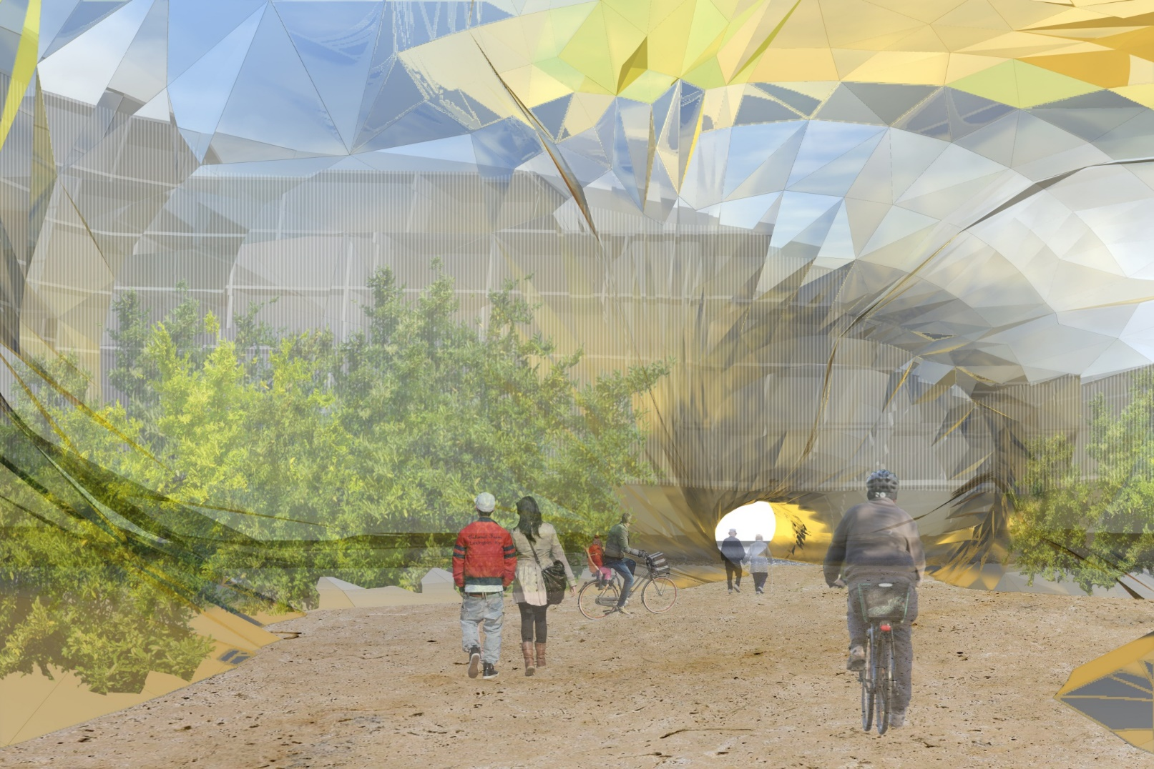

Slide 6
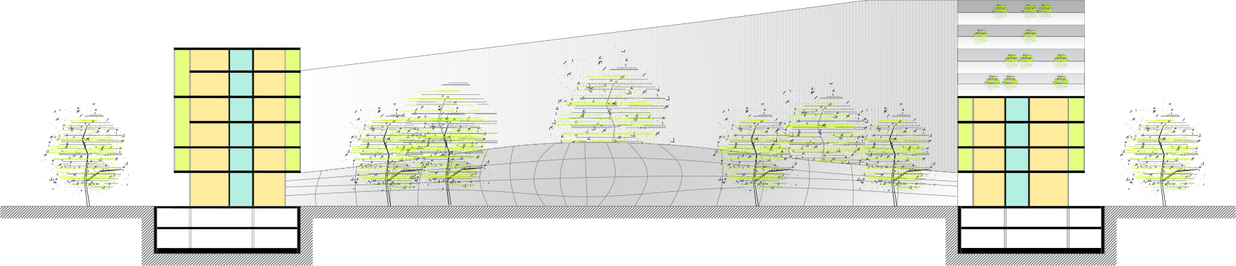
MASTER PLAN SECTION

Slide 7
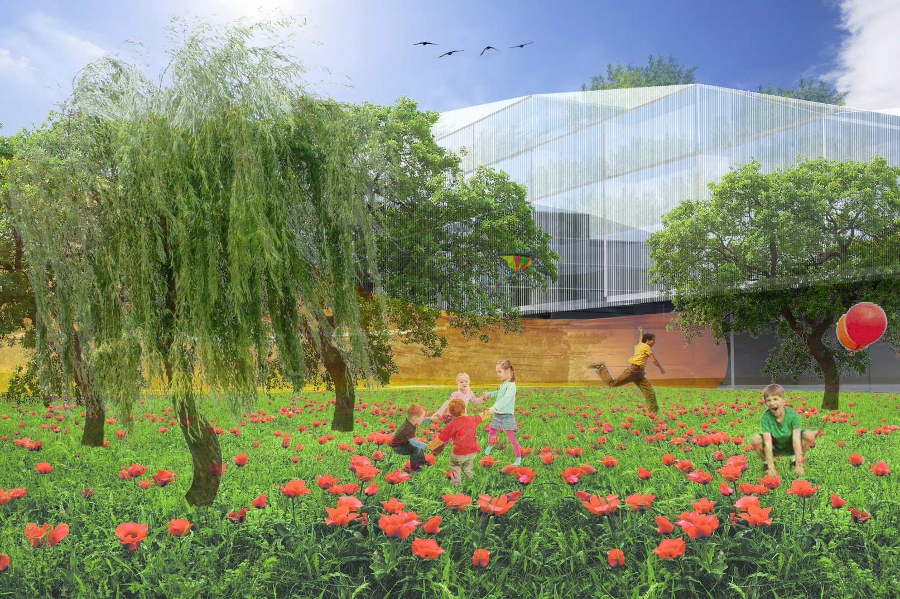

Slide 8
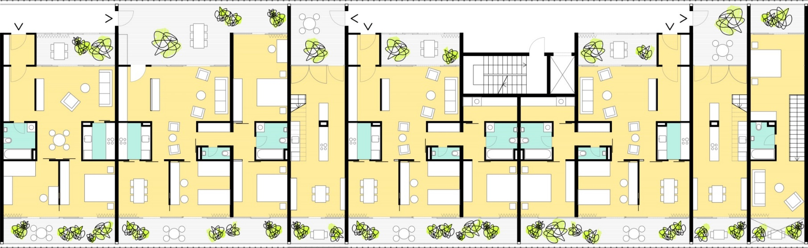
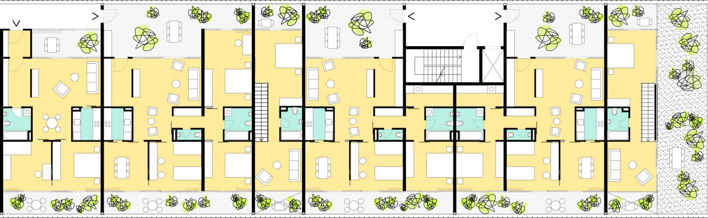
SEGMENTS OF THE 4TH AND THE 5TH FLOOR PLAN

Slide 9
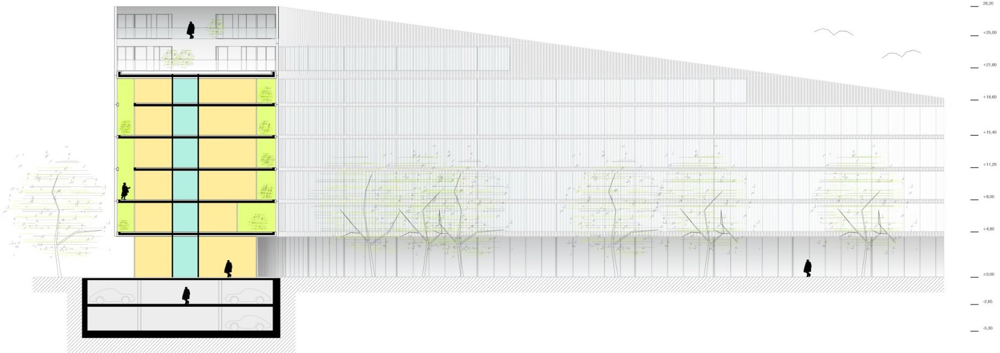
SECTION

Slide 10
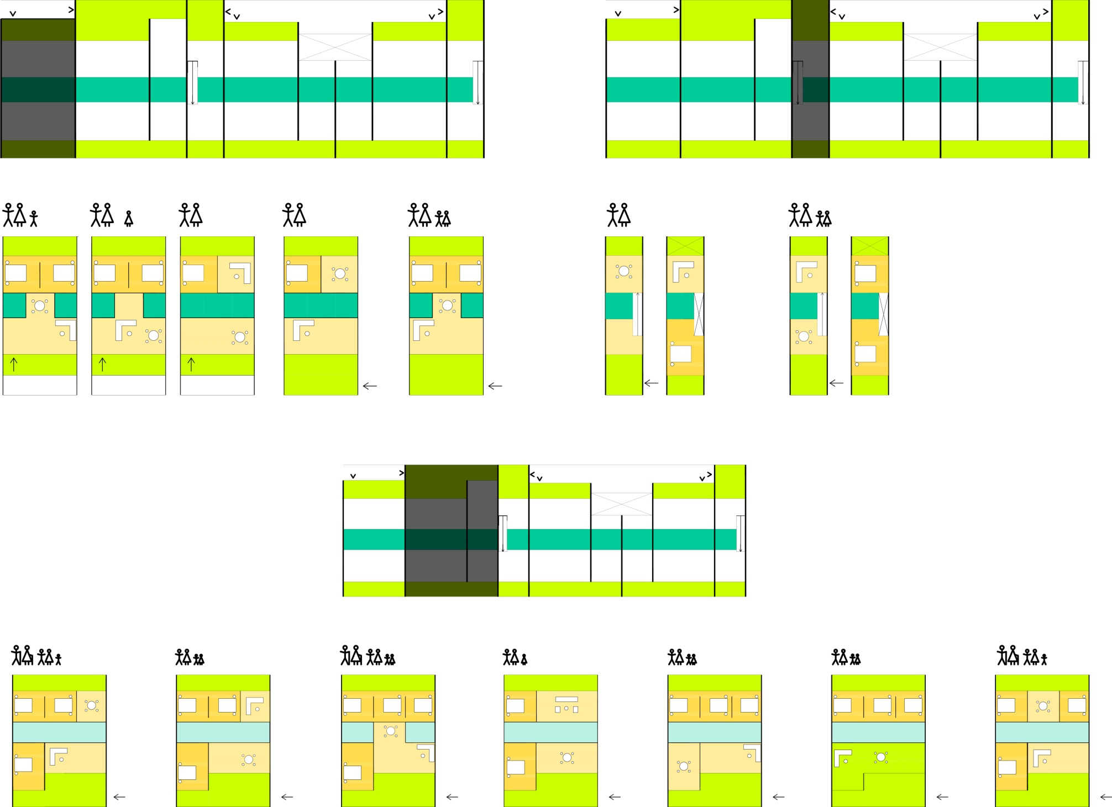
APARTMENT VARIATIONS

Slide 11
APARTMENT VARIATIONS

Slide 12
APARTMENT VARIATIONS

Slide 13
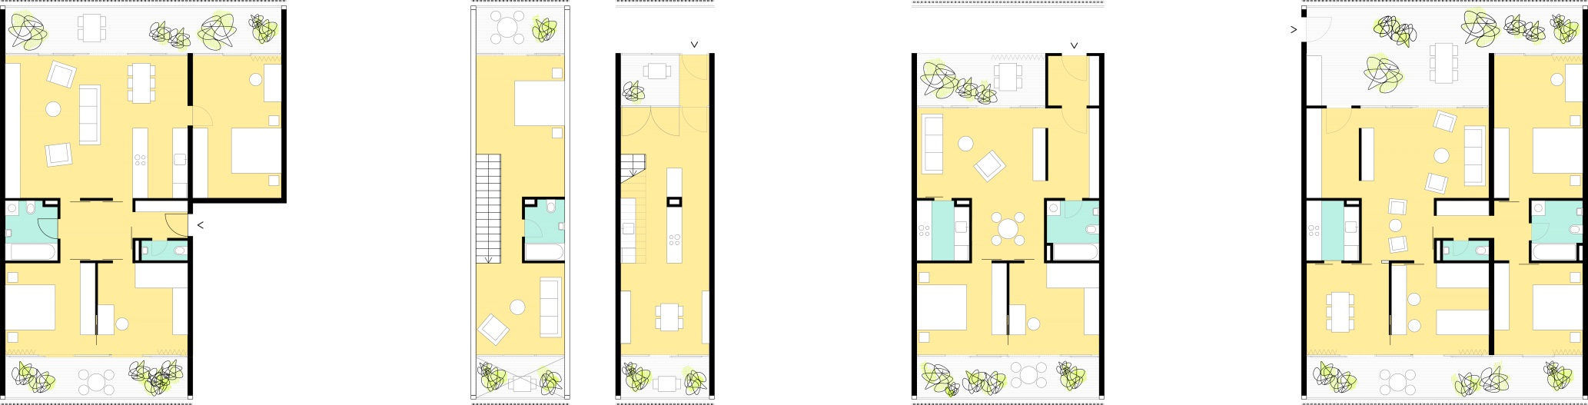
APARTMENT VARIATIONS
1-2 BEDROOM
2-3 BEDROOM
3-4 BEDROOM
1 BEDROOM DUPLEX

Slide 14
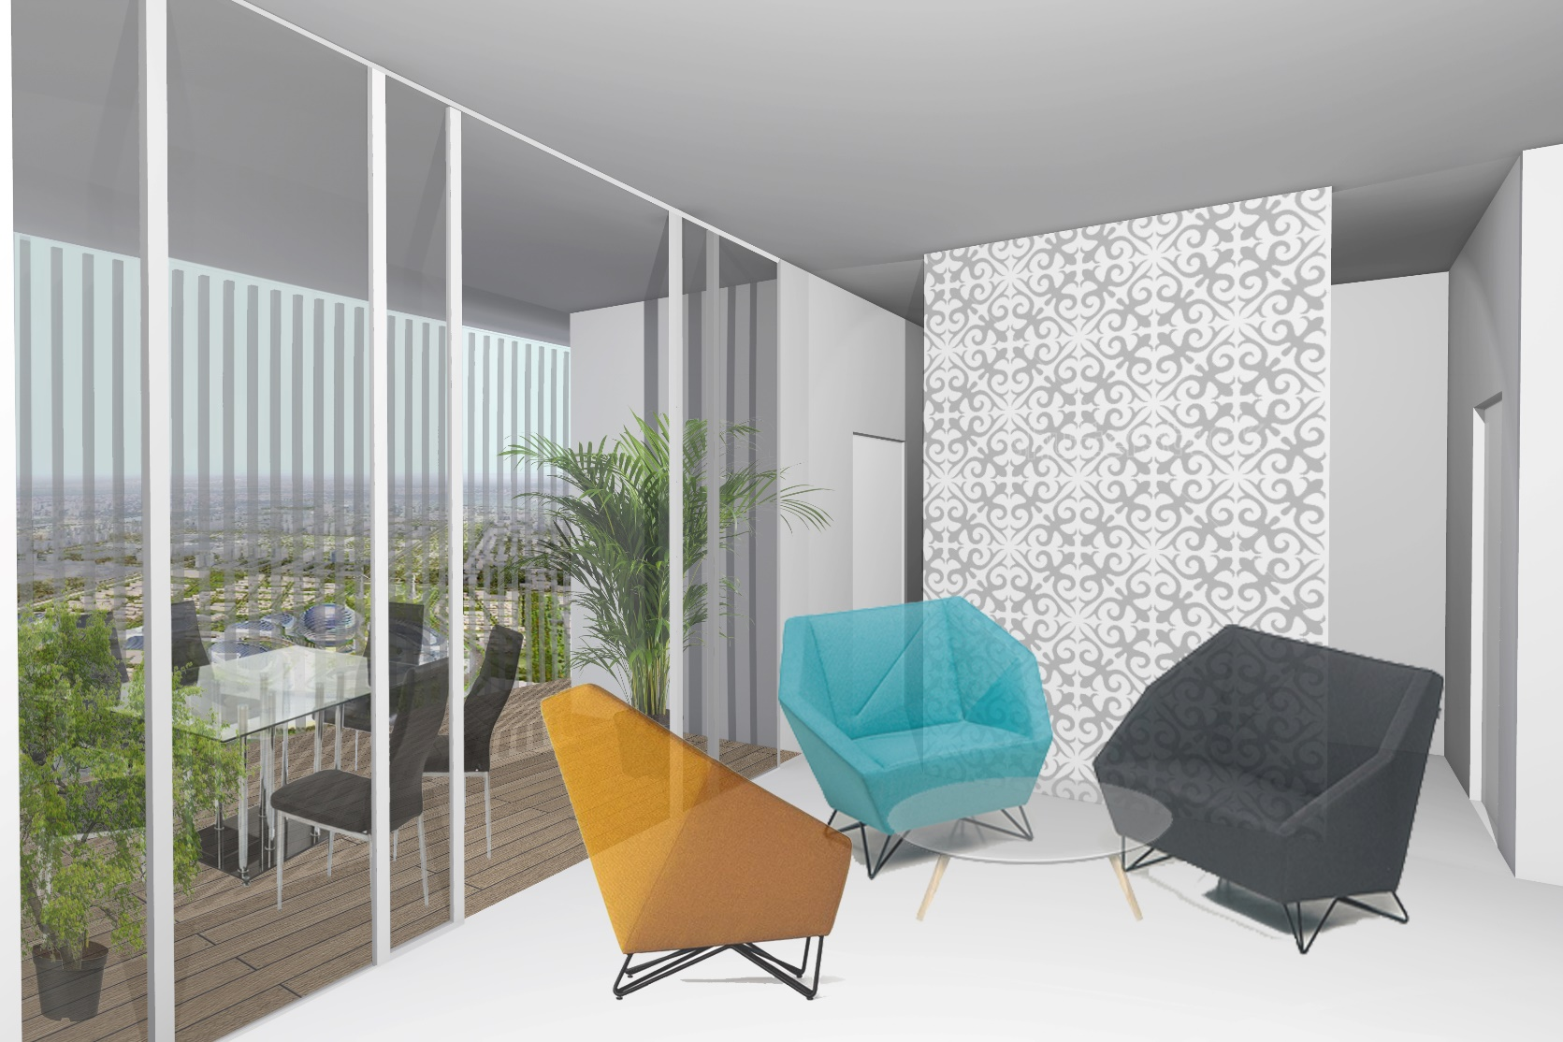

Slide 15
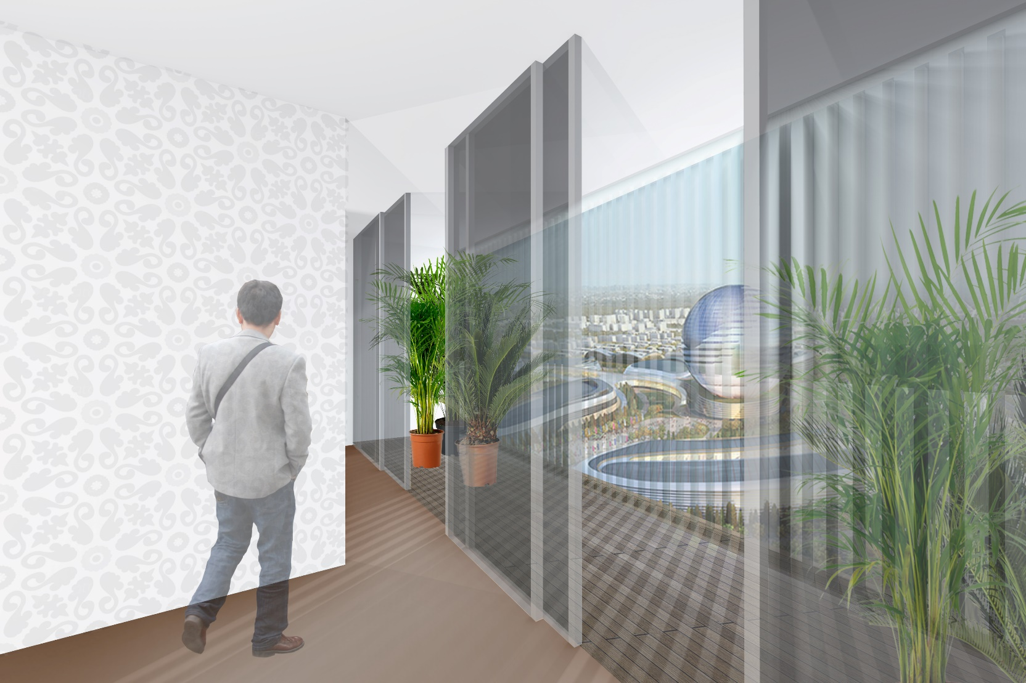

Slide 16
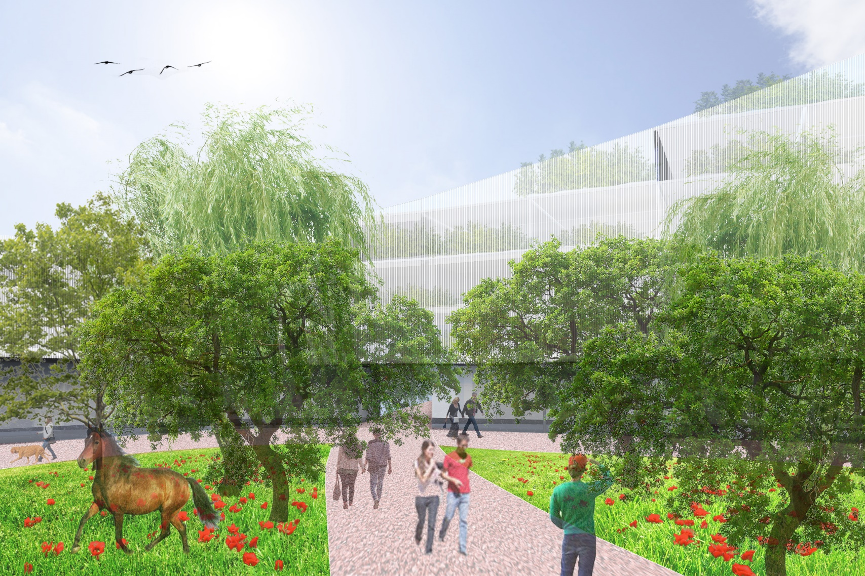

Slide 17
THANK YOU FOR YOUR ATTENTION!

