Slide 1
Return of Kyz-Jibek to glorify friendship and love
(Story of a manuscript from KARLAG)
Duishon Shamatov
Graduate School of Education
Nazarbayev University

Slide 2
Return of Kyz-Jibek to glorify friendship and love
(Story of a manuscript from KARLAG)

Slide 3
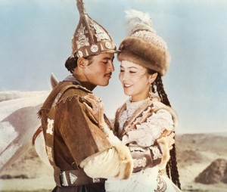

Slide 4
Poem of Kyz-Jibek a manuscript of 101 pages hand-written by a Kazakh political prisoner of KARLAG in Karaganda during the Stalin's period.

Slide 5
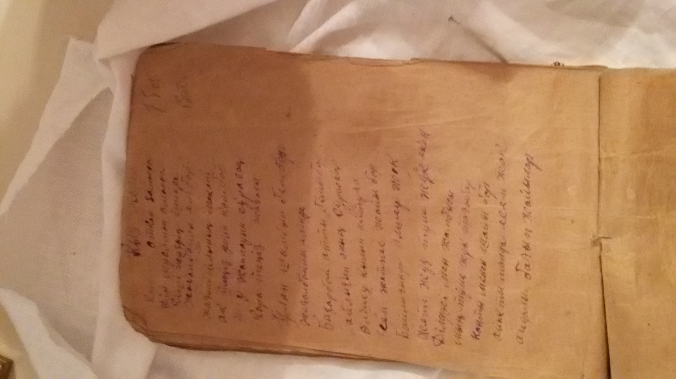

Slide 6
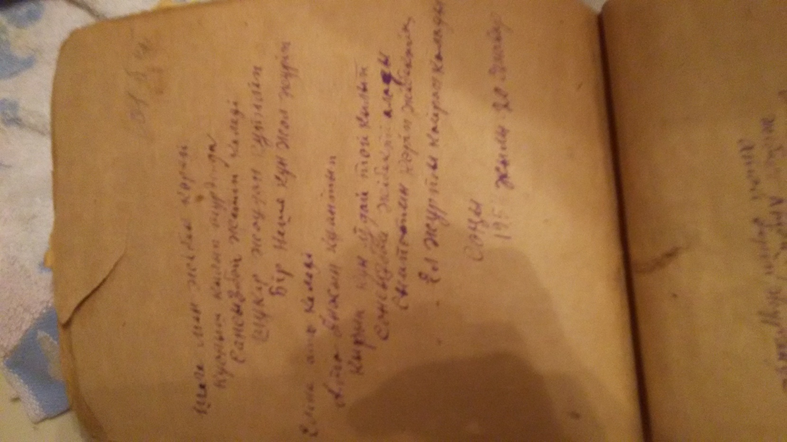

Slide 8
Manuscript that reached our days due to Kyrgyz-Kazakh tradition of amanat

Slide 9
In early 1950s, Küzöbay Kuranov from Aksy of Kyrgyz Republic imprisoned to Karlag

Slide 10
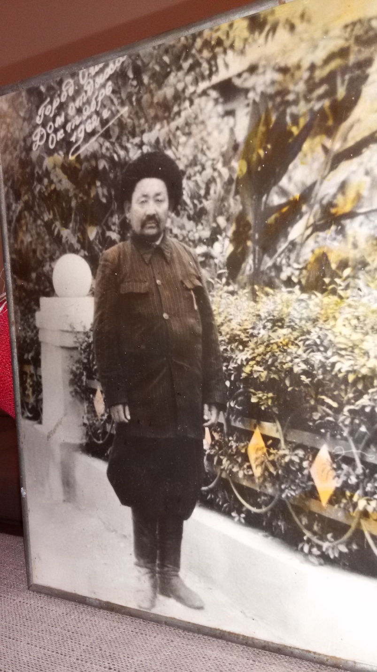
Küzöbay Kuranov

Slide 11
He became good friends with the Kazakh professor who narrated epic stories, verses and poems.

Slide 12
The Kazakh professor gives the manuscript of Kyz-Zhibek to his Kyrgyz friend Küzöbay

Slide 13
Küzöbay returned to Kyrgyzstan, but he did not tell anyone about the manuscript.

Slide 14
In 1978 before his death, he tells the story of the manuscript and passes it to his younger brother Kadyrbek.

Slide 15
In 2009, my wife’s father (Kadyrbek ata’s son) shared the manuscript with me.

Slide 16
I came to Kazakhstan in 2013
  continued my search, and I was planning to visit the archives and KARLAG....
  I shared the story of the manuscript with Shavkat Ismailov, the head of the Kyrgyz ethno-cultural center in Astana
  He addressed Ashimkhan Zhampeisov, a professional journalist from Karaganda

Slide 17
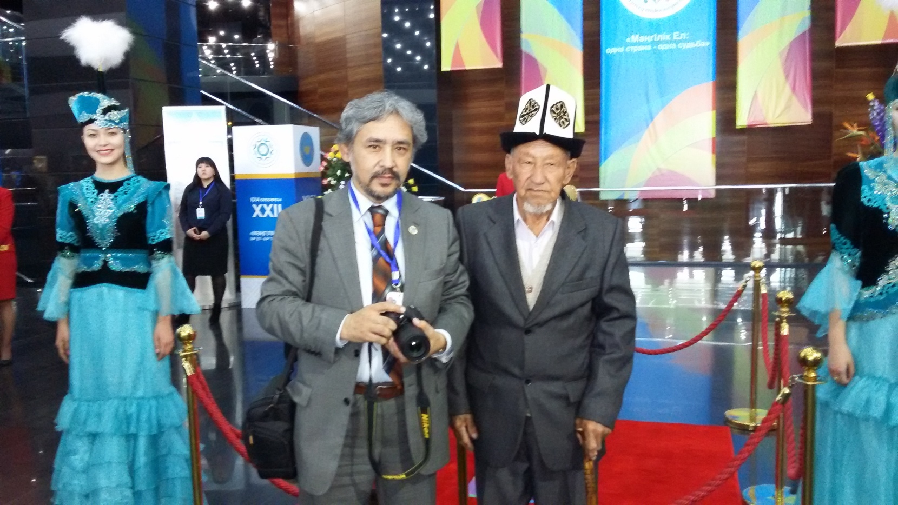
Ashimkhan Zhampeisov and Kadyrbek Ata

Slide 18
Ashimkan traced the history through archives and all other possible sources.
He started doing it, and moreover, he sent some TV journalists to Shamaldy-Say, a small town in Kyrgyzstan to interview the relatives of Küzöbay to find out more memories related to Küzöbay and the manuscript.

Slide 19
We also met with Professor Seit Kaskabasov a prominent Kazakh scholar at Eurasian National University.

Slide 20
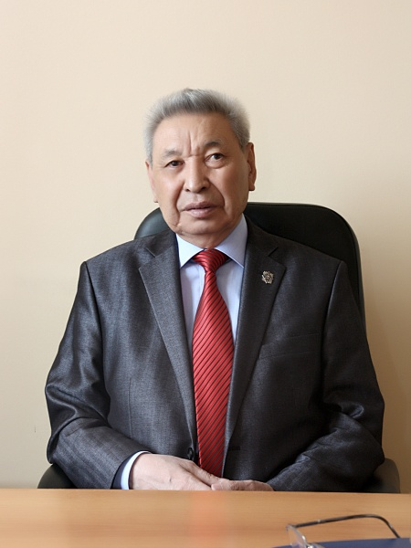

Slide 21
Professor Kaskabasov was deeply touched when he saw the manuscript
He carefully opened the manuscript page by page and read the verses line by line

Slide 22
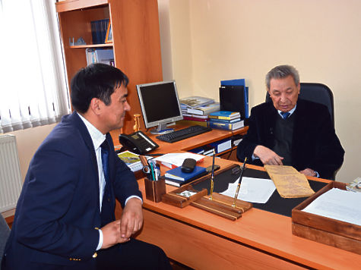

Slide 23
Laura Daurenbekova and her colleagues at NU
The manuscript is identical to Jambyl Jabayev’s version. Known as “Jambyl’s version” and was popular among the Kyrgyz
Jambyl lived in Tokmok and Kichi-Kemin for several years in 1930s.
Kyrgyz Alybay akyn learned Kyz-Jibek from Jambyl (Batma Kebekova, 2001).
Sultangaly Sadyrbayev and Maulen Kozhashev went to Kyrgyzstan in 1985 to write down the oral version of Kyz-Jibek from the Kyrgyz poet and Manas narrator Kedeikan Sultanov

Slide 24
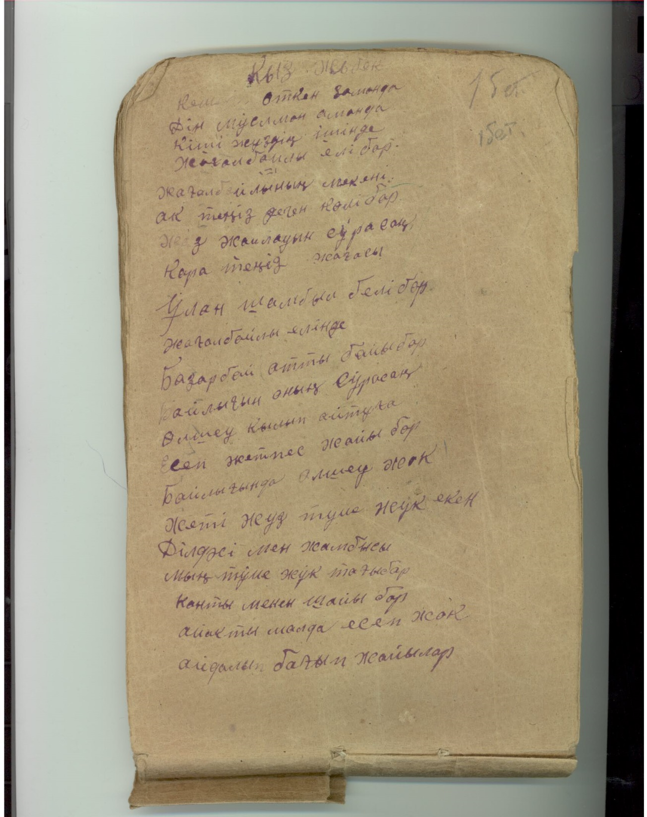

Slide 27
Questions
Who was the original author of the two identical versions of Kyz-Zhibek?
Who wrote Kyz-Zhibek manuscript in 1954 in Karlag and what kind of relations this person had with Zhambyl?
How did the oral version and the manuscript of Kyz-Jibek exist independently from each other in two different parts of Kyrgyzstan?

Slide 28
ALZHIR
http://alzhir.kz/en/2014-03-15-05-09-49.html
VIDEO
http://kartv.kz/ru/programs/viewArchive?id=148766

