Slide 1
Health Science Library System
University of Pittsburgh, USA
Anar Dautova,
Expert-Manager
Piotr Lapo,
General Library Expert
Nazarbayev University Library

Slide 2
Program
Pittsburgh
The University of Pittsburgh & Its Library
Health Science Library System
Visit of the Carnegie-Mellon University Library
Workshops
Participate in MLA preview presentations

Slide 3
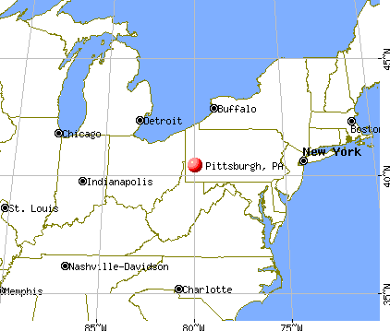
Notes:
Pittsburgh is located in the Commonwealth of Pennsylvania and its population is about 305,000 people.

Slide 4

Notes:
Pittsburgh is known as both "the Steel City" for its more than 300 steel-related businesses, as well as "the City of Bridges" for its 446 bridges.
The city is located at the confluence of the Monongahela and Allegheny Rivers which are the source of the Ohio River.
Pittsburgh has got the title of America's Most Livable City by Places Rated Almanac, Forbes, and The Economist as National Geographic and Today named the city a top world destination.
https://en.wikipedia.org/wiki/Pittsburgh

Slide 5
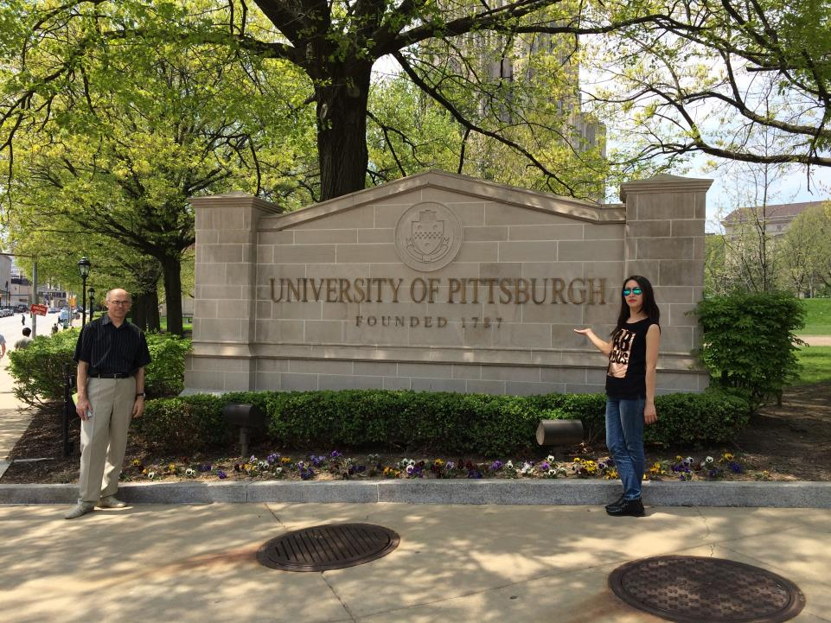
Notes:
The University of Pittsburgh (commonly referred to as Pitt), a state-related research university, was founded as the Pittsburgh Academy in 1787 and located now in the Oakland neighborhood of the city. For most of its history Pitt was a private institution, until it became part of the Commonwealth System of Higher Education in 1966.
The university is composed of 17 undergraduate and graduate schools and colleges with about 29,000 undergraduate, graduate, and professional students. The university also includes four additional undergraduate schools located at campuses within Western Pennsylvania: Bradford, Greensburg, Johnstown, and Titusville.
The main campus is situated adjacent to the flagship medical facilities of its closely affiliated University of Pittsburgh Medical Center (UPMC).

Slide 6
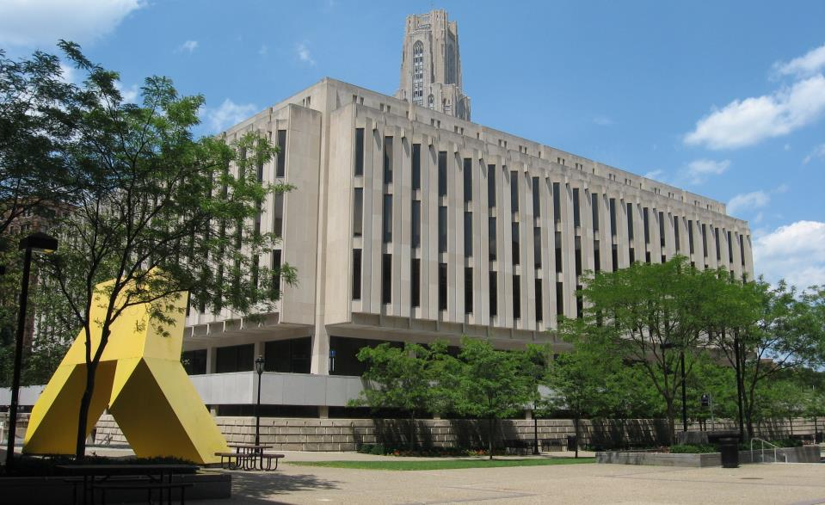
Notes:
The University has 4 campuses and the library system which unites 13 libraries, 2 of them (the Law and Medical Libraries) are the biggest and quite independent.
Hillman Library, the largest of the 13 libraries on the Pittsburgh campus, contains approximately 1.5 million volumes, specialized collections, more than 200 computers, study capacity for some 1,500 users, a media center, and more.

Slide 7
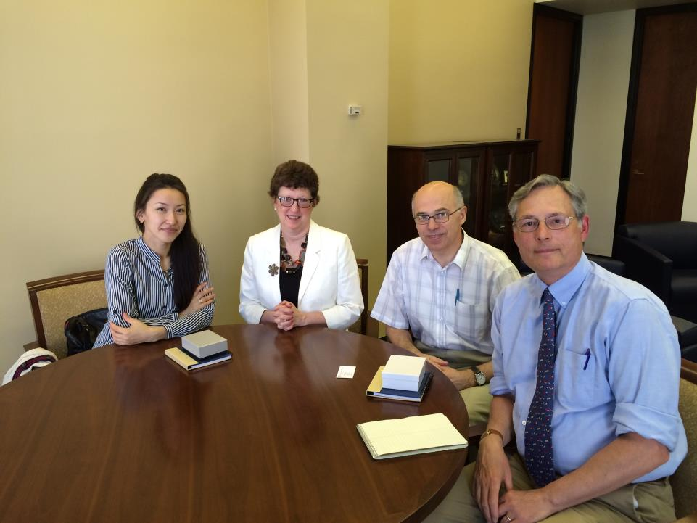
Notes:
Meeting with Mr. Paul B. Kohberger, Deputy Director of Hillman Library for research and training.
Nancy Tannery, Deputy Director of WP Health Science Library System.

Slide 8
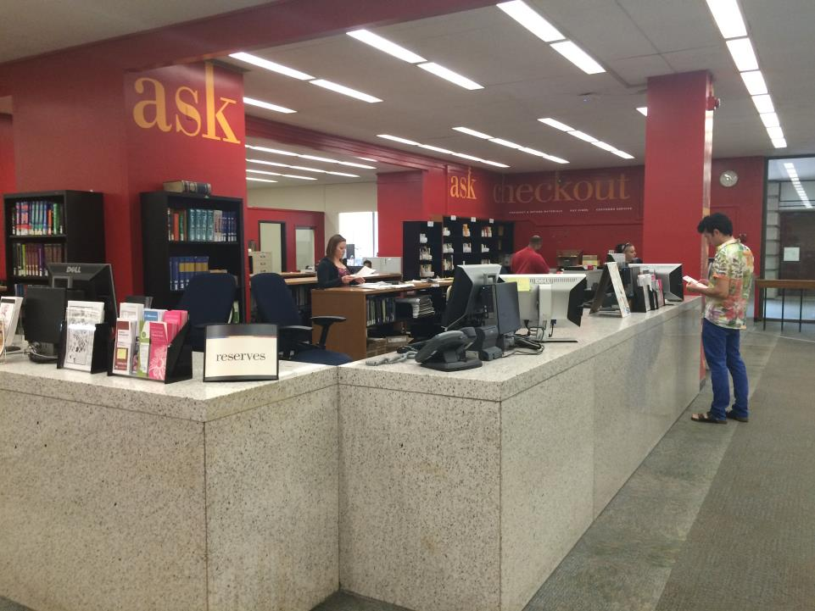
Notes:
A the entrance of the Hillman Library

Slide 9
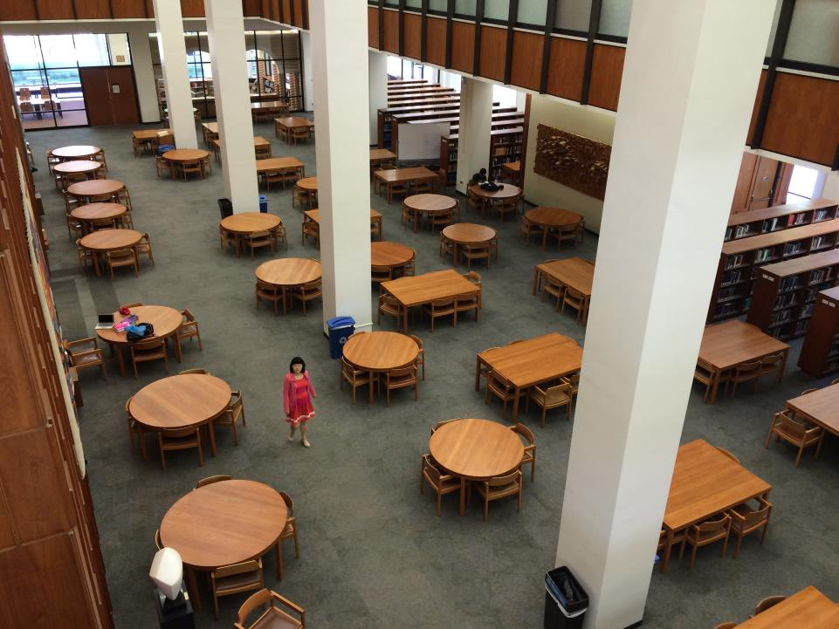
Notes:
The library currently is working on moving a bad demand literature in other place to equip the space for users.

Slide 10
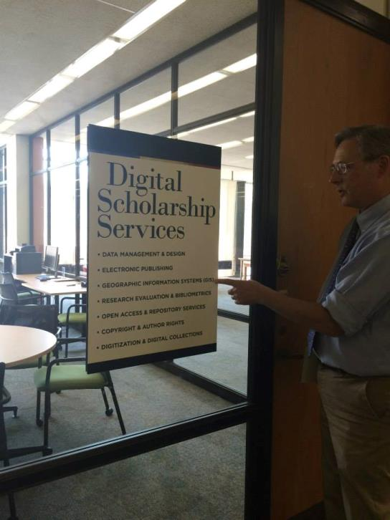
Notes:
There are open and closed space, quiet and noisy areas for users. As Paul told, in the library it is the higher the quieter.

Slide 11
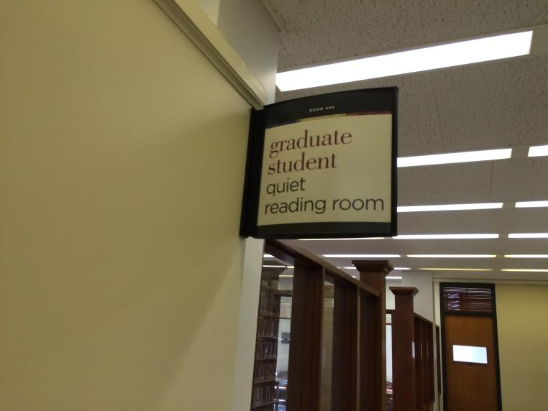
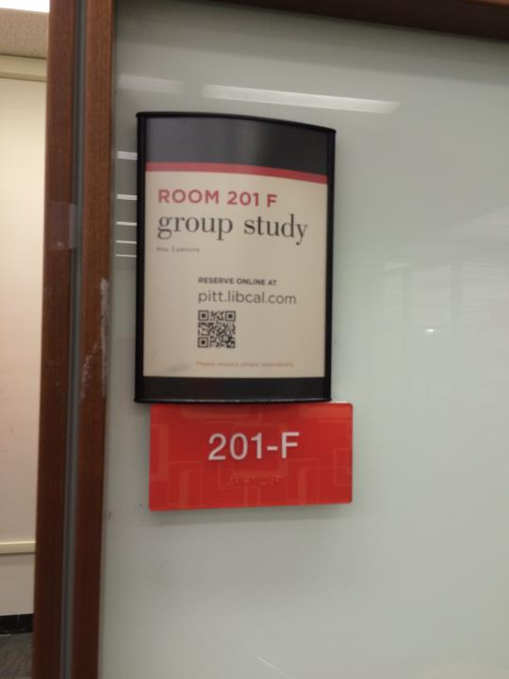

Slide 12
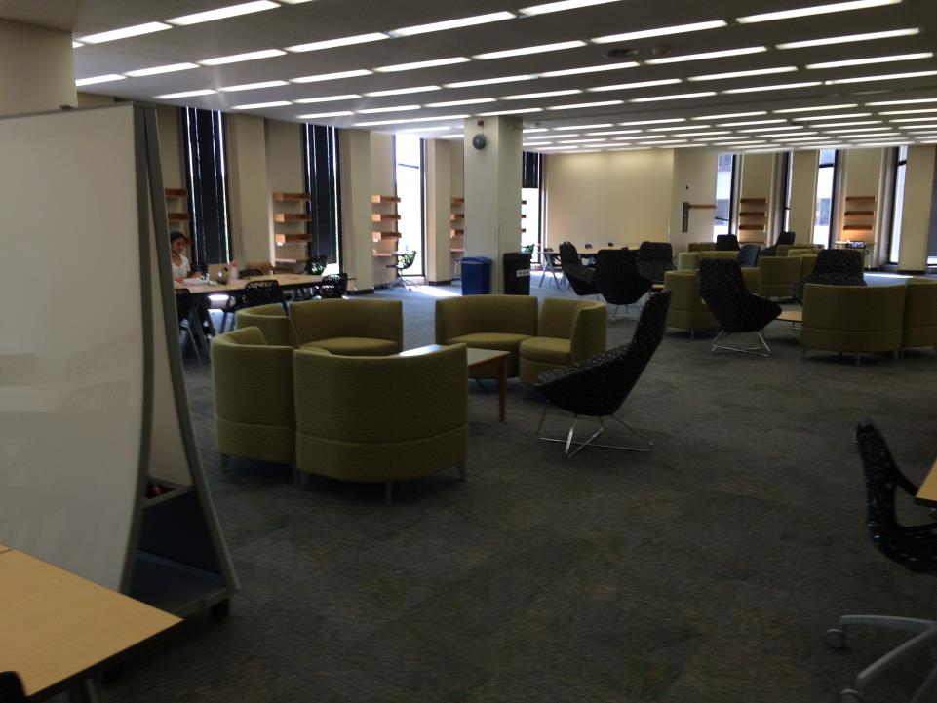
Notes:
Comfortable places for small groups discussions

Slide 13
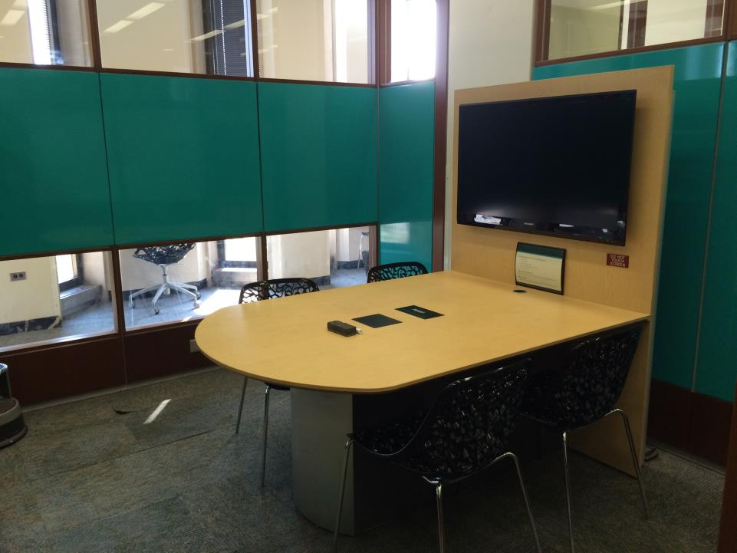
Notes:
It is a closed space for working in small groups

Slide 14
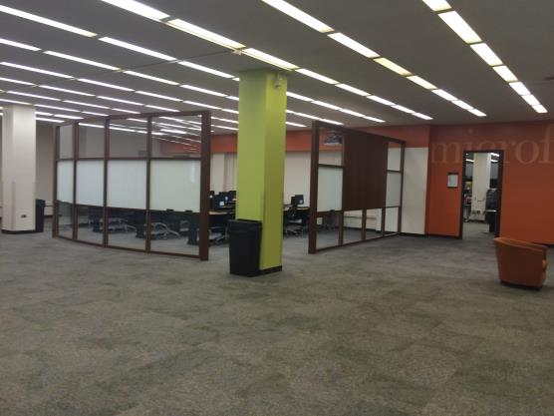
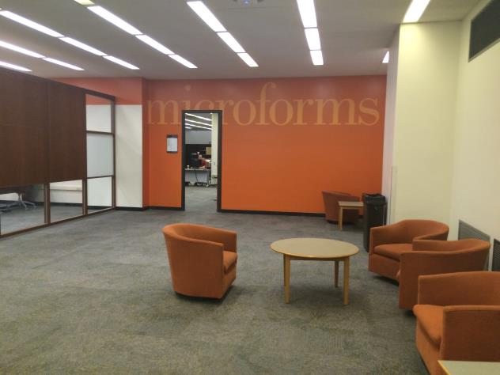
Notes:
Baffle plates (Partitions) are easily dismantled and easily re-installed.

Slide 15
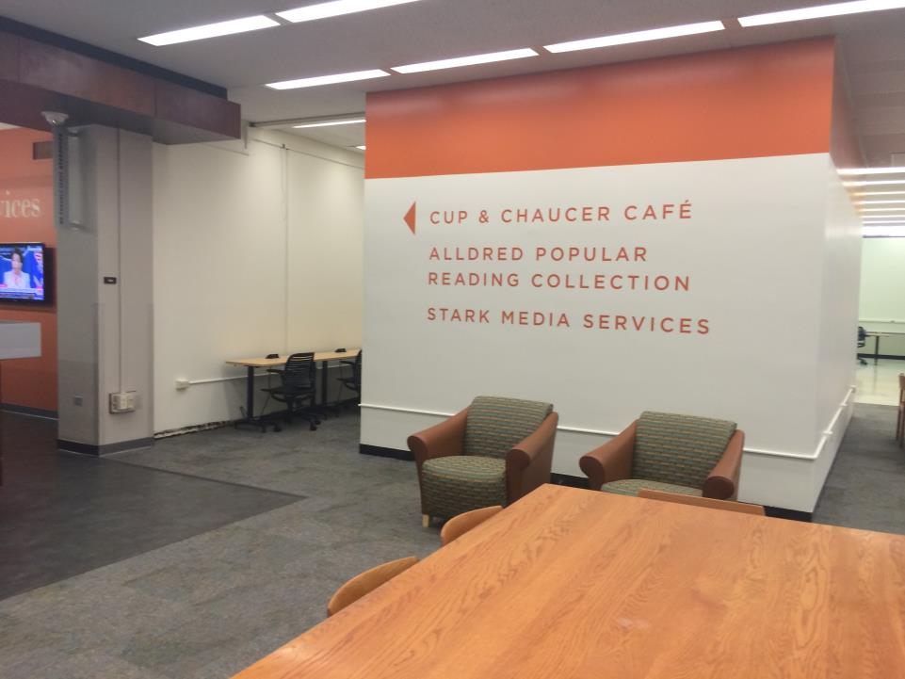
Notes:
On the ground floor the cafe is located next to the library services and collections.

Slide 16
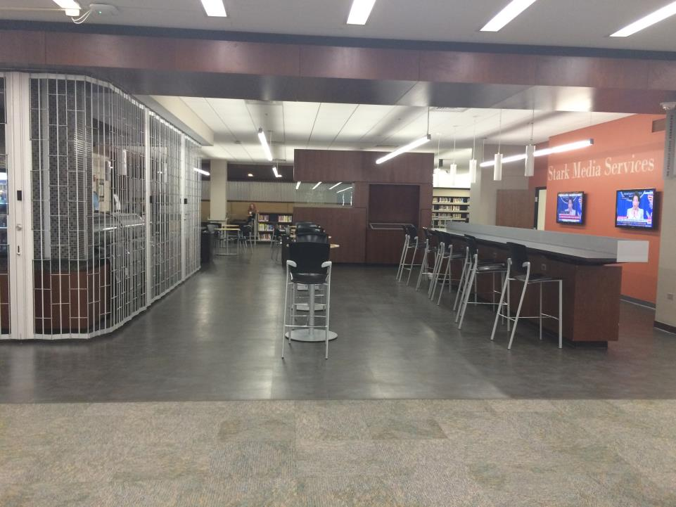
Notes:
In the café. That day it was closed.

Slide 17
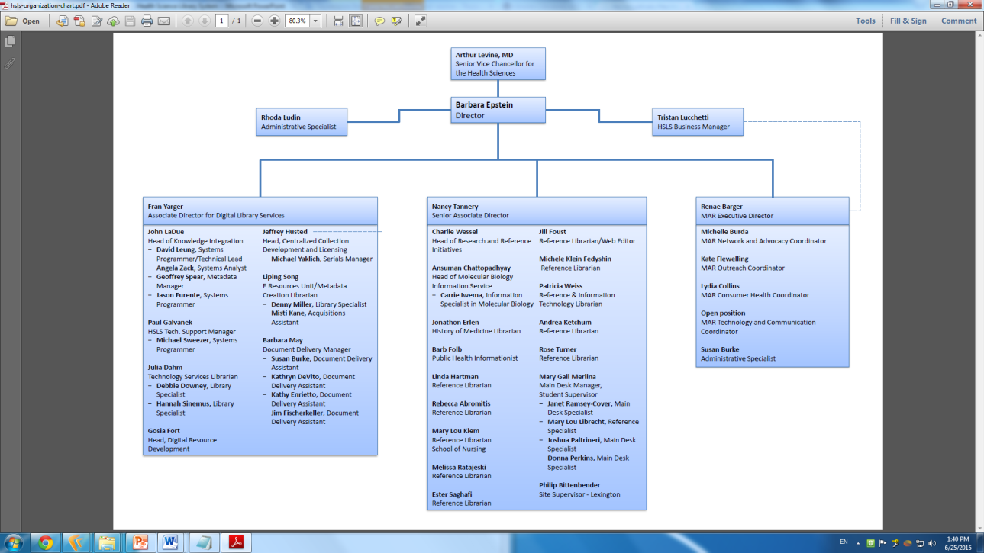
Notes:
The Health Sciences Library System (HSLS) at the University of Pittsburgh offers a wide array of information services, educational opportunities, and resources in print and electronic format to faculty, students, and researchers in the schools of the health sciences (Medicine, Dental Medicine, Pharmacy, Nursing, Health and Rehabilitation Sciences, and Public Health).

Slide 18
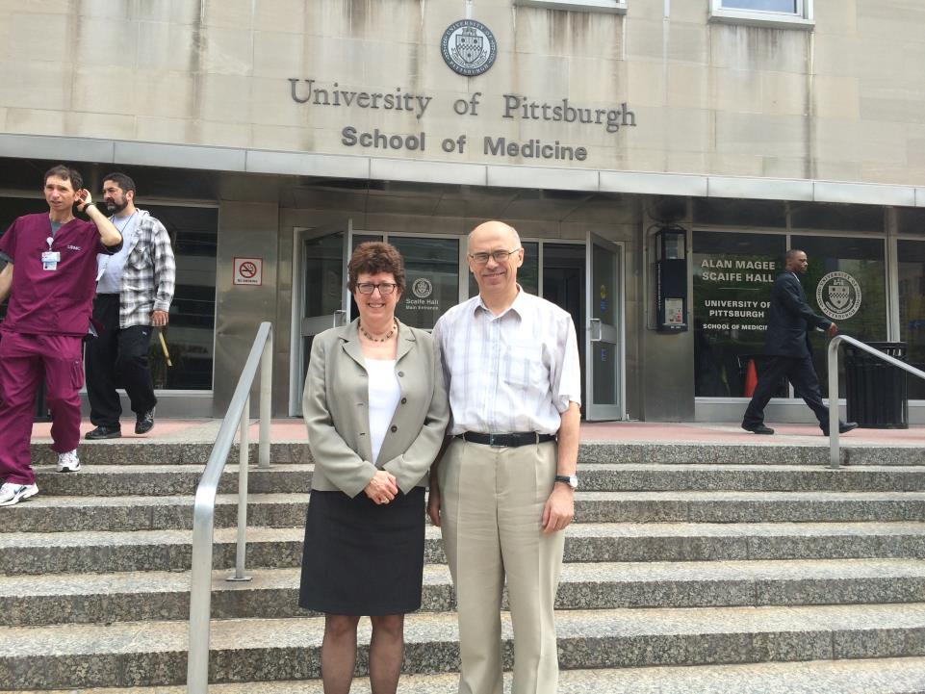
Notes:
Falk Library of the Health Sciences, the main division of the UP HSLS, is located in the building of the Faculty of Medicine. In the same building there is also a hospital.
Therefore, in the dining room available in the same building you can find a librarian, a professor, attending physician and the patient's relatives.
Nancy Tannery, deputy director of the HSLS provided me and Anar with her constant care of us.

Slide 19
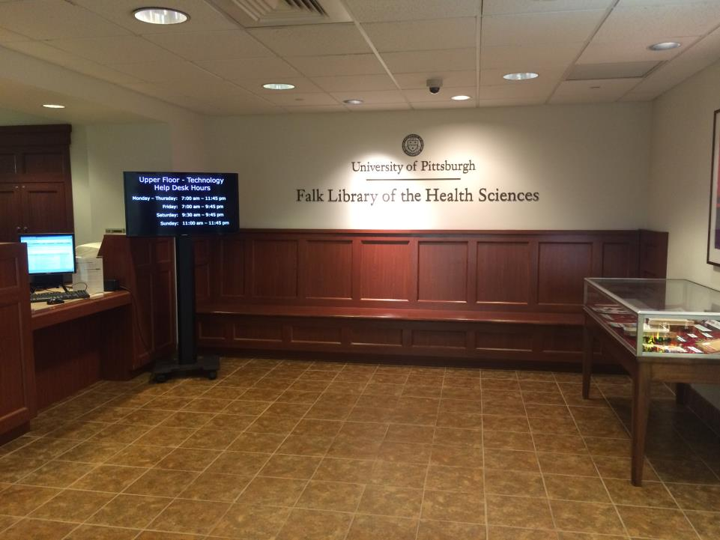
Notes:
At the entrance to the Library a stack of free bags hangs with the inscription "For Your Convenience. Wet Umbrella Bag".

Slide 20
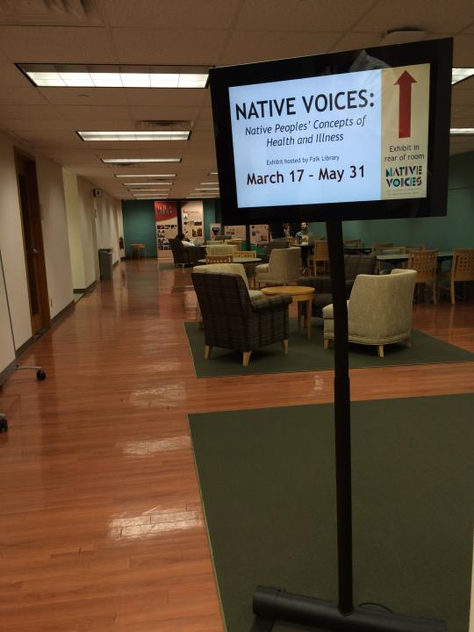
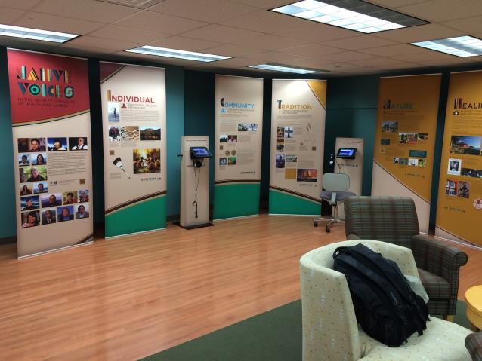
Notes:
Medical Libraries in the USA have two most authoritative organizations: the National Library of Medicine and the Medical Library Association.
At the HSLS a regional office of the National Medical Library operates, which mainly provides training for medical librarians and health care workers, teachers and researchers in medicine throughout the state of Pennsylvania.
The photo shows an exhibition provided by the NML.

Slide 21
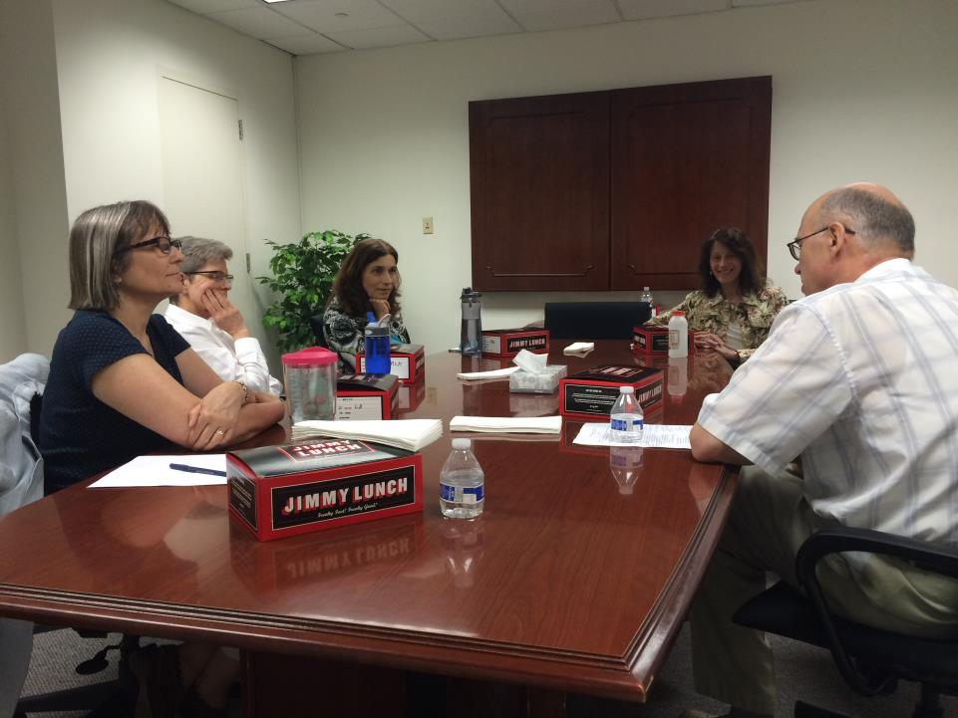
Notes:
A brown-bag seminar with HSLS reference librarians: Linda Hartman,Mary Lou Klem, Rebecca Abromitis и Michele Klein Fedyshin.
(http://en.wikipedia.org/wiki/Brown-bag_seminar).

Slide 22
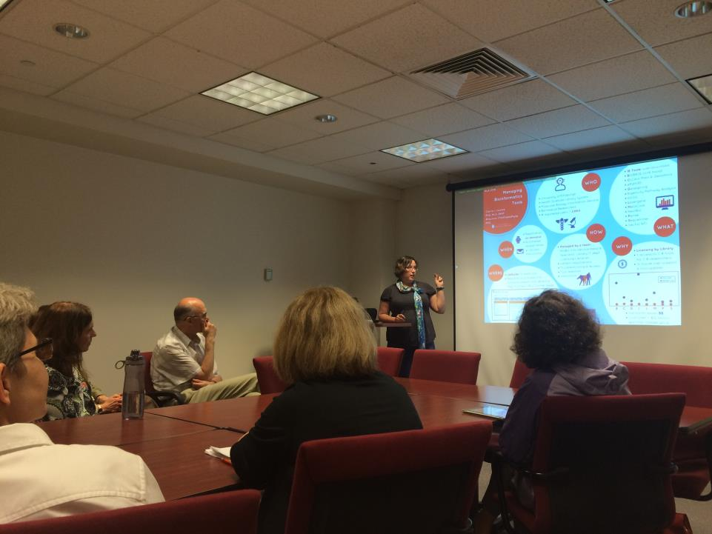
Notes:
It is very interesting form of discussion of presentations before a conference where they will be presented.
In this case, a demonstration of presentations in front of the colleagues on the eve of the 2015 Medical Library Association Annual Meeting and Exhibition (http://mla15.meeting.mlanet.org/).
It is an opportunity to "test" your report and get questions, comments and suggestions of your colleagues to improve its performance, content and form. - With Carrie Iwema.

Slide 23
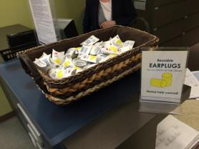
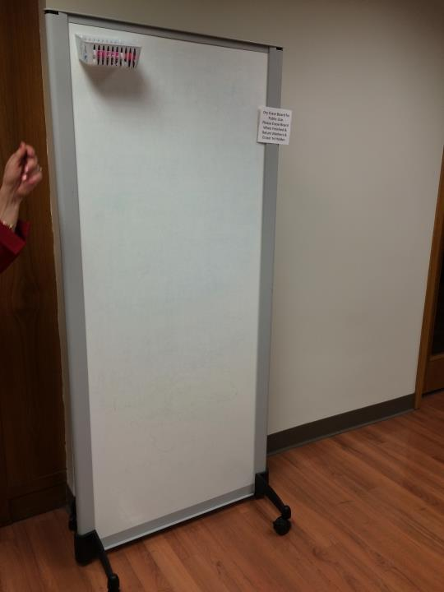
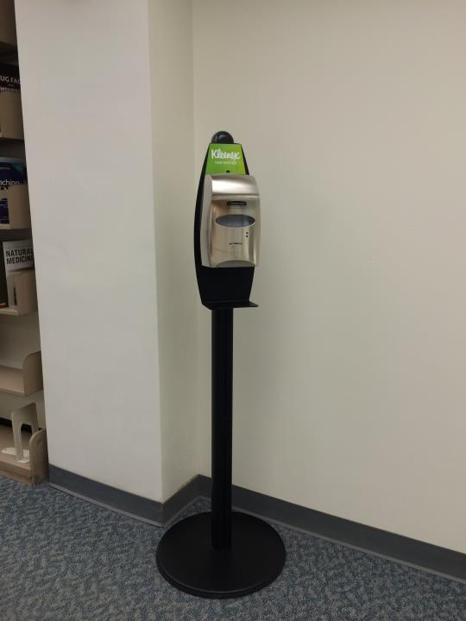
Notes:
Mobile blackboards are very popular among students for working by small groups.
This device is installed in the library and in other areas of the building of the Medical Faculty. From it you can get antimicrobial foam to wash your hands.
Students can take earplugs to increase their cognitive capabilities.

Slide 24
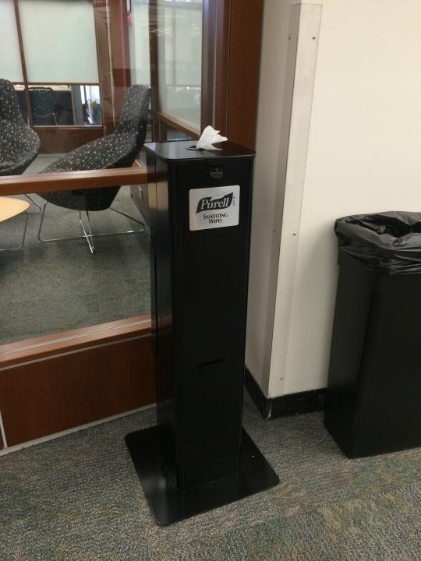
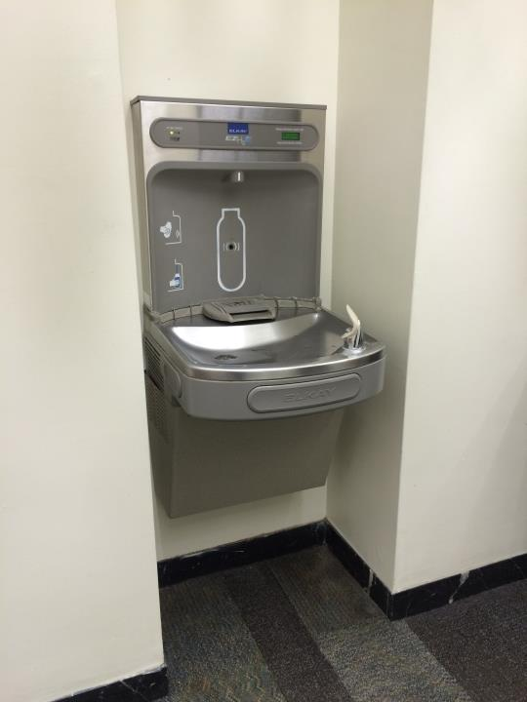
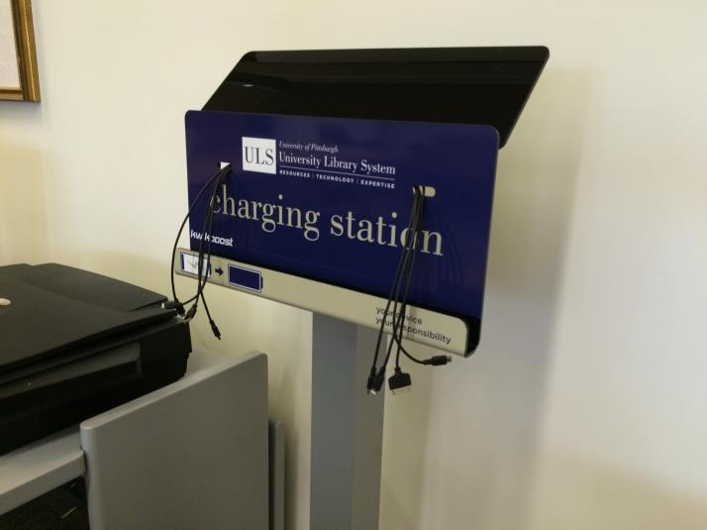
Notes:
Sometimes the water and napkins are very necessary

Slide 25
Carnegie-Mellon University

Slide 26
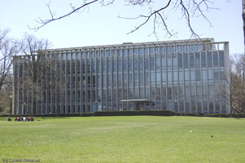
Notes:
Hunt Library (http://www.colorkinetics.com/showcase/installs/HuntLibrary/)
of the Carnegie Mellon University Libraries (http://www.library.cmu.edu/)

Slide 27
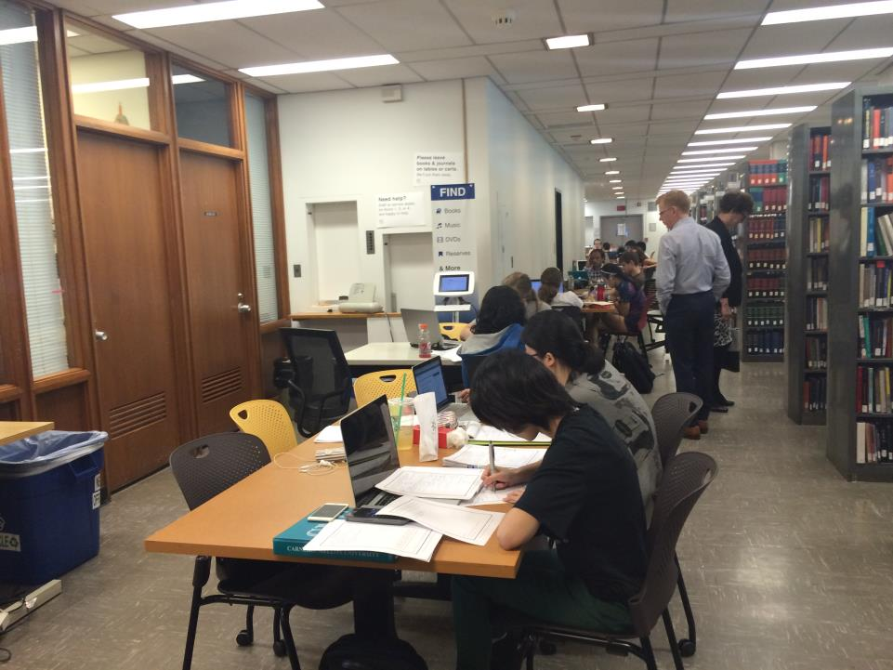
Notes:
You can see Mr. Keith Webster, Library Director. We discussed tendencies of the contemporary librarianship with him and he showed us his presentation: http://www.slideshare.net/cmkeithw/nfais-web-version
The University is one of the best world universities concerning computer science and the university library is very good equipped by computers.

Slide 28
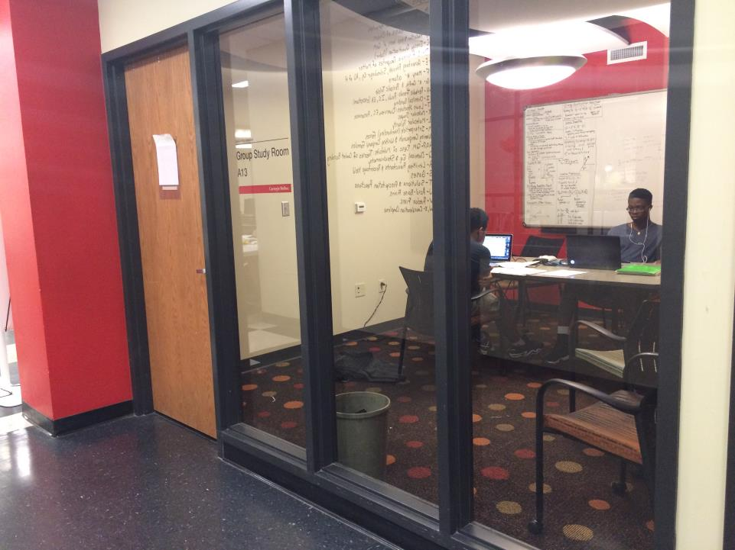
Notes:
Group study rooms are very popular there.

Slide 29
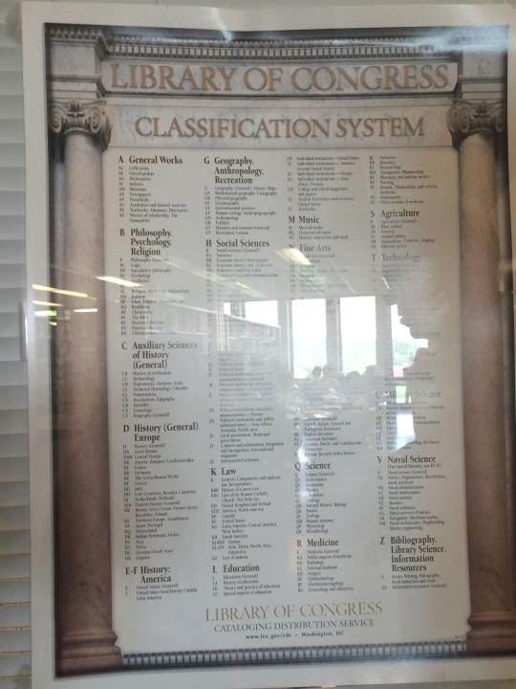
Notes:
LCC in a reading room.

Slide 30
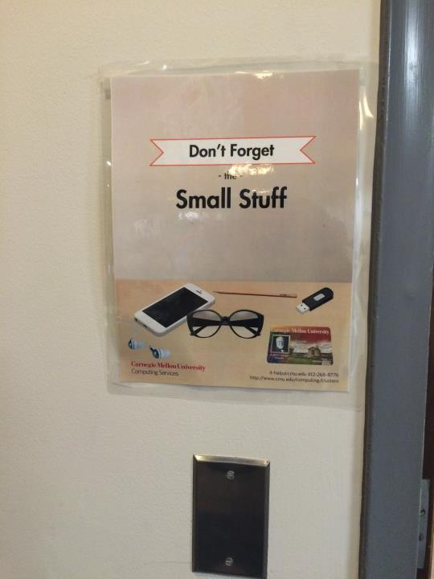
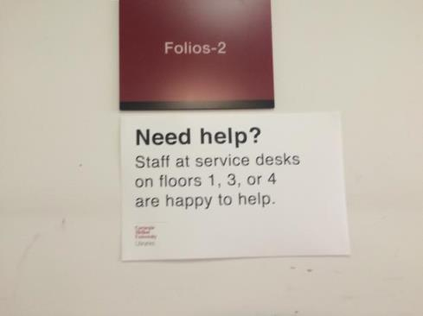
Notes:
Some nice examples of caring for users

Slide 31
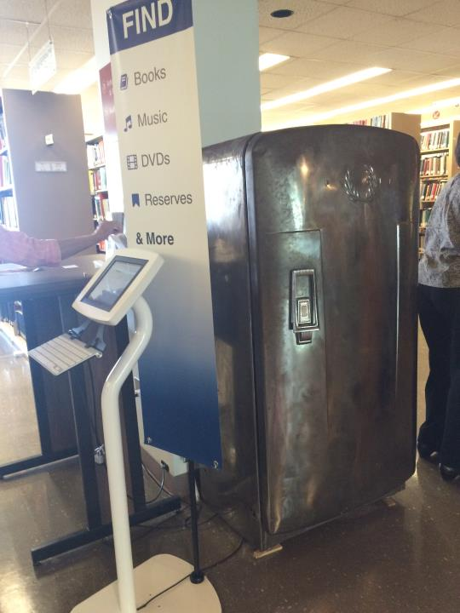
Notes:
In a reading room a terminal for searching in the OPAC near the refrigerator of Andy Warhol (https://en.wikipedia.org/wiki/Andy_Warhol) born in Pittsburgh, Pennsylvania.

Slide 32
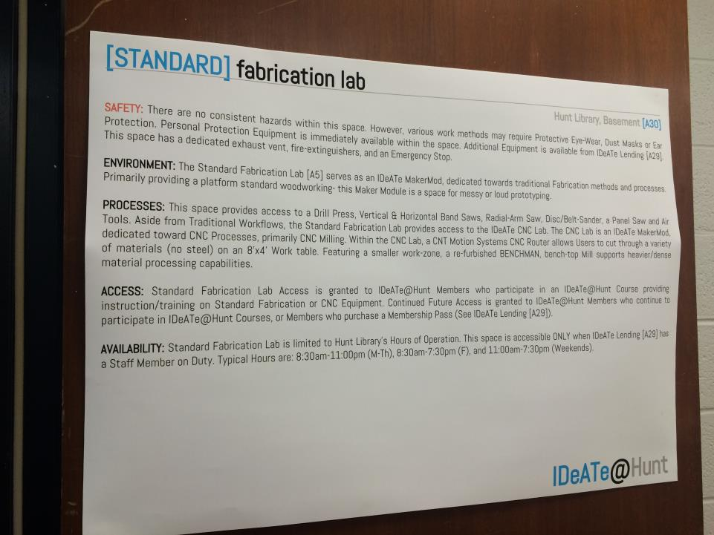
Notes:
This and the following pictures were made in the premises of the basement of the library at Carnegie Mellon University Library. Here are placed, as they say, the production area for innovation students.
There is a standard provision on the FabLab. For more information on the library FabLab at the Hunt Library can be found here: http://ideate.andrew.cmu.edu/tag/makermod/

Slide 33
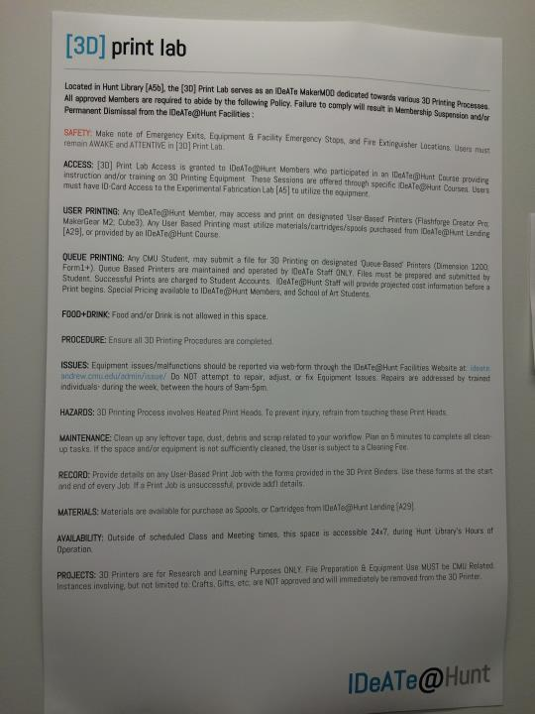
Notes:
The statement of the 3D Print Lab.

Slide 34
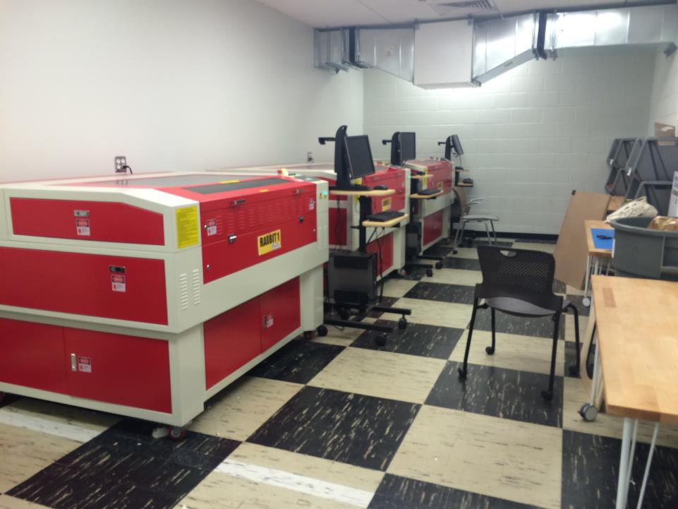
Notes:
For example, there are laser engraving and cutting Rabbit1 machines (see as an example, http://www.rabbitlaserusa.com/laser_RL1290.html)

Slide 35
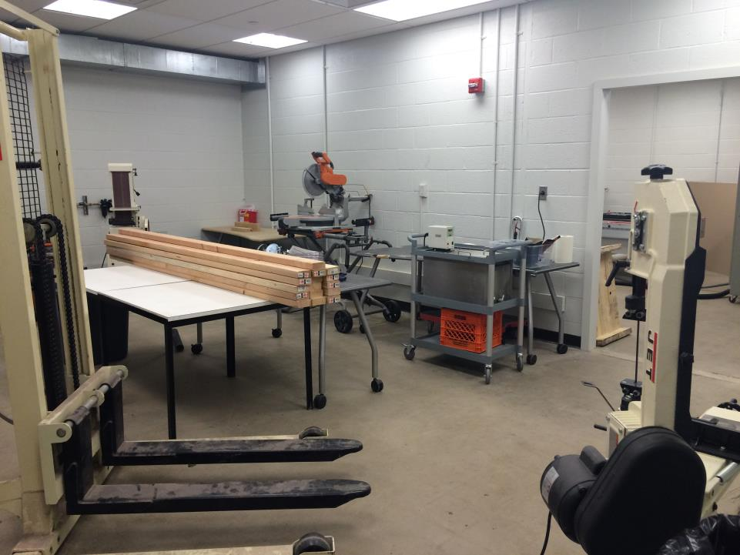
Notes:
A woodworking machinery

Slide 36
Workshops
PubMed
Link Resolver (Vivisimo Velacity)
MyNCBI
ClinicalKey
Literature Reviews
Systematic Reviews
Student orientation demonstration
Medical student instruction
Molecular Biology Information Services
Formulating a Question
Medline+

Slide 37

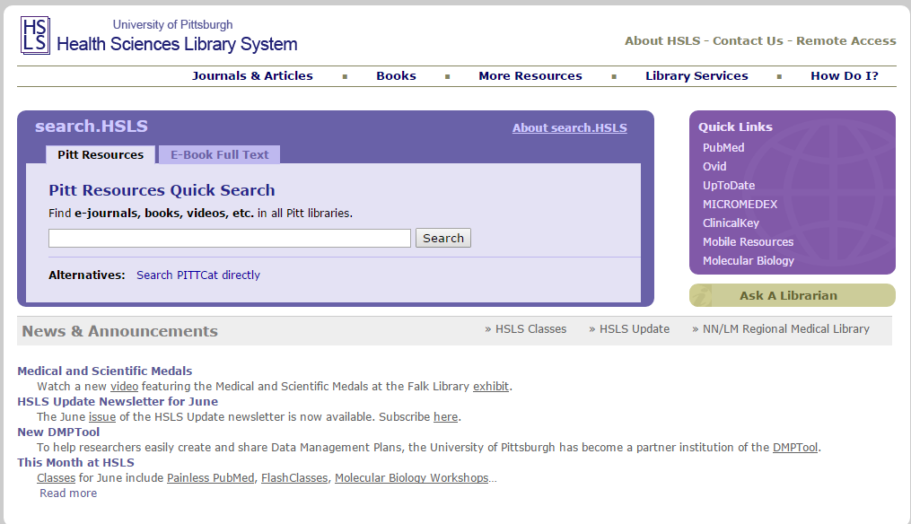
Pitt Cat

Slide 38
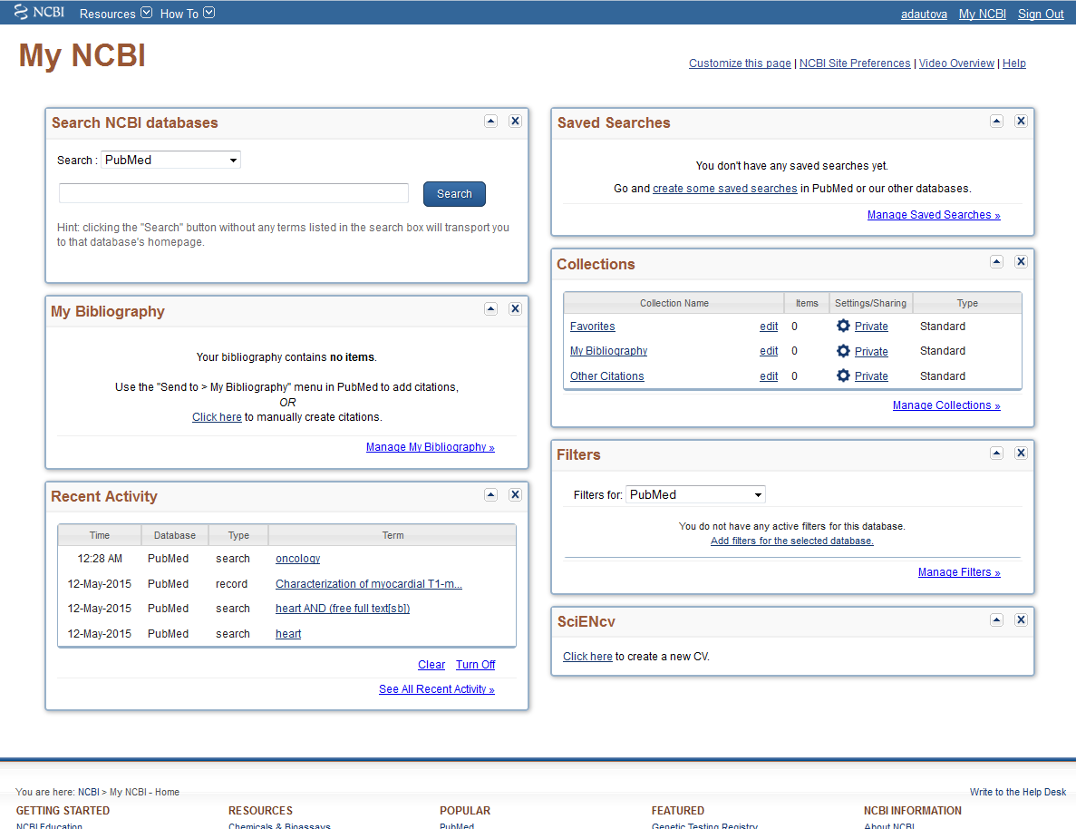
My NCBI

Slide 39

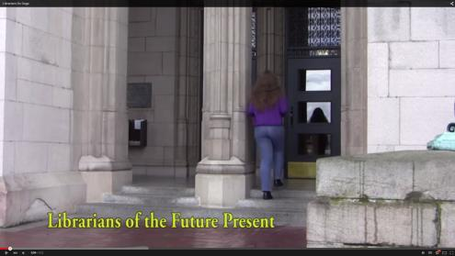
Student orientation demonstration
The Cephalonian Method
It’s not your ‘typical’ library orientation

Slide 40
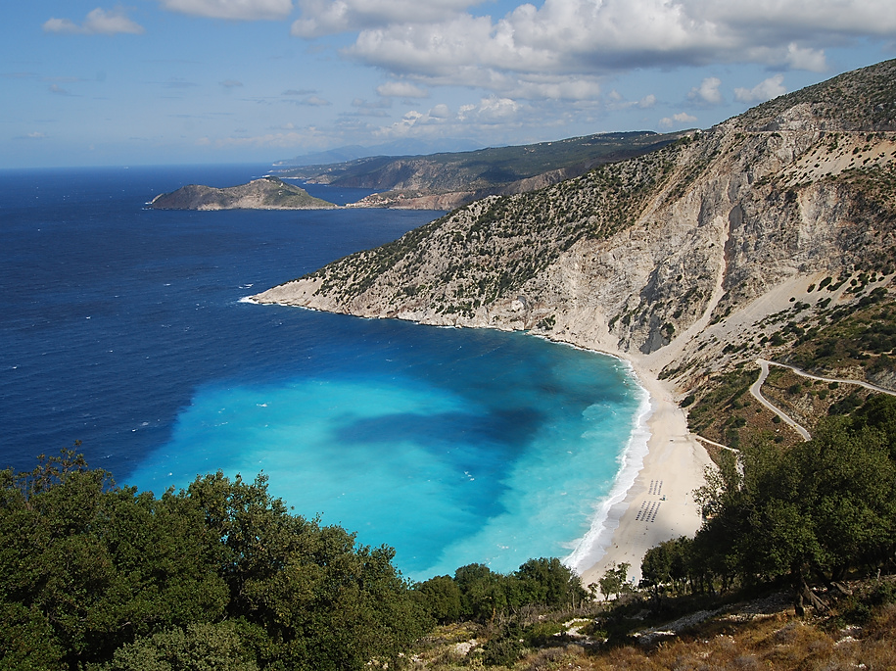
Cephalonian Method
MAIN OBJECTIVE Maximize learner engagement
ADVANTAGES
A good ice-breaker
Helps to establish a good rapport with students
It works!
WHY IT WORKS
Questions are phrased from the student perspective
Incorporates humor and music with learning
Mỳrtos Beach, Kefalloniá https://flic.kr/p/5opYQH by Matt Sims (CC BY 2.0)
Notes:
Advantages are CLICK
Why it works CLICK
Now I would like to demonstrate the method, You will all pretend to be new 1st year dental students……
Here is how it works….
START MUSIC VIDEO

Slide 41

https://www.youtube.com/channel/UCYaPyAeQNfJXv52tHQhcQ7w

Slide 42
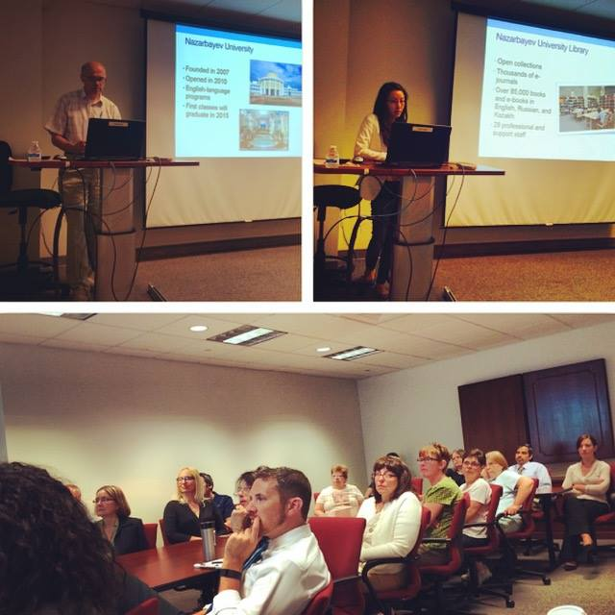

Slide 43
Any questions?

