Slide 1

Strategies to Improve Syllabus Design
Mr. Philip Montgomery

Slide 2
Workshop Overview
Needs analysis
Introduction to Course Design
Introduction to Syllabus Design
Learning Outcomes
Clear Assessment Guidelines

Slide 3
Needs Analysis
A gap between “what is” and “what should be” (Witkin et al., 1995).
Step 1 – Identify the audience and purposes for the analysis. What are the problems?
Step 2 – Describe the target population and environment. Who all is affected by this problem?
Step 3 – Identify the need and begin to generate possible solutions. What can we do?
Step 4 – Assess those needs. Are there any that are more important than others? Are there any conflicts? (McKillip, 1998)
Notes:
Questions to ask: Do you have a syllabus? What are the major components of a syllabus? Learning outcomes/assessment?

Slide 4
Quality Assurance
Bologna Requirements
Programmes:
are designed with overall programme objectives that are in line with the institutional strategy and have explicit intended learning outcomes;
are designed by involving students and other stakeholders;
benefit from external expertise and reference points;
are designed so that they enable smooth student progression;
define the expected student workload, e.g. in ECTS (ENQA, 2015)

Slide 5
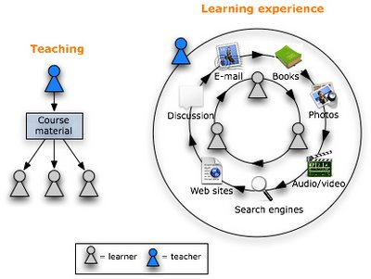
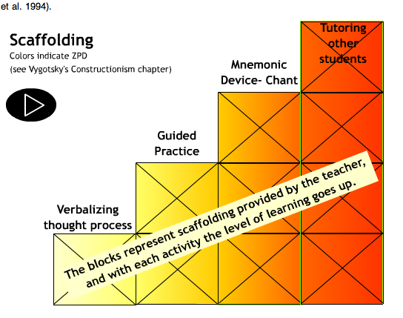

Course Design
Is it student centered?
Is it scaffolded?
Is it reflexive?
Student Attention
Student Progress
Student
Self-Awareness

Slide 6
Syllabus Design
What are the main components of a syllabus?
Title page with course name, number, year, number of credits, location, time, instructor contact info.
Course description (scope, purpose and relevance)
Course objectives/learning outcomes
Course organization (topics and themes)
Course requirements
Evaluation and grading policy
Course policies and expectations
Advice for learning
(Eberly, 2015)

Slide 7
Learning outcomes:
By the end of the class students should be able to…
Explain the scientific principles behind “natural” disasters, including cyclonic weather, global climate change, volcanoes, earthquakes, tsunamis, river flooding, famines, and diseases.
Analyze to what extent a given disaster is in fact “natural” at all, but rather was either caused by or exacerbated by human actions.
Draw connections between different types of disasters, recognizing that major disasters often produce predictable secondary disaster effects.
Describe past public policy debates in the United States that exemplify a broad range of historical and contemporary concerns.
Analyze these debates using theoretical frameworks provided in class.
Describe some aspects of the expansion and contraction of federal intervention in social and economic life over the past 200-plus years, and evaluate arguments for and against these actions.
Critically apply the lessons learned in this class to other history and SDS courses.
Advocate for particular policy choices using the knowledge and skills gained in this course.
Environmental Studies:
Public Policy:

Slide 8
Learning outcomes:
By the end of the class students should be able to…
Explain the scientific principles behind “natural” disasters, including cyclonic weather, global climate change, volcanoes, earthquakes, tsunamis, river flooding, famines, and diseases.
Analyze to what extent a given disaster is in fact “natural” at all, but rather was either caused by or exacerbated by human actions.
Draw connections between different types of disasters, recognizing that major disasters often produce predictable secondary disaster effects.
Describe past public policy debates in the United States that exemplify a broad range of historical and contemporary concerns.
Analyze these debates using theoretical frameworks provided in class.
Describe some aspects of the expansion and contraction of federal intervention in social and economic life over the past 200-plus years, and evaluate arguments for and against these actions.
Critically apply the lessons learned in this class to other history and SDS courses.
Advocate for particular policy choices using the knowledge and skills gained in this course.
Environmental Studies:
Public Policy:

Slide 9
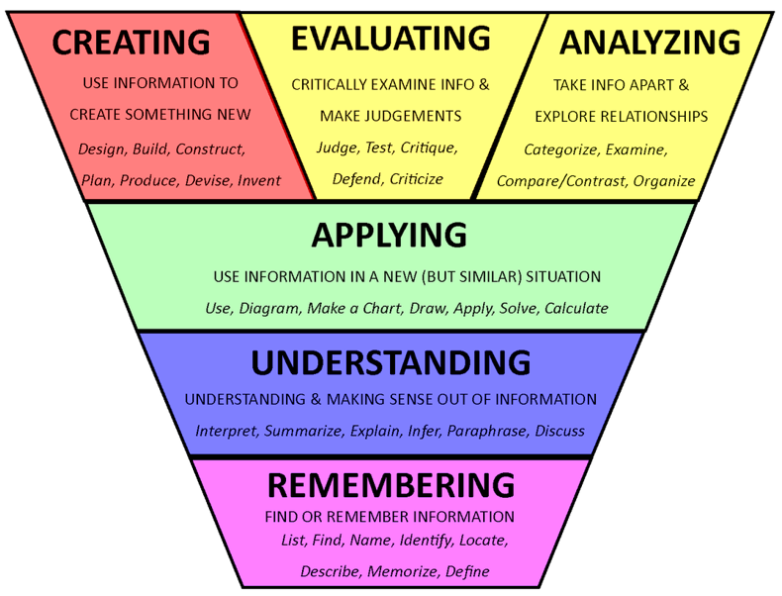
Learning Outcomes: Higher Level Learning
Evaluate
Analyze
Advocate for
Apply
Draw connections between
Explain
Describe

Slide 10
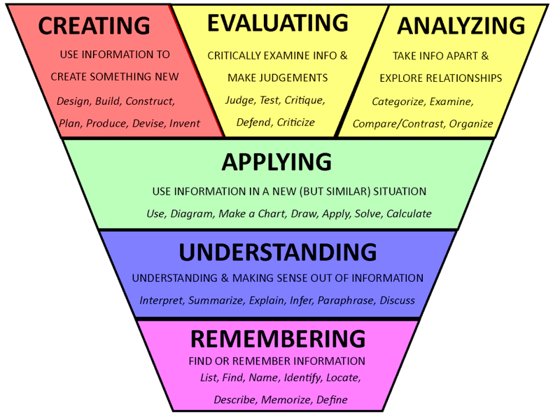
Learning outcome Assessment
By the end of this course, you will develop your capacity for:
Writing academically, with a focus on thesis organization, cohesion and argumentation;
Speaking and listening effectively, with a focus on interviewing and defending one’s position;
Reading with purpose and with greater effectiveness, with a focus on building useful vocabulary;
Working effectively with your colleagues in peer-feedback and collaborative learning activities;
Using the American Psychological Association (APA) citation and writing format system appropriately;
Using the words and ideas of others in ethical and responsible ways;
Self-evaluating and reflecting on areas of strength and challenge in using English academically;
Apply
Defend
Understand
Create
Apply
Analyze
Evaluate

Slide 11
Learning outcome Assessment
By the end of this course, you will develop your capacity for:
Writing academically, with a focus on thesis organization, cohesion and argumentation;
Speaking and listening effectively, with a focus on interviewing and defending one’s position;
Reading with purpose and with greater effectiveness, with a focus on building useful vocabulary;
Working effectively with your colleagues in peer-feedback and collaborative learning activities;
Using the American Psychological Association (APA) citation and writing format system appropriately;
Using the words and ideas of others in ethical and responsible ways;
Self-evaluating and reflecting on areas of strength and challenge in using English academically;
No. | Description | Weighting | Learning outcomes assessed
1 | Attendance (Measured by timely weekly posts) | 15% | -
2 | Weekly Blog Posts (7 total) | 20% | 1, 3, 4, 5, 6
3 | Weekly Comments (7 posts x 3 comments each = 21 total) | 10% | 1, 3, 4, 6, 7,
4 | Mini-thesis Assignments (5 segments + 1 overall = 6 total) | 40% | 1, 2, 3, 5, 6, 7
5 | Speaking Assignments (1 total) | 15% | 2, 4, 6, 7
Obser-vable,
Varied
and Aligned

Slide 12
Further Questions
Student centered teaching
Integrated Projects
Scaffolding
Reflexive learning
Your ideas

Slide 13
Homework
1) Evaluate your syllabus for these elements:
Title page, description, objectives/learning outcomes, organization, requirements, Evaluation and grading policy, policies and expectations, advice for learning
1) Evaluate your learning outcomes for these elements:
Clarity; observable learning; higher level thinking skills
Evaluate your assessment for these elements:
Various, multiple opportunities; alignment with outcomes

Slide 14
References
Eberly Center of Teaching Excellence & Educational Innovation. (2015). Design and teach a course. Carnegie Mellon. Retrieved from http://www.cmu.edu/teaching/designteach/design/syllabus/
ENQA. European Association for Quality Assurance in Higher Education. (2015). Standards and Guidelines for Quality Assurance in the European Higher Education Area. Helsinki. Retrieved from: http://www.enqa.eu/index.php/home/esg/
McKillip, J. (1998). Need Analysis. In Bickman, L and Rog, D.J. (Eds). Handbook of Applied Social Research Methods. Sage Publications: Thousand Oaks, CA.
Witkin, B. R. and Altschuld, J. W. (1995). Planning and conducting needs assessments: A practical guide. Sage Publications: Thousand Oaks, CA.
Eberly Center of Teaching Excellence & Educational Innovation. (2015). Design and teach a course. Carnegie Mellon. Retrieved from http://www.cmu.edu/teaching/designteach/design/syllabus/

