Slide 1
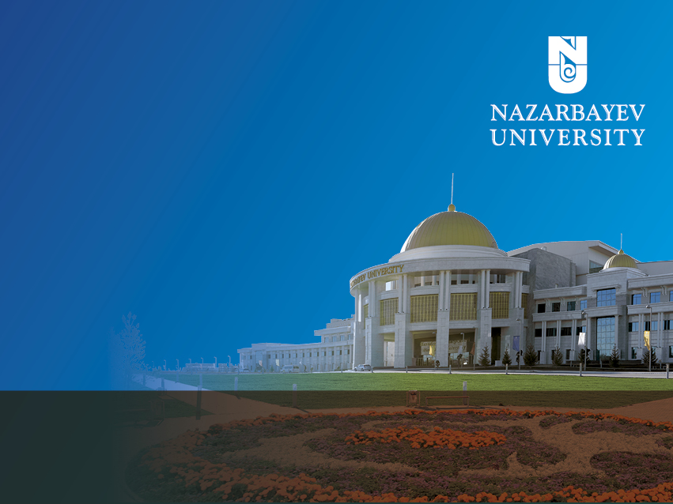
Gulzhan Yermekova,
Head, Sustainable Development Office
Nazarbayev University

Slide 2

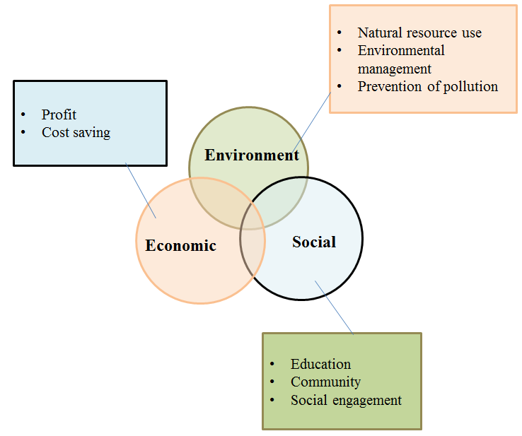
The Office of Sustainable Development (former Green Campus Office)
The Office of Sustainable Development – established in 2018, as the consequence of Green Campus movement
The GC Concept is based on principles of the Sustainable Development concept: environmental, economic and social aspects.
Green Campus – is an bottom-up initiative of the NU in order to make our University sustainable and green
Integration of the University’s core misssion:
education
research
innovation

Slide 3
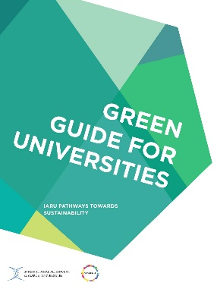









9 key areas for campus sustainability (IARU)
Sustainable campus organization
Defining key targets, priorities and strategy
Human resource, budget allocation
Campus-wide operations
Optimization of operational services on campus
land, water, energy and waste management
Buildings
Designing and construction of green buildings / making current buildings greener (LCC analysis, LCA analysis,
Eco-Charettes (expert group on energy efficiency)
Transport
Optimization of staff and students commuting and
staff business travel
Alternative sources of transport / greening the fleet
Laboratories
Making laboratories greener: waste management for laboratory waste, measures for efficient use of equipment
Communications
Reaching community through regular communication: web-site, social platforms: Facebook, VK, Twitter, regular reports on progress
Green procurement
Developing sustainable procurement procedures and practices
Employee and student engagement
Community engagement through trainings, competitions, cultural events
University as a catalyst for society
Supporting students and faculty projects (Living Lab)
Participating in joint project with city/region

Slide 4
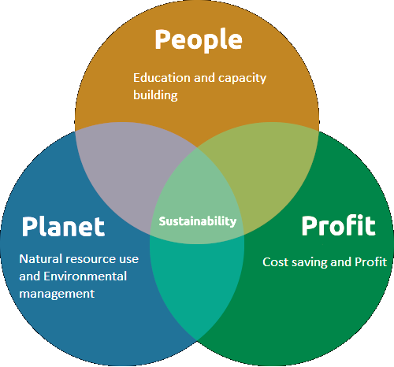
NU: Path to Sustainability Development
AGENDA:
1. Campus environmental performance
2. Education for Sustainable Development
3. Research for Sustainable Development
4. Building national sustainability network among local universities and institutions
5. Green networking space at NU (Sustainability Hub at NU)
6. Participation in international networks
7. Contribution to the City resilience and State’s response to Climate Change

Slide 5

1. Campus environmental performance
The University should inspire others to the Sustainable Future by its own example
Climate change & energy (mitigation of GHG emissions, energy efficiency, renewable energy, sustainable transport)
Waste (waste reducing, recycling programs)
Food (on campus horticulture, energy efficient greenhouse, urban agriculture)
Water resources (water use efficiency, water upcycling)
Landscape (greening the campus)
Biodiversity (local biodiversity maintenance)
Campus as a test-bed (Sustainability Living Lab CREATIVITY Program)
Green Procurement

Slide 6
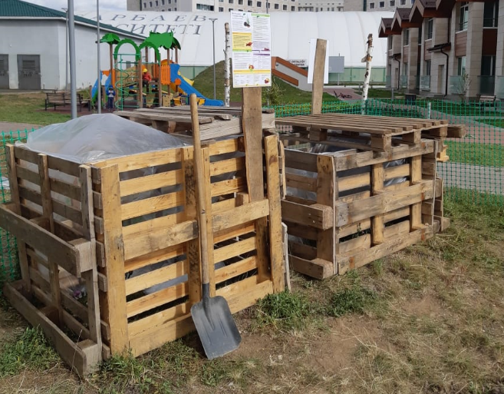
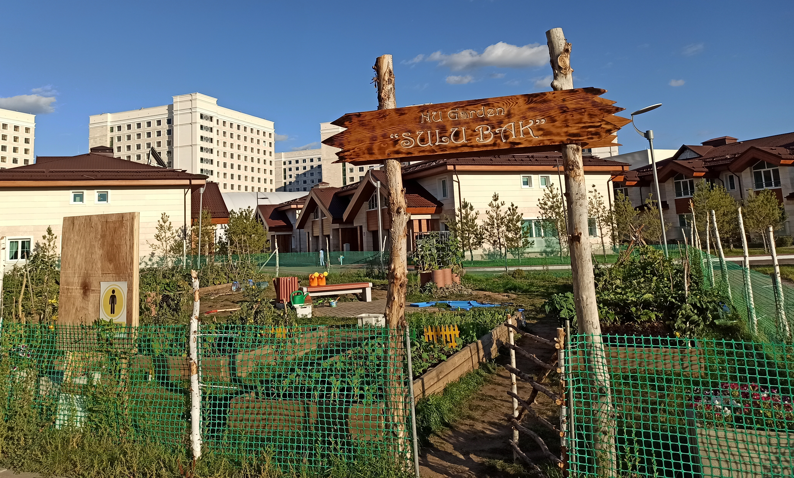
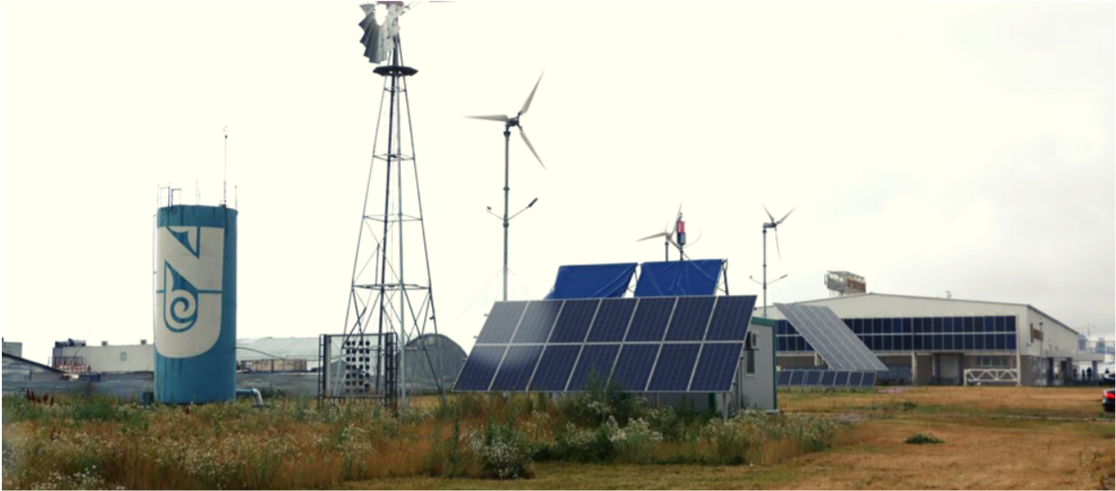
1. Campus performance
Climate change & Energy
Development of the NU Carbon Management Plan : GHG emissions mitigation plan for Scope 1,2
Energy dashboard for heat & electricity
Campus as a test-bed for research findings and innovation
Technology transfer
Waste
Development of the NU Waste Management Program
Organic waste composting
Trainings and masterclasses
Support of innovative projects on plastic recycling, waste reduction, composting, other.
Food
Support of the campus horticulture by residents
Construction of Energy-efficient greenhouse
Urban agriculture projects
SLL projects (e.g. Vegan meat)

Slide 7
Comparison
Total FTE: ~ 15,600 (2010)
Campus territory: ~ 200 ha
Goal: reduce Scope 1&2 emissions by 48% by 2020
Actions: Improving the energy performance of buildings: smart building technology options, replacement and retrofitting of luminaries, i.e. LED lamps, replace boilers with more efficient ones, etc.
new low carbon sources of energy: wind turbines, biomass boilers
Total FTE: ~ 51,000 (2013)
Campus territory: ~ 2,700 ha
Goal: Carbon neutrality for Scope 1&2 sources by 2025, for Scope 3 by 2050
Actions: Installing solar panels with a focus on new buildings and those under renovation; substituting carbon-free biogas for natural gas use; finding additional opportunities for constructing and renovating to maximize energy savings
Total FTE: ~7,400 (2019)
Campus territory: 100 ha
Focus:
Efficient energy use (->reduce energy use)
Alternative low/zero carbon sources of energy
Notes:
According CO2 emissions rate Scope 1 and 2 are mainly energy related. That’s why efforts on carbon reduction should be focused on 1) efficient use of energy, which will cause reduction of energy consumption 2) introducing alternative low/zero carbon sources of energy.

Slide 8
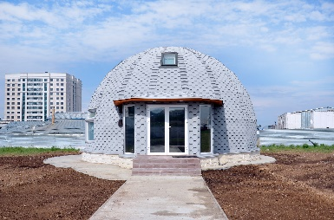
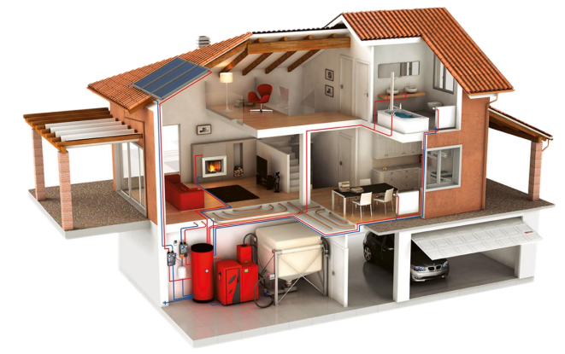
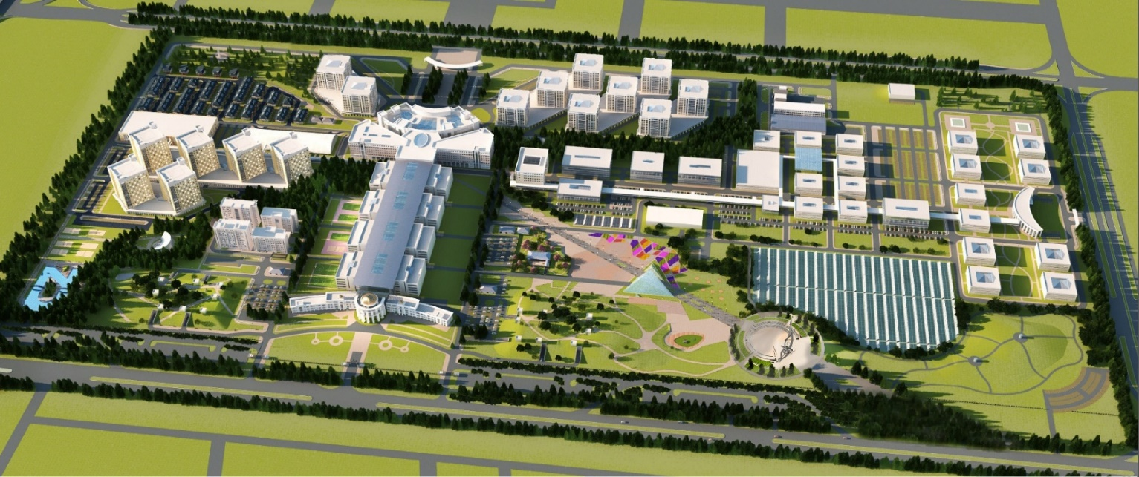
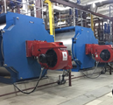
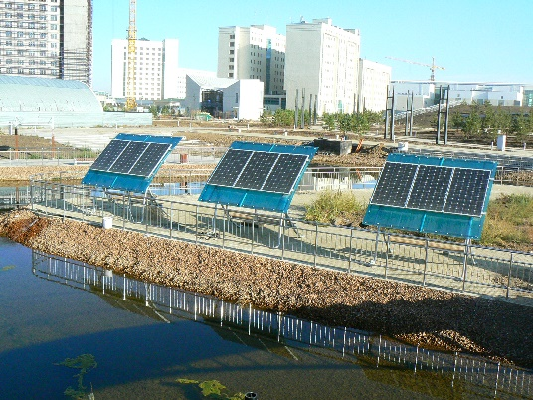
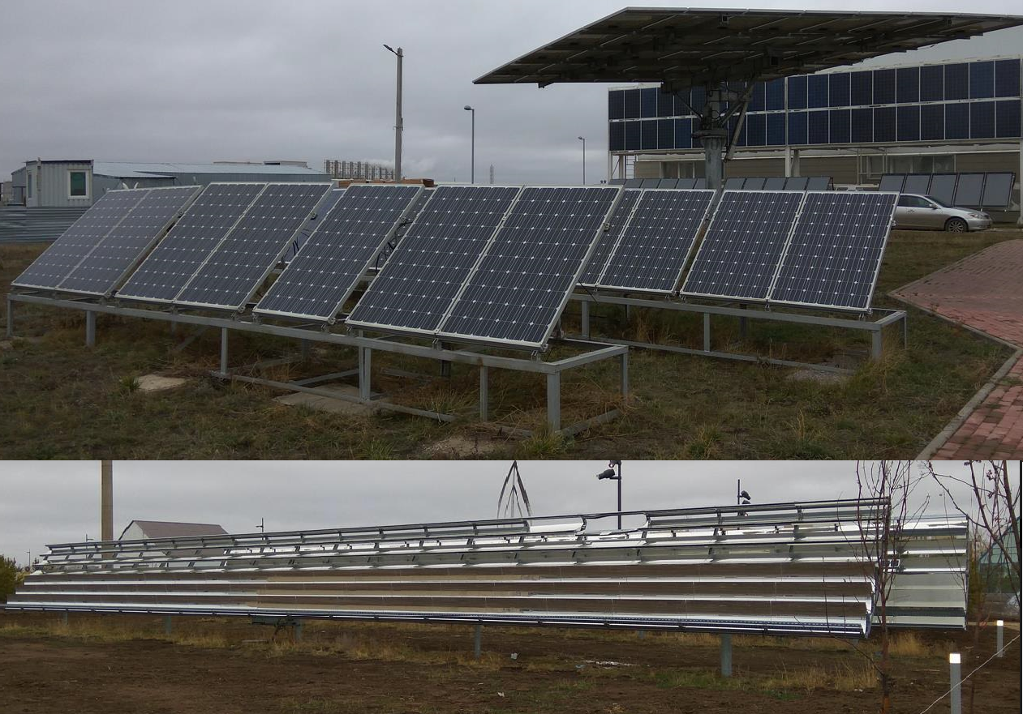
Ongoing green projects
BG yurt
passive house with energy efficient windows, Polyurethane-based insulation, the shape for handling wind and snow loads with minimal construction materials. Heating system consist of: Solar thermal collectors (30 vacuum tubes), heat pump (6 kW)
Solar collectors
67 town houses at campus equipped with solar collectors, that provides heating energy. Capacity of one collector is 4,26 kW. Commissioning date – 2018.
Gasification of campus
Shifting from diesel fuel to gas for heating system gives financial savings (KZT 100 mln in 2017) and CO2 reduction by 20%
Solar pumps
photo-electric water-elevators equipped to the benches supplies underground water to the reservoir, which has the ‘NU’ form
On-site electricity generation
50 kW on grid system integrated into Technopark. Building of Technopark consumed 159,52 MWh of energy in 2017, where the 50kW on grid system generated approximately 44 MWh of energy in 2107 (it is rough estimation, the meters have installed recently)
Notes:
These are ongoing energy related projects, which positively effects to our carbon footprint.

Slide 9
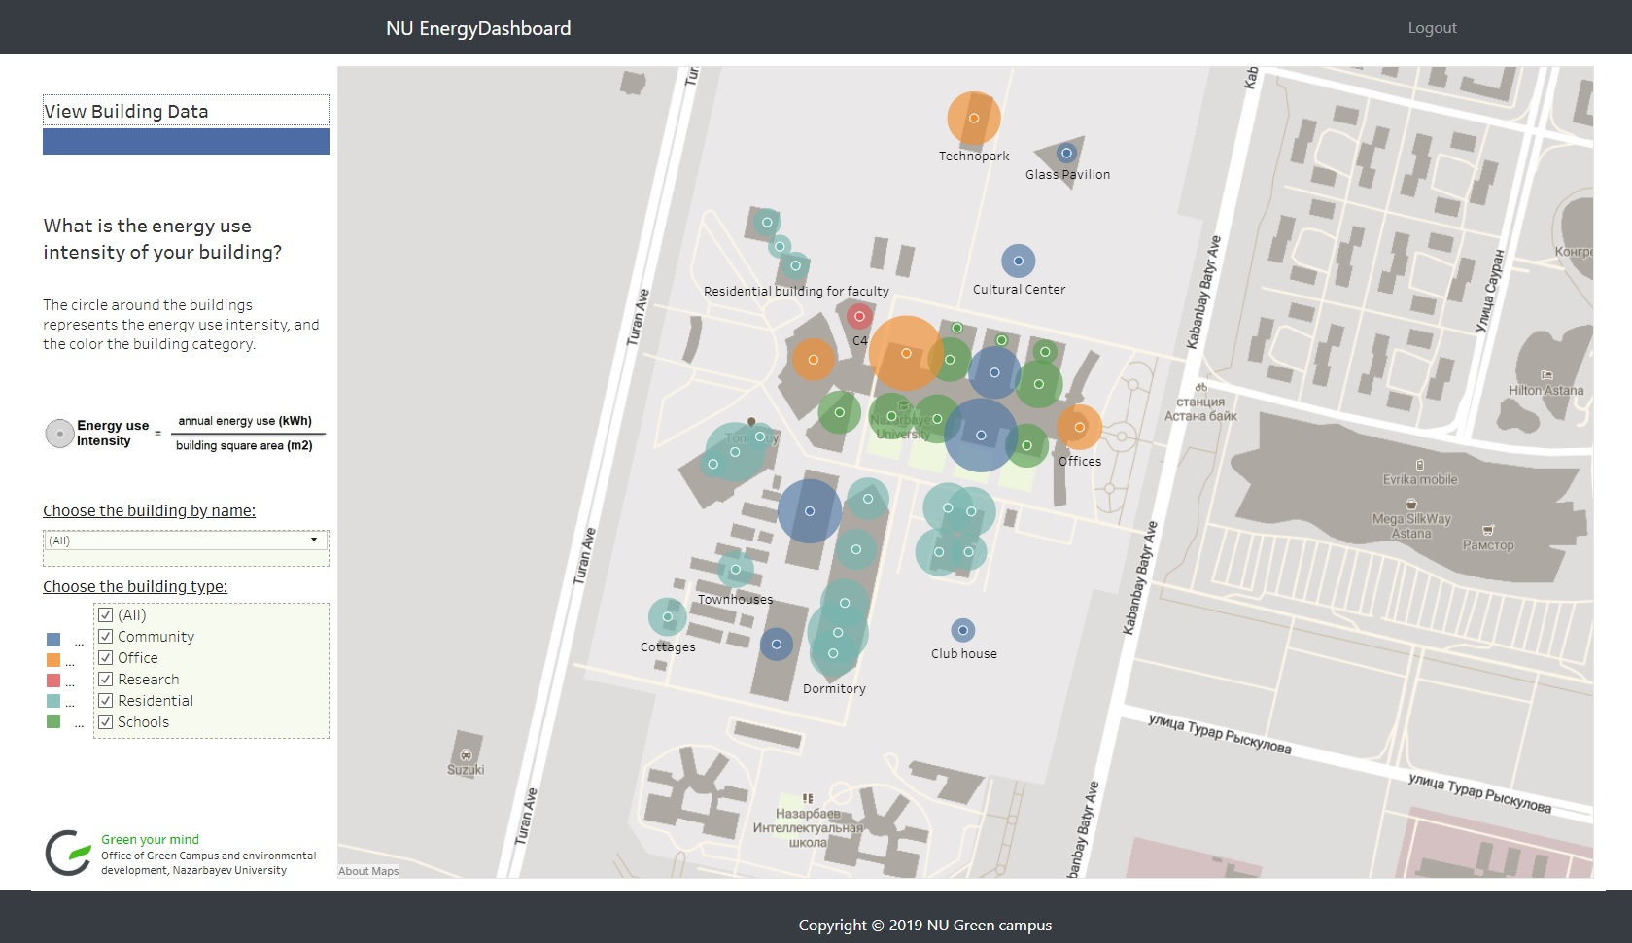

Slide 10
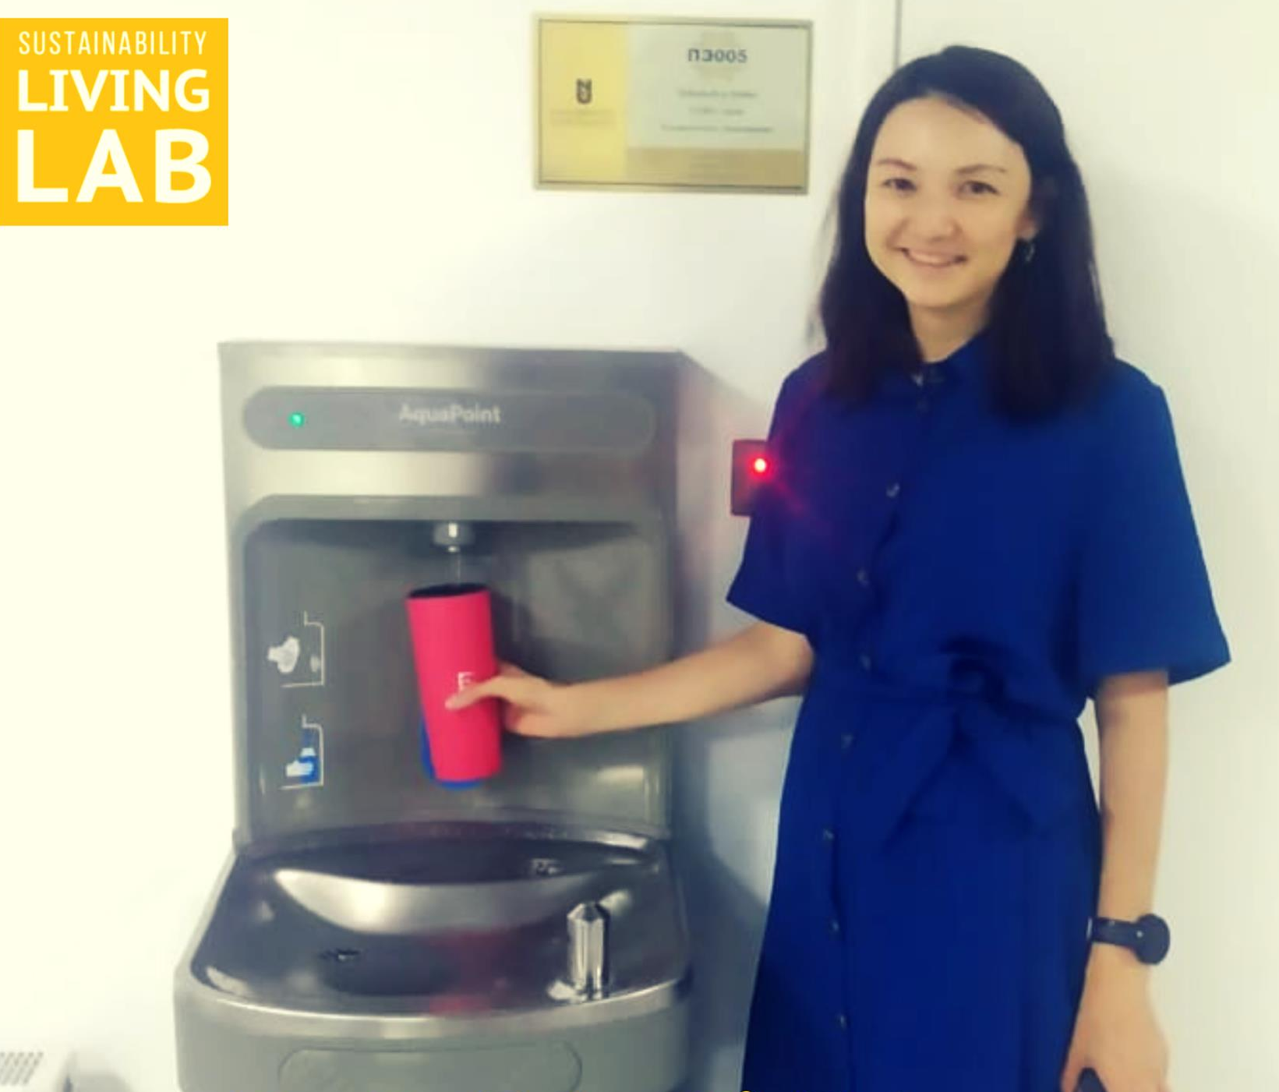
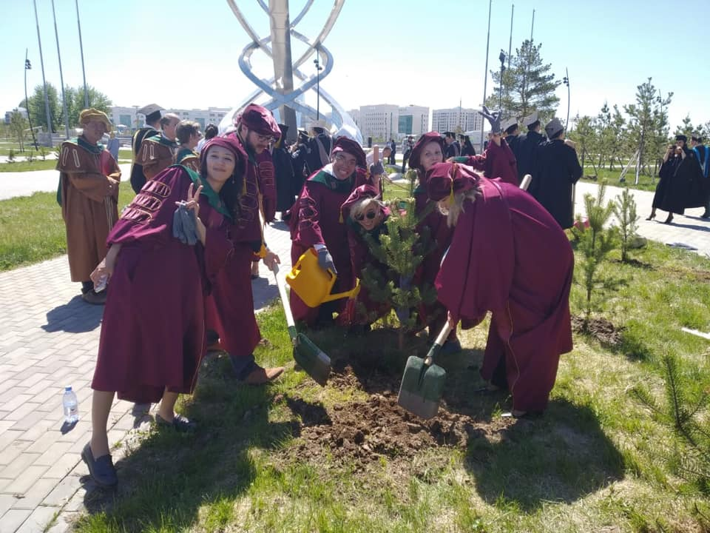
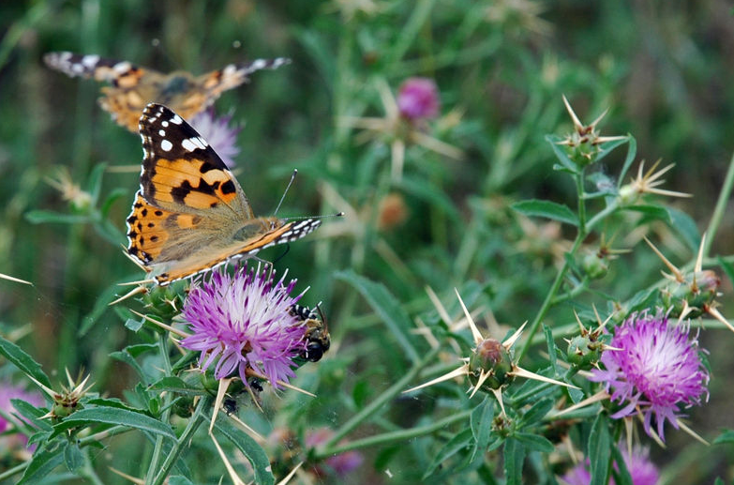

1. Campus performance
Water resources
Provision of free access to drinking water on campus
Water efficiency projects
Snow and rainwater conservation projects
Campus landscape
Development of the
Campus Landscaping program
Tree planting activities
NU Atrium, indoor green
spaces
Development of gardens
Biodiversity
NU Campus is a host for local biodiversity
Development of guideline on local biodiversity
Biodiversity conservation plan
Green Procurement
General guidelines for sustainable procurement
Using life cycle cost tools
Policies for packaging and reuse of goods

Slide 11


1. Campus performance
Sustainability Living Lab program intends to promote sustainability
within the University, where
campus becomes as a test-bed;
students and faculty realize ‘green’ research and innovative projects;
financial support
access to campus facilities
university engineering services
Consultations from experts
Opportunities for projects:
Incubation
Acceleration
Climate Launchpad

Slide 12
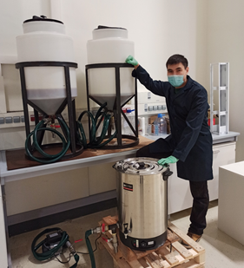
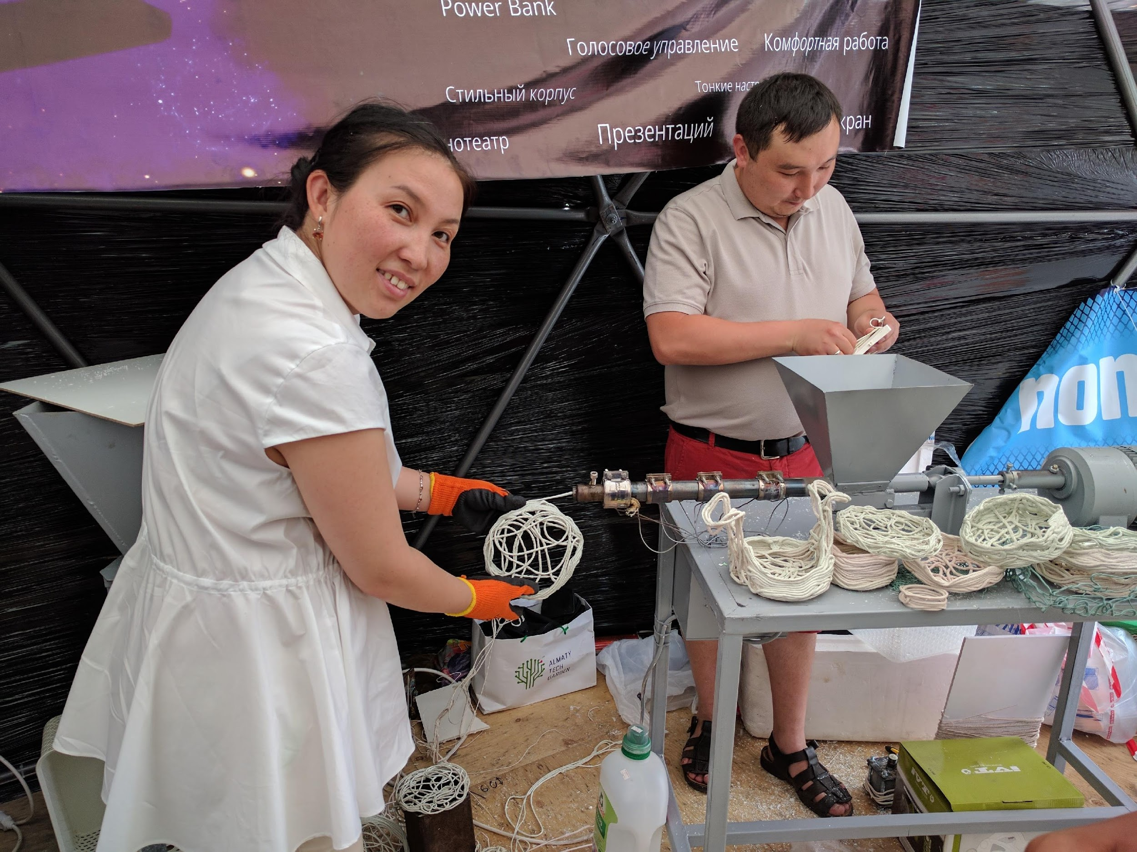
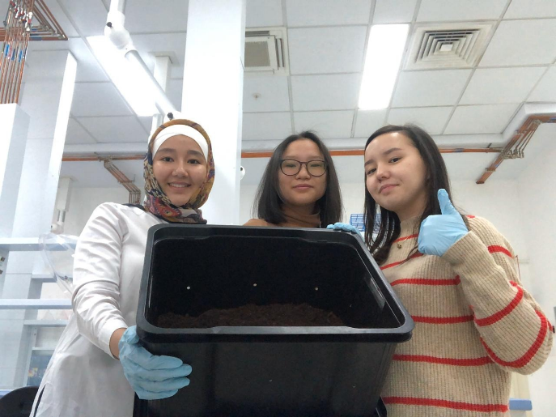
SLL Creativity projects
Precious plastic
Biodiesel from cooking oil
Vermicomposting
Precious plastic is the worldwide movement which is aimed to promote plastic recycling. It helps to turn plastic waste into valuable things.
On campus Biodiesel production from used cooking oil for NU transportation service
Composting of organic food waste from university canteens and cafes
Growing of greens and vegetables on that compost

Slide 13
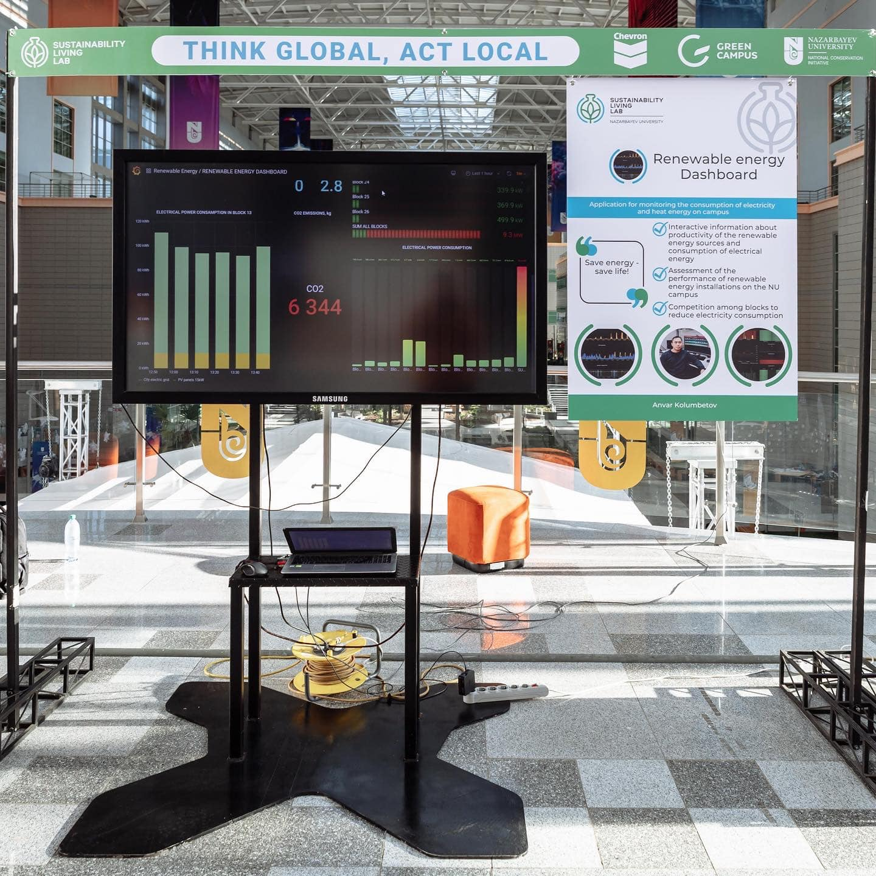
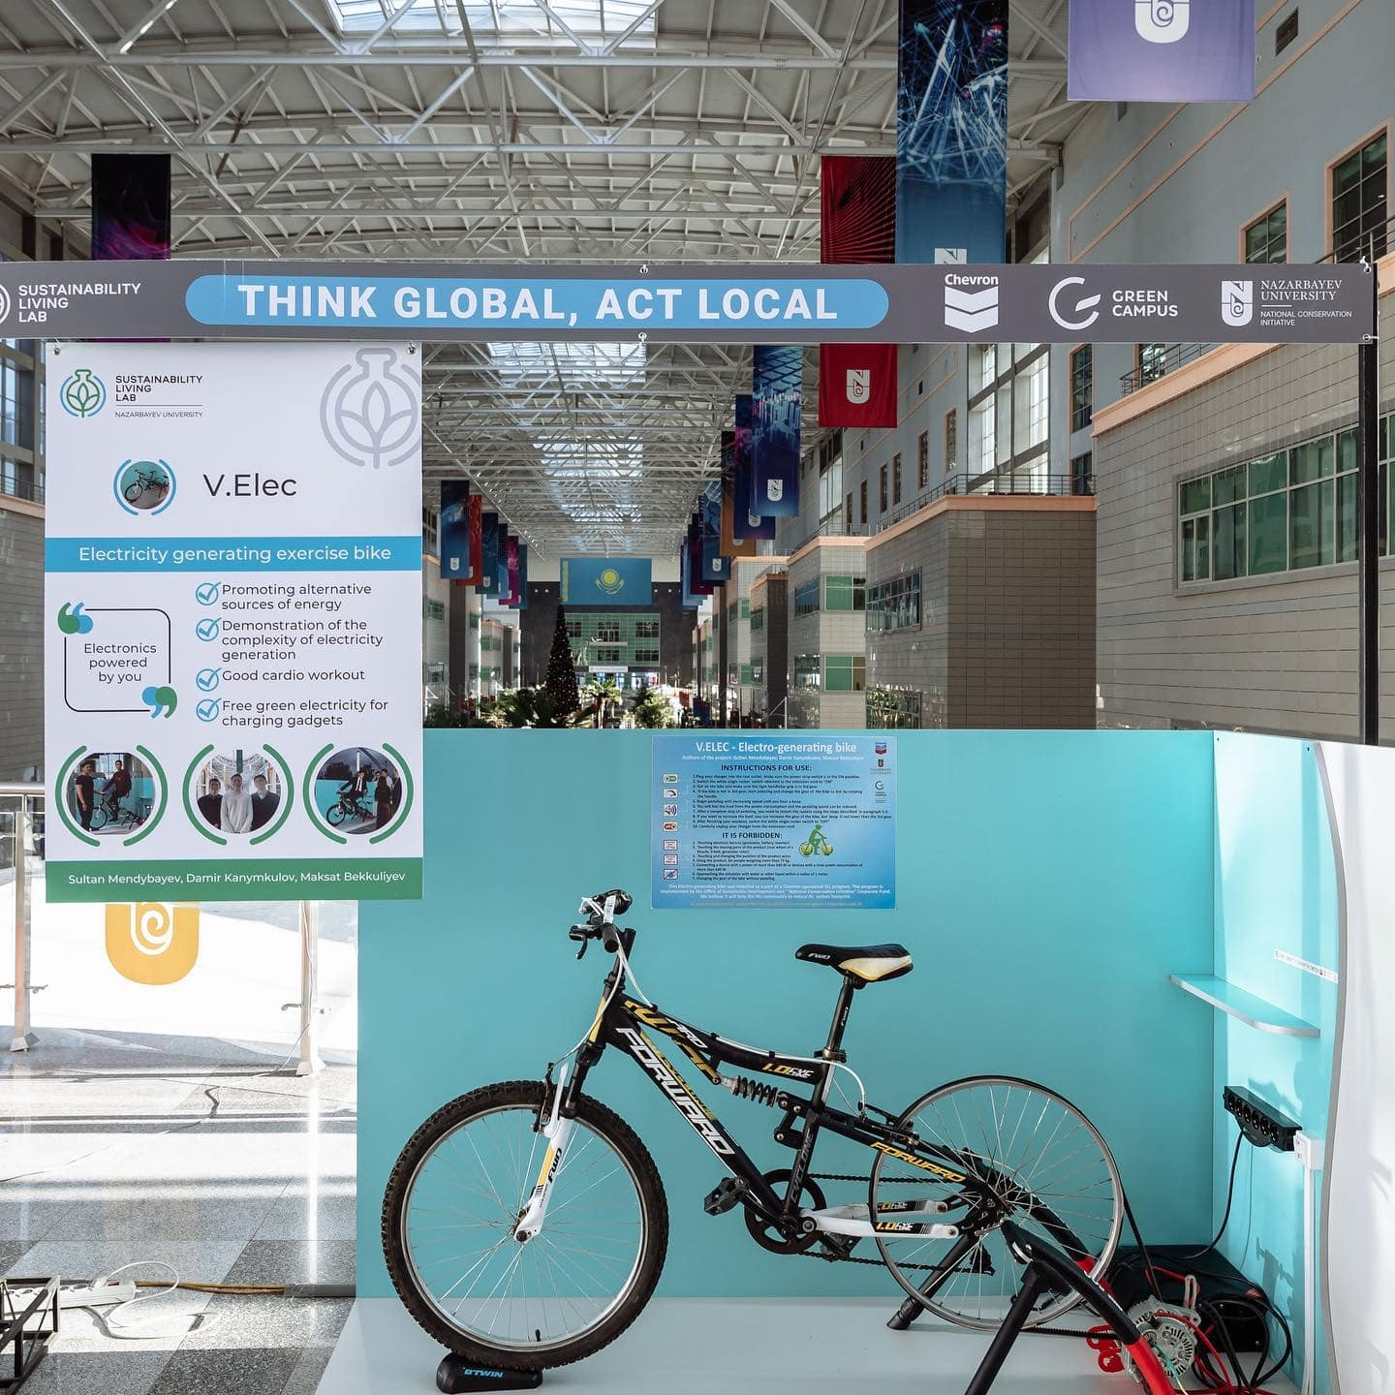

Slide 14
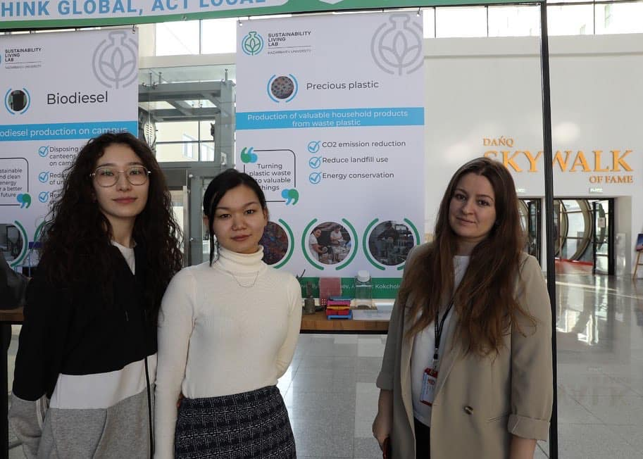
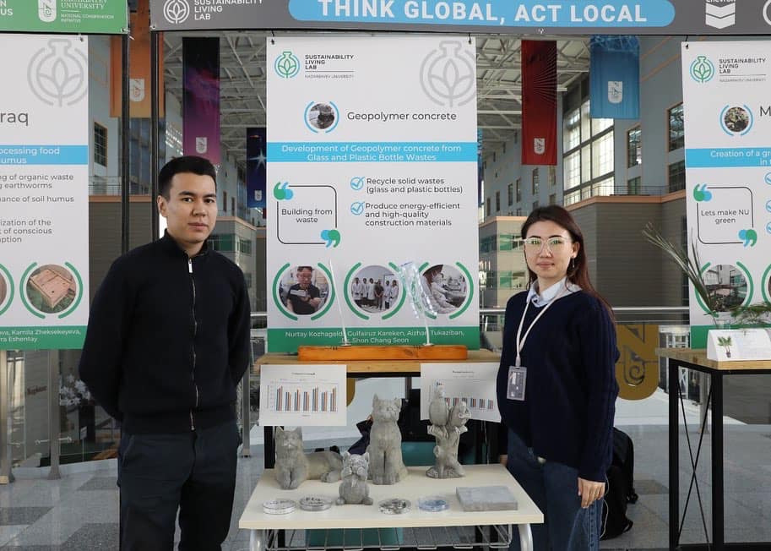

Slide 15

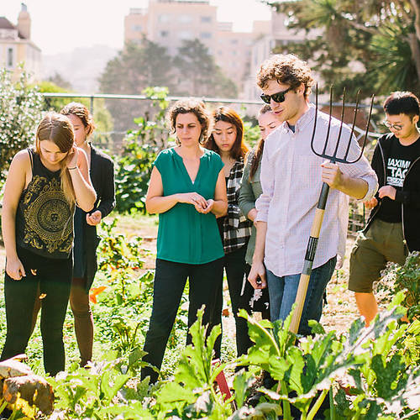

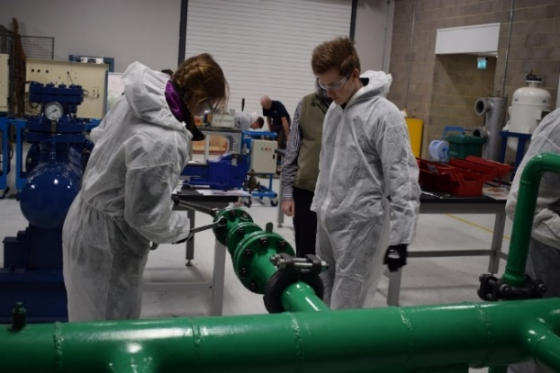
2. Education for Sustainable Future
Sustainability in curriculum: preparing graduates capable to future shocks
Education for all: transferring the knowledge to the wider community
General courses on sustainability are to be presented in all disciplines of NU schools. NU graduates are aware of global environmental threats.
SLL ACADEMICS supports development of STEM-oriented academic courses that would enhance students' awareness of global environmental challenges and their sustainable solutions.
Practical workshops – are designed for general public which gives overview on subject and contain hands-on exercises and field trips. NU infrastructure will serve as an excellent platform.
Online courses – professional online training courses on environmental topics for general public. The courses will provide knowledge on planetary boundaries, global threats and local solutions.

Slide 16
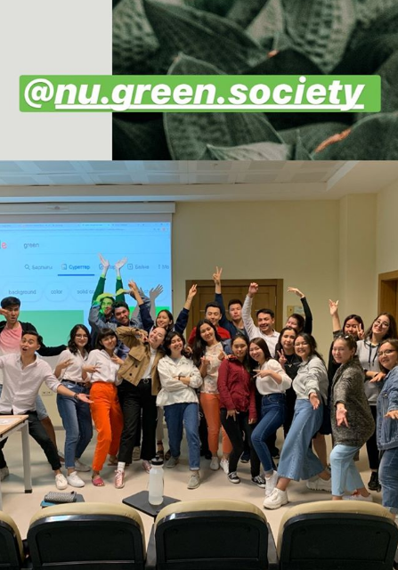
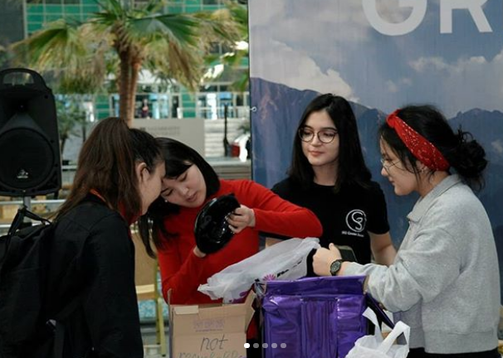
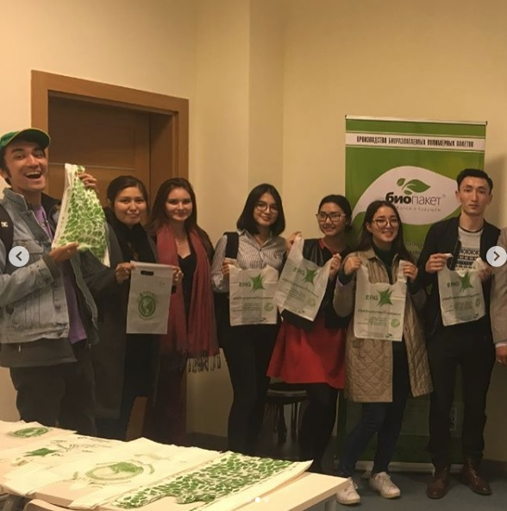
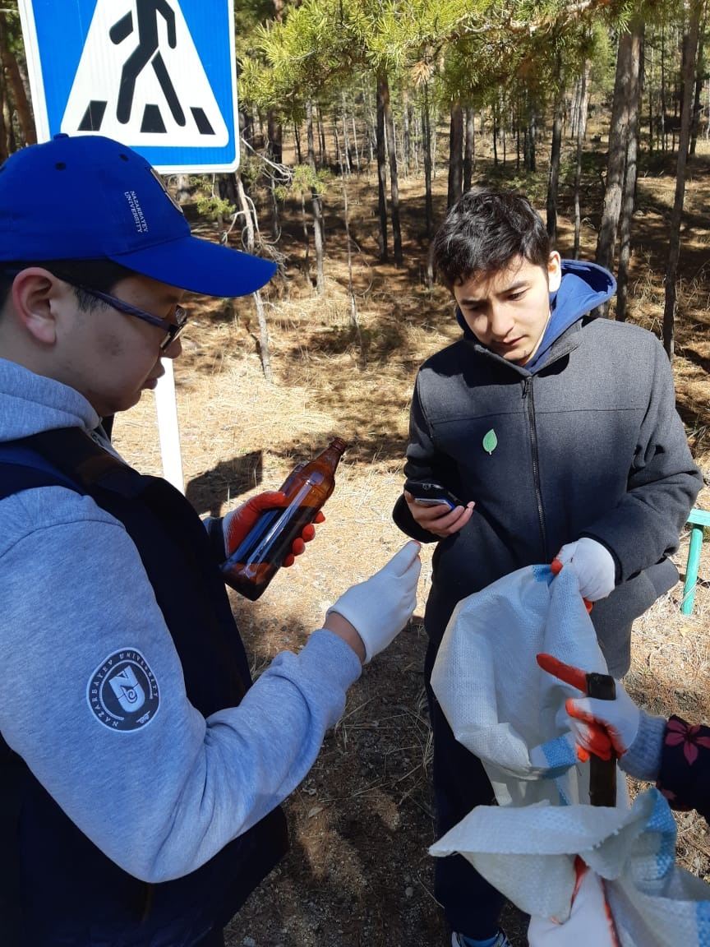
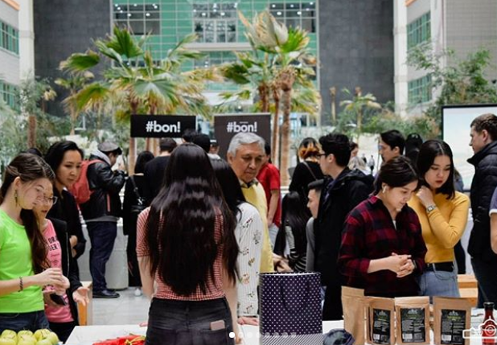
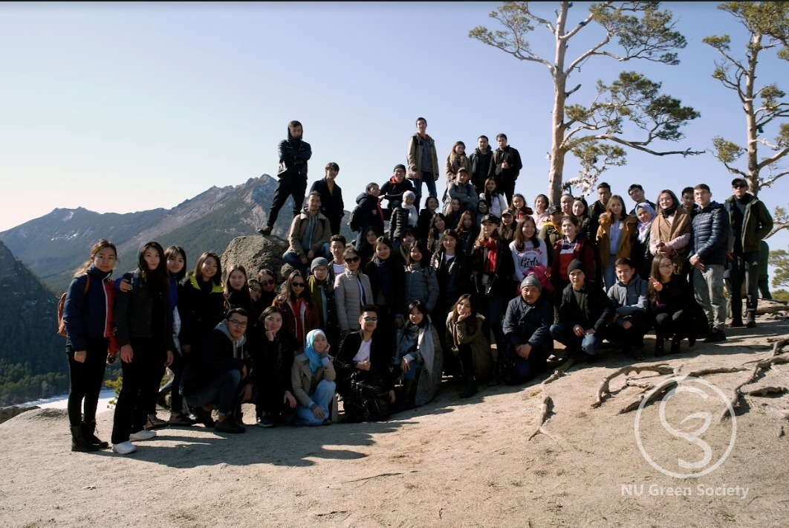
NU Green Society (NU students)
Green week:
Eco-talks
Movie screening
Vegan food fair
Art exhibitions
Quests/contests/games
Other activities:
Eco-trips
Master-classes
Social network
Outreach

Slide 17
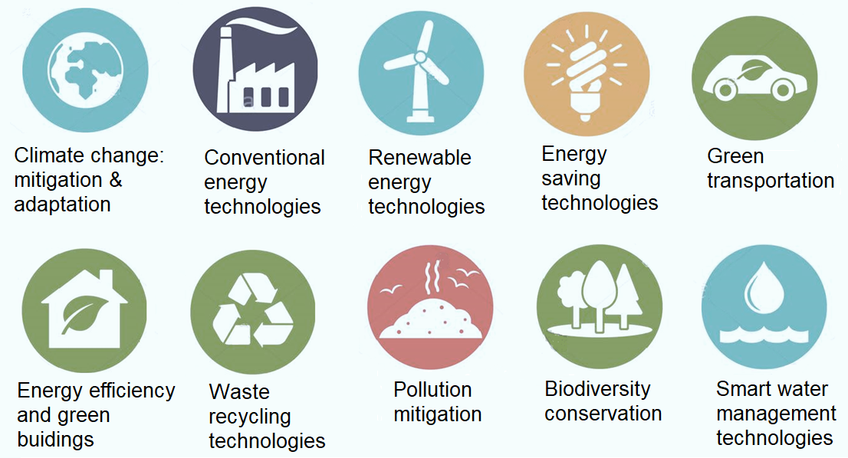
3. Research for Sustainable Future
Increasing the share of funding for research projects in environmental area
(governmental funding);
Fundraising for research projects from industry;
Building nation-wide network with local universities and institutions: joint research collaborations;
Participation in international networks with research intensive universities and institutions.

Slide 18
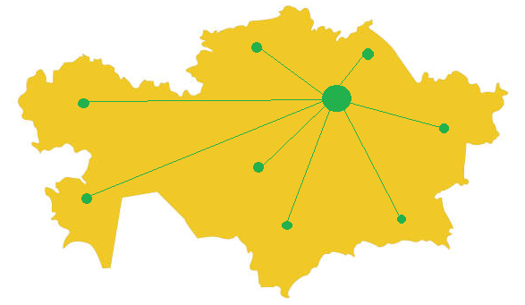
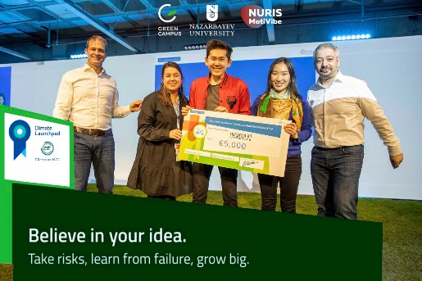
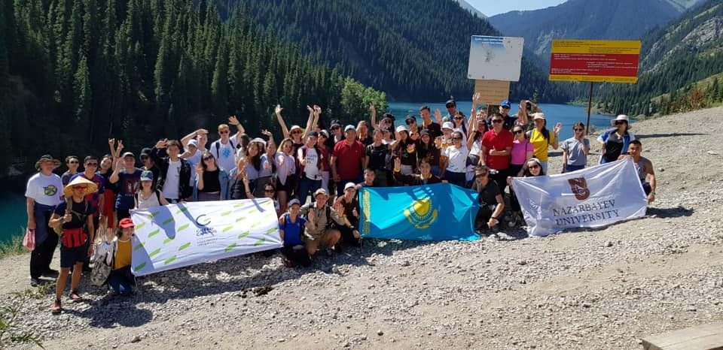
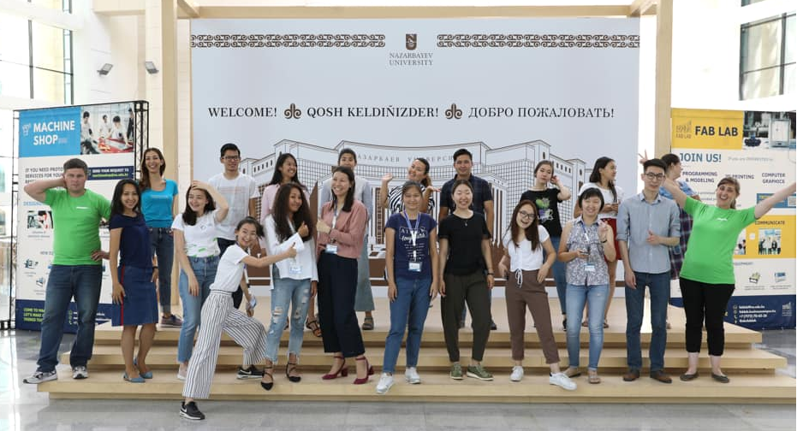
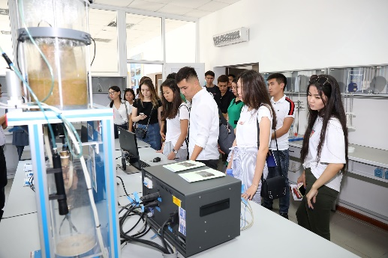
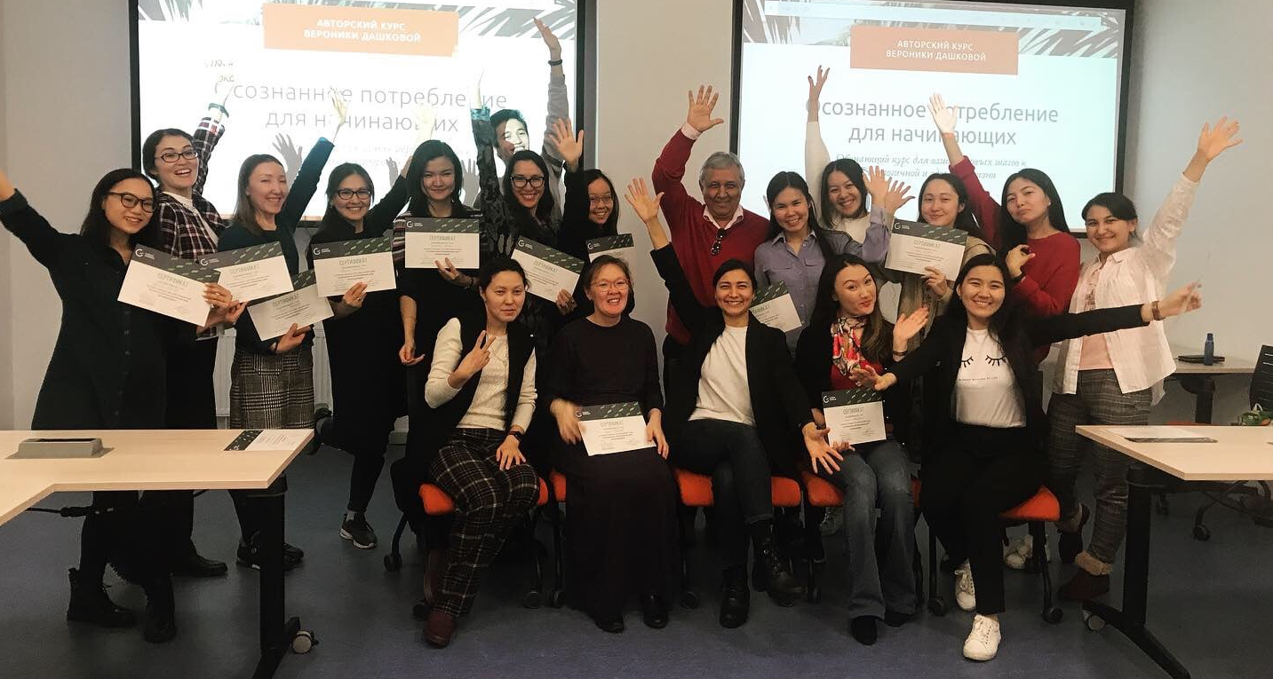
4. Building national network among local universities and institutions
Sharing the Green Campus program’s experience
Building Sustainability Living Lab network among local universities: experience sharing, consultations; -
9 universities
Joint conferences, workshops and fieldtrips (Climate Week, Climate Talks, others)
Joint research collaboration on local environmental issues
Engaging to the NU’s innovative events (Climate Launchpad KZ, Climathon Nur-Sultan)
Students’ network: NU Green Society

Slide 19

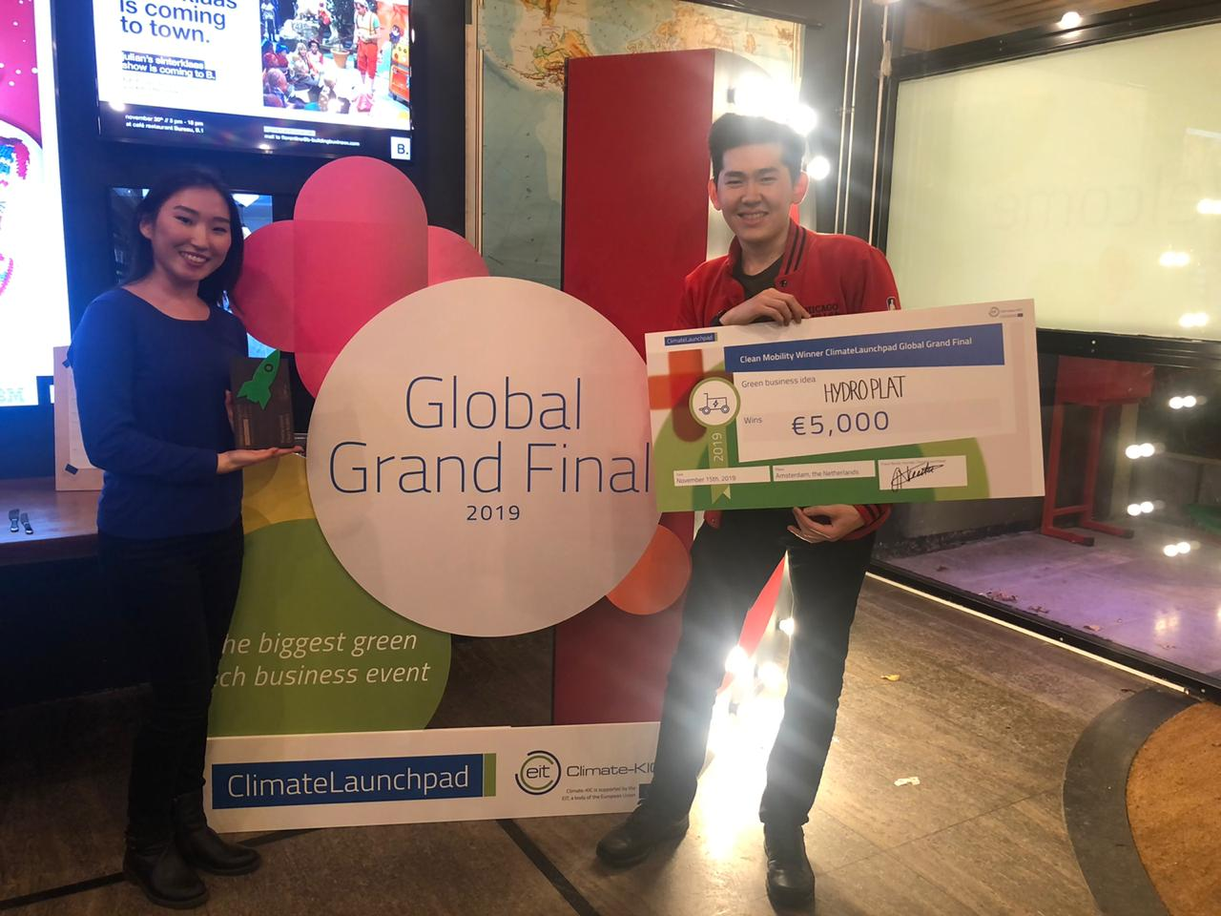
Climate Launchpad
Nazarbayev University is the national partner of the Climate Launchpad
Competition.
Training sessions: boot camp, follow-up
Climate KIC Acceleration program
Global Final 2019: Amsterdam
Two national finalists: Hydroplat (NU) and dECO (Hailey Bury)
Outreach
Joint events with other universities, schools, kindergartens (e.g. Climate Week, Green Week, field trips, conferences, seminars )
Joint research projects with universities
Joint events with city authority and municipalities (e.g. Climathon)

Slide 20
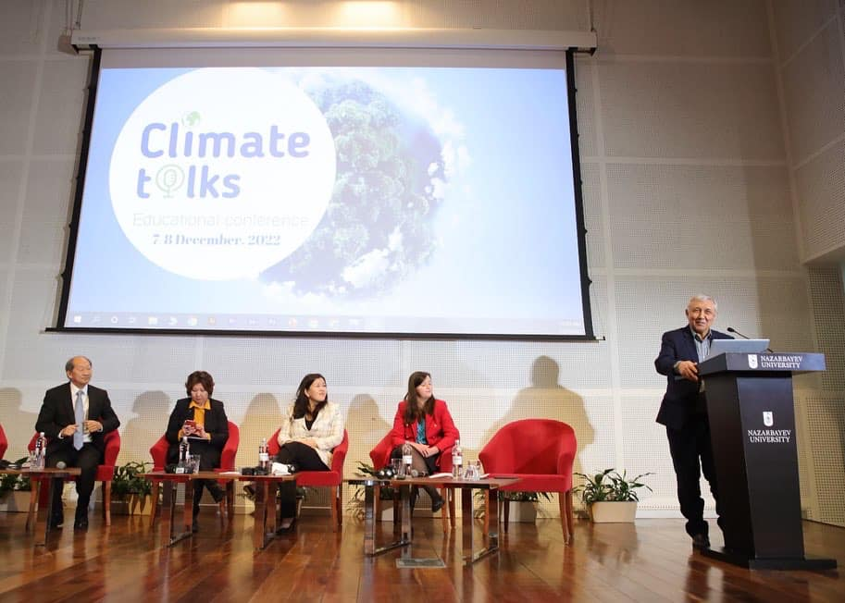
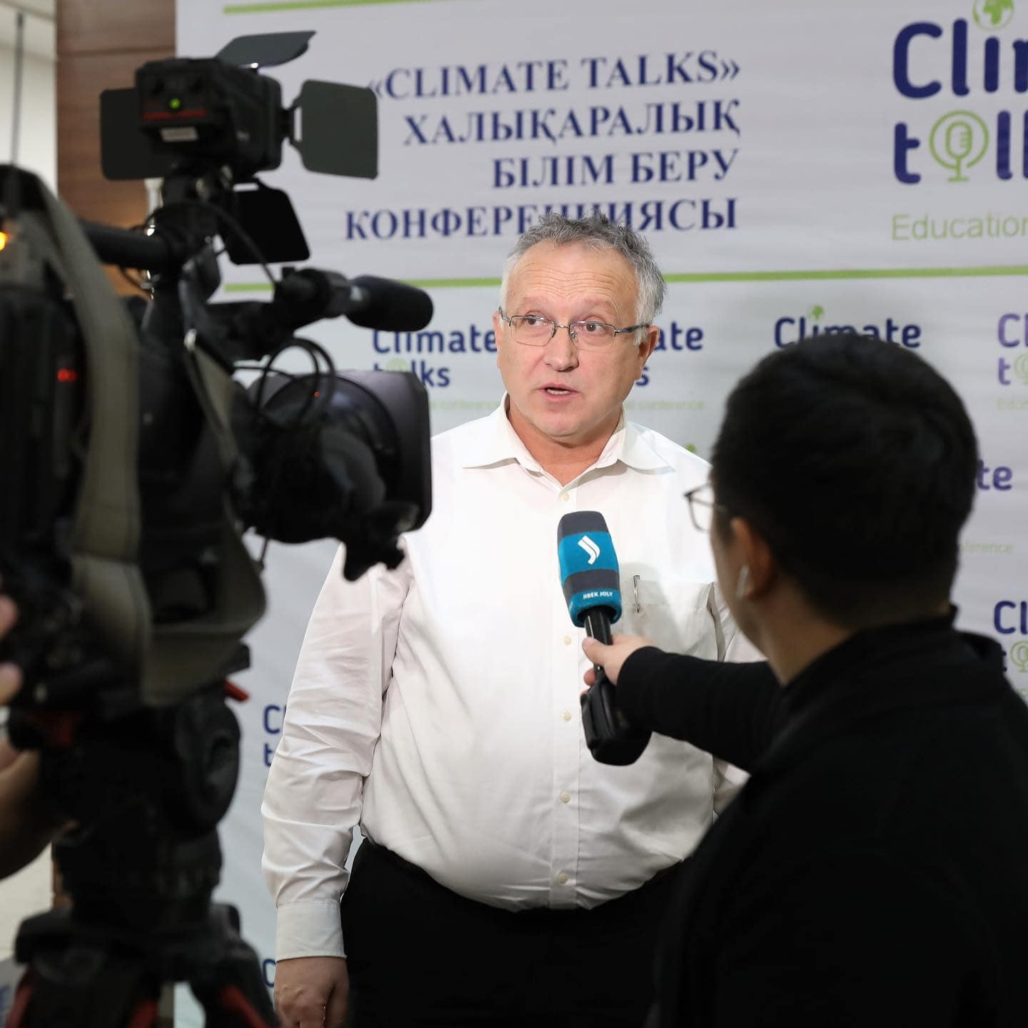
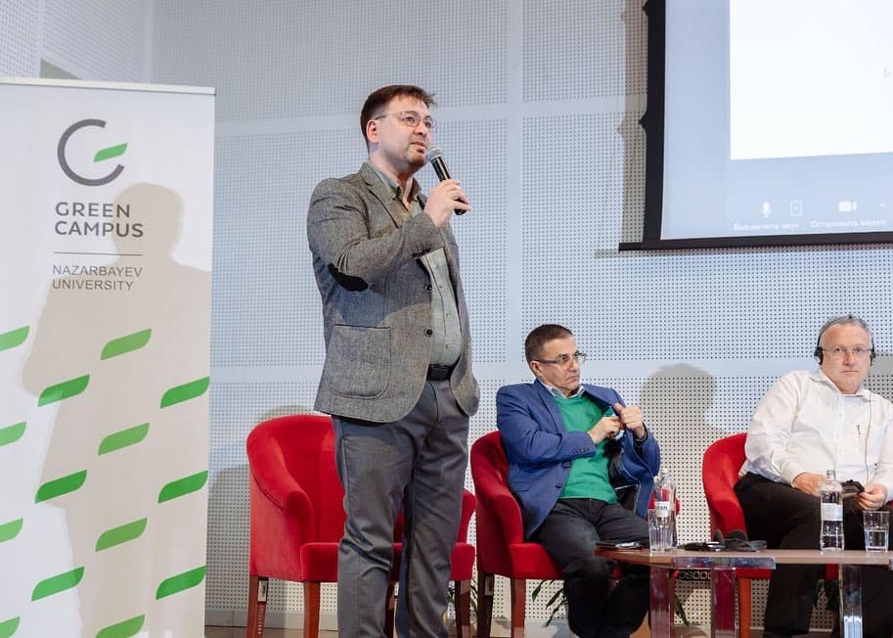

Slide 21
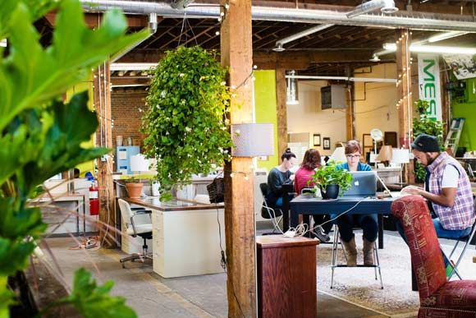
5. Green networking space at NU
Green networking space is a headquarter
for community where generate sustainable ideas.
It will have space for meetings and seminars, library, café, all office amenities
It is open for all who organize and participate in sustainability events (e.g. students, academia, SLL alumni and others)
It can serve as a venue for bootcamps and seminars of Climate Launchpad, Climathon, and other city- and national-wide innovative events.

Slide 22
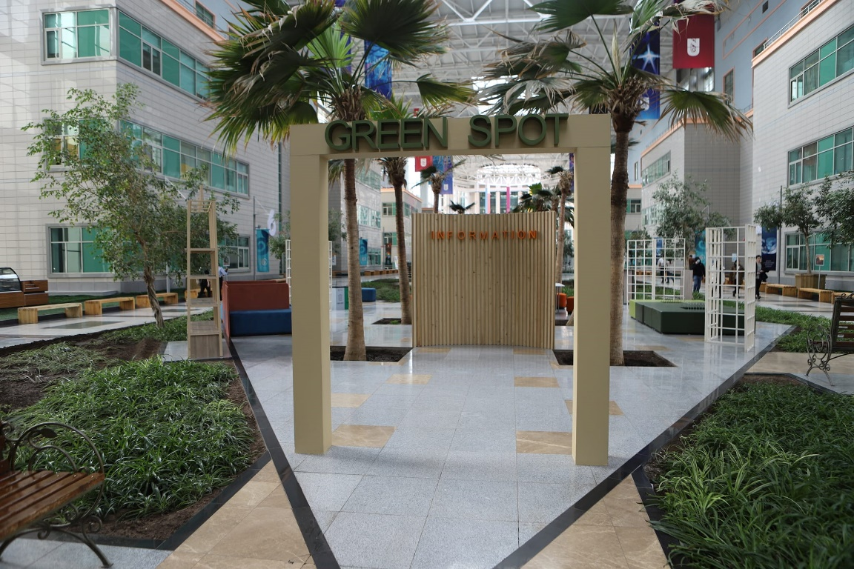
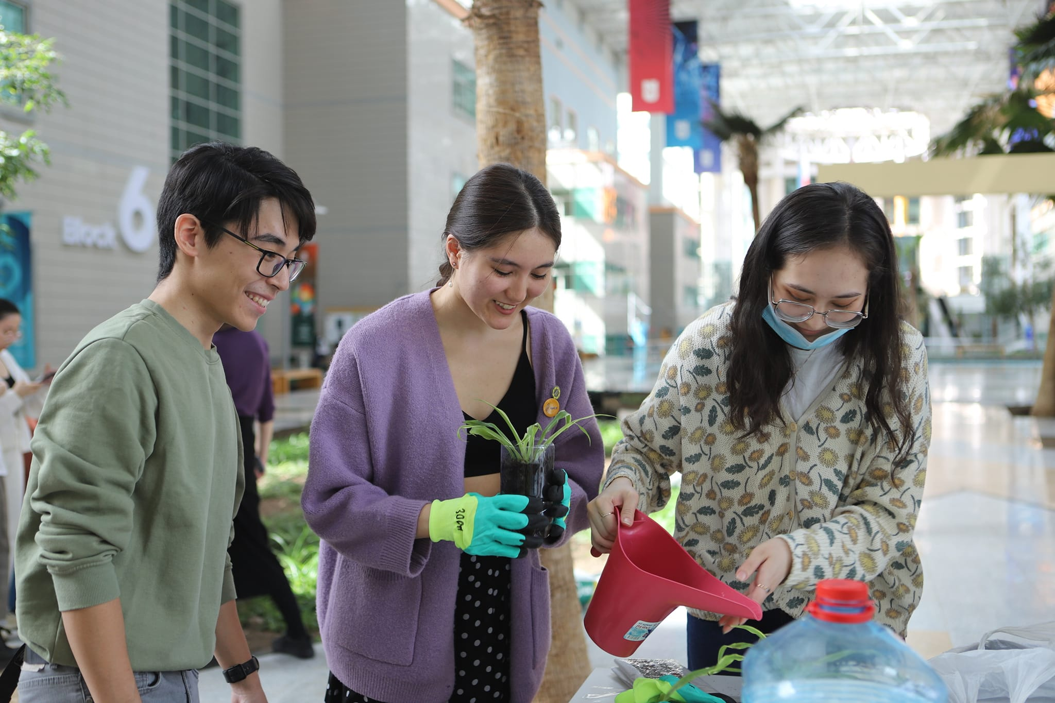
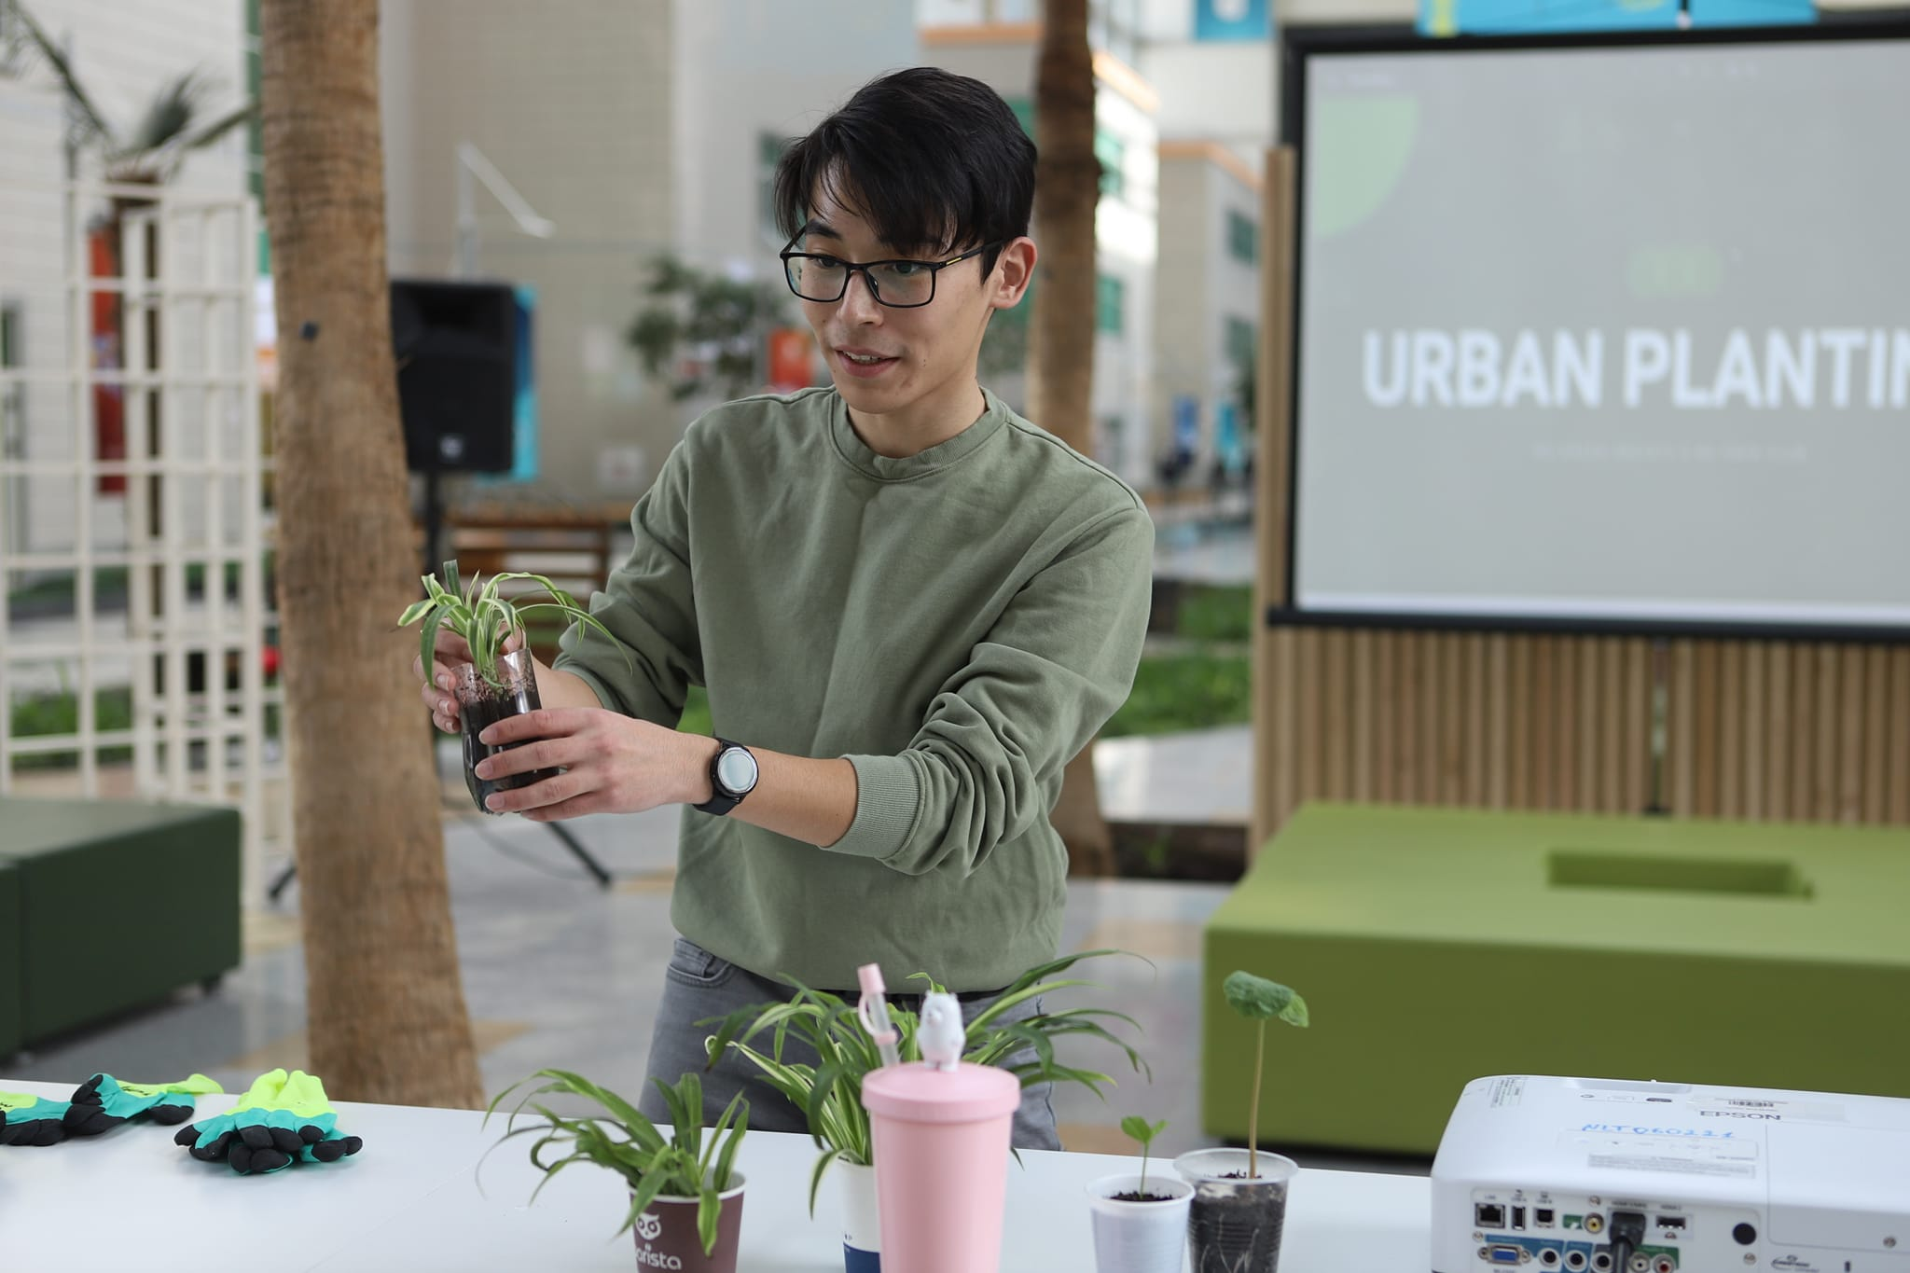

Slide 23






6. Participation in international networks
Joint research collaboration with research-leading universities and institutes:
Collaboration with international research alliances (e.g. IARU)
Extension of collaboration area with NU’s strategic partners
Collaboration with international development institutes
Collaboration for capacity building:
Vocational trainings, workshops
International internships
Academic/Research Fellowship programs
Conferences, summer programs
Student mobility programs
Participation in SDG and Campus sustainability ranking programs

Slide 24
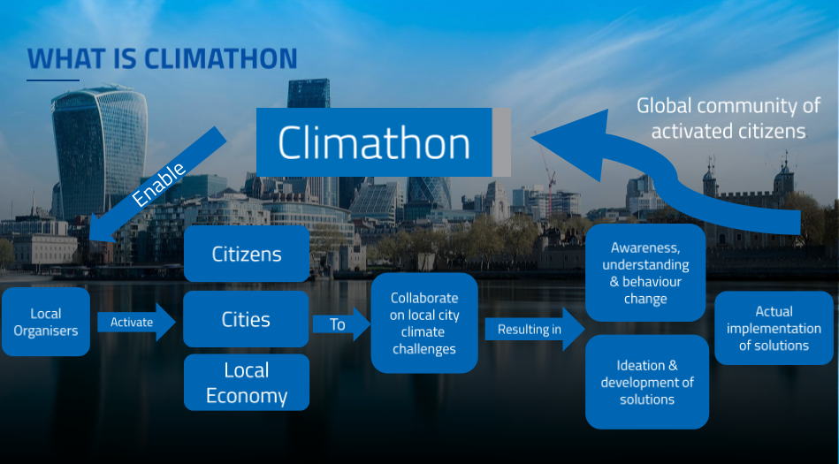






7. Contribution to the City resilience and State’s response
NU contributes to the city’s resilience by organizing:
Climathon - City as a living lab: realization of innovative green solutions
Educational seminars and workshops for city authorities
Joint projects
NU contributes to the State’s response by developing:
National Task Force for the State’s response to Climate Change: NU, UNDP Kazakhstan, NU NCI, Climate Change Coordination Center, Institute for Economic Development, KazNU, others.
Kazakhstan Net Zero Carbon strategy: development of academic vision
COP: NU participates in national capacity building and training of young generation (e.g. students) for climate negotiations
Think tank for the Government and local authorities in environmental issues
Participation in national environmental policymaking process

Slide 25
Thank you!

