Slide 1
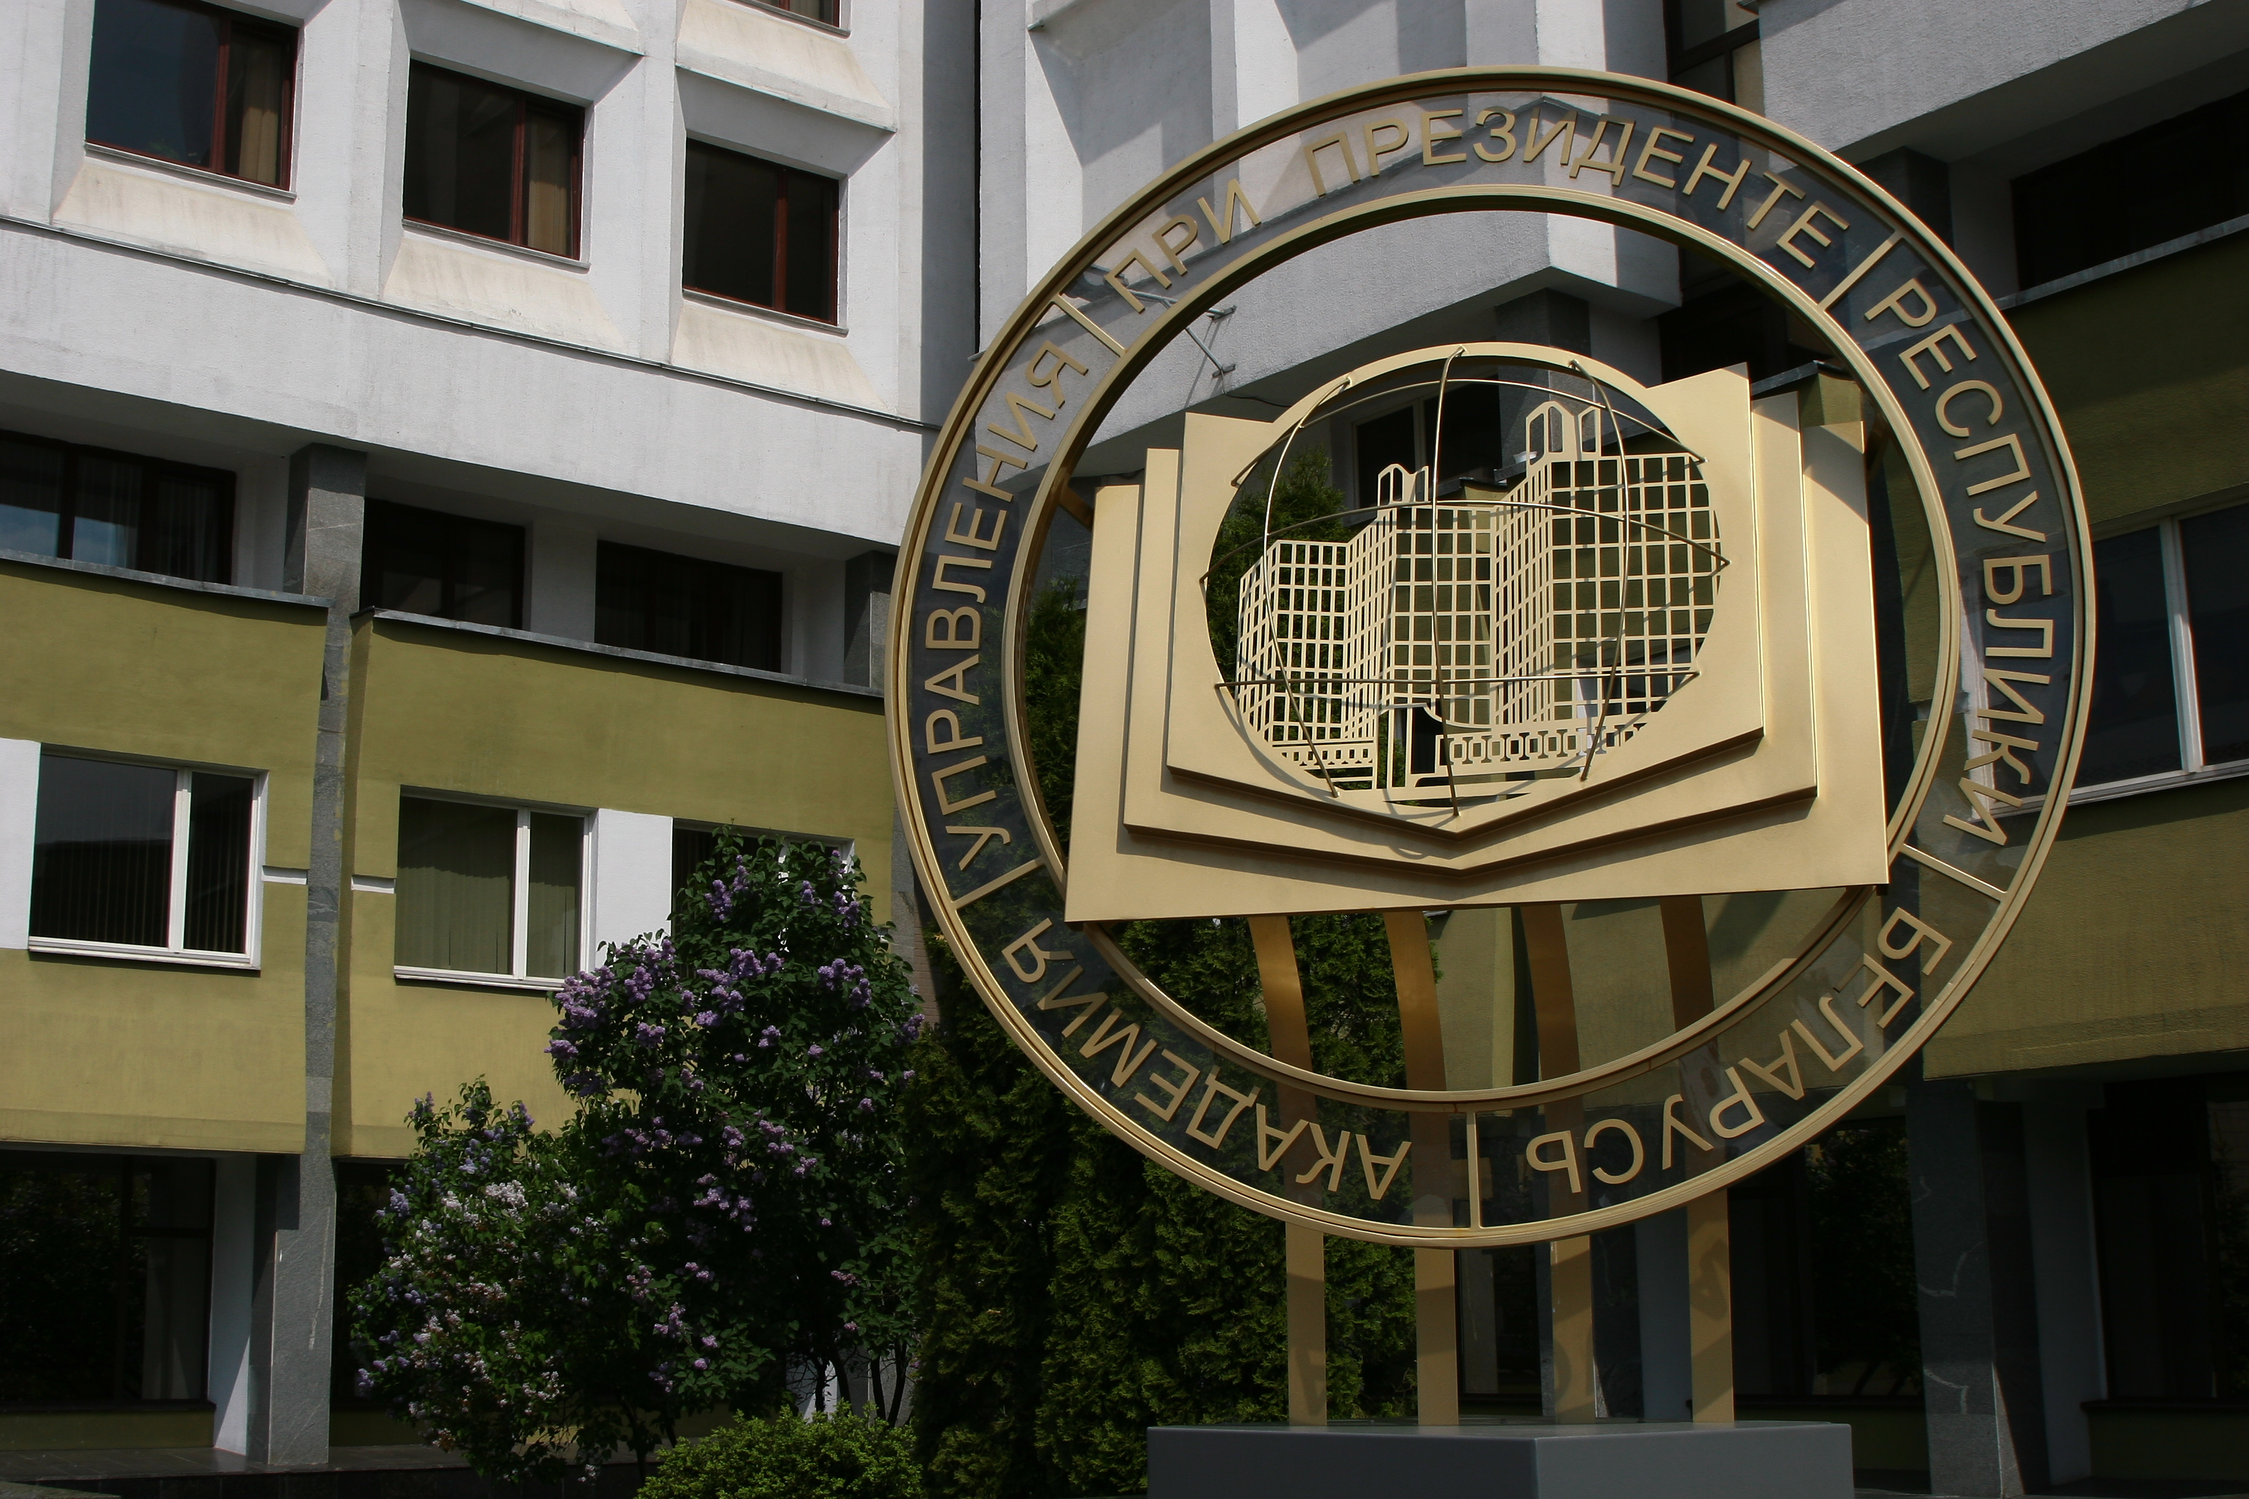
System of Professional Training for Public Administrators in the Republic of Belarus:
Current State and Prospects
October 5, 2018
Astana

Slide 2

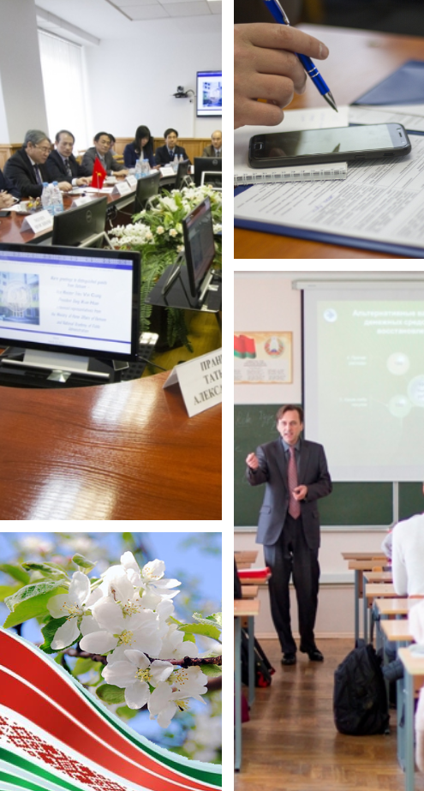
Legal framework regulating activities of civil servants in the Republic of Belarus
General rules that mediate labour relations
The status of top government officials
Specifics of serving in the public office

Slide 3

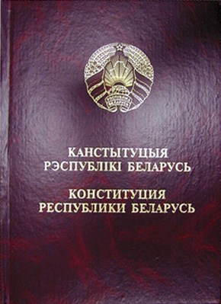
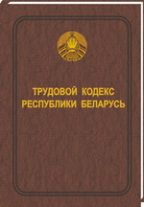

Legal acts defining general rules to mediate labour relations
The Civil Service Law
of the Republic of Belarus
The Constitution of the Republic of Belarus
The Labour Code
of the Republic of Belarus

Slide 4

The Civil Service Law of the Republic of Belarus
anchors ‘career’ model of civil service
applies
the ‘open doors system’
introduces elements
of ‘positional model’ (competitive selection and qualification examinations for entrants to the civil service)

Slide 5
Core legislation defining the status of top government officials
Law «On President of the Republic of Belarus»
Law «On the Council of Ministers of the Republic of Belarus and Public Bodies Reporting to the Council»
Law «On the Status of a Deputy of the Chamber of Representatives, Member of the Council of the Republic of the National Assembly of the Republic of Belarus»
Law «On Judicial System and the Status of Judges in the Republic of Belarus»
Law «On Constitutional Court of the Republic of Belarus»
Law «On the State Control Committee of the Republic of Belarus»

Slide 6
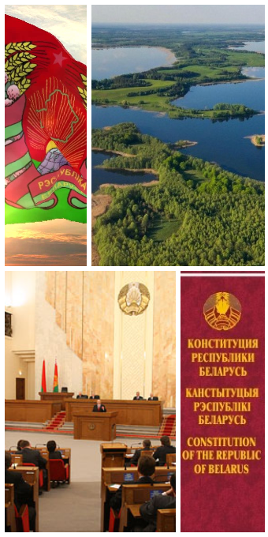
Core legislation defining specifics of serving in the public office
Law «On Local Government and Self-government in the Republic of Belarus»
Law «On Police»
Law «On the Status of Military Men»
Law «On Authorities within the Structure of the State Control Committee»
Law «On Border Forces of the Republic of Belarus»
Law «On Authorities and Units for Emergency Situations in the Republic of Belarus»
Law «On Internal Security Troops of the Ministry of Home Affairs of the Republic of Belarus»

Slide 7
The System of Public Authorities and
Public Administration Bodies in the Republic of Belarus
President of the Republic of Belarus
(Head of State)
Legislative Authorities
Judicial Authorities
The National Assembly
of the Republic of Belarus:
The Council of the Republic
The Chamber of Representatives
Constitutional Court
of the Republic of Belarus
Supreme Court
of the Republic of Belarus
Executive Authorities
The Council of Ministers of the Republic of Belarus, public bodies and organisations reporting to the President of the Republic of Belarus (10)
Public bodies and organisations reporting to the Government
of the Republic of Belarus (39)

Slide 8
Public bodies with a special constitutional legal status
Local government and self-government bodies
Public Prosecutor’s Office of the Republic of Belarus
State Control Committee of the Republic of Belarus
National Bank of the Republic of Belarus
The Central Commission of the Republic of Belarus for Elections and Republican Referenda
Local deputy councils (1309)
Local executive bodies and administrations (1334)

Slide 9
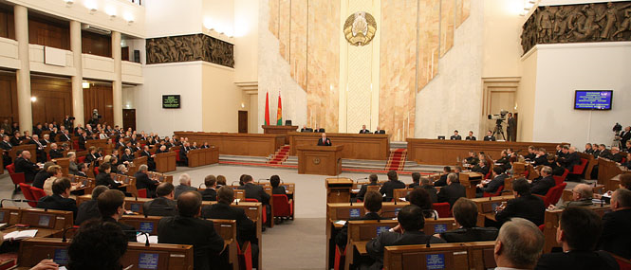
The Number of Civil Servants
in the Republic of Belarus
59 683
59 142
49 326
48 463
37 159
2009
2011
2013
2015
2017

Slide 10
Legal Regulation over Training, Retraining and
In-service Training of Civil Servants
Decree of the President
of the Republic of Belarus
Decree of President
of the Republic of Belarus
Regulation of the Council of Ministers of the Republic of Belarus
«On work with executive personnel within the system of public bodies and other state organisations»
«On certain measures to improve training, retraining and in-service training of personnel in the governance area»
«On certain measures to implement the Decree of the President of the Republic of Belarus
“On work with executive personnel within
the system of public bodies and other state organisations”»

Slide 11

Mission of Academy of Public Administration under the aegis of the President
of the Republic of Belarus
The Academy organises training, retraining, internships and in-service training for acting executive personnel and staff, enlisted in executive personnel pools, in line with the government commission
ACADEMY OF PUBLIC ADMINISTRATION UNDER THE AEGIS OF THE PRESIDENT OF THE REPUBLIC OF BELARUS

Slide 12
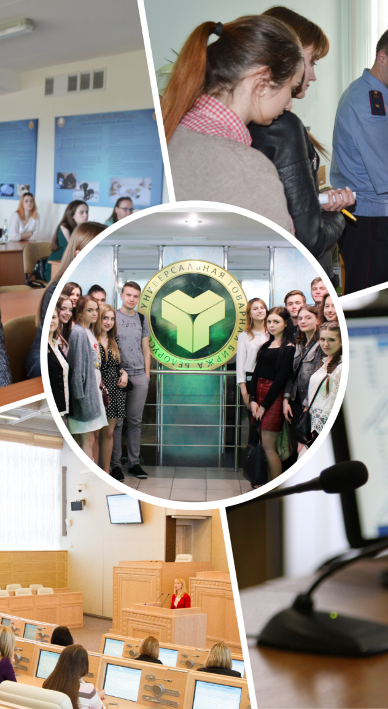
Academy’s Structure
The Institute of Civil Service
The Institute for Managerial Education
Research Institute for Theory and Practice of Public Administration

Slide 13

The Structure of the Research Institute for Theory and Practice of Public Administration
The Centre for Public Administration Studies
Research Centre for Public HR Policies
Centre for Research Methodological Support of the Automated Information System “Reserve”
Centre for Educational Techniques

Slide 14
Major Activities of the Research Institute
Initiates and conducts research in the sphere of public administration, HR policies, ideological work
Takes part in implementing public HR policies in the area of staff capacity building at public bodies and other state organisations
Monitors staff capacity at public bodies and state organisations in cooperation with the Centre for Research Methodological Support o the Automated Information System “Reserve”
Renders Consulting Services on issues of public administration, HR policies, educational technologies

Slide 15




Study Programmes
First Cycle of Higher Education
Second Cycle of Higher Education
Retraining
Additional
adult education
In-service training

Slide 16

Government Commission for Executive Personnel and Staff Enlisted for Managerial Positions
commissioned training
commissioned in-service training
commissioned retraining

Slide 17





Building Student Contingent
Competitive selection for training and retraining courses
Holding entrance examinations
Drawing lists
of candidates for competitive selection to training and retraining courses
Setting rationale
of the government commission for training, retraining and in-service training of executive personnel and staff enlisted for managerial positions
Defining demands
of public bodies and organisations in training, retraining and in-service training

Slide 18
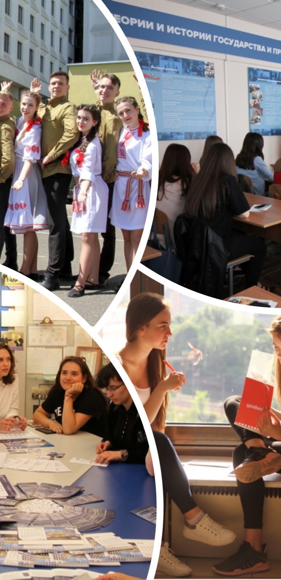
The Institute for Managerial Education
Department for Cross-cultural Communication
Department for Information Resources Management
Department for Physical Education
Department of Civil and Economic Law
Department of Constitutional and Administrative Law
Department for Theory and History of State and Law
Department of Enterprise Economics
Department of Economic Theory

Slide 19
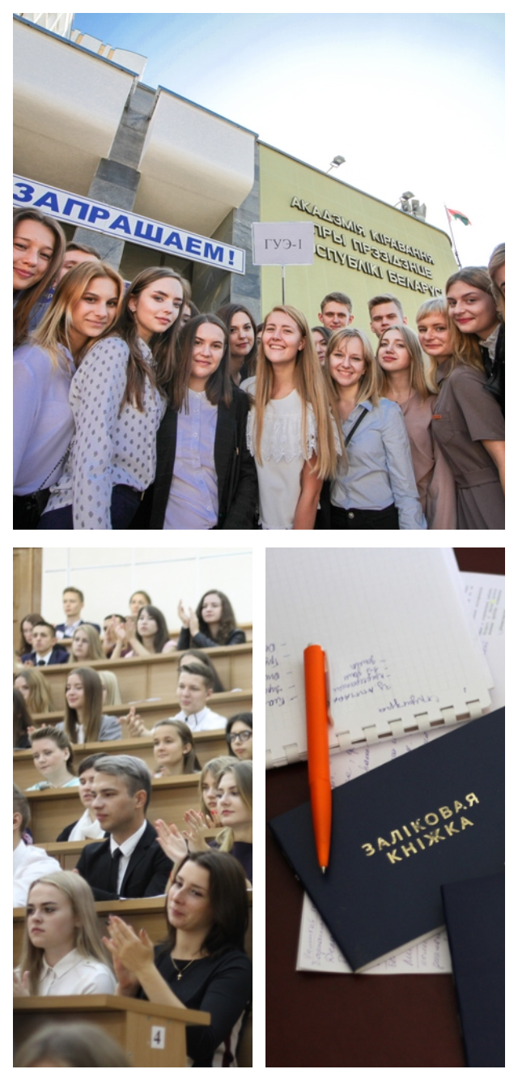
The Institute for Managerial Education
Majors:
Public Administration and Law
Public Administration and Economics
Information Resources Management

Slide 20


Master’s Degree Training
Law
World Economy
Economics and National Economy Management
Governance in Social and Economic Systems
Policy Analysis and Media Political Technologies
Investment Project Management in Public-Private Partnership
Legal Regulation over Management in Social and Economic Systems
e-Government

Slide 21
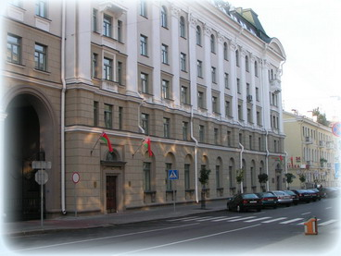
Institute of Civil Service
Department of State Building and Public Administration
Department for Regional Development Management
Department of Philosophy and Ideological Work
Department for Public Administration of the Social Sphere and for Belarusian Studies
Department of Foreign Languages
Department of International Relations
Department of Management Psychology

Slide 22
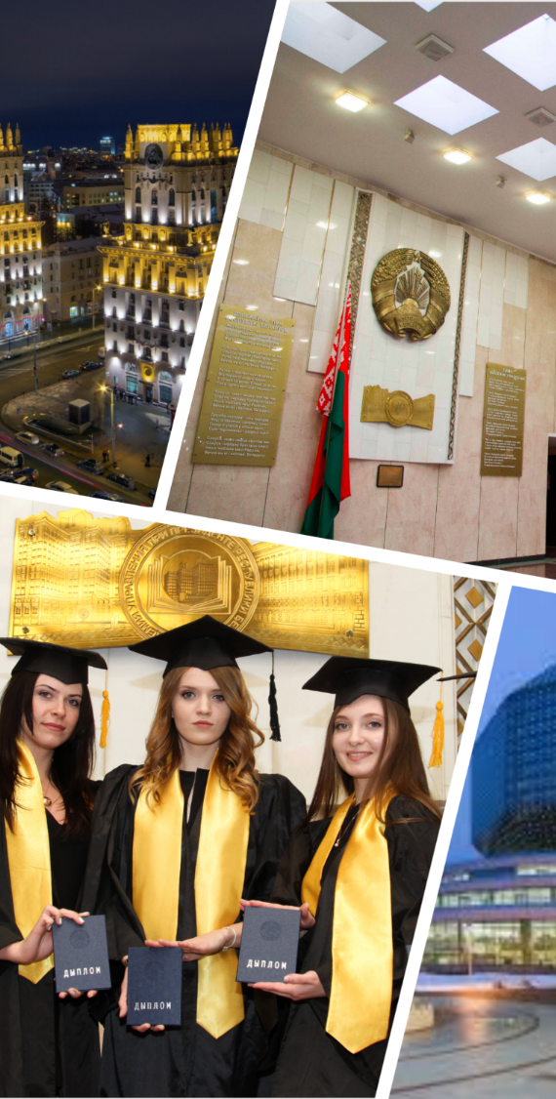
Retraining
Specialist in Public Administration
Specialist in Public Administration. Analyst
Ideologist
Specialist in Ideological Work and Human Resources Management
Specialist in Governance
Specialist in Personnel Management
Specialist in International Relations
Specialist in Anti-crisis Management
Marketing Specialist
Manager-Economist
Economist-Manager
HR Manager
New qualification
800 – 900 students
per year

Slide 23
In-service Training
Public Administration and Local Governance
Management
Personnel Management
Ideology, Law
Short-term courses
4 500 – 5 000
per year

Slide 24

Key Perspectives for Development
Implementation of the Sustainable Development Goals
as the National Trajectory for Civil Servants’ Activities
Implementation of the “e-Government” project as the system for life-long improvement of rendering public services, building responsiveness and citizen engagement in decision-making
The “Civil Servant’s Code” as a complex of effective anti-corruption measures

Slide 25
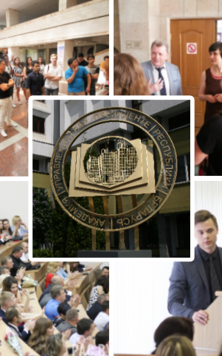
Thank you!
www.pac.by
post@pac.by
palchyk@pac.by

