Slide 1
A JOURNEY THROUGH THE PROGRESS OF INFORMATION TECHNOLOGIES IN GLOBE AND IN LIBRARIES – EXPERIENCE FROM TURKISH UNIVERSITY LIBRARIES…
TAYFUN BASAL
11.06.2015

Slide 2
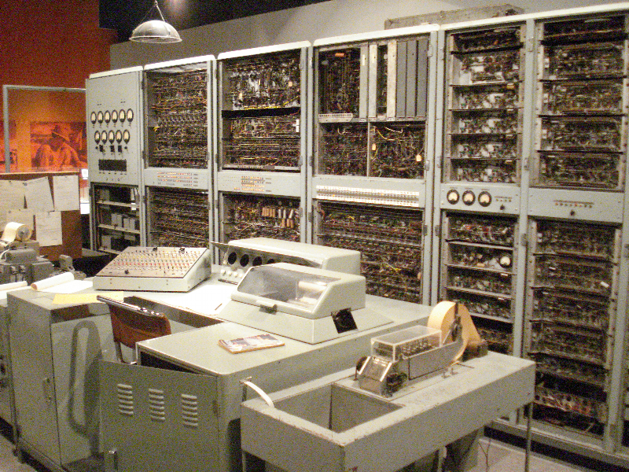
1960’s ..…
Early Mainframe
Notes:
50’s 60’s mainframes

Slide 3
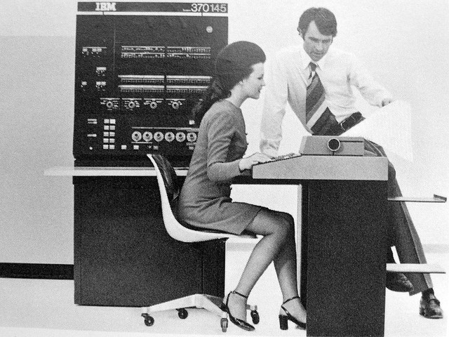
1970’s…
IBM 370 Mini
Notes:
70s mini computers

Slide 4
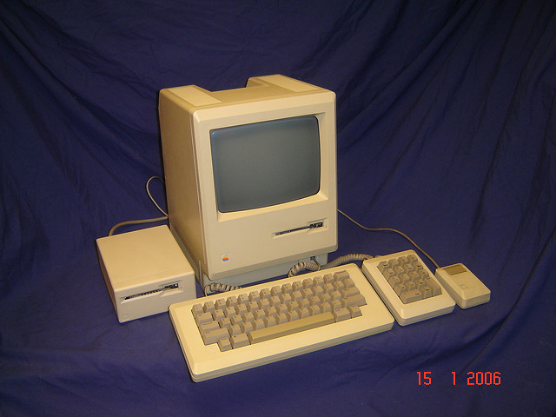
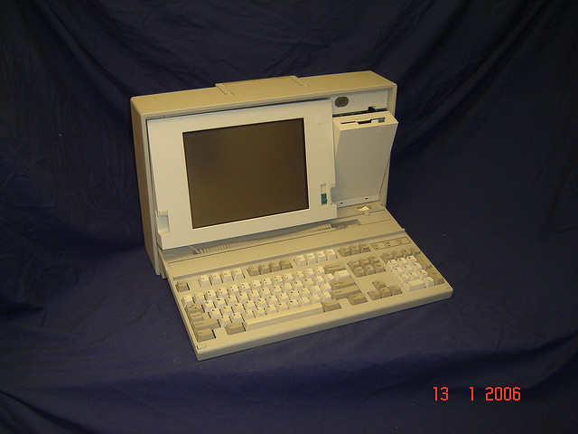
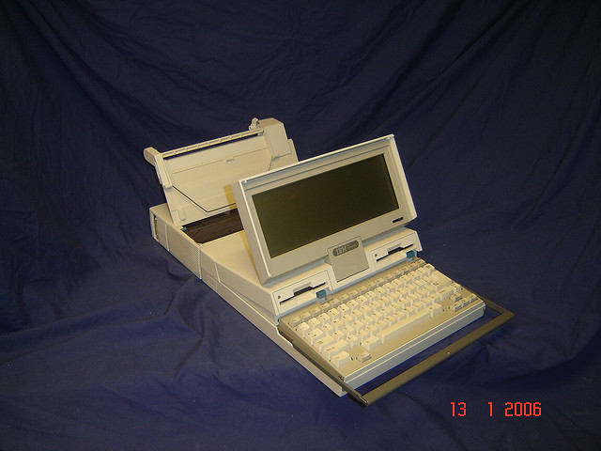
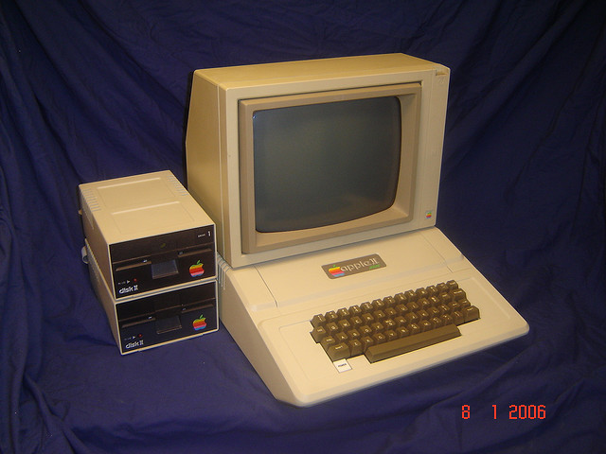
1980’s…
Apple I
IBM PS2
IBM Convertible
Apple II
Notes:
80’s Desktops
Apple II 1977
Apple Iie 1983

Slide 5

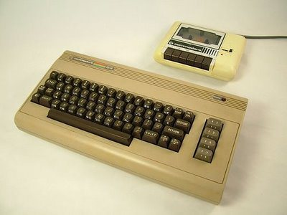
Remember Commodore ?
8 Bits 6510 processor
64 Kb ram
16 Color
64 Kb Memory

Slide 6


1990’s….
Notes:
90’s Desktop & Internet

Slide 7

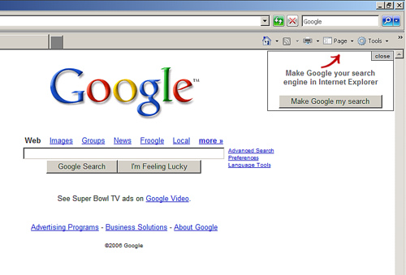

2000’s….
Notes:
2000’s Search Engines & Mobile

Slide 8

Search Engines…

Slide 9








Today’s World…
Notes:
90’s Desktop & Internet

Slide 10
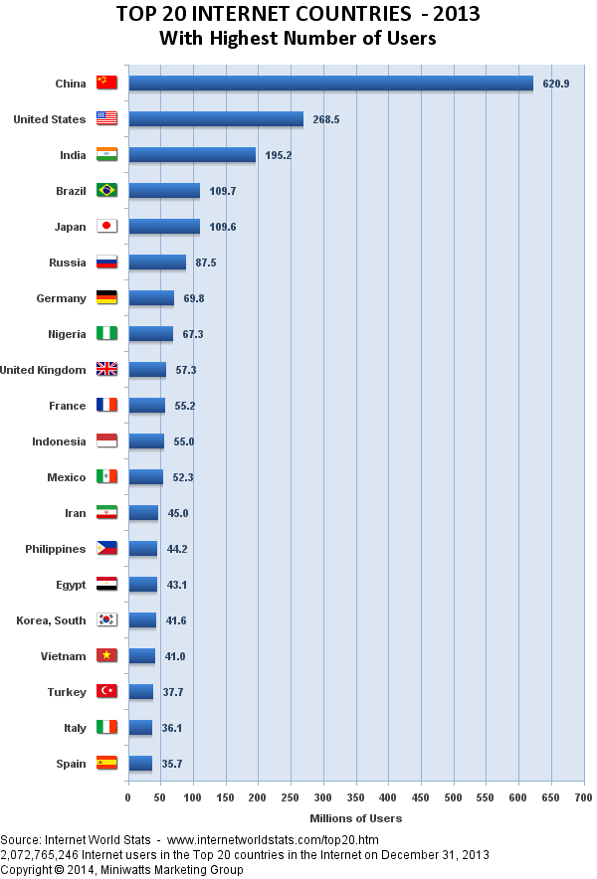

Slide 11
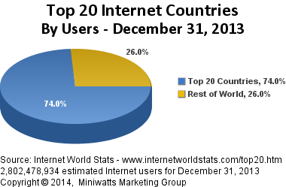

Slide 12
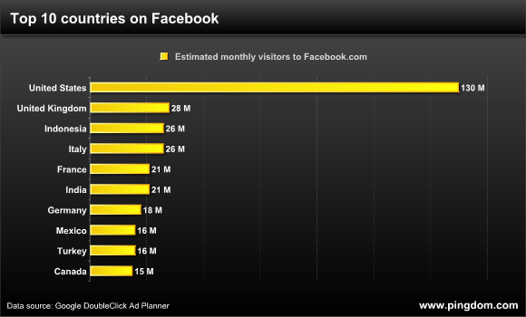

Slide 13

Google Generation…

Slide 14



CHANGE already started..

Slide 15

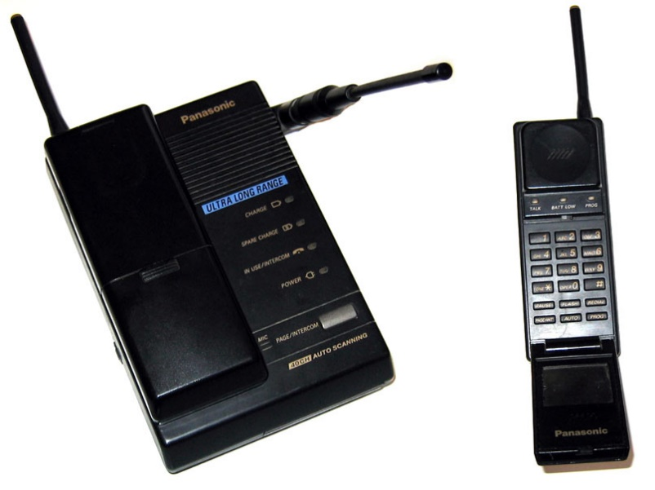
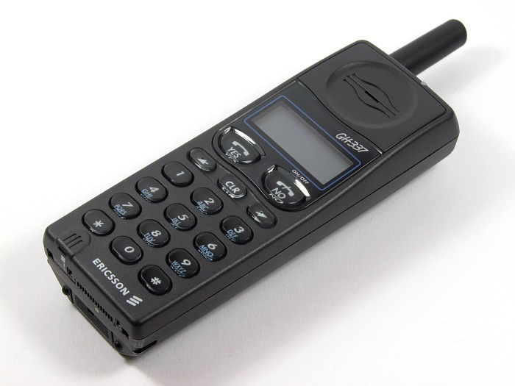
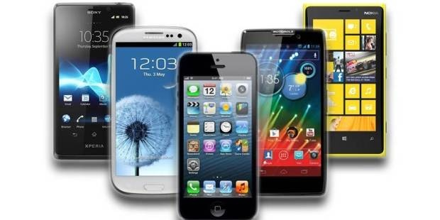
CHANGE already started..

Slide 16
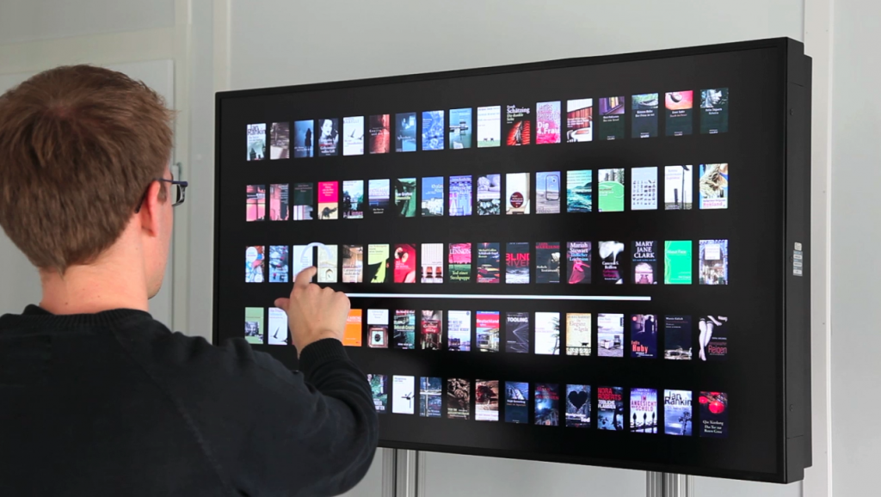
When the CHANGE Started in your LIBRARY?

Slide 17

How Active is your library in social media? Can your users access your library through Facebook?

Slide 18
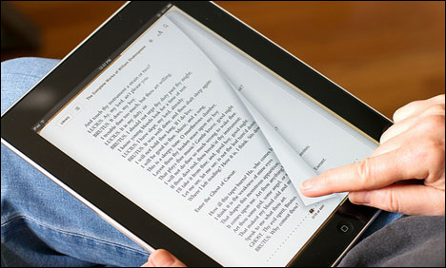
What percentage of your resources are electronic books?

Slide 19

Are you connected with all libraries in the Globe?

Slide 20
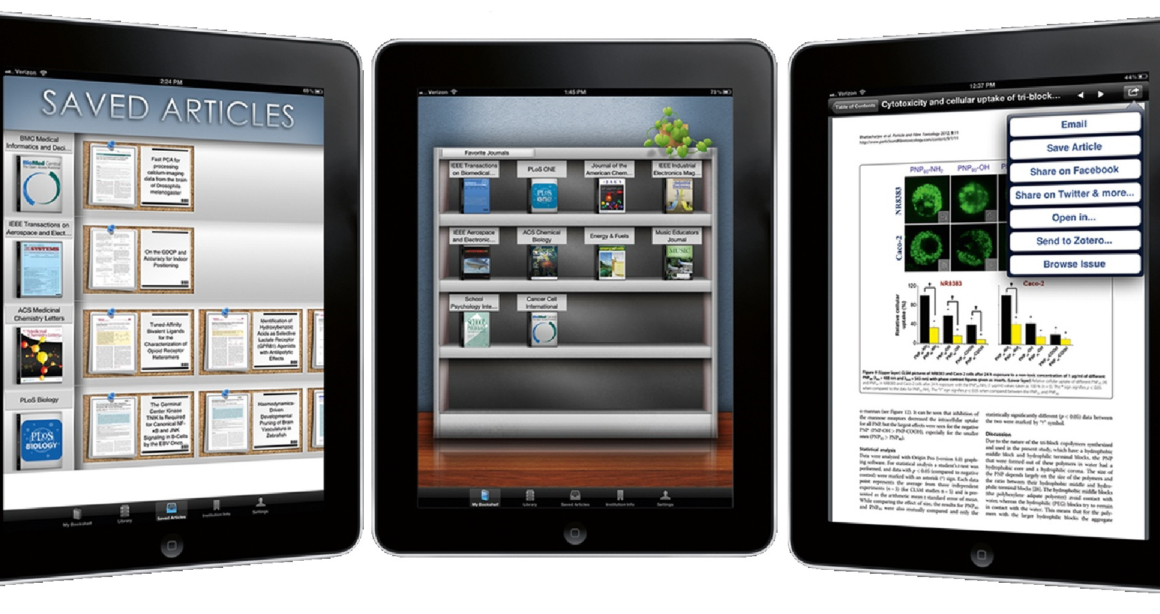
Can your users access your LIBRARY resources via smart devices ?

Slide 21
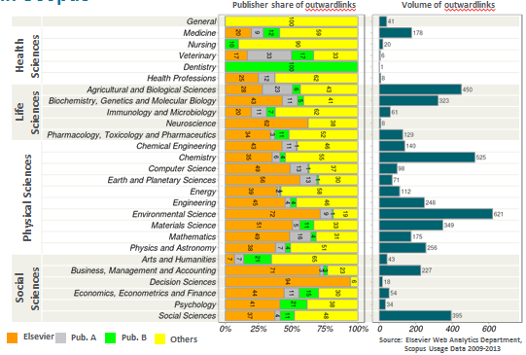
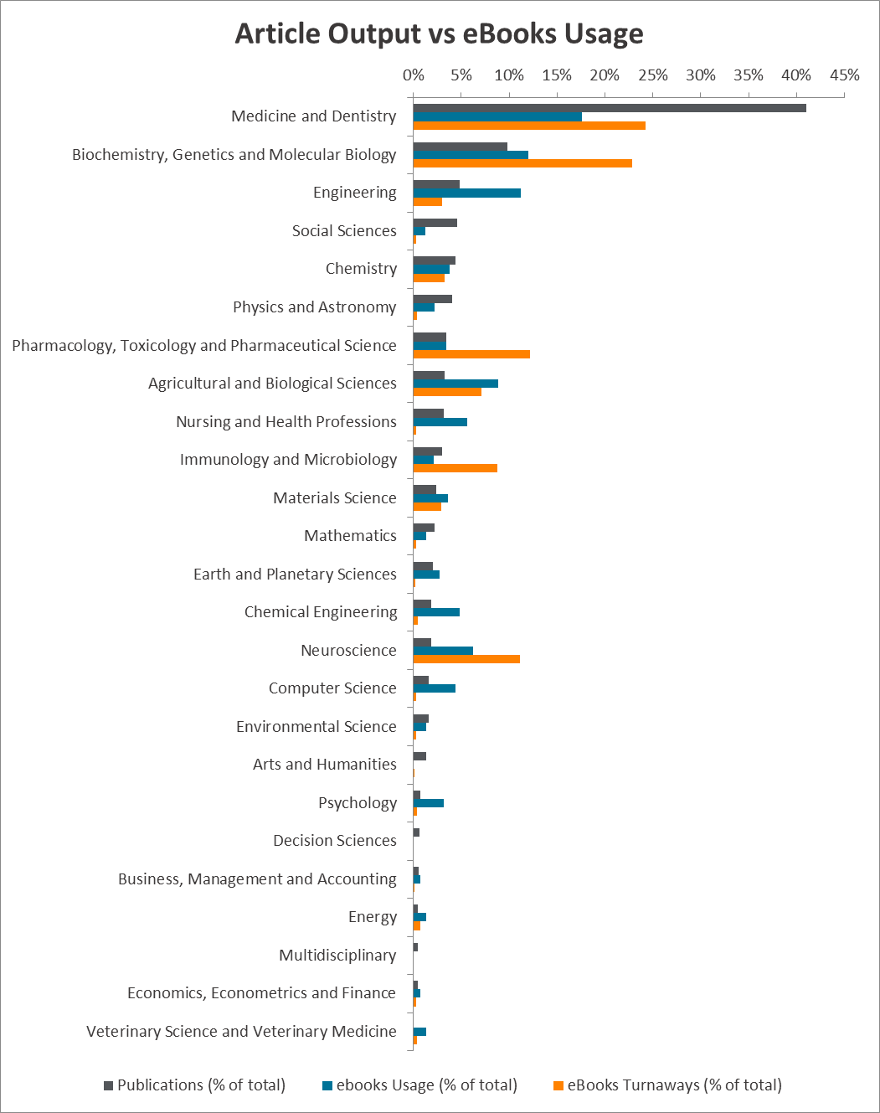
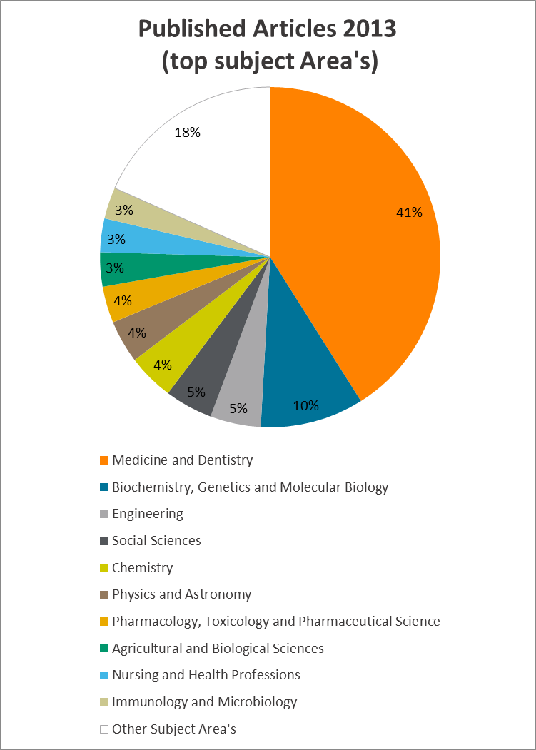
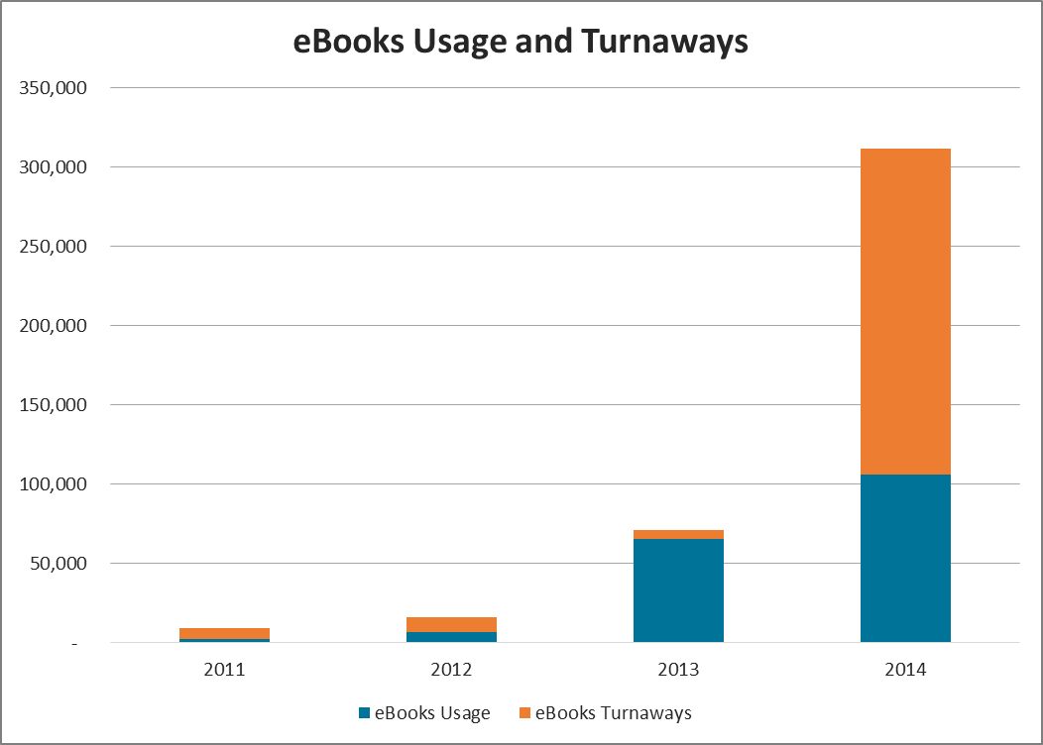
Are you using analysis and reporting tools to calculate the ROI of purchased resources?

Slide 22
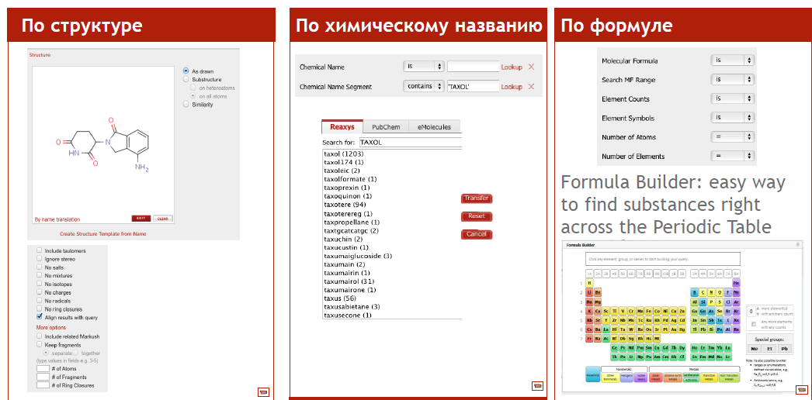
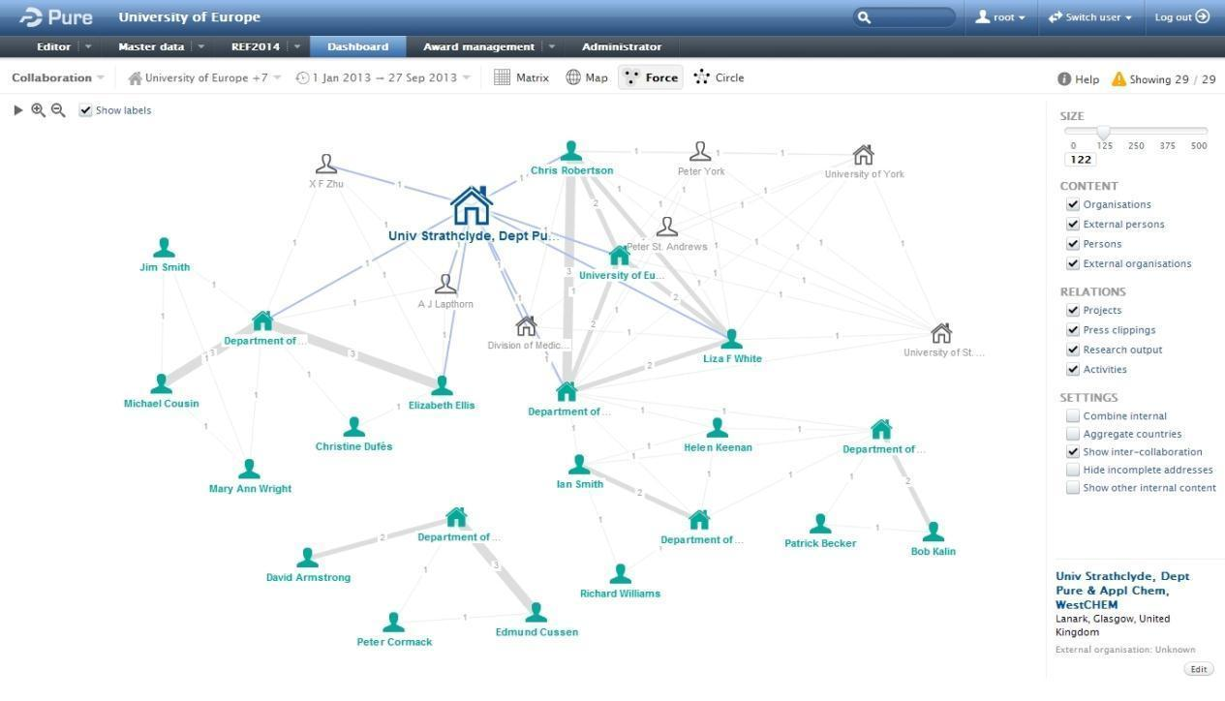
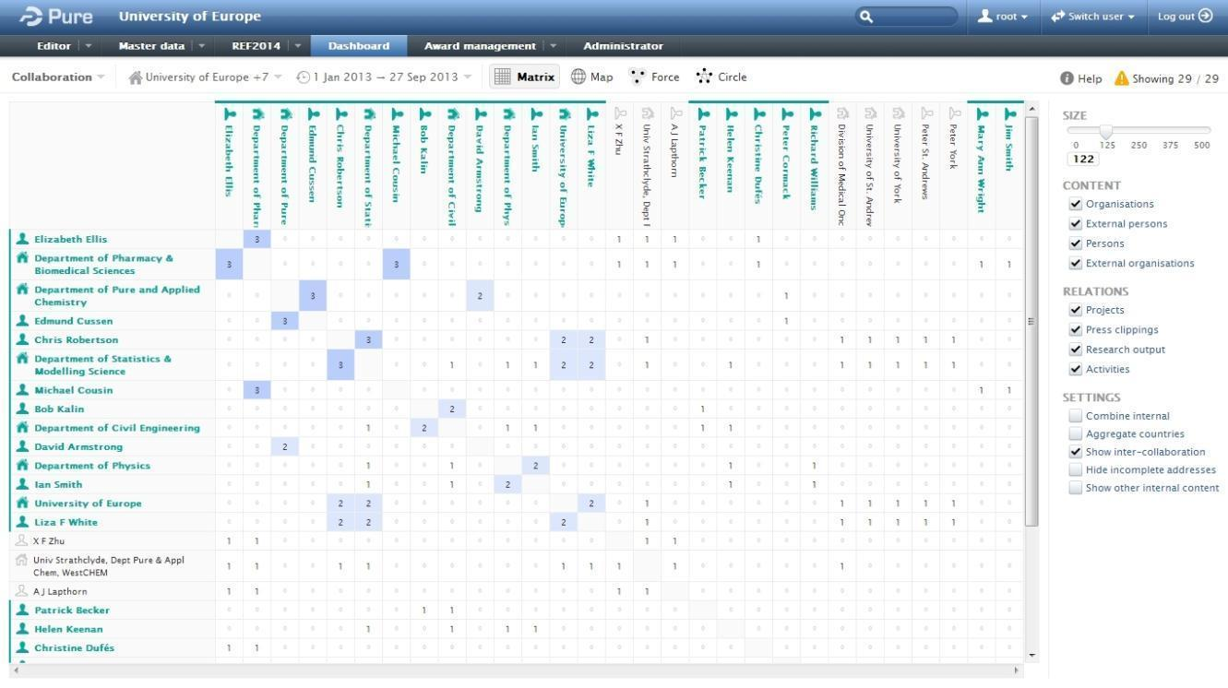
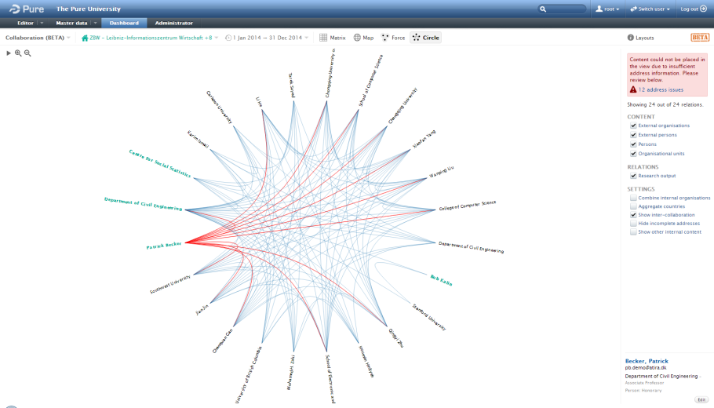
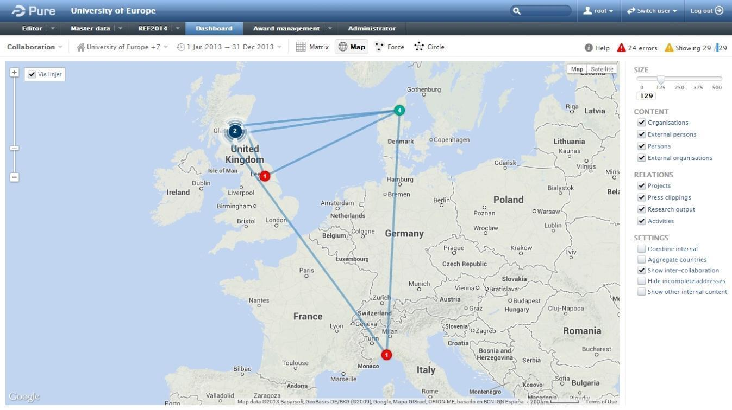
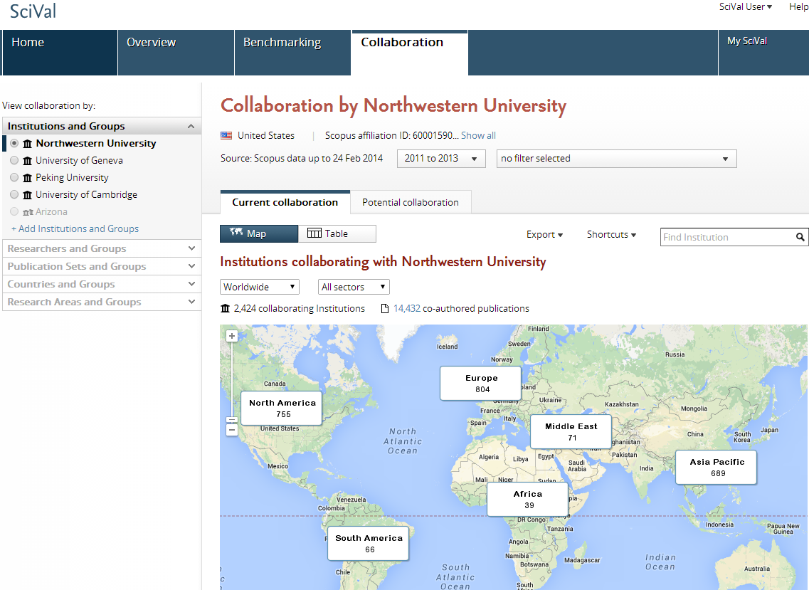
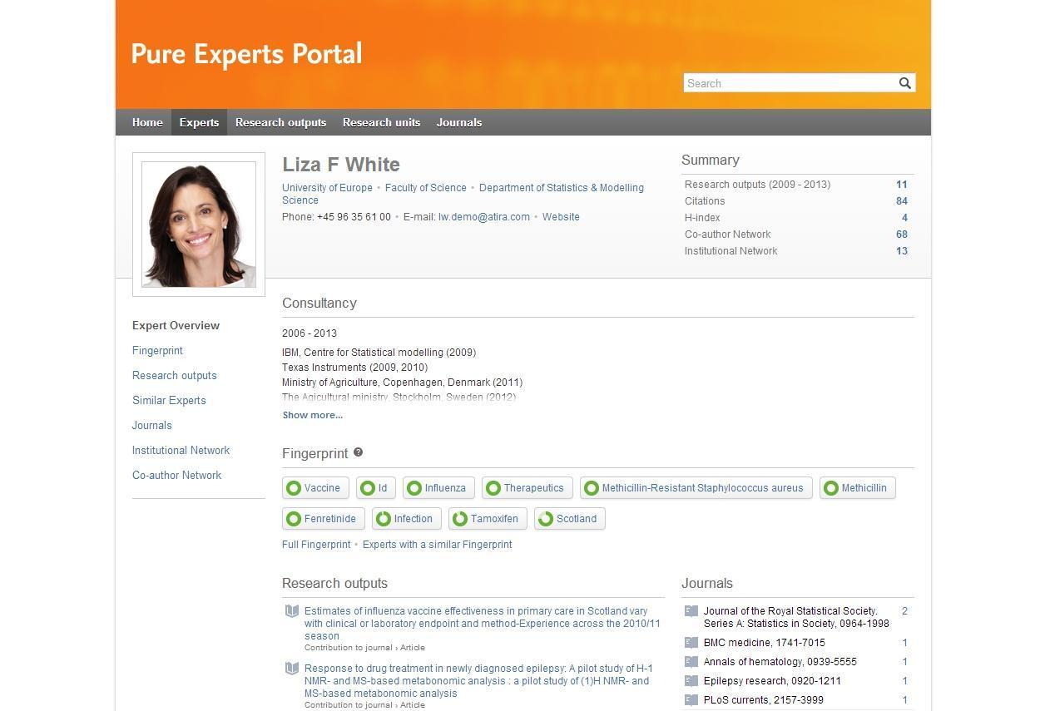
Do you help your researchers to advance their research activities through cutting edge solutions ?

Slide 23
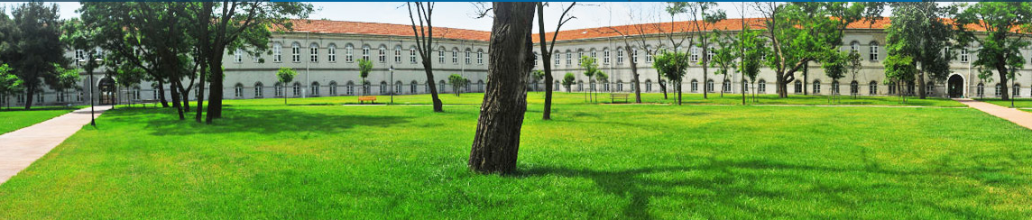
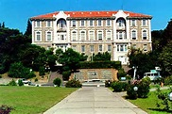
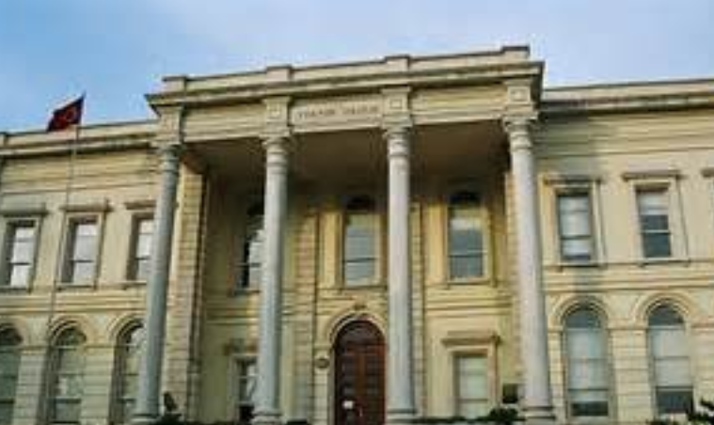
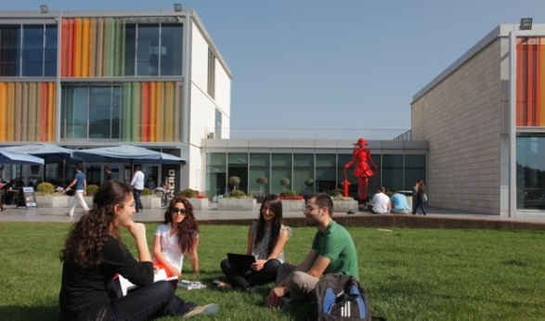
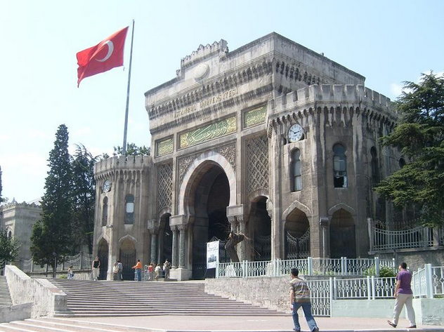

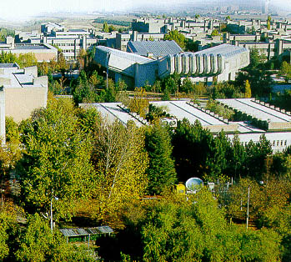
EXPREINCE OF TURKISH UNIVERSITIES

Slide 24



ULAKBIM..
The Turkish Academic Network and Information Centre (ULAKBIM) was founded as a R&D Facility Institute of TÜBİTAK(*) in 1996.
ULAKBIM’s main objectives have been set as operating a high speed computer network enabling interaction within the institutional elements of the national innovation system, and providing information technology support and information services to help scientific production.
ULAKBIM aims at providing technological facilities such as computer networks, information technology support, and information and document delivery services, to meet the information requirements of universities and research institutions, and to increase the efficiency and productivity of their end users.
ULAKBIM consists of National Academic Network (ULAKNET) Unit, which undertakes the task of formation and operation of research and education network infrastructure in Turkey, and Cahit Arf Information Center, which provides information and document supply services nationwide.
ULAKBIM consists of National Academic Network Unit, which undertakes the task of formation of academic network infrastructure in Turkey, and Cahit Arf Information Center, which provides information and document supply services nationwide.

Slide 25
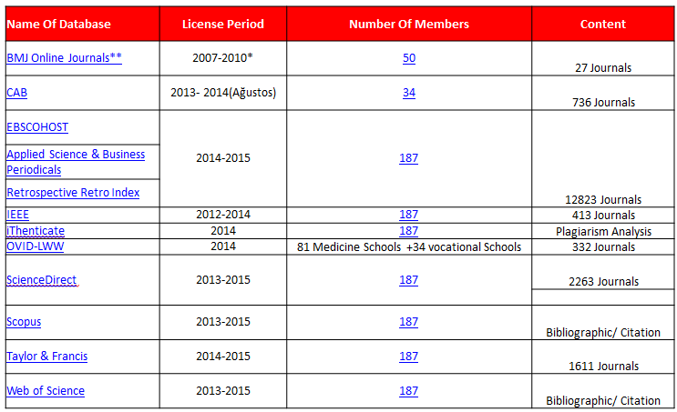
E-Resources Under EKUAL National License

Slide 26
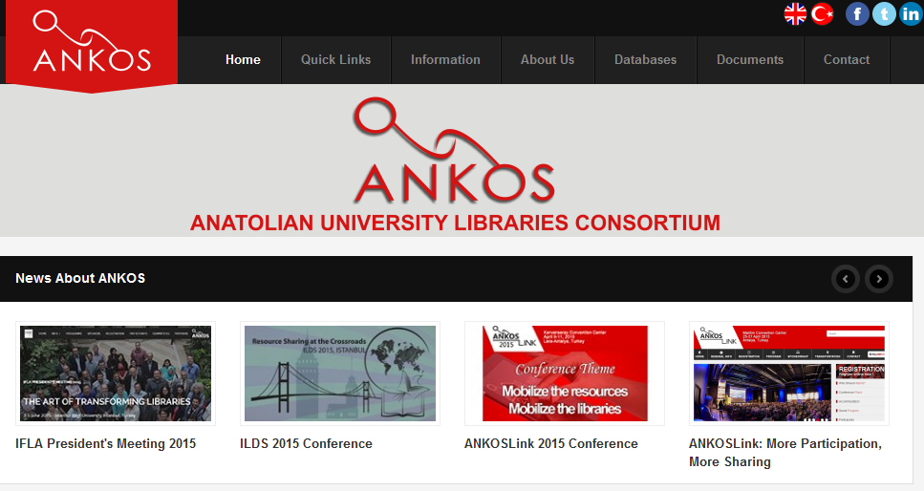

Slide 27
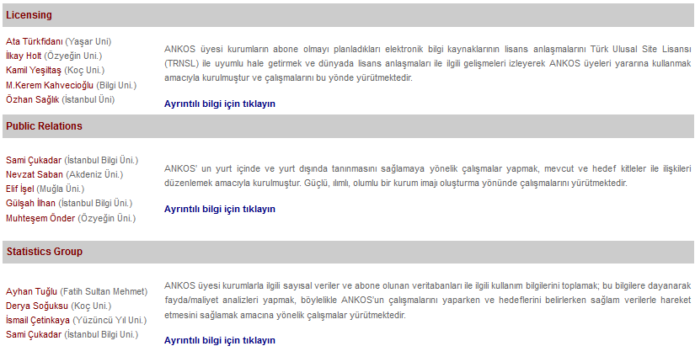
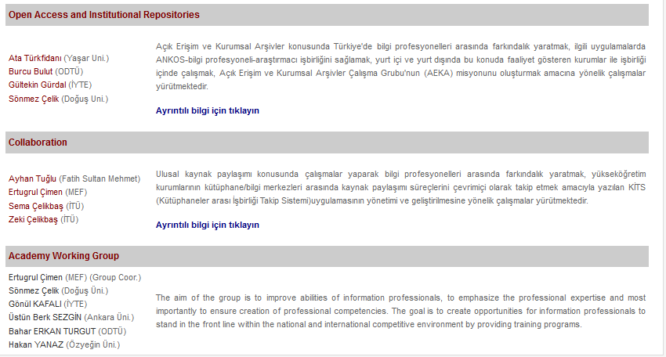
WORK GROUPS IN ANKOS ( HAVE SUBSCRIPTION TO 92 DIFFERENT DATABASES )

Slide 28

JOIN US STARTING CHANGE IN YOUR LIBRARY ?

