Slide 1
Leading Academic Resources from Cambridge University Press
Leszek Czerwinski
Regional Sales Manager for Central and Eastern Europen, Russia and CIS

Slide 2

Publishing at Cambridge
One of the oldest publishers in the world, since 1584
Notes:
Best universities in the world – consistently in the top 5 of THE, the telegraph, Shanghai world rankings

Slide 3
Publishing at Cambridge
It was founded on a royal Letter Patent to the University by Henry VIII in 1534
The first Press book was printed in 1584.
Notes:
Best universities in the world – consistently in the top 5 of THE, the telegraph, Shanghai world rankings

Slide 4
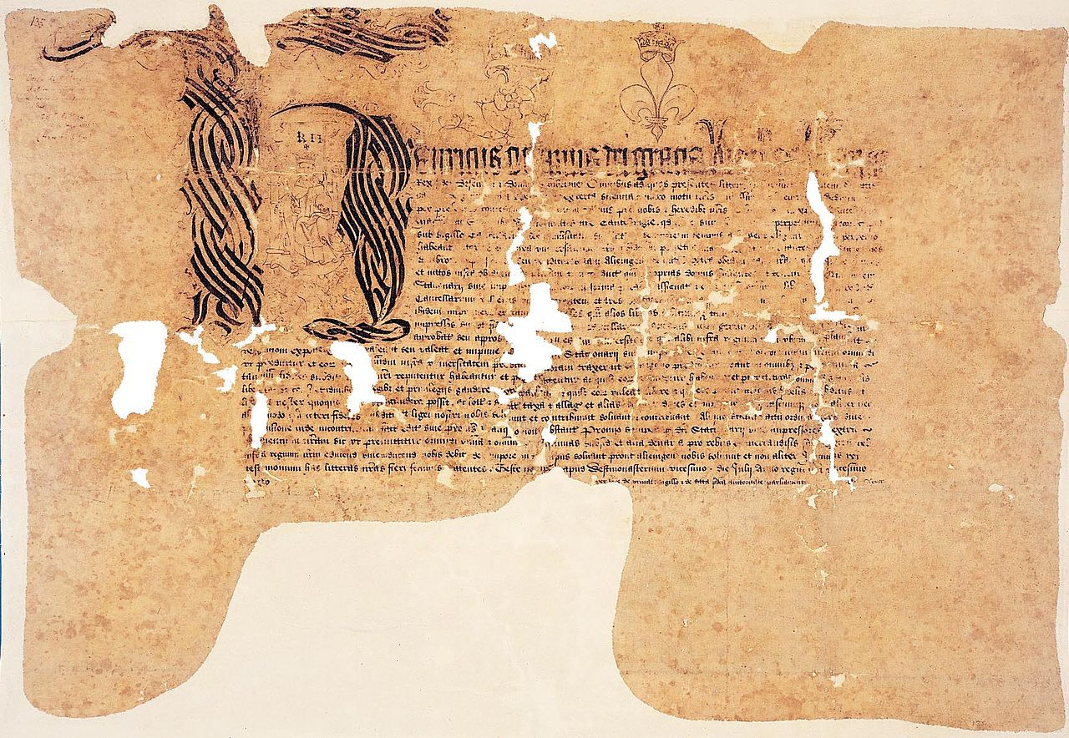
Notes:
Best universities in the world – consistently in the top 5 of THE, the telegraph, Shanghai world rankings

Slide 5
Publishing at Cambridge
One of the largest academic and educational publishers in the world
Publishing over 1,500 books a year and 390 journals
Notes:
Best universities in the world – consistently in the top 5 of THE, the telegraph, Shanghai world rankings

Slide 6
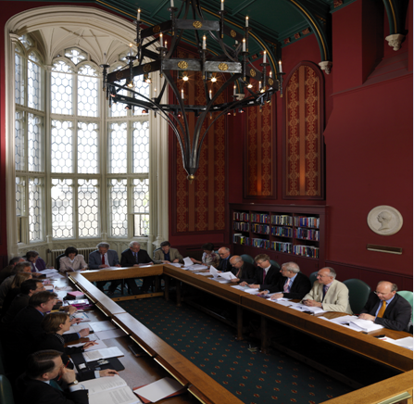
The University Press Syndicate: a committee of senior academics who must approve all offers of publication
Every single title undergoes a rigorous quality-control process
Notes:
Jack
Every single book has to pass through both a process of internal and external review culminating in the University Press syndicate meeting before a contract is offered to the author.
Press Syndicate: committee of senior academics from the university of Cambridge.
The most rigorous peer-review process of any publisher
End result: our quality is pretty awesome
Academic publishers provide vitally important services of peer review and quality control which makes their publications authoritative and trust-worthy

Slide 7
Subjects and Strengths of Cambridge Journals and Books

Slide 8
Multi-disciplinary Publisher
STM (Sciences, Technology, Medicine)
Agriculture
Animal Science
Aquatic Science
Biology
Biomedical Science
Computer Science
Earth & Atmospheric Science
Ecology & Conservation
Engineering
Mathematics
Materials Research
Medical Policy
Neuroscience
Nutrition
Physical Science
Psychology & Psychiatry
HSS (Humanities & Social Sciences)
African Studies
American Studies
Archaeology & Anthropology
Architecture
Asian Studies
Business Studies
Classical Studies
Cultural Studies
Economics
History
Law
Language & Linguistics
Literary Studies
Philosophy
Politics & International Relations
Religious Studies
Social Studies

Slide 9
Cambridge Journals-Basic Info
Medium-sized journal publisher, 390 journals
• 57% HSS/ 43% STM by no. of titles
• 45% HSS/ 55% STM by no. of volumes
• 60% proprietor/40% owned
• 16 journals rank top 5; 21 top 10 journals
• All our journals are published online via our own platform, Cambridge Core.

Slide 10
2016 Journal Citation Reports® (JCR)
Impact Factors (IF) across all Cambridge journals increased by an average of 18.4 (16.9% last year).
5 titles are number 1 in their categories (4 last year):
  Behavioral and Brain Sciences
  International Organization,
  Acta Numerica,
  Theory and Practice of Logic Programming
  World Politics

Slide 11
2016 Journal Citation Reports® (JCR)
16 Cambridge journals sit within the top 5 journals in their categories.
32 journals within the top 10 of their categories,
2 journals received IF for the first time

Slide 12
Journal Collection available in Kazachstan:
Full Collection = 390 titles
STM Collection = 166 titles
HSS Collection = 255 titles
Medical/Vet Collection = 74 titles
Perpetual access rights to all content published in year of purchase
Substantial shallow archive content available

Slide 13
Cambridge Core ebooks
Over 34,000 titles now available

Slide 14
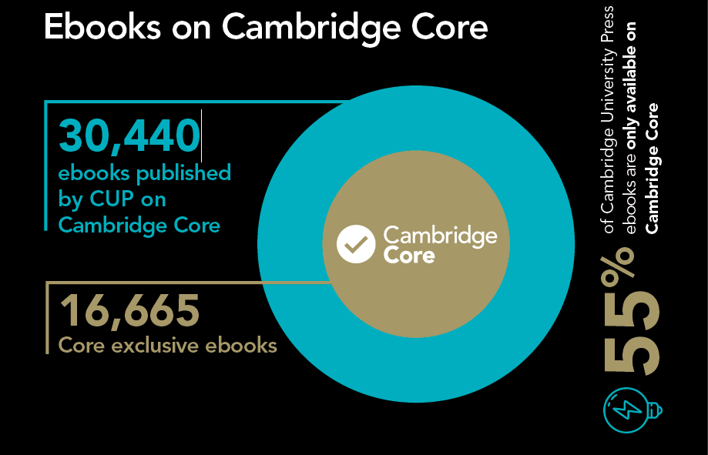

Slide 15
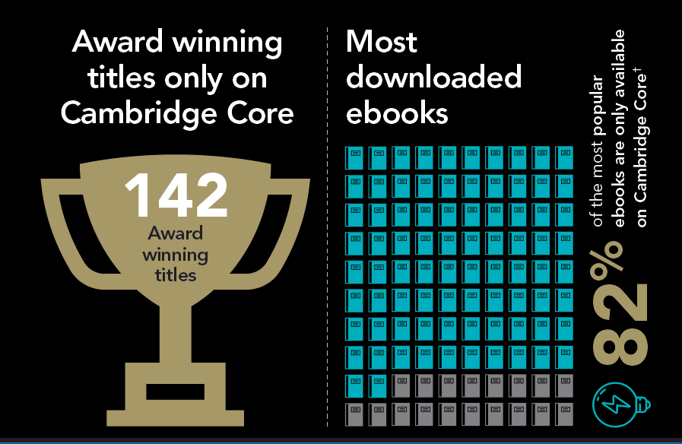
Core exclusive infographic

Slide 16
Ebooks
Pick and Choose (minimum of 5 titles on first order) Price list on the Core website
Discounted Collections
  Essential Ebooks
Evidence Based Acquisition

Slide 17
Evidence Based Acquisition

Slide 18
What is Evidence Based Acquisition (EBA)?
Institutions are given access to an extensive online collection of Cambridge and partner press ebooks, before they make decisions about which titles to buy access to in perpetuity at the end of the subscription period.

Slide 19
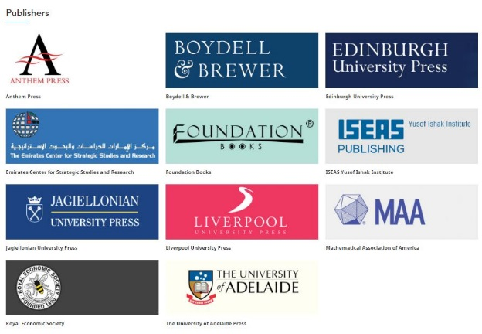




Notes:
There are over 33,000 ebook titles to choose from currently on Cambridge Core. We have our own ebooks as well as partner press titles, and then our key databases are also available via EBA.

Slide 20






How does EBA work?
Notes:
We will talk through the stages of implementing an EBA

Slide 21
Payment
Upfront payment – no extra fees
Flexible pricing based on
  book collection size
  length of access
Notes:
No extra fees. Libraries do not pay for the subscription access. All funds deposited are spent on the titles the library purchase in perpetuity at the end of the EBA.
So there is no cost for items you use but do not go on to purchase later in perpetuity.
No set up fee.
Generally people tend to go for 12 months as it’s most useful for them. But you can do 6 months etc.

Slide 22
Access
Access can be granted any time after payment
6 or 12 month duration
FREE full MARC Records provided
DRM free, unlimited concurrency
Newly published titles added monthly
34000+ online titles available
Notes:
WE DON’T RUSH YOU - YOU COULD PAY IN JULY AND START ACCESS IN SEPTEMBER
Unlike some other EBA deals, with CUP you do get access to newly published titles added to your monthly access.
Customers have fed back to us that this has been useful for discoverability as students are drawn to the newly added content.
Over 1000 titles are added each year.

Slide 23

Statistics
Usage statistics provided at any time
Final statistics provided at end
Detailed data
Notes:
We don’t suddenly cut your access during decision making month - Usage stats avail at any time. We usually send these monthly.
Cambridge Core provides a report for you but we can provide additional information for you.
Detailed data
Year of publication
Subject
Usage patterns
Percentage of list used i.e. 30%
Series i.e. how many books in a series you currently have and then purchase any holes.

Slide 24
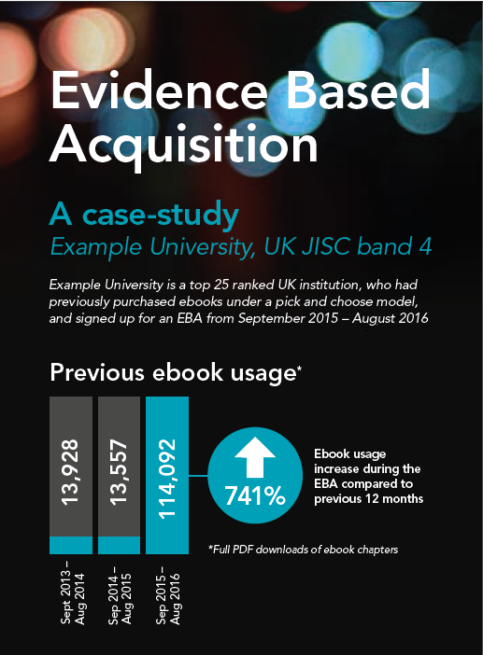
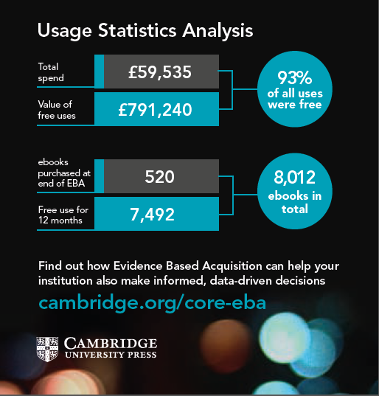
Visualising data
Notes:
We can provide very detailed analytics at the end of the EBA such as this that we did for a UK institution.

Slide 25

Decision making
Choose books with your prepayment
Access is maintained while choices are made
You are in control!
  Statistics provided
  also other criteria:
      reading lists
      current stock
      course knowledge
      Publication date
Notes:
NO ADDITIONAL FEE FOR HIGH USAGE
YOUR ORIGINAL FEE IS WHAT YOU PAY FOR YOUR EBA
IF YOU GET HIGH USAGE, GOOD FOR YOU!
You do not have to purchase the most downloaded titles. It’s completely up to the library which titles they choose to purchase at the end.
REMEMBER: IT’s NOT AUTOMATED PURCHASE after x amount of downloads (LIKE PDA)

Slide 26

Ownership
Perpetual ownership to chosen titles
Notes:
Once you’ve chosen the titles you want to keep at the end of the EBA, they are yours perpetually!
Usual hosting fees of 500 USD apply, but are waived, even if only one additional ebook is purchased each year.

Slide 27




EBA Resource bank
cambridge.org/EBAresources
Notes:
Marketing materials available from CUP if your library takes an EBA with us
These are banners for the library website.

Slide 28
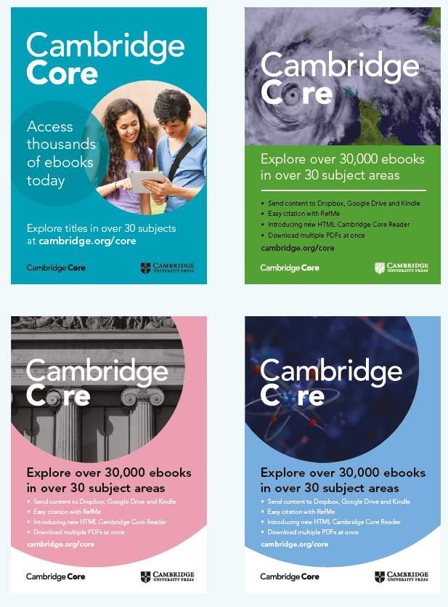
EBA Resource bank
cambridge.org/EBAresources
Notes:
We can also provide posters for your library to make researchers aware of the content available

Slide 29
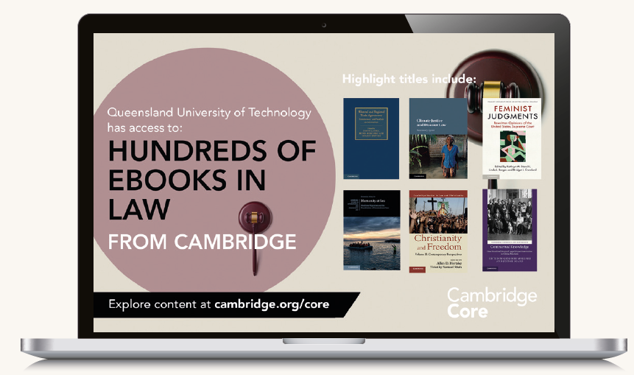
Customised desktop screens
Notes:
Australia example- different requirements for different territories

Slide 30
Visualising data
Notes:
We can provide very detailed analytics at the end of the EBA such as this that we did for a UK institution.

Slide 31
What are the benefits to your library? .
Notes:
What are the benefits?

Slide 32
Any time start
Allows the library to maintain control of the library collection
DRM free, unlimited concurrency content
“Free browses” – the EBA will give users use of titles that the library do not end up buying = free content
Ability to justify purchases, library will be purchasing with usage report information

Slide 33
Don’t have to purchase highest used titles if not required or relevant
Bespoke EBAs, we can tailor the content to your needs
No penalties for high usage
Access to over 33,000 ebooks including front list

Slide 34
Thank you!
Leszek Czerwinski
lczerwinski@Cambridge.org
Questions?

