Slide 1




Official or Original: Implementing Resource Description and Access (RDA) in Academic Libraries after the 3R Project
Eurasian Academic Libraries Conference – 2021
“Contemporary Trends in Information Organization in the Academic Library Environment”
June 29-30, 2021
Mark Anthony Santos
Assistant Professor
University of the Philippines School of Library and Information Studies
Quezon City, Philippines
masantos@up.edu.ph

Slide 2
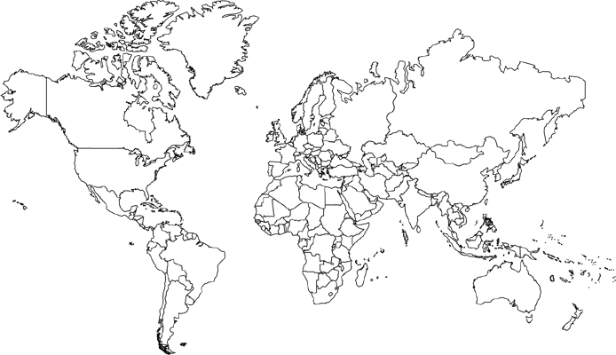
RDA Use and Implementation
https://www.worldatlas.com/aatlas/newart/wrldnanb.gif

Slide 3
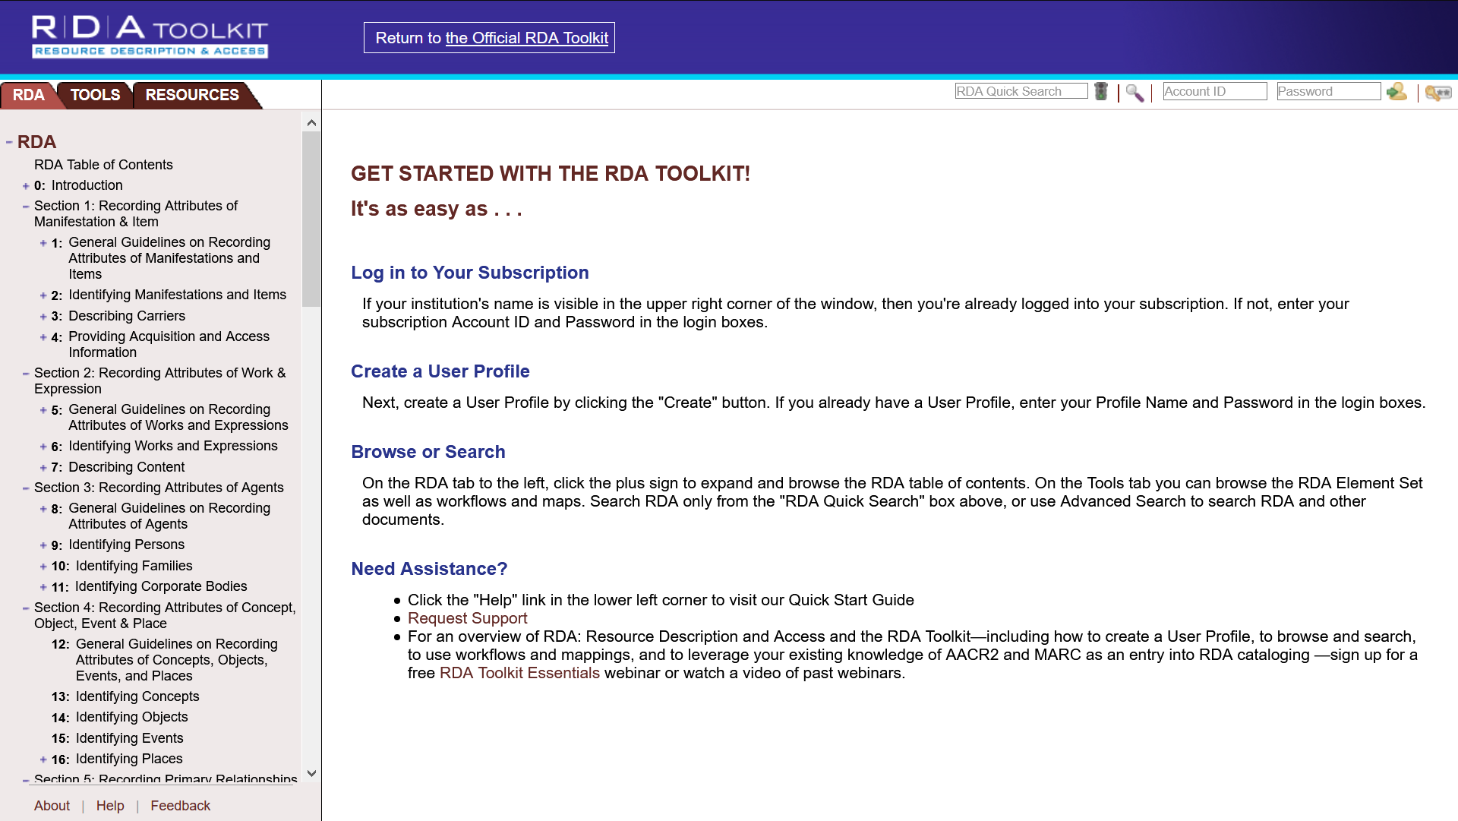
The Original RDA Toolkit
https://original.rdatoolkit.org

Slide 4
3R Project
RDA Restructure and Redesign Project

Slide 5
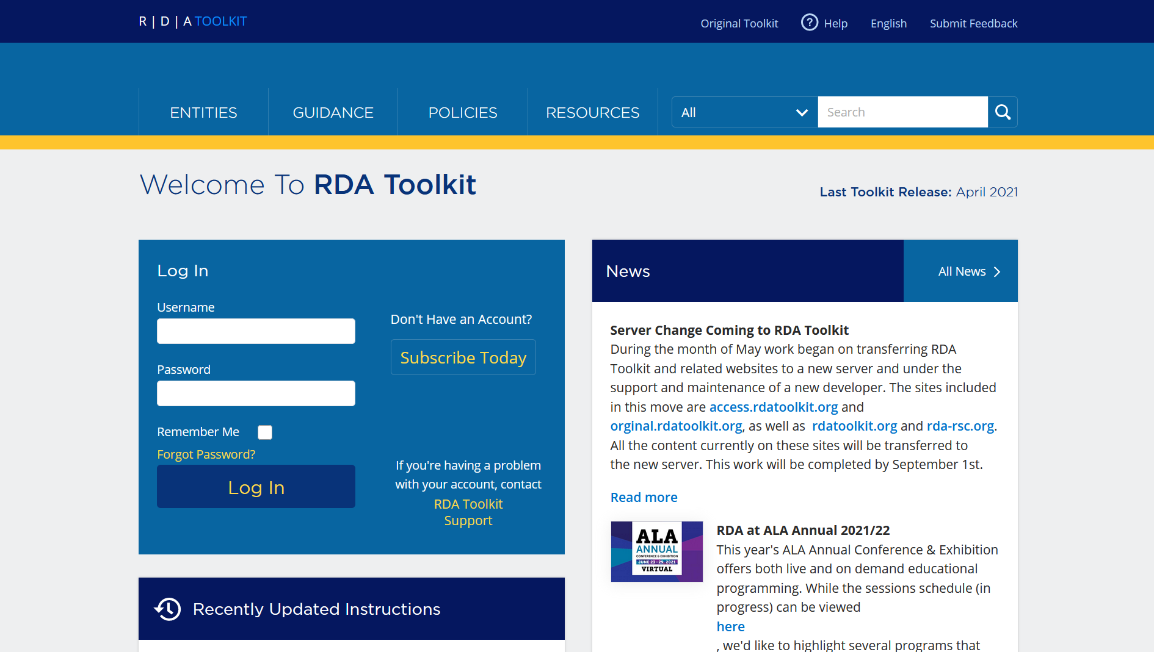
The Official RDA Toolkit
https://access.rdatoolkit.org

Slide 6
Transitioning to the Official RDA
No immediate implementation is expected
Learn from past RDA implementation experiences
Start familiarizing with the new official RDA (including IFLA LRM)

Slide 7
References
6 tips for teaching the new RDA Toolkit. (2021, March 24). Retrieved from https://www.rdatoolkit.org/node/243
About RDA. (2020). Retrieved from http://rda-rsc.org/content/about-rda
Hennelly, J. (2016, September 23). Is RDA a global standard? Usage, translation, and governance as indicators. American Libraries. Retrieved from https://americanlibrariesmagazine.org/2016/09/23/rda-global-standard/
Perez-Lizano, E. (2016). Implementing resource, description, and access in a time of change in the small academic library. Technical Services Quarterly, 33(4), 353–370. doi:10.1080/07317131.2016.1203640
Purpose statement. (n.d.). Retrieved from https://www.rdatoolkit.org/sites/default/files/2019-11/Purpose%20Statement.pdf
RDA Toolkit switchover: Beta toolkit becomes official RDA. (2020). Retrieved from http://www.rda-rsc.org/sites/all/files/RSC-Papers-2020-1.pdf
What is RDA? (n.d.). Retrieved from https://www.rdatoolkit.org/sites/default/files/2019-11/What%20is%20RDA.pdf
What you should know about the December switchover. (2020 November 18). Retrieved from https://www.rdatoolkit.org/index.php/node/230

Slide 8





THANK YOU FOR LISTENING!
Eurasian Academic Libraries Conference – 2021
“Contemporary Trends in Information Organization in the Academic Library Environment”
June 29-30, 2021
Mark Anthony Santos
Assistant Professor
University of the Philippines School of Library and Information Studies
Quezon City, Philippines
masantos@up.edu.ph

