Slide 1

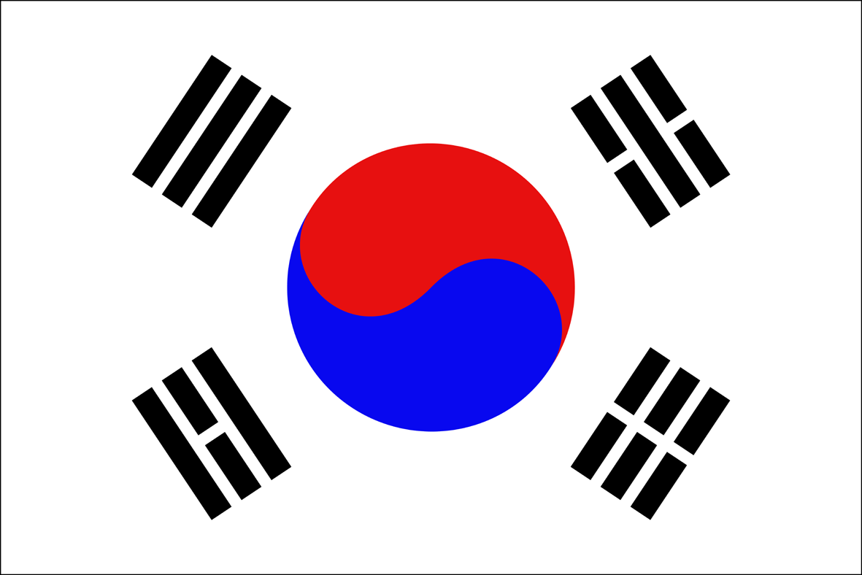
Korean Foreign Policy
&
Korea-Kazakhstan Relations
Prof. Jaechun Kim
Sogang University

Slide 2
Major Contents of the Lecture
Strategic Environment of Korea
Strategic Challenges of Korea
Foreign Policy Response of Park Geun-Hye Government
Geopolitics of Central Asia and Kazakhstan
Policy Response of Kazakhstan
Foreign Policy Cooperation of Korea and Kazakhstan

Slide 3
Strategic Environment of Korea
Status of South Korea as Middle Power
  Hard-Power: 11th Economic Power and 8th Military Power in the World in 2013
Now Korea’s Soft-Power is also Growing…
  Culture, Charm, Attraction, etc.

Slide 4
Korea’s Foreign Policy in Early Days
  Increase Hard-Power (Military and Economic Power)!
  Maintain Proactive Bilateral Relations with Key Countries in the Region!
  Korea’s Foreign Policy Now
    Cultivate Soft-Power as well as Hard-Power!

Slide 5
    Strengthen Multilateral Foreign Policy as well as Bilateral Foreign Policy!
      Participation in UN, World Bank, ASEAN+3, APEC, ARF, CICA, etc.
      Seeking Global Partnership with Like-Minded Countries

Slide 6
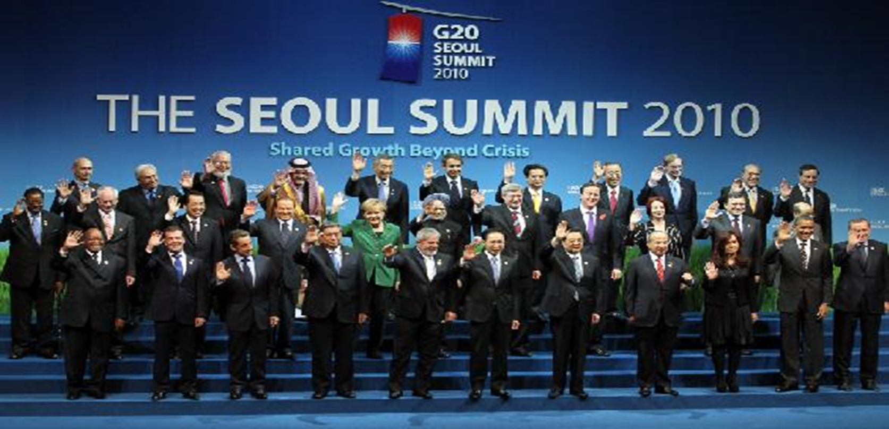
      Hosting G20 Summit Meeting (2010)

Slide 7
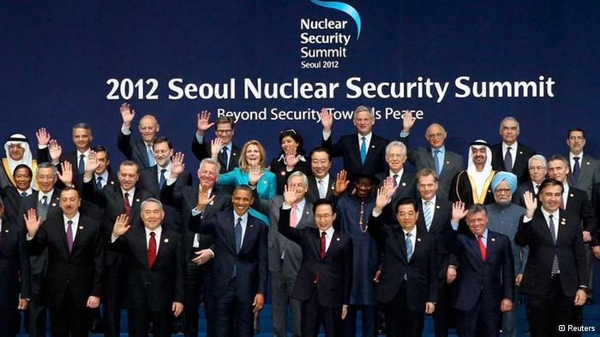
  Hosting Nuclear Summit Meeting (2012)

Slide 8
  Active Participation in Global Governance
    ODA (Official Development Assistance) – flows of official financing administered with the promotion of the economic development and welfare of developing countries as the main objective ← Unique Developmental Model of Korea!
    PKO (Peace Keeping Operation) – activities that tend to create conditions that favor lasting peace
    Environmental Protection, Climate Change, New Diseases, International Terrorism, etc.→ Requires Cooperation from Many States!

Slide 9

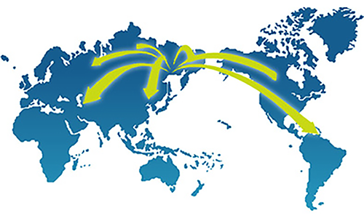
  “Global Korea!”

Slide 10
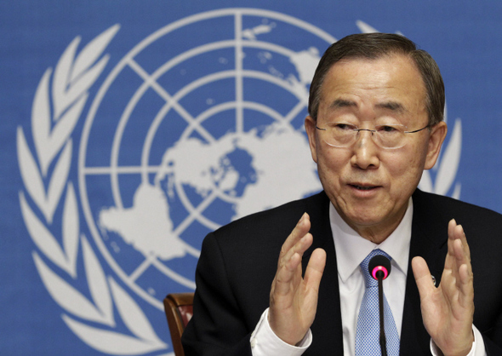
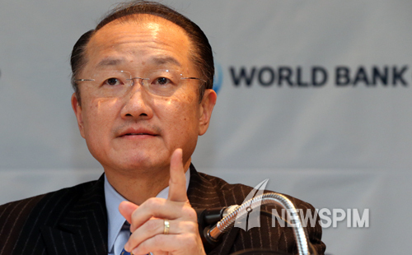
Ban Ki Moon of UN Jim Yong Kim of
World Bank

Slide 11
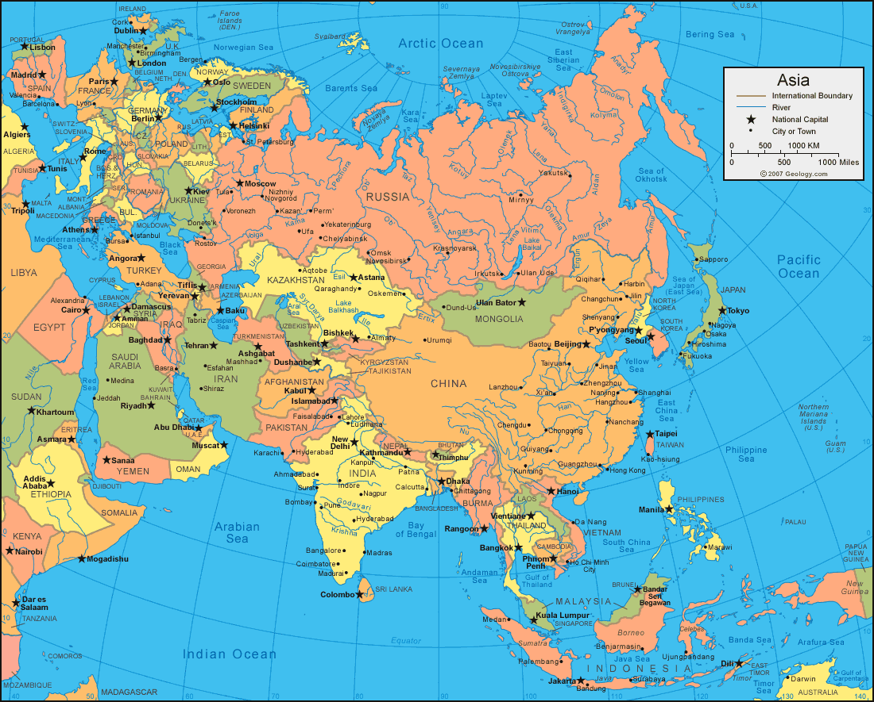
Geopolitical
Location
of Korea
South Korea is Geopolitical Lightweight in the Region…!

Slide 12
Strategic Challenges of Korea
On the Korean Peninsula
  North Korea as Existential Threat to S. Korea
  N. Korea as De Facto Nuclear Power Country → Denuclearize!
  Division of Korea → Unify Korean Peninsula!
  Task of S. Korea – Denuclearization and Unification
  Difficult to Coordinate both Policies…

Slide 13
Growing Rivalry in East Asian Region
  China – New Type of Great Power Relations (新型大國關係) with the US
  US – Pivot to Asia (Rebalancing)
  Japan – Renewed Aggression
    Abe Wants to Amend the “Peace Constitution” for “Collective Self Defense Right”
  Asia Paradox cf. Europe

Slide 14
Strategic Response of Park Geun-Hye Government
Trust-process toward North Korea
  Stand Firm on North’s Provocations, but Leave Open to Dialogues
  Build Trust First!
Northeast Asia Peace and Cooperation Initiative (NAPCI)
  ‘Asia Paradox’ – Urgent Need for Multilateral Security Forum!
  Start Small (Non-Traditional Security Issues First!); Gradualist Approach

Slide 15
    Eurasia Initiative
      Continent of One – Eurasia Should Be United!
      Eurasia – Home to 71 Percent of Global Population; Largest Continent with 12 Different Time Zones; Cradle of Ancient Civilization.
      Period of Isolation and Disconnect during the Cold War
      Now is Time to Take Advantage of Our Geographical Traits!
      Reconnect! (Continent of One)
      For Prosperity and Peace (Continent of Peace)

Slide 16
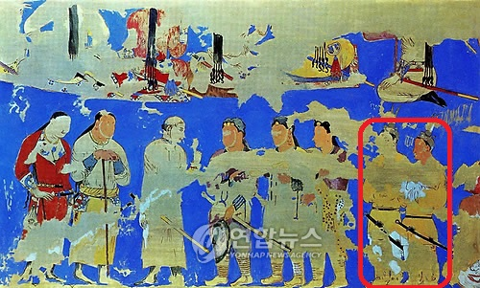
Afrasiab Mural Paintings in Samarqand, Uzbekistan

Slide 17
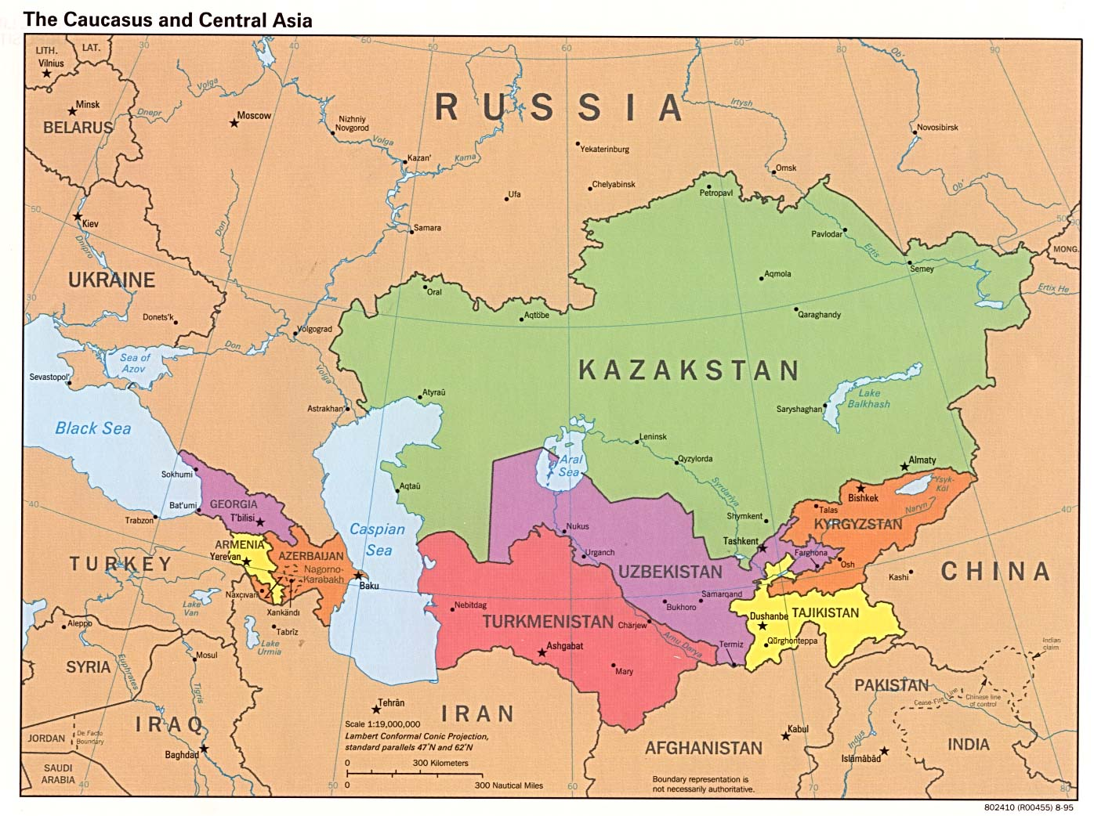
Geopolitics of Central Asia and Kazakhstan
Geopolitical Location of Kazakhstan
Geo-Political Importance
← Location, etc.
Geo-Economic Value
← Resources, etc.
Subject of Great Power Rivalry; Geopolitical Lightweight!

Slide 18
Policy Response of Kazakhstan
  Bilateral Foreign Policy with Key Countries in the Region
  Multi-Vector Diplomacy
Membership of Kazakhstan in Multilateral Regional Initiatives
SCO | Shanghai Cooperation Organization
CSTO | Collective Security Treaty Organization
CICA | Conference on Interaction and Confidence-Building Measures in Asia
OSCE | Organization for Security and Cooperation in Europe
CACO | Central Asian Cooperation Organization

Slide 19
Foreign Policy Cooperation of Korea & Kazakhstan
  Strategic Partnership
  Move beyond Economic Cooperation!
  Move beyond Bilateral Diplomatic Relations!
  Seek Closer Cooperation in Multilateral Settings!

Slide 20
  S. Korea and Kazakhstan as Responsible Middle Power Countries; Like-minded Countries!
  Kazakhstan – Nuclear free Central Asia
    “La Centra Aziano” Nuclear-Weapon-Free Zone (CANwFX)
    S. Korea – Nuclear Free Korea! Unified Kora will be Nuclear Free!
  Kazakhstan – Leading Role in the Regional Environmental Centre for Central Asia (CAREC)
    Korea as Leader in Green Growth!

Slide 21
Recommendations
  Upgrade Korea - Central Asia Cooperative Forum (in 2007) to Eurasia Cooperation Forum
  Eurasian Multilateral Security Dialogue for Peace and Security !
Reconnect as Continent of One and Continent of Peace!

Slide 22
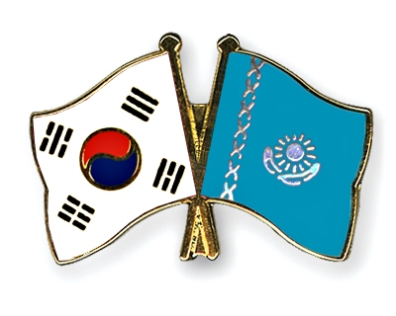
Thank You!

