Slide 1









Eurasian Academic Libraries Conference – 2021
“Contemporary Trends in Information Organization in the Academic Library Environment”
June 29-30, 2021

Slide 2
Implementing BIBFRAME in a Pilot Project at the Yale University Library
Eurasian Academic Libraries Conference – 2021
“Contemporary Trends in Information Organization in the Academic Library Environment”
June 29-30, 2021
Timothy A. Thompson
Librarian for Applied Metadata Research
timothy.thompson@yale.edu
Daniel Mugaburu
Metadata Technical Assistant
daniel.mugaburu@yale.edu
Yale University Library
New Haven, Connecticut, United States

Slide 3
Presentation Outline
Context and overview of the project
Introduction to BIBFRAME
  BIBFRAME and MARC
  BIBFRAME and RDA
  BIBFRAME and extensions
Introduction to the Sinopia Editor
Conclusions

Slide 4
Context and overview of the project

Slide 5
Linked Data for Production Project (LD4P2)
Two-year Project (2018–2020), funded by a grant from the Andrew W. Mellon Foundation.
Managed by Stanford University.
Focused on building a community of practice.
16 other research libraries participated in the project.
Stanford was responsible for creating a new cataloging tool (the Sinopia Editor) for the participating libraries.

Slide 6
Goals of Yale’s LD4P2 Subproject
Lay the foundation for workflows based on linked data standards.
Create descriptive metadata using BIBFRAME and the Art and Rare Materials Ontology (ARM).
Explore possibilities for search, discovery, and data visualization in the context of the Semantic Web.

Slide 7
Yale’s LD4P2 Subproject
Joint project between the technical services departments of the Central Library and the Beinecke Rare Book & Manuscript Library.
  Tim Thompson, responsible for the Central Library
  Audrey Pearson, responsible for the Beinecke Library
Divided into three groups:
  Leadership Team
    5 people who helped manage the project
  Metadata Creation Team
    20 people, incluiding professionals and paraprofessionals
  Advisory Team
    10 people who advised the project

Slide 8
Changes to the Original Timeline
We had planned to complete a year of cataloging in Sinopia (from April 2019 to April 2020).
However, development of the editor was delayed, and we did not begin until February 2020.
With the arrival of the COVID-19 pandemic, our expected time for cataloging was shortened further.
In the end, we were able to catalog over 200 items in total.
We completed the project in August 2020.

Slide 9
Introduction to BIBFRAME

Slide 10
What is BIBFRAME?
BIBFRAME timeline:
  2011: The US Library of Congress (LC) announces the creation of the BIBFRAME standard.
  2013: version 1.0 of BIBFRAME is released.
  2015: after initial tests, a review and evaluation process begins.
  2016: version 2.0 of BIBFRAME is published.
  To the present: LC continues carrying out cataloging pilot projects with BIBFRAME, using its own in-house editor.

Slide 11
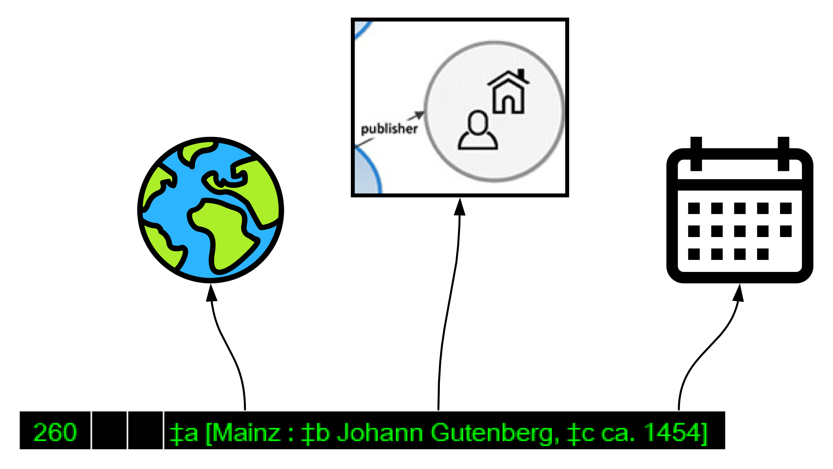
BIBFRAME and MARC
The MARC formats are over 50 years old and were not designed for linked data.
MARC is focused on standalone records.
BIBFRAME depends on relationships between resources.

Slide 12
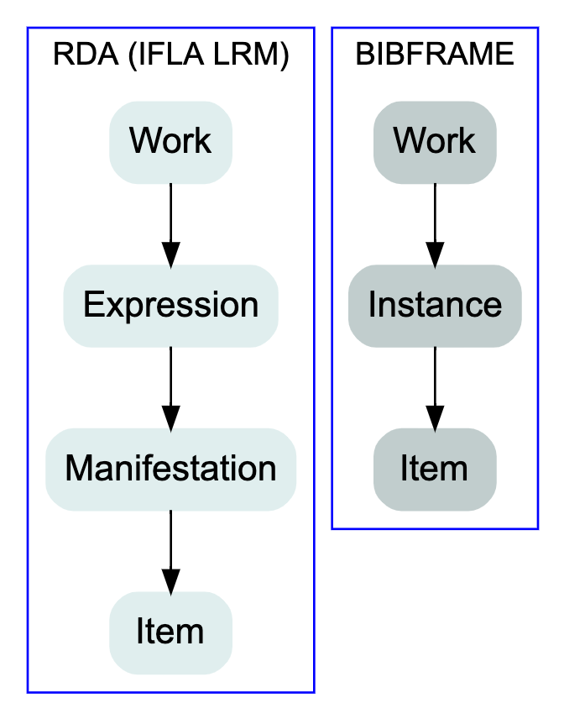
BIBFRAME and RDA

Slide 13
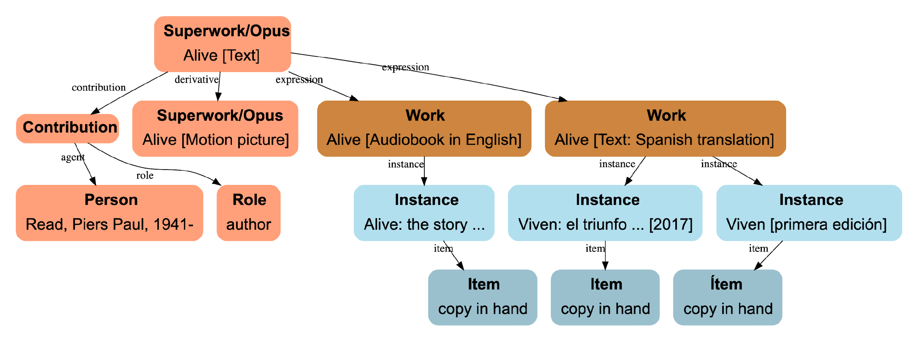

Graph of Relations in BIBFRAME
Source: Nicolasrnphoto, CC BY-SA 4.0, via Wikimedia Commons

Slide 14
BIBFRAME and Extensions
In contrast to RDA, BIBFRAME does not impose limits or constraints on the use of other ontologies and vocabularies.
One BIBFRAME extension used at Yale was the Art and Rare Materials Ontology (ARM).

Slide 15
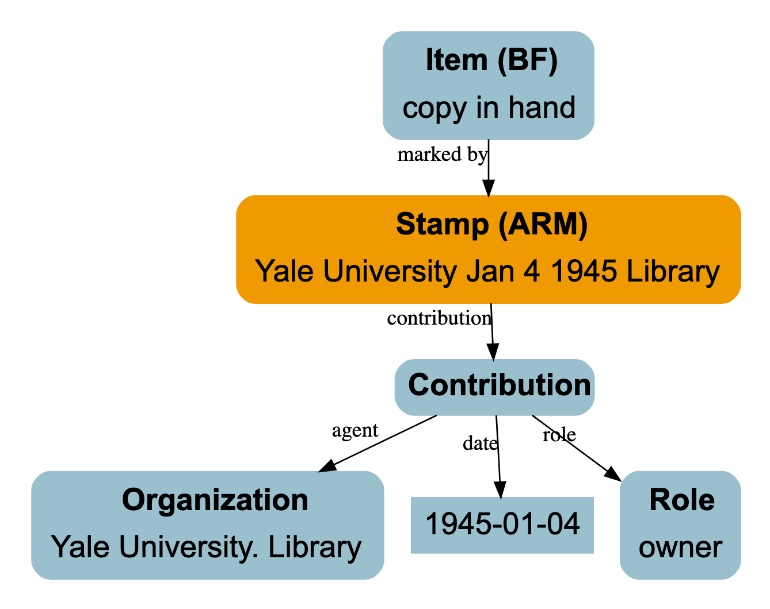
BIBFRAME and ARM

Slide 16
Introduction to the Sinopia Editor

Slide 17
Sinopia Linked Data Editor
Developed at Stanford University in the context of the LD4P2 project.
Still in development, as a primary focus of the third and current phase of the project (LD4P3).
To access Sinopia, visit:
  https://stage.sinopia.io (sandbox instance)
  https://sinopia.io (production instance)
Users must register and create and account to use the hosted version of the tool.

Slide 18
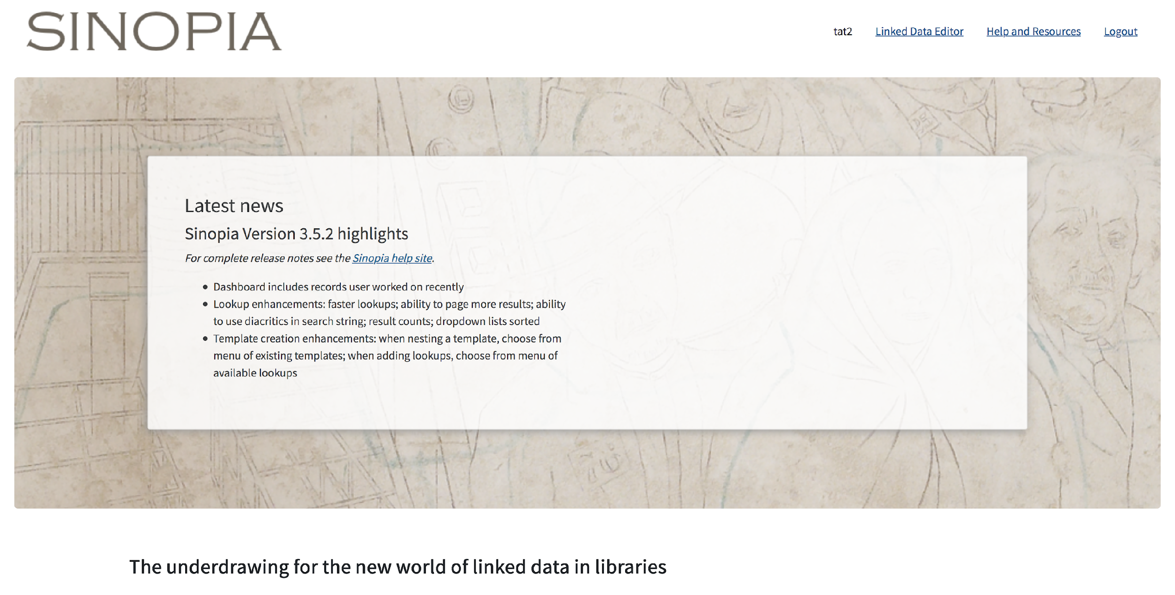

Slide 19
Templates in Sinopia
Each data entry form requires a corresponding template.
The hosted platform includes default templates for different formats.
There is a list of templates in Sinopia, with their corresponding identifiers.
Users can develop their own templates.
The primary templates used by Yale were: Superwork, Work, Instance, and Item.

Slide 20
Template Sequence
1.
2.
3.
4.
Superwork
Work
Instance
Item
expression
instance
item
Subject cataloging
Descriptive cataloging

Slide 21
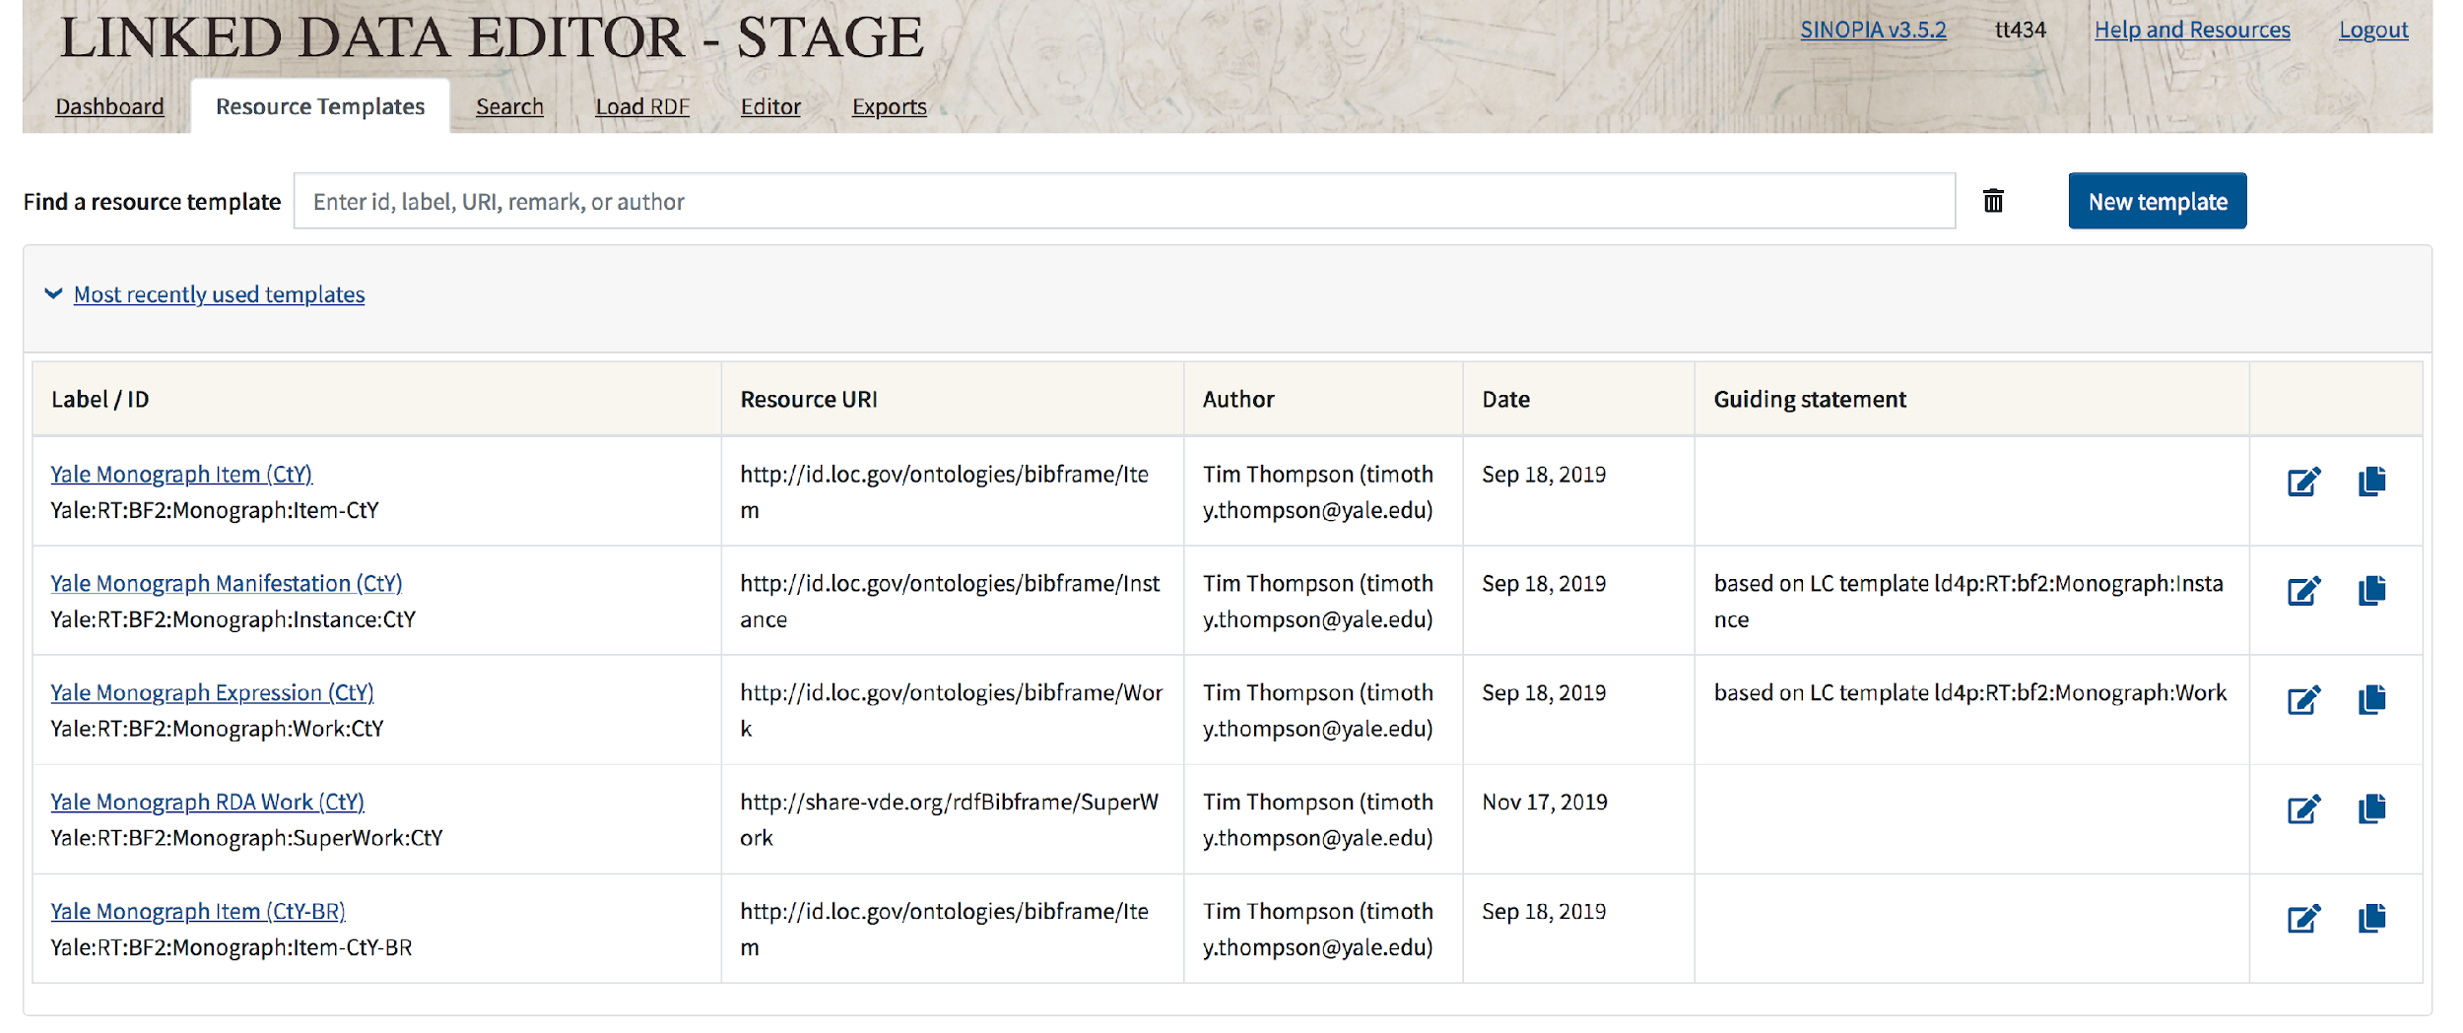
Insert the template identifier.

Slide 22
Sinopia: Superwork (RDA Work)
Name in Sinopia | MARC 21 Codes
contribution | 1XX
title information | 130, 240
classification number | 050
original language | 008:35-37, 041, 546$a
origin date | 008:07-14, 046, 26X$c
place of origin | 008:15-17, 370$g
subjects | 6XX
genre/form | 008:33, 380
admin metadata | cabecera, 005, 040, etc.

Slide 23
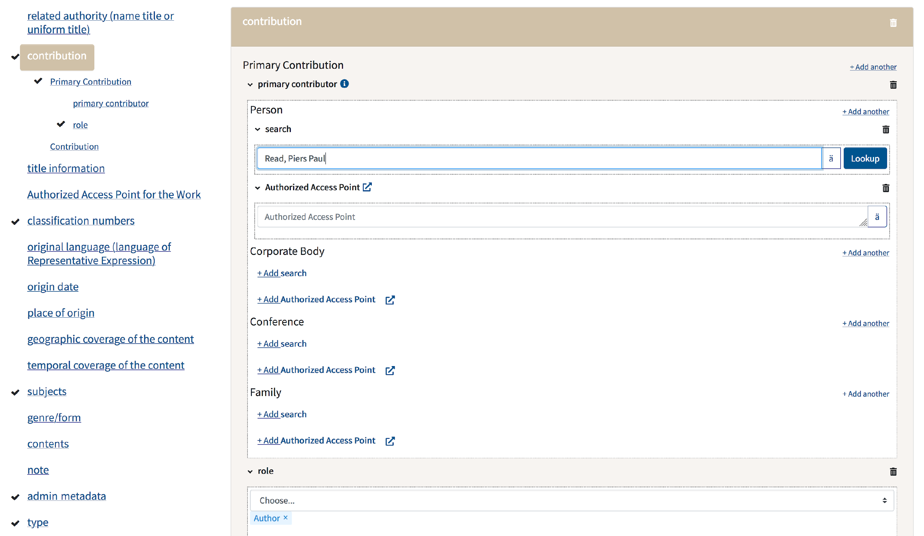
Input author (person).

Slide 24
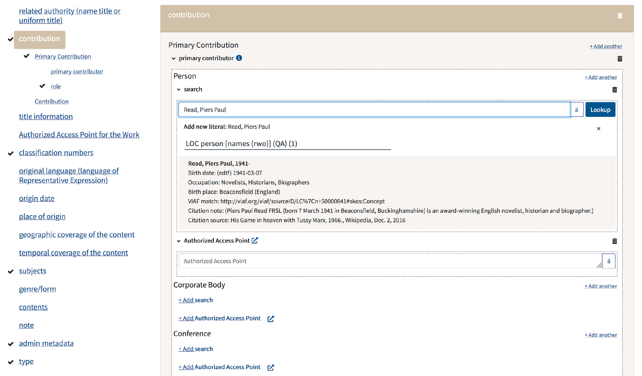
The author appears in the results as structured data. Click on the name.

Slide 25
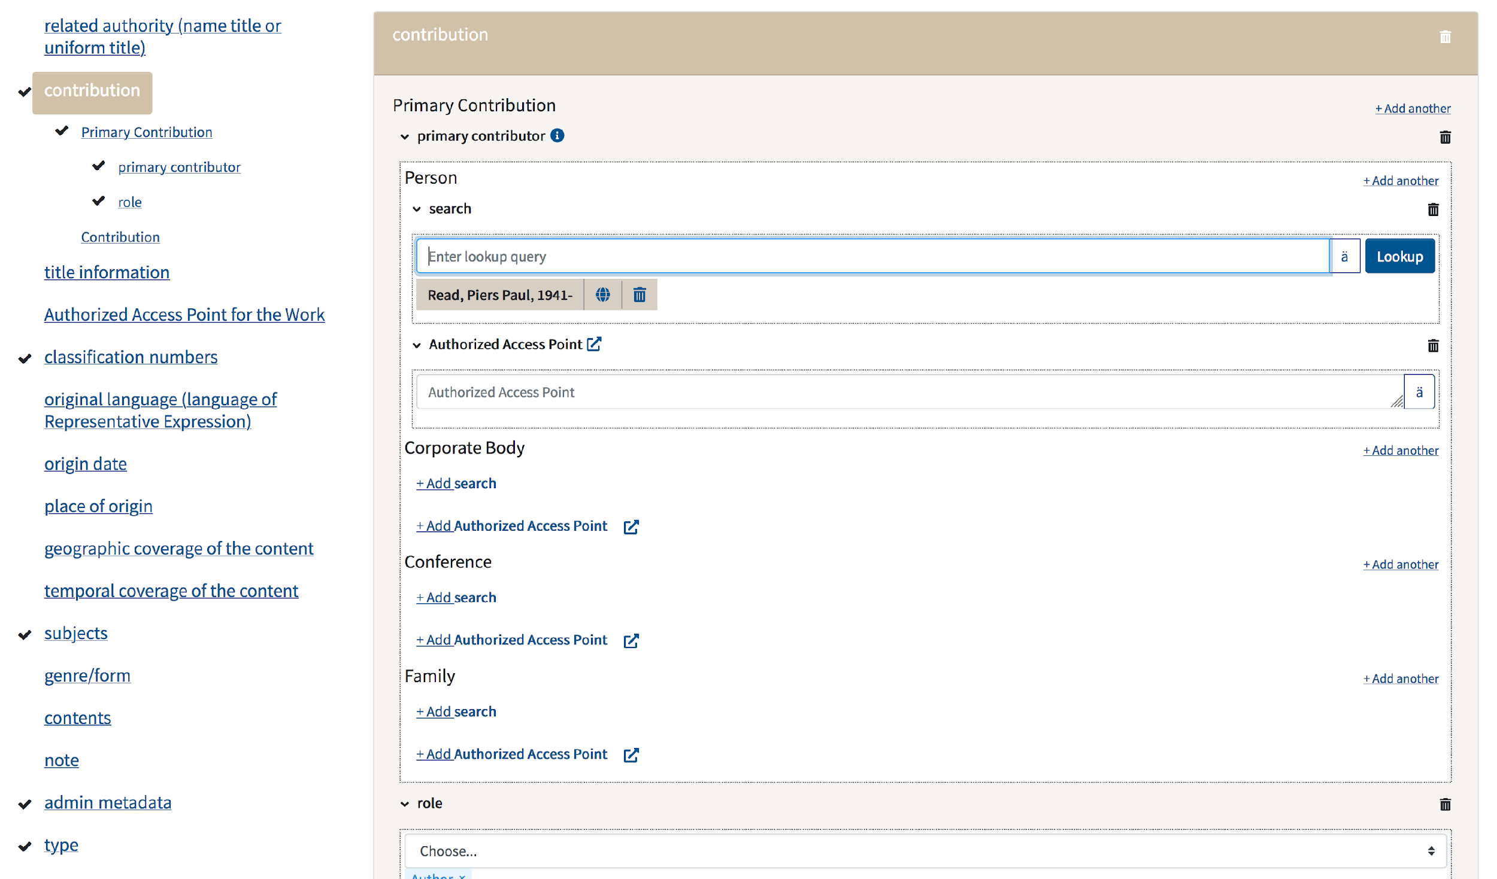
Once selected, the entity is displayed in the form.

Slide 26
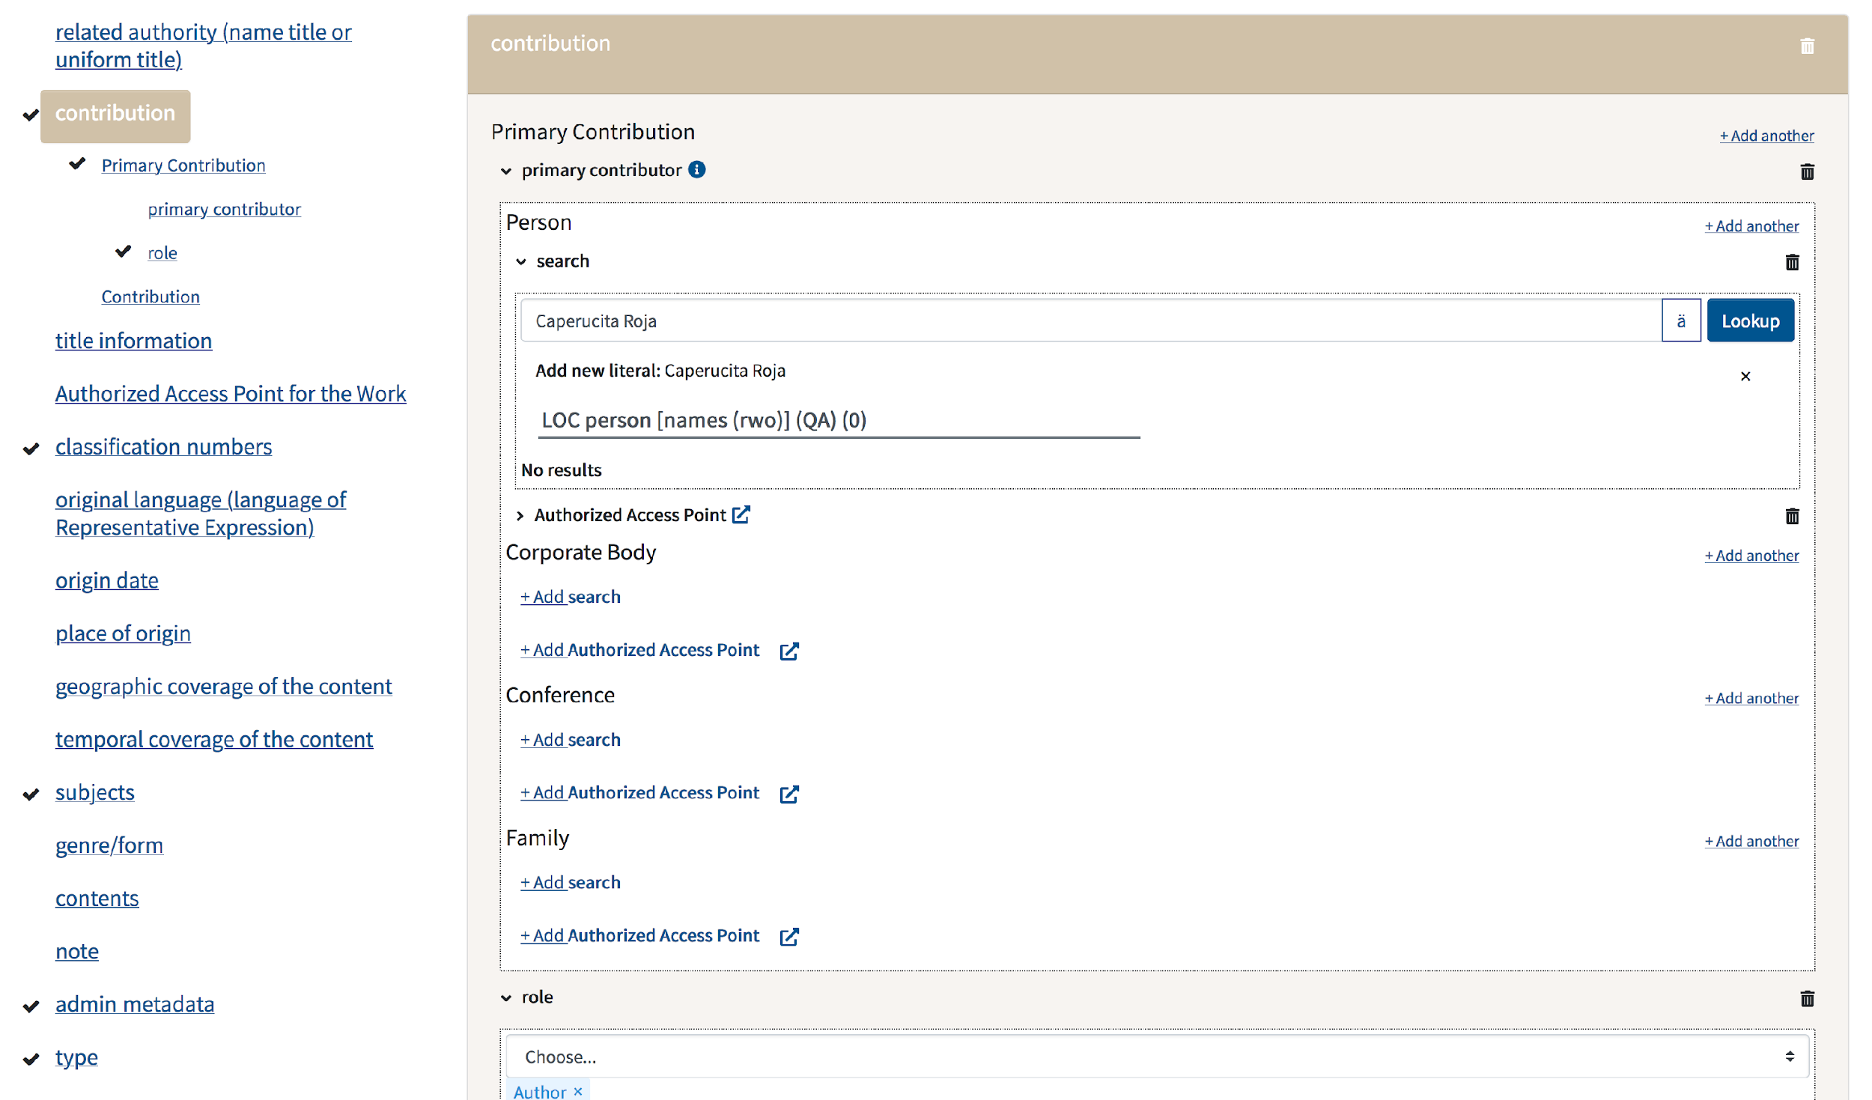
If the person is not registered in the lookup source, the name can be added as a string literal by clicking on “Authorized Access Point.”

Slide 27
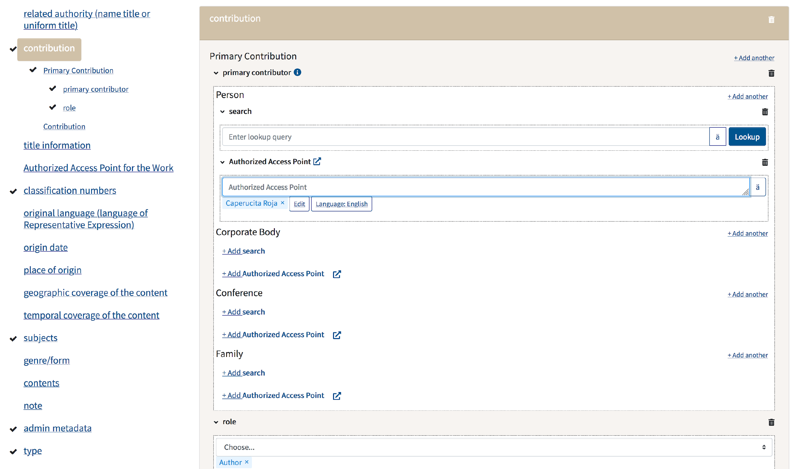
Name recorded as a literal.

Slide 28
Sinopia: Work (RDA Expression)
Name in Sinopia | MARC 21 Codes
contribution | 7XX
title information | 240
summary | 520
content type | 336
language | 008:35-37, 041, 546$a
origin date | 008:7-14, 046, 26X$c
script | 546$b
illustrative content | 008:18-21, 006:01-04, 300$b
admin metadata | cabecera, 005, 040, etc.

Slide 29
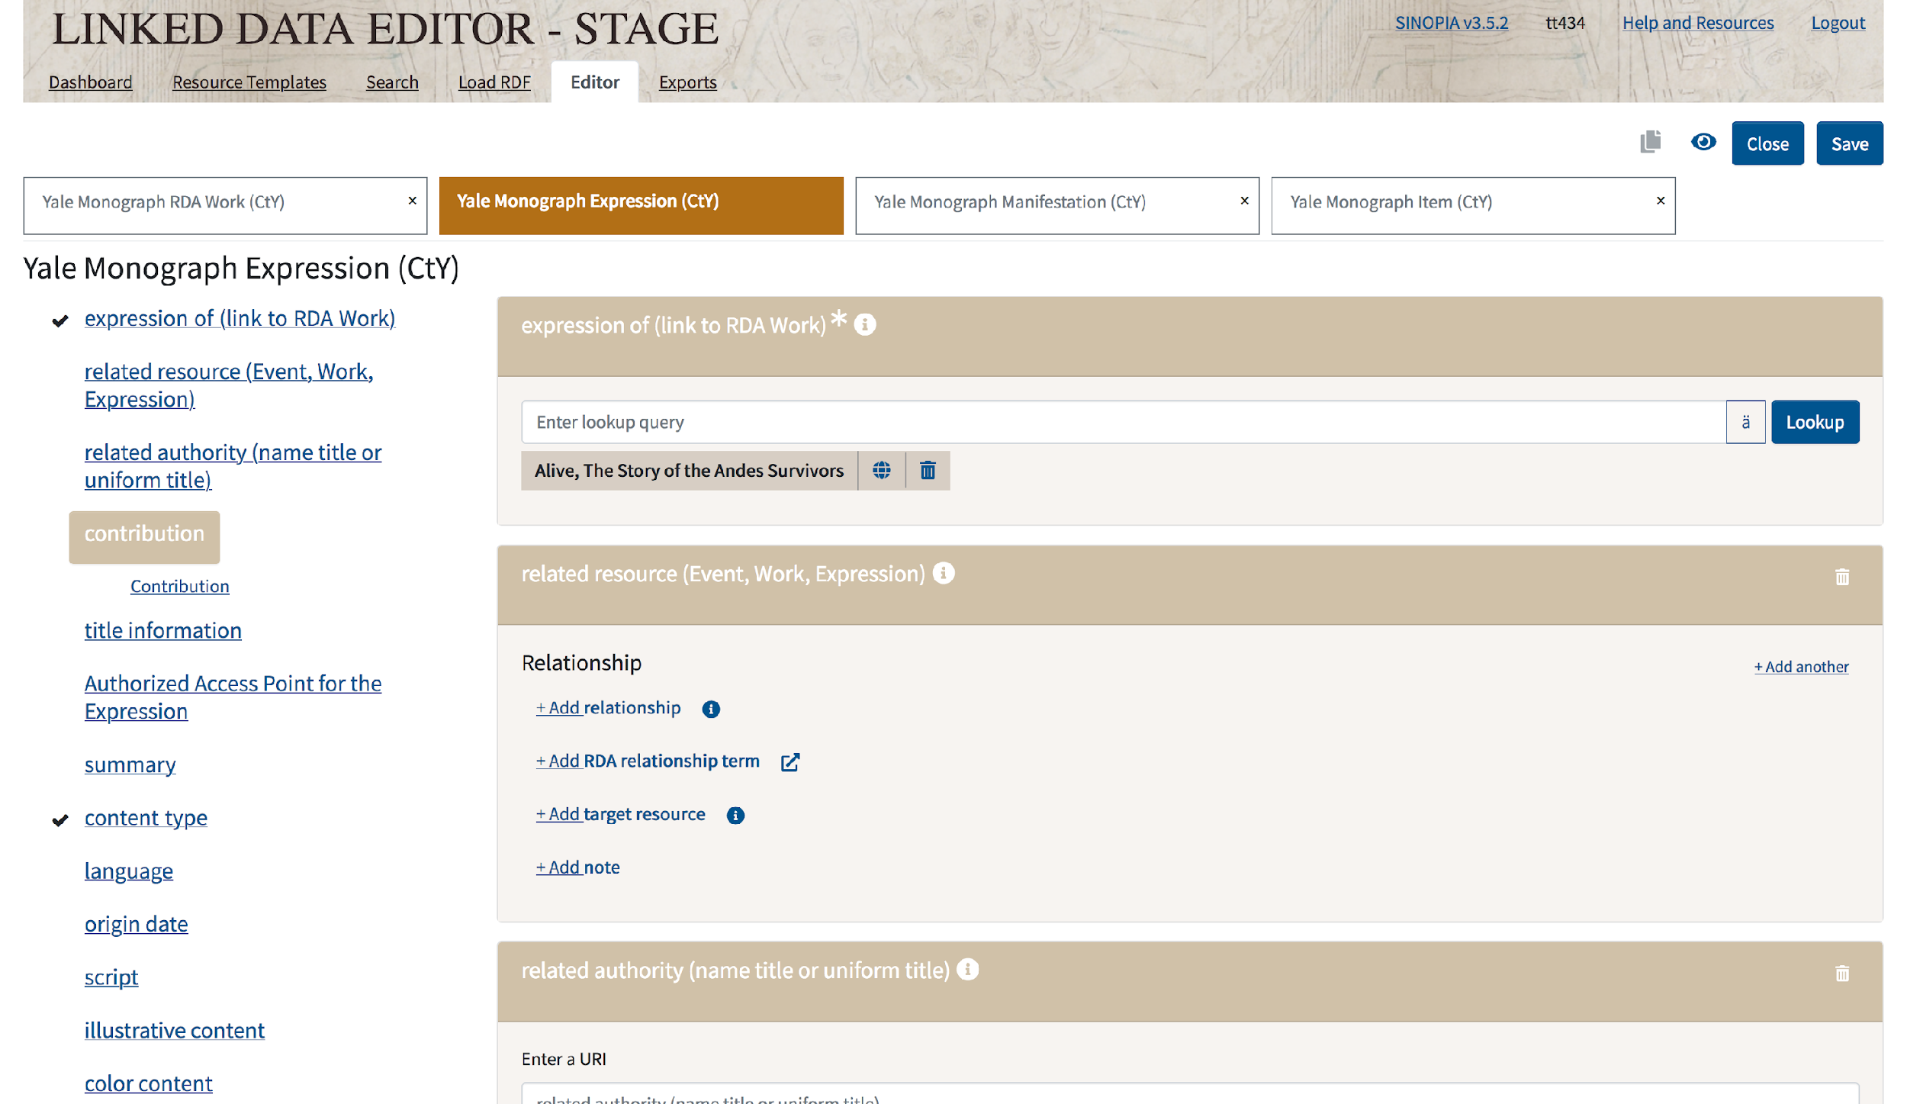
Input the hyperlink to the corresponding Superwork entity.

Slide 30
Sinopia: Instance (RDA Manifestation)
Name in Sinopia | MARC 21 Codes
identifiers | 020, 022
title information | 245$a, etc.
statement of responsibility | 245$c
publication, etc. | 26X
transcribed publication, etc. | 26X
extent | 300$a
dimensions | 300$c
admin metadata | cabecera, 005, 040, etc.

Slide 31
Sinopia: Item (RDA Item)
Name in Sinopia | MARC 21 Codes
held by
item identifiers
Voyager location code | 852 (holdings data)
lending information
custodial history | 561 (bibliographic or holdings data)
contribution | 5XX (bibliographic) or other local fields
enumeration and chronology | 863-865 (holdings data)
admin metadata | leader, 005, 040, etc.

Slide 32
Challenges and Next Steps
Sinopia is still in development.
To see the real benefits of linked data, a greater level of integration into core workflows is needed.
Transitioning from a model of individual MARC records to a new model based on linked data will take time.
Making this transition requires investments in resources, staff, and training.

Slide 33
Conclusions
BIBFRAME represents a more flexible and extensible approach to cataloging.
However, adapting to new tools, such as Sinopia, requires significant effort.
We observed that it took almost twice as long to catalog a resource in Sinopia than in MARC 21.
To advance in the implementation of better, more useful metadata, everyone needs to work together, across institutions.

Slide 34
THANK YOU FOR LISTENING!
Eurasian Academic Libraries Conference – 2021
“Contemporary Trends in Information Organization in the Academic Library Environment”
June 29-30, 2021
Timothy A. Thompson
Librarian for Applied Metadata Research
Yale University Library
New Haven, Connecticut, United States
timothy.thompson@yale.edu

